Slide 1
JAX-WS – Creating Java-based SOAP and WS-* Services
Oxford University
Software Engineering Programme
Dec 2012

Slide 2
Contents
Why JAX-WS
Origins and history
Introduction
Examples
Further resources

Slide 3
JAX-WS Motivation
Java API for XML Web Services
Currently version 2.2
Create a standard Java approach to creating and consuming SOAP/WSDL web services
Based on annotations
Work with WS-I Basic Profile
Work with JAX-B (Java API for XML Binding)
Replaced the (broken) JAX-RPC specification

Slide 4
Two approaches
Code first:
Create Java code, annotate
Run Java2WS to create WSDL / XSD etc
Contract first:
Create (or re-use) WSDL / XSD etc
run WSDL2Java to create the Java artefacts

Slide 5
Tool names and syntax ARE NOT part of the spec
In theory, tools should work with other spec implementations
Since the created artefacts should be portable
In practise, I’ve never tested this
Java2WS is equivalent to wsgen
WSDL2Java is equivalent to wsimport

Slide 6
Code first (annotated POJOs)
Start with a Plain Old Java Object
Create annotations that document the service definition, binding approach, etc

Slide 7
Common Annotations
@WebService
@SOAPBinding
@WebMethod
@WebParam
@OneWay
@HandlerChain

Slide 8
WebService
Applies to class or interface
All parameters are optional
@WebService
(name = “OrderService”,
serviceName = "OrderProcess",
portName = "OrderProcessPort", targetNamespace = "http://freo.me/order",
wsdlLocation=“path to existing wsdl”)

Slide 9
WebService continued
@WebService(endpointInterface = “me.freo.OrderProcess") applies to class only
This allows you to create an interface defining the service/WSDL and a separate implementation. This is especially important for WSDL first operation

Slide 10
SOAPBinding
Applies to class or interface
@SOAPBinding(
style=SOAPBinding.Style.DOCUMENT,
use=SOAPBinding.Use.LITERAL,
parameterStyle= SOAPBinding.ParameterStyle.WRAPPED)
My hint: ALWAYS use Doc/Lit/Wrapped
see http://pzf.fremantle.org/2007/05/handlign.html
Second hint: this is the default so don’t use @SOAPBinding!

Slide 11
WebMethod
Applies to Method
@WebMethod(
action=“MySOAPAction”, //optional
operationName=“myWSDLop”,
exclude=true) // do NOT expose this // inherited method

Slide 12
OneWay
Applies to a method that is marked @WebMethod
Indicates that there is no response expected
Assuming this is over HTTP, there should just be a HTTP 202 Accepted response
Over JMS, no response message expected

Slide 13
WebParam
A way of defining the mapping between the XML/SOAP message and the Java Parameters
@WebParam( name=“nameOfXMLElement”,
partName=“nameOfWSDLPart”,
targetNamespace=“xmlNamespace”,
mode=“IN|OUT|INOUT”,
header=true|false)

Slide 14
Java2WS tooling
java2ws -databinding <jaxb or aegis> -frontend <jaxws or simple>
-wsdl -wrapperbean -client -server -ant -o <output-file>
-d <resource-directory> -classdir <compile-classes-directory>
-cp <class-path> -soap12 -t <target-namespace>
-beans <ppathname of the bean definition file>*
-address <port-address> -servicename <service-name>
-portname <port-name> -createxsdimports -h -v -verbose
-quiet {classname}

Slide 15
Options
Option Interpretation
-?,-h,-help Displays the online help for this utility and exits.
-o Specifies the name of the generated WSDL file.
--databinding Specify the data binding (aegis or jaxb). Default is jaxb for jaxws frontend, and aegis for simple frontend.
-frontend Specify the frontend to use. jaxws and the simple frontend are supported.

Slide 16
Options (continued)
-wsdl Specify to generate the WSDL file.
-wrapperbean Specify to generate the wrapper and fault bean
-client Specify to generate client side code
-server Specify to generate server side code
-ant Specify to generate an Ant build.xml script
-cp Specify the SEI and types class search path of directories and zip/jar files.
-soap12 Specifies that the generated WSDL is to include a SOAP 1.2 binding.
-t Specifies the target namespace to use in the generated WSDL file.
-servicename Specifies the value of the generated service element's name attribute.
-v Displays the version number for the tool.

Slide 17
Options (continued)
-verbose Displays comments during the code generation process.
-quiet Suppresses comments during the code generation process.
-s The directory in which the generated source files(wrapper bean ,fault bean ,client side or server side code) are placed.
-classdir The directory in which the generated sources are compiled into. If not specified, the files are not compiled.

Slide 18
Options (continued)
-portname Specify the port name to use in the generated wsdl.
-address Specify the port address.
-beans Specify the pathname of a file defining additional Spring beans to customize databinding configuration.
-createxsdimports Output schemas to separate files and use imports to load them instead of inlining them into the wsdl.
-d The directory in which the resource files are placed, wsdl file will be placed into this directory by default
classname Specifies the name of the SEI class.

Slide 19
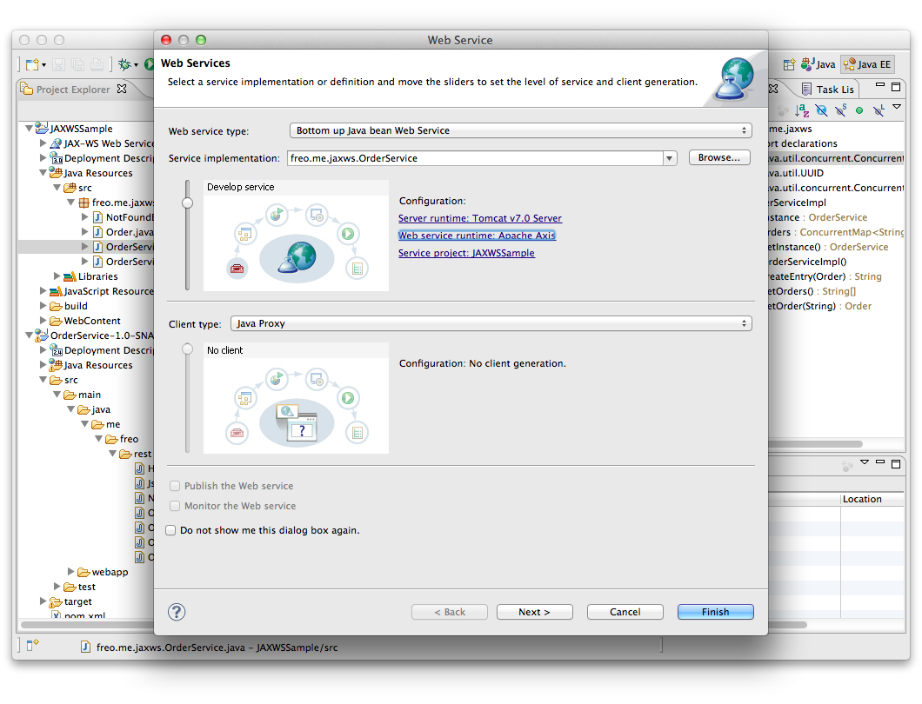
But you can ignore that!

Slide 20
HandlerChain
@HandlerChain(file = "handlers.xml")
Handlers.xml
<?xml version="1.0" encoding="UTF-8"?>
<handler-chains xmlns="http://java.sun.com/xml/ns/javaee">
<handler-chain>
<handler>
<handler-name>Transform</handler-name>
<handler-class>org.freo.jaxws.handlers.Transform</handler-class>
</handler>
<handler>
<handler-name>Log</handler-name>
<handler-class>org.freo.jaxws.handlers.Logger</handler-class>
</handler>
</handler-chain>
</handler-chains>

Slide 21
WSDL first
Again there is a tool for this
You might want to create a service
Contract-first (design the WSDL, then implement)
Implement a standard WSDL
Re-architect an existing service
Copy a competitor’s service (though this is a thorny issue!)
Very likely you need to call a service

Slide 22
WSDL2Java
wsdl2java -fe|-frontend <front-end-name> -db|-databinding <data-binding-name>
-wv <wsdl-version> -p <[wsdl-namespace =]package-name>* -sn <service-name>
-b <binding-file-name>* -reserveClass <class-name>* -catalog <catalog-file-name>
-d <output-directory> -compile -classdir <compile-classes-directory> -impl -server
-client -all -autoNameResolution -allowElementReferences|-aer<=true>
-defaultValues<=class-name-for-DefaultValueProvider> -ant
-nexclude <schema-namespace [= java-package-name]>* -exsh <(true, false)> -noTypes
-dns <(true, false> -dex <(true, false)> -validate -keep
-wsdlLocation <wsdlLocation> -xjc<xjc-arguments>* -asyncMethods<[=method1,method2,...]>*
-bareMethods<[=method1,method2,...]>* -mimeMethods<[=method1,method2,...]>* -noAddressBinding
-faultSerialVersionUID <fault-serialVersionUID> -exceptionSuper <exceptionSuper>
-mark-generated -h|-?|-help -version|-v -verbose|-V -quiet|-q|-Q -wsdlList <wsdlurl>

Slide 23
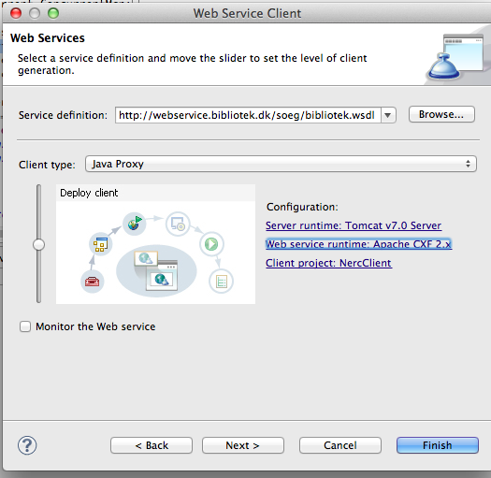
Again do this via the Eclipse tooling!

Slide 24
Resources
The Labs
The Spec
http://jcp.org/aboutJava/communityprocess/mrel/jsr224/index3.html
The CXF documentation
http://cxf.apache.org/docs/a-simple-jax-ws-service.html
The Reference Implementation
http://jax-ws.java.net/

