Slide 1
Composition of Web Services
Oxford University
Software Engineering Programme
Dec 2012

Slide 2
Business Process Management
Hammer & Champy [1993] “A collection of activities that takes one or more kinds of input and creates an output that is of value to the customer.”
Davenport [1992] “A structured, measured set of activities designed to produce a specific output for a particular customer or market. It implies a strong emphasis on how work is done within an organization, in contrast to a product focus’s emphasis on what.”

Slide 3
Composition
Services provide platform- and language-independent access to software components
But these components are isolated: they need to be assembled into service-oriented architectures
Ideally, they should be recursively composable to form composite services in their own right
Workflow languages for scripting or ‘glue’ between individual services
BPMN, WSCI, WSFL, XLANG, BPEL. . .
beyond mere business protocol specifications like RosettaNet, which are essentially paper specifications so can’t be automated and won’t scale

Slide 4
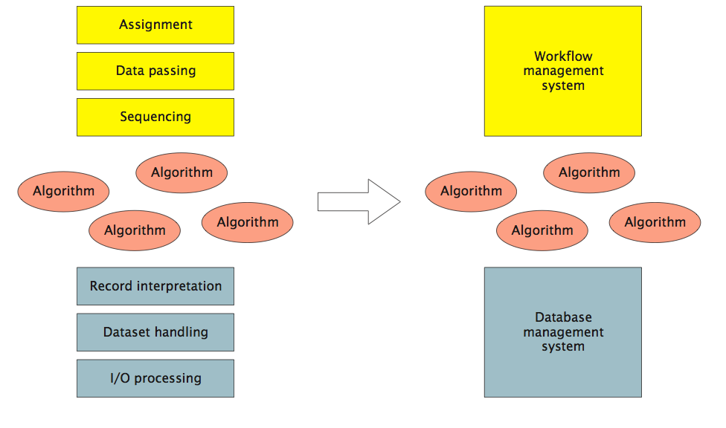
Removal of Dependencies (Leymann and Roller)
DBMS provides independence from data representation; workflow provides independence from control or data flow.

Slide 5
Heritage
Enterprise application integration (EAI)
resolving heterogeneity, typically via asynchronous message brokers
Workflow management systems (WfMS): automating interactions
origins in office automation: admin processes
Production workflows: from information between people to integration of systems
often associated with business process re-engineering: assessment, analysis, modelling, definition, implementation
Service composition = EAI + WfMS

Slide 6
Motivations
Model Business Processes
Understand what happens?
Who is responsible?
What is involved?
Simulate
Improve and model
Execute
Automate processes
Improve them more quickly
Monitor
Get a real-time health status of processes

Slide 7


Orchestration vs Choreography
http://www.flickr.com/photos/herrolm/
http://www.flickr.com/photos/tasuki/

Slide 8
Orchestration vs Choreography
Orchestration
Describes procedure
instructs participants globally – imperative; centralized
typically deterministic: ‘must’
Choreography
Describes protocol
Constraints on interaction, but participants act locally – declarative; no ‘current state’
Usually non-deterministic: ‘may’
Orchestra has a conductor, Ballet does not

Slide 9
WS-Choreography Description Language
http://www.w3.org/TR/ws-cdl-10/
Never got past Candidate Recommendation
Captures the flow of messages between parties
Temporal and logical dependencies between messages
features sequencing rules, correlation, exception handling and transactions
Not executable

Slide 10
BPMN 1.1
Designed to allow process designers to communicate
Think UML
Activities, Gateways, Events
Control and Data Flow
Organization modelling (Pools, Swimlanes)

Slide 11
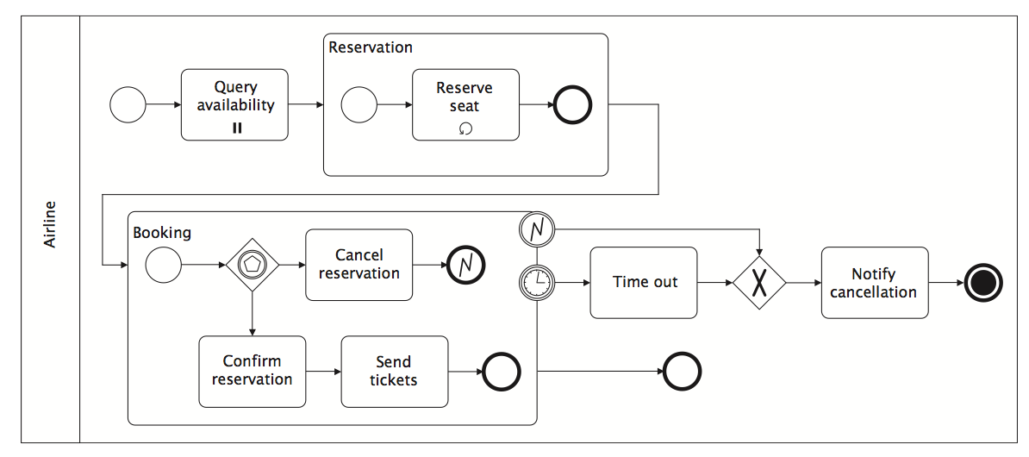
BPMN Example

Slide 12
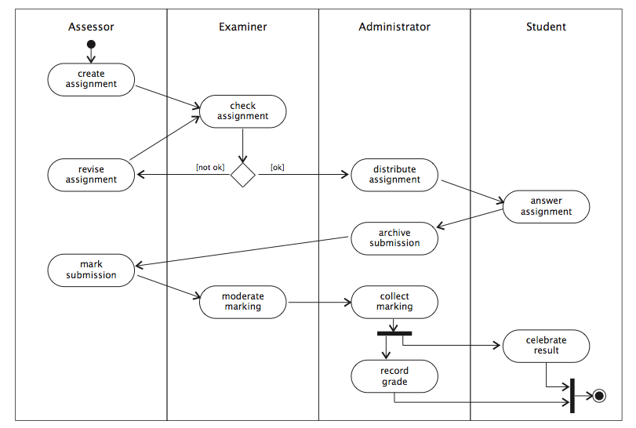
Swimlanes: partition an activity diagram into the responsibilities of different entities

Slide 13
Data Flow
Transitions between activities represent control dependencies: one activity must complete before another can start
Workflows also have data dependencies: one activity produces a result that another requires
UML activity diagrams allow object flow as well as control flow
Dependent data is shown as an object icon (rectangle with underlined name and type)
dependencies shown as dashed arrows from generating activity to object, and from object to consuming activity(s)
same object may occur multiple times in an activity diagram, typically in different states (shown in square brackets after object name)

Slide 14
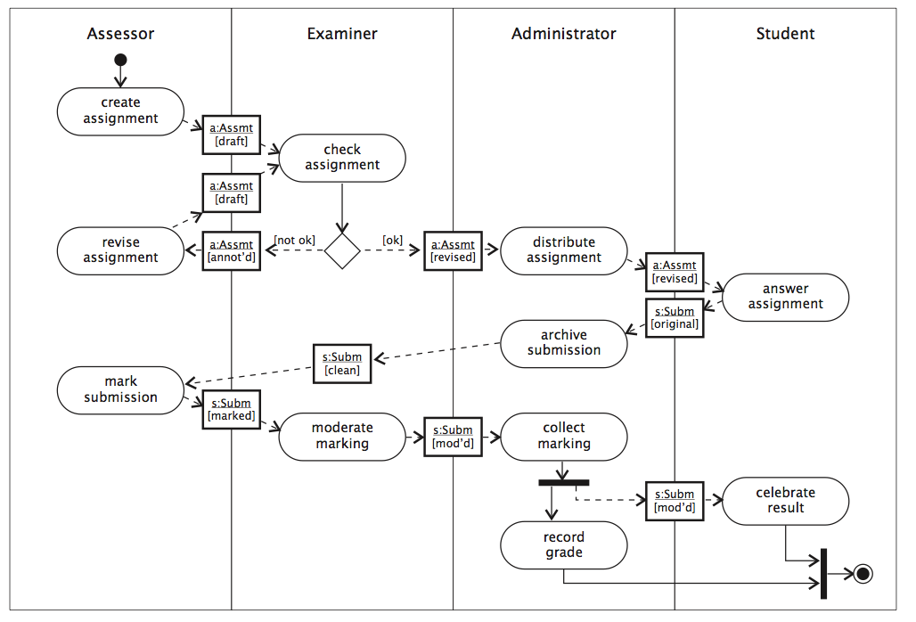
Example Object Flow

Slide 15
Business Process Execution Language (BPEL)
Standardised XML language for executable processes
Well defined execution
No deadlocks
Graphs must be acyclic
Tied to WSDL concepts
No built in support for human activities (though this has been added)
No graphical notation

Slide 16
BPMN + BPEL
In theory:
Process experts design and model in BPMN
Developers/Implementors implement in BPEL
No standard bridging/mapping
Double the effort

Slide 17
BPMN 2.0
A notation for a subset of BPEL
Execution semantics for BPMN
Notational support for choreography
The best of both worlds?

Slide 18
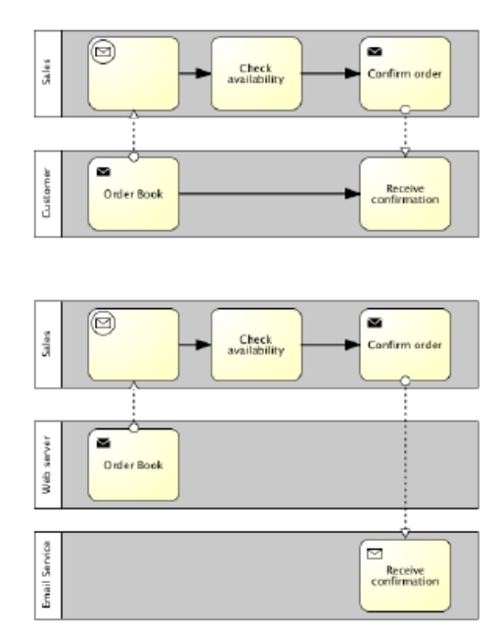
BPMN 2.0

Slide 19
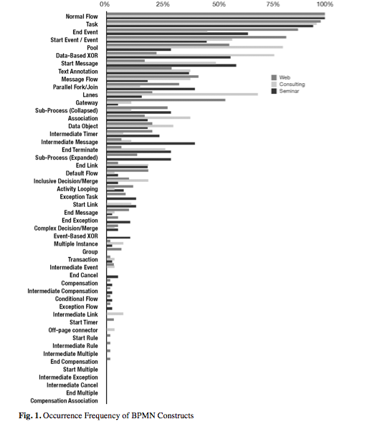
How much BPMN do you need?
How Much Language is Enough? Theoretical and Practical Use of the Business Process Management Notation
http://papers.ssrn.com/sol3/ papers.cfm?abstract_id=2038665

Slide 20
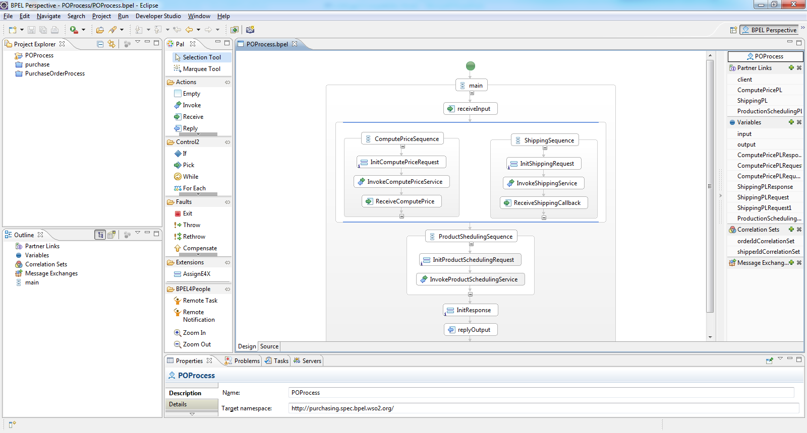
BPEL

Slide 21
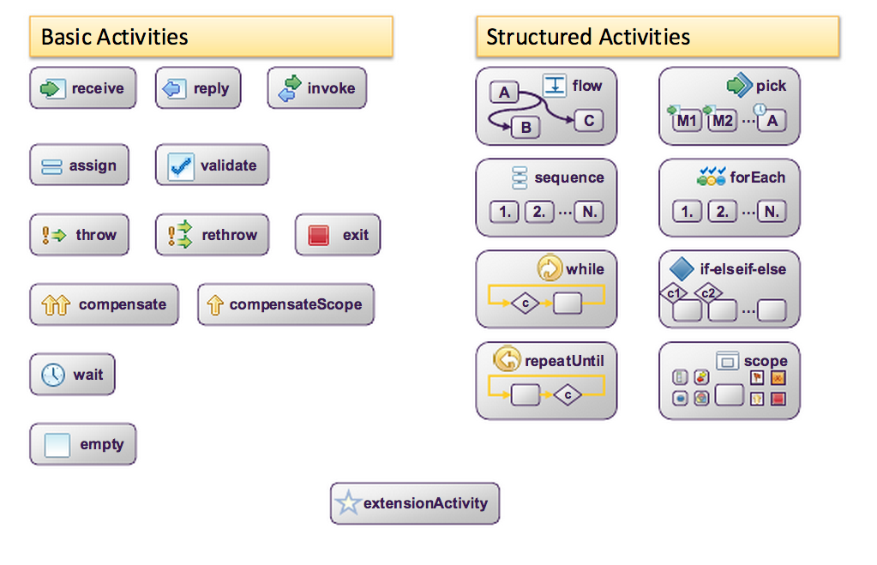
BPEL Activities

Slide 22
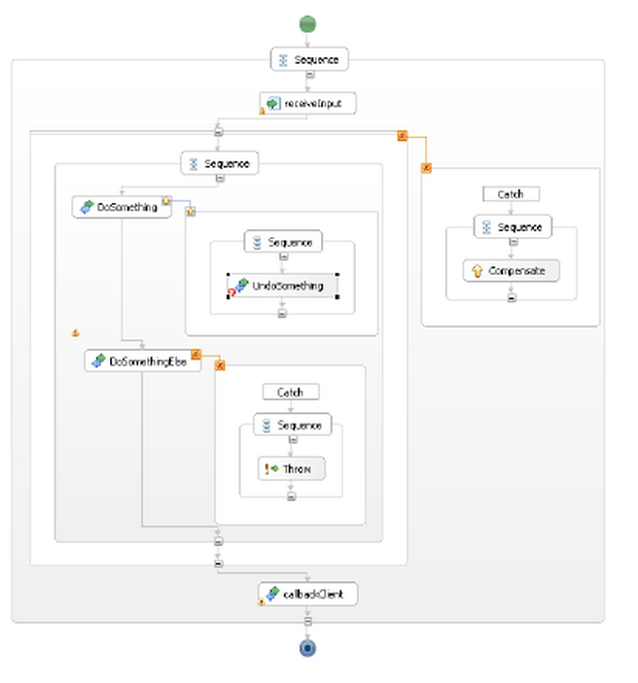
Fault Handling

Slide 23
Partner Links
Interactions between business process and external parties
Partner link type defines one (for unidirectional links) or two (for bi-directional) roles of corresponding port type
Partner links instantiate partner link types, specifying myRole (played by this process) and/or partnerRole (played by external party)
bindings of actual partners to external roles are omitted
Who takes what role?
A key concept for asynchronous messaging

Slide 24
BPEL data
Control flow not data flow
Variables are assigned on:
Input
Return
<assign>
Often need to jump into XSLT
Cumbersome

Slide 25
BPEL extensions and extras
BPEL4People/WS-HumanTasks
How people interact with BPEL
BPELlight
WSDL-less BPEL
BPEL JS/E4X
Simplified assignment
BPELScript/simBPEL/SimPEL
DSL/textual notations for BPEL

Slide 26
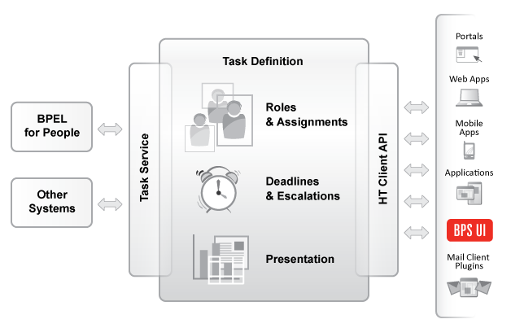
Human Tasks

Slide 27
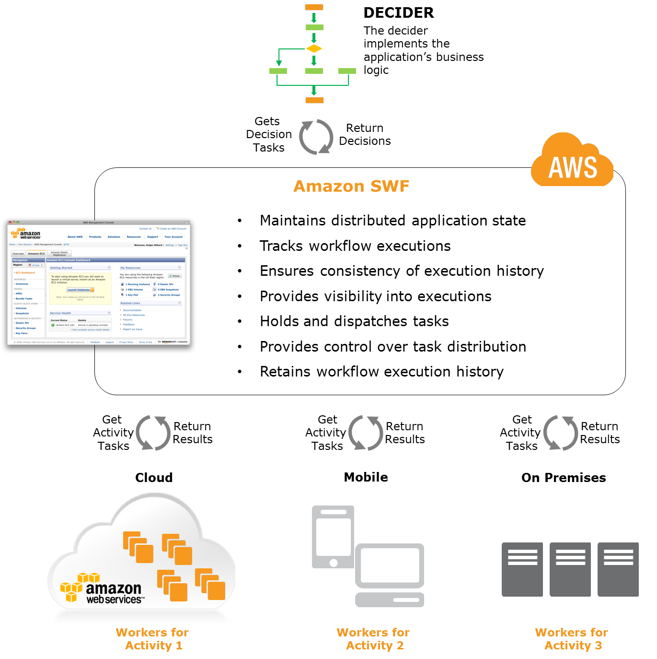
Amazon Simple Workflow Service
http://aws.amazon.com/swf/

Slide 28
Summary
Process Management has a strong place in composing SOA systems
Externalising dependencies
Agility
Sharing with the business owners
BPEL is the most common and standard model today
BPMN 2.0 is gaining a lot of mindshare
Other approaches like Amazon SWF may also appear

