Slide 1
Understanding REST

Slide 2
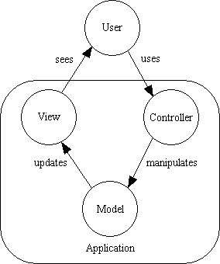
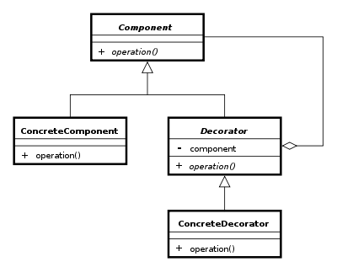
Design Patterns

Slide 3
REST is a design pattern

Slide 4
Principles of REST Architecture
REST isn't protocol specific, but in practice means the RESTful usage of HTTP
HTTP is actually a very rich application protocol which gives us features like content negotiation and distributed caching.
HTTP verbs nicely map to CRUD operations of data
RESTful web services try to leverage HTTP in its entirety using specific architectural principles.

Slide 5
JSON
A simple notation that originated in JavaScript
var x = {a:1, b:2, c:3}
equivalent to:
x.a = 1; x.b = 2; x.c = 3
Can be done “dynamically”
var x = “{a:1, b:2, c:3}”
// imagine this actually
// comes from a webserver
var z = eval(‘(‘+x+’)’)
assert(z.a == 1)

Slide 6
Resources
Addressable Resources. Every “object” on your network should have a unique ID. An important aspect is that each “object” or resource has its own specific URI where it can be addressed
A Uniform, Constrained Interface. When applying REST over HTTP, stick to the methods provided by the protocol
GET, POST, PUT, and DELETE.
These should be used properly
GET should have no side effects or change on state
PUT should update the resource “in-place”
The Content-Type of the resource should be useful and meaningful

Slide 7
Resource Representations and States
Interact with services using representations of resources.
An XML representation
A JSON representation
An object referenced by one URI can have different formats available. Different platforms need different formats.
A mobile application may need JSON
A Java application may need XML.
Utilize the Content-Type header
And the Accept: header
Communicate in a stateless manner
Stateless applications are far more scaleable

Slide 8
Hypertext as the Engine of Application State
Resources are identified by URIs
↓
Clients communicate with resources via requests using a
standard set of methods
↓
Requests and responses contain resource representations
in formats identified by media types
↓
Responses contain URIs that link to further resources
↓
Beginning

Slide 9
Quick look at the Sample Service

Slide 10
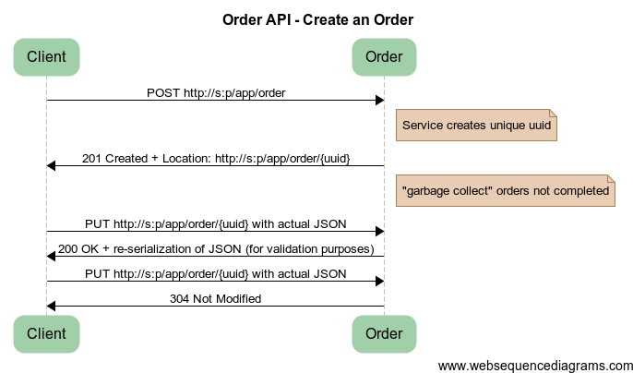
Create an Order
Notes:
title Order API - Create an Order
Client -> Order: POST http://s:p/app/order
note right of Order: Service creates unique uuid
Order -> Client: 201 Created + Location: http://s:p/app/order/{uuid}
note right of Order: "garbage collect" orders not completed
Client -> Order: PUT http://s:p/app/order/{uuid} with actual JSON
Order -> Client: 200 OK + re-serialization of JSON (for validation purposes)
Client -> Order: PUT http://s:p/app/order/{uuid} with actual JSON
Order -> Client: 304 Not Modified

Slide 11
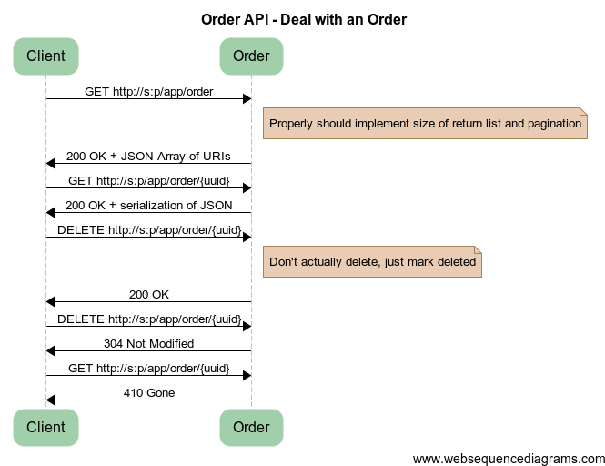
Notes:
title Order API - Deal with an Order
Client -> Order: GET http://s:p/app/order
note right of Order: Properly should implement size of return list and pagination
Order -> Client: 200 OK + JSON Array of URIs
Client -> Order: GET http://s:p/app/order/{uuid}
Order -> Client: 200 OK + serialization of JSON
Client -> Order: DELETE http://s:p/app/order/{uuid}
note right of Order: Don't actually delete, just mark deleted
Order -> Client: 200 OK
Client -> Order: DELETE http://s:p/app/order/{uuid}
Order -> Client: 304 Not Modified
Client -> Order: GET http://s:p/app/order/{uuid}
Order -> Client: 410 Gone

Slide 12
Questions?

