Slide 1
Case Studies
Oxford University
Software Engineering Programme
Dec 2012

Slide 2
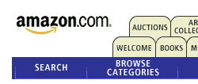
Source: Interview with Werner Vogels, ACM Queue

Slide 3
“Obidos”
Web App
Database
Web App
Web App
Single application

Slide 4

But it was Successful!

Slide 5
Internet Scale Up
Web App
Database
Web App
Web App
Single application

Slide 6
… to bursting point
Database
Web App
Web App
Web App
Web App
Web App
Web App
Web App
Web App
Web App
Web App
Web App
Web App
Web App
Web App
Web App
Single application

Slide 7
Problems
Too many complex pieces of software in a single system
No evolution possible
Need to scale independently
Parts sharing resources with other unknown code paths
No isolation
No clear ownership

Slide 8
Database scaling
Databases a shared resource
Hard to scale-out
Front-end and backend shared by
Too many teams
Too many processes

Slide 9
A new model
In 2001 decided on a new approach
SOA based – even before the term was in common usage
Encapsulating the data with the business logic that operates on the data
Only access through a published service interface
No direct database access is allowed from outside the service
No data sharing among the services.

Slide 10
Growth
Amazon services in the hundreds
A typical visit to the homepage may include calls to 100 services
Caching reduces the actual network traffic
Fully distributed, decentralized
The web servers are just one client into the service fabric

Slide 11
Matched by business growth
Amazon is supporting many new businesses
Books, CDs, Electronics, Toys, Tools and Hardware,…
Plus millions of independent retailers sharing the Amazon platform

Slide 12
New architecture
Service
Web App
Web App
Web App
Web App
Web App
Service
Web tier
Web App
Service
Web App
XML
External Services
Service
Customer Svc

Slide 13
Lessons learnt
Isolation
Service Orientation promotes ownership and control
Scalability
By preventing direct database access, can scale the services without affecting clients
Need a common service-access mechanism
Aggregation
Routing
Tracking

Slide 14
Organization
“Each service has a team associated with it, and that team is completely responsible for the service—from scoping out the functionality, to architecting it, to building it, and operating it… You build it, you run it” Werner Vogels, CTO, Amazon
Promotes Customer Focus and Innovation
Gives developers direct access to customers
And experience of how their code performs

Slide 15


Slide 16

Integration at the glass

Slide 17
Concur
Concur is an online expense management company
>$200m revenue
Multiple legacy systems:
Customer Relationship Management
ERP
Sales Force Automation
In house HR employee application
Main requirement – enable better reporting across applications
Internal project only – not in the direct flow of external customer systems
Needed an approach that supported:
Iterative development
Support changes to the underlying systems
Flexible

Slide 18
Architecture
Mashups
Registry
ESB
routing, synchronization and transformation
Restful
SOAP Services
WSAS
Data Services Spring Services
SOAP
File Access
Existing
Databases
Existing
Applications
Bug Tracking / ITIL Ticket / CRM / SFA / HR / (10 systems in all and growing)

Slide 19
Technical details
Everything deployed on Windows 2003 running on VMWare
Internal systems so limited security
Basic authentication
Some use of digital signature
Running in a blade server to simplify test and scaling
Currently Hot/Cold but moving to Hot/Hot
~75,000 transactions a day
95% SOAP, 5% Restful at this point
WSDLs and Schema’s stored in WSO2 Registry
Embedded in the ESB
Currently 18 services across 10 backends with 120 operations
Growing
Looking at moving to a more event-based approach in the future

Slide 20

Iterative development

Slide 21
Project Approach
Planned for iterative development over phases
Staff self-educated on SOA and looked at Open Source systems before talking to vendors
One week “kickstart” education and POC session
Built a data synchronization application
Proof to the business:
Concur built a prototype that offered real value to executives:
Single customer view mashup – pulled open CRM tickets, ERP and CRM data.
The demo was an “instant hit” – gaining an executive sponsor
Team identified re-usable services
Put extra effort into the design
Several refactoring iterations

Slide 22
Benefits
Lower cost of licenses/users on SaaS systems
Previously were using licenses for occasional users
Intermittent users were being trained on systems that they rarely used – the new mashups replaced this requirement
The SOA design has allowed incremental replacement of some legacy systems
Existing test plans for Sarbanes-Oxley could be re-used
Open source meant that a POC could prove the benefits to the business without upfront expenditure

Slide 23
Lessons Learnt
Keep it Simple
In-house expertise has paid off
Steeper learning curve but
Better technology selection
Lower overall cost
More agility
Use of open source projects has
Reduced cost
Been more flexible
Given better access to the community and developers

Slide 24

Business to Government

Slide 25
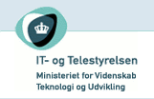
OIO SOI

Slide 26
OIO SOI
Danish Government wanted to simplify electronic business
Especially for Business-to-Government (B2G)
Potential savings of 630m Euros by digitalizing business
Requirements
Reliable delivery
Secure – encrypted and signed messages
Support small businesses

Slide 27
OIO SOI
Several aspects
A registry for service lookup
A profile of transport protocols
Open Source toolkits for Java and .NET
A reference implementation of a message handler
A legal framework
Some existing framework
A nationwide digital certificate framework
A standard XML syntax for invoices and orders (UBL2)

Slide 28
Registry
A profile of OASIS UDDI v3.0
A central registry run by the Danish Government
https://publish.uddi.ehandel.gov.dk:12443/registry/uddi/web
Designed to be used by electronic clients
Not to be browsed by humans!
Requires a Danish Certified Certificate to publish

Slide 29

RASP

Slide 30
RASP Reliable Asynchronous Secure Profile
A profile of
SOAP 1.2
WS-Security 1.1
WS-ReliableMessaging 1.0
WS-Addressing
Two bindings: HTTP and SMTP
Why SMTP?
To allow small businesses to communicate
No requirement to host a web server
No 24x7 operation
No firewall configuration
Only an email address

Slide 31
RASP capabilities
Authentication
Confidentiality
Integrity
Non-repudiation / proof of delivery
Support for intermediaries
Asynchronisity

Slide 32
Interoperability
RASP includes libraries for both
.NET – based on WCF 3.0
Java – based on Apache Axis2
Defined a set of tests and run using a continuous test environment
Biggest problems were found with
WSRM and SMTP

Slide 33
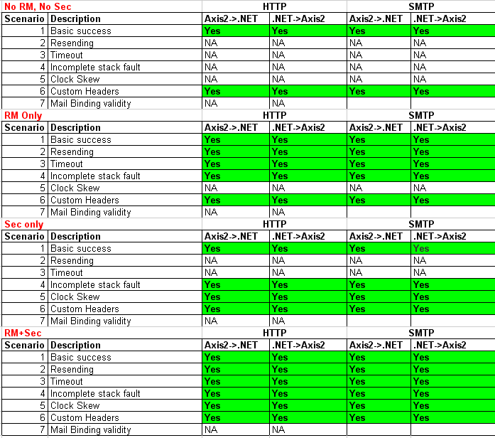
NITA Interop

Slide 34
Logical architecture
This is logically a complete peer-to-peer architecture
With only a central registry
Any company can talk to any other company
Even those with only mail accounts
Cannot track all the requests!

Slide 35
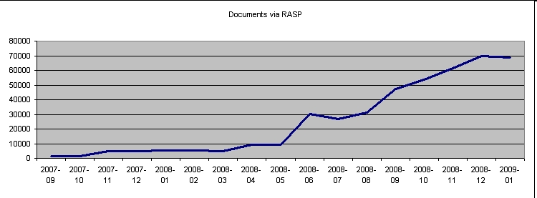
Results
18,500 companies sending invoices via RASP
Mandatory to send invoices to all government agencies
Scanning companies and a web gateway allow bridging

Slide 36
Lessons learnt
SMTP in the real world is tricky
Spam filters can modify or drop messages
Our email accounts got shut down for “spamming”
i.e. sending many messages in a short time
Timeouts were too long for the RM system
We made mistakes layering SMTP and WS-Addressing
Publishing interoperable reference implementations was a big win
Proved interoperability
Formed the basis for other implementations to test against
The RASP team is now working on a European initiative:
PEPPOL http://peppol.eu
Trying to bring the same results across Europe

Slide 37
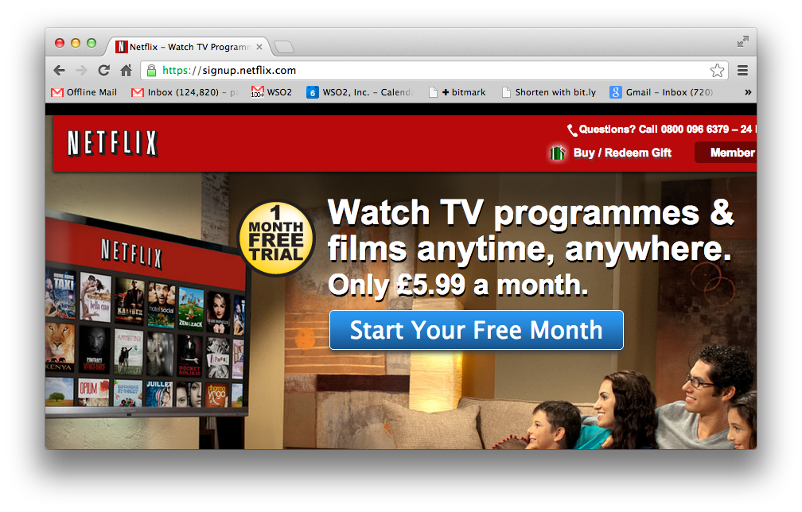

Slide 38
Netflix
A REST and Cloud based SOA approach
Continuous Delivery
100% Based in the cloud
See excellent presentations from Adrian Cockcroft
e.g. http://www.slideshare.net/adrianco/global-netflix-platform

Slide 39
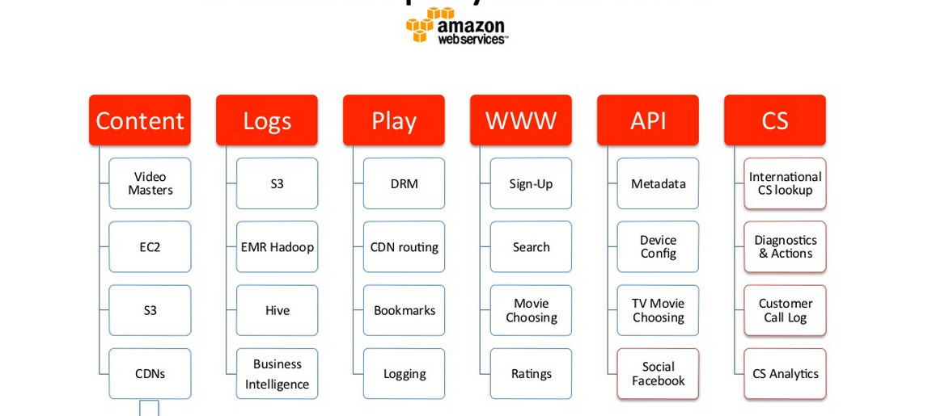
Netflix Deployed on AWS

Slide 40
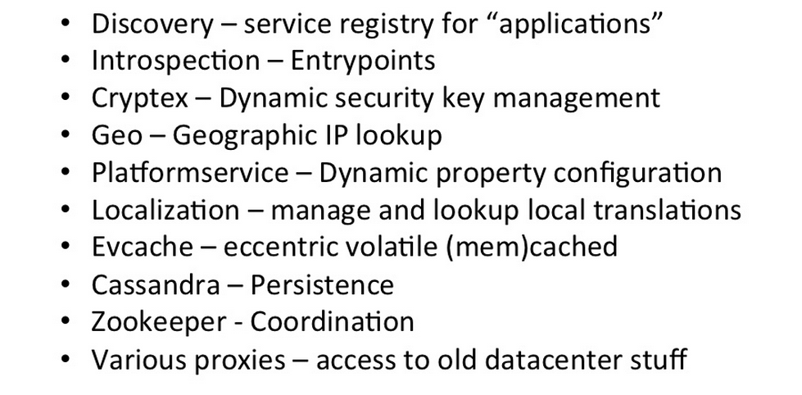
Platform Services

Slide 41
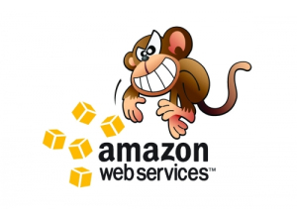
The (in)famous Chaos Monkey
Randomly kills machines
Yes, production systems
Proves that the system is resilient

Slide 42
Twitter Architecture
Open Sourced their technology:
Finagle
http://twitter.github.io/finagle/
Called an RPC system, but completely asynchronous
Based on “Services”

Slide 43
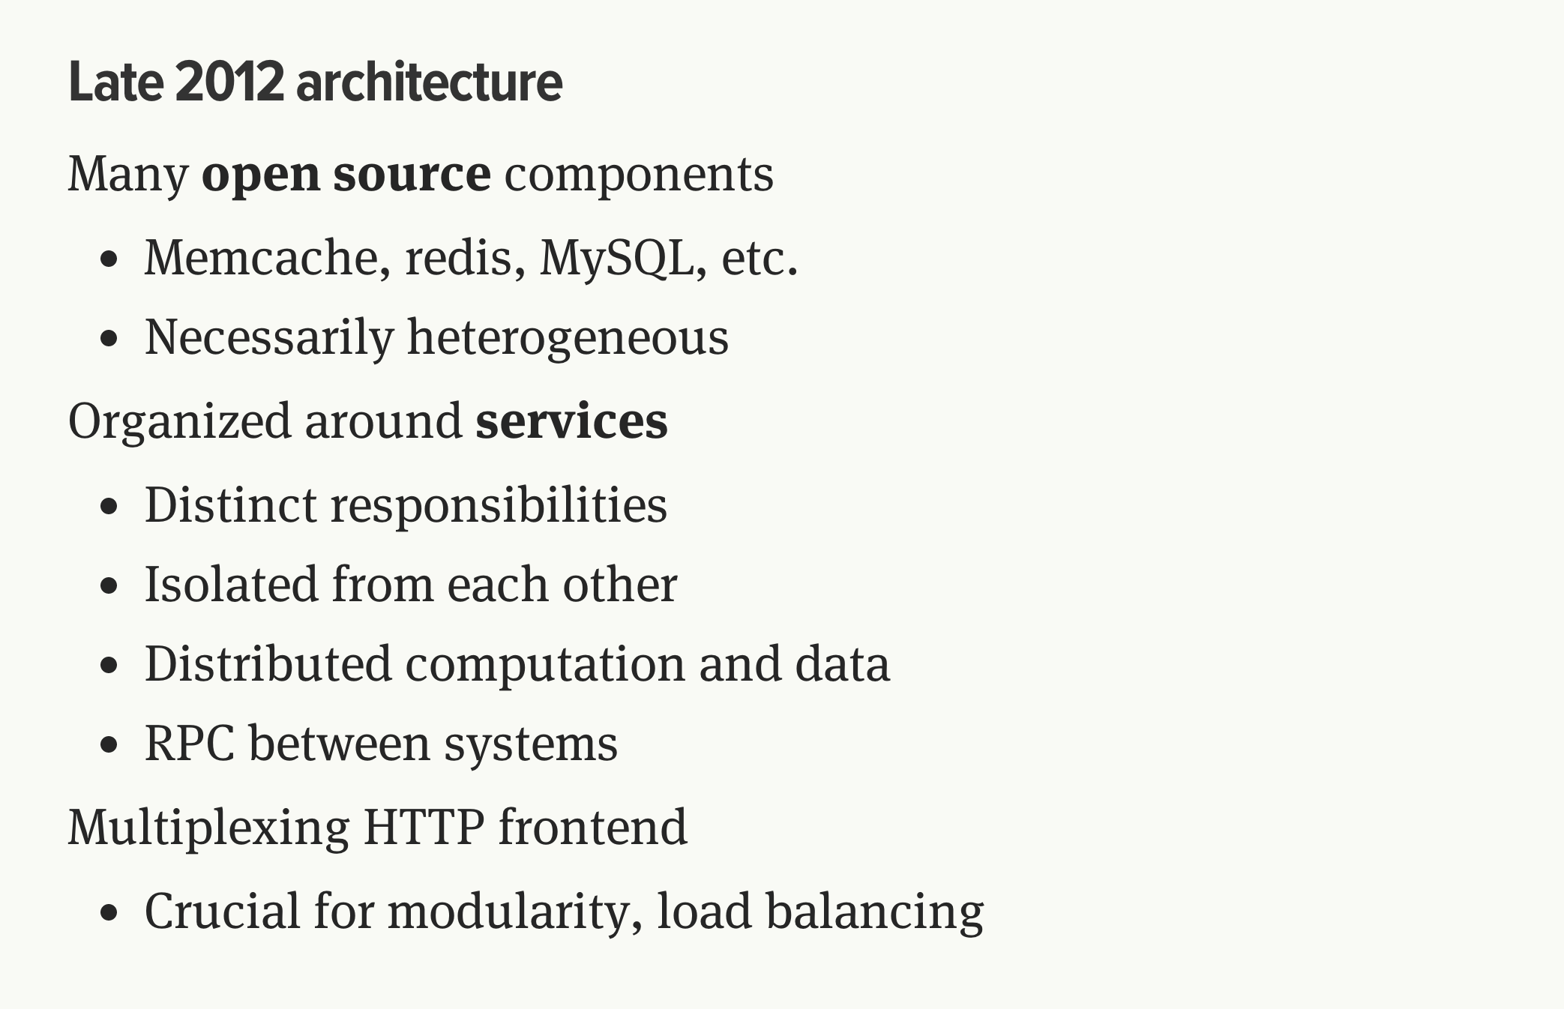
http://monkey.org/~marius/talks/twittersystems/#4

Slide 44
Anti-patterns
Use a full waterfall model
Don’t budget time for integration test
Assume that standard coding unit test->integration test will work
Build unit tests that don’t test interoperability
E.g. Simulate XML request/response inside the calling system rather than calling a remote system
Wait until all the systems are ready before starting any integration test
A delay to one system will hold up testing all the others
Don’t bother with continuous build and test
Even better build by hand
Even better test by hand too
Have a nice complex process to hand over from development to test
That way each defect will take a long time
Wait until the project is failing to find out your team doesn’t have the skills

Slide 45
Conclusions

Slide 46

Thin slice prototyping is always a good idea

Slide 47

Iterative project plans are essential

Slide 48

Prove the concept to the business

Slide 49
KISS

Slide 50
Questions?

