Slide 1
Registries

Slide 2
Contents
UDDI
WS-Discovery
S-RAMP
WSO2 Governance Registry

Slide 3
UDDI
An XML-ization of the Windows Registry
Lots of nasty UUIDs
But aimed at Internet Scale
Launched with the concept of major public UDDI servers (like DNS)
Universal Business Registry (UBR)

Slide 4
UDDI
A UDDI business registration consists of three components:
White Pages — address, contact, and known identifiers;
Yellow Pages — industrial categorizations based on standard taxonomies;
Green Pages — technical information about services exposed by the business.

Slide 5
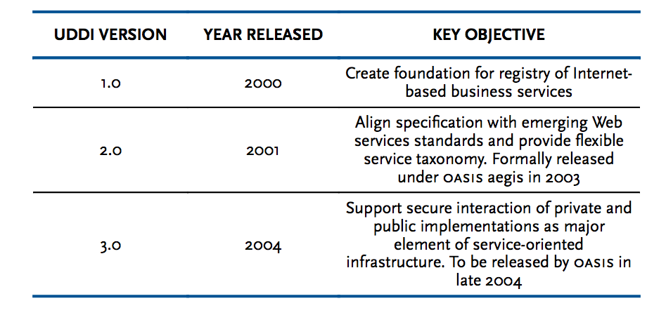
History

Slide 6
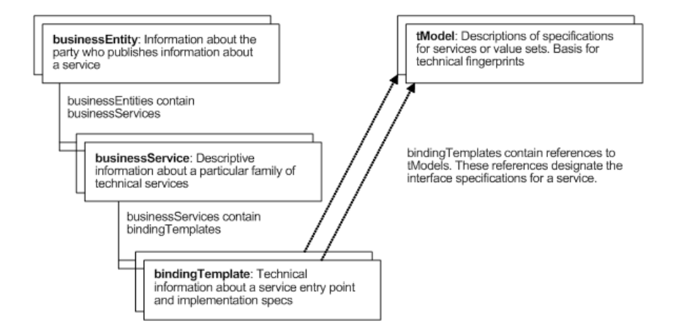
Key Data Types

Slide 7
UDDI problems
tModel concept too complex and unwieldy
Lack of any standard tModels
No simple link into WSDL
Doesn’t address the major issues of Service Registry and Governance
Lifecycle management
Notification
Dependency Management

Slide 8
WS-Discovery
A simple(r) protocol just aimed at finding “live” endpoints
For example used by HP printers for network printing
Though my own experience is that mine is a bit hit and miss!
Supports UDP and TCP
Managed or Ad-Hoc mode

Slide 9
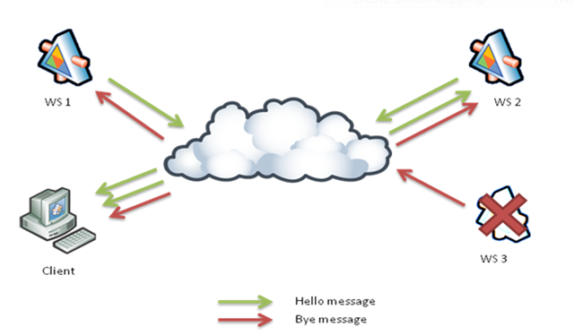
WS-Discovery “ad-hoc”

Slide 10
WS-Discovery Message Types
Hello messages
Bye messages
Probe messages
Probe match messages
Resolve messages
Resolve match messages

Slide 11
Hello
<wsd:Hello>
<wsa:EndpointReference >
<wsa:Address>urn:uuid:50bccd63-8c1f-4f9d-a0db </wsa:Address>
</wsa:EndpointReference>
<wsd:Types xmlns:a="http://echo..wso2.org">a:echoPortType </wsd:Types>
<wsd:Scopes>http://…/ws-dd/ns/discovery/2009/01/DefaultScope </wsd:Scopes>
<wsd:XAddrs>https://localhost:8243/services/echo http://localhost:8280/services/echo</wsd:XAddrs>
<wsd:MetadataVersion>1</wsd:MetadataVersion>
</wsd:Hello>

Slide 12
SOA Repository Artefact Model and Protocol (S-RAMP)
In progress at OASIS
Based on Atom/AtomPub concepts
Aimed at solving the real world problems left unanswered by UDDI
Which WSDLs and schemas import a particular schema
Which of my services are in production?
Which services are governed by a specific SLA?
What is the latest version of service X?

Slide 13
Aspects of “real” registries
Meta-Modelling
Taxonomies
Versioning
Associations and Properties
Lifecycle Management
Dependency Management
Repository
Search
Machine and Human interfaces

Slide 14
Meta-Modelling
Creating / modifying the model to support new artefacts
e.g. Teams, Projects, Organizations, etc
Also used for extending more technical attributes
e.g. adding WADL or Swagger support

Slide 15
Versioning
Micro-versioning/revision management
Keeping track of every minor update to a WSDL
Permanent URLs for given versions
“Business” Versioning
Service A is available as
1.2.3 deprecated
2.5.1 current

Slide 16
Associations and Properties
Properties
General name / value pairs attached to resources
Associations
Named Links between resources
e.g.
A isUsedBy B
B isManagedBy C

Slide 17
Lifecycle Management
Each service in the corporate datacentre MUST:
Start as “In Design”
Be approved by the Design Review Team
Iterate through Development
Pass validation tests before entering Staging
Be approved by the Security and Performance Teams before entering Production
Be deprecated when no longer supported

Slide 18
Dependency Management
Each Service Sn depends on Schemas {Y1..n}
Schema Y depends on Schemas {Z1..n}
Schemas are shared between services
Owners and users of services need to be made aware of new versions of schemas they depend on (even if they didn’t know it!)

Slide 19
Interfaces
Registries are used by humans, but shouldn’t always be!
e.g. Maven build rather than forcing developers to use a website
One company I know hires a “Registry Monkey” who ONLY enters services into a registry
Each service takes 83 steps
He hasn’t yet committed suicide

Slide 20
Resources
UDDI
http://uddi.xml.org/
S-RAMP
https://www.oasis-open.org/committees/tc_home.php?wg_abbrev=s-ramp
WS-Dynamic Discovery
http://docs.oasis-open.org/ws-dd/ns/discovery/2009/01
WSO2 Governance Registry
http://wso2.com/products/governance-registry/

