Slide 1

Higher Education Students Performance Evaluation Dataset Analysis Mathematics in Machine Learning
Ali Ghasemi(s289223)

Slide 2
Abstract
This Thesina is about analyzing the Higher Education Students Performance Evaluation Dataset

Slide 3
Dataset Details
The dataset is consisted of 145 instances and 33 attributes
It’s a multivariant dataset of integer values
8 class labels which are the grades of students (multiclass classification)
No NA or Null values

Slide 4
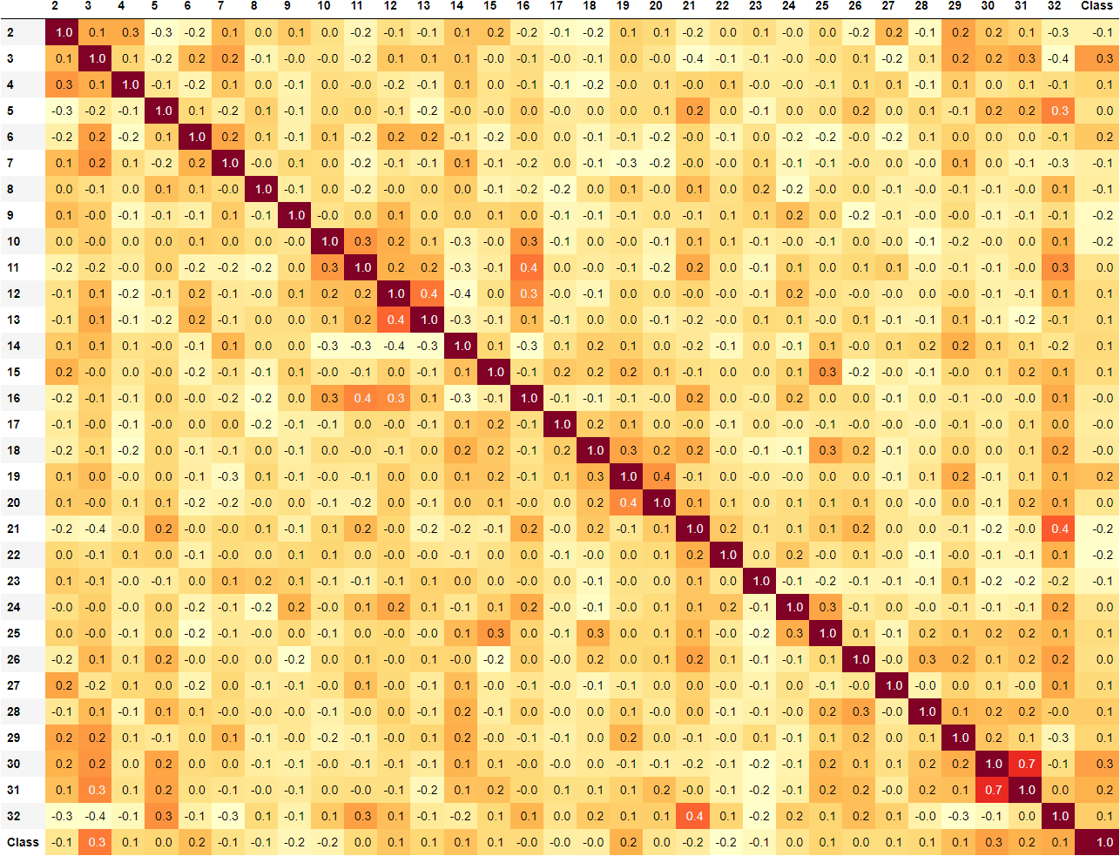
Correlation

Slide 5
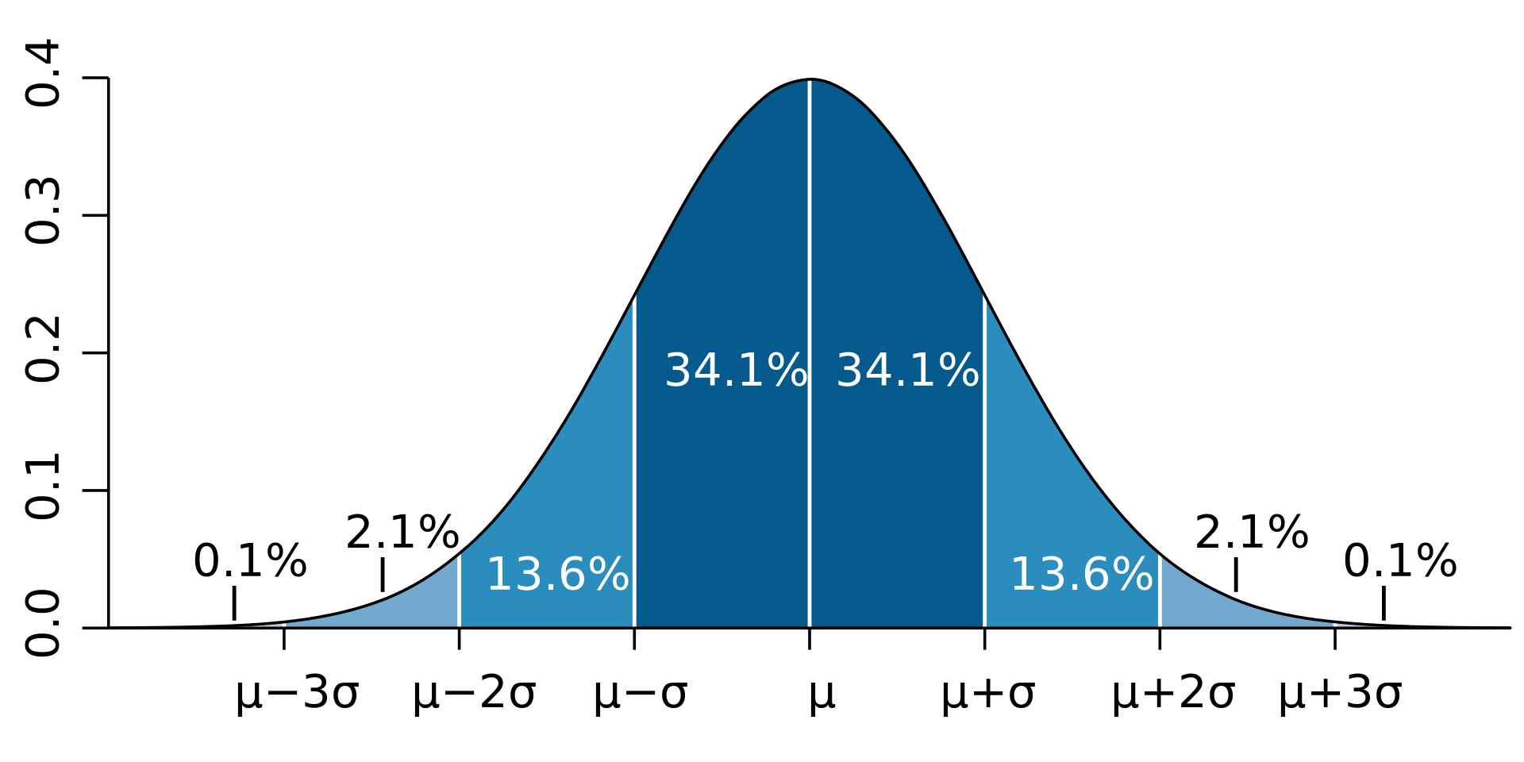
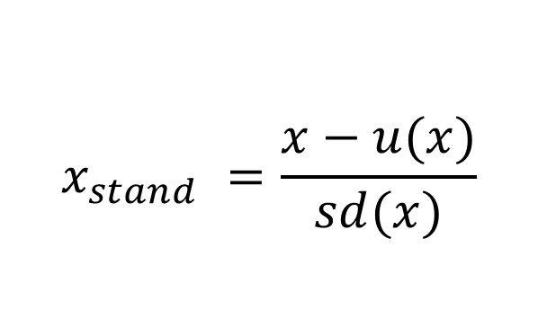
Standardization
$$x_{stand} =\frac{x−u(x)}{sd(x)}$$

Slide 6
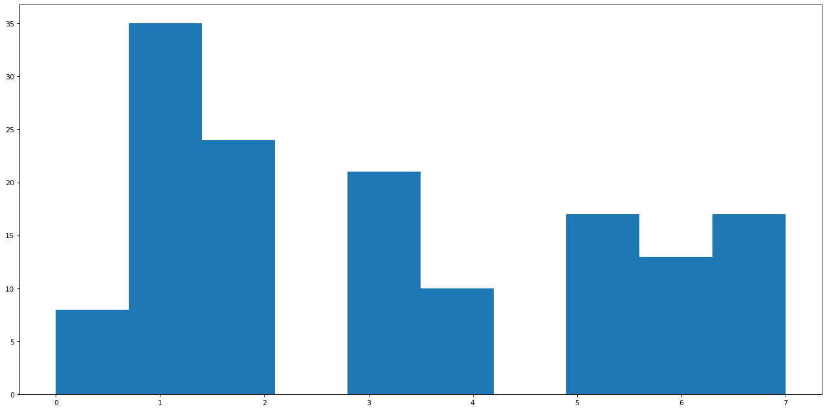
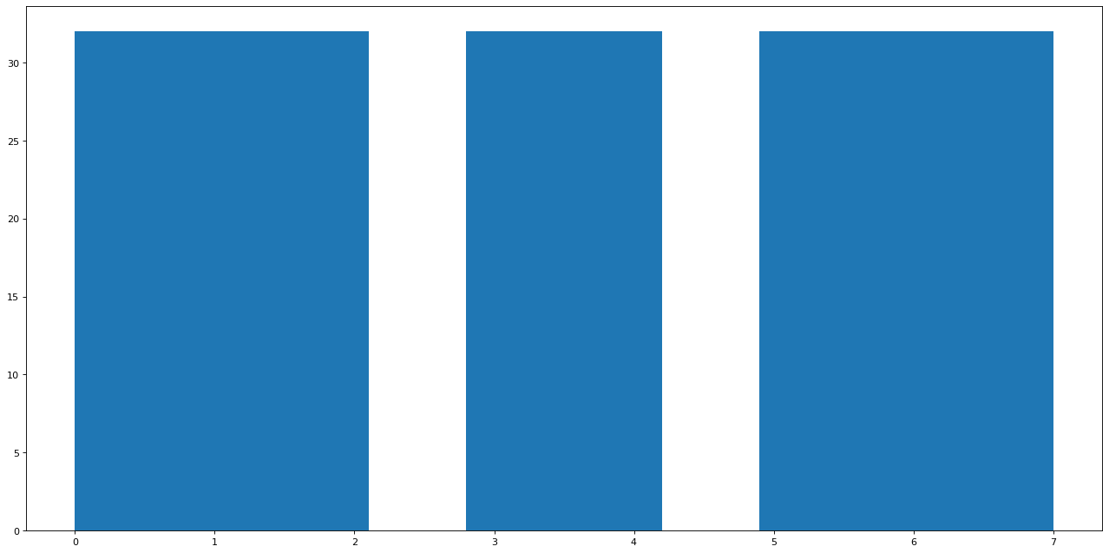
Random Oversampling
Before Random Oversampling After Random Oversampling

Slide 7
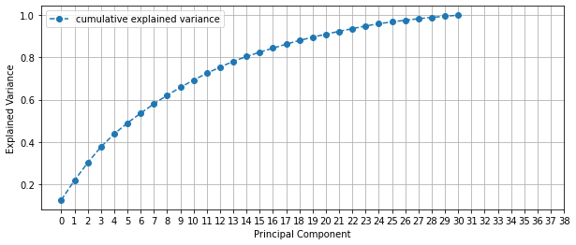
PCA
Must find the right number of principle components

Slide 8
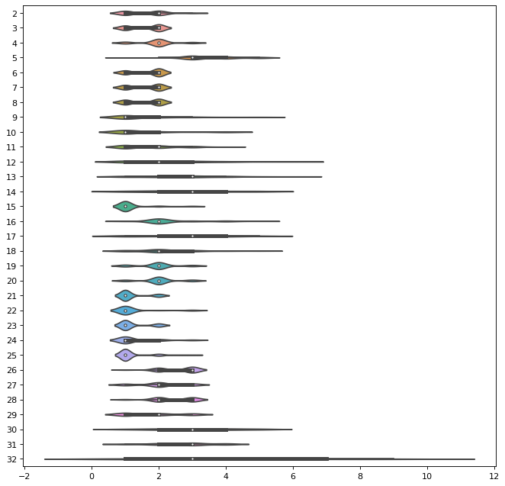
Outliers

Slide 9

z-score
$$z=\frac{(\text{x}\text{−}\text{u}\text{)}}{\text{σ}}$$
Attributes with a Z-score more that 3 will be eliminated

Slide 10
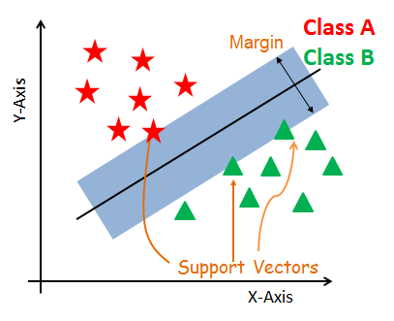
SVM

Slide 11
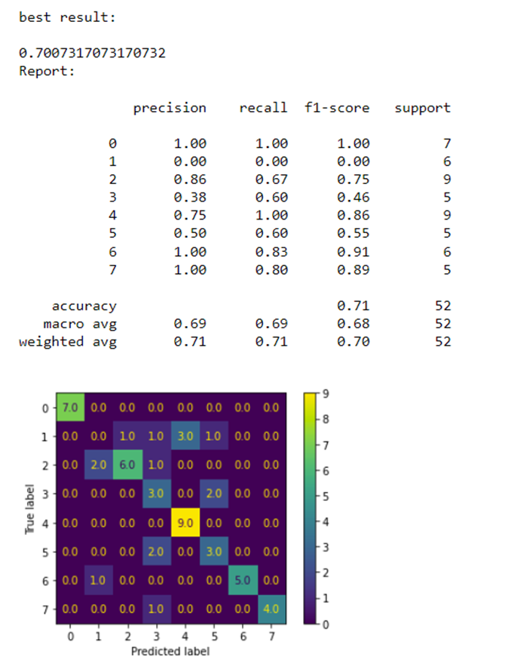
SVM
Results without PCA

Slide 12
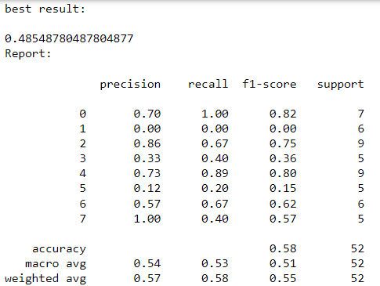
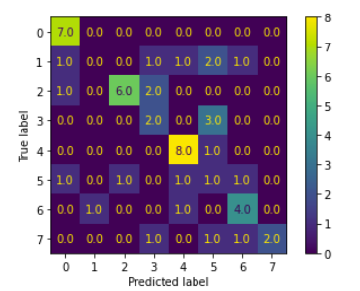
SVM
Results with PCA

Slide 13
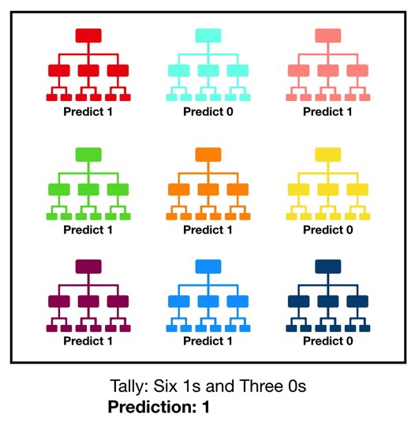
Random Forests

Slide 14
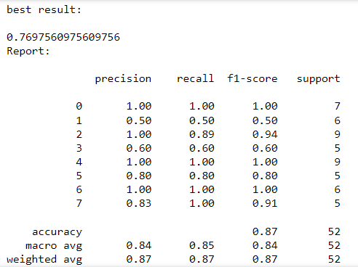
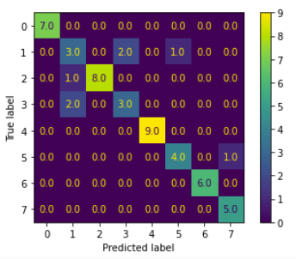
Random Forests
Results without PCA

Slide 15
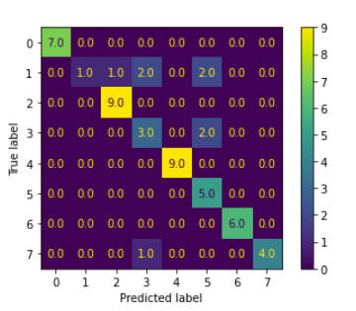
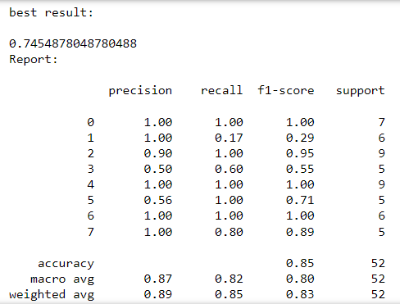
Random Forests
Results with PCA

Slide 16
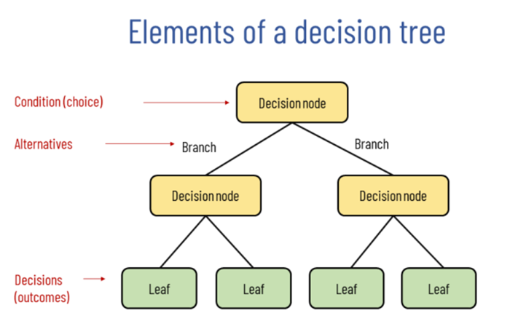
Decision Trees

Slide 17
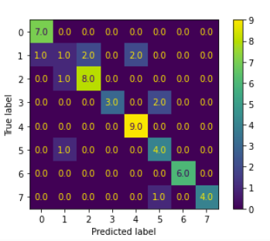
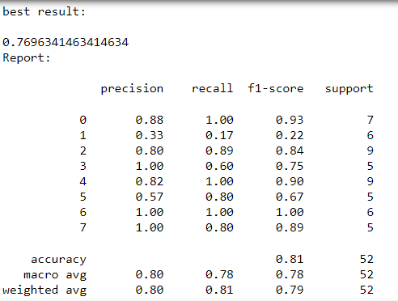
Decision Trees
Results without PCA

Slide 18
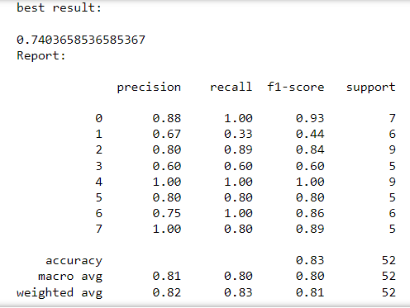
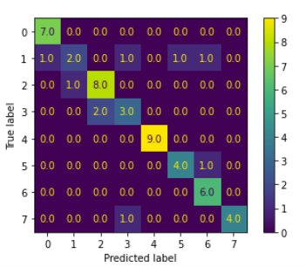
Decision Trees
Results with PCA

Slide 19
Summary
Model Name | F1 Score | PCA
SVM | 0.70 | No
SVM | 0.48 | Yes
Random Forests | 0.76 | No
Random Forests | 0.74 | Yes
Decision Trees | 0.76 | No
Decision Trees | 0.74 | Yes

Slide 20
Thank you for you time!

