Slide 1
My textbook story: what, why and how
What: a textbook on Feature Engineering
The Art of Feature Engineering: Essentials for Machine Learning
Coming in 2019, Cambridge University Press
Sharing my personal story
Meet more people in Vancouver
Encouraging others to write

Slide 2
My background
Computer Science, Cordoba, Argentina
Years 1994-1998
Thesis in Spanish parsing using Haskell
PhD in Computer Science, Columbia University NY
Years 1999-2005
Natural Language Generation (NLP / AI)
Thesis on weakly supervised learning
Good ML Practitioner
NLP uses tons of Feature Engineering
Consulting company in Vancouver

Slide 3
Why: my time at IBM Research
After my PhD, I joined IBM Research/NY
Years 2005-2010
Research Staff Member
Watson Project
Jeopardy! show requirements
Machine Learning ought to be fast
Combines information from multiple sources
Used a simpler model (logistic regression)
Tons of feature engineering
Wrote a DSL for feature engineering

Slide 4
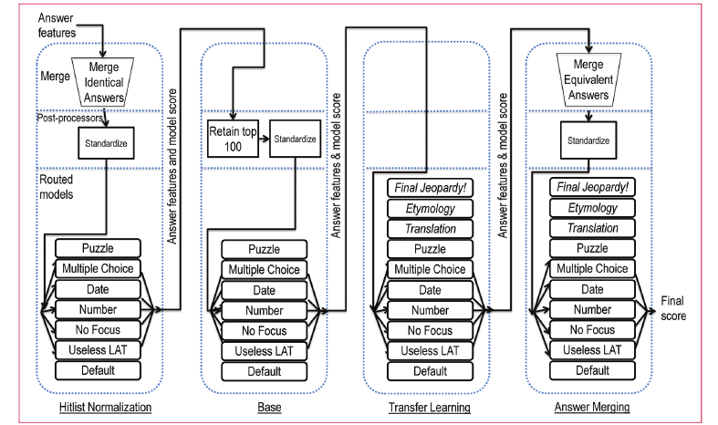
A framework for merging and ranking of answers in DeepQA
Gondek, Lally,Kalyanpur, Murdock, Duboue, Zhang, Pan, Qiu, Welty (IBM Journal of R&D, 2012)

Slide 5
Why: Cordoba University Course
Taught a semester course in Argentina
Year 2014
Machine Learning over Large Datasets
Apache Mahout and Hadoop
Course is in YouTube
In Spanish
http://aprendizajengrande.net
Lecture 5 covered Feature Engineering
Realized there was a lack of material

Slide 6
Why: Sabbatical
Moved to NY on a spouse visa
Year 2016
Not legally allowed to work
Revisited the idea of writing a textbook
Main concern with textbook
Wasting my time?
Adding to the uncountable existing books?

Slide 7
How: Background Search
Decided to start researching the book
Found Alice Zhang's O'Reily's book
Look into potential publishers
Traditional sources
Papers
ML Textbooks
Researching non-traditional sources
Videos
Quora/Stack Overflow/Blogs
Course material

Slide 8
What: Table of Contents
Focus
Helping a practitioner
People already familiar with ML algos
Helping also approach new domains
Part I
Domain independent methods
Part II
Case studies on popular domains
200 pages, 10 chapters

Slide 9
Part I
Chapter 1
Introduction
Chapter 2
Normalization
Histograms
Outliers
Chapter 3
Computable Features
Imputation
Kernels

Slide 10
Part I
Chapter 4
Feature Selection
Dimensionality Reduction
Embeddings
Chapter 5
Variable-length feature vectors
Deep-learning
Feature Learning

Slide 11
Part II
Chapter 6
WikiCities dataset
Semantic Graph population prediction
Chapter 7
Time Series population prediction

Slide 12
Part II
Chapter 8
Text description population prediction
Chapter 9
Satellite image population prediction
Chapter 10
Video
GIS
Preferences

Slide 13
How: Proposal writing process
Approaching publishers
Book proposal document
Sometimes directly available on their website
Otherwise need to contact editor in your area
My case I approached two publishers
One wanted a more general book
Reviewed my proposal
Then asked for a sample chapter
While writing, I approached a second publisher
It was a better fit and signed contract in May

Slide 14
Proposal sections
Proposal structure is similar
I have seen them for three publishers
Similar sections
Reasons for writing
Table of Contents
Target audience / Marketing
Proof that you can write such book

Slide 15
Proposal feedback
Your proposal will be reviewed by peers
In one case I got the reviewers feedback, in other I did not
For the current publisher I did
It was very useful in shaping the final book
Once you express interest to write, the editors might offer to review
I have reviewed a few proposals already
Can learn a lot from a well written proposal

Slide 16
Sample Chapter
The first chapter is the hardest
It goes from zero to 100
Some publishers insist on it
Writing logistics are key to finish chapters
My writing style is not focused on finishing chapters
That has some logistic problems
Next time I will do things differently

Slide 17
Money
Normal agreement
Royalties (% of profit)
Profit, after subtracting all costs
Advance
If you want an advance, you have to ask it
Depends on the publisher
Bottom-line
Time spent writing >> expected money

Slide 18
Proposed Feature Engineering Cycle
Start by splitting raw data into train and final test
Use the train data to cycle through feature engineering
Propose two feature sets:
Best features
Conservative features
Evaluate both on the final test
Use “best features” only if it performs similarly to training

Slide 19
Chapter proofreaders
I can still use a few more proofreaders for some chapters
Just read a chapter and comment
Content is correct?
Understandable?
Not editing
Volunteer work
If interested, just ping me on TW @pabloduboue

Slide 20
AI in Production upcoming talk
A tale of 80,251 cities: Feature Engineering for Semantic Graphs
Covering
Feature Engineering lifecycle (Chapter 1)
DBpedia Case Study (Chapter 6)
Including
Sample code (jupyter notebooks)
Date tentatively Dec. 4Th and place TBA

