Slide 1
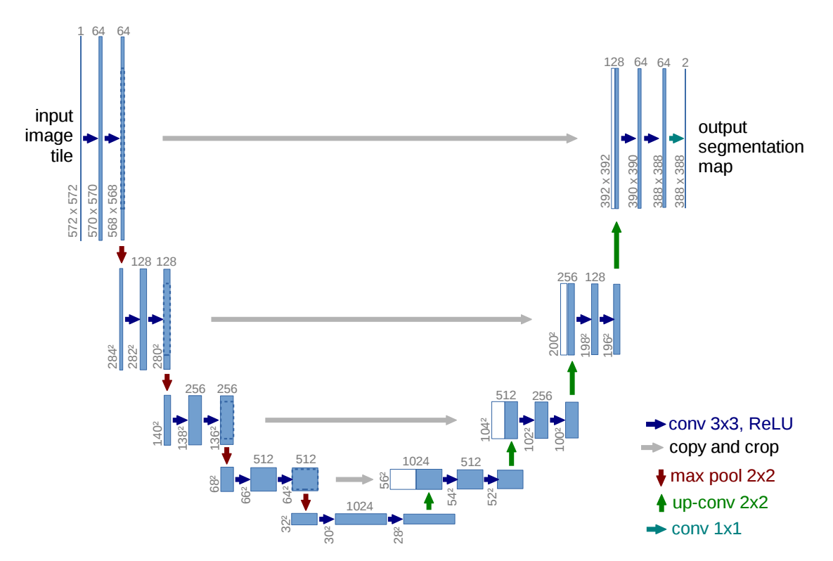

Slide 2
UNet
3x3 Convolution, ReLU
Copy and Crop
2x2 Max Pool
2x2 Unpooling
5x5 Convolution
1x1 Convolution

Slide 3
3x3 Convolution, ReLU
Copy and Crop
2x2 Max Pool
2x2 Unpooling
5x5 Convolution
1x1 Convolution

Slide 4
3x3 Convolution, ReLU
Copy and Crop
2x2 Max Pool
2x2 Transposed Convolution
1x1 Convolution

Slide 5
U-Net
Input
Output
3x3 Convolution, ReLU
Copy and Crop
2x2 Max Pool
2x2 Transposed Convolution
1x1 Convolution

Slide 6
U-Net
Input
Output
3x3 Convolution, ReLU
Copy and Crop
2x2 Max Pool
2x2 Transposed Convolution
1x1 Convolution

