Slide 1



1) What does a bank do today, and why do people trust it?
Core Role
Most “moving money” is really about securely updating records — within the bank and across multiple banks.
Bank A ledger + Bank B ledger
When money moves across banks, it’s usually messages + book updates + reconciliation.
Interest income
Non-Interest income
Trading income
Bank “A” Ledger
Bank “B” Ledger
Loans, mortgages, credit — earn spread over funding costs.
Payments, account fees, FX spreads, services.
Market activities (FX, securities, derivatives) with control
Bank A’s internal record of balances and transactions.
→
Bank B’s internal record of balances and transactions.
RECONCILIATION
+ investigations + exceptions
Because multiple ledgers exists, banks must ensure they match - even if it takes time
Debit/credit entries
Every transaction becomes a
debit/credit
Entry in a controlled ledger
Reconciliation
Because multiple ledgers exist, banks must ensure they match eventually – through investigations and handling exceptions
TRUST DRIVERS
Controls + regulation + audits are why people trust the banks record
Challenges across banks
Each institution has its own books, leading to reconciliation delays and operational costs

Slide 2


2) Cryptocurrencies: the shared ledger concept (before blockchain details)
Traditional finance vs a shared ledger
Traditional finance: each institution keeps its own ledger, requiring reconciliation — creating “multiple versions of truth.”
Bank A ledger + Bank B ledger
When money moves across banks, it’s usually messages + book updates + reconciliation.
TRADITIONAL
many ledgers
SHARED LEDGER
One unified view
PARTICIPANT A
SHARED LEDGER
PARTICIPANT B
Each institution keeps its own ledger, then reconciles later.
All participants see the same transaction state (pending/confirmed) without constant reconciliation.
Submits a transaction request.
→
Stores the agreed state: pending → confirmed (one unified view).
→
Reads the same state and acts on it.
→
Ledger = record of ownership
Crypto provides a way to maintain this record across multiple parties
WHY IT MATTERS
Less “who’s right?” and more “we all see the same record.”
Trust model shift
Instead of trusting one institution’s ledger, participants trust the rules and validation mechanisms
TRUST DRIVERS
Ledger • shared state • validation • finality (we’ll unpack later)
Why it matters
Less “who’s right” and more “we all see the same record”

Slide 3
3) What crypto changes (and what banks still do)
What crypto changes
Crypto changes how trust and record‑keeping happen. It can replace certain system roles (shared ledger + rule‑based validation), but banks still provide regulatory responsibilities and customer services.
One sentence to remember
Crypto is not “a bank.” It’s a different way to build a trusted record and move value — banks still deliver products, compliance, and protection.
REPLACE
DOES NOT REPLACE
TRADITIONAL
CRYPTO-STYLE
Who keeps the record: a shared ledger can become the common reference point.
Compliance, risk management, customer onboarding, product design, legal accountability.
Trust is institutional + reconciled across separate ledgers.
→
Trust is rules + validation on a shared record (plus bank controls around it).
Replaces: “who keeps the record”
Shared ledger can become the common record that parties reference.
NEXT SLIDE LATER
How do shared ledgers validate and synchronize? (blockchain basics, simplified)
Banks still provide Responsibilities
Regulatory responsibilities and customer services (compliance, onboarding, risk, support) still matter.
Key takeaway
Crypto can improve shared record‑keeping, but banks still run the controls that make it safe.

Slide 4
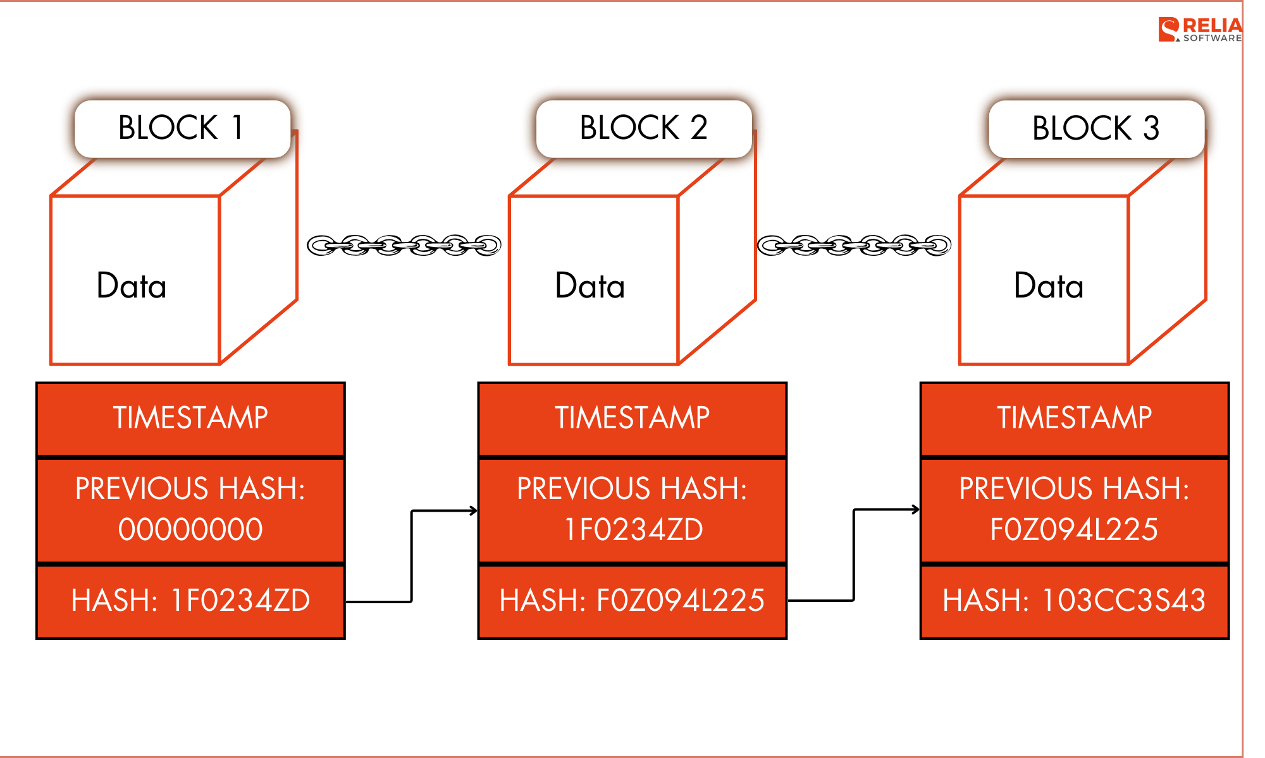
4) What is a blockchain?
Blockchain = a shared notebook that’s hard to edit.
Think of it like pages in a notebook. Each page “locks” the page before it.
Block → Block → Block
A very simplified view (not real cryptography details).
Block = a page
It contains a list of transactions (who sent what to whom).
BLOCK 101
BLOCK 102
Transactions + “fingerprint”(hash) of Block 100
→
Transactions + “fingerprint”(hash) of Block 100
Chain = pages linked
Each block points to the previous block, so the order is fixed.
WHY IT MATTERS
Everyone can check if someone tried to change an old record.
Hard to change history
If you change an old block, it breaks the links to every block after it.

Slide 5
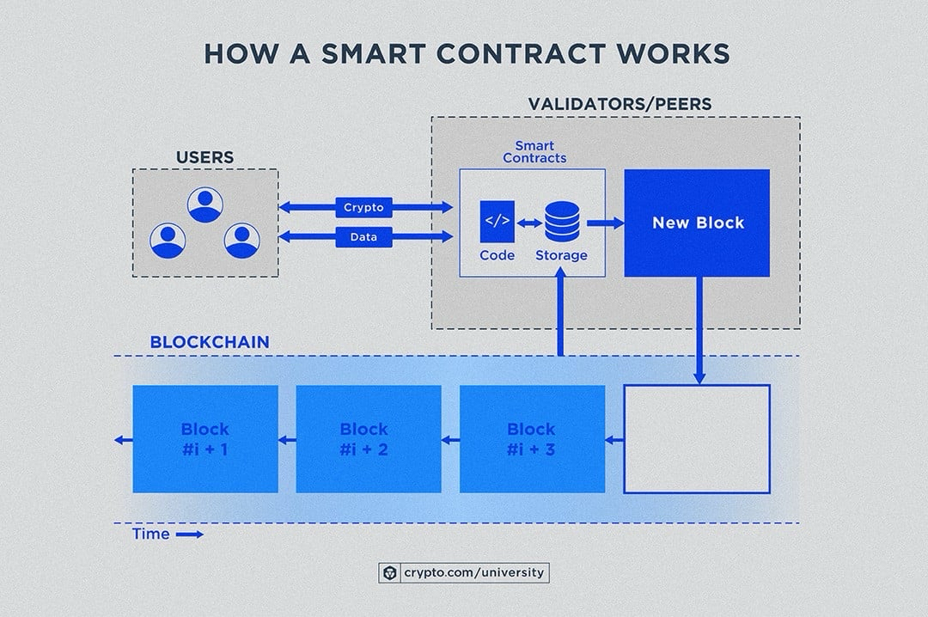
5) Smart contracts: “rules that run” on the shared ledger
What is a smart contract?
A smart contract is shared business logic that runs on a blockchain. Instead of one party enforcing rules, the network enforces the same rules for everyone.
Open-ended question: If some rules become “code on a shared ledger,” which bank processes could be safer or faster — and which should remain off-chain?
Example smart contract functions (bank-friendly)
These are examples of what “rules that run” can do.
Analogy: “vending machine rules”
Put in $2 + choose item → machine releases item automatically. No clerk needed to interpret rules.
1) Allowlist transfers
POLICY
2) Limits & approvals
CONTROLS
Only allow transfers to approved counterparties (addresses/participants).
Enforce transaction limits; require extra approval above threshold.
How it works (high-level)
Users submit transactions → contract checks rules → updates shared ledger state (approved / rejected).
3) Mint / burn rules
SUPPLY
4) Escrow & atomic swap
SETTLEMENT
Create/destroy tokens only when specific conditions are met (e.g., backed by deposit/liability rules).
“Either both sides happen, or neither happens” (reduce settlement risk).
TINY PESUDO LOGIC
IF receiver is allowlisted AND amount <= limit AND approvals >= required THEN transfer & mark confirmed ELSE reject (no ledger update)
TAKEAWAY
Smart contracts = shared rules that automate decisions on the shared ledger.

Slide 6
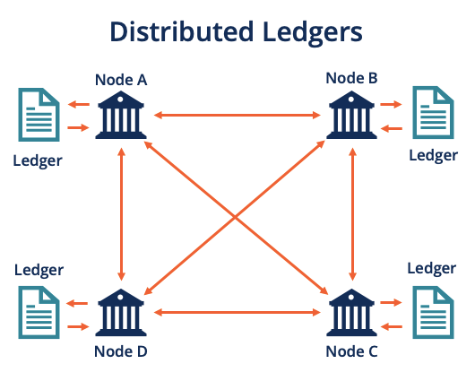
6) Introducing a blockchain network
A network is “many computers agreeing on the same notebook.”
Instead of one server updating the ledger, many nodes verify and share updates.
What happens when you send?
Simple flow: create → broadcast → validate → confirm.
Nodes
Computers that keep a copy of the blockchain and check transactions.
YOU
NETWORK
“Send $ 10 to Alex” (a transaction request).
→
Nodes check rules, then add it into a new block.
Consensus
Rules for how the network decides what is “true” and what gets added next.
RESULT
Finality
When the network considers a transaction “done” (no take-backs) Can only be reversed by reverse transaction, not update.
Everyone’s copy updates to the same state.

Slide 7
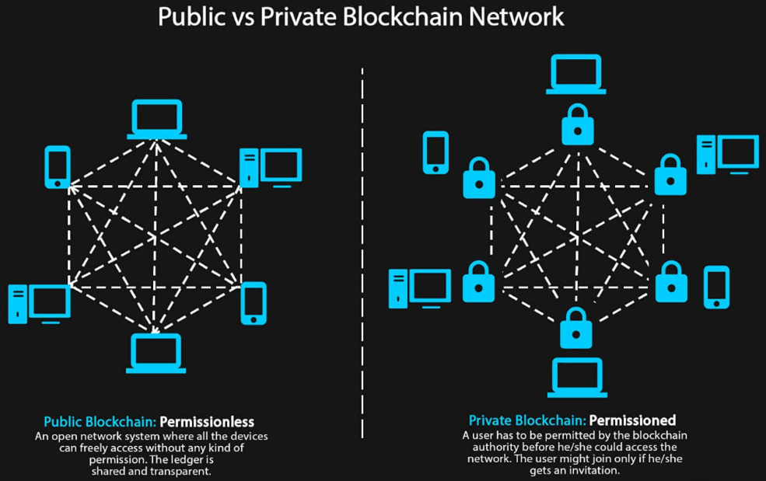
7) Two network models: Public vs Private
Same idea (shared record), different rules (who can join).
Public = open to anyone. Private = only approved members.
Quick comparison
Not “better or worse” — just different trade-offs.
Public networks
Anyone can use it and run nodes. Very transparent.
PUBLIC
PRIVATE
Open access • transparent Fees can change • global reach
Member-only • privacy controls Governed rules • faster finality
Private networks
Only known members can join. Better privacy and governance.
KEY TAKEAWAY
Banks usually want strong identity, controls, and audit — so private/permissioned models are common.
Bank-friendly question
Do we need openness, or do we need controlled membership + privacy? FYR: JPM Kinexys is on private network

Slide 8
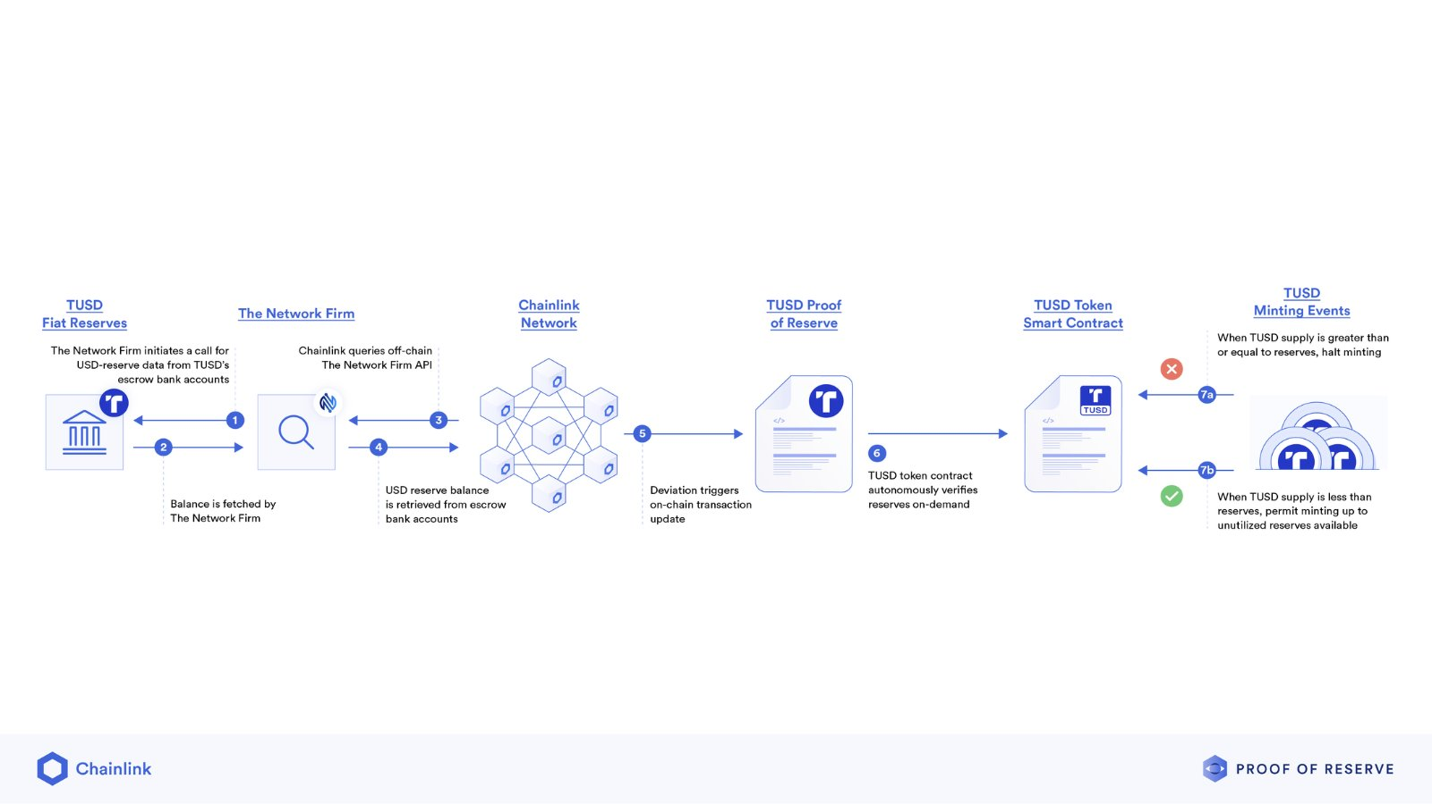
8) Stablecoin (simple idea)
Stablecoin = “digital dollars” that try to stay at $1.
A company (issuer) promises you can trade 1 token for 1 dollar (or similar).
Simple “money loop”
How tokens relate to real money.
Why people use it
Fast 24/7 transfers on crypto rails without wild price swings.
CASH (FIAT)
STABLECOIN
You give $ to the issuer (or an approved partner).
→
issuer mints tokens you can send anywhere on the network.
Key actions
Mint (create) • Transfer • Redeem/burn (cash out).
REDEEM
Later you trade tokens back for cash (if issuer allows).
Big risk question
Do you trust the issuer’s reserves and controls?

Slide 9
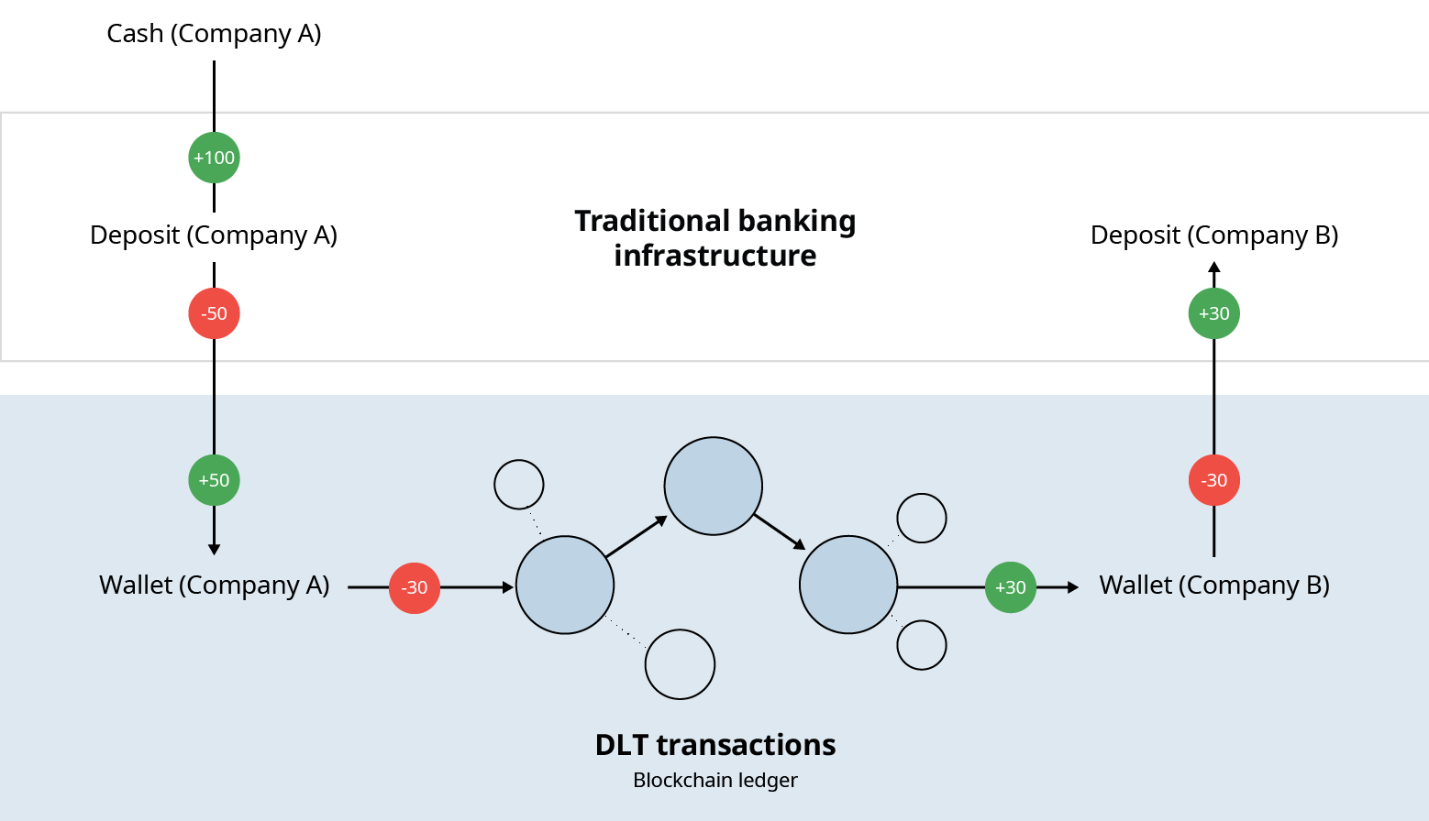
9) Tokenized deposits
Tokenized deposit = “your bank deposit, represented as a token.”
Unlike stablecoins, it’s typically issued by the bank and tied to the bank’s deposit ledger.
How it connects to the bank
Tokens should always reconcile to the bank’s books.
CORE DEPOSIT LEDGER
TOKEN NETWORK
It’s still bank money
The bank remains the issuer and operator of the deposit liability.
The bank’s “source of truth” for balances.
→
Approved members transfer deposit-tokens under policy rules.
Why do it?
Faster settlement between approved members (e.g., internal flows or partner networks).
CONTROLS
Identity, approvals, limits, audit logs, and reconciliation are essential.
Key promise
1 token matches 1 unit of deposit balance (with clear rules).

Slide 10
10) NB250A (tokenizing operations)
Sometimes we don’t tokenize money — we tokenize the process.
NB250A can be thought of as using a shared log to prove “what happened” across teams.
A simple workflow log
Each step adds an immutable event.
1) REQUEST
2) APPROVE
Shared audit trail
Each step writes an event (who/what/when).
Created with a unique ID
→
Approvers sign/attest.
Fewer disputes
If everyone sees the same status, there’s less “who is right?”
3) EXECUTE & RECORD
Execution + evidence is written to the shared log.
Works with many workflows
Trade ops, approvals, investigations, handoffs, reporting, etc.

Slide 11
11) Potential use cases at Scotiabank
Where this can help (simple examples)
Think “faster settlement, clearer audit, fewer handoff gaps.”
A simple “fit check”
Use cases tend to fit when these are true:
Cross-border payments
Treasury
Operations audit
WHY IT MATTERS
CRYPTO-STYLE
24/7 transfer + clearer status tracking.
Liquidity moves faster; better intraday control.
Shared event log reduces disputes and manual checking.
Multiple teams/banks need the same status.
Today there is lots of matching and exceptions.
AUDIT MATTERS
Because multiple ledgers exists, banks must ensure they match - even if it takes time
Important note
Every use case needs controls: identity, approvals, monitoring, and reconciliation.

