Slide 1
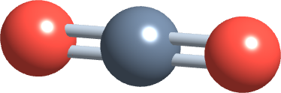
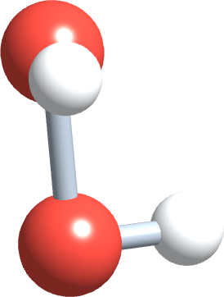
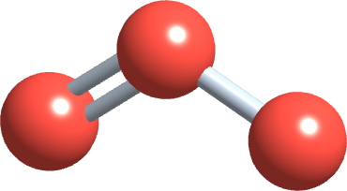
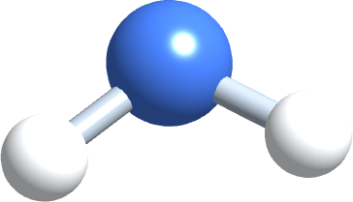
PHD115 Fundamentals of Chemistry
Chemical Reactions II
Dr. Nur 'Ainun Mokhtar (Dr. NAM) · Faculty of Pharmacy, UiTM Bertam, Penang
Core reference: Ball, Hill & Scott, The Basics of GOB Chemistry, 6.S and 7.4; rates and equilibrium expanded from Introductory Chemistry (LibreTexts), chapter 15
PHD115 · Chemical Reactions II
Dr. NAM · Faculty of Pharmacy, UiTM Bertam, Penang
Notes:
This lecture covers energy changes in reactions and reaction rates. It builds on Energy & Matters (bond energies, Ball 7.4) and Chemical Reactions I (moles and stoichiometry).

Slide 2
Learning outcomes
CR2-LO1
Explain the energy changes in a reaction (bonds broken and formed), classify reactions as exothermic or endothermic, and use a thermochemical equation to calculate the heat involved
CR2-LO2
Draw and interpret energy diagrams: reactants, products, transition state, activation energy (E_{a}) and ΔH
CR2-LO3
Use collision theory (collision, energy and orientation) to explain why some collisions lead to reaction and others do not
CR2-LO4
Define reaction rate and explain how concentration, temperature, surface area and catalysts change it, including drug stability and storage
CR2-LO5
Describe how catalysts and enzymes speed up reactions without being used up, and relate enzymes and enzyme inhibitors to pharmacy
CR2-LO6
Describe reversible reactions and dynamic equilibrium, and use Le Châtelier's principle to predict how an equilibrium shifts
PHD115 · Chemical Reactions II
Dr. NAM · Faculty of Pharmacy, UiTM Bertam, Penang
Notes:
The same six outcomes appear in the before-class activity, the after-class activity, the tutorial and the exam questions.

Slide 3
Lecture map
Part 1 · Energy changes in reactions (Ball 7.4 recap, 6.S): exothermic, endothermic, thermochemical equations
Part 2 · Energy diagrams and activation energy (Ball 6.S): the energy hill every reaction must climb
Part 3 · Collision theory (Ball 6.S): collision, energy and orientation
Part 4 · Reaction rates: concentration, temperature, surface area, and why medicines expire
Part 5 · Catalysts and enzymes (Ball 6.S): lowering the barrier, in the flask and in the body
Part 6 · Equilibrium and Le Châtelier's principle (Ball 6.S): reactions that go both ways
Links
Part 1 builds on bond energies (Energy & Matters, Part 4). The calculations reuse moles and molar mass (Chemical Reactions I, Parts 6–7).
PHD115 · Chemical Reactions II
Dr. NAM · Faculty of Pharmacy, UiTM Bertam, Penang
Notes:
The core reference summary (Ball 6.S) introduces collision theory, enthalpy, activation energy, catalysts and equilibrium. Rates and equilibrium are expanded here to match the course plan.

Slide 4
THINK FIRST
Insulin is kept in the fridge, yet a box of matches can sit in a drawer for years without catching fire. What does this tell us about chemical reactions?
Discuss with a partner for one minute.
PHD115 · Chemical Reactions II
Dr. NAM · Faculty of Pharmacy, UiTM Bertam, Penang
Notes:
Ask students to discuss for one minute. Collect ideas: 'heat makes things go bad', 'the match needs a spark'. Both are the core of today's lecture.

Slide 5
THINK FIRST · ANSWER
Insulin is kept in the fridge, yet a box of matches can sit in a drawer for years without catching fire. What does this tell us about chemical reactions?
Whether a reaction can happen (energy) is a different question from how fast it happens (rate). A match needs a strike to get over an energy barrier; cold slows the breakdown of medicines. This lecture explains both.
PHD115 · Chemical Reactions II
Dr. NAM · Faculty of Pharmacy, UiTM Bertam, Penang
Notes:
Ask students to discuss for one minute. Collect ideas: 'heat makes things go bad', 'the match needs a spark'. Both are the core of today's lecture.

Slide 6
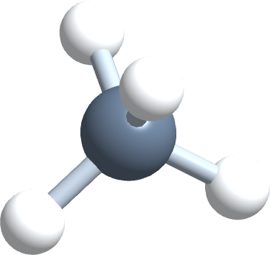
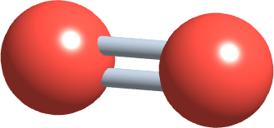
1
PART 1
Energy changes in reactions
Every reaction breaks bonds and makes new ones, so every reaction either releases or absorbs energy.
CR2-LO1 · Ball 7.4 (recap) · 6.S
PHD115 · Chemical Reactions II
Dr. NAM · Faculty of Pharmacy, UiTM Bertam, Penang
Notes:
Part 1 is a short recap of Energy & Matters Part 4, then extends it to calculations with moles.

Slide 7
1
CR2-LO1
Recap: where the energy comes from
Breaking a bond absorbs energy. Forming a bond releases energy.
Energy is neither created nor destroyed (law of conservation of energy): it moves between the reaction (the system) and its surroundings.
The energy difference between products and reactants is the enthalpy change, ΔH: ΔH ≈ Σ(bonds broken) − Σ(bonds formed).
Exothermic: heat is released, ΔH is negative. Endothermic: heat is absorbed, ΔH is positive.
From Energy & Matters
H₂ + Cl₂ → 2HCl: bonds broken 163 kcal, bonds formed 206 kcal, ΔH ≈ −43 kcal. Exothermic.
PHD115 · Chemical Reactions II
Dr. NAM · Faculty of Pharmacy, UiTM Bertam, Penang
Notes:
Recap from EM Part 4 (Ball 7.4). The kcal example is the EM try-it; from here on we use kJ.

Slide 8
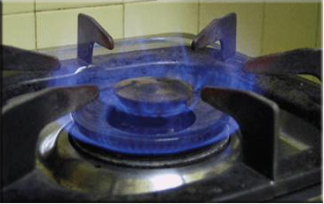
1
CR2-LO1
Exothermic: heat is a product
Burning methane: CH₄(g) + 2O₂(g) → CO₂(g) + 2H₂O(ℓ), ΔH = −890 kJ.
The bonds formed in CO₂ and H₂O are stronger than the bonds broken in CH₄ and O₂, so energy is left over.
The extra energy flows to the surroundings: the flame and the pot get hot.
In the body, oxidising glucose is exothermic too: about 2800 kJ per mole of glucose.
Burning natural gas, Figure 5.6.1 (Ball, The Basics of GOB Chemistry 5.6)
PHD115 · Chemical Reactions II
Dr. NAM · Faculty of Pharmacy, UiTM Bertam, Penang
Notes:
Ball 5.6 figure reused from CR1 (combustion is redox). Methane value matches EM (890.4 kJ).

Slide 9
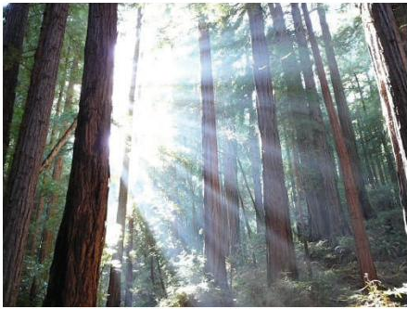
1
CR2-LO1
Endothermic: energy is a reactant
Photosynthesis: 6CO₂ + 6H₂O + energy → C₆H₁₂O₆ + 6O₂, ΔH ≈ +2800 kJ.
Sunlight supplies the energy; it is stored in the bonds of glucose.
It is exactly the reverse of respiration, so ΔH has the same size and the opposite sign.
Decomposing CaCO₃ into CaO and CO₂ also absorbs heat: ΔH = +177.8 kJ.
Photosynthesis is the ultimate source of all food on Earth, Figure 5.6.3 (Ball, The Basics of GOB Chemistry 5.6)
PHD115 · Chemical Reactions II
Dr. NAM · Faculty of Pharmacy, UiTM Bertam, Penang
Notes:
Photosynthesis figure from Ball 5.6. CaCO3 value matches EM.

Slide 10
1
CR2-LO1
Thermochemical equations
2H₂(g) + O₂(g) → 2H₂O(ℓ) ΔH = −572 kJ
as written | ΔH belongs to the equation as written: 2 mol H₂ react with 1 mol O₂ to give 2 mol H₂O and release 572 kJ
states | states matter: making H₂O(g) instead of H₂O(ℓ) releases less heat
scale | halve the coefficients, halve ΔH: H₂ + ½O₂ → H₂O(ℓ), ΔH = −286 kJ
reverse | reverse the equation, change the sign: 2H₂O(ℓ) → 2H₂(g) + O₂(g), ΔH = +572 kJ
ΔH can be read as 'kJ per the moles shown in the equation', so it works like a mole ratio from Chemical Reactions I.
PHD115 · Chemical Reactions II
Dr. NAM · Faculty of Pharmacy, UiTM Bertam, Penang
Notes:
Key idea: ΔH is a stoichiometric quantity.

Slide 11
1
CR2-LO1
Heat from a thermochemical equation
1. Convert the given mass to moles (divide by the molar mass).
2. Use the equation: ΔH is the heat for the number of moles shown by the coefficient.
3. Heat = moles × (ΔH ÷ coefficient). Keep the sign: negative = released, positive = absorbed.
4. State the answer in words: '... kJ of heat is released' or '... is absorbed'.
Road map
mass → moles → heat
g ÷ (g/mol) → mol × (kJ/mol) → kJ
PHD115 · Chemical Reactions II
Dr. NAM · Faculty of Pharmacy, UiTM Bertam, Penang
Notes:
Same road map as mole–mass problems in CR1, with ΔH as the last conversion factor.

Slide 12
1
CR2-LO1
Example 1.1 · Burning methane
CH₄(g) + 2O₂(g) → CO₂(g) + 2H₂O(ℓ), ΔH = −890 kJ. How much heat is released when 24.0 g of CH₄ burns? (C = 12.01, H = 1.01)
1
Molar mass of CH₄ = 12.01 + 4(1.01) = 16.05 g/mol
2
Moles of CH₄ = 24.0 g ÷ 16.05 g/mol = 1.50 mol
3
The equation releases 890 kJ per 1 mol CH₄: 1.50 mol × 890 kJ/mol = 1.33 × 10³ kJ
4
1.33 × 10³ kJ of heat is released (ΔH negative, exothermic).
PHD115 · Chemical Reactions II
Dr. NAM · Faculty of Pharmacy, UiTM Bertam, Penang
Notes:
1.4953 × 890 = 1331 kJ; 3 s.f. from 24.0 g.

Slide 13
1
CR2-LO1
Example 1.2 · Reversing and scaling
N₂(g) + O₂(g) → 2NO(g), ΔH = +180.6 kJ. (a) What is ΔH for 2NO(g) → N₂(g) + O₂(g)? (b) How much heat is needed to make 1 mol of NO?
1
(a) Reversing the equation changes the sign: ΔH = −180.6 kJ (exothermic).
2
(b) 180.6 kJ makes 2 mol NO, so 1 mol needs 180.6 ÷ 2 = 90.3 kJ, absorbed.
3
This endothermic reaction happens in hot car engines and lightning; NO contributes to air pollution.
PHD115 · Chemical Reactions II
Dr. NAM · Faculty of Pharmacy, UiTM Bertam, Penang
Notes:
Reverse = change sign; scale = scale ΔH.

Slide 14
1
CR2-LO1
Try it · Energy from glucose
C₆H₁₂O₆ + 6O₂ → 6CO₂ + 6H₂O, ΔH = −2803 kJ. How much heat is released when the body oxidises 9.00 g of glucose? (C = 12.01, H = 1.01, O = 16.00)
Work it out, then check on the next slide.
PHD115 · Chemical Reactions II
Dr. NAM · Faculty of Pharmacy, UiTM Bertam, Penang
Notes:
140 kJ ÷ 4.184 = 33.5 kcal.

Slide 15
1
CR2-LO1
Try it · Energy from glucose · answer
C₆H₁₂O₆ + 6O₂ → 6CO₂ + 6H₂O, ΔH = −2803 kJ. How much heat is released when the body oxidises 9.00 g of glucose? (C = 12.01, H = 1.01, O = 16.00)
Answer
Molar mass = 6(12.01) + 12(1.01) + 6(16.00) = 180.18 g/mol
Moles = 9.00 ÷ 180.18 = 0.0500 mol
Heat = 0.0500 × 2803 = 140 kJ released (about 33 kcal, a few sweets' worth).
PHD115 · Chemical Reactions II
Dr. NAM · Faculty of Pharmacy, UiTM Bertam, Penang
Notes:
140 kJ ÷ 4.184 = 33.5 kcal.

Slide 16
1
CR2-LO1
Pharmacy in your hand: cold packs and hot packs
Instant packs used for sprains and muscle aches contain a solid and a pouch of water. Squeezing the pack lets them mix.
Cold pack · endothermic
Hot pack · exothermic
Ammonium nitrate dissolves: NH₄NO₃(s) → NH₄⁺(aq) + NO₃⁻(aq)
ΔH = +25.7 kJ/mol: heat is taken from the surroundings
The pack (and the injury) cools down: reduces swelling
Calcium chloride dissolves: CaCl₂(s) → Ca²⁺(aq) + 2Cl⁻(aq)
ΔH = −82.8 kJ/mol: heat is released to the surroundings
Air-activated warmers use iron rusting: 4Fe + 3O₂ → 2Fe₂O₃, ΔH = −1648 kJ
PHD115 · Chemical Reactions II
Dr. NAM · Faculty of Pharmacy, UiTM Bertam, Penang
Notes:
Dissolving is a physical change but the same sign rules apply. Values are standard enthalpies of solution.

Slide 17
1
CR2-LO1
Try it · Inside a cold pack
A cold pack contains 40.0 g of NH₄NO₃. Dissolving it has ΔH = +25.7 kJ/mol. How much heat does the pack absorb? Is the process endothermic or exothermic? (N = 14.01, H = 1.01, O = 16.00)
Work it out, then check on the next slide.
PHD115 · Chemical Reactions II
Dr. NAM · Faculty of Pharmacy, UiTM Bertam, Penang
Notes:
0.49963 × 25.7 = 12.84 kJ.

Slide 18
1
CR2-LO1
Try it · Inside a cold pack · answer
A cold pack contains 40.0 g of NH₄NO₃. Dissolving it has ΔH = +25.7 kJ/mol. How much heat does the pack absorb? Is the process endothermic or exothermic? (N = 14.01, H = 1.01, O = 16.00)
Answer
Molar mass = 2(14.01) + 4(1.01) + 3(16.00) = 80.06 g/mol
Moles = 40.0 ÷ 80.06 = 0.500 mol
Heat = 0.500 × 25.7 = 12.8 kJ absorbed. ΔH is positive, so it is endothermic.
PHD115 · Chemical Reactions II
Dr. NAM · Faculty of Pharmacy, UiTM Bertam, Penang
Notes:
0.49963 × 25.7 = 12.84 kJ.

Slide 19
1
CR2-LO1
Key takeaways: energy changes
Bond breaking absorbs energy; bond forming releases energy. The balance decides the sign of ΔH.
Exothermic: ΔH < 0, heat released, surroundings warm. Endothermic: ΔH > 0, heat absorbed, surroundings cool.
ΔH in a thermochemical equation refers to the moles shown. Reverse the equation: change the sign. Scale the equation: scale ΔH.
Heat = moles × (ΔH per mole): the same road map as stoichiometry.
PHD115 · Chemical Reactions II
Dr. NAM · Faculty of Pharmacy, UiTM Bertam, Penang
Notes:
Summary of Part 1.

Slide 20
1
CR2-LO1
Quick check
2H₂(g) + O₂(g) → 2H₂O(ℓ), ΔH = −572 kJ. What is ΔH for 4H₂O(ℓ) → 4H₂(g) + 2O₂(g)?
A −1144 kJ
B +572 kJ
C +1144 kJ
D −286 kJ
PHD115 · Chemical Reactions II
Dr. NAM · Faculty of Pharmacy, UiTM Bertam, Penang

Slide 21
1
CR2-LO1
Quick check · answer
2H₂(g) + O₂(g) → 2H₂O(ℓ), ΔH = −572 kJ. What is ΔH for 4H₂O(ℓ) → 4H₂(g) + 2O₂(g)?
A −1144 kJ
B +572 kJ
C +1144 kJ
D −286 kJ
Answer C. Reversing changes the sign (+572 kJ) and doubling the coefficients doubles ΔH: +1144 kJ.
PHD115 · Chemical Reactions II
Dr. NAM · Faculty of Pharmacy, UiTM Bertam, Penang

Slide 22
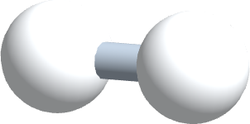
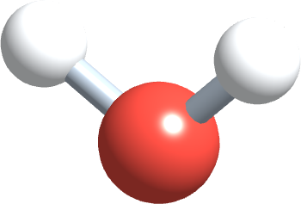
2
PART 2
Energy diagrams and activation energy
Even a reaction that releases energy must first climb an energy hill.
CR2-LO2 · Ball 6.S
PHD115 · Chemical Reactions II
Dr. NAM · Faculty of Pharmacy, UiTM Bertam, Penang
Notes:
Part 2 extends the uphill/downhill diagrams from EM by adding the activation energy barrier.

Slide 23
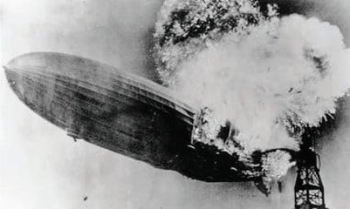
2
CR2-LO2
If it releases energy, why doesn't it just happen?
Hydrogen and oxygen react very exothermically (ΔH = −572 kJ per 2 mol H₂O).
Yet a mixture of the two gases can stand for years without reacting. The Hindenburg's hydrogen needed a spark to ignite.
Paper, wood and glucose all burn exothermically, but none of them bursts into flame on the desk.
Reactants must first gain enough energy to start breaking bonds: the activation energy.
Hydrogen in the Hindenburg reacting with oxygen to form water, Figure 5.2.1 (Ball, The Basics of GOB Chemistry 5.2)
PHD115 · Chemical Reactions II
Dr. NAM · Faculty of Pharmacy, UiTM Bertam, Penang
Notes:
Hindenburg photo from Ball 5.2 (reused from CR1). This is the 'match in the drawer' idea from the hook.

Slide 24
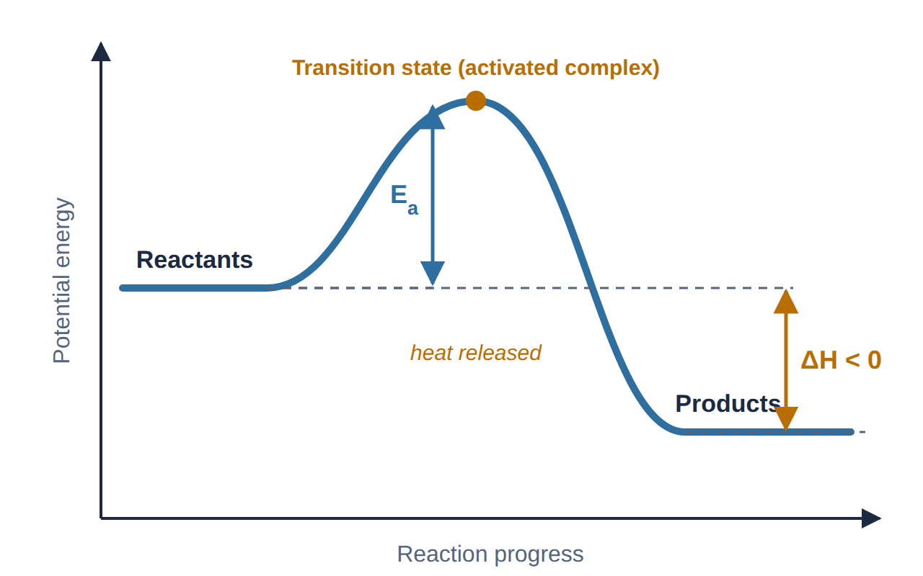
2
CR2-LO2
Reading an energy diagram: exothermic
x-axis: progress of the reaction. y-axis: potential energy.
The peak is the transition state (activated complex): old bonds half broken, new bonds half formed.
E_{a} = energy of the peak − energy of the reactants.
ΔH = energy of the products − energy of the reactants. Products lower: ΔH < 0.
Energy diagram for an exothermic reaction (drawn by Dr. NAM)
PHD115 · Chemical Reactions II
Dr. NAM · Faculty of Pharmacy, UiTM Bertam, Penang
Notes:
Draw this on the board with students. The hill is the barrier; the drop is ΔH.

Slide 25
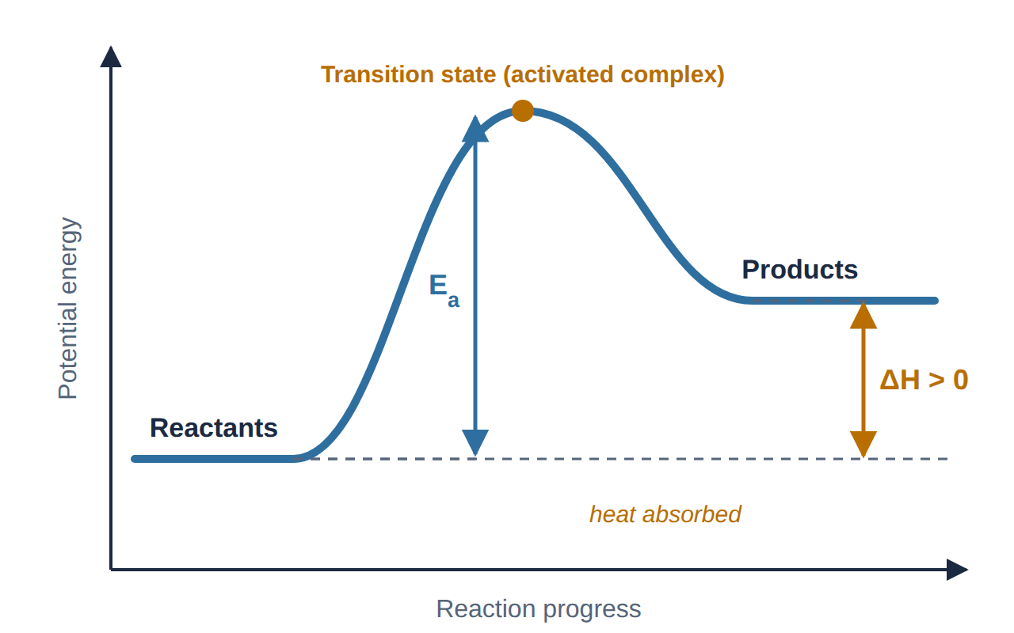
2
CR2-LO2
Reading an energy diagram: endothermic
Products are higher than reactants, so ΔH > 0: energy is absorbed.
E_{a} is still measured from the reactants to the peak.
For an endothermic reaction, E_{a} is always at least as large as ΔH.
The reverse reaction has its own barrier: E_{a}(reverse) = E_{a}(forward) − ΔH.
Energy diagram for an endothermic reaction (drawn by Dr. NAM)
PHD115 · Chemical Reactions II
Dr. NAM · Faculty of Pharmacy, UiTM Bertam, Penang
Notes:
E_a(reverse) = peak − products.

Slide 26
2
CR2-LO2
Two different questions: ΔH and E_{a}
 | ΔH (enthalpy change) | E_{a} (activation energy)
Measures | energy of products − energy of reactants | energy of transition state − energy of reactants
Sign | negative (exothermic) or positive (endothermic) | always positive: there is always a hill
Tells us | how much heat is released or absorbed | how fast the reaction goes: higher E_{a}, slower reaction
Changed by a catalyst? | no | yes, a catalyst lowers it (Part 5)
A reaction can be very exothermic and still very slow if E_{a} is large (glucose in air, paper, the H₂/O₂ mixture).
PHD115 · Chemical Reactions II
Dr. NAM · Faculty of Pharmacy, UiTM Bertam, Penang
Notes:
Core reference summary: 'The larger the activation energy, the slower the reaction rate.'

Slide 27
2
CR2-LO2
Example 2.1 · Values from a diagram
On an energy diagram, the reactants are at 50 kJ, the transition state at 150 kJ and the products at 20 kJ. Find E_{a} (forward), ΔH and E_{a} (reverse). Is the reaction exothermic or endothermic?
1
E_{a}(forward) = 150 − 50 = 100 kJ
2
ΔH = 20 − 50 = −30 kJ: products are lower, so the reaction is exothermic
3
E_{a}(reverse) = 150 − 20 = 130 kJ (check: 100 − (−30) = 130 kJ)
PHD115 · Chemical Reactions II
Dr. NAM · Faculty of Pharmacy, UiTM Bertam, Penang
Notes:
Encourage students to sketch the diagram before calculating.

Slide 28
2
CR2-LO2
Try it · Values from a diagram
Reactants 30 kJ, transition state 120 kJ, products 80 kJ. Find E_{a} (forward), ΔH and E_{a} (reverse), and classify the reaction. Then sketch the diagram.
Work it out, then check on the next slide.
PHD115 · Chemical Reactions II
Dr. NAM · Faculty of Pharmacy, UiTM Bertam, Penang
Notes:
Uphill diagram with a peak at 120.

Slide 29
2
CR2-LO2
Try it · Values from a diagram · answer
Reactants 30 kJ, transition state 120 kJ, products 80 kJ. Find E_{a} (forward), ΔH and E_{a} (reverse), and classify the reaction. Then sketch the diagram.
Answer
E_{a}(forward) = 120 − 30 = 90 kJ
ΔH = 80 − 30 = +50 kJ: endothermic
E_{a}(reverse) = 120 − 80 = 40 kJ
PHD115 · Chemical Reactions II
Dr. NAM · Faculty of Pharmacy, UiTM Bertam, Penang
Notes:
Uphill diagram with a peak at 120.

Slide 30
2
CR2-LO2
Quick check
On an energy diagram, what does the height from the reactants up to the peak represent?
A ΔH of the reaction
B The activation energy, E_{a}
C The energy of the products
D The rate of the reaction
PHD115 · Chemical Reactions II
Dr. NAM · Faculty of Pharmacy, UiTM Bertam, Penang

Slide 31
2
CR2-LO2
Quick check · answer
On an energy diagram, what does the height from the reactants up to the peak represent?
A ΔH of the reaction
B The activation energy, E_{a}
C The energy of the products
D The rate of the reaction
Answer B. E_{a} is measured from the reactants to the transition state at the top of the hill.
PHD115 · Chemical Reactions II
Dr. NAM · Faculty of Pharmacy, UiTM Bertam, Penang

Slide 32
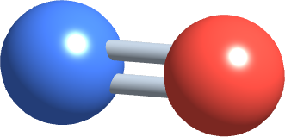
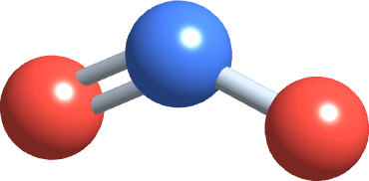
3
PART 3
Collision theory
Particles have to meet, hard enough and the right way round, before they can react.
CR2-LO3 · Ball 6.S
PHD115 · Chemical Reactions II
Dr. NAM · Faculty of Pharmacy, UiTM Bertam, Penang
Notes:
Core reference: 'Collision theory can be used to describe the energetic aspects of chemical reactions.'

Slide 33
3
CR2-LO3
The three conditions of collision theory
1. Collide. Reactant particles must come into contact: no collision, no reaction.
2. With enough energy. The collision must supply at least E_{a} to start breaking bonds.
3. In the right orientation. The reacting parts of the particles must meet.
A collision that meets all three is an effective collision and forms products. Any other collision is ineffective: the particles bounce apart unchanged.
Scale
In a gas at room temperature, each molecule collides billions of times per second. If every collision worked, every reaction would be instant.
PHD115 · Chemical Reactions II
Dr. NAM · Faculty of Pharmacy, UiTM Bertam, Penang
Notes:
Ask: if collisions are so frequent, why are many reactions slow? Answer: most collisions are ineffective.

Slide 34
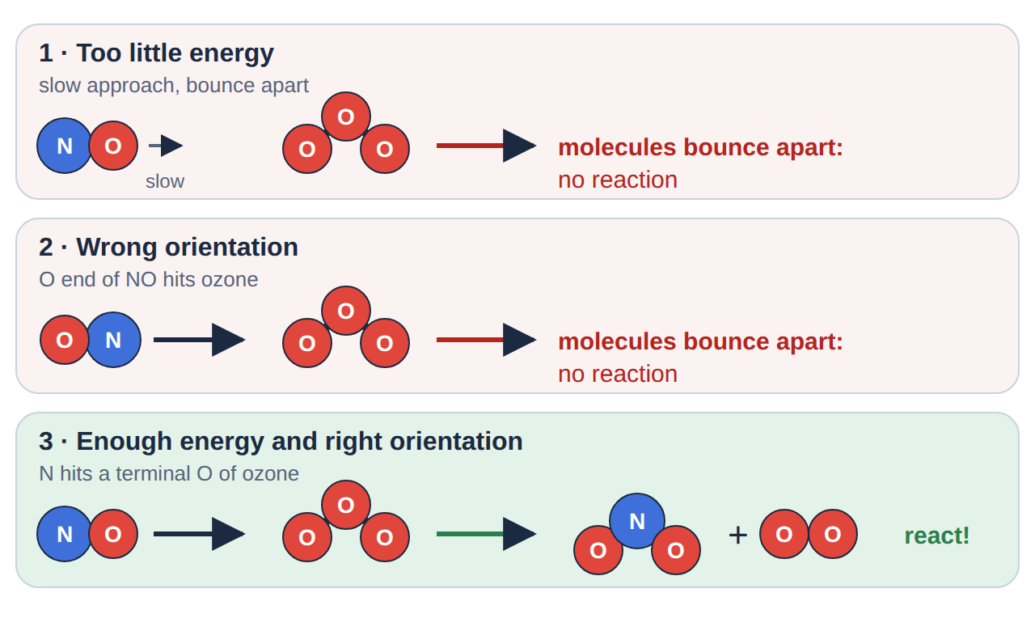
3
CR2-LO3
Effective and ineffective collisions
NO + O₃ → NO₂ + O₂: only one of these three collisions reacts (drawn by Dr. NAM)
Nitrogen monoxide reacts with ozone only if the N atom strikes an end O atom of O₃, with enough energy.
Too slow, or the wrong end first: the molecules simply bounce apart.
PHD115 · Chemical Reactions II
Dr. NAM · Faculty of Pharmacy, UiTM Bertam, Penang
Notes:
This reaction occurs in polluted air and destroys ozone.

Slide 35
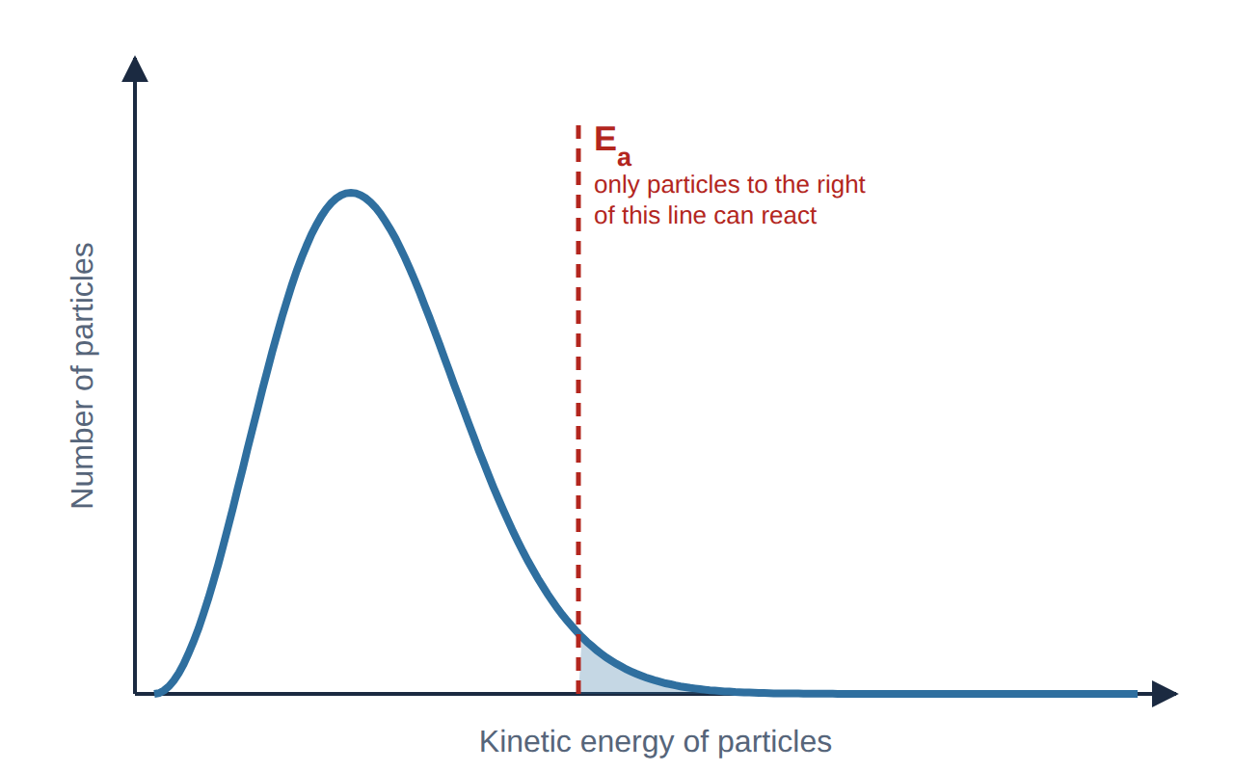
3
CR2-LO3
Not every particle has enough energy
Particles in a sample move at many different speeds.
Most have moderate energy; a few are very slow or very fast.
Only the particles in the shaded tail, with energy ≥ E_{a}, can react when they collide.
Higher E_{a} → smaller tail → fewer effective collisions → slower reaction.
Spread of kinetic energies in a sample at one temperature (drawn by Dr. NAM)
PHD115 · Chemical Reactions II
Dr. NAM · Faculty of Pharmacy, UiTM Bertam, Penang
Notes:
Maxwell–Boltzmann idea, qualitative only. Students do not need the name for the exam unless you choose to use it.

Slide 36
3
CR2-LO3
Example 3.1 · Why a spark?
Use collision theory to explain why a mixture of hydrogen and oxygen can be kept safely, but explodes when a spark is applied.
1
H₂ and O₂ molecules collide all the time, but at room temperature almost none of the collisions have energy ≥ E_{a}.
2
The spark gives some molecules enough energy to react. The reaction is exothermic, so the heat released raises the energy of nearby molecules.
3
More and more collisions become effective: a chain of fast reactions, an explosion.
PHD115 · Chemical Reactions II
Dr. NAM · Faculty of Pharmacy, UiTM Bertam, Penang
Notes:
Same idea for striking a match: friction supplies E_a.

Slide 37
3
CR2-LO3
Try it · Big molecules
Two large drug-like molecules react only when a small group on one meets a small group on the other. Their reaction is much slower than a reaction between two small molecules colliding just as often. Use collision theory to explain why.
Work it out, then check on the next slide.
PHD115 · Chemical Reactions II
Dr. NAM · Faculty of Pharmacy, UiTM Bertam, Penang
Notes:
Orientation matters more for big molecules: important for enzymes and receptors.

Slide 38
3
CR2-LO3
Try it · Big molecules · answer
Two large drug-like molecules react only when a small group on one meets a small group on the other. Their reaction is much slower than a reaction between two small molecules colliding just as often. Use collision theory to explain why.
Answer
With large molecules, most collisions bring the wrong parts together. Only collisions in the right orientation (reactive groups touching, with enough energy) are effective, so a smaller fraction of collisions lead to reaction and the rate is lower.
PHD115 · Chemical Reactions II
Dr. NAM · Faculty of Pharmacy, UiTM Bertam, Penang
Notes:
Orientation matters more for big molecules: important for enzymes and receptors.

Slide 39
3
CR2-LO3
Quick check
According to collision theory, which collision is most likely to form products?
A A slow collision in the correct orientation
B A fast collision in the wrong orientation
C A collision with energy ≥ E_{a} in the correct orientation
D Any collision between reactant particles
PHD115 · Chemical Reactions II
Dr. NAM · Faculty of Pharmacy, UiTM Bertam, Penang

Slide 40
3
CR2-LO3
Quick check · answer
According to collision theory, which collision is most likely to form products?
A A slow collision in the correct orientation
B A fast collision in the wrong orientation
C A collision with energy ≥ E_{a} in the correct orientation
D Any collision between reactant particles
Answer C. An effective collision needs both enough energy (≥ E_{a}) and the correct orientation.
PHD115 · Chemical Reactions II
Dr. NAM · Faculty of Pharmacy, UiTM Bertam, Penang

Slide 41
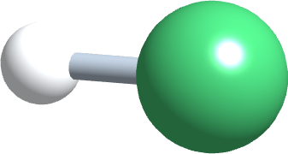
4
PART 4
Reaction rates
How fast reactants are used up, and the four things that change it.
CR2-LO4 · Ball 6.S
PHD115 · Chemical Reactions II
Dr. NAM · Faculty of Pharmacy, UiTM Bertam, Penang
Notes:
Course plan: 'Reaction rates'. Factors follow directly from collision theory.

Slide 42
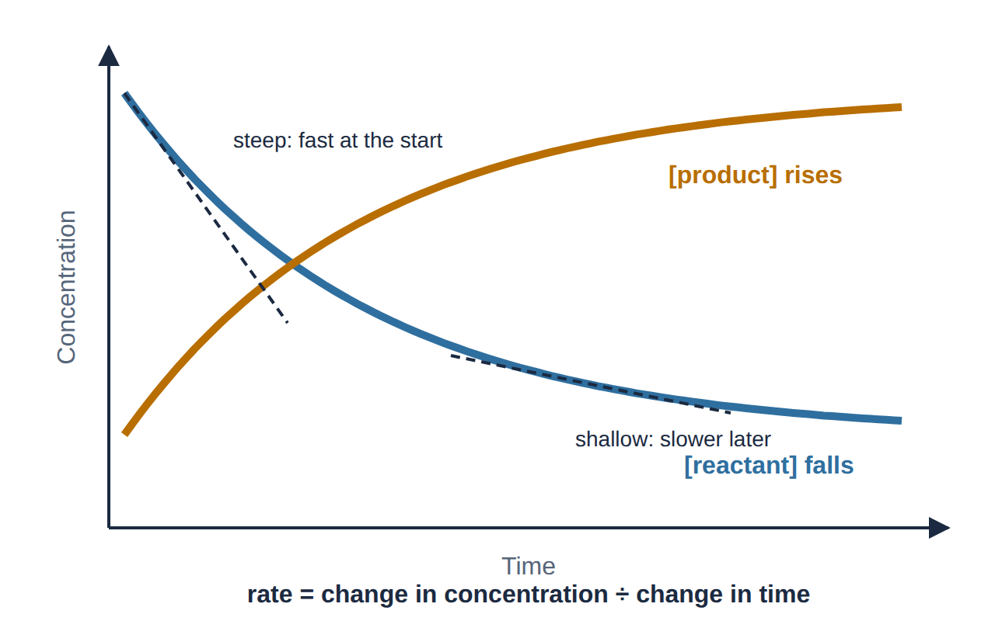
4
CR2-LO4
What is a reaction rate?
Rate = change in concentration ÷ change in time.
Units: mol/L per second (M/s), or per minute or hour for slow reactions.
Measured as the loss of a reactant or the gain of a product (gas volume, colour, mass).
Rate is fastest at the start and slows as the reactants are used up (fewer collisions).
Reactant and product concentrations during a reaction (drawn by Dr. NAM)
PHD115 · Chemical Reactions II
Dr. NAM · Faculty of Pharmacy, UiTM Bertam, Penang
Notes:
Square brackets mean concentration in mol/L.

Slide 43
4
CR2-LO4
Example 4.1 · Average rate
In the decomposition 2H₂O₂(aq) → 2H₂O(ℓ) + O₂(g), the concentration of H₂O₂ falls from 1.00 M to 0.80 M in 50 s. Find (a) the average rate of loss of H₂O₂ and (b) the rate of formation of O₂.
1
Change in [H₂O₂] = 1.00 − 0.80 = 0.20 M
2
(a) Rate = 0.20 M ÷ 50 s = 4.0 × 10⁻³ M/s
3
(b) Mole ratio O₂ : H₂O₂ = 1 : 2, so O₂ forms at half that rate: 2.0 × 10⁻³ M/s
PHD115 · Chemical Reactions II
Dr. NAM · Faculty of Pharmacy, UiTM Bertam, Penang
Notes:
Links rates to the stoichiometry of CR1.

Slide 44
4
CR2-LO4
Four factors that change the rate
Each factor changes how often particles collide, or what fraction of collisions are effective.
Concentration
More particles in the same volume → more collisions per second → faster.
For gases, higher pressure has the same effect.
Temperature
Faster particles → more collisions and a much larger fraction with energy ≥ E_{a} → faster.
Many reactions roughly double in rate for each 10 °C rise.
Surface area and catalysts
Smaller pieces of a solid expose more surface to collisions → faster.
A catalyst lowers E_{a} so more collisions are effective (Part 5).
PHD115 · Chemical Reactions II
Dr. NAM · Faculty of Pharmacy, UiTM Bertam, Penang
Notes:
The nature of the reactants also matters (ions in solution react almost instantly; covalent bonds react more slowly).

Slide 45
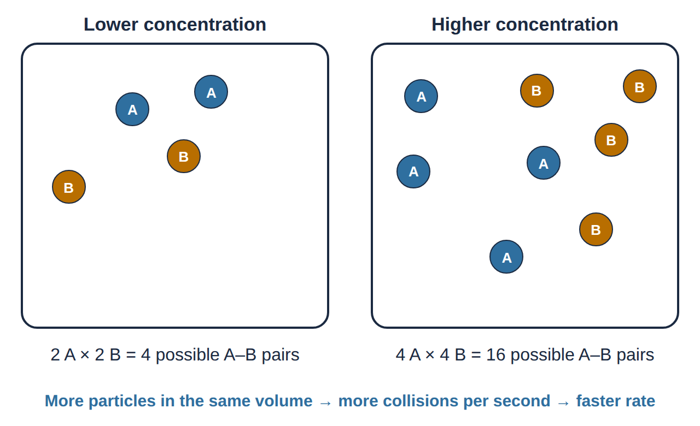
4
CR2-LO4
Concentration
Double the number of A and B particles in the same volume and the possible A–B pairs go from 4 to 16.
More collisions per second means more effective collisions per second.
Example: magnesium ribbon fizzes faster in 2 M HCl than in 1 M HCl.
Rates fall during a reaction because the reactant concentrations fall.
Doubling the particles of each reactant quadruples the possible A–B collisions (drawn by Dr. NAM)
PHD115 · Chemical Reactions II
Dr. NAM · Faculty of Pharmacy, UiTM Bertam, Penang
Notes:
Qualitative only; rate laws are beyond this course.

Slide 46
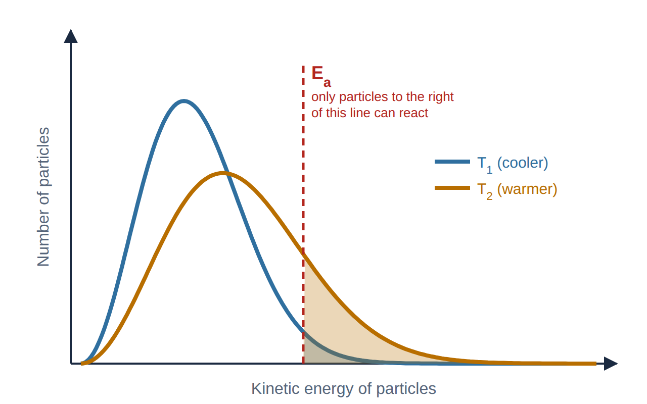
4
CR2-LO4
Temperature
Heating makes particles move faster, so they collide more often.
More importantly, the energy curve shifts: the shaded area above E_{a} grows a lot.
This is why a small temperature rise can speed up a reaction greatly.
Cooling does the opposite: refrigeration slows the spoiling of food and the breakdown of medicines.
At the higher temperature, far more particles have energy ≥ E_{a} (drawn by Dr. NAM)
PHD115 · Chemical Reactions II
Dr. NAM · Faculty of Pharmacy, UiTM Bertam, Penang
Notes:
Both curves have the same area (same number of particles).

Slide 47
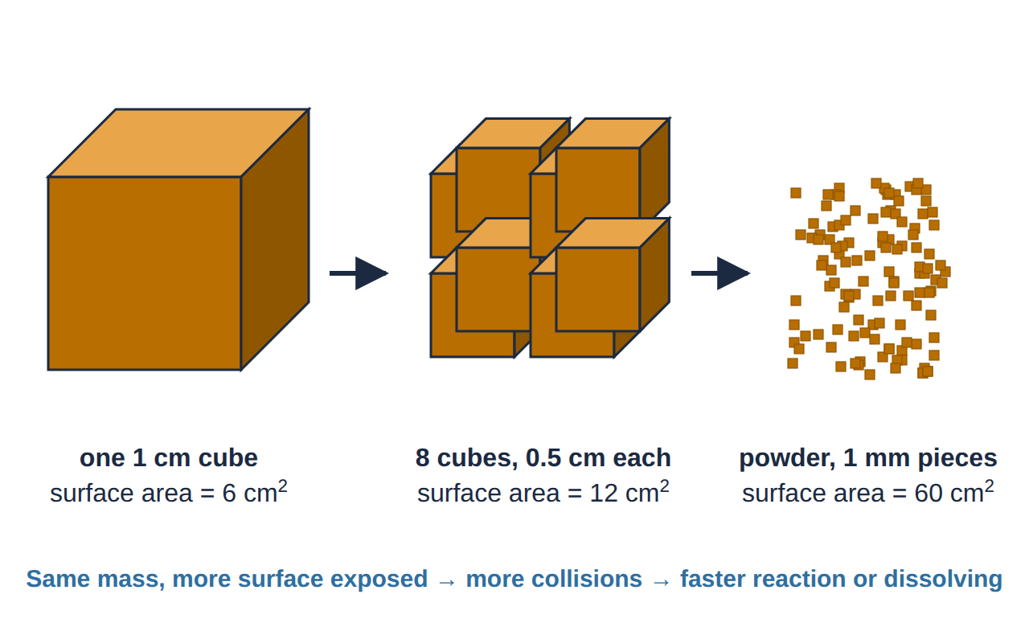
4
CR2-LO4
Surface area and particle size
Only particles on the surface of a solid can collide with the other reactant.
Smaller pieces → larger total surface area → more collisions → faster.
Magnesium powder reacts faster than ribbon; powdered sugar dissolves faster than a cube.
Pharmacy: fine powders and micronised drugs dissolve faster, which can speed up absorption.
Cutting the same mass into smaller pieces increases the surface area (drawn by Dr. NAM)
PHD115 · Chemical Reactions II
Dr. NAM · Faculty of Pharmacy, UiTM Bertam, Penang
Notes:
Mention that some tablets must not be crushed (modified-release) precisely because crushing changes the release rate.

Slide 48
4
CR2-LO4
Example 4.2 · Predict the effect
Zinc granules react with 1.0 M hydrochloric acid at 25 °C. Predict the effect on the rate, and explain using collision theory: (a) using 2.0 M HCl; (b) using zinc powder; (c) cooling the flask in ice.
1
(a) Faster: more H⁺ ions per litre → more collisions per second.
2
(b) Faster: larger surface area of zinc → more collisions per second.
3
(c) Slower: particles move more slowly, collide less often, and fewer collisions have energy ≥ E_{a}.
PHD115 · Chemical Reactions II
Dr. NAM · Faculty of Pharmacy, UiTM Bertam, Penang
Notes:
Always name the factor AND the collision-theory reason; that is where exam marks are.

Slide 49
4
CR2-LO4
Pharmacy focus: why medicines expire
Drugs slowly react (degrade) in the pack. Storage instructions are reaction-rate chemistry.
Instruction on the label | What it slows down | Rate factor
'Store below 25 °C' · 'Refrigerate at 2–8 °C' (insulin, many vaccines) | all degradation reactions | temperature
'Keep the container tightly closed' · desiccant sachets | hydrolysis by moisture, e.g. aspirin → salicylic acid + acetic acid (a vinegar smell means it has degraded) | concentration of water
Amber bottles · 'protect from light' | light-driven breakdown (photodegradation) | energy supplied by light
Expiry date | the time until too much drug has broken down to be safe and effective | overall rate
Expiry dates come from stability testing: manufacturers measure how fast the drug degrades under set conditions.
PHD115 · Chemical Reactions II
Dr. NAM · Faculty of Pharmacy, UiTM Bertam, Penang
Notes:
Good place to connect to the pharmacy profession: correct storage protects patients.

Slide 50
4
CR2-LO4
Try it · On the ward
A patient keeps an opened bottle of aspirin tablets in a hot, steamy bathroom. Name two factors that will speed up the breakdown of the aspirin, and explain each using collision theory.
Work it out, then check on the next slide.
PHD115 · Chemical Reactions II
Dr. NAM · Faculty of Pharmacy, UiTM Bertam, Penang
Notes:
Model answer names the factor and gives the collision reason.

Slide 51
4
CR2-LO4
Try it · On the ward · answer
A patient keeps an opened bottle of aspirin tablets in a hot, steamy bathroom. Name two factors that will speed up the breakdown of the aspirin, and explain each using collision theory.
Answer
Temperature: in the warm room, molecules move faster, collide more often and more collisions have energy ≥ E_{a}.
Moisture (concentration of water): steam increases the water available to react with aspirin (hydrolysis), so collisions between aspirin and water are more frequent.
Advice: store in a cool, dry place with the lid closed.
PHD115 · Chemical Reactions II
Dr. NAM · Faculty of Pharmacy, UiTM Bertam, Penang
Notes:
Model answer names the factor and gives the collision reason.

Slide 52
4
CR2-LO4
Key takeaways: reaction rates
Rate = change in concentration ÷ time; it is fastest at the start.
Higher concentration and larger surface area → more collisions per second → faster.
Higher temperature → more collisions and a larger fraction with energy ≥ E_{a} → much faster.
Storage instructions (cool, dry, dark, closed) slow the reactions that degrade medicines.
PHD115 · Chemical Reactions II
Dr. NAM · Faculty of Pharmacy, UiTM Bertam, Penang
Notes:
Summary of Part 4.

Slide 53
4
CR2-LO4
Quick check
Why does raising the temperature increase the rate of a reaction?
A It lowers the activation energy
B It increases the fraction of collisions with energy ≥ E_{a}
C It changes ΔH from positive to negative
D It increases the number of reactant particles
PHD115 · Chemical Reactions II
Dr. NAM · Faculty of Pharmacy, UiTM Bertam, Penang

Slide 54
4
CR2-LO4
Quick check · answer
Why does raising the temperature increase the rate of a reaction?
A It lowers the activation energy
B It increases the fraction of collisions with energy ≥ E_{a}
C It changes ΔH from positive to negative
D It increases the number of reactant particles
Answer B. Temperature does not change E_{a} or ΔH. It gives more particles enough energy, and they also collide more often.
PHD115 · Chemical Reactions II
Dr. NAM · Faculty of Pharmacy, UiTM Bertam, Penang

Slide 55
5
PART 5
Catalysts and enzymes
A catalyst opens an easier path over the energy hill and comes out unchanged.
CR2-LO5 · Ball 6.S
PHD115 · Chemical Reactions II
Dr. NAM · Faculty of Pharmacy, UiTM Bertam, Penang
Notes:
Core reference: 'Catalysts can be added to reactions to lower the activation energy and increase the reaction rate.'

Slide 56
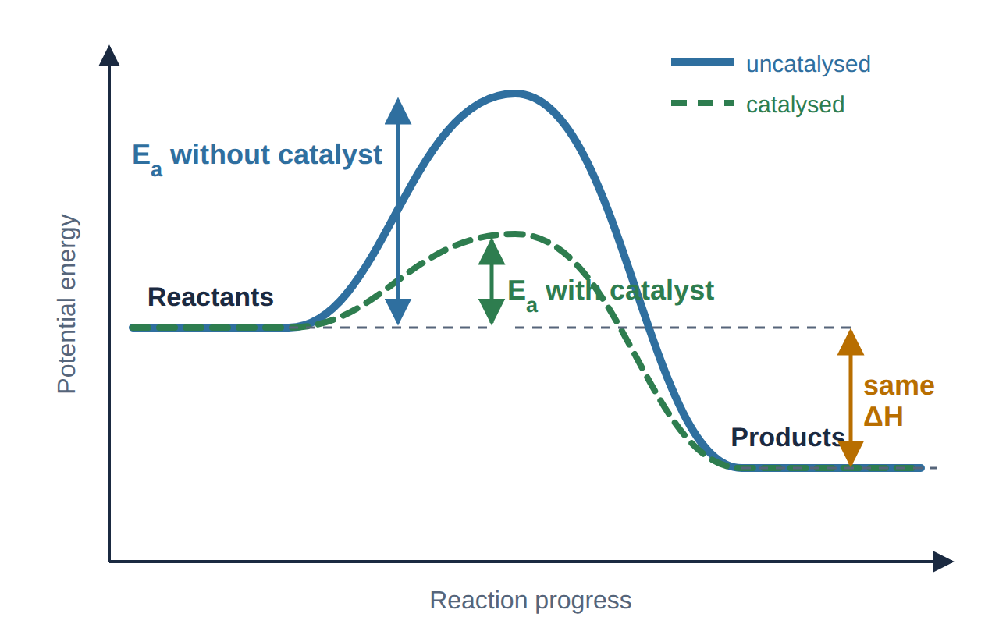
5
CR2-LO5
How a catalyst works
A catalyst speeds up a reaction without being used up.
It provides a different pathway with a lower E_{a}, so more collisions are effective.
It does not change ΔH, the reactants or the products.
It speeds up the forward and reverse reactions equally.
A catalyst provides a pathway with a lower activation energy (drawn by Dr. NAM)
PHD115 · Chemical Reactions II
Dr. NAM · Faculty of Pharmacy, UiTM Bertam, Penang
Notes:
Catalysts are written over the arrow, for example MnO2 or 'catalase'.

Slide 57
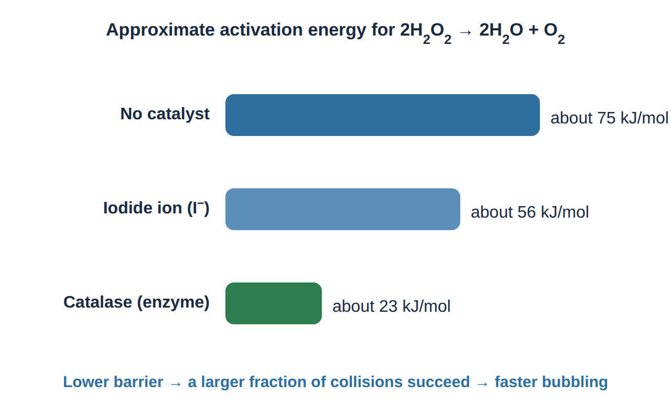
5
CR2-LO5
Hydrogen peroxide: one reaction, three speeds
H₂O₂ (used as an antiseptic) decomposes slowly in the bottle: 2H₂O₂ → 2H₂O + O₂.
Add iodide ions or manganese(IV) oxide and it bubbles quickly.
On a cut, it fizzes at once: the enzyme catalase in blood and tissue is a very effective catalyst.
Catalase protects our cells by destroying H₂O₂ made during metabolism.
Approximate activation energies for decomposing H₂O₂ (values vary between sources) (drawn by Dr. NAM)
PHD115 · Chemical Reactions II
Dr. NAM · Faculty of Pharmacy, UiTM Bertam, Penang
Notes:
Easy classroom demonstration with a piece of potato or liver.

Slide 58
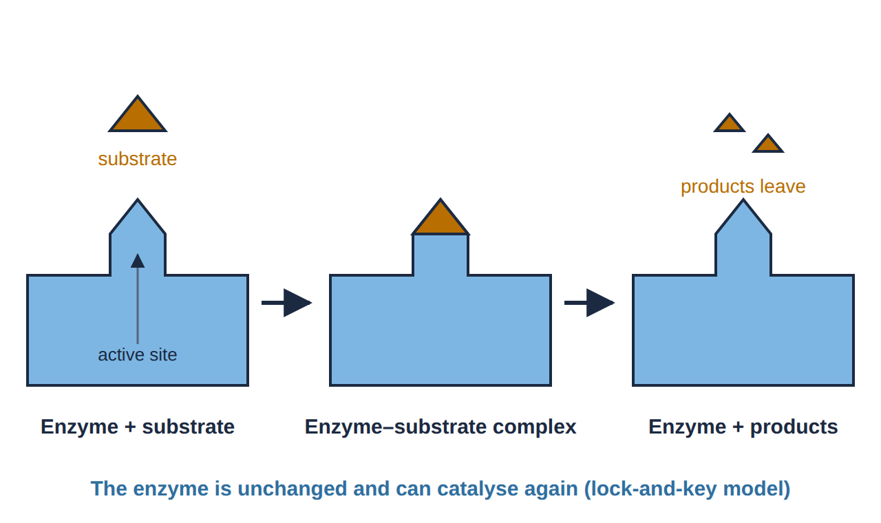
5
CR2-LO5
Enzymes: the body's catalysts
Enzymes are proteins that catalyse reactions in living things.
The reactant (substrate) binds in a pocket called the active site, which holds it in the right orientation.
Each enzyme is very specific: its active site fits only certain substrates.
Enzymes can speed up reactions millions of times, at body temperature.
The lock-and-key model of enzyme action (drawn by Dr. NAM)
PHD115 · Chemical Reactions II
Dr. NAM · Faculty of Pharmacy, UiTM Bertam, Penang
Notes:
Induced fit is a refinement: the active site changes shape slightly as the substrate binds.

Slide 59
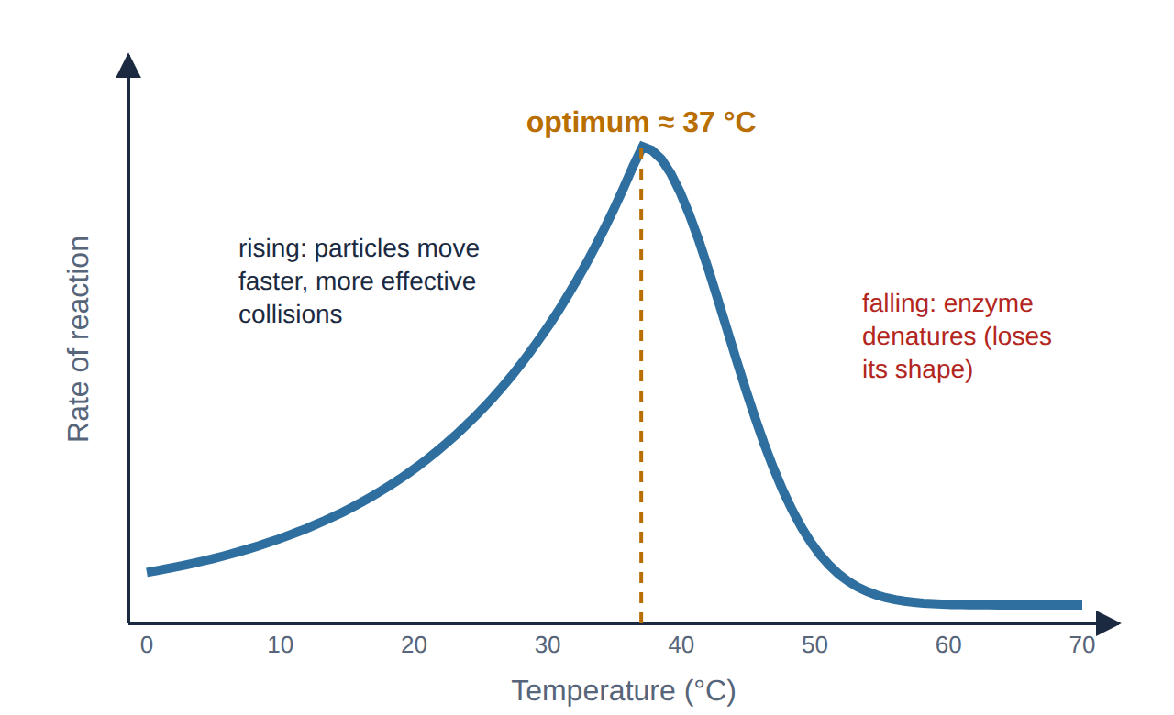
5
CR2-LO5
Enzymes and temperature
Up to about 37 °C, rate rises: more frequent and more energetic collisions.
Above the optimum, the protein unfolds (denatures) and the active site loses its shape, so the rate drops sharply.
Enzymes also have an optimum pH; strong acid or base denatures them.
This is why a high fever is dangerous and why enzyme products are stored cool.
Rate of a typical human enzyme-catalysed reaction against temperature (drawn by Dr. NAM)
PHD115 · Chemical Reactions II
Dr. NAM · Faculty of Pharmacy, UiTM Bertam, Penang
Notes:
Contrast with an ordinary reaction, where rate keeps rising with temperature.

Slide 60
5
CR2-LO5
Pharmacy link: drugs that block enzymes
Many medicines work by slowing down an enzyme-catalysed reaction. They are called enzyme inhibitors.
Examples
The chemistry behind it
Aspirin, ibuprofen: inhibit cyclooxygenase (COX) enzymes, so less prostaglandin is made: less pain, fever and inflammation
Statins (e.g. simvastatin): inhibit HMG-CoA reductase, an enzyme in cholesterol synthesis
ACE inhibitors (e.g. captopril): inhibit angiotensin-converting enzyme, lowering blood pressure
An inhibitor binds to the enzyme, often in or near the active site
Fewer substrate molecules can bind, so fewer effective 'collisions' happen
The reaction slows, without the drug being a reactant itself
Industry too: catalytic converters (Pt, Pd, Rh) speed up the removal of CO and NO from car exhaust
PHD115 · Chemical Reactions II
Dr. NAM · Faculty of Pharmacy, UiTM Bertam, Penang
Notes:
Pharmacology will cover these mechanisms in detail; here we only connect them to rates.

Slide 61
5
CR2-LO5
Try it · What does a catalyst change?
A student says: 'Adding a catalyst makes the reaction release more heat and gives more product.' Is the student right? Explain.
Work it out, then check on the next slide.
PHD115 · Chemical Reactions II
Dr. NAM · Faculty of Pharmacy, UiTM Bertam, Penang
Notes:
Common misconception.

Slide 62
5
CR2-LO5
Try it · What does a catalyst change? · answer
A student says: 'Adding a catalyst makes the reaction release more heat and gives more product.' Is the student right? Explain.
Answer
No. A catalyst lowers E_{a} only. ΔH stays the same, so the heat released is unchanged. It speeds up the forward and reverse reactions equally, so the final amount of product (the equilibrium position, Part 6) is unchanged. The product simply forms faster.
PHD115 · Chemical Reactions II
Dr. NAM · Faculty of Pharmacy, UiTM Bertam, Penang
Notes:
Common misconception.

Slide 63
5
CR2-LO5
Quick check
Which statement about catalysts is correct?
A They are used up in the reaction
B They make ΔH more negative
C They provide a pathway with a lower activation energy
D They only work at high temperature
PHD115 · Chemical Reactions II
Dr. NAM · Faculty of Pharmacy, UiTM Bertam, Penang

Slide 64
5
CR2-LO5
Quick check · answer
Which statement about catalysts is correct?
A They are used up in the reaction
B They make ΔH more negative
C They provide a pathway with a lower activation energy
D They only work at high temperature
Answer C. A catalyst lowers E_{a} and is recovered unchanged; ΔH is not affected. Enzymes work at body temperature.
PHD115 · Chemical Reactions II
Dr. NAM · Faculty of Pharmacy, UiTM Bertam, Penang

Slide 65
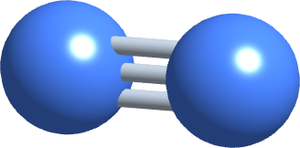
6
PART 6
Equilibrium and Le Châtelier's principle
Some reactions go both ways at once, and settle into a balance that can be pushed.
CR2-LO6 · Ball 6.S
PHD115 · Chemical Reactions II
Dr. NAM · Faculty of Pharmacy, UiTM Bertam, Penang
Notes:
Core reference summary: forward and reverse reactions, equilibrium, Le Chatelier's principle. Leads into Acids and Bases.

Slide 66
6
CR2-LO6
Reversible reactions
Not all reactions go to completion. In a reversible reaction, products can react to re-form the reactants.
We use a double arrow: N₂(g) + 3H₂(g) ⇌ 2NH₃(g). Left to right is the forward reaction; right to left is the reverse reaction.
Carbon dioxide in water: CO₂(aq) + H₂O(ℓ) ⇌ H₂CO₃(aq), in fizzy drinks and in our blood.
Oxygen transport: haemoglobin + O₂ ⇌ oxyhaemoglobin.
Coming next
Acids and bases, later in this course, are full of equilibria, such as the dissociation of water and buffers.
PHD115 · Chemical Reactions II
Dr. NAM · Faculty of Pharmacy, UiTM Bertam, Penang
Notes:
Haber process for ammonia is the classic industrial example.

Slide 67
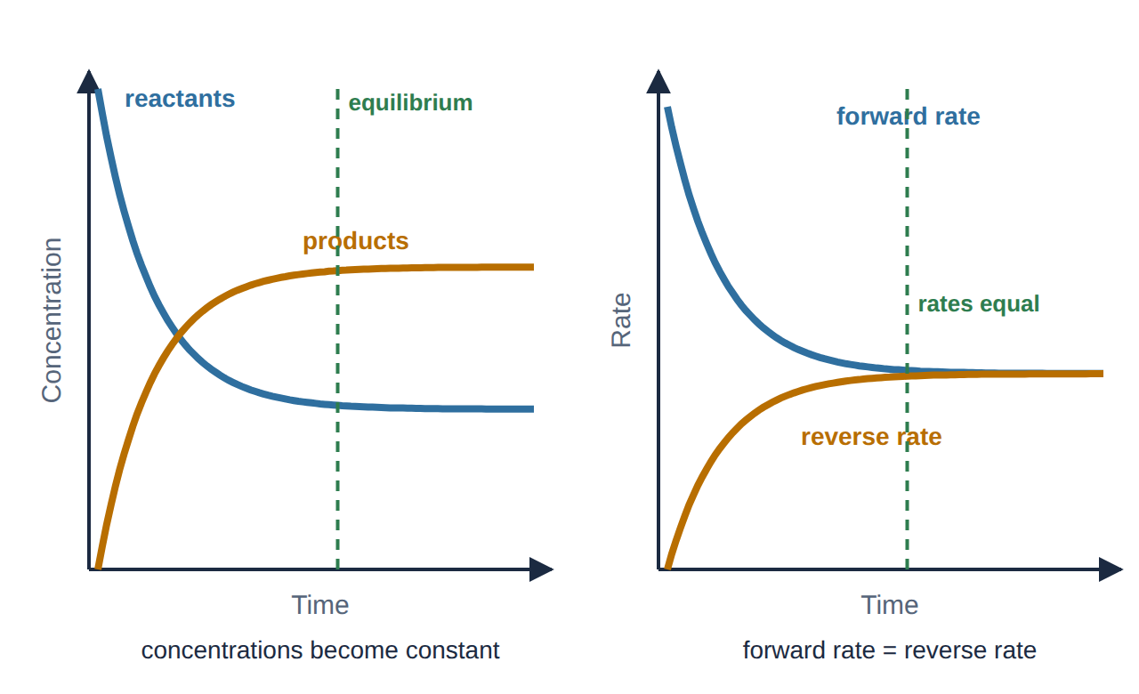
6
CR2-LO6
Reaching dynamic equilibrium
Concentrations level off when the forward and reverse rates become equal (drawn by Dr. NAM)
At first only the forward reaction runs. As products build up, the reverse reaction speeds up.
Equilibrium: forward rate = reverse rate. Both reactions keep going (dynamic), so concentrations stay constant, but usually not equal.
PHD115 · Chemical Reactions II
Dr. NAM · Faculty of Pharmacy, UiTM Bertam, Penang
Notes:
Core reference: 'When the forward and reverse reaction rates are equal, the reaction is described as being at equilibrium'; concentrations remain constant.

Slide 68
6
CR2-LO6
Le Châtelier's principle
If a system at equilibrium is disturbed (stressed), it shifts in the direction that reduces the stress.
'Shift right' means more products form; 'shift left' means more reactants form.
Stresses: changing a concentration, changing the temperature, changing the pressure of a gas mixture.
Treat heat like a substance: it is a product of an exothermic reaction and a reactant of an endothermic one.
Analogy
A crowded room with two doors: push more people in through one door and more leave through the other until the flow balances again.
PHD115 · Chemical Reactions II
Dr. NAM · Faculty of Pharmacy, UiTM Bertam, Penang
Notes:
Core reference: 'Le Chatelier's principle states that the direction of an equilibrium reaction will shift to reduce the stress.'

Slide 69
6
CR2-LO6
Predicting the shift
Stress | The system responds by | Shift
Add a reactant / remove a product | using up the added reactant / replacing the product | right →
Add a product / remove a reactant | using up the added product | ← left
Raise the temperature | absorbing heat: favours the endothermic direction | exothermic forward: ← left endothermic forward: right →
Increase pressure (gases) | reducing the number of gas molecules | towards fewer moles of gas
Add a catalyst | reaching equilibrium faster | no shift
Concentration and pressure changes move the position of equilibrium without changing the equilibrium constant, K; a temperature change does change K. You will meet K in later courses.
PHD115 · Chemical Reactions II
Dr. NAM · Faculty of Pharmacy, UiTM Bertam, Penang
Notes:
Students should be able to give the direction AND the reason.

Slide 70
6
CR2-LO6
Example 6.1 · Making ammonia
N₂(g) + 3H₂(g) ⇌ 2NH₃(g), ΔH = −92 kJ. Predict the shift when: (a) N₂ is added; (b) NH₃ is removed; (c) the temperature is raised; (d) the pressure is increased; (e) an iron catalyst is added.
1
(a) Right: the system uses up the added N₂.
2
(b) Right: the system replaces the NH₃ removed.
3
(c) Left: the forward reaction is exothermic (heat is a product); adding heat favours the reverse reaction.
4
(d) Right: 4 mol of gas on the left, 2 mol on the right; higher pressure favours fewer gas molecules.
5
(e) No shift: equilibrium is reached faster.
PHD115 · Chemical Reactions II
Dr. NAM · Faculty of Pharmacy, UiTM Bertam, Penang
Notes:
The industrial compromise: moderate temperature (for rate) with a catalyst and high pressure.

Slide 71
6
CR2-LO6
Equilibrium in the body: oxygen transport
Hb + O₂ ⇌ HbO₂ (haemoglobin + oxygen ⇌ oxyhaemoglobin)
In the lungs
In the tissues
O₂ concentration is high
Le Châtelier: the equilibrium shifts right
Haemoglobin loads up with oxygen
Cells use O₂, so its concentration is low
The equilibrium shifts left
Oxyhaemoglobin releases oxygen where it is needed
PHD115 · Chemical Reactions II
Dr. NAM · Faculty of Pharmacy, UiTM Bertam, Penang
Notes:
Carbon monoxide poisoning: CO binds haemoglobin much more strongly than O2, so oxygen cannot be loaded.

Slide 72
6
CR2-LO6
Try it · Opening a fizzy drink
In a sealed bottle: CO₂(g) ⇌ CO₂(aq). Dissolving CO₂ is exothermic. Use Le Châtelier's principle to explain (a) why the drink fizzes when opened and (b) why a warm drink goes flat faster.
Work it out, then check on the next slide.
PHD115 · Chemical Reactions II
Dr. NAM · Faculty of Pharmacy, UiTM Bertam, Penang
Notes:
Also explains why carbonated drinks are bottled under pressure and served cold.

Slide 73
6
CR2-LO6
Try it · Opening a fizzy drink · answer
In a sealed bottle: CO₂(g) ⇌ CO₂(aq). Dissolving CO₂ is exothermic. Use Le Châtelier's principle to explain (a) why the drink fizzes when opened and (b) why a warm drink goes flat faster.
Answer
(a) Opening the bottle lowers the pressure of CO₂ gas. The equilibrium shifts left, towards gas, to replace it: dissolved CO₂ comes out as bubbles.
(b) Dissolving is exothermic, so heat is a 'product'. Raising the temperature shifts the equilibrium left: less CO₂ stays dissolved.
PHD115 · Chemical Reactions II
Dr. NAM · Faculty of Pharmacy, UiTM Bertam, Penang
Notes:
Also explains why carbonated drinks are bottled under pressure and served cold.

Slide 74
6
CR2-LO6
Key takeaways: equilibrium
In a reversible reaction, forward and reverse reactions run at the same time.
At dynamic equilibrium, the two rates are equal and the concentrations stay constant (not necessarily equal).
Le Châtelier: a stressed equilibrium shifts to reduce the stress (concentration, temperature, gas pressure).
A catalyst helps equilibrium arrive sooner but does not move it.
PHD115 · Chemical Reactions II
Dr. NAM · Faculty of Pharmacy, UiTM Bertam, Penang
Notes:
Summary of Part 6.

Slide 75
6
CR2-LO6
Quick check
Which statement about a system at dynamic equilibrium is correct?
A The forward and reverse reactions have stopped
B The concentrations of reactants and products are always equal
C The forward and reverse rates are equal
D Adding a catalyst shifts it to the right
PHD115 · Chemical Reactions II
Dr. NAM · Faculty of Pharmacy, UiTM Bertam, Penang

Slide 76
6
CR2-LO6
Quick check · answer
Which statement about a system at dynamic equilibrium is correct?
A The forward and reverse reactions have stopped
B The concentrations of reactants and products are always equal
C The forward and reverse rates are equal
D Adding a catalyst shifts it to the right
Answer C. Both reactions continue at equal rates, so concentrations stay constant (not necessarily equal). A catalyst does not shift equilibrium.
PHD115 · Chemical Reactions II
Dr. NAM · Faculty of Pharmacy, UiTM Bertam, Penang

Slide 77
Summary: key rules
Energy change | ΔH < 0 exothermic (heat out) · ΔH > 0 endothermic (heat in)
Thermochemistry | heat = mol × ΔH per mol · reverse → change sign · double → double ΔH
Energy diagram | E_{a} = peak − reactants; ΔH = products − reactants
Collision theory | collide + energy ≥ E_{a} + right orientation = effective
Rate factors | ↑ concentration · ↑ temperature · ↑ surface area · catalyst
Catalysts | lower E_{a} · not used up · ΔH and equilibrium unchanged
Le Châtelier | shifts to reduce the stress · catalyst: no shift
PHD115 · Chemical Reactions II
Dr. NAM · Faculty of Pharmacy, UiTM Bertam, Penang
Notes:
These rules are the basis of the tutorial and exam questions.

Slide 78
Before the next topic
1
Do the After class activity in the Study Hub (about 25 minutes).
2
Try the Tutorial: exam-style questions with full worked solutions.
3
Next topic: Solution: solubility, concentration, dilution and osmosis.
Core reference: The Basics of GOB Chemistry (Ball, Hill & Scott), LibreTexts, CC BY-NC-SA 3.0: sections 5.2 and 5.6 (photographs), 6.S (chapter summary) and 7.4 (bond energies). Rates and equilibrium are expanded to match Introductory Chemistry (LibreTexts), chapter 15. Diagrams drawn by Dr. NAM. Shared under the same licence for non-commercial teaching.
PHD115 · Chemical Reactions II
Dr. NAM · Faculty of Pharmacy, UiTM Bertam, Penang
Notes:
Point students to the Study Hub.

Slide 79
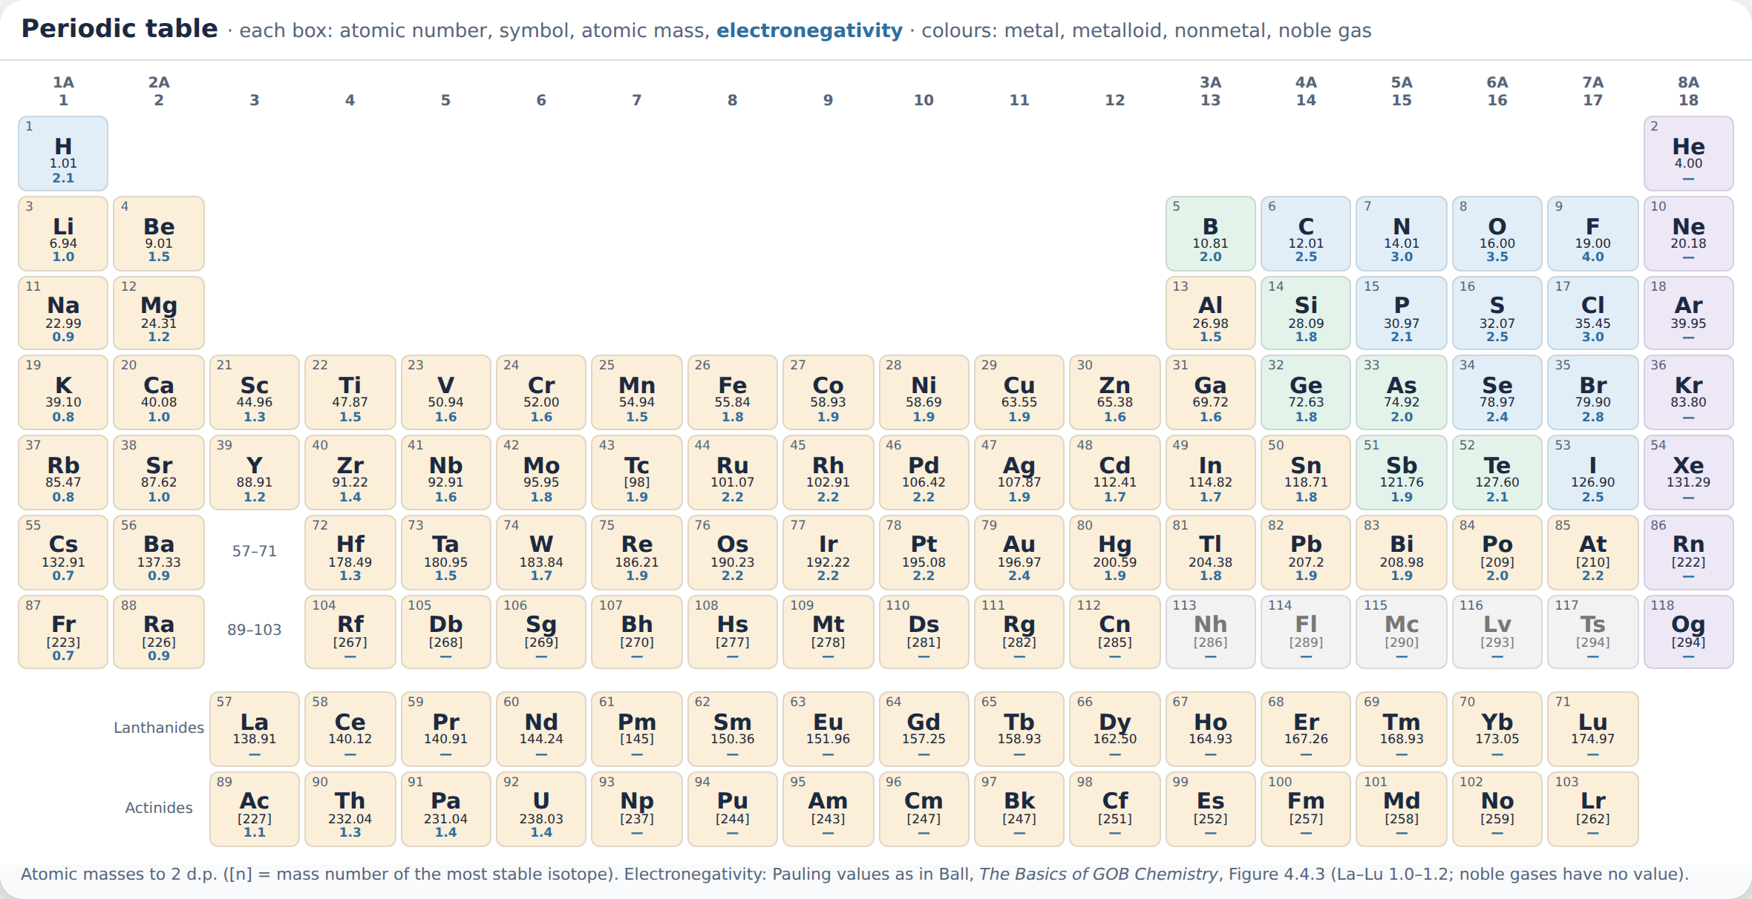
Appendix · Periodic table
PHD115 · Chemical Reactions II
Dr. NAM · Faculty of Pharmacy, UiTM Bertam, Penang

