Slide 1
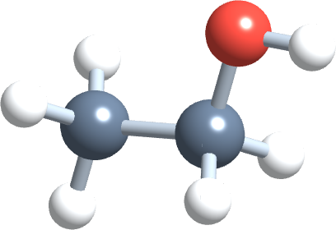
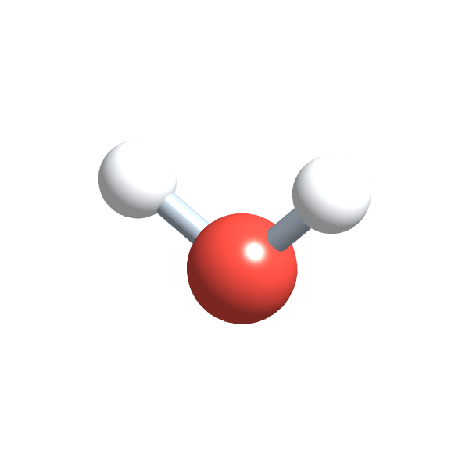
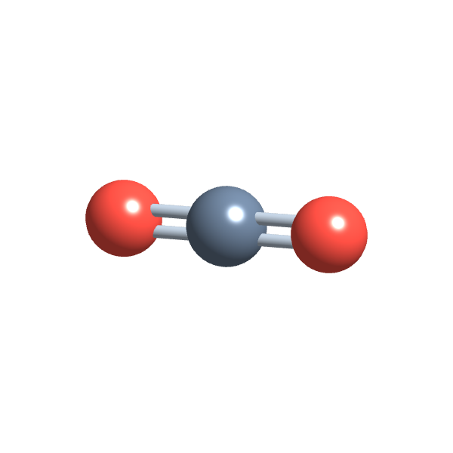
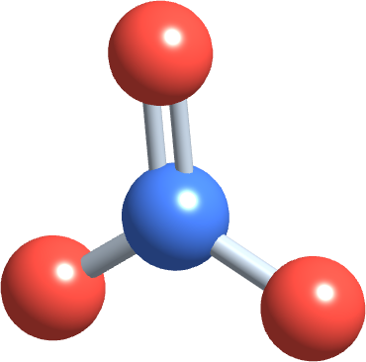
PHD115 Fundamentals of Chemistry
Solution
Dr. Nur 'Ainun Mokhtar (Dr. NAM) · Faculty of Pharmacy, UiTM Bertam, Penang
Core reference: Ball, Hill & Scott, The Basics of GOB Chemistry, chapter 9 (9.0–9.4, 9.7)
PHD115 · Solution
Dr. NAM · Faculty of Pharmacy, UiTM Bertam, Penang
Notes:
This lecture follows Ball chapter 9: 9.0–9.4 and 9.7. Equilibrium (9.5–9.6) was taught in Chemical Reactions II.

Slide 2
Learning outcomes
SOL-LO1
Define solution terms and predict solubility using “like dissolves like”
SOL-LO2
Calculate concentration as %, ppm/ppb and molarity
SOL-LO3
Perform dilution calculations
SOL-LO4
Describe the dissolution process and electrolytes, and explain colligative properties
SOL-LO5
Explain osmosis, osmolarity and tonicity using IV fluids
PHD115 · Solution
Dr. NAM · Faculty of Pharmacy, UiTM Bertam, Penang
Notes:
The same five outcomes appear in the before-class activity, the after-class activity, the tutorial and the exam questions.

Slide 3
Lecture map
Part 1 · Solutions and solubility (Ball 9.0–9.1, 9.2): solute, solvent, like dissolves like, saturated solutions
Part 2 · Percent concentration, ppm and ppb (Ball 9.2): % m/m, % v/v, % m/v and trace amounts
Part 3 · Molarity (Ball 9.2): moles per litre, and molarity in calculations
Part 4 · Dilution (Ball 9.2): M₁V₁ = M₂V₂ and preparing IV solutions
Part 5 · Dissolving, electrolytes and colligative properties (Ball 9.3–9.4)
Part 6 · Osmosis, osmolarity and tonicity (Ball 9.4, 9.7): why IV fluids must be isotonic
Links
Like dissolves like uses polarity and intermolecular forces (Ionic & Covalent II). Molarity reuses moles and molar mass (Chemical Reactions I).
PHD115 · Solution
Dr. NAM · Faculty of Pharmacy, UiTM Bertam, Penang
Notes:
Every calculation in this lecture is a conversion factor, just like stoichiometry.

Slide 4
THINK FIRST
Every day, nurses infuse litres of normal saline into patients' veins. Why would they never infuse pure, sterile water instead?
Discuss with a partner for one minute.
PHD115 · Solution
Dr. NAM · Faculty of Pharmacy, UiTM Bertam, Penang
Notes:
Let students discuss for a minute. Return to this question in Part 6.

Slide 5
THINK FIRST · ANSWER
Every day, nurses infuse litres of normal saline into patients' veins. Why would they never infuse pure, sterile water instead?
Water would rush into the red blood cells by osmosis and burst them. Normal saline (0.9% NaCl) has the same particle concentration as blood, so cells stay intact. To understand this we need solutions, concentration and osmosis: this lecture.
PHD115 · Solution
Dr. NAM · Faculty of Pharmacy, UiTM Bertam, Penang
Notes:
Let students discuss for a minute. Return to this question in Part 6.

Slide 6
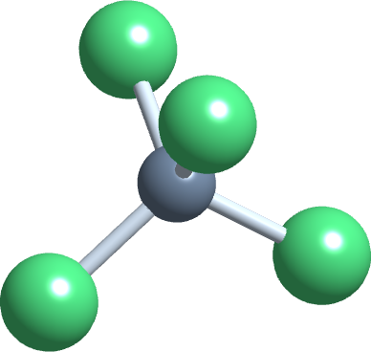
1
PART 1
Solutions and solubility
What a solution is, and why some things dissolve and others do not.
SOL-LO1 · Ball 9.0–9.1 · 9.2
PHD115 · Solution
Dr. NAM · Faculty of Pharmacy, UiTM Bertam, Penang
Notes:
Part 1 covers 9.1 and the solubility section at the start of 9.2.

Slide 7
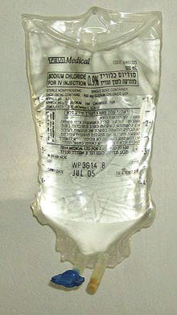
1
SOL-LO1
Solutions in the hospital: IV fluids
Intravenous (IV) solutions put ions, sugar or drugs into the bloodstream, or increase blood volume.
Normal saline: 9.0 g of NaCl in every litre of solution (0.9%).
Ringer's lactate: normal saline plus small amounts of K⁺, Ca²⁺ and about 2.5 g/L of lactate ions; the liver turns lactate into HCO₃⁻.
D5W: 5% dextrose (glucose) in water.
The 0.9% NaCl concentration on this IV bag is mass/volume percent, Figure 9.2.1 (Ball, The Basics of GOB Chemistry 9.2)
PHD115 · Solution
Dr. NAM · Faculty of Pharmacy, UiTM Bertam, Penang
Notes:
Ball 9.0 opening essay. These three fluids return throughout the lecture.

Slide 8
1
SOL-LO1
What is a solution?
A solution is a homogeneous mixture: the parts cannot be told apart, even with a microscope.
Salt and pepper is a mixture but not a solution; salt dissolved in water is a solution.
The solvent is the major component, usually in the same phase as the solution.
Each minor component is a solute. In saline, NaCl is the solute and water is the solvent.
A solution in water is called aqueous, written (aq).
Words that sound alike
Dilute: little solute. Concentrated: a lot of solute. Both are relative words; Parts 2–3 make them exact.
PHD115 · Solution
Dr. NAM · Faculty of Pharmacy, UiTM Bertam, Penang
Notes:
Ball 9.1 and 9.2 introduction.

Slide 9
1
SOL-LO1
Solutions come in all phases
Solvent | Solute | Example
gas | gas | air (about 80% N₂, 20% O₂)
liquid | gas | carbonated drinks (CO₂ in water)
liquid | liquid | ethanol in water; 70% alcohol swabs
liquid | solid | saltwater; normal saline; syrups
solid | gas | H₂ gas absorbed by palladium metal
solid | liquid | mercury in dental fillings
solid | solid | steel and other alloys
Table 9.1.1, Types of Solutions (Ball 9.1), with pharmacy examples added.
PHD115 · Solution
Dr. NAM · Faculty of Pharmacy, UiTM Bertam, Penang
Notes:
Solute and solvent need not be in the same phase.

Slide 10
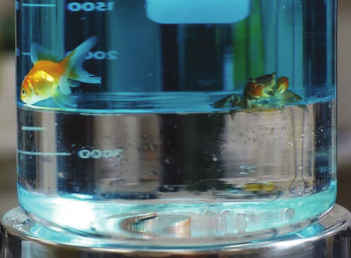
1
SOL-LO1
Like dissolves like
A solution forms when solvent and solute have similar intermolecular forces.
Polar solvents (water) dissolve polar and ionic solutes: NaCl, glucose, ethanol.
Nonpolar solvents (hexane, oils) dissolve nonpolar solutes: fats, waxes, iodine.
Methanol mixes with water in any amount: both are polar and both form hydrogen bonds. Oil does not.
Water with blue dye floats on a dense fluorocarbon; the two liquids do not mix, Figure 9.1.1 (Ball, The Basics of GOB Chemistry 9.1)
PHD115 · Solution
Dr. NAM · Faculty of Pharmacy, UiTM Bertam, Penang
Notes:
Recall polarity and hydrogen bonding from IC2.

Slide 11
1
SOL-LO1
Soluble, insoluble, miscible
Soluble: the solute dissolves in that solvent. Insoluble: it does not.
NaCl is soluble in water but insoluble in hexane (C₆H₁₄).
Miscible: two liquids mix in any proportion (ethanol and water). Immiscible: they form layers (oil and water).
Big molecules with one small polar group behave mostly as nonpolar: hexanol is far less soluble in water than ethanol.
Pharmacy
Many drugs are made as salts (e.g. sodium or hydrochloride salts) because the ionic form dissolves better in water than the neutral molecule.
PHD115 · Solution
Dr. NAM · Faculty of Pharmacy, UiTM Bertam, Penang
Notes:
Ball 9.1.

Slide 12
1
SOL-LO1
Example 1.1 · Will it dissolve in water?
Water is a polar solvent. Which should dissolve in water: (a) methanol, CH₃OH; (b) sodium sulfate, Na₂SO₄; (c) octane, C₈H₁₈?
1
(a) The OH group makes methanol polar and able to hydrogen bond: soluble (both are liquids, so miscible).
2
(b) Sodium sulfate is ionic: soluble.
3
(c) Octane is a hydrocarbon, so it is nonpolar: insoluble in water.
PHD115 · Solution
Dr. NAM · Faculty of Pharmacy, UiTM Bertam, Penang
Notes:
Ball Example 9.1.1.

Slide 13
1
SOL-LO1
Try it · A nonpolar solvent
Toluene (C₆H₅CH₃) is a nonpolar industrial solvent. Which dissolves in toluene: (a) water; (b) sodium sulfate; (c) octane? And would iodine (I₂) dissolve better in CCl₄ or in water?
Work it out, then check on the next slide.
PHD115 · Solution
Dr. NAM · Faculty of Pharmacy, UiTM Bertam, Penang

Slide 14
1
SOL-LO1
Try it · A nonpolar solvent · answer
Toluene (C₆H₅CH₃) is a nonpolar industrial solvent. Which dissolves in toluene: (a) water; (b) sodium sulfate; (c) octane? And would iodine (I₂) dissolve better in CCl₄ or in water?
Answer
Only octane: it is nonpolar like toluene. Water (polar) and sodium sulfate (ionic) do not.
I₂ is nonpolar, so it is more soluble in CCl₄ (nonpolar) than in water (polar).
PHD115 · Solution
Dr. NAM · Faculty of Pharmacy, UiTM Bertam, Penang

Slide 15
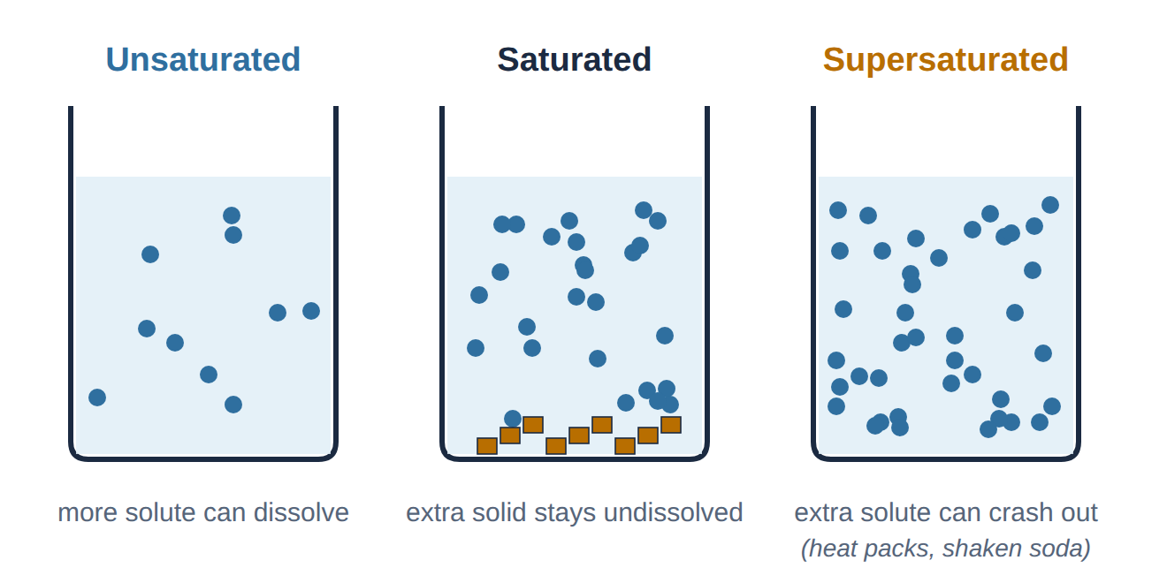
1
SOL-LO1
Solubility: there is a limit
Unsaturated, saturated and supersaturated solutions (drawn by Dr. NAM)
Solubility = the maximum amount of solute that dissolves in a given amount of solvent at a stated temperature.
Saturated: at the limit. Unsaturated: below it. Supersaturated: above it and unstable. Reusable heat packs contain supersaturated sodium acetate; it crystallises and releases heat.
PHD115 · Solution
Dr. NAM · Faculty of Pharmacy, UiTM Bertam, Penang
Notes:
Ball 9.2, Solubility.

Slide 16
1
SOL-LO1
Solubilities in water at 25 °C
Substance | Solubility (g in 100 mL water) | Like dissolves like?
KBr(s) | 67.8 | ionic in polar water: very soluble
NaCl(s) | 36.0 | ionic: soluble
benzene, C₆H₆(ℓ) | 0.178 | nonpolar: barely soluble
CO₂(g) | 0.150 | gas: slightly soluble
Values from Table 9.2.1 (Ball 9.2). Solubility changes with temperature, so the temperature is always quoted.
PHD115 · Solution
Dr. NAM · Faculty of Pharmacy, UiTM Bertam, Penang
Notes:
Ask: if 50.0 g of NaCl is stirred into 100 mL of water at 25 °C, how much dissolves? (36.0 g; 14.0 g stays solid: saturated.)

Slide 17
1
SOL-LO1
Quick check
Which pair is most likely to form a solution?
A Oil and water
B Iodine and water
C Glucose and water
D Wax and water
PHD115 · Solution
Dr. NAM · Faculty of Pharmacy, UiTM Bertam, Penang

Slide 18
1
SOL-LO1
Quick check · answer
Which pair is most likely to form a solution?
A Oil and water
B Iodine and water
C Glucose and water
D Wax and water
Answer C. Glucose is polar with many OH groups, so it hydrogen bonds with water. The others are nonpolar solutes in a polar solvent.
PHD115 · Solution
Dr. NAM · Faculty of Pharmacy, UiTM Bertam, Penang

Slide 19
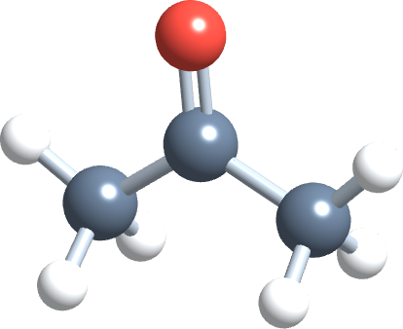
2
PART 2
Percent concentration, ppm and ppb
How much solute is in how much solution: the language of labels and prescriptions.
SOL-LO2 · Ball 9.2
PHD115 · Solution
Dr. NAM · Faculty of Pharmacy, UiTM Bertam, Penang
Notes:
Concentration = amount of solute per amount of solution (not solvent).

Slide 20
2
SOL-LO2
Three percent concentrations
percent = (amount of solute ÷ amount of solution) × 100%
% m/m | mass of solute (g) ÷ mass of solution (g) × 100: creams, ointments
% v/v | volume of solute (mL) ÷ volume of solution (mL) × 100: alcohol, hand rubs
% m/v | mass of solute (g) ÷ volume of solution (mL) × 100: IV fluids, syrups, injections
units | m/m and v/v need the same units top and bottom; m/v is always g per mL
A percentage is parts of solute per 100 parts of solution: 0.9% m/v NaCl = 0.9 g NaCl per 100 mL of solution.
PHD115 · Solution
Dr. NAM · Faculty of Pharmacy, UiTM Bertam, Penang
Notes:
Ball 9.2, Percent Composition.

Slide 21
2
SOL-LO2
Example 2.1 · Mass/mass percent
A saline solution with a mass of 355 g has 36.5 g of NaCl dissolved in it. What is its % m/m?
1
% m/m = (mass of solute ÷ mass of solution) × 100%
2
= (36.5 g ÷ 355 g) × 100%
3
= 10.3% m/m NaCl
PHD115 · Solution
Dr. NAM · Faculty of Pharmacy, UiTM Bertam, Penang
Notes:
Ball Example 9.2.1.

Slide 22
2
SOL-LO2
Example 2.2 · Normal saline in % m/v
A normal saline IV solution contains 9.0 g of NaCl in every litre of solution. What is its mass/volume percent?
1
Volume must be in mL: 1 L = 1,000 mL (exact).
2
% m/v = (9.0 g ÷ 1,000 mL) × 100%
3
= 0.90% m/v NaCl: the 0.9% printed on every saline bag.
PHD115 · Solution
Dr. NAM · Faculty of Pharmacy, UiTM Bertam, Penang
Notes:
Ball Example 9.2.3.

Slide 23
2
SOL-LO2
Percent as a conversion factor
5% v/v alcohol means 5 mL alcohol in every 100 mL solution.
Two conversion factors: (5 mL alcohol / 100 mL solution) or (100 mL solution / 5 mL alcohol).
Use the first to go from solution to solute; use the second to go from solute to solution.
Given any two of solute, solution and percent, you can find the third.
Road map
amount of solution × (solute / 100 solution) = amount of solute
PHD115 · Solution
Dr. NAM · Faculty of Pharmacy, UiTM Bertam, Penang
Notes:
Ball 9.2, Using Percent Composition in Calculations.

Slide 24
2
SOL-LO2
Example 2.3 · Using % v/v
A sample of 45.0% v/v ethanol (C₂H₅OH) in water has a volume of 115 mL. What volume of ethanol does it contain?
1
45.0% v/v means 45.0 mL C₂H₅OH per 100 mL solution.
2
115 mL solution × (45.0 mL C₂H₅OH ÷ 100 mL solution)
3
= 51.8 mL C₂H₅OH
PHD115 · Solution
Dr. NAM · Faculty of Pharmacy, UiTM Bertam, Penang
Notes:
Ball Example 9.2.2.

Slide 25
2
SOL-LO2
Try it · Paracetamol syrup
A paracetamol syrup label says 120 mg per 5 mL. (a) What is its % m/v? (b) How many grams of paracetamol are in a 60 mL bottle?
Work it out, then check on the next slide.
PHD115 · Solution
Dr. NAM · Faculty of Pharmacy, UiTM Bertam, Penang

Slide 26
2
SOL-LO2
Try it · Paracetamol syrup · answer
A paracetamol syrup label says 120 mg per 5 mL. (a) What is its % m/v? (b) How many grams of paracetamol are in a 60 mL bottle?
Answer
(a) 120 mg = 0.120 g. % m/v = (0.120 g ÷ 5 mL) × 100% = 2.4% m/v.
(b) 60 mL × (2.4 g ÷ 100 mL) = 1.44 g of paracetamol.
PHD115 · Solution
Dr. NAM · Faculty of Pharmacy, UiTM Bertam, Penang

Slide 27
2
SOL-LO2
Try it · Hand rub and glucose
(a) An alcohol hand rub is 70% v/v ethanol. How much ethanol is in a 500 mL bottle? (b) What volume of 12.5% m/v glucose solution contains 50.0 g of glucose?
Work it out, then check on the next slide.
PHD115 · Solution
Dr. NAM · Faculty of Pharmacy, UiTM Bertam, Penang

Slide 28
2
SOL-LO2
Try it · Hand rub and glucose · answer
(a) An alcohol hand rub is 70% v/v ethanol. How much ethanol is in a 500 mL bottle? (b) What volume of 12.5% m/v glucose solution contains 50.0 g of glucose?
Answer
(a) 500 mL × (70 mL ÷ 100 mL) = 350 mL ethanol.
(b) 50.0 g × (100 mL ÷ 12.5 g) = 400 mL of solution.
PHD115 · Solution
Dr. NAM · Faculty of Pharmacy, UiTM Bertam, Penang

Slide 29
2
SOL-LO2
Very small amounts: ppm and ppb
ppm = (mass of solute ÷ mass of solution) × 1,000,000
ppb = (mass of solute ÷ mass of solution) × 1,000,000,000
In water: 1 ppm ≈ 1 mg/L and 1 ppb ≈ 1 µg/L.
Used for trace elements in the body, poisons and pollutants: cobalt in the body is about 21 ppb.
Scale
1 ppm is like 1 drop in a 50 L bucket. 1 ppb is like 1 drop in a small swimming pool.
PHD115 · Solution
Dr. NAM · Faculty of Pharmacy, UiTM Bertam, Penang
Notes:
Ball 9.2.

Slide 30
2
SOL-LO2
Example 2.4 · Cobalt in the body
The concentration of cobalt in the human body is 21 ppb. What mass of Co is in a body of 70.0 kg?
1
21 ppb means 21 g Co per 1,000,000,000 g of body.
2
70.0 kg = 7.00 × 10⁴ g
3
7.00 × 10⁴ g × (21 g ÷ 1,000,000,000 g) = 0.0015 g
4
1.5 × 10⁻³ g = 1.5 mg of cobalt
PHD115 · Solution
Dr. NAM · Faculty of Pharmacy, UiTM Bertam, Penang
Notes:
Ball Example 9.2.4.

Slide 31
2
SOL-LO2
The dose makes the poison
Whether a substance helps or harms depends on its concentration.
Arsenic
Water
May be an essential trace element at about 50 ppb or less
A toxic dose is about 7,000 ppb and higher
That is over 140 times the trace amount
Drinking too much water too fast dilutes Na⁺, K⁺ and other ions in the blood
Water intoxication can be fatal
Athletes and hikers must replace the salts lost in sweat
PHD115 · Solution
Dr. NAM · Faculty of Pharmacy, UiTM Bertam, Penang
Notes:
Ball 9.2, Looking Closer: The Dose Makes the Poison.

Slide 32
2
SOL-LO2
Quick check
A 250 mL bag of 5% m/v dextrose contains how much dextrose?
A 5 g
B 12.5 g
C 50 g
D 1.25 g
PHD115 · Solution
Dr. NAM · Faculty of Pharmacy, UiTM Bertam, Penang

Slide 33
2
SOL-LO2
Quick check · answer
A 250 mL bag of 5% m/v dextrose contains how much dextrose?
A 5 g
B 12.5 g
C 50 g
D 1.25 g
Answer B. 5 g per 100 mL, so 250 mL × (5 g ÷ 100 mL) = 12.5 g.
PHD115 · Solution
Dr. NAM · Faculty of Pharmacy, UiTM Bertam, Penang

Slide 34
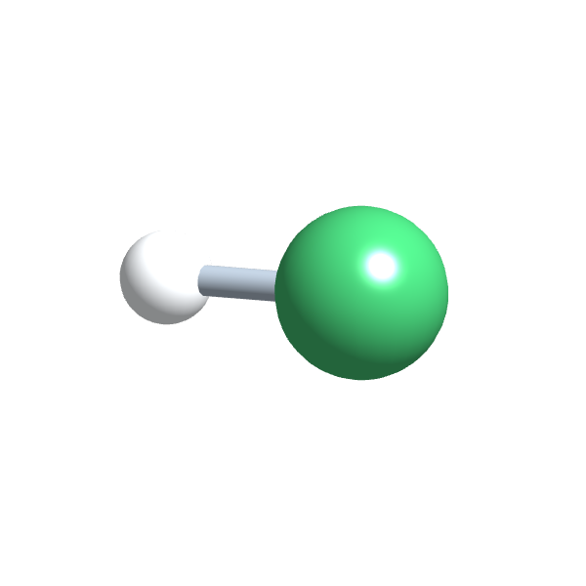
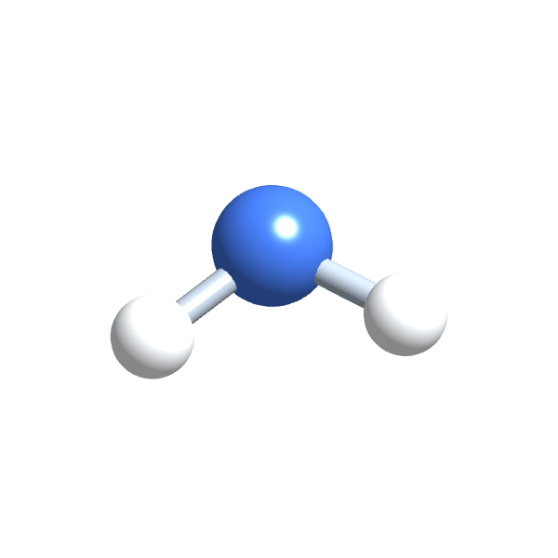
3
PART 3
Molarity
Moles of solute per litre of solution: the unit chemists use for reactions.
SOL-LO2 · Ball 9.2
PHD115 · Solution
Dr. NAM · Faculty of Pharmacy, UiTM Bertam, Penang
Notes:
Molarity links concentration to the mole (CR1).

Slide 35
3
SOL-LO2
Molarity
M = moles of solute ÷ litres of solution
units | mol/L, written M and read 'molar'
moles | solute amount must be in moles: convert grams with the molar mass
litres | volume is of the whole solution, in L: divide mL by 1,000
example | 1.5 mol NaCl in 0.500 L solution = 3.0 M NaCl(aq)
Molarity counts particles, so it is the concentration used in reactions and in osmolarity (Part 6).
PHD115 · Solution
Dr. NAM · Faculty of Pharmacy, UiTM Bertam, Penang
Notes:
Ball 9.2, Molarity.

Slide 36
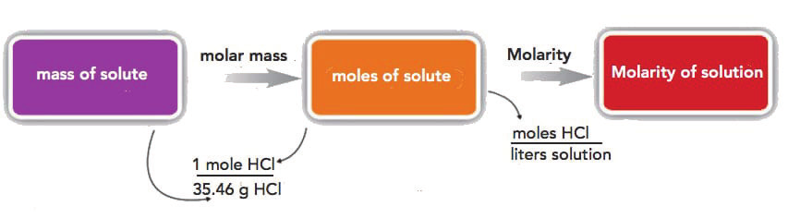
3
SOL-LO2
From grams to molarity
Mass of solute → moles of solute → molarity, for 22.4 g HCl (Ball, The Basics of GOB Chemistry 9.2)
22.4 g HCl dissolved in 1.56 L. Step 1: 22.4 g ÷ 36.46 g/mol = 0.614 mol HCl.
Step 2: M = 0.614 mol ÷ 1.56 L = 0.394 M HCl.
PHD115 · Solution
Dr. NAM · Faculty of Pharmacy, UiTM Bertam, Penang
Notes:
Ball 9.2 worked example.

Slide 37
3
SOL-LO2
Example 3.1 · Molarity from mass
What is the molarity of a solution of 25.0 g of NaOH in 750 mL? (Na = 22.99, O = 16.00, H = 1.01)
1
Molar mass NaOH = 40.00 g/mol; 25.0 g ÷ 40.00 g/mol = 0.625 mol
2
750 mL = 0.750 L
3
M = 0.625 mol ÷ 0.750 L = 0.833 M NaOH
PHD115 · Solution
Dr. NAM · Faculty of Pharmacy, UiTM Bertam, Penang
Notes:
Ball Example 9.2.5.

Slide 38
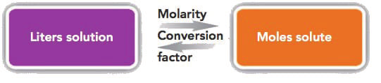
3
SOL-LO2
Molarity as a conversion factor
Litres of solution ↔ moles of solute (Ball, The Basics of GOB Chemistry 9.2)
3.0 M sucrose means 3.0 mol sucrose = 1 L solution: use (3.0 mol / 1 L) or (1 L / 3.0 mol).
Moles in 0.108 L: 0.108 L × 3.0 mol/L = 0.32 mol. Volume for 4.88 mol: 4.88 mol × (1 L ÷ 3.0 mol) = 1.63 L.
PHD115 · Solution
Dr. NAM · Faculty of Pharmacy, UiTM Bertam, Penang
Notes:
Equivalent shortcut: mol = M × L, and L = mol ÷ M.

Slide 39
3
SOL-LO2
Example 3.2 · Mass from molarity
Engine coolant is ethylene glycol (C₂H₆O₂, 62.08 g/mol) in water. How many grams are in 5.00 L of a 6.00 M solution?
1
mol = M × L = 6.00 mol/L × 5.00 L = 30.0 mol
2
mass = 30.0 mol × 62.08 g/mol
3
= 1.86 × 10³ g (1,860 g) C₂H₆O₂
PHD115 · Solution
Dr. NAM · Faculty of Pharmacy, UiTM Bertam, Penang
Notes:
Ball Example 9.2.6 (b). Part (a): 0.450 mol ÷ 0.0753 M = 5.98 L.

Slide 40
3
SOL-LO2
Try it · Making a glucose solution
A pharmacist needs 250 mL of 0.310 M glucose (C₆H₁₂O₆, 180.18 g/mol). What mass of glucose must be weighed?
Work it out, then check on the next slide.
PHD115 · Solution
Dr. NAM · Faculty of Pharmacy, UiTM Bertam, Penang

Slide 41
3
SOL-LO2
Try it · Making a glucose solution · answer
A pharmacist needs 250 mL of 0.310 M glucose (C₆H₁₂O₆, 180.18 g/mol). What mass of glucose must be weighed?
Answer
mol = 0.310 mol/L × 0.250 L = 0.0775 mol
mass = 0.0775 mol × 180.18 g/mol = 14.0 g glucose, made up to 250 mL with water (not added to 250 mL of water).
PHD115 · Solution
Dr. NAM · Faculty of Pharmacy, UiTM Bertam, Penang

Slide 42
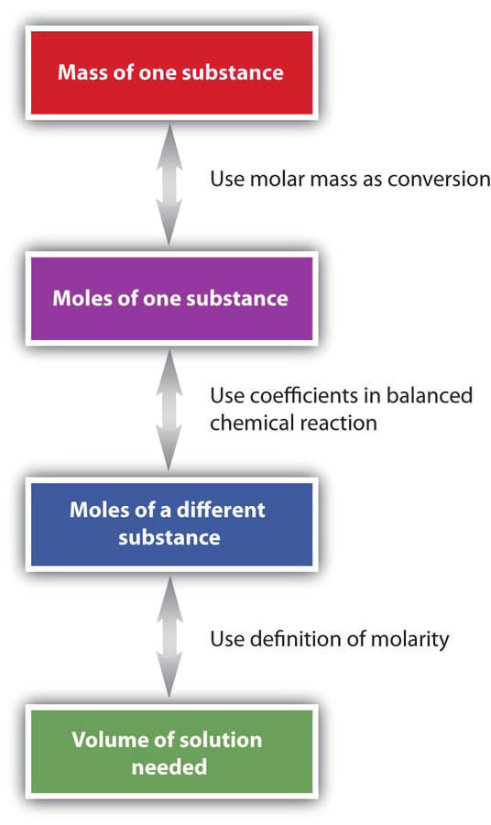
3
SOL-LO2
Molarity in reactions
Mass of A → moles of A (molar mass)
Moles of A → moles of B (coefficients of the balanced equation)
Moles of B → volume of solution (molarity)
The arrows go both ways: start from either end.
Steps for using molarity in stoichiometry, Figure 9.2.3 (Ball, The Basics of GOB Chemistry 9.2)
PHD115 · Solution
Dr. NAM · Faculty of Pharmacy, UiTM Bertam, Penang
Notes:
Same road map as CR1 stoichiometry, with molarity as the last step.

Slide 43
3
SOL-LO2
Example 3.3 · Volume needed for a reaction
How many mL of 2.75 M HCl are needed to react with 185 g of NaOH (40.00 g/mol)? HCl(aq) + NaOH(s) → H₂O(ℓ) + NaCl(aq)
1
185 g NaOH ÷ 40.00 g/mol = 4.63 mol NaOH
2
Mole ratio 1 : 1, so 4.63 mol HCl
3
Volume = 4.63 mol ÷ 2.75 mol/L = 1.68 L
4
= 1,680 mL of 2.75 M HCl
PHD115 · Solution
Dr. NAM · Faculty of Pharmacy, UiTM Bertam, Penang
Notes:
Ball Example 9.2.7.

Slide 44
3
SOL-LO2
Try it · An antacid tablet
A tablet contains 500 mg of Mg(OH)₂ (58.33 g/mol). Mg(OH)₂ + 2HCl → MgCl₂ + 2H₂O. What volume of 0.10 M stomach acid (HCl) can it neutralise?
Work it out, then check on the next slide.
PHD115 · Solution
Dr. NAM · Faculty of Pharmacy, UiTM Bertam, Penang

Slide 45
3
SOL-LO2
Try it · An antacid tablet · answer
A tablet contains 500 mg of Mg(OH)₂ (58.33 g/mol). Mg(OH)₂ + 2HCl → MgCl₂ + 2H₂O. What volume of 0.10 M stomach acid (HCl) can it neutralise?
Answer
0.500 g ÷ 58.33 g/mol = 8.57 × 10⁻³ mol Mg(OH)₂
× 2 = 1.71 × 10⁻² mol HCl
Volume = 0.0171 mol ÷ 0.10 mol/L = 0.17 L = about 170 mL of stomach acid.
PHD115 · Solution
Dr. NAM · Faculty of Pharmacy, UiTM Bertam, Penang

Slide 46
3
SOL-LO2
Equivalents: concentration of charge
One equivalent (Eq) = 1 mol of positive or negative charge.
1 mol/L Na⁺ = 1 Eq/L. 1 mol/L Ca²⁺ = 2 Eq/L, because each ion carries 2+.
Body fluids are usually given in milliequivalents: blood plasma has about 150 mEq/L of cations.
You will see mEq on potassium chloride injections and lab reports.
Quick rule
Eq/L = mol/L × size of the charge
PHD115 · Solution
Dr. NAM · Faculty of Pharmacy, UiTM Bertam, Penang
Notes:
Ball 9.2, Equivalents.

Slide 47
3
SOL-LO2
Quick check
5.85 g of NaCl (58.44 g/mol) is dissolved to make 500 mL of solution. Its molarity is:
A 0.100 M
B 0.200 M
C 11.7 M
D 0.0100 M
PHD115 · Solution
Dr. NAM · Faculty of Pharmacy, UiTM Bertam, Penang

Slide 48
3
SOL-LO2
Quick check · answer
5.85 g of NaCl (58.44 g/mol) is dissolved to make 500 mL of solution. Its molarity is:
A 0.100 M
B 0.200 M
C 11.7 M
D 0.0100 M
Answer B. 5.85 ÷ 58.44 = 0.100 mol; 0.100 mol ÷ 0.500 L = 0.200 M.
PHD115 · Solution
Dr. NAM · Faculty of Pharmacy, UiTM Bertam, Penang

Slide 49
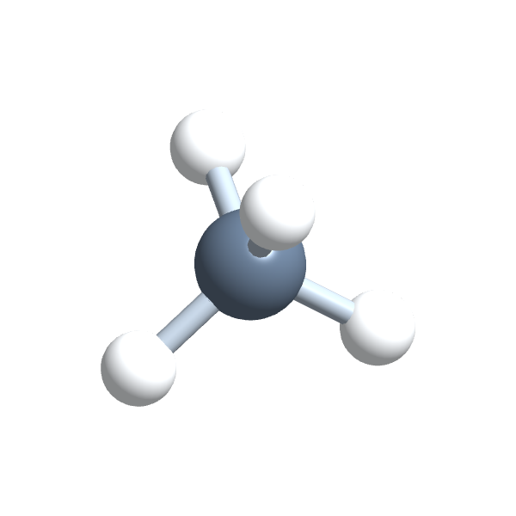
4
PART 4
Dilution
Adding solvent changes the concentration but not the amount of solute.
SOL-LO3 · Ball 9.2
PHD115 · Solution
Dr. NAM · Faculty of Pharmacy, UiTM Bertam, Penang
Notes:
Daily work in hospital pharmacy.

Slide 50
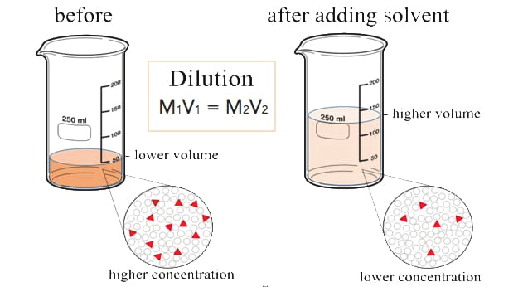
4
SOL-LO3
What happens in a dilution
Adding water does not change the moles of solute: mol₁ = mol₂.
Moles = M × V, so M₁V₁ = M₂V₂.
Any volume unit works, as long as V₁ and V₂ use the same unit.
Works for % too: %₁V₁ = %₂V₂.
Diluting a solution: more volume, same solute, lower concentration, Figure 9.2.4 (Ball, The Basics of GOB Chemistry 9.2)
PHD115 · Solution
Dr. NAM · Faculty of Pharmacy, UiTM Bertam, Penang
Notes:
Ball 9.2, Dilutions.

Slide 51
4
SOL-LO3
Example 4.1 · Finding the new concentration
100. mL of 2.0 M HCl is diluted with water to a volume of 500. mL. What is the new molarity?
1
M₂ = M₁V₁ ÷ V₂
2
= (2.0 M × 100. mL) ÷ 500. mL
3
= 0.40 M HCl: five times the volume, one fifth of the concentration.
PHD115 · Solution
Dr. NAM · Faculty of Pharmacy, UiTM Bertam, Penang
Notes:
Ball 9.2.

Slide 52
4
SOL-LO3
Example 4.2 · A saline dilution
A 125 mL sample of 0.900 M NaCl is diluted to 1,125 mL. What is the final concentration?
1
0.900 M × 125 mL = M₂ × 1,125 mL
2
M₂ = (0.900 M × 125 mL) ÷ 1,125 mL
3
= 0.100 M NaCl
PHD115 · Solution
Dr. NAM · Faculty of Pharmacy, UiTM Bertam, Penang
Notes:
Ball Example 9.2.8.

Slide 53
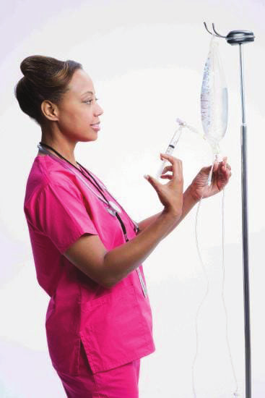
4
SOL-LO3
Preparing IV solutions
A doctor orders 100 mL of 0.50% KCl for a patient with low potassium (hypokalaemia).
The ward has a sterile stock solution of 10.0% KCl and a bag of IV fluid.
(10.0%) V₁ = (0.50%)(100 mL), so V₁ = 5.0 mL of stock.
A wrong dilution can be useless, harmful or fatal: always double-check.
Medical personnel commonly perform dilutions for IV solutions, Figure 9.2.5 (Ball, The Basics of GOB Chemistry 9.2)
PHD115 · Solution
Dr. NAM · Faculty of Pharmacy, UiTM Bertam, Penang
Notes:
Ball 9.2, Preparing IV Solutions.

Slide 54
4
SOL-LO3
Try it · D50 to D5W
How many mL of 50% m/v dextrose (D50) are needed to make 500 mL of 5% m/v dextrose (D5W)?
Work it out, then check on the next slide.
PHD115 · Solution
Dr. NAM · Faculty of Pharmacy, UiTM Bertam, Penang

Slide 55
4
SOL-LO3
Try it · D50 to D5W · answer
How many mL of 50% m/v dextrose (D50) are needed to make 500 mL of 5% m/v dextrose (D5W)?
Answer
(50%) V₁ = (5%)(500 mL)
V₁ = 2,500 ÷ 50 = 50 mL of D50, made up to 500 mL.
PHD115 · Solution
Dr. NAM · Faculty of Pharmacy, UiTM Bertam, Penang

Slide 56
4
SOL-LO3
Try it · Final volume
20.0 mL of 1.50 M KBr is diluted until its concentration is 0.250 M. What is the final volume, and how much water was added?
Work it out, then check on the next slide.
PHD115 · Solution
Dr. NAM · Faculty of Pharmacy, UiTM Bertam, Penang

Slide 57
4
SOL-LO3
Try it · Final volume · answer
20.0 mL of 1.50 M KBr is diluted until its concentration is 0.250 M. What is the final volume, and how much water was added?
Answer
V₂ = M₁V₁ ÷ M₂ = (1.50 M × 20.0 mL) ÷ 0.250 M = 120. mL
Water added = 120. − 20.0 = 100. mL
PHD115 · Solution
Dr. NAM · Faculty of Pharmacy, UiTM Bertam, Penang

Slide 58
4
SOL-LO3
Key takeaways: concentration and dilution
Percent: % m/m, % v/v and % m/v (g per 100 mL). ppm and ppb for trace amounts.
Molarity = mol solute ÷ L solution; mol = M × L.
Every concentration is a conversion factor between solute and solution.
Dilution keeps the moles of solute constant: M₁V₁ = M₂V₂.
PHD115 · Solution
Dr. NAM · Faculty of Pharmacy, UiTM Bertam, Penang

Slide 59
4
SOL-LO3
Quick check
10.0 mL of 6.0 M HCl is diluted to 60.0 mL. The new concentration is:
A 36 M
B 1.0 M
C 0.60 M
D 6.0 M
PHD115 · Solution
Dr. NAM · Faculty of Pharmacy, UiTM Bertam, Penang

Slide 60
4
SOL-LO3
Quick check · answer
10.0 mL of 6.0 M HCl is diluted to 60.0 mL. The new concentration is:
A 36 M
B 1.0 M
C 0.60 M
D 6.0 M
Answer B. (6.0 M × 10.0 mL) ÷ 60.0 mL = 1.0 M.
PHD115 · Solution
Dr. NAM · Faculty of Pharmacy, UiTM Bertam, Penang

Slide 61
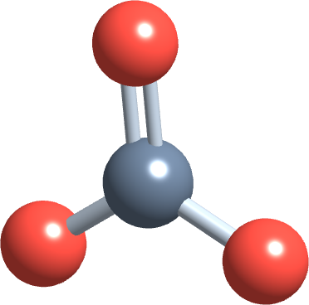
5
PART 5
Dissolving, electrolytes and colligative properties
What dissolving looks like at the particle level, and why the number of particles matters.
SOL-LO4 · Ball 9.3–9.4
PHD115 · Solution
Dr. NAM · Faculty of Pharmacy, UiTM Bertam, Penang
Notes:
Sets up osmolarity in Part 6.

Slide 62
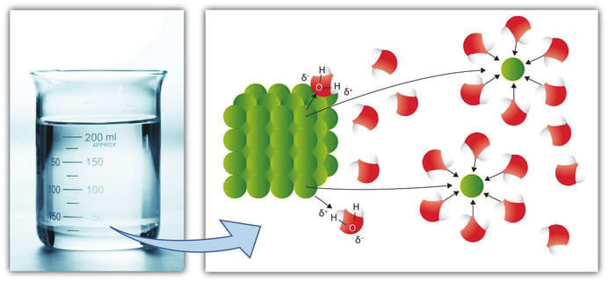
5
SOL-LO4
The dissolution process
Solvation: solute particles become surrounded by solvent particles, Figure 9.3.1 (Ball, The Basics of GOB Chemistry 9.3)
Solvation: each solute particle is pulled away and surrounded by solvent molecules. In water it is called hydration.
Molecular solutes (glucose) separate into molecules. Ionic solutes separate into ions: dissociation, NaCl(s) → Na⁺(aq) + Cl⁻(aq).
PHD115 · Solution
Dr. NAM · Faculty of Pharmacy, UiTM Bertam, Penang
Notes:
Ball 9.3.

Slide 63
5
SOL-LO4
Electrolytes and nonelectrolytes
Type | In water | Conducts electricity? | Examples
Strong electrolyte | dissociates completely into ions | well | NaCl, KCl, Mg(OH)₂
Weak electrolyte | dissociates only partly | weakly | acetic acid (vinegar)
Nonelectrolyte | stays as neutral molecules | no | sucrose, glucose, ethanol
In medicine, 'electrolytes' means the important ions dissolved in body fluids: Na⁺, K⁺, Ca²⁺, Mg²⁺, Cl⁻ and HCO₃⁻.
PHD115 · Solution
Dr. NAM · Faculty of Pharmacy, UiTM Bertam, Penang
Notes:
Ball 9.3.

Slide 64
5
SOL-LO4
Example 5.1 · Electrolyte or not?
Classify each as an electrolyte or a nonelectrolyte: (a) KCl; (b) fructose, C₆H₁₂O₆; (c) isopropyl alcohol, CH₃CH(OH)CH₃; (d) Mg(OH)₂.
1
Ionic solutes dissociate into ions: electrolytes. Molecular (covalent) solutes do not: nonelectrolytes.
2
(a) KCl: ionic, electrolyte. (d) Mg(OH)₂: ionic, electrolyte.
3
(b) fructose and (c) isopropyl alcohol: covalent molecules, nonelectrolytes.
PHD115 · Solution
Dr. NAM · Faculty of Pharmacy, UiTM Bertam, Penang
Notes:
Ball Example 9.3.1.

Slide 65
5
SOL-LO4
Electrolytes in body fluids
Electrolyte balance is crucial for nerves, muscles and the heart.
When balance is lost
Putting it right
High K⁺: cardiac arrhythmias
Low K⁺ outside cells: paralysis
Too much Na⁺ outside cells: fluid retention
Low Ca²⁺ and Mg²⁺: muscle spasms
Oral rehydration salts (ORS) for diarrhoea have saved millions of children's lives
IV fluids such as Ringer's lactate
Sports drinks replace Na⁺, K⁺, water and sugar lost in sweat
PHD115 · Solution
Dr. NAM · Faculty of Pharmacy, UiTM Bertam, Penang
Notes:
Ball 9.3, Electrolytes in Body Fluids.

Slide 66
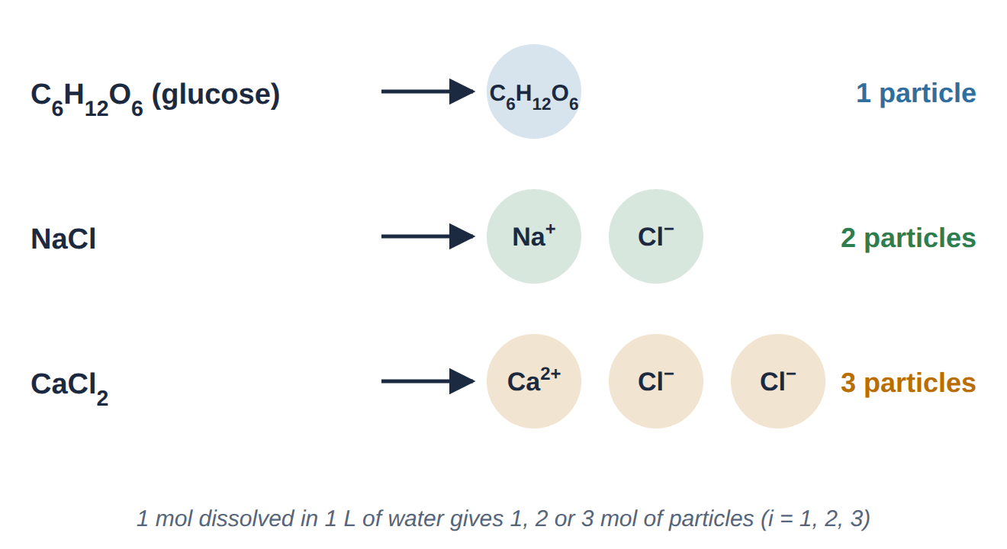
5
SOL-LO4
Colligative properties count particles
Particles formed per formula unit (drawn by Dr. NAM)
Colligative properties depend only on the number of dissolved particles, not on what they are.
Four of them: vapour pressure lowering, boiling point elevation, freezing point depression and osmotic pressure. 1 mol NaCl gives 2 mol of particles, so its effect is about twice that of 1 mol glucose.
PHD115 · Solution
Dr. NAM · Faculty of Pharmacy, UiTM Bertam, Penang
Notes:
Ball 9.4. i is the number of particles per formula unit.

Slide 67
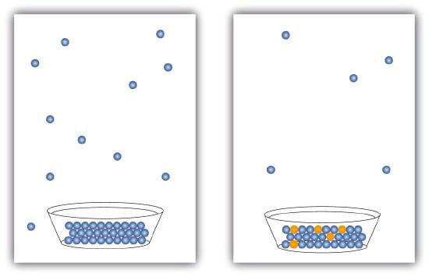
5
SOL-LO4
Vapour pressure lowering
Every liquid evaporates until evaporation and condensation balance: its vapour pressure.
Dissolved solid particles take up space at the surface, so fewer solvent molecules escape.
A solution therefore has a lower vapour pressure than the pure solvent.
This one effect causes the boiling and freezing point changes on the next slide.
Solute particles block some solvent molecules from evaporating, Figure 9.4.1 (Ball, The Basics of GOB Chemistry 9.4)
PHD115 · Solution
Dr. NAM · Faculty of Pharmacy, UiTM Bertam, Penang
Notes:
Ball 9.4.

Slide 68
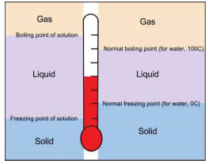
5
SOL-LO4
Boiling point up, freezing point down
Boiling point elevation: about +0.5 °C per mol of particles per litre of water.
Freezing point depression: about −1.9 °C per mol of particles per litre.
1 mol sucrose in 1 L: 100.5 °C. 1 mol NaCl: 101.0 °C. 1 mol CaCl₂: 101.5 °C.
Uses: ethylene glycol coolant boils above 100 °C; salt on icy roads stops ice forming.
Boiling and freezing points of a solution (left) and a pure liquid (right), Figure 9.4.2 (Ball, The Basics of GOB Chemistry 9.4)
PHD115 · Solution
Dr. NAM · Faculty of Pharmacy, UiTM Bertam, Penang
Notes:
Ball 9.4. Salt in pasta water makes almost no difference.

Slide 69
5
SOL-LO4
Example 5.2 · Estimating a boiling point
Estimate the boiling point of a 0.2 M CaCl₂ solution.
1
CaCl₂ → Ca²⁺ + 2Cl⁻: 3 particles per formula unit.
2
0.2 mol/L × 3 = 0.6 mol of particles per litre
3
0.6 × 0.5 °C = 0.3 °C rise
4
Boiling point ≈ 100.3 °C
PHD115 · Solution
Dr. NAM · Faculty of Pharmacy, UiTM Bertam, Penang
Notes:
Ball Example 9.4.2.

Slide 70
5
SOL-LO4
Try it · Freezing point
(a) Estimate the freezing point of 0.3 M CaCl₂. (b) Which changes the boiling point of water more, 1 M CaCl₂ or 1 M MgSO₄?
Work it out, then check on the next slide.
PHD115 · Solution
Dr. NAM · Faculty of Pharmacy, UiTM Bertam, Penang

Slide 71
5
SOL-LO4
Try it · Freezing point · answer
(a) Estimate the freezing point of 0.3 M CaCl₂. (b) Which changes the boiling point of water more, 1 M CaCl₂ or 1 M MgSO₄?
Answer
(a) 0.3 × 3 = 0.9 mol particles/L; 0.9 × 1.9 °C = 1.7 °C lower: about −1.7 °C.
(b) CaCl₂: 3 particles per unit, against 2 for MgSO₄ (Mg²⁺ + SO₄²⁻).
PHD115 · Solution
Dr. NAM · Faculty of Pharmacy, UiTM Bertam, Penang

Slide 72
5
SOL-LO4
Quick check
Which 1 M solution has the lowest freezing point?
A glucose
B NaCl
C CaCl₂
D KCl
PHD115 · Solution
Dr. NAM · Faculty of Pharmacy, UiTM Bertam, Penang

Slide 73
5
SOL-LO4
Quick check · answer
Which 1 M solution has the lowest freezing point?
A glucose
B NaCl
C CaCl₂
D KCl
Answer C. CaCl₂ gives 3 particles per formula unit, the most particles, so the largest freezing point depression.
PHD115 · Solution
Dr. NAM · Faculty of Pharmacy, UiTM Bertam, Penang

Slide 74
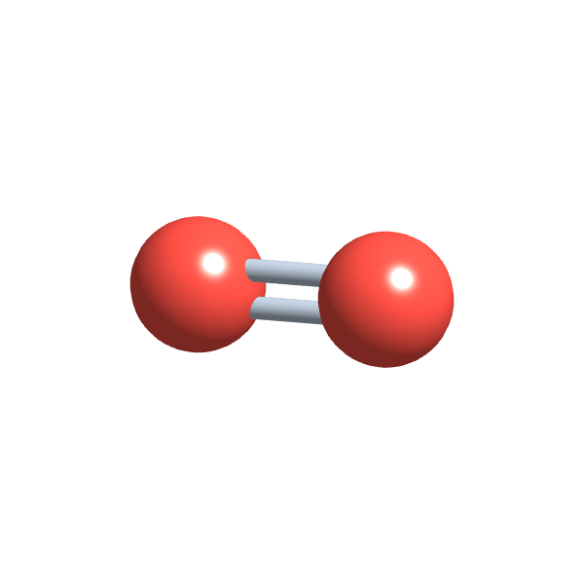
6
PART 6
Osmosis, osmolarity and tonicity
Water follows the particles: the chemistry behind every IV bag.
SOL-LO5 · Ball 9.4 · 9.7
PHD115 · Solution
Dr. NAM · Faculty of Pharmacy, UiTM Bertam, Penang
Notes:
Answers the opening question.

Slide 75
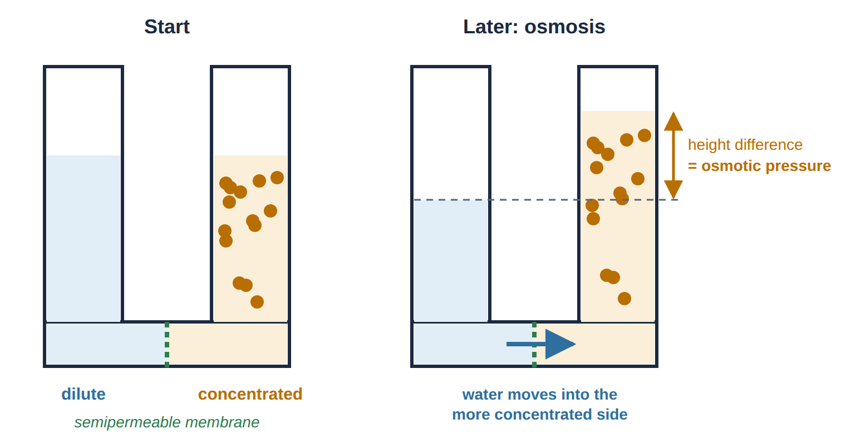
6
SOL-LO5
Osmosis
Osmosis through a semipermeable membrane (drawn by Dr. NAM)
A semipermeable membrane lets solvent (water) through but not solute particles. Cell membranes are semipermeable.
Osmosis: water moves from the more dilute solution into the more concentrated one. The pressure needed to stop it is the osmotic pressure.
PHD115 · Solution
Dr. NAM · Faculty of Pharmacy, UiTM Bertam, Penang
Notes:
Ball 9.4, Osmotic Pressure, and 9.7.

Slide 76
6
SOL-LO5
Osmolarity
osmol = M × i
M | molarity of the solute (mol/L)
i | particles formed by one formula unit: glucose 1, NaCl 2, CaCl₂ 3, Al(NO₃)₃ 4
mixtures | add the osmolarities of all solutes
direction | water moves from lower osmolarity to higher osmolarity
Equal osmolarity means equal osmotic pressure. Pushing harder than the osmotic pressure forces water the other way: reverse osmosis, used to make drinking water from seawater.
PHD115 · Solution
Dr. NAM · Faculty of Pharmacy, UiTM Bertam, Penang
Notes:
Ball 9.4.

Slide 77
6
SOL-LO5
Example 6.1 · Which way does water flow?
0.50 M NaCl and 0.30 M Ca(NO₃)₂ are on opposite sides of a semipermeable membrane. Find each osmolarity and the direction of water flow.
1
NaCl → Na⁺ + Cl⁻: 0.50 M × 2 = 1.0 osmol
2
Ca(NO₃)₂ → Ca²⁺ + 2NO₃⁻: 0.30 M × 3 = 0.90 osmol
3
Water flows from the Ca(NO₃)₂ side into the NaCl side (lower → higher osmolarity).
PHD115 · Solution
Dr. NAM · Faculty of Pharmacy, UiTM Bertam, Penang
Notes:
Ball Example 9.4.3.

Slide 78
6
SOL-LO5
Try it · Glucose against aluminium nitrate
1.5 M glucose (C₆H₁₂O₆) and 0.40 M Al(NO₃)₃ are separated by a semipermeable membrane. Which way does water flow?
Work it out, then check on the next slide.
PHD115 · Solution
Dr. NAM · Faculty of Pharmacy, UiTM Bertam, Penang

Slide 79
6
SOL-LO5
Try it · Glucose against aluminium nitrate · answer
1.5 M glucose (C₆H₁₂O₆) and 0.40 M Al(NO₃)₃ are separated by a semipermeable membrane. Which way does water flow?
Answer
Glucose: 1.5 M × 1 = 1.5 osmol. Al(NO₃)₃ → Al³⁺ + 3NO₃⁻: 0.40 M × 4 = 1.6 osmol.
Water flows from the glucose solution into the Al(NO₃)₃ solution.
PHD115 · Solution
Dr. NAM · Faculty of Pharmacy, UiTM Bertam, Penang

Slide 80
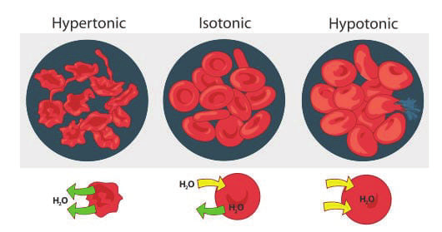
6
SOL-LO5
Tonicity: red blood cells
Red blood cells in hypertonic, isotonic and hypotonic solutions, Figure 9.7.1 (Ball, The Basics of GOB Chemistry 9.7)
Hypertonic (higher osmolarity outside): water leaves, cells shrivel: crenation. Isotonic (same): no net flow, cells stay normal.
Hypotonic (lower osmolarity outside): water enters, cells swell and burst: haemolysis. That is why pure water is never infused.
PHD115 · Solution
Dr. NAM · Faculty of Pharmacy, UiTM Bertam, Penang
Notes:
Ball 9.4 and 9.7.

Slide 81
6
SOL-LO5
Pharmacy focus: IV fluids and tonicity
Blood plasma is about 0.30 osmol. Glucose about 0.31 M and NaCl about 0.16 M are isotonic with it.
IV fluid | Osmolarity (approx.) | Tonicity | Effect on red cells
0.9% NaCl (normal saline) | 9.0 g/L ÷ 58.44 = 0.154 M × 2 = 0.31 osmol | isotonic | none
5% dextrose (D5W) | 50 g/L ÷ 180.18 = 0.28 M × 1 = 0.28 osmol | about isotonic in the bag | none at infusion
3% NaCl | 30 g/L ÷ 58.44 = 0.51 M × 2 = 1.0 osmol | hypertonic | crenation; used only for special cases
sterile water | 0 osmol | hypotonic | haemolysis: never given IV
Isotonic NaCl is about half the molarity of isotonic glucose, because each NaCl gives 2 particles.
PHD115 · Solution
Dr. NAM · Faculty of Pharmacy, UiTM Bertam, Penang
Notes:
Applies 9.4 osmolarity to real fluids. D5W becomes effectively hypotonic once the glucose is used by cells.

Slide 82
6
SOL-LO5
Example 6.2 · Is normal saline isotonic?
Show that 0.9% m/v NaCl (58.44 g/mol) is isotonic with blood (about 0.30 osmol).
1
0.9% m/v = 0.9 g per 100 mL = 9.0 g per litre
2
9.0 g ÷ 58.44 g/mol = 0.154 mol, so 0.154 M
3
osmol = 0.154 M × 2 = 0.31 osmol
4
0.31 ≈ 0.30 osmol: isotonic, so red blood cells neither swell nor shrink.
PHD115 · Solution
Dr. NAM · Faculty of Pharmacy, UiTM Bertam, Penang
Notes:
Links Parts 2, 3 and 6.

Slide 83
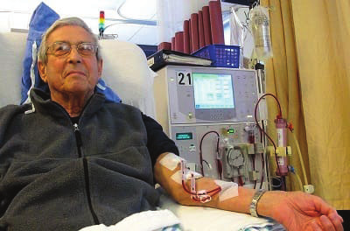
6
SOL-LO5
Dialysis: osmosis as treatment
Damaged kidneys cannot filter waste and extra water from the blood.
In haemodialysis, blood flows through tubing made of a semipermeable membrane, bathed in a sterile solution of water, glucose, amino acids and electrolytes.
Waste molecules and excess water cross the membrane; blood cells are too large and stay in the blood.
Sessions last hours and are repeated several times a week; a transplant is the permanent solution.
A patient undergoing haemodialysis, Figure 9.4.3 (Ball, The Basics of GOB Chemistry 9.4)
PHD115 · Solution
Dr. NAM · Faculty of Pharmacy, UiTM Bertam, Penang
Notes:
Ball 9.4, To Your Health: Dialysis.

Slide 84
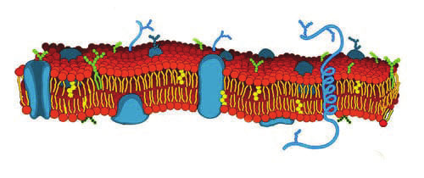
6
SOL-LO5
Diffusion and the cell membrane
The phospholipid bilayer of the plasma membrane, Figure 9.7.2 (Ball, The Basics of GOB Chemistry 9.7)
Diffusion: molecules move from high to low concentration (down the concentration gradient) until it is even. Osmosis is the diffusion of water.
The membrane is a bilayer of phospholipids: hydrophilic heads outside, hydrophobic tails inside. O₂, CO₂ and water cross; ions, glucose and proteins do not cross freely.
PHD115 · Solution
Dr. NAM · Faculty of Pharmacy, UiTM Bertam, Penang
Notes:
Ball 9.7. Passive transport needs no energy from the cell.

Slide 85
6
SOL-LO5
Try it · Lost at sea
Seawater has about three times the osmolarity of body fluids. Explain why a person in a lifeboat should not drink seawater.
Work it out, then check on the next slide.
PHD115 · Solution
Dr. NAM · Faculty of Pharmacy, UiTM Bertam, Penang

Slide 86
6
SOL-LO5
Try it · Lost at sea · answer
Seawater has about three times the osmolarity of body fluids. Explain why a person in a lifeboat should not drink seawater.
Answer
Seawater is hypertonic to body fluids. Water moves by osmosis from the cells (lower osmolarity) into the salty fluid (higher osmolarity), so the cells lose water and the person becomes even more dehydrated and thirsty.
PHD115 · Solution
Dr. NAM · Faculty of Pharmacy, UiTM Bertam, Penang

Slide 87
6
SOL-LO5
Quick check
Red blood cells are placed in a solution and swell until they burst. The solution was:
A isotonic
B hypertonic
C hypotonic
D saturated
PHD115 · Solution
Dr. NAM · Faculty of Pharmacy, UiTM Bertam, Penang

Slide 88
6
SOL-LO5
Quick check · answer
Red blood cells are placed in a solution and swell until they burst. The solution was:
A isotonic
B hypertonic
C hypotonic
D saturated
Answer C. In a hypotonic solution water moves into the cells, which swell and undergo haemolysis.
PHD115 · Solution
Dr. NAM · Faculty of Pharmacy, UiTM Bertam, Penang

Slide 89
Summary: key rules
Solubility | like dissolves like · saturated = at the limit
Percent | % m/m · % v/v · % m/v = g per 100 mL
ppm / ppb | × 10⁶ / × 10⁹ · 1 ppm ≈ 1 mg/L
Molarity | M = mol ÷ L · mol = M × L
Dilution | M₁V₁ = M₂V₂
Colligative | depend on particle number · +0.5 °C bp, −1.9 °C fp per mol/L
Osmosis | osmol = M × i · water → higher osmolarity · IV = isotonic
PHD115 · Solution
Dr. NAM · Faculty of Pharmacy, UiTM Bertam, Penang
Notes:
These rules are the basis of the tutorial and exam questions.

Slide 90
Before the next topic
1
Do the After class activity in the Study Hub (about 25 minutes).
2
Try the Tutorial: exam-style questions with full worked solutions.
3
Revise all five of Dr. NAM's topics with the Study Hub before the final assessment.
Core reference: The Basics of GOB Chemistry (Ball, Hill & Scott), LibreTexts, CC BY-NC-SA 3.0: sections 9.0–9.4 and 9.7, including the photographs and figures reproduced from those sections. Saturation, osmosis and particle diagrams drawn by Dr. NAM. Shared under the same licence for non-commercial teaching.
PHD115 · Solution
Dr. NAM · Faculty of Pharmacy, UiTM Bertam, Penang
Notes:
Point students to the Study Hub.

Slide 91
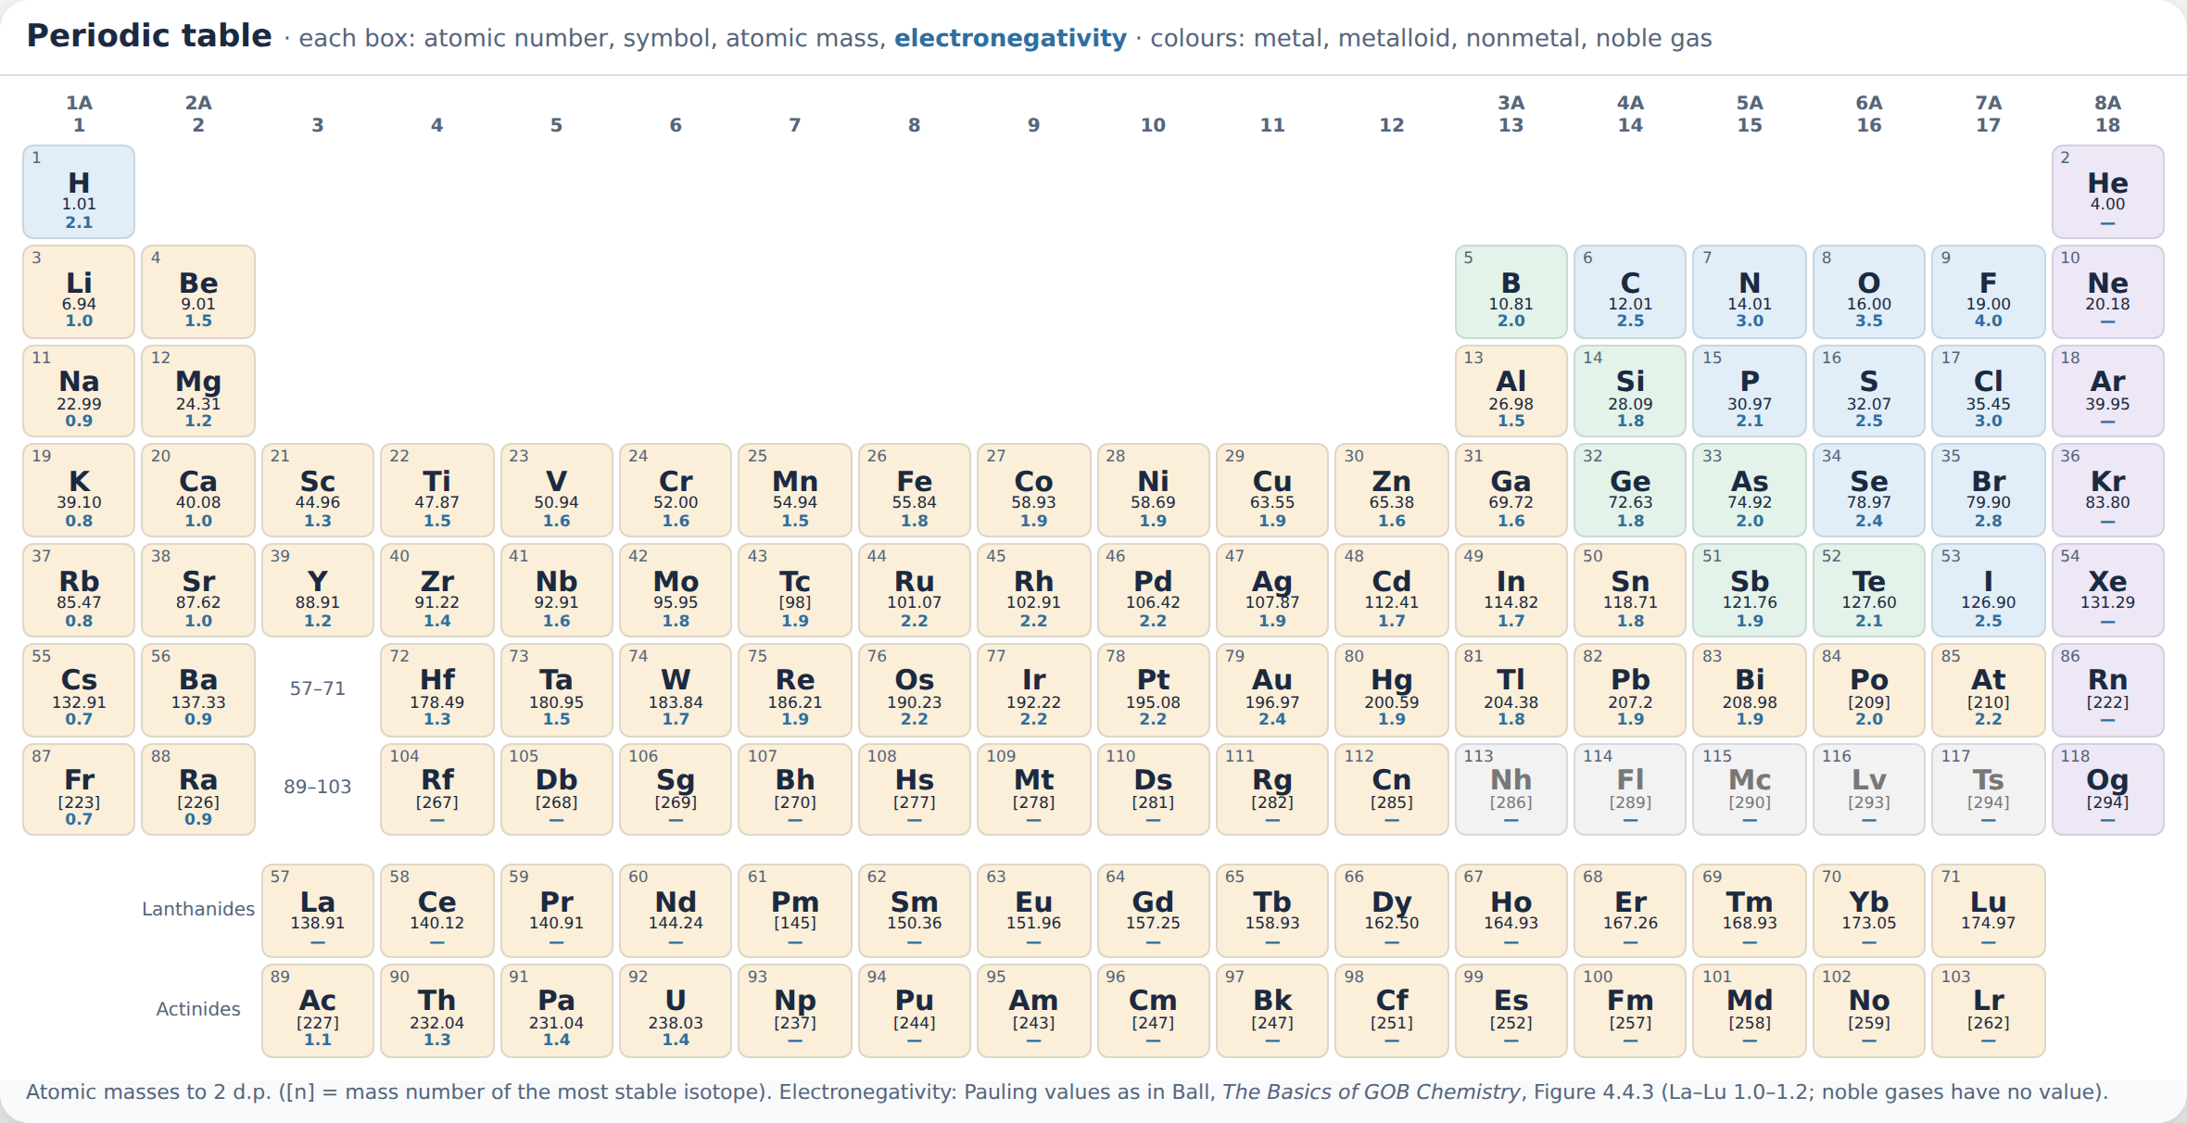
Appendix · Periodic table
PHD115 · Solution
Dr. NAM · Faculty of Pharmacy, UiTM Bertam, Penang

