Slide 1
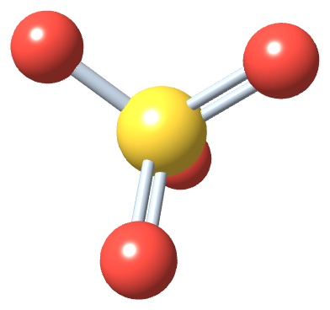
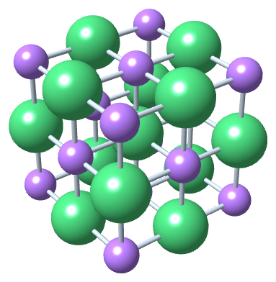
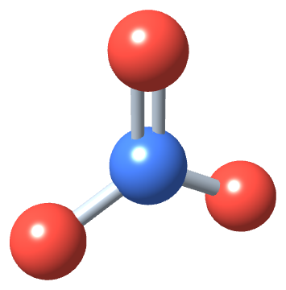
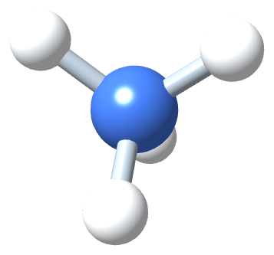
PHD115 Fundamentals of Chemistry
Ionic & Covalent Compounds I
Week of 19 Oct 2026 · Dr. Nur 'Ainun Mokhtar (NAM)
Core reference: Ball, Hill & Scott, The Basics of GOB Chemistry, chapter 3 (3.0–3.6)
PHD115 · Ionic & Covalent I
Notes:
This lecture follows chapter 3 of the core reference, section by section: two types of bonding, ions, formulas, naming, formula mass, and the properties of ionic compounds.

Slide 2
Learning outcomes
IC1-LO1
IC1-LO2
Define the octet rule and describe how ionic bonds form
Describe cations and anions, use Lewis diagrams to show ion formation, and predict ionic charges
IC1-LO3
IC1-LO4
Write formulas for ionic compounds, including those with polyatomic ions, and recognise ionic compounds
Name ions and ionic compounds using the Stock and common systems
IC1-LO5
IC1-LO6
Calculate the formula mass of ionic compounds, including hydrates
Describe the physical properties of ionic compounds and write dissociation equations
PHD115 · Ionic & Covalent I
Notes:
The same six outcomes appear in the notes, activities, tutorial, game and exam questions.

Slide 3
Lecture map
Part 1 · Two types of bonding (Ball 3.1): the octet rule, ionic and covalent bonds
Part 2 · Ions (Ball 3.2): cations and anions, electron transfer, Lewis diagrams, predicting charges
Part 3 · Formulas for ionic compounds (Ball 3.3): charge balance, crossing charges, polyatomic ions
Part 4 · Ionic nomenclature (Ball 3.4): naming ions and compounds, Stock and common systems
Part 5 · Formula mass (Ball 3.5): adding atomic masses, hydrates
Part 6 · Characteristics of ionic compounds (Ball 3.6): melting, shattering, conductivity
PHD115 · Ionic & Covalent I
Notes:
Six parts, in the book's order. Covalent bonding is the main subject of IC2 next week.

Slide 4
THINK FIRST
Sodium is a reactive metal and chlorine is a poisonous gas. So why is sodium chloride safe to eat and put into IV drips?
Discuss with a partner for one minute.
PHD115 · Ionic & Covalent I
Notes:
Based on the chapter 3 introduction. Pairs discuss for one minute.

Slide 5
THINK FIRST · ANSWER
Sodium is a reactive metal and chlorine is a poisonous gas. So why is sodium chloride safe to eat and put into IV drips?
When sodium and chlorine combine, they form ions with stable octets. The compound's properties are completely different from those of the elements. Parts 1 and 2 explain how.
PHD115 · Ionic & Covalent I
Notes:
Based on the chapter 3 introduction. Pairs discuss for one minute.

Slide 6
Salt: from salary to saline
Two thousand years ago Roman soldiers were partly paid in salt, which is why salt and salary share a Latin root (salarium).
Table salt is sodium chloride (NaCl), a simple compound of two elements the body needs. Sodium is important for nerve conduction and fluid balance.
Human blood is about a 0.9% NaCl solution, and normal saline (0.9% NaCl) is given intravenously in hospitals.
Too much salt is unhealthy. The RDI of sodium is 2400 mg (about 1 teaspoon of salt), but many people eat more, because salt is added to prepared foods.
Salt substitutes use potassium instead of sodium; some people find them slightly bitter.
PHD115 · Ionic & Covalent I
Notes:
Ball 3.0 Prelude. Pharmacy link: normal saline, and potassium chloride salt substitutes are relevant for patients on some antihypertensives.

Slide 7
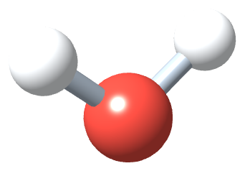
1
PART 1
Two types of bonding
Why atoms bond at all, and the two ways they reach a stable octet.
IC1-LO1 · Ball 3.1
PHD115 · Ionic & Covalent I
Notes:
Part 1 = section 3.1.

Slide 8
1
IC1-LO1
The octet rule
A chemical bond is a very strong attraction between two atoms. It forms when electrons interact to give an arrangement more stable than the separate atoms.
Clue: the noble gases (He, Ne, Ar, Kr, Xe, Rn) rarely form compounds, so they are especially stable as single atoms.
Except helium, they all have eight valence electrons.
Octet rule: atoms are especially stable with eight electrons in their outermost shell. This is the key to why compounds form.
Small atoms (H, He, Li) have only the first shell, which holds two electrons: they follow a duet rule.
Did you know?
Of the noble gases, only krypton, xenon and radon have ever been made to form compounds.
PHD115 · Ionic & Covalent I
Notes:
Ball 3.1.

Slide 9
1
IC1-LO1
Two ways to reach an octet
An atom without an octet can get one by transferring or by sharing electrons.
Transfer → ionic bond
Sharing → covalent bond
Electrons move from one atom to another until all have octets
Atoms that lose electrons become positive; atoms that gain electrons become negative
Charged atoms are ions
Opposite charges attract: this is an ionic bond, giving an ionic compound
Total number of electrons is unchanged
Atoms share electrons
Shared electrons occupy the outer shell of both atoms at once
The bond is a covalent bond
Main subject of IC2 next week
PHD115 · Ionic & Covalent I
Notes:
Ball 3.1. This chapter focuses on the transfer route.

Slide 10
1
IC1-LO1
Example 1.1 · Lose one or gain seven?
A sodium atom has one valence electron. Is it more likely to lose one electron or gain seven to obtain an octet?
1
Either is possible, but losing one electron is far easier than gaining seven.
2
Sodium atom: 11 protons (11+), 11 electrons (11−), overall charge 0
3
Sodium ion: 11 protons (11+), 10 electrons (10−), overall charge 1+, written Na⁺
PHD115 · Ionic & Covalent I
Notes:
Ball Example 3.1.1.

Slide 11
1
IC1-LO1
Try it · Fluorine
A fluorine atom has seven valence electrons. Is it more likely to lose seven electrons or gain one to obtain an octet? Write the formula of the resulting ion.
Work it out, then check on the next slide.
PHD115 · Ionic & Covalent I
Notes:
Ball Exercise 3.1.1.

Slide 12
1
IC1-LO1
Try it · Fluorine · answer
A fluorine atom has seven valence electrons. Is it more likely to lose seven electrons or gain one to obtain an octet? Write the formula of the resulting ion.
Answer
The process involving fewer electrons is more favourable: fluorine gains one electron.
The ion is F⁻.
PHD115 · Ionic & Covalent I
Notes:
Ball Exercise 3.1.1.

Slide 13
1
IC1-LO1
Key takeaways: two types of bonding
Atoms tend to have eight electrons in their valence shell (the octet rule).
The attraction between oppositely charged ions makes ionic bonds.
An ionic compound is unlikely to contain two positive ions, or two negative ions, because like charges repel.
Check yourself: calcium (2 valence electrons) loses 2 → Ca²⁺; aluminium (3) loses 3 → Al³⁺; selenium (6) gains 2 → Se²⁻; iodine (7) gains 1 → I⁻.
PHD115 · Ionic & Covalent I
Notes:
Ball 3.1 Key Takeaways, plus end-of-section exercises 3 to 8 as quick checks.

Slide 14
1
IC1-LO1
Quick check
Why is an ionic compound unlikely to consist of two positively charged ions?
A Positive ions have no electrons
B Like charges repel each other
C Positive ions are always too large
D It would break the octet rule
PHD115 · Ionic & Covalent I
Notes:
Answer B.

Slide 15
1
IC1-LO1
Quick check · answer
Why is an ionic compound unlikely to consist of two positively charged ions?
A Positive ions have no electrons
B Like charges repel each other
C Positive ions are always too large
D It would break the octet rule
Answer B. Ionic bonds come from the attraction of opposite charges. Two positive ions repel.
PHD115 · Ionic & Covalent I
Notes:
Answer B.

Slide 16
2
PART 2
Ions
How atoms become ions, how to draw it, and how the periodic table predicts the charge.
IC1-LO2 · Ball 3.2
PHD115 · Ionic & Covalent I
Notes:
Part 2 = section 3.2.

Slide 17
2
IC1-LO2
Two types of ions
Most atoms do not have eight valence electrons, so they gain or lose electrons.
Cations (CAT-eye-ons)
Anions (ANN-eye-ons)
Atoms with three or fewer valence electrons lose them easily
What remains is a lower shell with an octet
Fewer electrons than protons: positive charge
Most metals become cations
Atoms with nearly eight valence electrons gain electrons
They now have more electrons than protons: negative charge
Most nonmetals become anions
PHD115 · Ionic & Covalent I
Notes:
Ball 3.2. Pronunciation note from the book.

Slide 18
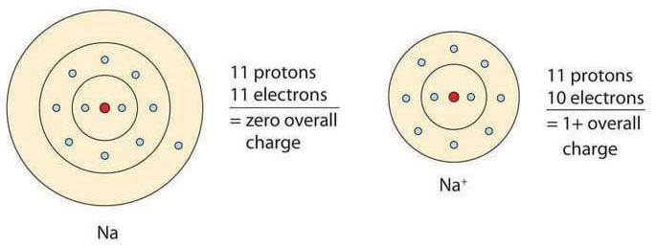
2
IC1-LO2
Electron transfer: forming the sodium ion
The formation of a sodium ion (Ball, The Basics of GOB Chemistry Figure 3.2.1)
Na: 1s² 2s²2p⁶ 3s¹. One valence electron in the third energy level.
Losing it gives Na⁺, the sodium ion: 1s² 2s²2p⁶, an octet in the second level.
Na⁺ has the same configuration as neon. Species with the same electron configuration are isoelectronic.
PHD115 · Ionic & Covalent I
Notes:
Ball 3.2 'Electron Transfer'.

Slide 19
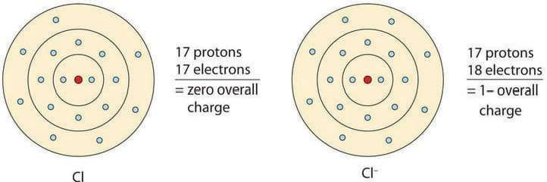
2
IC1-LO2
Electron transfer: forming the chloride ion
The formation of a chloride ion (Ball, The Basics of GOB Chemistry Figure 3.2.2)
Cl: 1s² 2s²2p⁶ 3s²3p⁵. It needs only one more electron.
Gaining one gives Cl⁻, the chloride ion. Note the suffix change: chlorine → chloride.
In table salt, this electron comes from the sodium atom.
PHD115 · Ionic & Covalent I
Notes:
Ball 3.2.

Slide 20

2
IC1-LO2
Sodium + chlorine → sodium chloride
Ball, The Basics of GOB Chemistry 3.2
The oppositely charged ions attract: this is the compound sodium chloride.
No electrons are left over. Electrons lost by Na (one) = electrons gained by Cl (one), so the compound is electrically neutral.
A real sample holds billions of ions, but always the same number of cations and anions.
PHD115 · Ionic & Covalent I
Notes:
Ball 3.2.

Slide 21
2
IC1-LO2
Example 2.1 · Aluminium
Write the electron configuration of an aluminium atom (Z = 13). How many electrons must Al lose or gain to achieve an octet? Write the resulting ion and its configuration.
1
Al: 1s² 2s²2p⁶ 3s²3p¹. The second shell already has an octet; the valence shell has 3 electrons.
2
Al achieves an octet by losing the 3 valence electrons.
3
The ion is Al³⁺: 1s² 2s²2p⁶.
PHD115 · Ionic & Covalent I
Notes:
Ball Example 3.2.1. The book's solution says 'Mg can achieve octet'; it should read Al.

Slide 22
2
IC1-LO2
Try it · Oxygen
Write the electron configuration of an oxygen atom (Z = 8). How many electrons must O lose or gain? Write the resulting ion and its configuration.
Work it out, then check on the next slide.
PHD115 · Ionic & Covalent I
Notes:
Ball Exercise 3.2.1.

Slide 23
2
IC1-LO2
Try it · Oxygen · answer
Write the electron configuration of an oxygen atom (Z = 8). How many electrons must O lose or gain? Write the resulting ion and its configuration.
Answer
O: 1s² 2s²2p⁴. The second shell has six electrons and needs two more.
Oxygen gains 2 electrons → O²⁻: 1s² 2s²2p⁶.
PHD115 · Ionic & Covalent I
Notes:
Ball Exercise 3.2.1.

Slide 24
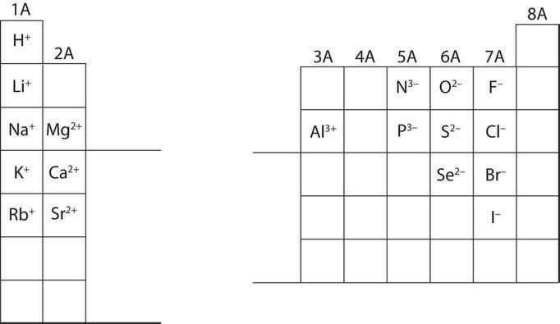
2
IC1-LO2
Predicting ionic charges
Elements in the same group usually form ions with the same charge, because they have the same number of valence electrons.
Group 1A (alkali metals): 1+. Group 2A (alkaline earth metals): 2+. Group 3A: 3+.
Group 7A (halogens): 1−. Group 6A: 2−. Group 5A: 3−.
Write the number first, then the sign: Ba²⁺, not Ba⁺².
Predicting ionic charges (Ball, The Basics of GOB Chemistry Figure 3.2.3)
PHD115 · Ionic & Covalent I
Notes:
Ball 3.2, Figure 3.2.3.

Slide 25
2
IC1-LO2
Example 2.2 · Which ion is not likely to form?
(a) Mg⁺ (b) K⁺
1
Mg is in Group 2A with two valence electrons. It reaches an octet by losing two electrons: Mg²⁺.
2
Losing only one (Mg⁺) does not give an octet, so Mg⁺ is not likely. K⁺ (Group 1A) is fine.
PHD115 · Ionic & Covalent I
Notes:
Ball Example 3.2.2.

Slide 26
2
IC1-LO2
Try it · Which ion is not likely to form?
(a) S³⁻ (b) N³⁻
Work it out, then check on the next slide.
PHD115 · Ionic & Covalent I
Notes:
Ball Exercise 3.2.2.

Slide 27
2
IC1-LO2
Try it · Which ion is not likely to form? · answer
(a) S³⁻ (b) N³⁻
Answer
S is in Group 6A with six valence electrons: it reaches an octet by gaining two (S²⁻).
Gaining three does not give an octet, so S³⁻ is not likely. N³⁻ (Group 5A) is fine.
PHD115 · Ionic & Covalent I
Notes:
Ball Exercise 3.2.2.

Slide 28

2
IC1-LO2
Lewis diagrams
Building the Lewis diagram of fluorine one dot at a time (Ball, The Basics of GOB Chemistry 3.2)
Lewis electron dot diagrams show only the valence electrons, as dots around the symbol (after Gilbert N. Lewis).
Up to two dots on each side (top, bottom, left, right).
Place the first four dots singly, one per side, then pair them up. Which side you start on does not matter.
PHD115 · Ionic & Covalent I
Notes:
Ball 3.2 'Lewis Diagrams'.

Slide 29
2
IC1-LO2
Lewis diagrams of the second period
Lewis diagrams of lithium through neon (Ball, The Basics of GOB Chemistry Figure 3.2.4)
For main-group elements, the number of valence electrons equals the group number (1A → 1 dot, 7A → 7 dots).
Neon has a full octet: eight dots, all paired.
Elements in the same column have the same Lewis diagram pattern (Li and Na; F, Cl and Br).
PHD115 · Ionic & Covalent I
Notes:
Ball Figure 3.2.4.

Slide 30

2
IC1-LO2
Example 2.3 · Forming LiBr with Lewis diagrams
Starting with lithium and bromine atoms, use Lewis diagrams to show the formation of LiBr.
1
Li is in the same column as Na, so it has one dot. Br is in the same column as Cl, so it has seven.
Ball, The Basics of GOB Chemistry Example 3.2.3
2
Li transfers its electron to Br: Li⁺ + Br⁻ (bromide now has an octet).
3
In the final formula the dots are omitted: LiBr.
PHD115 · Ionic & Covalent I
Notes:
Ball Example 3.2.3.

Slide 31
2
IC1-LO2
Try it · Forming MgO
Starting with magnesium and oxygen atoms, use Lewis diagrams to show the formation of MgO.
Work it out, then check on the next slide.
PHD115 · Ionic & Covalent I
Notes:
Ball Exercise 3.2.3; the book's answer figure shows Mg· transferring two electrons to O.

Slide 32

2
IC1-LO2
Try it · Forming MgO · answer
Starting with magnesium and oxygen atoms, use Lewis diagrams to show the formation of MgO.
Answer
Mg (2 dots) transfers both electrons to O (6 dots): Mg²⁺ + O²⁻ → MgO. The oxide ion now has an octet.
Ball, The Basics of GOB Chemistry Exercise 3.2.3 answer
PHD115 · Ionic & Covalent I
Notes:
Ball Exercise 3.2.3; the book's answer figure shows Mg· transferring two electrons to O.

Slide 33
2
IC1-LO2
Charge balance: forming MgBr₂
Ball, The Basics of GOB Chemistry 3.2
Some compounds need different numbers of cations and anions. Electron transfer then involves more than two atoms.
Mg gives one electron to each of two Br atoms: one Mg²⁺ balances two Br⁻.
Total charge = zero: this is charge balance. The number of each ion appears as the subscript: MgBr₂.
PHD115 · Ionic & Covalent I
Notes:
Ball 3.2.

Slide 34
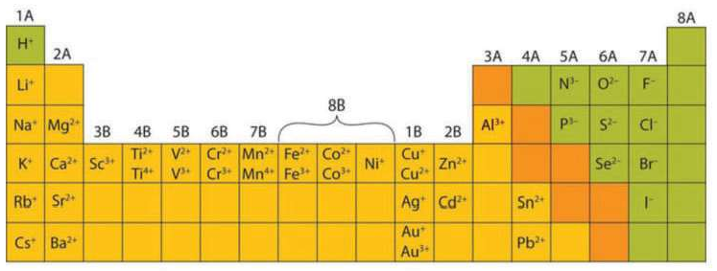
2
IC1-LO2
Charges of the monatomic ions
Most elements that form ionic compounds have a characteristic charge: Na always 1+, Cl always 1−.
Main-group charges follow the group pattern.
Transition metals (and larger main-group elements) can form ions of more than one charge, e.g. Fe²⁺/Fe³⁺, Cu⁺/Cu²⁺. There is no simple pattern: learn them.
Charges of the monatomic ions (Ball, The Basics of GOB Chemistry Figure 3.2.5)
PHD115 · Ionic & Covalent I
Notes:
Ball Figure 3.2.5.

Slide 35
2
IC1-LO2
Key takeaways: ions
Ions can be positively charged (cations) or negatively charged (anions).
A Lewis diagram shows how electrons are transferred to make ions and ionic compounds.
Check yourself: Li → Li⁺; S → S²⁻; Ca → Ca²⁺; F → F⁻.
Neither cation nor anion: neutral molecules such as NH₃, O₂, CH₄ and CS₂.
PHD115 · Ionic & Covalent I
Notes:
Ball 3.2 Key Takeaways and exercises 3–5.

Slide 36
2
IC1-LO2
Quick check
Which ion is isoelectronic with neon?
A K⁺
B Mg²⁺
C Cl⁻
D S²⁻
PHD115 · Ionic & Covalent I
Notes:
Answer B.

Slide 37
2
IC1-LO2
Quick check · answer
Which ion is isoelectronic with neon?
A K⁺
B Mg²⁺
C Cl⁻
D S²⁻
Answer B. Mg²⁺ has 10 electrons (1s²2s²2p⁶), like neon. K⁺, Cl⁻ and S²⁻ are isoelectronic with argon.
PHD115 · Ionic & Covalent I
Notes:
Answer B.

Slide 38
3
PART 3
Formulas for ionic compounds
Writing correct formulas, including compounds that contain polyatomic ions.
IC1-LO3 · Ball 3.3
PHD115 · Ionic & Covalent I
Notes:
Part 3 = section 3.3.

Slide 39
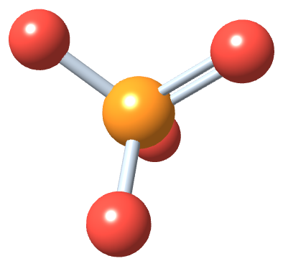
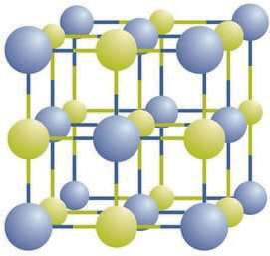
3
IC1-LO3
Ionic crystals and formula units
A chemical formula is a concise list of the elements in a compound and their ratios.
Ionic compounds exist as alternating positive and negative ions in regular 3D arrays called crystals.
There are no separate 'particles': each ion is surrounded by ions of opposite charge.
NaCl has a 1:1 ratio, so its formula is NaCl. One NaCl pair is a formula unit.
A sodium chloride crystal (Ball, The Basics of GOB Chemistry Figure 3.3.1)
PHD115 · Ionic & Covalent I
Notes:
Ball 3.3.

Slide 40
3
IC1-LO3
Rules for writing ionic formulas
Write the cation first, then the anion (usually metal, then nonmetal).
No charges are written in the formula, even though the particles are ions.
The formula must have charge balance: total positive charge = total negative charge (matter is electrically neutral).
No subscript means one; we never write 1.
Use the lowest whole-number ratio. LiBr: 1+ and 1−. MgO: 2+ and 2−. MgCl₂: one Mg²⁺ needs two Cl⁻. (Cl₂ here means two chloride ions, not a chlorine molecule.)
Exception
Lowest ratios are the rule, but a few ions break it, e.g. the mercury(I) ion, Hg₂²⁺.
PHD115 · Ionic & Covalent I
Notes:
Ball 3.3.

Slide 41
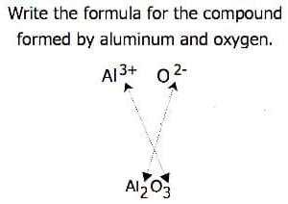
3
IC1-LO3
Crossing charges
When the ratio is not obvious, cross the charges: the size of each ion's charge becomes the other ion's subscript.
Al³⁺ and O²⁻ → Al₂O₃ (2 × 3+ = 6+; 3 × 2− = 6−).
Sometimes reduce afterwards: Pb⁴⁺ and O²⁻ → Pb₂O₄ → PbO₂.
Crossing charges (Ball, The Basics of GOB Chemistry Figure 3.3.2)
PHD115 · Ionic & Covalent I
Notes:
Ball 3.3, Figure 3.3.2.

Slide 42
3
IC1-LO3
Example 3.1 · Writing ionic formulas
Write the formula for the compound of: (a) the sodium ion and the sulfur ion (b) the aluminium ion and the fluoride ion (c) the 3+ iron ion and the oxygen ion
1
(a) Na⁺ and S²⁻: two 1+ ions balance one 2− → Na₂S
2
(b) Al³⁺ and F⁻: three 1− ions balance one 3+ → AlF₃
3
(c) Fe³⁺ and O²⁻: least common multiple 6 → two Fe³⁺ (6+) and three O²⁻ (6−) → Fe₂O₃
PHD115 · Ionic & Covalent I
Notes:
Ball Example 3.3.1.

Slide 43
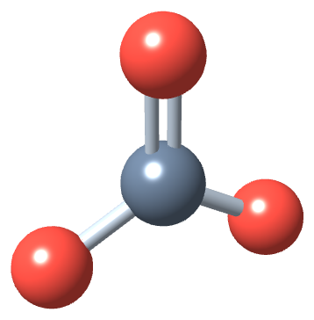
3
IC1-LO3
Try it · Writing ionic formulas
Write the formula for the compound of: (a) the calcium ion and the oxygen ion (b) the 2+ copper ion and the sulfur ion (c) the 1+ copper ion and the sulfur ion
Work it out, then check on the next slide.
PHD115 · Ionic & Covalent I
Notes:
Ball Exercise 3.3.1.

Slide 44
3
IC1-LO3
Try it · Writing ionic formulas · answer
Write the formula for the compound of: (a) the calcium ion and the oxygen ion (b) the 2+ copper ion and the sulfur ion (c) the 1+ copper ion and the sulfur ion
Answer
(a) CaO (b) CuS (c) Cu₂S
PHD115 · Ionic & Covalent I
Notes:
Ball Exercise 3.3.1.

Slide 45
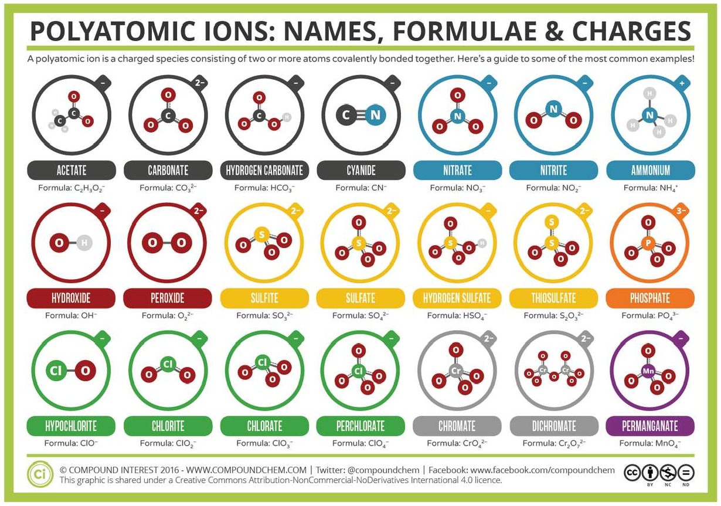
3
IC1-LO3
Polyatomic ions
Some ions are groups of atoms covalently bonded together with an overall charge: polyatomic ions.
Their formulas, names and charges are fixed and cannot be changed.
They must be memorised.
Polyatomic ions: names, formulae and charges (© Compound Interest, CC BY-NC-ND, as in Ball 3.3)
PHD115 · Ionic & Covalent I
Notes:
Ball 3.3 'Polyatomic Ions'.

Slide 46
3
IC1-LO3
Common polyatomic ions
Ion name | Formula | Ion name | Formula
ammonium | NH₄⁺ | nitrate | NO₃⁻
hydroxide | OH⁻ | nitrite | NO₂⁻
cyanide | CN⁻ | sulfate | SO₄²⁻
carbonate | CO₃²⁻ | sulfite | SO₃²⁻
bicarbonate (hydrogen carbonate) | HCO₃⁻ | phosphate | PO₄³⁻
acetate | C₂H₃O₂⁻ or CH₃CO₂⁻ | phosphite | PO₃³⁻
Source: Ball Table 3.3.2. Only ammonium is a cation.
PHD115 · Ionic & Covalent I
Notes:
Ball Table 3.3.2.

Slide 47
3
IC1-LO3
Naming patterns: -ide, -ate and -ite
Only ammonium, NH₄⁺, is a cation; the rest are anions.
Only hydroxide and cyanide use the usual -ide ending.
The oxygen-containing anions come in series. The -ate ion has one more oxygen than the -ite ion: nitrate NO₃⁻ vs nitrite NO₂⁻; sulfate SO₄²⁻ vs sulfite SO₃²⁻.
The endings are only relative: nitrate has three O but sulfate has four, and nitrate and sulfite both have three. So the formulas must be learnt.
Sulfate ion, SO₄²⁻
PHD115 · Ionic & Covalent I
Notes:
Ball 3.3.

Slide 48
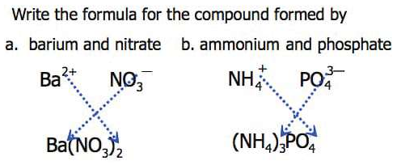
3
IC1-LO3
Formulas with polyatomic ions
Same rule as before: positive and negative charges must balance.
If more than one polyatomic ion is needed, put the whole ion in parentheses with the subscript outside.
Ba²⁺ and NO₃⁻ → Ba(NO₃)₂
NH₄⁺ and PO₄³⁻ → (NH₄)₃PO₄
Ball, The Basics of GOB Chemistry 3.3
PHD115 · Ionic & Covalent I
Notes:
Ball 3.3.

Slide 49
3
IC1-LO3
Example 3.2 · Formulas with polyatomic ions
Write the formula for the compound of: (a) the potassium ion and the sulfate ion (b) the calcium ion and the nitrate ion
1
(a) K⁺ and SO₄²⁻: two K⁺ balance one 2− → K₂SO₄
2
(b) Ca²⁺ and NO₃⁻: two nitrates needed, in parentheses → Ca(NO₃)₂
PHD115 · Ionic & Covalent I
Notes:
Ball Example 3.3.2.

Slide 50
3
IC1-LO3
Try it · Formulas with polyatomic ions
Write the formula for the compound of: (a) the magnesium ion and the carbonate ion (b) the aluminium ion and the acetate ion
Work it out, then check on the next slide.
PHD115 · Ionic & Covalent I
Notes:
Ball Exercise 3.3.2.

Slide 51
3
IC1-LO3
Try it · Formulas with polyatomic ions · answer
Write the formula for the compound of: (a) the magnesium ion and the carbonate ion (b) the aluminium ion and the acetate ion
Answer
(a) Mg²⁺ + CO₃²⁻ → MgCO₃
(b) Al³⁺ + C₂H₃O₂⁻ → Al(C₂H₃O₂)₃
PHD115 · Ionic & Covalent I
Notes:
Ball Exercise 3.3.2.

Slide 52
3
IC1-LO3
Recognising ionic compounds
Metal + nonmetal compounds are usually ionic: CaBr₂ (Ca is a Group 2A metal, Br a Group 7A nonmetal).
Two nonmetals are usually not ionic: NO₂ is covalent (and, with no charge shown, it is not the nitrite ion).
If you recognise a polyatomic ion, the compound is ionic: in Ba(NO₃)₂, NO₃ is nitrate, so Ba is Ba²⁺.
PHD115 · Ionic & Covalent I
Notes:
Ball 3.3 'Recognizing Ionic Compounds'.

Slide 53
3
IC1-LO3
Example 3.3 · Ionic or not?
(a) Na₂O (b) PCl₃ (c) NH₄Cl (d) OF₂
1
(a) Na is a metal and O a nonmetal: ionic
2
(b) P and Cl are both nonmetals: not ionic
3
(c) NH₄ is the ammonium ion: ionic
4
(d) O and F are both nonmetals: not ionic
PHD115 · Ionic & Covalent I
Notes:
Ball Example 3.3.3.

Slide 54
3
IC1-LO3
Try it · Ionic or not?
(a) N₂O (b) FeCl₃ (c) (NH₄)₃PO₄ (d) SOCl₂
Work it out, then check on the next slide.
PHD115 · Ionic & Covalent I
Notes:
Ball Exercise 3.3.3.

Slide 55
3
IC1-LO3
Try it · Ionic or not? · answer
(a) N₂O (b) FeCl₃ (c) (NH₄)₃PO₄ (d) SOCl₂
Answer
(a) not ionic (b) ionic (c) ionic (d) not ionic
PHD115 · Ionic & Covalent I
Notes:
Ball Exercise 3.3.3.

Slide 56
3
IC1-LO3
Looking closer: blood and seawater
A 0.9% NaCl solution approximates blood; seawater is about 3% NaCl, over three times more concentrated.
Ion | % in seawater | % in blood
Na⁺ | 2.36 | 0.322
Cl⁻ | 1.94 | 0.366
Mg²⁺ | 0.13 | 0.002
SO₄²⁻ | 0.09 | —
K⁺ | 0.04 | 0.016
Ca²⁺ | 0.04 | 0.0096
HCO₃⁻ | 0.002 | 0.165
HPO₄²⁻, H₂PO₄⁻ | — | 0.01
Note
Blood has far more bicarbonate and phosphate ions, which control the acid–base balance of blood. Pharmacy link: IV fluids and bicarbonate infusions are designed around these ions.
Source: Ball 3.3 'Looking Closer'.
PHD115 · Ionic & Covalent I
Notes:
Ball 3.3 Looking Closer.

Slide 57
3
IC1-LO3
Quick check
What is the correct formula for the compound of Ca²⁺ and PO₄³⁻?
A CaPO₄
B Ca₂(PO₄)₃
C Ca₃(PO₄)₂
D Ca₃PO₄
PHD115 · Ionic & Covalent I
Notes:
Answer C.

Slide 58
3
IC1-LO3
Quick check · answer
What is the correct formula for the compound of Ca²⁺ and PO₄³⁻?
A CaPO₄
B Ca₂(PO₄)₃
C Ca₃(PO₄)₂
D Ca₃PO₄
Answer C. Three Ca²⁺ (6+) balance two PO₄³⁻ (6−); the phosphate goes in parentheses.
PHD115 · Ionic & Covalent I
Notes:
Answer C.

Slide 59
4
PART 4
Ionic nomenclature
The systematic rules for naming ions and ionic compounds.
IC1-LO4 · Ball 3.4
PHD115 · Ionic & Covalent I
Notes:
Part 4 = section 3.4.

Slide 60
4
IC1-LO4
Naming cations
A monatomic cation takes the element name + ion: Na⁺ sodium ion, Al³⁺ aluminium ion, Ca²⁺ calcium ion.
Some elements form ions of different charges (e.g. Fe²⁺, Fe³⁺), which make different compounds, so each needs its own name.
Stock system (modern): the charge as a Roman numeral in brackets. Fe²⁺ = iron(II) ion; Fe³⁺ = iron(III) ion.
Use Roman numerals only for elements with more than one common charge: sodium ion, never 'sodium(I) ion'.
PHD115 · Ionic & Covalent I
Notes:
Ball 3.4 'Naming Ions'.

Slide 61
4
IC1-LO4
The common system of cation names
The older common system is still used in the health sciences: -ic = the higher charge, -ous = the lower charge, often on the Latin stem.
Element | Stem | Lower charge (-ous) | Higher charge (-ic)
iron | ferr- | Fe²⁺ ferrous | Fe³⁺ ferric
copper | cupr- | Cu⁺ cuprous | Cu²⁺ cupric
tin | stann- | Sn²⁺ stannous | Sn⁴⁺ stannic
lead | plumb- | Pb²⁺ plumbous | Pb⁴⁺ plumbic
chromium | chrom- | Cr²⁺ chromous | Cr³⁺ chromic
gold | aur- | Au⁺ aurous | Au³⁺ auric
Source: Ball Table 3.4.1. Pharmacy example: ferrous sulfate tablets are an iron supplement.
PHD115 · Ionic & Covalent I
Notes:
Ball Table 3.4.1.

Slide 62
4
IC1-LO4
Naming monatomic anions
Anion name = stem of the element + -ide + ion: Cl⁻ is chlor- + -ide → chloride ion.
Ion | Name | Ion | Name
F⁻ | fluoride ion | O²⁻ | oxide ion
Cl⁻ | chloride ion | S²⁻ | sulfide ion
Br⁻ | bromide ion | P³⁻ | phosphide ion
I⁻ | iodide ion | N³⁻ | nitride ion
Source: Ball Table 3.4.2. Polyatomic ions keep their own names.
PHD115 · Ionic & Covalent I
Notes:
Ball Table 3.4.2.

Slide 63
4
IC1-LO4
Example 4.1 · Naming ions
Name each ion: (a) Ca²⁺ (b) S²⁻ (c) SO₃²⁻ (d) NH₄⁺ (e) Cu⁺
1
(a) calcium ion (b) sulfide ion (c) sulfite ion (d) ammonium ion
2
(e) copper(I) ion or cuprous ion: copper can be 1+ or 2+, so the charge must be shown
PHD115 · Ionic & Covalent I
Notes:
Ball Example 3.4.1.

Slide 64
4
IC1-LO4
Try it · Naming ions
Name each ion: (a) Fe²⁺ (b) Fe³⁺ (c) SO₄²⁻ (d) Ba²⁺ (e) HCO₃⁻
Work it out, then check on the next slide.
PHD115 · Ionic & Covalent I
Notes:
Ball Exercise 3.4.1.

Slide 65
4
IC1-LO4
Try it · Naming ions · answer
Name each ion: (a) Fe²⁺ (b) Fe³⁺ (c) SO₄²⁻ (d) Ba²⁺ (e) HCO₃⁻
Answer
(a) iron(II) or ferrous ion (b) iron(III) or ferric ion (c) sulfate ion
(d) barium ion (e) bicarbonate or hydrogen carbonate ion
PHD115 · Ionic & Covalent I
Notes:
Ball Exercise 3.4.1.

Slide 66
4
IC1-LO4
Example 4.2 · Writing ion formulas
Write the formula for: (a) the bromide ion (b) the phosphate ion (c) the cupric ion (d) the magnesium ion
1
(a) Br⁻ (b) PO₄³⁻
2
(c) cupric = the higher copper charge → Cu²⁺ (d) Mg²⁺
PHD115 · Ionic & Covalent I
Notes:
Ball Example 3.4.2.

Slide 67
4
IC1-LO4
Try it · Writing ion formulas
Write the formula for: (a) the fluoride ion (b) the carbonate ion (c) the ferrous ion (d) the potassium ion
Work it out, then check on the next slide.
PHD115 · Ionic & Covalent I
Notes:
Ball Exercise 3.4.2.

Slide 68
4
IC1-LO4
Try it · Writing ion formulas · answer
Write the formula for: (a) the fluoride ion (b) the carbonate ion (c) the ferrous ion (d) the potassium ion
Answer
(a) F⁻ (b) CO₃²⁻ (c) Fe²⁺ (d) K⁺
PHD115 · Ionic & Covalent I
Notes:
Ball Exercise 3.4.2.

Slide 69
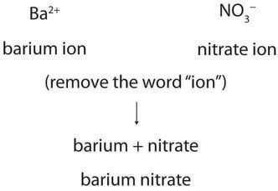
4
IC1-LO4
Naming ionic compounds
Cation name first, then anion name, and drop the word 'ion' from both: Ba(NO₃)₂ → barium nitrate.
The name does not say how many of each ion; you work that out from charge balance.
If the cation can have more than one charge, find its charge first: FeCl₂ has Fe²⁺ (two Cl⁻); FeCl₃ has Fe³⁺.
So FeCl₂ = iron(II) chloride (ferrous chloride) and FeCl₃ = iron(III) chloride (ferric chloride).
Ball, The Basics of GOB Chemistry 3.4
PHD115 · Ionic & Covalent I
Notes:
Ball 3.4 'Naming Compounds'.

Slide 70
4
IC1-LO4
Example 4.3 · Naming ionic compounds
Name each compound, using both Stock and common systems if necessary: (a) Ca₃(PO₄)₂ (b) (NH₄)₂Cr₂O₇ (c) KCl (d) CuCl (e) SnF₂
1
(a) calcium phosphate (b) ammonium dichromate (di- is part of the anion's name) (c) potassium chloride
2
(d) copper(I) chloride or cuprous chloride
3
(e) tin(II) fluoride or stannous fluoride
PHD115 · Ionic & Covalent I
Notes:
Ball Example 3.4.3. Pharmacy link: stannous fluoride is used in toothpastes.

Slide 71
4
IC1-LO4
Try it · Naming ionic compounds
Name each compound: (a) ZnBr₂ (b) Fe(NO₃)₃ (c) Al₂O₃ (d) CuF₂ (e) AgF
Work it out, then check on the next slide.
PHD115 · Ionic & Covalent I
Notes:
Ball Exercise 3.4.3.

Slide 72
4
IC1-LO4
Try it · Naming ionic compounds · answer
Name each compound: (a) ZnBr₂ (b) Fe(NO₃)₃ (c) Al₂O₃ (d) CuF₂ (e) AgF
Answer
(a) zinc bromide (b) iron(III) nitrate or ferric nitrate (c) aluminium oxide
(d) copper(II) fluoride or cupric fluoride (e) silver fluoride
PHD115 · Ionic & Covalent I
Notes:
Ball Exercise 3.4.3.

Slide 73
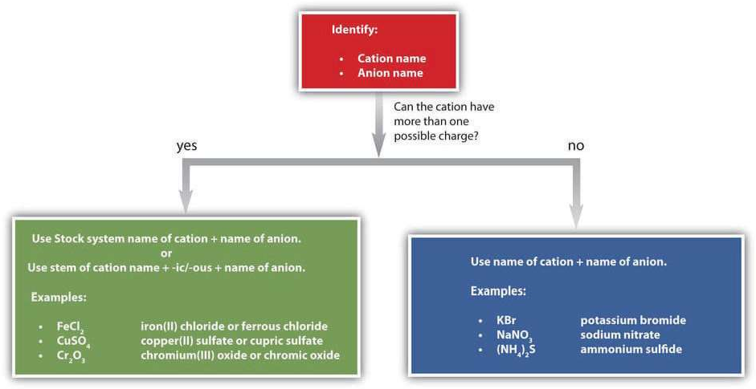
4
IC1-LO4
A guide to naming simple ionic compounds
Can the cation have more than one charge? Yes: Stock name or -ic/-ous name + anion, e.g. FeCl₂ iron(II) chloride, CuSO₄ copper(II) sulfate, Cr₂O₃ chromium(III) oxide.
No: cation name + anion name, e.g. KBr potassium bromide, NaNO₃ sodium nitrate, (NH₄)₂S ammonium sulfide.
A guide to naming simple ionic compounds (Ball, The Basics of GOB Chemistry Figure 3.4.1)
PHD115 · Ionic & Covalent I
Notes:
Ball Figure 3.4.1. Key takeaway: each ionic compound has its own unique name that comes from the names of its ions.

Slide 74
4
IC1-LO4
Quick check
What is the Stock name of Fe₂O₃?
A iron oxide
B iron(II) oxide
C iron(III) oxide
D diiron trioxide
PHD115 · Ionic & Covalent I
Notes:
Answer C.

Slide 75
4
IC1-LO4
Quick check · answer
What is the Stock name of Fe₂O₃?
A iron oxide
B iron(II) oxide
C iron(III) oxide
D diiron trioxide
Answer C. Three O²⁻ (6−) are balanced by two Fe, so each iron is 3+: iron(III) oxide (ferric oxide).
PHD115 · Ionic & Covalent I
Notes:
Answer C.

Slide 76
5
PART 5
Formula mass
Adding up atomic masses: a skill used again in Chemical Reactions and Solution.
IC1-LO5 · Ball 3.5
PHD115 · Ionic & Covalent I
Notes:
Part 5 = section 3.5.

Slide 77
5
IC1-LO5
What is formula mass?
The formula mass of an ionic compound is the sum of the masses of all the atoms in its formula.
A proper formula is electrically neutral, so the ions can be treated as atoms for this calculation.
Use atomic masses from the periodic table (here, to two decimal places), in amu.
NaCl: Na 22.99 + Cl 35.45 = 58.44 amu
PHD115 · Ionic & Covalent I
Notes:
Ball 3.5.

Slide 78
5
IC1-LO5
Example 5.1 · Using subscripts
Find the formula mass of (a) CaF₂ (b) KNO₃ (c) Ca(NO₃)₂
1
(a) Ca 1 × 40.08 + F 2 × 19.00 = 40.08 + 38.00 = 78.08 amu
2
(b) K 39.10 + N 14.01 + O 3 × 16.00 = 101.11 amu (KNO₃ is in gunpowder and has been used as a diuretic)
3
(c) The 2 outside the brackets doubles everything inside: Ca 40.08 + N 2 × 14.01 + O 6 × 16.00 = 40.08 + 28.02 + 96.00 = 164.10 amu
PHD115 · Ionic & Covalent I
Notes:
Ball 3.5 worked tables.

Slide 79
5
IC1-LO5
Example 5.2 · Formula mass
Determine the formula mass of (a) FeCl₃ (b) (NH₄)₃PO₄
1
(a) Fe 55.84 + Cl 3 × 35.45 = 55.84 + 106.35 = 162.19 amu
2
(b) Three NH₄⁺ = 3 N and 12 H: N 3 × 14.01 = 42.03; H 12 × 1.01 = 12.12
3
P 30.97; O 4 × 16.00 = 64.00. Total = 149.12 amu
PHD115 · Ionic & Covalent I
Notes:
Ball Example 3.5.1.

Slide 80
5
IC1-LO5
Try it · Formula mass
Determine the formula mass of (a) TiO₂ (b) AgBr (c) Au(NO₃)₃ (d) Fe₃(PO₄)₂
Work it out, then check on the next slide.
PHD115 · Ionic & Covalent I
Notes:
Ball Exercise 3.5.1.

Slide 81
5
IC1-LO5
Try it · Formula mass · answer
Determine the formula mass of (a) TiO₂ (b) AgBr (c) Au(NO₃)₃ (d) Fe₃(PO₄)₂
Answer
(a) 47.87 + 2(16.00) = 79.87 amu (b) 107.87 + 79.90 = 187.77 amu
(c) 196.97 + 3(14.01) + 9(16.00) = 383.00 amu (d) 3(55.84) + 2(30.97) + 8(16.00) = 357.46 amu
PHD115 · Ionic & Covalent I
Notes:
Ball Exercise 3.5.1.

Slide 82
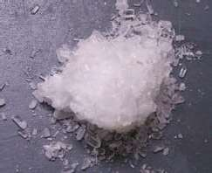
5
IC1-LO5
Hydrates
Some ionic compounds include water in their formula unit: hydrates. They are solids, not solutions.
Write the number of water units after the formula, separated by a centred dot: CuSO₄·5H₂O.
Name: copper(II) sulfate pentahydrate (penta- = five water units per formula unit).
Include the water in the formula mass: CuSO₄·5H₂O adds 5 × 18.02.
Magnesium sulfate heptahydrate, Epsom salt (Public Domain, Chemicalinterest; as in Ball 3.5)
PHD115 · Ionic & Covalent I
Notes:
Ball 3.5.

Slide 83
5
IC1-LO5
To your health: useful hydrates
Formula | Name | Uses
AlCl₃·6H₂O | aluminium chloride hexahydrate | antiperspirant
CaSO₄·½H₂O | calcium sulfate hemihydrate (plaster of Paris) | casts for broken bones, castings
CaSO₄·2H₂O | calcium sulfate dihydrate (gypsum) | drywall component
CoCl₂·6H₂O | cobalt(II) chloride hexahydrate | drying agent, humidity indicator
CuSO₄·5H₂O | copper(II) sulfate pentahydrate | fungicide, algicide, herbicide
MgSO₄·7H₂O | magnesium sulfate heptahydrate (Epsom salts) | laxative, bathing salt
Na₂CO₃·10H₂O | sodium carbonate decahydrate (washing soda) | laundry additive, cleaner
Source: Ball Table 3.5.1 (To Your Health: Hydrates).
PHD115 · Ionic & Covalent I
Notes:
Ball 3.5 To Your Health.

Slide 84
5
IC1-LO5
Quick check
What is the formula mass of MgCl₂? (Mg 24.31, Cl 35.45)
A 59.76 amu
B 95.21 amu
C 130.66 amu
D 84.21 amu
PHD115 · Ionic & Covalent I
Notes:
Answer B.

Slide 85
5
IC1-LO5
Quick check · answer
What is the formula mass of MgCl₂? (Mg 24.31, Cl 35.45)
A 59.76 amu
B 95.21 amu
C 130.66 amu
D 84.21 amu
Answer B. 24.31 + 2 × 35.45 = 95.21 amu.
PHD115 · Ionic & Covalent I
Notes:
Answer B.

Slide 86
6
PART 6
Characteristics of ionic compounds
Why ionic compounds are hard, brittle, high-melting, and conduct only when melted or dissolved.
IC1-LO6 · Ball 3.6
PHD115 · Ionic & Covalent I
Notes:
Part 6 = section 3.6.

Slide 87
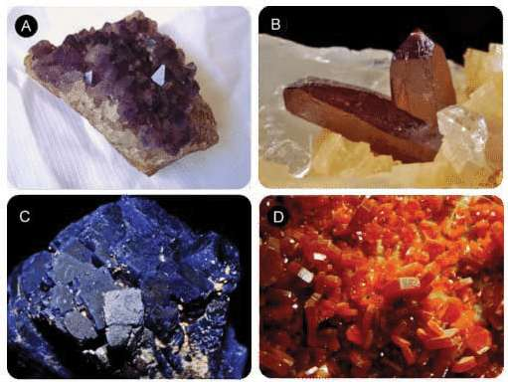
6
IC1-LO6
Ionic crystals in nature
The regular, orderly arrangement of ions in the lattice gives crystals their shapes; transition-metal ions give the colours.
(A) Amethyst: quartz, SiO₂, coloured purple by iron ions
(B) Cinnabar: mercury(II) sulfide, HgS, the main ore of mercury
(C) Azurite: a copper mineral, Cu₃(CO₃)₂(OH)₂
(D) Vanadinite: Pb₃(VO₄)₃Cl, the main ore of vanadium
Naturally occurring ionic crystals (Ball, The Basics of GOB Chemistry Figure 3.6.1)
PHD115 · Ionic & Covalent I
Notes:
Ball Figure 3.6.1.

Slide 88
6
IC1-LO6
High melting points
Each ion is attracted to many oppositely charged neighbours at once, so the crystal lattice is very strong.
Melting means breaking all those ionic attractions, which takes a large amount of energy.
Sodium chloride melts at about 800 °C. The molecular compound water melts at 0 °C.
Each Na⁺ (purple) is surrounded by Cl⁻ (green), and vice versa
PHD115 · Ionic & Covalent I
Notes:
Ball 3.6 'Melting Points'.

Slide 89
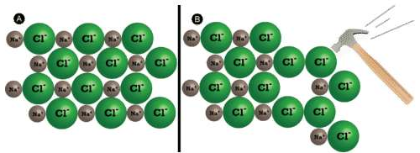
6
IC1-LO6
Hard but brittle
(A) NaCl in two dimensions. (B) A hammer blow forces chloride ions together (Ball, The Basics of GOB Chemistry Figure 3.6.2)
Ionic compounds are hard: a large force is needed to shift one layer of ions against the next.
But they are brittle: the shift brings like charges side by side, they repel, and the crystal shatters.
Crystals break along smooth planes because the ions are regularly arranged.
PHD115 · Ionic & Covalent I
Notes:
Ball 3.6 'Shattering'.

Slide 90
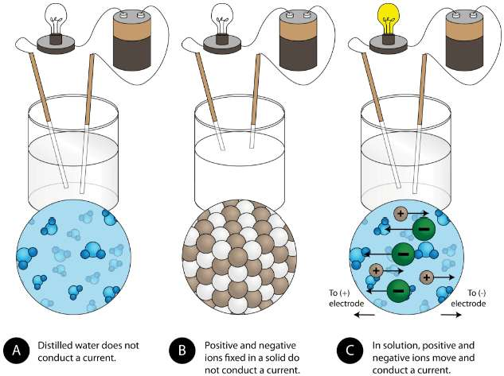
6
IC1-LO6
Electrical conductivity
(A) Distilled water does not conduct: water is a molecular compound.
(B) Solid NaCl does not conduct: the ions are locked in the lattice and cannot move.
(C) NaCl dissolved in water conducts well: the lattice breaks up and the ions move freely.
Melting an ionic compound also frees the ions to conduct.
(Ball, The Basics of GOB Chemistry Figure 3.6.3)
PHD115 · Ionic & Covalent I
Notes:
Ball 3.6.

Slide 91
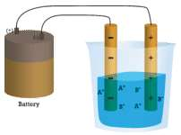
6
IC1-LO6
Ions move to the electrodes: dissociation
In solution, cations move to the negative electrode and anions to the positive electrode, so current flows.
Dissolving an ionic compound separates it into ions: dissociation.
NaCl(s) → Na⁺(aq) + Cl⁻(aq)
Dissolving ionic compounds is covered in Solution (Ball 9.3).
Ion migration in an ionic solution (Ball, The Basics of GOB Chemistry Figure 3.6.4)
PHD115 · Ionic & Covalent I
Notes:
Ball 3.6 and Example 3.6.1.

Slide 92
6
IC1-LO6
Try it · Dissociation
Write the dissociation equation of solid NH₄NO₃ in water.
Work it out, then check on the next slide.
PHD115 · Ionic & Covalent I
Notes:
Ball Exercise 3.6.1. Link: this is the instant cold pack compound from Energy & Matters.

Slide 93
6
IC1-LO6
Try it · Dissociation · answer
Write the dissociation equation of solid NH₄NO₃ in water.
Answer
NH₄NO₃(s) → NH₄⁺(aq) + NO₃⁻(aq)
The polyatomic ions stay intact.
PHD115 · Ionic & Covalent I
Notes:
Ball Exercise 3.6.1. Link: this is the instant cold pack compound from Energy & Matters.

Slide 94
6
IC1-LO6
Key takeaways: characteristics of ionic compounds
Ionic compounds have high melting points.
Ionic compounds are hard and brittle.
Ionic compounds dissociate into ions when dissolved in water.
Solutions and melts of ionic compounds conduct electricity; the solids do not.
An ionic compound can be identified by its formula: metal + nonmetal, or polyatomic ions.
Pharmacy link: many drugs are made as ionic salts (e.g. sodium or hydrochloride salts) because salts dissolve and dissociate well in water.
PHD115 · Ionic & Covalent I
Notes:
Ball 3.6 Key Takeaways, plus a pharmacy link.

Slide 95
6
IC1-LO6
Quick check
Under which condition does sodium chloride conduct electricity?
A As a solid crystal
B Only when mixed with distilled water that stays pure
C When dissolved in water or melted
D Never, because it is neutral
PHD115 · Ionic & Covalent I
Notes:
Answer C.

Slide 96
6
IC1-LO6
Quick check · answer
Under which condition does sodium chloride conduct electricity?
A As a solid crystal
B Only when mixed with distilled water that stays pure
C When dissolved in water or melted
D Never, because it is neutral
Answer C. Ions must be free to move. That happens only when the lattice is broken up by dissolving or melting.
PHD115 · Ionic & Covalent I
Notes:
Answer C.

Slide 97
Summary: key rules
Octet rule
atoms are most stable with 8 valence electrons (duet for H, He, Li)
Ions
metals lose electrons → cations; nonmetals gain → anions
Charge from group
1A 1+ · 2A 2+ · 3A 3+ · 5A 3− · 6A 2− · 7A 1−
Formulas
cation first · no charges shown · charges balance · lowest ratio · brackets for >1 polyatomic ion
Naming
cation + anion; Roman numeral (Stock) or -ous/-ic for variable-charge metals; anions end -ide
-ate vs -ite
-ate has one more O than -ite (nitrate NO₃⁻, nitrite NO₂⁻)
Formula mass
sum of all atomic masses × subscripts (include hydrate water)
Properties
high melting point · hard, brittle · conduct only when melted or dissolved
PHD115 · Ionic & Covalent I
Notes:
Everything here appears in the summary page of the notes.

Slide 98
Before next week
1
Complete the post-lecture activity (25 min)
2
Attempt the tutorial questions
3
Play the ion game to find your weak outcomes
4
Next week: Ionic & Covalent Compounds II
Adapted from The Basics of GOB Chemistry (Ball, Hill & Scott), LibreTexts, CC BY-NC-SA 3.0, sections 3.0–3.6. Polyatomic ion chart © Compound Interest (CC BY-NC-ND). Shared under the same licence for non-commercial teaching.
PHD115 · Ionic & Covalent I
Notes:
Point students to the student hub.

