Slide 1
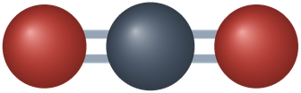
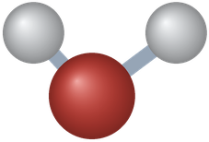
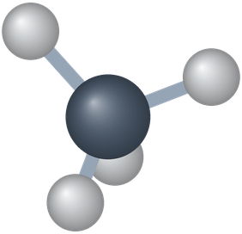
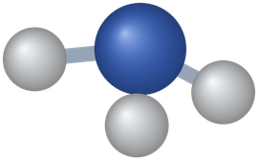
PHD115 Fundamentals of Chemistry
Chemical Reactions I
Dr. Nur 'Ainun Mokhtar (Dr. NAM) · Faculty of Pharmacy, UiTM Bertam, Penang
Core reference: Ball, Hill & Scott, The Basics of GOB Chemistry, chapters 5 (5.0–5.6) and 6 (6.0–6.5)
PHD115 · Chemical Reactions I
Dr. NAM · Faculty of Pharmacy, UiTM Bertam, Penang
Notes:
This lecture follows chapters 5 and 6 of the core reference: chemical equations, reaction types, redox reactions, the mole and stoichiometry.

Slide 2
Learning outcomes
CR1-LO1
CR1-LO2
State the law of conservation of matter, and write and balance chemical equations
Use the coefficients of a balanced equation as ratios between reactants and products
CR1-LO3
CR1-LO4
Classify reactions as combination, decomposition or combustion
Identify oxidation and reduction (electrons, oxygen, hydrogen), write half reactions and name the oxidizing and reducing agents
CR1-LO5
CR1-LO6
Use the mole, Avogadro's number and molar mass to convert between particles, moles and mass
Solve mole–mole, mole–mass and mass–mass problems from a balanced equation
PHD115 · Chemical Reactions I
Dr. NAM · Faculty of Pharmacy, UiTM Bertam, Penang
Notes:
The same six outcomes appear in the activities, tutorial, game and exam questions.

Slide 3
Lecture map
Part 1 · Chemical equations (Ball 5.1–5.2): conservation of matter, writing and balancing equations
Part 2 · Ratios from equations (Ball 5.3): stoichiometry with molecules
Part 3 · Types of reactions (Ball 5.4): combination, decomposition, combustion
Part 4 · Oxidation–reduction (Ball 5.5): electron transfer, half reactions, agents
Part 5 · Redox in organic chemistry and biochemistry (Ball 5.6): alcohols, antioxidants, respiration
Part 6 · The mole and molar mass (Ball 6.1–6.3): counting by weighing
Part 7 · Stoichiometry with moles and mass (Ball 6.4–6.5): mole–mole, mole–mass, mass–mass
PHD115 · Chemical Reactions I
Dr. NAM · Faculty of Pharmacy, UiTM Bertam, Penang
Notes:
Parts follow the book's order. Chemical Reactions II covers energy changes and reaction rates.

Slide 4
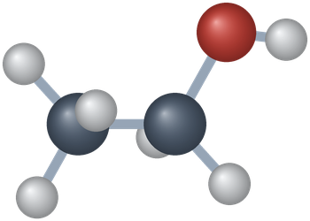
THINK FIRST
A nurse once read a prescription of “2–3 mg” as “23 mg” and gave a child a dangerous dose of morphine. Why do pharmacists care so much about exact amounts in chemistry?
Discuss with a partner for one minute.
PHD115 · Chemical Reactions I
Dr. NAM · Faculty of Pharmacy, UiTM Bertam, Penang
Notes:
Story from Ball 6.0 (chapter-opening essay). Let students discuss for a minute.

Slide 5
THINK FIRST · ANSWER
A nurse once read a prescription of “2–3 mg” as “23 mg” and gave a child a dangerous dose of morphine. Why do pharmacists care so much about exact amounts in chemistry?
Because substances react in fixed ratios. A balanced equation tells us the ratio, and the mole lets us turn it into grams we can weigh. Getting the amount wrong changes the outcome, in a flask or in a patient. This lecture builds both tools.
PHD115 · Chemical Reactions I
Dr. NAM · Faculty of Pharmacy, UiTM Bertam, Penang
Notes:
Story from Ball 6.0 (chapter-opening essay). Let students discuss for a minute.

Slide 6

1
PART 1
Chemical equations
Matter is neither created nor destroyed, so equations must balance.
CR1-LO1 · Ball 5.1–5.2
PHD115 · Chemical Reactions I
Dr. NAM · Faculty of Pharmacy, UiTM Bertam, Penang
Notes:
Part 1 = sections 5.1 and 5.2.

Slide 7

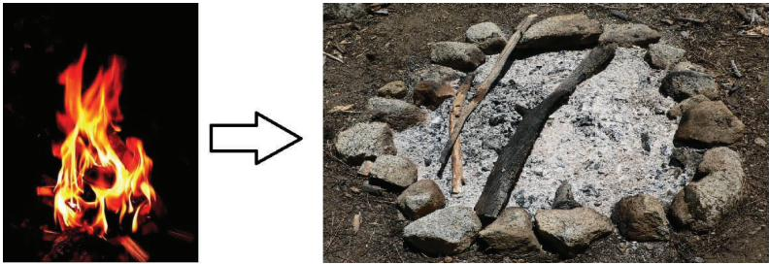
1
CR1-LO1
The law of conservation of matter
A scientific law is a general statement that explains a large number of observations, verified many times.
Law of conservation of matter: in a system closed to matter, the amount of matter stays constant. Matter is neither created nor destroyed.
Lavoisier: in any physical or chemical change, the total mass of the products equals the total mass of the reactants.
Burning wood seems to destroy matter, but wood + oxygen = ash + carbon dioxide + water vapour in mass.
Burning wood leaves ashes, but the gases carry the rest of the mass away, Figure 5.1.1 (Ball, The Basics of GOB Chemistry 5.1)
PHD115 · Chemical Reactions I
Dr. NAM · Faculty of Pharmacy, UiTM Bertam, Penang
Notes:
Ball 5.1.

Slide 8
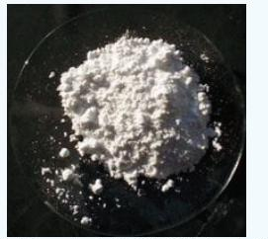
1
CR1-LO1
Example 1.1 · Checking the law
Heating 10 g of CaCO₃ produces 4.4 g of CO₂ and 5.6 g of CaO. Do these data agree with the law of conservation of mass?
1
Mass of reactants: CaCO₃ = 10 g
2
Mass of products: 4.4 g + 5.6 g = 10 g
3
Reactant mass = product mass, so the data agree with the law.
A sample of calcium carbonate (CaCO₃) (Ball, The Basics of GOB Chemistry 5.1)
PHD115 · Chemical Reactions I
Dr. NAM · Faculty of Pharmacy, UiTM Bertam, Penang
Notes:
Ball Example 5.1.1.

Slide 9
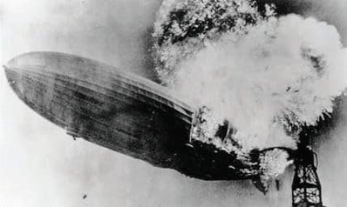
1
CR1-LO1
Chemical reactions and equations
A chemical reaction turns substances into new substances: hydrogen and oxygen react to make water.
A chemical equation uses formulas: H₂ + O₂ → H₂O. Reactants on the left, products on the right.
Phase labels: (s) solid, (ℓ) liquid, (g) gas, (aq) dissolved in water.
This equation is not finished yet: it does not obey the conservation of matter.
Hydrogen in the Hindenburg reacting with oxygen to form water, Figure 5.2.1 (Ball, The Basics of GOB Chemistry 5.2)
PHD115 · Chemical Reactions I
Dr. NAM · Faculty of Pharmacy, UiTM Bertam, Penang
Notes:
Ball 5.2.

Slide 10
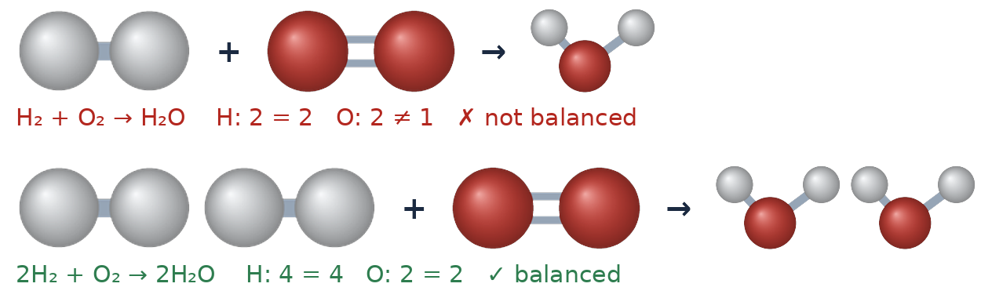
1
CR1-LO1
Balanced: yes or no?
Counting atoms on each side (Dr. NAM, after Ball Figures 5.2.2 and 5.2.3)
Count the atoms of each element on both sides. H₂ + O₂ → H₂O has 2 O on the left but 1 on the right.
Put coefficients in front of formulas: 2H₂ + O₂ → 2H₂O now has 4 H and 2 O on each side.
Never change a subscript to balance an equation: H₂O₂ is hydrogen peroxide, not water.
PHD115 · Chemical Reactions I
Dr. NAM · Faculty of Pharmacy, UiTM Bertam, Penang
Notes:
Ball 5.2.

Slide 11
1
CR1-LO1
How to balance an equation
1. Write the correct formula of every reactant and product: the skeleton equation.
2. Count the atoms of each element on each side. If a polyatomic ion is unchanged, count it as one unit.
3. Balance one element at a time with coefficients. Start with elements that appear in only one formula on each side. No coefficient is written for 1.
4. Check every atom and polyatomic ion.
5. Make sure the coefficients are in the lowest whole-number ratio.
Remember
Only coefficients change. Subscripts belong to the substance.
PHD115 · Chemical Reactions I
Dr. NAM · Faculty of Pharmacy, UiTM Bertam, Penang
Notes:
Ball 5.2 guidelines.

Slide 12
1
CR1-LO1
Worked example: CH₄ + Cl₂ → CCl₄ + HCl
Balance H first, then Cl (Cl₂ is diatomic).
Step | Equation | C | H | Cl (left : right)
Skeleton | CH₄ + Cl₂ → CCl₄ + HCl | 1 : 1 | 4 : 1 | 2 : 5
Balance H | CH₄ + Cl₂ → CCl₄ + 4HCl | 1 : 1 | 4 : 4 | 2 : 8
Balance Cl | CH₄ + 4Cl₂ → CCl₄ + 4HCl | 1 : 1 | 4 : 4 | 8 : 8
Source: Ball 5.2. The coefficients 1 : 4 : 1 : 4 are already the lowest ratio.
PHD115 · Chemical Reactions I
Dr. NAM · Faculty of Pharmacy, UiTM Bertam, Penang
Notes:
Ball 5.2 worked example.

Slide 13
1
CR1-LO1
Example 1.2 · Is it balanced?
Is each equation balanced? (a) 2Na + O₂ → 2Na₂O (b) CH₄ + 2O₂ → CO₂ + 2H₂O (c) AgNO₃ + 2KCl → AgCl + KNO₃
1
(a) Left: 2 Na, 2 O. Right: 4 Na, 2 O. Not balanced.
2
(b) Each side: 1 C, 4 H, 4 O. Balanced.
3
(c) Left: 2 K and 2 Cl. Right: 1 K and 1 Cl. Not balanced.
PHD115 · Chemical Reactions I
Dr. NAM · Faculty of Pharmacy, UiTM Bertam, Penang
Notes:
Ball Example 5.2.1.

Slide 14
1
CR1-LO1
Try it · Is it balanced?
(a) 2Hg + O₂ → Hg₂O₂ (b) C₂H₄ + 2O₂ → 2CO₂ + 2H₂O (c) Mg(NO₃)₂ + 2Li → Mg + 2LiNO₃
Work it out, then check on the next slide.
PHD115 · Chemical Reactions I
Dr. NAM · Faculty of Pharmacy, UiTM Bertam, Penang
Notes:
Ball Exercise 5.2.1.

Slide 15
1
CR1-LO1
Try it · Is it balanced? · answer
(a) 2Hg + O₂ → Hg₂O₂ (b) C₂H₄ + 2O₂ → 2CO₂ + 2H₂O (c) Mg(NO₃)₂ + 2Li → Mg + 2LiNO₃
Answer
(a) balanced (2 Hg, 2 O each side)
(b) not balanced: 4 O on the left, 6 O on the right
(c) balanced (count NO₃⁻ as a unit: 2 on each side)
PHD115 · Chemical Reactions I
Dr. NAM · Faculty of Pharmacy, UiTM Bertam, Penang
Notes:
Ball Exercise 5.2.1.

Slide 16
1
CR1-LO1
Example 1.3 · Writing and balancing
Aqueous lead(II) nitrate and sodium chloride are mixed. The products are aqueous sodium nitrate and a solid precipitate of lead(II) chloride. Write the balanced equation.
1
Skeleton: Pb(NO₃)₂(aq) + NaCl(aq) → NaNO₃(aq) + PbCl₂(s)
2
Count: NO₃⁻ 2 : 1 and Cl 1 : 2 are unbalanced.
3
Put 2 in front of NaCl and 2 in front of NaNO₃:
4
Pb(NO₃)₂(aq) + 2NaCl(aq) → 2NaNO₃(aq) + PbCl₂(s)
PHD115 · Chemical Reactions I
Dr. NAM · Faculty of Pharmacy, UiTM Bertam, Penang
Notes:
Ball Example 5.2.2.

Slide 17
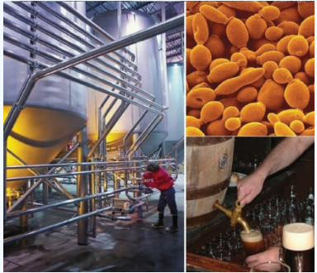
1
CR1-LO1
Try it · Fermentation
Yeast converts glucose (C₆H₁₂O₆) into ethanol (C₂H₅OH) and carbon dioxide. Write the balanced equation.
Work it out, then check on the next slide.
PHD115 · Chemical Reactions I
Dr. NAM · Faculty of Pharmacy, UiTM Bertam, Penang
Notes:
Ball Exercise 5.2.2 and the chapter-opening essay on yeast.

Slide 18
1
CR1-LO1
Try it · Fermentation · answer
Yeast converts glucose (C₆H₁₂O₆) into ethanol (C₂H₅OH) and carbon dioxide. Write the balanced equation.
Answer
C₆H₁₂O₆ → 2C₂H₅OH + 2CO₂
Check: 6 C, 12 H, 6 O on each side. This reaction makes bread rise (CO₂) and produces alcohol.
PHD115 · Chemical Reactions I
Dr. NAM · Faculty of Pharmacy, UiTM Bertam, Penang
Notes:
Ball Exercise 5.2.2 and the chapter-opening essay on yeast.

Slide 19
1
CR1-LO1
Key takeaways: chemical equations
The amount of matter in a closed system is conserved.
Chemical reactions are shown by chemical equations listing reactants and products.
A proper equation is balanced: the same number of each element's atoms on each side.
Balance with coefficients only, in the lowest whole-number ratio.
PHD115 · Chemical Reactions I
Dr. NAM · Faculty of Pharmacy, UiTM Bertam, Penang
Notes:
Ball 5.1–5.2 key takeaways.

Slide 20
1
CR1-LO1
Quick check
Which is the balanced form of Al + O₂ → Al₂O₃?
A 2Al + O₂ → Al₂O₃
B 4Al + 3O₂ → 2Al₂O₃
C Al + O₃ → AlO₃
D 2Al + 3O₂ → Al₂O₃
PHD115 · Chemical Reactions I
Dr. NAM · Faculty of Pharmacy, UiTM Bertam, Penang
Notes:
Answer B.

Slide 21
1
CR1-LO1
Quick check · answer
Which is the balanced form of Al + O₂ → Al₂O₃?
A 2Al + O₂ → Al₂O₃
B 4Al + 3O₂ → 2Al₂O₃
C Al + O₃ → AlO₃
D 2Al + 3O₂ → Al₂O₃
Answer B. 4 Al and 6 O on each side. Option C changes a formula, which is never allowed.
PHD115 · Chemical Reactions I
Dr. NAM · Faculty of Pharmacy, UiTM Bertam, Penang
Notes:
Answer B.

Slide 22

2
PART 2
Ratios from balanced equations
Coefficients tell us how many of each particle react and form.
CR1-LO2 · Ball 5.3
PHD115 · Chemical Reactions I
Dr. NAM · Faculty of Pharmacy, UiTM Bertam, Penang
Notes:
Part 2 = section 5.3.

Slide 23
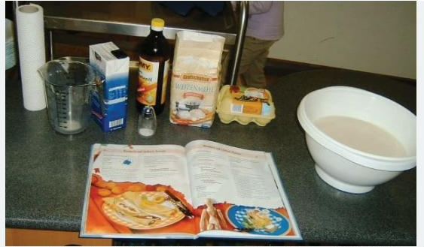
2
CR1-LO2
Stoichiometry: a recipe for reactions
Stoichiometry (stow-ee-key-OM-eh-tree) is the study of the numerical relationships between reactants and products.
A biscuit recipe: 2 cups flour + 1 egg + … → 12 biscuits. With 4 cups of flour: 4 cups × (12 biscuits / 2 cups) = 24 biscuits.
A balanced equation works the same way: its coefficients give the ratios in which substances react and form.
Doubling or halving a recipe is stoichiometry.
A recipe shows how much of each ingredient is needed (Ball, The Basics of GOB Chemistry 5.3)
PHD115 · Chemical Reactions I
Dr. NAM · Faculty of Pharmacy, UiTM Bertam, Penang
Notes:
Ball 5.3 Looking Closer: Stoichiometry in Cooking.

Slide 24
2
CR1-LO2
Ratios from 2C₂H₂ + 5O₂ → 4CO₂ + 2H₂O
Every statement gives a ratio and its inverse. Twelve such conversion factors can be built from this one equation.
Statement from the equation | Ratio | Inverse
two C₂H₂ react with five O₂ | 2 C₂H₂ / 5 O₂ | 5 O₂ / 2 C₂H₂
two C₂H₂ make four CO₂ | 2 C₂H₂ / 4 CO₂ | 4 CO₂ / 2 C₂H₂
five O₂ make two H₂O | 5 O₂ / 2 H₂O | 2 H₂O / 5 O₂
four CO₂ form with two H₂O | 4 CO₂ / 2 H₂O | 2 H₂O / 4 CO₂
Source: Ball 5.3. Units here are molecules.
PHD115 · Chemical Reactions I
Dr. NAM · Faculty of Pharmacy, UiTM Bertam, Penang
Notes:
Ball 5.3 table.

Slide 25
2
CR1-LO2
Example 2.1 · Using a ratio
Using 2C₂H₂ + 5O₂ → 4CO₂ + 2H₂O, how many CO₂ molecules form when 26 molecules of C₂H₂ react?
1
Start with what is given: 26 C₂H₂
2
Choose the ratio with C₂H₂ on the bottom: 4 CO₂ / 2 C₂H₂
3
26 C₂H₂ × (4 CO₂ / 2 C₂H₂) = 52 CO₂ molecules
4
This only works with a balanced equation.
PHD115 · Chemical Reactions I
Dr. NAM · Faculty of Pharmacy, UiTM Bertam, Penang
Notes:
Ball 5.3 worked example.

Slide 26
2
CR1-LO2
Example 2.2 · Verify and find ratios
KMnO₄ + 8HCl + 5FeCl₂ → 5FeCl₃ + MnCl₂ + 4H₂O + KCl. (a) Verify it is balanced. (b) Give two ratios relating HCl and FeCl₃.
1
(a) K 1 : 1, Mn 1 : 1, Fe 5 : 5, H 8 : 8, O 4 : 4.
2
Cl: left 8 (HCl) + 10 (5FeCl₂) = 18; right 15 + 2 + 1 = 18. Balanced.
3
(b) 8 HCl / 5 FeCl₃ and 5 FeCl₃ / 8 HCl (42 ratios are possible in all).
PHD115 · Chemical Reactions I
Dr. NAM · Faculty of Pharmacy, UiTM Bertam, Penang
Notes:
Ball Example 5.3.1.

Slide 27
2
CR1-LO2
Try it · Ratios
2KMnO₄ + 3CH₂=CH₂ + 4H₂O → 2MnO₂ + 3HOCH₂CH₂OH + 2KOH. (a) Verify it is balanced. (b) Give two ratios relating KMnO₄ and CH₂=CH₂.
Work it out, then check on the next slide.
PHD115 · Chemical Reactions I
Dr. NAM · Faculty of Pharmacy, UiTM Bertam, Penang
Notes:
Ball Exercise 5.3.1.

Slide 28
2
CR1-LO2
Try it · Ratios · answer
2KMnO₄ + 3CH₂=CH₂ + 4H₂O → 2MnO₂ + 3HOCH₂CH₂OH + 2KOH. (a) Verify it is balanced. (b) Give two ratios relating KMnO₄ and CH₂=CH₂.
Answer
(a) K 2 : 2, Mn 2 : 2, C 6 : 6, H 20 : 20, O 12 : 12. Balanced.
(b) 2 KMnO₄ / 3 CH₂=CH₂ and 3 CH₂=CH₂ / 2 KMnO₄
PHD115 · Chemical Reactions I
Dr. NAM · Faculty of Pharmacy, UiTM Bertam, Penang
Notes:
Ball Exercise 5.3.1.

Slide 29
2
CR1-LO2
Quick check
In N₂ + 3H₂ → 2NH₃, how many H₂ molecules react with 10 N₂ molecules?
A 3
B 10
C 20
D 30
PHD115 · Chemical Reactions I
Dr. NAM · Faculty of Pharmacy, UiTM Bertam, Penang
Notes:
Answer D.

Slide 30
2
CR1-LO2
Quick check · answer
In N₂ + 3H₂ → 2NH₃, how many H₂ molecules react with 10 N₂ molecules?
A 3
B 10
C 20
D 30
Answer D. 10 N₂ × (3 H₂ / 1 N₂) = 30 H₂.
PHD115 · Chemical Reactions I
Dr. NAM · Faculty of Pharmacy, UiTM Bertam, Penang
Notes:
Answer D.

Slide 31
3
PART 3
Types of chemical reactions
Most reactions fall into a few families, which helps us predict products.
CR1-LO3 · Ball 5.4
PHD115 · Chemical Reactions I
Dr. NAM · Faculty of Pharmacy, UiTM Bertam, Penang
Notes:
Part 3 = section 5.4.

Slide 32
3
CR1-LO3
Three reaction types
Classifying reactions shows similarities and helps predict products. A reaction can belong to more than one type.
Combination
Decomposition
Combustion
Two or more reactants → one product substance
4Fe + 3O₂ → 2Fe₂O₃
Fe₂O₃ + 3SO₃ → Fe₂(SO₄)₃
One reactant substance → two or more products
2NaHCO₃ → Na₂CO₃ + CO₂ + H₂O
2KClO₃ → 2KCl + 3O₂
A substance + O₂ → oxides, usually releasing heat
C₃H₈ + 5O₂ → 3CO₂ + 4H₂O
Hydrocarbons → CO₂ + H₂O
PHD115 · Chemical Reactions I
Dr. NAM · Faculty of Pharmacy, UiTM Bertam, Penang
Notes:
Ball 5.4.

Slide 33
3
CR1-LO3
Example 3.1 · Combination?
Which are combination reactions? (a) Co + Cl₂ → CoCl₂ (b) CO + Cl₂ → COCl₂ (c) N₂H₄ + O₂ → N₂ + 2H₂O
1
(a) Two reactants make one product: combination.
2
(b) Combination. (COCl₂ is phosgene, once used as a chemical weapon.)
3
(c) Two products form: not a combination reaction.
PHD115 · Chemical Reactions I
Dr. NAM · Faculty of Pharmacy, UiTM Bertam, Penang
Notes:
Ball Example 5.4.1.

Slide 34
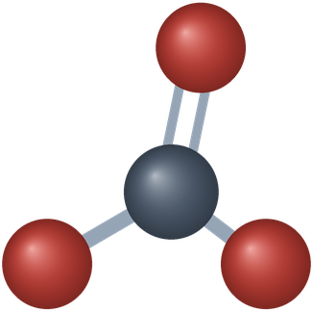
3
CR1-LO3
Decomposition: baking soda on a fire
2NaHCO₃(s) → Na₂CO₃(s) + CO₂(g) + H₂O(ℓ)
This happens when baking soda is poured on a small kitchen fire: the CO₂ and H₂O produced help smother the flames.
2KClO₃(s) → 2KCl(s) + 3O₂(g) was once used to make oxygen in the laboratory.
Pharmacy link: sodium bicarbonate is also an antacid.
The carbonate ion, part of NaHCO₃ (Dr. NAM model)
PHD115 · Chemical Reactions I
Dr. NAM · Faculty of Pharmacy, UiTM Bertam, Penang
Notes:
Ball 5.4.

Slide 35
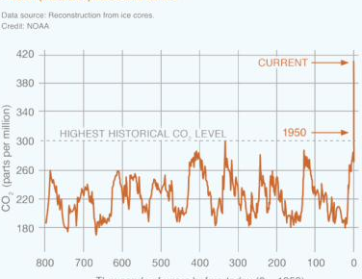
3
CR1-LO3
Combustion and carbon dioxide
Burning fossil fuels such as octane releases CO₂:
2C₈H₁₈ + 25O₂ → 16CO₂ + 18H₂O
Every 2 octane molecules burned make 16 CO₂ molecules.
CO₂ is the main greenhouse gas from human activity; today's level is far above the historical range.
CO₂ levels over the last three glacial cycles, from ice cores (NOAA) (Ball, The Basics of GOB Chemistry 5.4)
PHD115 · Chemical Reactions I
Dr. NAM · Faculty of Pharmacy, UiTM Bertam, Penang
Notes:
Ball 5.4 Looking Closer and Example 5.4.2.

Slide 36
3
CR1-LO3
Example 3.2 · Identify the type
(a) 2K + S + 2O₂ → K₂SO₄ (b) (NH₄)₂Cr₂O₇ → N₂ + Cr₂O₃ + 4H₂O (c) CH₄ + 2O₂ → CO₂ + 2H₂O
1
(a) Several reactants make one product: combination.
2
(b) One substance makes several products: decomposition.
3
(c) O₂ reacts to give oxides of C and H: combustion.
PHD115 · Chemical Reactions I
Dr. NAM · Faculty of Pharmacy, UiTM Bertam, Penang
Notes:
Ball Example 5.4.3.

Slide 37
3
CR1-LO3
Try it · Identify the type
(a) C₂H₅OH + 3O₂ → 2CO₂ + 3H₂O (b) 2Mg + O₂ → 2MgO (c) P₄ + 6Cl₂ → 4PCl₃
Work it out, then check on the next slide.
PHD115 · Chemical Reactions I
Dr. NAM · Faculty of Pharmacy, UiTM Bertam, Penang
Notes:
Ball Exercises 5.4.1 and 5.4.2.

Slide 38
3
CR1-LO3
Try it · Identify the type · answer
(a) C₂H₅OH + 3O₂ → 2CO₂ + 3H₂O (b) 2Mg + O₂ → 2MgO (c) P₄ + 6Cl₂ → 4PCl₃
Answer
(a) combustion (b) combination (also a combustion) (c) combination
PHD115 · Chemical Reactions I
Dr. NAM · Faculty of Pharmacy, UiTM Bertam, Penang
Notes:
Ball Exercises 5.4.1 and 5.4.2.

Slide 39
3
CR1-LO3
Quick check
CaCO₃(s) → CaO(s) + CO₂(g) is a:
A combination reaction
B decomposition reaction
C combustion reaction
D none of these
PHD115 · Chemical Reactions I
Dr. NAM · Faculty of Pharmacy, UiTM Bertam, Penang
Notes:
Answer B.

Slide 40
3
CR1-LO3
Quick check · answer
CaCO₃(s) → CaO(s) + CO₂(g) is a:
A combination reaction
B decomposition reaction
C combustion reaction
D none of these
Answer B. One reactant breaks into two products.
PHD115 · Chemical Reactions I
Dr. NAM · Faculty of Pharmacy, UiTM Bertam, Penang
Notes:
Answer B.

Slide 41
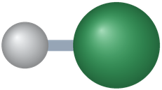
4
PART 4
Oxidation–reduction (redox)
Electrons move from one substance to another.
CR1-LO4 · Ball 5.5
PHD115 · Chemical Reactions I
Dr. NAM · Faculty of Pharmacy, UiTM Bertam, Penang
Notes:
Part 4 = section 5.5.

Slide 42
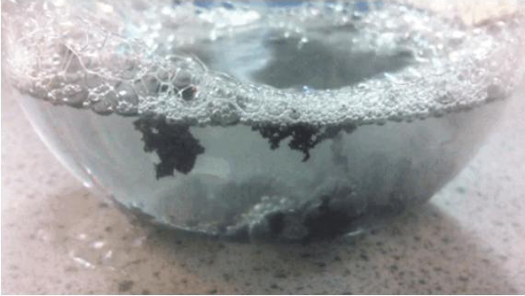
4
CR1-LO4
Zinc in hydrochloric acid
Zn(s) + 2HCl(aq) → H₂(g) + ZnCl₂(aq): Zn replaces H (a single replacement reaction).
As ions: Zn + 2H⁺ + 2Cl⁻ → H₂ + Zn²⁺ + 2Cl⁻. Chloride does not change.
Electrons pass from zinc atoms to hydrogen ions: an electron-transfer reaction.
Zinc metal reacting with hydrochloric acid; the bubbles are hydrogen, Figure 5.5.1 (Ball, The Basics of GOB Chemistry 5.5)
PHD115 · Chemical Reactions I
Dr. NAM · Faculty of Pharmacy, UiTM Bertam, Penang
Notes:
Ball 5.5.

Slide 43
4
CR1-LO4
Oxidation and reduction always go together
Loss of electrons is oxidation; gain of electrons is reduction. Memory aid: OIL RIG (Oxidation Is Loss, Reduction Is Gain).
Oxidation
Reduction
Loss of electrons
The substance is oxidized
It is the reducing agent (it causes the reduction)
Zn → Zn²⁺ + 2e⁻
Gain of electrons
The substance is reduced
It is the oxidizing agent
2H⁺ + 2e⁻ → H₂
PHD115 · Chemical Reactions I
Dr. NAM · Faculty of Pharmacy, UiTM Bertam, Penang
Notes:
Ball 5.5. OIL RIG is a common memory aid added for students.

Slide 44
4
CR1-LO4
Half reactions
Write oxidation and reduction separately as half reactions. Electrons lost appear as products; electrons gained appear as reactants.
Oxidation: Zn → Zn²⁺ + 2e⁻ (charge 0 = 0 on each side)
Reduction: 2H⁺ + 2e⁻ → H₂ (charge 0 = 0)
Add them: Zn + 2H⁺ → Zn²⁺ + H₂. The electrons cancel exactly: that is the key test of a balanced redox equation.
Check the charge too: 2+ on each side.
PHD115 · Chemical Reactions I
Dr. NAM · Faculty of Pharmacy, UiTM Bertam, Penang
Notes:
Ball 5.5.

Slide 45
4
CR1-LO4
Example 4.1 · Silver ions and aluminium
Balance the redox reaction of Ag⁺ with Al metal, giving Ag metal and Al³⁺. Identify the substance oxidized, the substance reduced, and the two agents.
1
Ag⁺ + Al → Ag + Al³⁺ looks balanced, but the charge is +1 on the left and +3 on the right.
2
Reduction: Ag⁺ + e⁻ → Ag. Oxidation: Al → Al³⁺ + 3e⁻
3
Multiply the reduction by 3 so the electrons cancel: 3Ag⁺ + Al → 3Ag + Al³⁺
4
Oxidized: Al (the reducing agent). Reduced: Ag⁺ (the oxidizing agent).
PHD115 · Chemical Reactions I
Dr. NAM · Faculty of Pharmacy, UiTM Bertam, Penang
Notes:
Ball Example 5.5.1.

Slide 46
4
CR1-LO4
Try it · Calcium and potassium
Calcium ions react with potassium metal to give calcium metal and potassium ions. Write the half reactions and the balanced equation, and identify the agents.
Work it out, then check on the next slide.
PHD115 · Chemical Reactions I
Dr. NAM · Faculty of Pharmacy, UiTM Bertam, Penang
Notes:
Ball Exercise 5.5.1. Potassium has been used as a reducing agent to obtain metals.

Slide 47
4
CR1-LO4
Try it · Calcium and potassium · answer
Calcium ions react with potassium metal to give calcium metal and potassium ions. Write the half reactions and the balanced equation, and identify the agents.
Answer
Reduction: Ca²⁺ + 2e⁻ → Ca. Oxidation: 2 × (K → K⁺ + e⁻)
Ca²⁺ + 2K → Ca + 2K⁺
Oxidized / reducing agent: K. Reduced / oxidizing agent: Ca²⁺.
PHD115 · Chemical Reactions I
Dr. NAM · Faculty of Pharmacy, UiTM Bertam, Penang
Notes:
Ball Exercise 5.5.1. Potassium has been used as a reducing agent to obtain metals.

Slide 48
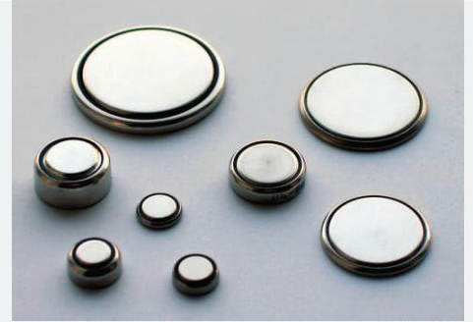
4
CR1-LO4
To your health: pacemaker batteries
All batteries run on redox reactions: electricity is a stream of electrons.
Older pacemakers used NiCad batteries: Cd is oxidized and nickel is reduced; rechargeable but heavy.
Today: the lithium/iodine battery, 2Li + I₂ → 2LiI. Lithium is oxidized, iodine is reduced.
It cannot be recharged but lasts up to 10 years, so the unit is replaced about once a decade.
Button batteries used in watches, pacemakers and calculators (Ball, The Basics of GOB Chemistry 5.5)
PHD115 · Chemical Reactions I
Dr. NAM · Faculty of Pharmacy, UiTM Bertam, Penang
Notes:
Ball 5.5 To Your Health.

Slide 49
4
CR1-LO4
Oxidation and reduction without counting electrons
Oxygen and hydrogen changes give quick clues, especially for molecules.
Process | Oxygen | Hydrogen | Example
Oxidation | gain O | lose H | 2CH₃CHO + O₂ → 2CH₃COOH
Reduction | lose O | gain H | CH₃CHO + H₂ → CH₃CH₂OH
Source: Ball 5.5. Acetaldehyde is oxidized to acetic acid, or reduced to ethanol.
PHD115 · Chemical Reactions I
Dr. NAM · Faculty of Pharmacy, UiTM Bertam, Penang
Notes:
Ball 5.5.

Slide 50
4
CR1-LO4
Example 4.2 · Oxidation or reduction?
(a) N₂ → NH₃ (b) CH₃CH(OH)CH₃ → CH₃COCH₃ (c) HCHO → HCOOH
1
(a) Hydrogen added: reduction.
2
(b) Hydrogen removed: oxidation.
3
(c) Oxygen added: oxidation.
PHD115 · Chemical Reactions I
Dr. NAM · Faculty of Pharmacy, UiTM Bertam, Penang
Notes:
Ball Example 5.5.2.

Slide 51
4
CR1-LO4
Try it · Oxidation or reduction?
(a) CH₄ → CO₂ + H₂O (b) NO₂ → N₂ (c) CH₂=CH₂ → CH₃CH₃
Work it out, then check on the next slide.
PHD115 · Chemical Reactions I
Dr. NAM · Faculty of Pharmacy, UiTM Bertam, Penang
Notes:
Ball Exercise 5.5.2.

Slide 52
4
CR1-LO4
Try it · Oxidation or reduction? · answer
(a) CH₄ → CO₂ + H₂O (b) NO₂ → N₂ (c) CH₂=CH₂ → CH₃CH₃
Answer
(a) oxygen added: oxidation (b) oxygen removed: reduction (c) hydrogen added: reduction
PHD115 · Chemical Reactions I
Dr. NAM · Faculty of Pharmacy, UiTM Bertam, Penang
Notes:
Ball Exercise 5.5.2.

Slide 53
4
CR1-LO4
Quick check
In Cu²⁺ + Zn → Cu + Zn²⁺, the oxidizing agent is:
A Zn
B Cu²⁺
C Cu
D Zn²⁺
PHD115 · Chemical Reactions I
Dr. NAM · Faculty of Pharmacy, UiTM Bertam, Penang
Notes:
Answer B.

Slide 54
4
CR1-LO4
Quick check · answer
In Cu²⁺ + Zn → Cu + Zn²⁺, the oxidizing agent is:
A Zn
B Cu²⁺
C Cu
D Zn²⁺
Answer B. Cu²⁺ gains electrons (it is reduced), so it is the oxidizing agent.
PHD115 · Chemical Reactions I
Dr. NAM · Faculty of Pharmacy, UiTM Bertam, Penang
Notes:
Answer B.

Slide 55
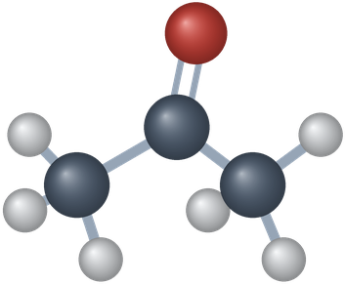
5
PART 5
Redox in organic chemistry and biochemistry
Fuels, drugs, metabolism and photosynthesis all run on redox.
CR1-LO4 · Ball 5.6
PHD115 · Chemical Reactions I
Dr. NAM · Faculty of Pharmacy, UiTM Bertam, Penang
Notes:
Part 5 = section 5.6.

Slide 56
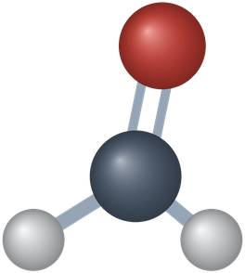
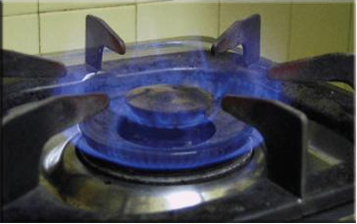
5
CR1-LO4
Combustion and respiration are redox
All combustion reactions are redox reactions: CH₄ + 2O₂ → CO₂ + 2H₂O
In respiration, the oxygen we breathe oxidizes food to CO₂ and water, releasing energy for cells:
C₆H₁₂O₆ + 6O₂ → 6CO₂ + 6H₂O
Burning natural gas, Figure 5.6.1 (Ball, The Basics of GOB Chemistry 5.6)
PHD115 · Chemical Reactions I
Dr. NAM · Faculty of Pharmacy, UiTM Bertam, Penang
Notes:
Ball 5.6.

Slide 57
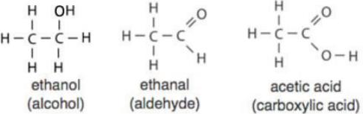
5
CR1-LO4
Oxidizing alcohols: the Breathalyzer
Ethanol → ethanal → acetic acid (Ball, The Basics of GOB Chemistry 5.6)
Potassium dichromate oxidizes ethanol to acetaldehyde (ethanal): 3CH₃CH₂OH + Cr₂O₇²⁻ + 8H⁺ → 3CH₃CHO + 2Cr³⁺ + 7H₂O. This is the Breathalyzer reaction.
Ethanol loses H (6 → 4 H atoms): the carbon is oxidized. Chromium loses O (Cr₂O₇²⁻ → Cr³⁺): it is reduced.
If acetaldehyde is not removed, it is oxidized further to acetic acid (gains O).
PHD115 · Chemical Reactions I
Dr. NAM · Faculty of Pharmacy, UiTM Bertam, Penang
Notes:
Ball 5.6.

Slide 58
5
CR1-LO4
Ketones, aldehydes and lactic acid
An alcohol with OH on an interior carbon is oxidized to a ketone: 2-propanol → acetone (nail polish remover, varnish solvent).
The reverse also happens: aldehydes and ketones can be reduced to alcohols.
In muscles during vigorous exercise (without enough O₂), pyruvic acid is reduced to lactic acid: CH₃COCOOH → CH₃CH(OH)COOH.
Lactic acid build-up is largely responsible for the fatigue we feel.
PHD115 · Chemical Reactions I
Dr. NAM · Faculty of Pharmacy, UiTM Bertam, Penang
Notes:
Ball 5.6.

Slide 59
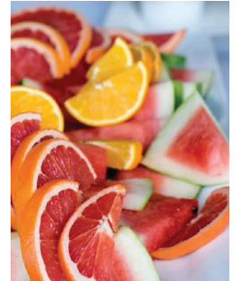
5
CR1-LO4
Antioxidants are reducing agents
Antioxidants are reducing agents: they are oxidized themselves and protect other molecules.
Vitamin C (ascorbic acid, C₆H₈O₆) is oxidized to dehydroascorbic acid. In the stomach it reduces nitrite (NO₂⁻) to nitric oxide (NO).
Without this, nitrite from food could oxidize the iron in haemoglobin and stop it carrying oxygen.
Vitamin E (tocopherol) scavenges free radicals in the body and stops fats in food turning rancid.
Citrus fruits are good sources of vitamin C, Figure 5.6.2 (Ball, The Basics of GOB Chemistry 5.6)
PHD115 · Chemical Reactions I
Dr. NAM · Faculty of Pharmacy, UiTM Bertam, Penang
Notes:
Ball 5.6.

Slide 60

5
CR1-LO4
Photosynthesis: the redox that feeds the world
6CO₂ + 6H₂O → C₆H₁₂O₆ + 6O₂, using enzymes, chlorophyll and sunlight.
Carbon dioxide is reduced to glucose; water is oxidized to oxygen gas.
It is the reverse of respiration, and the ultimate source of almost all food on Earth.
Photosynthesis is the ultimate source of all food on Earth, Figure 5.6.3 (Ball, The Basics of GOB Chemistry 5.6)
PHD115 · Chemical Reactions I
Dr. NAM · Faculty of Pharmacy, UiTM Bertam, Penang
Notes:
Ball 5.6.

Slide 61
5
CR1-LO4
Quick check
Pyruvic acid (CH₃COCOOH) → lactic acid (CH₃CH(OH)COOH) in muscle. What happens to pyruvic acid?
A It is oxidized: it gains H
B It is reduced: it gains H
C It is oxidized: it loses O
D It is neither
PHD115 · Chemical Reactions I
Dr. NAM · Faculty of Pharmacy, UiTM Bertam, Penang
Notes:
Answer B.

Slide 62
5
CR1-LO4
Quick check · answer
Pyruvic acid (CH₃COCOOH) → lactic acid (CH₃CH(OH)COOH) in muscle. What happens to pyruvic acid?
A It is oxidized: it gains H
B It is reduced: it gains H
C It is oxidized: it loses O
D It is neither
Answer B. Two H atoms are added to the ketone group: gaining hydrogen is reduction.
PHD115 · Chemical Reactions I
Dr. NAM · Faculty of Pharmacy, UiTM Bertam, Penang
Notes:
Answer B.

Slide 63
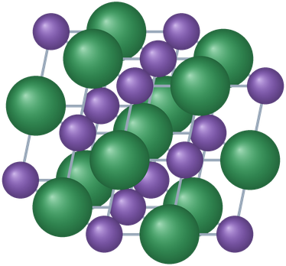
6
PART 6
The mole and molar mass
We count atoms by weighing them.
CR1-LO5 · Ball 6.1–6.3
PHD115 · Chemical Reactions I
Dr. NAM · Faculty of Pharmacy, UiTM Bertam, Penang
Notes:
Part 6 = sections 6.1 to 6.3.

Slide 64
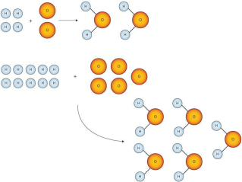
6
CR1-LO5
Why we need a counting unit
Making water always needs H and O atoms in a 2 : 1 ratio, however many molecules we make.
Atoms are far too small to count one by one, so we use mass. An O atom (≈16 u) is ≈16 times heavier than an H atom (≈1 u).
Equal numbers of atoms always keep the same mass ratio: 40 g of Ca has the same number of atoms as 7 g of Li.
We need a number that represents a convenient, huge quantity of atoms.
The H : O ratio in water is always 2 : 1, Figure 6.1.1 (Ball, The Basics of GOB Chemistry 6.1)
PHD115 · Chemical Reactions I
Dr. NAM · Faculty of Pharmacy, UiTM Bertam, Penang
Notes:
Ball 6.1.

Slide 65
6
CR1-LO5
The mole
A mole (mol) is 6.022 × 10²³ things, just as a dozen is 12 things. This is Avogadro's number.
1 mol Na = 6.022 × 10²³ Na atoms. 2 mol Na = 1.2044 × 10²⁴ atoms. 0.5 mol C₆H₆ = 3.011 × 10²³ molecules.
A mole is enormous: 1 mol of coins stacked in a column would stretch between Earth and the Sun 6.8 billion times.
Always say what you are counting: atoms, molecules, formula units or ions.
PHD115 · Chemical Reactions I
Dr. NAM · Faculty of Pharmacy, UiTM Bertam, Penang
Notes:
Ball 6.1.

Slide 66
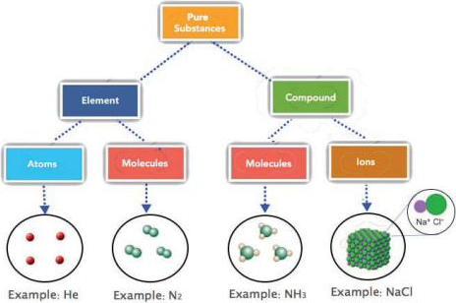
6
CR1-LO5
What is being counted?
Most elements: atoms (1 mol He = 6.022 × 10²³ He atoms).
Diatomic elements and covalent compounds: molecules (1 mol N₂ = 6.022 × 10²³ N₂ molecules, containing 2 mol N atoms).
Ionic compounds: formula units (1 mol NaCl = 6.022 × 10²³ formula units, each one Na⁺ and one Cl⁻).
Basic units of elements, covalent compounds and ionic compounds, Figure 6.1.2 (Ball, The Basics of GOB Chemistry 6.1)
PHD115 · Chemical Reactions I
Dr. NAM · Faculty of Pharmacy, UiTM Bertam, Penang
Notes:
Ball 6.1.

Slide 67
6
CR1-LO5
Example 6.1 · Moles of atoms in a compound
A sample has 2.5 mol of ethanol (C₂H₆O). How many moles of C, H and O atoms does it contain?
1
1 mol C₂H₆O contains 2 mol C, 6 mol H and 1 mol O.
2
C: 2.5 × 2 = 5.0 mol
3
H: 2.5 × 6 = 15 mol
4
O: 2.5 × 1 = 2.5 mol
PHD115 · Chemical Reactions I
Dr. NAM · Faculty of Pharmacy, UiTM Bertam, Penang
Notes:
Ball Example 6.1.1.

Slide 68
6
CR1-LO5
Example 6.2 · Using Avogadro's number
How many formula units are in 2.34 mol of NaCl? How many ions?
1
Use 6.022 × 10²³ formula units / 1 mol NaCl.
2
2.34 mol × 6.022 × 10²³ = 1.41 × 10²⁴ formula units
3
Each formula unit has 2 ions: 1.41 × 10²⁴ × 2 = 2.82 × 10²⁴ ions
PHD115 · Chemical Reactions I
Dr. NAM · Faculty of Pharmacy, UiTM Bertam, Penang
Notes:
Ball Example 6.1.2.

Slide 69
6
CR1-LO5
Try it · Counting
(a) How many moles of Na, S and O atoms are in 6.75 mol of Na₂SO₄? (b) How many molecules and how many atoms are in 16.02 mol of C₄H₁₀?
Work it out, then check on the next slide.
PHD115 · Chemical Reactions I
Dr. NAM · Faculty of Pharmacy, UiTM Bertam, Penang
Notes:
Ball Exercises 6.1.1 and 6.1.2.

Slide 70
6
CR1-LO5
Try it · Counting · answer
(a) How many moles of Na, S and O atoms are in 6.75 mol of Na₂SO₄? (b) How many molecules and how many atoms are in 16.02 mol of C₄H₁₀?
Answer
(a) Na 13.5 mol, S 6.75 mol, O 27.0 mol
(b) 16.02 × 6.022 × 10²³ = 9.647 × 10²⁴ molecules; × 14 atoms each = 1.351 × 10²⁶ atoms
PHD115 · Chemical Reactions I
Dr. NAM · Faculty of Pharmacy, UiTM Bertam, Penang
Notes:
Ball Exercises 6.1.1 and 6.1.2.

Slide 71
6
CR1-LO5
Molar mass
One H atom has a mass of about 1 u; 1 mol of H atoms has a mass of about 1 g. One Na atom ≈ 23 u; 1 mol Na ≈ 23 g.
One mole of a substance has the same mass in grams that one atom or molecule has in atomic mass units.
So the atomic masses on the periodic table are also the masses of 1 mol in grams: 1 mol Al = 26.98 g.
Molar mass (g/mol) = the sum of the atomic masses in the formula. O₂: 2 × 16.00 = 32.00 g/mol.
Link to IC1 and IC2
Formula mass and molecular mass in u become molar mass in g/mol.
PHD115 · Chemical Reactions I
Dr. NAM · Faculty of Pharmacy, UiTM Bertam, Penang
Notes:
Ball 6.2.

Slide 72
6
CR1-LO5
Worked example: molar mass of bilirubin
Bilirubin (C₃₃H₃₆N₄O₆) is the main pigment in bile.
Element | Atoms | Molar mass (g/mol) | Subtotal (g)
C | 33 | 12.01 | 396.33
H | 36 | 1.01 | 36.36
N | 4 | 14.01 | 56.04
O | 6 | 16.00 | 96.00
Total |  |  | 584.73 g/mol
Source: Ball Example 6.2.2. For NaCl: 22.99 + 35.45 = 58.44 g/mol.
PHD115 · Chemical Reactions I
Dr. NAM · Faculty of Pharmacy, UiTM Bertam, Penang
Notes:
Ball Example 6.2.2.

Slide 73
6
CR1-LO5
Example 6.3 · Brackets in formulas
Find the molar mass of (a) barium sulfate, BaSO₄, used for X-rays of the gut, and (b) Ba(OH)₂. (Ba 137.33, S 32.07, O 16.00, H 1.01)
1
(a) 137.33 + 32.07 + 4 × 16.00 = 233.40 g/mol
2
(b) The subscript outside the brackets applies to every atom inside: 1 Ba, 2 O and 2 H.
3
137.33 + 2 × 16.00 + 2 × 1.01 = 171.35 g/mol
PHD115 · Chemical Reactions I
Dr. NAM · Faculty of Pharmacy, UiTM Bertam, Penang
Notes:
Ball Exercise 6.2.2 and text. The book gives 233.36 g for BaSO₄ using slightly different rounding.

Slide 74
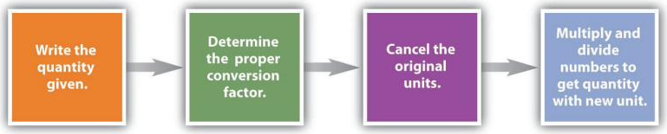
6
CR1-LO5
Mole–mass conversions
The steps of a unit conversion, Figure 6.3.2 (Ball, The Basics of GOB Chemistry 6.3)
Molar mass is a conversion factor: 1 mol Al = 26.98 g Al, so we can use 26.98 g / 1 mol or 1 mol / 26.98 g.
Moles → grams: multiply by molar mass. Grams → moles: divide by molar mass (multiply by its inverse).
Choose the factor that cancels the unit you start with.
PHD115 · Chemical Reactions I
Dr. NAM · Faculty of Pharmacy, UiTM Bertam, Penang
Notes:
Ball 6.3, Figures 6.3.1 and 6.3.2.

Slide 75
6
CR1-LO5
Example 6.4 · Moles to grams
A biochemist needs 0.00655 mol of bilirubin (584.73 g/mol). How many grams is that? And what is the mass of 3.987 mol of Al?
1
0.00655 mol × (584.73 g / 1 mol) = 3.83 g bilirubin
2
3.987 mol Al × (26.98 g / 1 mol) = 107.6 g Al
3
The mol units cancel, leaving grams.
PHD115 · Chemical Reactions I
Dr. NAM · Faculty of Pharmacy, UiTM Bertam, Penang
Notes:
Ball Examples 6.3.1 and 6.3.2.

Slide 76
6
CR1-LO5
Try it · Grams to moles
(a) How many moles are in 100.0 g of Al? (b) A chemist needs 457.8 g of KMnO₄ (158.04 g/mol). How many moles is that?
Work it out, then check on the next slide.
PHD115 · Chemical Reactions I
Dr. NAM · Faculty of Pharmacy, UiTM Bertam, Penang
Notes:
Ball Exercises 6.3.1 and 6.3.2.

Slide 77
6
CR1-LO5
Try it · Grams to moles · answer
(a) How many moles are in 100.0 g of Al? (b) A chemist needs 457.8 g of KMnO₄ (158.04 g/mol). How many moles is that?
Answer
(a) 100.0 g × (1 mol / 26.98 g) = 3.706 mol
(b) 457.8 g × (1 mol / 158.04 g) = 2.897 mol
PHD115 · Chemical Reactions I
Dr. NAM · Faculty of Pharmacy, UiTM Bertam, Penang
Notes:
Ball Exercises 6.3.1 and 6.3.2.

Slide 78
6
CR1-LO5
To your health: minerals in moles
Daily needs vary hugely, whether measured in grams or in moles (adults 19–30 years).
Mineral | Male | Female
Na | 2,400 mg · 1.0 × 10⁻¹ mol | 2,400 mg · 1.0 × 10⁻¹ mol
K | 3,500 mg · 9.0 × 10⁻² mol | 3,500 mg · 9.0 × 10⁻² mol
Ca | 1,000 mg · 0.025 mol | 1,000 mg · 0.025 mol
Fe | 8 mg · 1.4 × 10⁻⁴ mol | 18 mg · 3.2 × 10⁻⁴ mol
I | 150 µg · 1.2 × 10⁻⁶ mol | 150 µg · 1.2 × 10⁻⁶ mol
Adapted from Ball Table 6.3.1 (selected rows). Women need over twice as much iron as men.
PHD115 · Chemical Reactions I
Dr. NAM · Faculty of Pharmacy, UiTM Bertam, Penang
Notes:
Ball 6.3 To Your Health. Rows selected from the book's table.

Slide 79
6
CR1-LO5
Quick check
What is the mass of 2.00 mol of water (H₂O, 18.02 g/mol)?
A 9.01 g
B 18.02 g
C 36.04 g
D 1.20 × 10²⁴ g
PHD115 · Chemical Reactions I
Dr. NAM · Faculty of Pharmacy, UiTM Bertam, Penang
Notes:
Answer C.

Slide 80
6
CR1-LO5
Quick check · answer
What is the mass of 2.00 mol of water (H₂O, 18.02 g/mol)?
A 9.01 g
B 18.02 g
C 36.04 g
D 1.20 × 10²⁴ g
Answer C. 2.00 mol × 18.02 g/mol = 36.04 g.
PHD115 · Chemical Reactions I
Dr. NAM · Faculty of Pharmacy, UiTM Bertam, Penang
Notes:
Answer C.

Slide 81
7
PART 7
Stoichiometry with moles and mass
Coefficients are mole ratios, and molar mass turns moles into grams.
CR1-LO6 · Ball 6.4–6.5
PHD115 · Chemical Reactions I
Dr. NAM · Faculty of Pharmacy, UiTM Bertam, Penang
Notes:
Part 7 = sections 6.4 and 6.5.

Slide 82
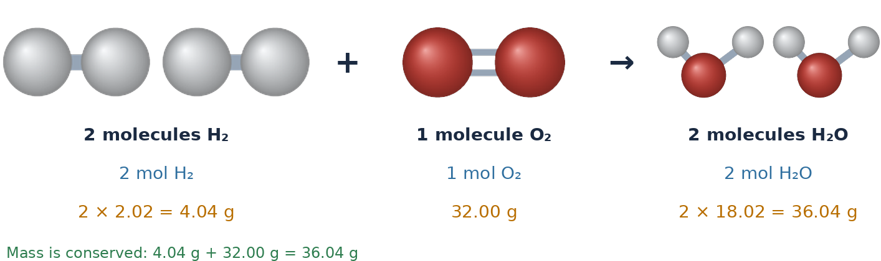
7
CR1-LO6
Coefficients are mole ratios
Three ways to read 2H₂ + O₂ → 2H₂O (Dr. NAM, after Ball Figure 6.4.1)
Balanced equations are balanced in molecules and in moles: “two moles of hydrogen react with one mole of oxygen to make two moles of water.”
The ratio of coefficients used to convert between substances is the stoichiometric factor (mole ratio).
PHD115 · Chemical Reactions I
Dr. NAM · Faculty of Pharmacy, UiTM Bertam, Penang
Notes:
Ball 6.4.

Slide 83
7
CR1-LO6
Example 7.1 · Mole–mole
Using 2H₂ + O₂ → 2H₂O, how many moles of O₂ are needed to make 27.6 mol of H₂O?
1
Given H₂O, want O₂: use the ratio with H₂O on the bottom, 1 mol O₂ / 2 mol H₂O.
2
27.6 mol H₂O × (1 mol O₂ / 2 mol H₂O) = 13.8 mol O₂
PHD115 · Chemical Reactions I
Dr. NAM · Faculty of Pharmacy, UiTM Bertam, Penang
Notes:
Ball Example 6.4.1.

Slide 84
7
CR1-LO6
Try it · Mole–mole
Using 2H₂ + O₂ → 2H₂O, how many moles of H₂ react with 3.97 mol of O₂?
Work it out, then check on the next slide.
PHD115 · Chemical Reactions I
Dr. NAM · Faculty of Pharmacy, UiTM Bertam, Penang
Notes:
Ball Exercise 6.4.1.

Slide 85
7
CR1-LO6
Try it · Mole–mole · answer
Using 2H₂ + O₂ → 2H₂O, how many moles of H₂ react with 3.97 mol of O₂?
Answer
3.97 mol O₂ × (2 mol H₂ / 1 mol O₂) = 7.94 mol H₂
PHD115 · Chemical Reactions I
Dr. NAM · Faculty of Pharmacy, UiTM Bertam, Penang
Notes:
Ball Exercise 6.4.1.

Slide 86
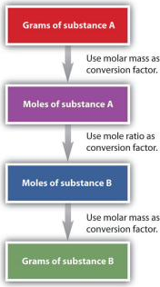
7
CR1-LO6
The road map
Mole–mass: moles of A → (mole ratio) → moles of B → (molar mass of B) → grams of B.
Mass–mass: first convert grams of A to moles of A with A's molar mass. Then, and only then, use the mole ratio.
The mole ratio always links moles, never grams.
Steps can be done one at a time or in a single line.
Mass–mass calculation sequence (Ball, The Basics of GOB Chemistry 6.5)
PHD115 · Chemical Reactions I
Dr. NAM · Faculty of Pharmacy, UiTM Bertam, Penang
Notes:
Ball 6.5.

Slide 87
7
CR1-LO6
Example 7.2 · Mole–mass
Fe₂O₃ + 3SO₃ → Fe₂(SO₄)₃. How many grams of SO₃ (80.07 g/mol) react with 3.59 mol of Fe₂O₃?
1
Mole ratio: 3.59 mol Fe₂O₃ × (3 mol SO₃ / 1 mol Fe₂O₃) = 10.77 mol SO₃
2
Molar mass: 10.77 mol × 80.07 g/mol = 862 g SO₃
3
In one line: 3.59 × 3/1 × 80.07 = 862 g
PHD115 · Chemical Reactions I
Dr. NAM · Faculty of Pharmacy, UiTM Bertam, Penang
Notes:
Ball 6.5 worked example.

Slide 88
7
CR1-LO6
Example 7.3 · An antacid reaction
CaCO₃ + 2HCl → CaCl₂ + CO₂ + H₂O. How many grams of CO₂ (44.01 g/mol) form from 2.09 mol of HCl?
1
2.09 mol HCl × (1 mol CO₂ / 2 mol HCl) = 1.045 mol CO₂
2
1.045 mol × 44.01 g/mol = 46.0 g CO₂
3
Pharmacy link: this is how calcium carbonate neutralizes stomach acid, which is why antacids can cause burping.
PHD115 · Chemical Reactions I
Dr. NAM · Faculty of Pharmacy, UiTM Bertam, Penang
Notes:
Ball Example 6.5.1. The pharmacy link is added.

Slide 89
7
CR1-LO6
Try it · Photosynthesis
6CO₂ + 6H₂O → C₆H₁₂O₆ + 6O₂. How many grams of glucose (180.18 g/mol) are produced from 17.3 mol of H₂O?
Work it out, then check on the next slide.
PHD115 · Chemical Reactions I
Dr. NAM · Faculty of Pharmacy, UiTM Bertam, Penang
Notes:
Ball Exercise 6.5.1.

Slide 90
7
CR1-LO6
Try it · Photosynthesis · answer
6CO₂ + 6H₂O → C₆H₁₂O₆ + 6O₂. How many grams of glucose (180.18 g/mol) are produced from 17.3 mol of H₂O?
Answer
17.3 mol H₂O × (1 mol C₆H₁₂O₆ / 6 mol H₂O) × 180.18 g/mol = 520 g glucose
PHD115 · Chemical Reactions I
Dr. NAM · Faculty of Pharmacy, UiTM Bertam, Penang
Notes:
Ball Exercise 6.5.1.

Slide 91
7
CR1-LO6
Worked example: mass–mass
CH₄ + 4Cl₂ → CCl₄ + 4HCl. How many grams of HCl form from 100.0 g of CH₄?
Step | Conversion | Result
1 · grams → moles (CH₄) | 100.0 g × (1 mol / 16.05 g) | 6.231 mol CH₄
2 · mole ratio | 6.231 mol × (4 mol HCl / 1 mol CH₄) | 24.92 mol HCl
3 · moles → grams (HCl) | 24.92 mol × 36.46 g/mol | 908.6 g HCl
Source: Ball Example 6.5.2. Done in one line, the answer is 908.7 g because rounding happens only at the end.
PHD115 · Chemical Reactions I
Dr. NAM · Faculty of Pharmacy, UiTM Bertam, Penang
Notes:
Ball Example 6.5.2.

Slide 92
7
CR1-LO6
Try it · Mass–mass
CH₃CH₂CHO + 2K₂Cr₂O₇ → CH₃CH₂COOH + other products. How many grams of propionic acid (74.09 g/mol) come from 135.8 g of K₂Cr₂O₇ (294.20 g/mol)?
Work it out, then check on the next slide.
PHD115 · Chemical Reactions I
Dr. NAM · Faculty of Pharmacy, UiTM Bertam, Penang
Notes:
Ball Exercise 6.5.2.

Slide 93
7
CR1-LO6
Try it · Mass–mass · answer
CH₃CH₂CHO + 2K₂Cr₂O₇ → CH₃CH₂COOH + other products. How many grams of propionic acid (74.09 g/mol) come from 135.8 g of K₂Cr₂O₇ (294.20 g/mol)?
Answer
135.8 g × (1 mol / 294.20 g) = 0.4616 mol K₂Cr₂O₇
× (1 mol acid / 2 mol K₂Cr₂O₇) = 0.2308 mol
× 74.09 g/mol = 17.10 g propionic acid
PHD115 · Chemical Reactions I
Dr. NAM · Faculty of Pharmacy, UiTM Bertam, Penang
Notes:
Ball Exercise 6.5.2.

Slide 94
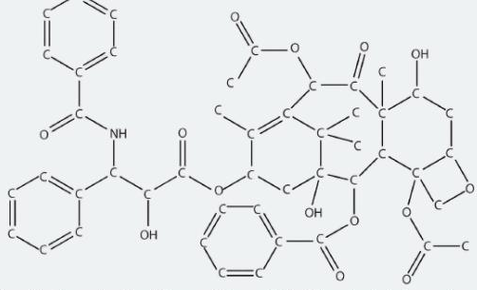
7
CR1-LO6
To your health: the synthesis of Taxol
Taxol (C₄₇H₅₁NO₁₄) is an anticancer drug first extracted from the Pacific yew tree; about six trees are needed per patient.
The first laboratory syntheses (1994) needed over 30 reactions with an overall efficiency below 0.05%.
One 300 mg dose needed about 600 g of starting material. Better stoichiometric efficiency means cheaper drugs and less waste.
The structure of the cancer drug Taxol, Figure 6.5.1 (Ball, The Basics of GOB Chemistry 6.5)
PHD115 · Chemical Reactions I
Dr. NAM · Faculty of Pharmacy, UiTM Bertam, Penang
Notes:
Ball 6.5 To Your Health.

Slide 95
7
CR1-LO6
Quick check
In a mass–mass problem, what must you do before using the mole ratio?
A Convert grams of the given substance to moles
B Multiply by Avogadro's number
C Balance only the oxygen atoms
D Convert moles to grams
PHD115 · Chemical Reactions I
Dr. NAM · Faculty of Pharmacy, UiTM Bertam, Penang
Notes:
Answer A.

Slide 96
7
CR1-LO6
Quick check · answer
In a mass–mass problem, what must you do before using the mole ratio?
A Convert grams of the given substance to moles
B Multiply by Avogadro's number
C Balance only the oxygen atoms
D Convert moles to grams
Answer A. The mole ratio links moles, so the given mass must first become moles.
PHD115 · Chemical Reactions I
Dr. NAM · Faculty of Pharmacy, UiTM Bertam, Penang
Notes:
Answer A.

Slide 97
Summary: key rules
Conservation
mass of reactants = mass of products
Balancing
change coefficients, never subscripts; lowest whole-number ratio
Ratios
coefficients = molecule ratios = mole ratios
Reaction types
combination (→ one) · decomposition (one →) · combustion (+ O₂)
Redox
OIL RIG · oxidized = reducing agent · oxidation also = gain O / lose H
The mole
1 mol = 6.022 × 10²³ particles; molar mass in g/mol
Stoichiometry
g A → mol A → (mole ratio) → mol B → g B
PHD115 · Chemical Reactions I
Dr. NAM · Faculty of Pharmacy, UiTM Bertam, Penang
Notes:
Recap.

Slide 98
Before the next topic
1
Complete the post-lecture activity
2
Attempt the tutorial questions
3
Play the game to find your weak outcomes
4
Next topic: Chemical Reactions II
Adapted from The Basics of GOB Chemistry (Ball, Hill & Scott), LibreTexts, CC BY-NC-SA 3.0, sections 5.0–5.6 and 6.0–6.5, including the photographs and figures reproduced from those sections. Balancing and mole diagrams drawn by Dr. NAM. Shared under the same licence for non-commercial teaching.
PHD115 · Chemical Reactions I
Dr. NAM · Faculty of Pharmacy, UiTM Bertam, Penang
Notes:
Point students to the study hub.

Slide 99
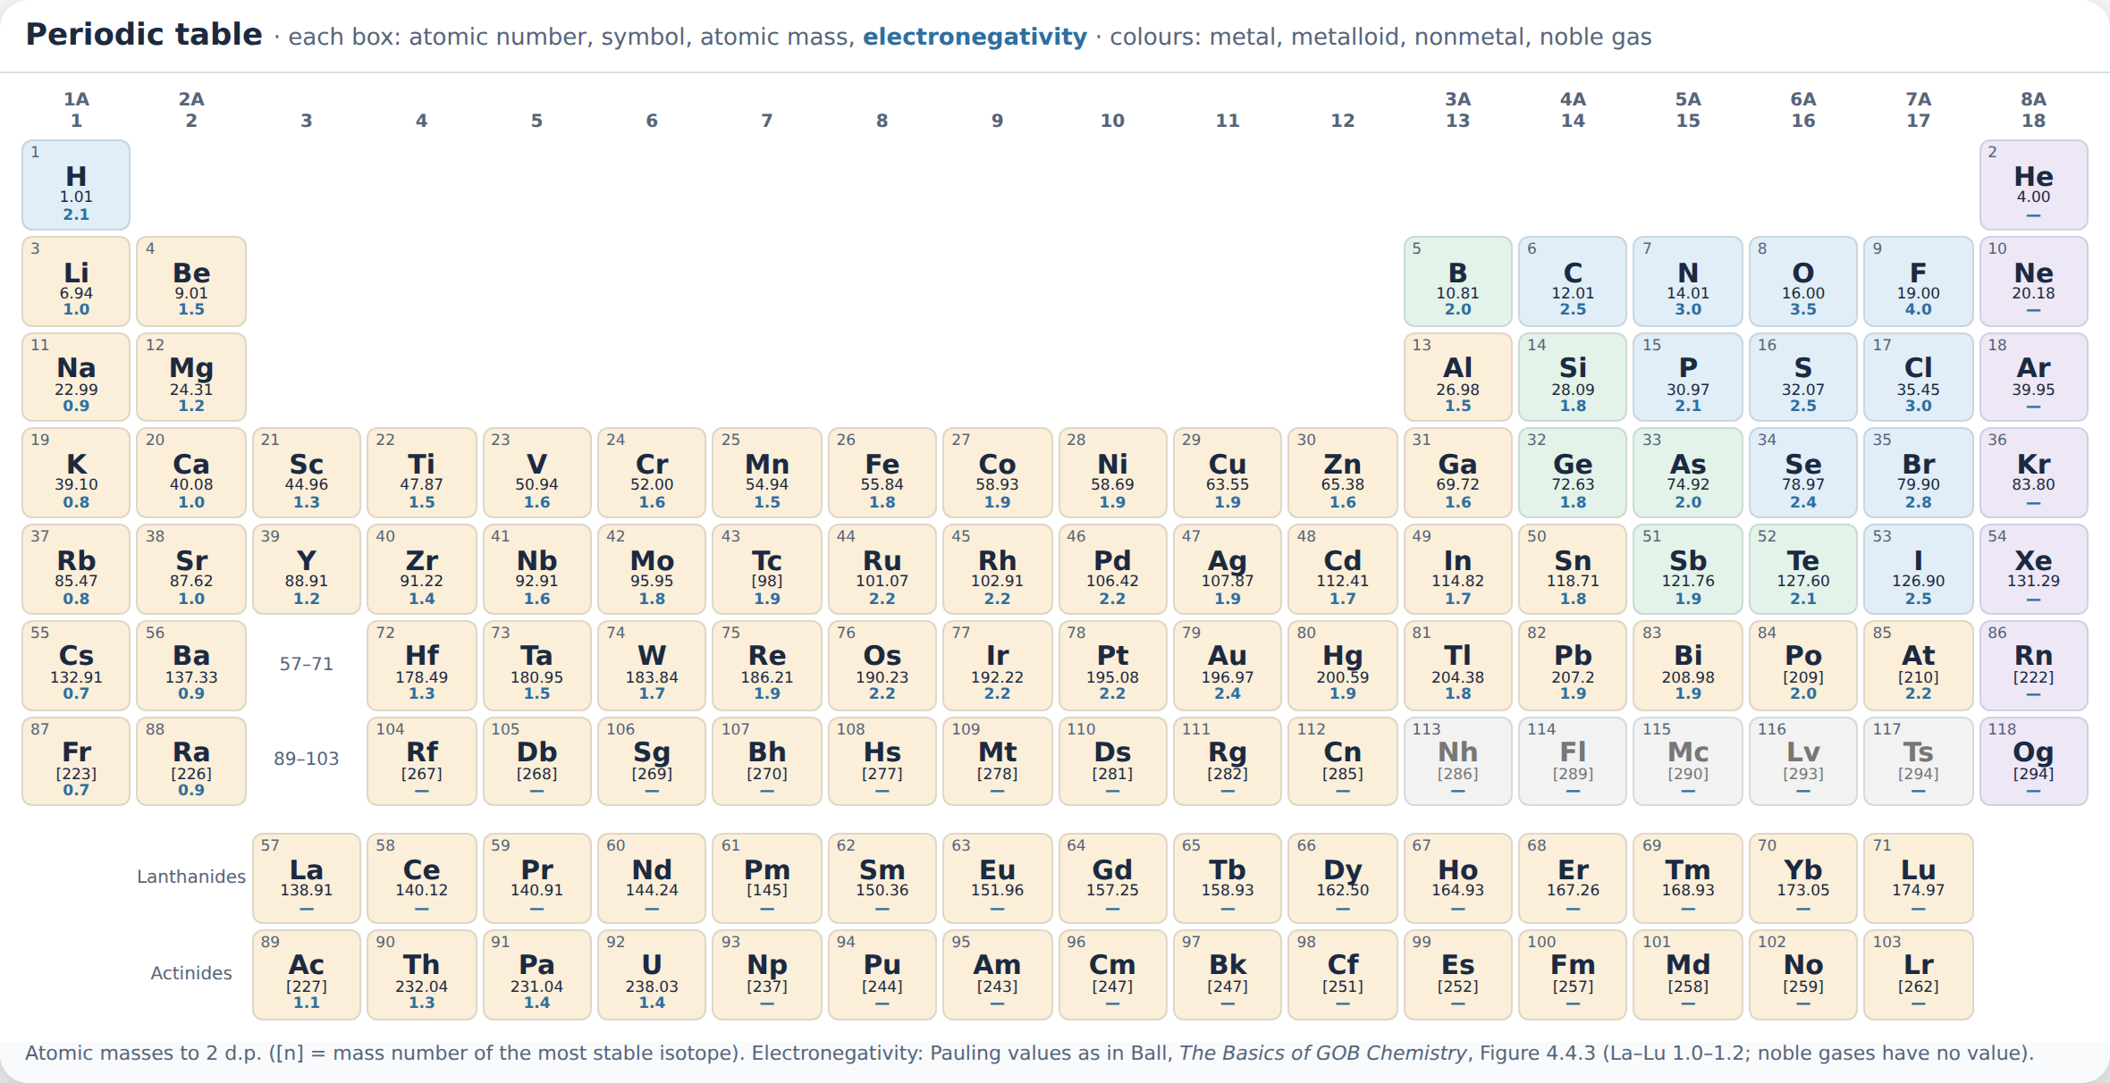
Appendix · Periodic table
PHD115 · Chemical Reactions I
Dr. NAM · Faculty of Pharmacy, UiTM Bertam, Penang
Notes:
Reference periodic table: atomic masses to 2 d.p.; electronegativity values as in Ball Figure 4.4.3. In the interactive slides, press P or tap Periodic table to show it on any slide.

