Slide 1

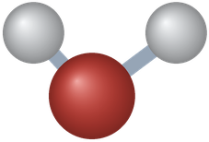
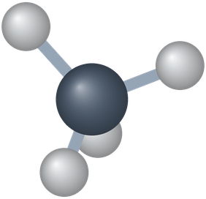
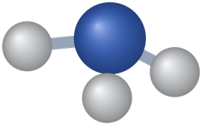
PHD115 Fundamentals of Chemistry
Ionic & Covalent Compounds II
Dr. Nur 'Ainun Mokhtar (Dr. NAM) · Faculty of Pharmacy, UiTM Bertam, Penang
Core reference: Ball, Hill & Scott, The Basics of GOB Chemistry, chapter 4 (4.0–4.5) and section 8.1
PHD115 · Ionic & Covalent II
Dr. NAM · Faculty of Pharmacy, UiTM Bertam, Penang
Notes:
This lecture follows chapter 4 of the core reference (4.0 to 4.5): covalent bonds, naming, Lewis structures, bond polarity, molecular shape and polarity. Part 6 adds intermolecular forces from section 8.1 of the same book.

Slide 2
Learning outcomes
IC2-LO1
IC2-LO2
Describe how covalent bonds form, apply the octet and duet rules, and predict how many bonds an atom forms
Tell ionic, covalent and mixed bonding apart (including polyatomic ions), and write formulas and names of binary covalent compounds
IC2-LO3
IC2-LO4
Draw Lewis structures of molecules and polyatomic ions, including double and triple bonds
Relate bond length to bond type, and use electronegativity to classify bonds as nonpolar, polar or ionic
IC2-LO5
IC2-LO6
Calculate molecular mass, predict molecular shape with VSEPR, and decide whether a molecule is polar
Identify dispersion forces, dipole–dipole forces and hydrogen bonds, and use them to explain boiling points and solubility
PHD115 · Ionic & Covalent II
Dr. NAM · Faculty of Pharmacy, UiTM Bertam, Penang
Notes:
The same six outcomes appear in the notes, activities, tutorial, game and exam questions.

Slide 3
Lecture map
Part 1 · Covalent bonds (Ball 4.1): electron sharing, Lewis diagrams, how many bonds an atom forms
Part 2 · Covalent compounds: formulas and names (Ball 4.2): covalent vs ionic, polyatomic ions, prefixes
Part 3 · Drawing Lewis structures (Ball 4.3): the five-step method, double and triple bonds
Part 4 · Characteristics of covalent bonds (Ball 4.4): bond length, electronegativity, bond polarity
Part 5 · Characteristics of molecules (Ball 4.5): molecular mass, VSEPR shapes, molecular polarity
Part 6 · Intermolecular forces (Ball 8.1): dispersion, dipole–dipole, hydrogen bonding
PHD115 · Ionic & Covalent II
Dr. NAM · Faculty of Pharmacy, UiTM Bertam, Penang
Notes:
Parts 1 to 5 follow the book's order. Part 6 is the bridge to Energy & Matters (phase changes).

Slide 4
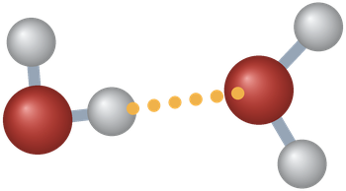
THINK FIRST
Table salt dissolves easily in water. Cholesterol, a waxy solid, does not dissolve in blood. Why do these two compounds behave so differently?
Discuss with a partner for one minute.
PHD115 · Ionic & Covalent II
Dr. NAM · Faculty of Pharmacy, UiTM Bertam, Penang
Notes:
Based on the chapter 4 prelude (cholesterol). Pairs discuss for one minute.

Slide 5
THINK FIRST · ANSWER
Table salt dissolves easily in water. Cholesterol, a waxy solid, does not dissolve in blood. Why do these two compounds behave so differently?
Salt is ionic, and water pulls its ions apart. Cholesterol is a covalent molecule made mostly of nonpolar C–C and C–H bonds, so water does not attract it; blood carries it inside lipoprotein particles. This lecture explains why.
PHD115 · Ionic & Covalent II
Dr. NAM · Faculty of Pharmacy, UiTM Bertam, Penang
Notes:
Based on the chapter 4 prelude (cholesterol). Pairs discuss for one minute.

Slide 6
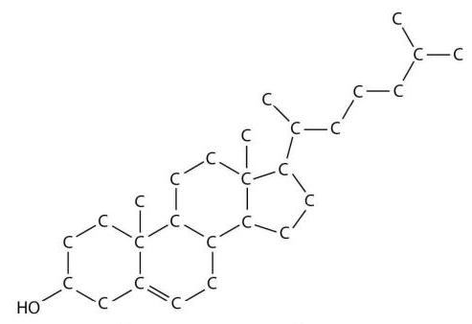
Cholesterol: a covalent molecule
Cholesterol (C₂₇H₄₆O) is a white, waxy solid made in the liver of every animal, including humans.
It is needed to build cell membranes and to make certain hormones.
We also take it in from meat and other animal foods. Excess can build up as plaque on blood vessel walls, blocking arteries: heart attacks and strokes can follow.
Pharmacy link: blood tests measure cholesterol, and several drugs lower it.
A molecular model of cholesterol, Figure 4.0.1 (Ball, The Basics of GOB Chemistry 4.0)
PHD115 · Ionic & Covalent II
Dr. NAM · Faculty of Pharmacy, UiTM Bertam, Penang
Notes:
Ball 4.0 Prelude. Point out that every line in the model is a covalent bond.

Slide 7
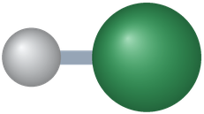
1
PART 1
Covalent bonds
The second way to reach an octet: sharing electrons.
IC2-LO1 · Ball 4.1
PHD115 · Ionic & Covalent II
Dr. NAM · Faculty of Pharmacy, UiTM Bertam, Penang
Notes:
Part 1 = section 4.1.

Slide 8
1
IC2-LO1
Two ways to reach an octet
In IC1 atoms reached an octet by transferring electrons. There is a second way: sharing.
Transfer → ionic bond (IC1)
Sharing → covalent bond (IC2)
Metal loses electrons, nonmetal gains them
Oppositely charged ions attract
Gives ionic compounds such as NaCl
Water (H₂O) is not like this: it is not a metal plus a nonmetal
Two atoms share a pair of electrons
The shared pair counts toward the valence shell of both atoms
Usually between nonmetals
Gives molecules such as H₂, H₂O, CH₄
PHD115 · Ionic & Covalent II
Dr. NAM · Faculty of Pharmacy, UiTM Bertam, Penang
Notes:
Ball 4.1 introduction.

Slide 9
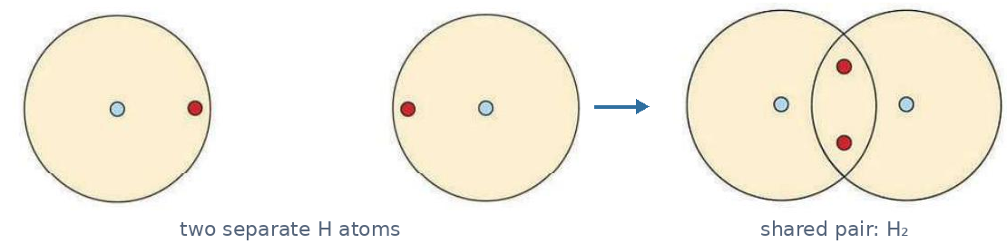
1
IC2-LO1
Electron sharing: the hydrogen molecule
Two hydrogen atoms, then the shared pair in H₂ (Ball, The Basics of GOB Chemistry 4.1)
Each H atom has one electron. Its valence shell is the first shell, which holds only two electrons (the duet rule).
When two H atoms come close enough, they share their electrons: each now has two in its valence shell, which is more stable.
The shared pair is a covalent bond; the two electrons are a bonding pair. A group of atoms joined by covalent bonds is a molecule.
PHD115 · Ionic & Covalent II
Dr. NAM · Faculty of Pharmacy, UiTM Bertam, Penang
Notes:
Ball 4.1 'Electron Sharing'.

Slide 10
1
IC2-LO1
Lewis diagrams for H₂
Two H atoms, the shared pair, and the dash (Ball, The Basics of GOB Chemistry 4.1)
Chemists use Lewis diagrams for covalent bonding. The shared pair sits between the two symbols: H:H.
A dash (H–H) is simpler. A dash is a single bond and always means one pair of electrons.
The H–H bond length is about 74 pm (7.4 × 10⁻¹¹ m). It balances attraction (electrons to nuclei) against repulsion (electron–electron and nucleus–nucleus).
PHD115 · Ionic & Covalent II
Dr. NAM · Faculty of Pharmacy, UiTM Bertam, Penang
Notes:
Ball 4.1. 1 pm = 1 × 10⁻¹² m.

Slide 11

1
IC2-LO1
Fluorine: bonding pairs and lone pairs
Two F atoms form F₂; circles show each atom's octet (Ball, The Basics of GOB Chemistry 4.1)
Fluorine atoms bond in pairs to form diatomic (two-atom) molecules, F₂.
Each F contributes one electron to a single bond, and each now has eight electrons around it: the octet rule is met.
Each F also keeps six electrons (three pairs) that are not shared: nonbonding pairs, also called lone pairs.
PHD115 · Ionic & Covalent II
Dr. NAM · Faculty of Pharmacy, UiTM Bertam, Penang
Notes:
Ball 4.1.

Slide 12
1
IC2-LO1
Covalent bonds between different atoms: HF
H and F each give one electron to make HF (Ball, The Basics of GOB Chemistry 4.1)
H and F each need one more electron, so each contributes one to a shared pair.
H now has a duet and no nonbonding electrons. F has an octet with three lone pairs (six nonbonding electrons).
PHD115 · Ionic & Covalent II
Dr. NAM · Faculty of Pharmacy, UiTM Bertam, Penang
Notes:
Ball 4.1 'Covalent Bonds between Different Atoms'.

Slide 13
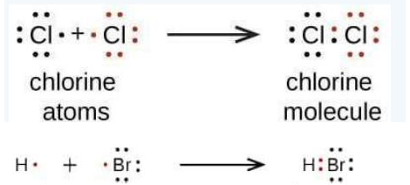
1
IC2-LO1
Example 1.1 · Cl₂ and HBr
Use Lewis diagrams to show the formation of (a) Cl₂ (b) HBr.
1
(a) Each Cl has 7 valence electrons. The two atoms share one pair, so each is surrounded by an octet (like F₂).
2
(b) H (1 electron) and Br (7 electrons) share one pair. H reaches a duet, Br reaches an octet with three lone pairs (like HF).
Example 4.1.1 (Ball, The Basics of GOB Chemistry 4.1)
PHD115 · Ionic & Covalent II
Dr. NAM · Faculty of Pharmacy, UiTM Bertam, Penang
Notes:
Ball Example 4.1.1.

Slide 14
1
IC2-LO1
Try it · ClF and HI
Draw the Lewis diagram for (a) a molecule of one chlorine atom and one fluorine atom (b) a molecule of one hydrogen atom and one iodine atom.
Work it out, then check on the next slide.
PHD115 · Ionic & Covalent II
Dr. NAM · Faculty of Pharmacy, UiTM Bertam, Penang
Notes:
Ball Exercise 4.1.1.

Slide 15
1
IC2-LO1
Try it · ClF and HI · answer
Draw the Lewis diagram for (a) a molecule of one chlorine atom and one fluorine atom (b) a molecule of one hydrogen atom and one iodine atom.
Answer
(a) Cl and F share one pair: each keeps three lone pairs and has an octet. Cl–F.
(b) H and I share one pair: H has a duet, I has an octet with three lone pairs. H–I.
PHD115 · Ionic & Covalent II
Dr. NAM · Faculty of Pharmacy, UiTM Bertam, Penang
Notes:
Ball Exercise 4.1.1.

Slide 16
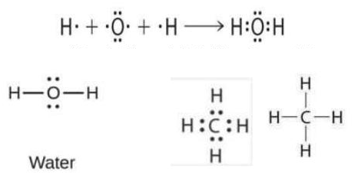
1
IC2-LO1
Covalent bonds in larger molecules
Water and methane (Ball, The Basics of GOB Chemistry 4.1)
Water: two H atoms each share a pair with O. O has two bonding pairs and two lone pairs (an octet); each H has a duet. This is the Lewis structure of H₂O.
Methane (CH₄): the central C shares a pair with each of four H atoms. C reaches an octet, each H a duet.
Some atoms take part in more than one covalent bond.
PHD115 · Ionic & Covalent II
Dr. NAM · Faculty of Pharmacy, UiTM Bertam, Penang
Notes:
Ball 4.1 'Covalent Bonds in Larger Molecules'.

Slide 17
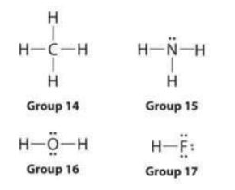
1
IC2-LO1
How many covalent bonds are formed?
An atom forms as many bonds as the electrons it needs to reach an octet.
Atom (group) | Bonds | Lone pairs
Carbon (14 or 4A) | 4 | 0
Nitrogen (15 or 5A) | 3 | 1
Oxygen (16 or 6A) | 2 | 2
Fluorine (17 or 7A) | 1 | 3
In each case bonds + lone pairs = 4 pairs = an octet (Ball Table 4.1).
CH₄, NH₃, H₂O and HF (Ball, The Basics of GOB Chemistry 4.1)
PHD115 · Ionic & Covalent II
Dr. NAM · Faculty of Pharmacy, UiTM Bertam, Penang
Notes:
Ball 4.1 'How Many Covalent Bonds Are Formed?'

Slide 18
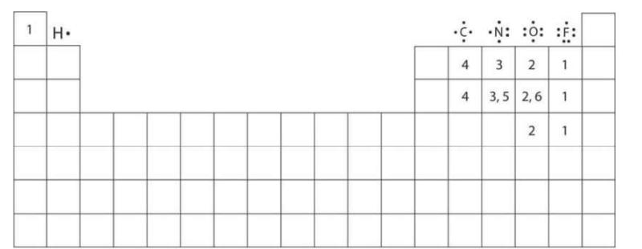
1
IC2-LO1
A pattern across the periodic table
How many covalent bonds are formed? Figure 4.1.1 (Ball, The Basics of GOB Chemistry 4.1)
Each number is the usual number of covalent bonds that atom forms in neutral compounds.
Hydrogen follows the duet rule, so it forms only one bond. It is always a terminal atom, never a central one.
Transition and inner transition elements do not follow the octet rule: their d and f electrons are involved.
PHD115 · Ionic & Covalent II
Dr. NAM · Faculty of Pharmacy, UiTM Bertam, Penang
Notes:
Ball Figure 4.1.1. Some elements (e.g. P and S) show more than one value.

Slide 19

1
IC2-LO1
Example 1.2 · Does OF₂ follow the octet rule?
Count the bonds on each atom in OF₂. Does this match the expected number for each group? Is the octet rule obeyed?
1
F (group 7A) forms one bond; O (group 6A) forms two bonds, as expected.
2
Each atom is surrounded by 8 electrons, so yes, the structure obeys the octet rule.
Example 4.1.2 (Ball, The Basics of GOB Chemistry 4.1)
PHD115 · Ionic & Covalent II
Dr. NAM · Faculty of Pharmacy, UiTM Bertam, Penang
Notes:
Ball Example 4.1.2.

Slide 20
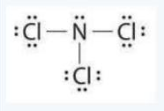
1
IC2-LO1
Try it · NCl₃
Examine the Lewis structure of NCl₃. Count the bonds on each atom. Do they match the expected numbers? Is the octet rule obeyed?
Work it out, then check on the next slide.
PHD115 · Ionic & Covalent II
Dr. NAM · Faculty of Pharmacy, UiTM Bertam, Penang
Notes:
Ball Exercise 4.1.2.

Slide 21
1
IC2-LO1
Try it · NCl₃ · answer
Examine the Lewis structure of NCl₃. Count the bonds on each atom. Do they match the expected numbers? Is the octet rule obeyed?
Answer
Yes. Each Cl (group 7A) has one bond and three lone pairs. The central N (group 5A) has three bonds and one lone pair. Every atom has an octet.
PHD115 · Ionic & Covalent II
Dr. NAM · Faculty of Pharmacy, UiTM Bertam, Penang
Notes:
Ball Exercise 4.1.2.

Slide 22
1
IC2-LO1
Key takeaways: covalent bonds
A covalent bond forms when two atoms share a pair of electrons.
The number of bonds an element forms equals the number of electrons it needs to reach an octet.
Hydrogen is the exception: it needs only two electrons, so it forms one bond.
Check yourself: tellurium (group 6A, like O) forms two bonds, so its hydride is H₂Te. Astatine (a halogen) forms one bond.
A molecule is a discrete group of covalently bonded atoms; a formula unit is the lowest ratio of ions in an ionic crystal.
PHD115 · Ionic & Covalent II
Dr. NAM · Faculty of Pharmacy, UiTM Bertam, Penang
Notes:
Ball 4.1 Key Takeaways and end-of-chapter exercises 4.1.

Slide 23
1
IC2-LO1
Quick check
In a neutral molecule, nitrogen (group 5A) usually has:
A 4 bonds and 0 lone pairs
B 3 bonds and 1 lone pair
C 2 bonds and 2 lone pairs
D 1 bond and 3 lone pairs
PHD115 · Ionic & Covalent II
Dr. NAM · Faculty of Pharmacy, UiTM Bertam, Penang
Notes:
Answer B.

Slide 24
1
IC2-LO1
Quick check · answer
In a neutral molecule, nitrogen (group 5A) usually has:
A 4 bonds and 0 lone pairs
B 3 bonds and 1 lone pair
C 2 bonds and 2 lone pairs
D 1 bond and 3 lone pairs
Answer B. N has five valence electrons: three unpaired (three bonds) and one lone pair. Example: NH₃.
PHD115 · Ionic & Covalent II
Dr. NAM · Faculty of Pharmacy, UiTM Bertam, Penang
Notes:
Answer B.

Slide 25
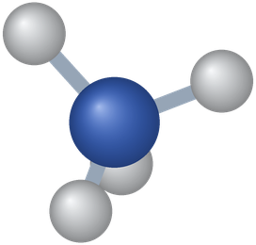
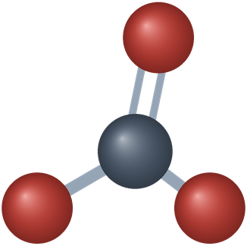
2
PART 2
Covalent compounds: formulas and names
Recognise covalent compounds, then write and name them.
IC2-LO2 · Ball 4.2
PHD115 · Ionic & Covalent II
Dr. NAM · Faculty of Pharmacy, UiTM Bertam, Penang
Notes:
Part 2 = section 4.2.

Slide 26
2
IC2-LO2
Covalent or ionic?
A quick rule of thumb based on the types of elements.
Covalent (molecular) compounds
Ionic compounds
Two or more nonmetals, or a semimetal with a nonmetal
Water H₂O (H and O are nonmetals)
Nitrogen monoxide NO (two nonmetals)
Silicon dioxide SiO₂ (semimetal + nonmetal)
A metal with a nonmetal (or semimetal)
Sodium chloride NaCl
Magnesium chloride MgCl₂
Revise IC1 for formulas and naming
PHD115 · Ionic & Covalent II
Dr. NAM · Faculty of Pharmacy, UiTM Bertam, Penang
Notes:
Ball 4.2 'Covalent and Ionic Compounds'.

Slide 27
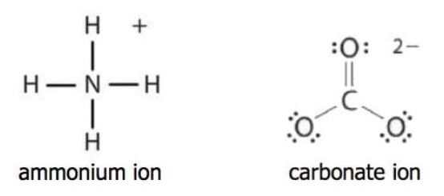
2
IC2-LO2
Polyatomic ions: covalent inside, ionic outside
A polyatomic ion is a group of atoms with an overall charge (poly = many). It behaves as a single unit.
Ammonium, NH₄⁺: one N and four H, joined by covalent bonds, 1+ overall. Carbonate, CO₃²⁻: one C and three O, 2− overall.
In NH₄Cl and CaCO₃ there is ionic bonding between the ions, but covalent bonding within the polyatomic ion. These compounds contain both.
Lewis structures of the ammonium and carbonate ions (Ball, The Basics of GOB Chemistry 4.2)
PHD115 · Ionic & Covalent II
Dr. NAM · Faculty of Pharmacy, UiTM Bertam, Penang
Notes:
Ball 4.2. Links back to the polyatomic ion list in IC1.

Slide 28
2
IC2-LO2
Covalent compounds behave differently
Attractions between neutral molecules are weaker than those between ions.
Property | Covalent (molecular) | Ionic
Melting and boiling points | much lower (water boils at 100 °C) | high (NaCl boils at 1413 °C)
State at room temperature | often liquids or gases | solids
Hardness of solids | typically softer | hard, brittle
Electrical conductivity | poor in any state (neutral molecules) | good when dissolved or molten
Source: Ball 4.2. Forces between molecules are covered in Part 6.
PHD115 · Ionic & Covalent II
Dr. NAM · Faculty of Pharmacy, UiTM Bertam, Penang
Notes:
Ball 4.2 'Characteristics of Covalent (Molecular) Compounds'.

Slide 29
2
IC2-LO2
Example 2.1 · Ionic, covalent or both?
(a) Na₂O (b) Na₃PO₄ (c) N₂O₄
1
(a) Na is a metal and O a nonmetal: ionic.
2
(b) Na is a metal and PO₄³⁻ is the phosphate ion: ionic between the ions, covalent inside phosphate: both.
3
(c) N and O are both nonmetals: covalent.
PHD115 · Ionic & Covalent II
Dr. NAM · Faculty of Pharmacy, UiTM Bertam, Penang
Notes:
Ball Example 4.2.1.

Slide 30
2
IC2-LO2
Try it · Ionic, covalent or both?
(a) Ba(OH)₂ (b) F₂ (c) PCl₃
Work it out, then check on the next slide.
PHD115 · Ionic & Covalent II
Dr. NAM · Faculty of Pharmacy, UiTM Bertam, Penang
Notes:
Ball Exercise 4.2.1.

Slide 31
2
IC2-LO2
Try it · Ionic, covalent or both? · answer
(a) Ba(OH)₂ (b) F₂ (c) PCl₃
Answer
(a) both: Ba²⁺ and OH⁻ ions, with a covalent O–H bond inside hydroxide
(b) covalent (c) covalent
PHD115 · Ionic & Covalent II
Dr. NAM · Faculty of Pharmacy, UiTM Bertam, Penang
Notes:
Ball Exercise 4.2.1.

Slide 32
2
IC2-LO2
Molecular formulas
Covalent compounds exist as separate molecules, so their formulas are called molecular formulas.
Usually start with the nonmetal closest to the lower left of the periodic table, then list the others.
Hydrogen is almost never written first (H₂O is the well-known exception): SiH₄, not H₄Si.
Subscripts give the number of each atom. In NH₃, no subscript on N means one N atom; the 3 means three H atoms.
Ammonia, NH₃
PHD115 · Ionic & Covalent II
Dr. NAM · Faculty of Pharmacy, UiTM Bertam, Penang
Notes:
Ball 4.2 'Molecular Formulas'.

Slide 33
2
IC2-LO2
Numerical prefixes
Atoms | Prefix | Atoms | Prefix
1 | mono-* | 6 | hexa-
2 | di- | 7 | hepta-
3 | tri- | 8 | octa-
4 | tetra- | 9 | nona-
5 | penta- | 10 | deca-
Note
*mono- is not used for the first element.
With oxide, the final vowel of a longer prefix is dropped: monoxide, pentoxide. Short ones keep it: dioxide, trioxide.
Source: Ball Table 4.2.1.
PHD115 · Ionic & Covalent II
Dr. NAM · Faculty of Pharmacy, UiTM Bertam, Penang
Notes:
Ball Table 4.2.1.

Slide 34
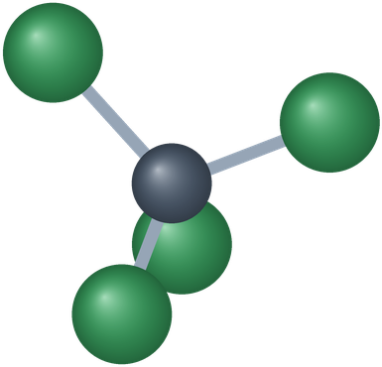
2
IC2-LO2
Naming binary covalent compounds
Name the first element as the element.
Name the second element with its stem + -ide (chlorine → chloride, oxygen → oxide).
Add prefixes for the number of atoms (no mono- on the first element).
Worked: CCl₄ → carbon + chloride + tetra- → carbon tetrachloride.
Unlike ionic names, these names must show the numbers, because two nonmetals can combine in many ratios (NO, NO₂, N₂O₄…).
Carbon tetrachloride, CCl₄
PHD115 · Ionic & Covalent II
Dr. NAM · Faculty of Pharmacy, UiTM Bertam, Penang
Notes:
Ball 4.2 'Naming Covalent Compounds'.

Slide 35
2
IC2-LO2
Example 2.2 · Name → formula
Write the molecular formula: (a) chlorine trifluoride (b) phosphorus pentachloride (c) sulfur dioxide (d) dinitrogen pentoxide
1
No prefix on the first element means one atom of it.
2
(a) ClF₃ (b) PCl₅ (c) SO₂
3
(d) N₂O₅: the di- on nitrogen means two N atoms.
PHD115 · Ionic & Covalent II
Dr. NAM · Faculty of Pharmacy, UiTM Bertam, Penang
Notes:
Ball Example 4.2.2.

Slide 36
2
IC2-LO2
Try it · Name → formula
(a) nitrogen dioxide (b) dioxygen difluoride (c) sulfur hexafluoride (d) selenium monoxide
Work it out, then check on the next slide.
PHD115 · Ionic & Covalent II
Dr. NAM · Faculty of Pharmacy, UiTM Bertam, Penang
Notes:
Ball Exercise 4.2.2.

Slide 37
2
IC2-LO2
Try it · Name → formula · answer
(a) nitrogen dioxide (b) dioxygen difluoride (c) sulfur hexafluoride (d) selenium monoxide
Answer
(a) NO₂ (b) O₂F₂ (c) SF₆ (d) SeO
Sulfur hexafluoride is so unreactive that it is used to suppress sparks in electrical transformers.
PHD115 · Ionic & Covalent II
Dr. NAM · Faculty of Pharmacy, UiTM Bertam, Penang
Notes:
Ball Exercise 4.2.2.

Slide 38
2
IC2-LO2
Example 2.3 · Formula → name
Name: (a) BrF₅ (b) S₂F₂ (c) CO
1
(a) bromine pentafluoride
2
(b) disulfur difluoride
3
(c) carbon monoxide
PHD115 · Ionic & Covalent II
Dr. NAM · Faculty of Pharmacy, UiTM Bertam, Penang
Notes:
Ball Example 4.2.3.

Slide 39
2
IC2-LO2
Try it · Formula → name
Name: (a) CF₄ (b) SeCl₂ (c) SO₃
Work it out, then check on the next slide.
PHD115 · Ionic & Covalent II
Dr. NAM · Faculty of Pharmacy, UiTM Bertam, Penang
Notes:
Ball Exercise 4.2.3.

Slide 40
2
IC2-LO2
Try it · Formula → name · answer
Name: (a) CF₄ (b) SeCl₂ (c) SO₃
Answer
(a) carbon tetrafluoride (b) selenium dichloride (c) sulfur trioxide
PHD115 · Ionic & Covalent II
Dr. NAM · Faculty of Pharmacy, UiTM Bertam, Penang
Notes:
Ball Exercise 4.2.3.

Slide 41
2
IC2-LO2
Common names you must know
Some simple covalent compounds keep common names: H₂O water, NH₃ ammonia, CH₄ methane.
Methane is the simplest organic compound. Organic compounds have their own naming system.
Pharmacy link: N₂O (dinitrogen monoxide) is nitrous oxide, used with oxygen for pain relief. NO (nitrogen monoxide) is nitric oxide, a signalling molecule that relaxes blood vessels; glyceryl trinitrate works by releasing it.
Check yourself
Why is SF₆ written with S first and not as F₆S? S is further to the lower left (less electronegative), so it comes first.
PHD115 · Ionic & Covalent II
Dr. NAM · Faculty of Pharmacy, UiTM Bertam, Penang
Notes:
Ball 4.2 plus end-of-chapter exercise 6. Pharmacy link added by Dr. NAM.

Slide 42
2
IC2-LO2
Quick check
What is the name of SCl₂?
A sulfur(II) chloride
B monosulfur dichloride
C sulfur dichloride
D sulfur chloride
PHD115 · Ionic & Covalent II
Dr. NAM · Faculty of Pharmacy, UiTM Bertam, Penang
Notes:
Answer C.

Slide 43
2
IC2-LO2
Quick check · answer
What is the name of SCl₂?
A sulfur(II) chloride
B monosulfur dichloride
C sulfur dichloride
D sulfur chloride
Answer C. Two nonmetals: prefixes, no mono- on the first element, second element ends in -ide. Roman numerals are only for ionic compounds.
PHD115 · Ionic & Covalent II
Dr. NAM · Faculty of Pharmacy, UiTM Bertam, Penang
Notes:
Answer C.

Slide 44
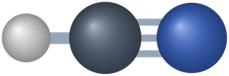
3
PART 3
Drawing Lewis structures
A step-by-step method that works for molecules and polyatomic ions.
IC2-LO3 · Ball 4.3
PHD115 · Ionic & Covalent II
Dr. NAM · Faculty of Pharmacy, UiTM Bertam, Penang
Notes:
Part 3 = section 4.3.

Slide 45
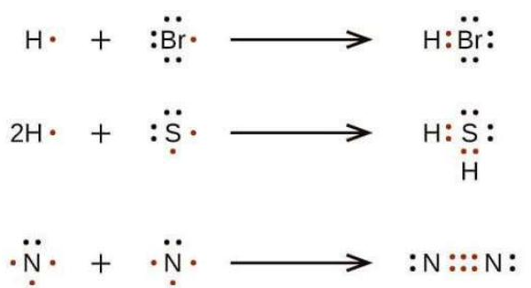
3
IC2-LO3
Simple molecules: pair up the electrons
HBr, H₂S and N₂ from their atoms (Ball, The Basics of GOB Chemistry 4.3)
For very simple molecules, just pair up the unpaired electrons on each atom.
N has three unpaired electrons, so two N atoms share three pairs: a triple bond in N₂.
PHD115 · Ionic & Covalent II
Dr. NAM · Faculty of Pharmacy, UiTM Bertam, Penang
Notes:
Ball 4.3.

Slide 46
3
IC2-LO3
The five-step method
1. Count all valence electrons (group number for each atom). For a cation subtract one per + charge; for an anion add one per − charge.
2. Skeleton: put the least electronegative atom in the centre and join each outer atom with a single bond. H and F are always outer atoms.
3. Outer atoms: put the remaining electrons as lone pairs on the outer atoms (except H) to complete their octets.
4. Central atom: put any electrons left over on the central atom.
5. Multiple bonds: if the central atom still lacks an octet, turn outer lone pairs into shared pairs (double or triple bonds).
Final check
Total electrons used = step 1 count. Every H has 2; every other main-group atom has 8.
PHD115 · Ionic & Covalent II
Dr. NAM · Faculty of Pharmacy, UiTM Bertam, Penang
Notes:
Ball 4.3 'Drawing Lewis Structures'.

Slide 47
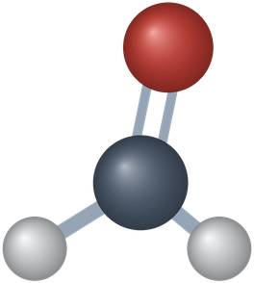
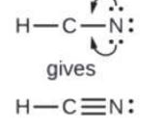
3
IC2-LO3
Example 3.1 · OF₂ and HCN, step by step
Draw the Lewis structures of OF₂ and HCN.
1
Count: OF₂ = 6 + (2 × 7) = 20 e⁻. HCN = 1 + 4 + 5 = 10 e⁻.
2
Skeleton: F–O–F and H–C–N (4 electrons used in each).
3
Outer atoms: 6 on each F; 6 on N. Central atom: the last 4 go on O. HCN has none left.
4
OF₂ is complete. In HCN, C has only 4 electrons, so two N lone pairs become shared: H–C≡N:
Step 5 for HCN (Ball, The Basics of GOB Chemistry 4.3)
PHD115 · Ionic & Covalent II
Dr. NAM · Faculty of Pharmacy, UiTM Bertam, Penang
Notes:
Ball 4.3 worked procedure.

Slide 48
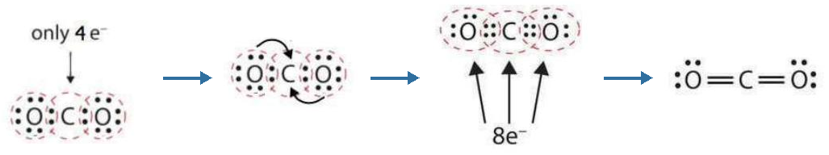
3
IC2-LO3
Multiple bonds: carbon dioxide
Building the double bonds in CO₂ (Ball, The Basics of GOB Chemistry 4.3)
CO₂ has 4 + (2 × 6) = 16 electrons. With single bonds only, C has just 4 electrons.
Each O shares a second pair with C. Now every atom has 8 electrons.
Two shared pairs = a double bond (4 electrons), drawn as a double dash: O=C=O.
PHD115 · Ionic & Covalent II
Dr. NAM · Faculty of Pharmacy, UiTM Bertam, Penang
Notes:
Ball 4.3 'Multiple Bonds'.

Slide 49
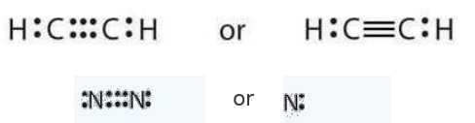
3
IC2-LO3
Triple bonds
Acetylene (C₂H₂) and nitrogen (N₂) (Ball, The Basics of GOB Chemistry 4.3)
In a triple bond, two atoms share three pairs (6 electrons), drawn as three dashes.
Examples: HCN, acetylene H–C≡C–H, and N₂ (:N≡N:).
Clue: when there are too few electrons to give every atom an octet with single bonds, expect multiple bonds.
PHD115 · Ionic & Covalent II
Dr. NAM · Faculty of Pharmacy, UiTM Bertam, Penang
Notes:
Ball 4.3.

Slide 50
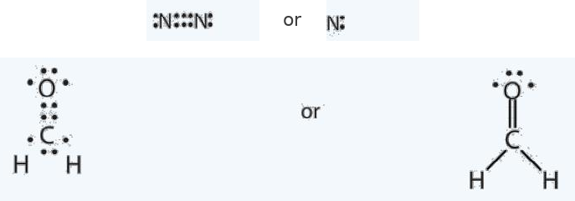
3
IC2-LO3
Example 3.2 · N₂ and formaldehyde
Draw the Lewis diagrams of (a) N₂ (b) CH₂O (C is central).
1
(a) 2 × 5 = 10 electrons. Only a triple bond gives both N atoms an octet: :N≡N:
2
(b) 4 + 2(1) + 6 = 12 electrons. C bonds to two H and to O; a C=O double bond completes the octets.
Example 4.3.1 (Ball, The Basics of GOB Chemistry 4.3)
PHD115 · Ionic & Covalent II
Dr. NAM · Faculty of Pharmacy, UiTM Bertam, Penang
Notes:
Ball Example 4.3.1. Formalin (aqueous CH₂O) preserves biological specimens.

Slide 51
3
IC2-LO3
Try it · O₂ and C₂H₄
Draw the Lewis diagrams of (a) O₂ (b) C₂H₄.
Work it out, then check on the next slide.
PHD115 · Ionic & Covalent II
Dr. NAM · Faculty of Pharmacy, UiTM Bertam, Penang
Notes:
Ball Exercise 4.3.1.

Slide 52
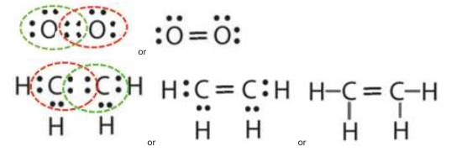
3
IC2-LO3
Try it · O₂ and C₂H₄ · answer
Draw the Lewis diagrams of (a) O₂ (b) C₂H₄.
Answer
(a) 12 electrons: an O=O double bond, two lone pairs on each O.
(b) 12 electrons: a C=C double bond, each C also bonded to two H.
PHD115 · Ionic & Covalent II
Dr. NAM · Faculty of Pharmacy, UiTM Bertam, Penang
Notes:
Ball Exercise 4.3.1.

Slide 53
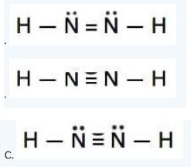
3
IC2-LO3
Example 3.3 · Which structure is right for N₂H₂?
Three structures are proposed for N₂H₂. Which is correct?
1
Count: (2 × 5) + (2 × 1) = 12 electrons.
2
A is correct: 12 electrons, both N have octets, both H have duets.
3
B has only 10 electrons (electron deficient). C has 14 (two extra); the N atoms do not have octets.
Structures A, B and C, Example 4.3.2 (Ball, The Basics of GOB Chemistry 4.3)
PHD115 · Ionic & Covalent II
Dr. NAM · Faculty of Pharmacy, UiTM Bertam, Penang
Notes:
Ball Example 4.3.2.

Slide 54
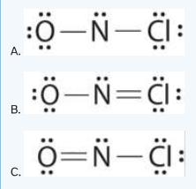
3
IC2-LO3
Try it · Which is right for NOCl?
Which is the correct Lewis structure for NOCl?
Work it out, then check on the next slide.
PHD115 · Ionic & Covalent II
Dr. NAM · Faculty of Pharmacy, UiTM Bertam, Penang
Notes:
Ball Exercise 4.3.2.

Slide 55
3
IC2-LO3
Try it · Which is right for NOCl? · answer
Which is the correct Lewis structure for NOCl?
Answer
C: 6 + 5 + 7 = 18 electrons and every atom has an octet (O=N–Cl).
A: N has only 6 electrons. B: Cl has 10 electrons and the total is 20.
PHD115 · Ionic & Covalent II
Dr. NAM · Faculty of Pharmacy, UiTM Bertam, Penang
Notes:
Ball Exercise 4.3.2.

Slide 56
3
IC2-LO3
Example 3.4 · A polyatomic ion: hydroxide, OH⁻
Draw the Lewis structure of the hydroxide ion, OH⁻.
1
Count: O (6) + H (1) + 1 for the negative charge = 8 electrons.
2
Skeleton O–H uses 2. The remaining 6 go on O as three lone pairs: O has an octet, H a duet.
3
Put the ion in square brackets with the charge outside: [:Ö–H]⁻. Ammonium works the same way: 5 + 4 − 1 = 8 electrons, four N–H bonds, [NH₄]⁺.
PHD115 · Ionic & Covalent II
Dr. NAM · Faculty of Pharmacy, UiTM Bertam, Penang
Notes:
Applies step 1 of Ball 4.3 to an anion. Ammonium's bracketed structure appears in Ball 4.5 (Example 4.5.2).

Slide 57
3
IC2-LO3
Key takeaways: Lewis structures
A Lewis structure shows the bonding and nonbonding electrons around each atom in a molecule.
Some molecules need multiple bonds to satisfy the octet rule.
A double bond contains four electrons; a triple bond contains six.
Hydrogen never forms double bonds: it can share only one pair.
Never draw a double bond for MgO: it is ionic. Mg transfers two electrons to O; nothing is shared.
PHD115 · Ionic & Covalent II
Dr. NAM · Faculty of Pharmacy, UiTM Bertam, Penang
Notes:
Ball 4.3 Key Takeaways plus exercises 4.3 (5, 6).

Slide 58
3
IC2-LO3
Quick check
How many valence electrons must the Lewis structure of CO₂ contain?
A 12
B 16
C 18
D 22
PHD115 · Ionic & Covalent II
Dr. NAM · Faculty of Pharmacy, UiTM Bertam, Penang
Notes:
Answer B.

Slide 59
3
IC2-LO3
Quick check · answer
How many valence electrons must the Lewis structure of CO₂ contain?
A 12
B 16
C 18
D 22
Answer B. C has 4 and each O has 6: 4 + 2(6) = 16.
PHD115 · Ionic & Covalent II
Dr. NAM · Faculty of Pharmacy, UiTM Bertam, Penang
Notes:
Answer B.

Slide 60

4
PART 4
Characteristics of covalent bonds
How long a bond is, and how equally its electrons are shared.
IC2-LO4 · Ball 4.4
PHD115 · Ionic & Covalent II
Dr. NAM · Faculty of Pharmacy, UiTM Bertam, Penang
Notes:
Part 4 = section 4.4.

Slide 61
4
IC2-LO4
Bond length
Every covalent bond has a typical length, which depends on the two atoms.
Bond | Length (pm) | Bond | Length (pm)
H–H | 74 | C–C | 154
H–C | 110 | C–N | 147
H–N | 100 | C–O | 143
H–O | 97 | N–N | 145
H–I | 161 | O–O | 145
Note
The exact length varies a little from molecule to molecule, but stays close to these values.
Bonds to H are short because H is small.
Source: Ball Table 4.4.1 (× 10⁻¹² m).
PHD115 · Ionic & Covalent II
Dr. NAM · Faculty of Pharmacy, UiTM Bertam, Penang
Notes:
Ball Table 4.4.1.

Slide 62
4
IC2-LO4
More bonds, shorter bond
Without exception, as the number of bonds between two atoms increases, the bond gets shorter.
Atoms | Single | Double | Triple
C and C | 154 | 134 | 120
C and N | 147 | 128 | 116
C and O | 143 | 120 | 113
N and N | 145 | 123 | 110
O and O | 145 | 121 | —
Note
More electrons between the two nuclei pull them closer before the nuclei repel each other strongly enough to balance the attraction.
Source: Ball Table 4.4.2 (pm).
PHD115 · Ionic & Covalent II
Dr. NAM · Faculty of Pharmacy, UiTM Bertam, Penang
Notes:
Ball Table 4.4.2.

Slide 63
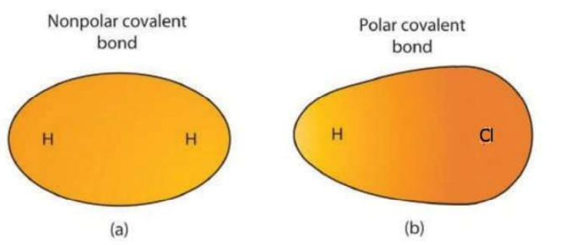
4
IC2-LO4
Nonpolar and polar covalent bonds
Polar versus nonpolar covalent bonds, Figure 4.4.1 (Ball, The Basics of GOB Chemistry 4.4)
In H₂ the two atoms are identical, so the pair is shared equally: a nonpolar covalent bond.
In HCl, Cl attracts the pair more strongly, so electron density is greater around Cl: a polar covalent bond (unequal sharing).
PHD115 · Ionic & Covalent II
Dr. NAM · Faculty of Pharmacy, UiTM Bertam, Penang
Notes:
Ball 4.4 'Electronegativity and Bond Polarity'.

Slide 64
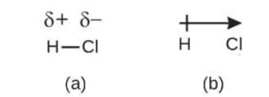
4
IC2-LO4
Showing polarity: δ+, δ− and the dipole arrow
Uneven sharing gives a partial negative charge (δ−) on one atom and a partial positive charge (δ+) on the other.
This separation of charge is an electric dipole (two poles).
The dipole arrow points towards the δ− end; the crossed tail marks the δ+ end.
Figure 4.4.2 (Ball, The Basics of GOB Chemistry 4.4)
PHD115 · Ionic & Covalent II
Dr. NAM · Faculty of Pharmacy, UiTM Bertam, Penang
Notes:
Ball Figure 4.4.2.

Slide 65
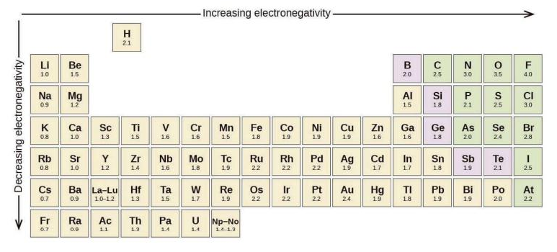
4
IC2-LO4
Electronegativity: the Pauling scale
Electronegativity measures how strongly an atom attracts electrons in a covalent bond.
It increases towards the upper right of the periodic table (noble gases excluded).
Fluorine is highest (4.0). Learn: F 4.0, O 3.5, N 3.0, Cl 3.0, C 2.5, H 2.1, Na 0.9.
Pauling electronegativity values, Figure 4.4.3 (Ball, The Basics of GOB Chemistry 4.4)
PHD115 · Ionic & Covalent II
Dr. NAM · Faculty of Pharmacy, UiTM Bertam, Penang
Notes:
Ball Figure 4.4.3.

Slide 66
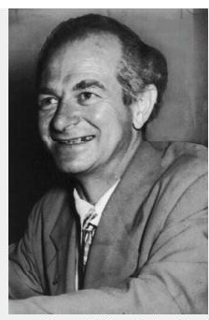
4
IC2-LO4
Looking closer: Linus Pauling
Linus Pauling (1901–94) is the only person to have won two unshared Nobel Prizes.
In the 1930s he set out key principles of the chemical bond; his 1939 book The Nature of the Chemical Bond is one of the most important in chemistry.
He won the 1954 Chemistry Prize for work on protein structure, and the 1962 Peace Prize for opposing nuclear weapons testing.
Later he claimed large doses of vitamin C prevent disease. Most clinical research failed to show this: a reminder that even great scientists need evidence.
Linus Pauling (Ball, The Basics of GOB Chemistry 4.4)
PHD115 · Ionic & Covalent II
Dr. NAM · Faculty of Pharmacy, UiTM Bertam, Penang
Notes:
Ball 4.4 Looking Closer.

Slide 67
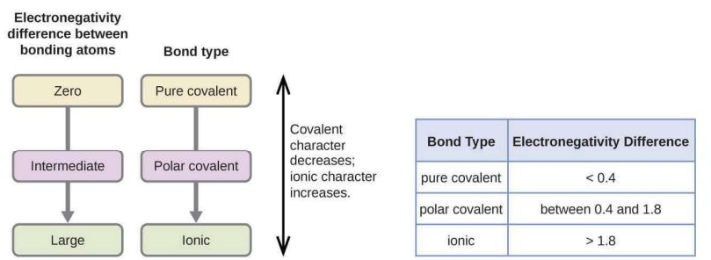
4
IC2-LO4
Electronegativity difference → bond type
Subtract the two electronegativities (larger minus smaller).
Less than 0.4: nonpolar covalent. 0.4 to 1.8: polar covalent. Greater than 1.8: ionic.
A difference of zero (identical atoms) is always nonpolar. Ionic bonds are the extreme of polarity: electrons are transferred, not shared.
Figure 4.4.4 (Ball, The Basics of GOB Chemistry 4.4)
PHD115 · Ionic & Covalent II
Dr. NAM · Faculty of Pharmacy, UiTM Bertam, Penang
Notes:
Ball 4.4. These cut-offs are guidelines, not hard rules.

Slide 68
4
IC2-LO4
Example 4.1 · Classify the bond
Give the electronegativity difference and bond type: (a) C and H (b) H and H (c) Na and Cl (d) O and H
1
(a) 2.5 − 2.1 = 0.4, rather small: C–H is treated as nonpolar.
2
(b) 2.1 − 2.1 = 0: nonpolar.
3
(c) 3.0 − 0.9 = 2.1: ionic.
4
(d) 3.5 − 2.1 = 1.4: a very polar covalent bond, electrons drawn towards O.
PHD115 · Ionic & Covalent II
Dr. NAM · Faculty of Pharmacy, UiTM Bertam, Penang
Notes:
Ball Example 4.4.1.

Slide 69
4
IC2-LO4
Try it · Classify the bond
(a) C and O (b) K and Br (c) N and N (d) Cs and F
K 0.8 · Br 2.8 · Cs 0.7 · C 2.5 · O 3.5 · F 4.0
Work it out, then check on the next slide.
PHD115 · Ionic & Covalent II
Dr. NAM · Faculty of Pharmacy, UiTM Bertam, Penang
Notes:
Ball Exercise 4.4.1.

Slide 70
4
IC2-LO4
Try it · Classify the bond · answer
(a) C and O (b) K and Br (c) N and N (d) Cs and F
K 0.8 · Br 2.8 · Cs 0.7 · C 2.5 · O 3.5 · F 4.0
Answer
(a) 1.0: polar, electrons drawn to O (b) 2.0: ionic
(c) 0: nonpolar (d) 3.3: ionic
PHD115 · Ionic & Covalent II
Dr. NAM · Faculty of Pharmacy, UiTM Bertam, Penang
Notes:
Ball Exercise 4.4.1.

Slide 71
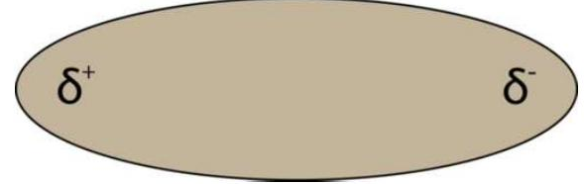
4
IC2-LO4
From bond polarity to molecular polarity
A molecular dipole, Figure 4.4.5 (Ball, The Basics of GOB Chemistry 4.4)
With only one bond, the bond polarity decides the molecule's polarity.
Diatomic molecules of one element (H₂, O₂, Cl₂) are nonpolar. HF has a polar bond, so it is a polar molecule: one end δ+, the other δ−, like the two poles of a magnet.
PHD115 · Ionic & Covalent II
Dr. NAM · Faculty of Pharmacy, UiTM Bertam, Penang
Notes:
Ball 4.4 'Bond Polarity and Molecular Polarity'.

Slide 72
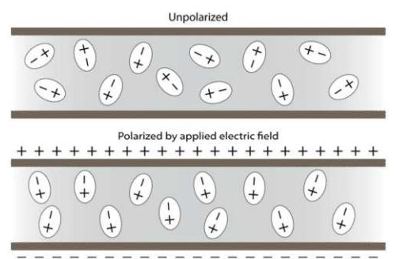
4
IC2-LO4
Polar molecules line up in an electric field
Without a field, polar molecules point in random directions.
Between charged plates, their δ+ ends turn towards the negative plate and their δ− ends towards the positive plate.
Experiments like this show whether a substance is polar, and how polar.
Figure 4.4.6 (Ball, The Basics of GOB Chemistry 4.4)
PHD115 · Ionic & Covalent II
Dr. NAM · Faculty of Pharmacy, UiTM Bertam, Penang
Notes:
Ball Figure 4.4.6.

Slide 73
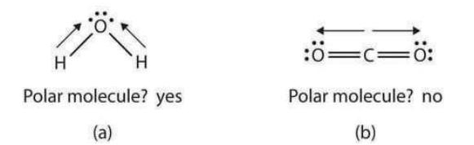
4
IC2-LO4
Shape matters: CO₂ and H₂O
Both molecules have polar bonds. CO₂ is linear: its two equal dipoles point in opposite directions and cancel. CO₂ is nonpolar.
H₂O is bent: the dipoles do not cancel, so water is polar.
Polarity changes properties: water boils at 100 °C, high for such a small molecule; CO₂ becomes a gas at about −78 °C.
Figure 4.4.7 (Ball, The Basics of GOB Chemistry 4.4)
PHD115 · Ionic & Covalent II
Dr. NAM · Faculty of Pharmacy, UiTM Bertam, Penang
Notes:
Ball 4.4. More on shape in Part 5, more on attractions in Part 6.

Slide 74
4
IC2-LO4
Quick check
Which bond is the most polar? (C 2.5, H 2.1, N 3.0, O 3.5, Cl 3.0)
A C–H
B N–H
C O–H
D C–Cl
PHD115 · Ionic & Covalent II
Dr. NAM · Faculty of Pharmacy, UiTM Bertam, Penang
Notes:
Answer C.

Slide 75
4
IC2-LO4
Quick check · answer
Which bond is the most polar? (C 2.5, H 2.1, N 3.0, O 3.5, Cl 3.0)
A C–H
B N–H
C O–H
D C–Cl
Answer C. Differences: C–H 0.4, N–H 0.9, O–H 1.4, C–Cl 0.5. The largest difference is the most polar.
PHD115 · Ionic & Covalent II
Dr. NAM · Faculty of Pharmacy, UiTM Bertam, Penang
Notes:
Answer C.

Slide 76
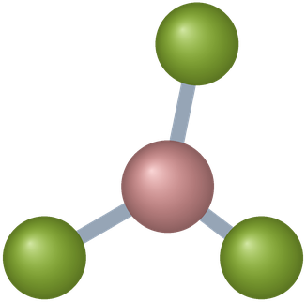
5
PART 5
Characteristics of molecules
Each molecule has its own mass, three-dimensional shape and polarity.
IC2-LO5 · Ball 4.5
PHD115 · Ionic & Covalent II
Dr. NAM · Faculty of Pharmacy, UiTM Bertam, Penang
Notes:
Part 5 = section 4.5.

Slide 77
5
IC2-LO5
Molecular mass
Ions in ionic compounds form crystal lattices. Covalent molecules are discrete units with a characteristic mass and shape.
Molecular mass (molecular weight) = the sum of the masses of all atoms in the molecule, in amu.
Multiply each atomic mass by its subscript, then add. It works like formula mass in IC1.
Masses used: H 1.01, C 12.01, N 14.01, O 16.00, B 10.81, F 19.00.
H₂O: 2(1.01) + 16.00 = 18.02 amu
PHD115 · Ionic & Covalent II
Dr. NAM · Faculty of Pharmacy, UiTM Bertam, Penang
Notes:
Ball 4.5 'Molecular Mass'.

Slide 78
5
IC2-LO5
Example 5.1 · Molecular mass
Find the molecular mass of (a) H₂O (b) C₆H₆ (c) NO₂ (d) N₂O₅
1
(a) 2 × 1.01 + 16.00 = 18.02 amu
2
(b) 6 × 12.01 + 6 × 1.01 = 72.06 + 6.06 = 78.12 amu
3
(c) 14.01 + 2 × 16.00 = 46.01 amu
4
(d) 2 × 14.01 + 5 × 16.00 = 28.02 + 80.00 = 108.02 amu. Same two elements as (c), different mass.
PHD115 · Ionic & Covalent II
Dr. NAM · Faculty of Pharmacy, UiTM Bertam, Penang
Notes:
Ball Example 4.5.1.

Slide 79
5
IC2-LO5
Try it · Molecular mass
(a) C₂H₂ (b) CO (c) CO₂ (d) BF₃
Work it out, then check on the next slide.
PHD115 · Ionic & Covalent II
Dr. NAM · Faculty of Pharmacy, UiTM Bertam, Penang
Notes:
Ball Exercise 4.5.1.

Slide 80
5
IC2-LO5
Try it · Molecular mass · answer
(a) C₂H₂ (b) CO (c) CO₂ (d) BF₃
Answer
(a) 26.04 amu (b) 28.01 amu (c) 44.01 amu (d) 10.81 + 3(19.00) = 67.81 amu
PHD115 · Ionic & Covalent II
Dr. NAM · Faculty of Pharmacy, UiTM Bertam, Penang
Notes:
Ball Exercise 4.5.1.

Slide 81
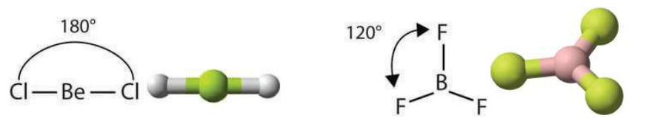
5
IC2-LO5
VSEPR theory: bonds push each other apart
BeCl₂ is linear; BF₃ is trigonal planar (Ball, The Basics of GOB Chemistry 4.5)
Valence shell electron pair repulsion (VSEPR): electron pairs around the central atom repel and stay as far apart as possible.
Two bonds (BeCl₂) → 180° apart: linear. Three bonds (BF₃) → 120° apart in a plane: trigonal planar.
(BeCl₂ and BF₃ are rare exceptions to the octet rule.)
PHD115 · Ionic & Covalent II
Dr. NAM · Faculty of Pharmacy, UiTM Bertam, Penang
Notes:
Ball 4.5 'Molecular Shape: VSEPR Theory'.

Slide 82
5
IC2-LO5
Shapes with no lone pairs on the central atom
Atoms around A | Formula | Shape | Angle | Example
2 | AB₂ | linear | 180° | BeCl₂, CO₂
3 | AB₃ | trigonal planar | 120° | BF₃, CH₂O
4 | AB₄ | tetrahedral | 109.5° | CCl₄, CH₄
Source: Ball 4.5. Four bonds point to the corners of a tetrahedron.
CCl₄: tetrahedral, 109.5°
PHD115 · Ionic & Covalent II
Dr. NAM · Faculty of Pharmacy, UiTM Bertam, Penang
Notes:
Ball 4.5 table.

Slide 83
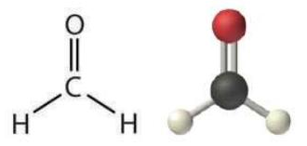
5
IC2-LO5
Multiple bonds count as one
Draw the Lewis structure first.
For shape, a double or triple bond counts as one group.
Formaldehyde (CH₂O) has three groups around C (two C–H and one C=O), so like BF₃ it is trigonal planar.
Formaldehyde, CH₂O (Ball, The Basics of GOB Chemistry 4.5)
PHD115 · Ionic & Covalent II
Dr. NAM · Faculty of Pharmacy, UiTM Bertam, Penang
Notes:
Ball 4.5.

Slide 84
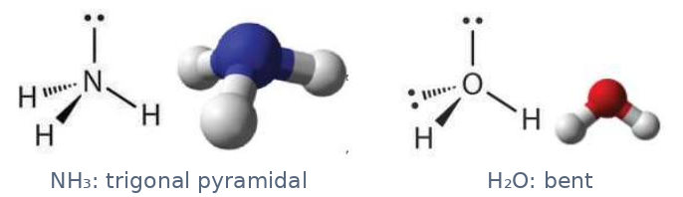
5
IC2-LO5
Lone pairs on the central atom
Ammonia and water (Ball, The Basics of GOB Chemistry 4.5)
Lone pairs also repel, but the shape is named from the atoms only.
NH₃: 3 bonds + 1 lone pair. The four pairs are tetrahedral, but the shape is trigonal pyramidal.
H₂O: 2 bonds + 2 lone pairs → bent, with an angle of about 109.5° (in fact slightly less).
PHD115 · Ionic & Covalent II
Dr. NAM · Faculty of Pharmacy, UiTM Bertam, Penang
Notes:
Ball 4.5 'Molecules With Lone Pairs Around Central Atom'.

Slide 85
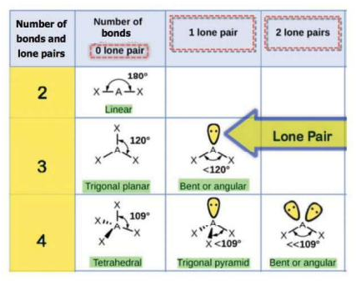
5
IC2-LO5
Predicting the shape in three steps
Step 1: draw the Lewis structure.
Step 2: count bonds (a double or triple bond counts as one) and lone pairs on the central atom.
Step 3: read the shape from the table.
2 + 0 linear · 3 + 0 trigonal planar · 3 + 1 bent (120°) · 4 + 0 tetrahedral · 4 + 1 trigonal pyramidal · 4 + 2 bent (109.5°)
Table 4.5.1 (Ball, The Basics of GOB Chemistry 4.5)
PHD115 · Ionic & Covalent II
Dr. NAM · Faculty of Pharmacy, UiTM Bertam, Penang
Notes:
Ball Table 4.5.1.

Slide 86
5
IC2-LO5
VSEPR shapes in 3D
Linear
Trigonal planar
Tetrahedral
Trigonal pyramidal
Bent
CO₂ · 2 groups · 180°
BF₃ · 3 groups · 120°
CH₄ · 4 bonds · 109.5°
NH₃ · 3 bonds + 1 lone pair
H₂O · 2 bonds + 2 lone pairs
PHD115 · Ionic & Covalent II
Dr. NAM · Faculty of Pharmacy, UiTM Bertam, Penang
Notes:
The models rotate so students can see the 3D arrangement. On small phones the models are hidden; the labels still apply.

Slide 87
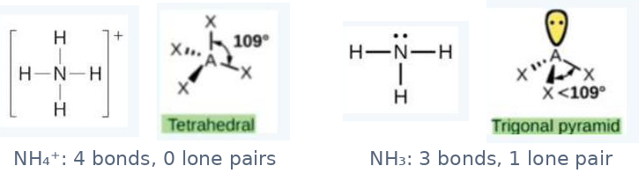
5
IC2-LO5
Example 5.2 · NH₄⁺ versus NH₃
What is the shape of the ammonium ion, NH₄⁺? How is it different from ammonia, NH₃?
1
NH₄⁺: N has 4 bonds and no lone pair → tetrahedral (109.5°).
2
NH₃: N has 3 bonds and 1 lone pair → trigonal pyramidal (angle a little under 109.5°).
Example 4.5.2 (Ball, The Basics of GOB Chemistry 4.5)
PHD115 · Ionic & Covalent II
Dr. NAM · Faculty of Pharmacy, UiTM Bertam, Penang
Notes:
Ball Example 4.5.2.

Slide 88

5
IC2-LO5
Try it · Nitrosyl chloride
What is the shape of nitrosyl chloride (NOCl), a corrosive reddish-orange gas?
Work it out, then check on the next slide.
PHD115 · Ionic & Covalent II
Dr. NAM · Faculty of Pharmacy, UiTM Bertam, Penang
Notes:
Ball Exercise 4.5.1 (shape).

Slide 89
5
IC2-LO5
Try it · Nitrosyl chloride · answer
What is the shape of nitrosyl chloride (NOCl), a corrosive reddish-orange gas?
Answer
The central N has a double bond to O (count as one) and a single bond to Cl: 2 bonds + 1 lone pair. The three groups spread about 120° apart, but the shape counts atoms only: bent (angular), less than 120°.
PHD115 · Ionic & Covalent II
Dr. NAM · Faculty of Pharmacy, UiTM Bertam, Penang
Notes:
Ball Exercise 4.5.1 (shape).

Slide 90
5
IC2-LO5
Molecular polarity: the rules
If all bonds are nonpolar, the molecule is nonpolar: I₂, O₂, H₂, CH₄, C₂H₆, C₃H₈.
If it has polar bonds, it is polar unless the bond dipoles cancel because of a symmetrical shape.
Symmetrical shapes with identical outer atoms and no lone pairs on the centre (linear AB₂, trigonal planar AB₃, tetrahedral AB₄) are nonpolar.
Lone pairs on the centre (bent, pyramidal), or different outer atoms, usually make the molecule polar.
PHD115 · Ionic & Covalent II
Dr. NAM · Faculty of Pharmacy, UiTM Bertam, Penang
Notes:
Ball 4.5 'Molecular Polarity'.

Slide 91
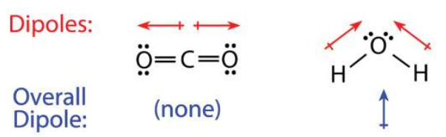
5
IC2-LO5
Linear vs bent: CO₂ and H₂O
Figure 4.5.1 (Ball, The Basics of GOB Chemistry 4.5)
CO₂: the two C=O dipoles are directly opposite: no overall dipole, nonpolar.
H₂O: the two O–H dipoles (red) are not opposite. The net dipole (blue) points towards O: polar, with δ− on O and δ+ between the H atoms.
PHD115 · Ionic & Covalent II
Dr. NAM · Faculty of Pharmacy, UiTM Bertam, Penang
Notes:
Ball Figure 4.5.1.

Slide 92
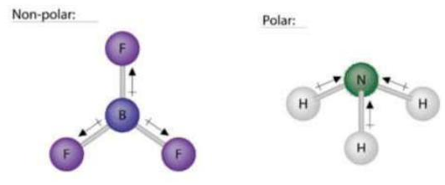
5
IC2-LO5
Trigonal planar vs trigonal pyramidal
BF₃ (trigonal planar): each B–F dipole is cancelled by the sum of the other two: nonpolar.
NH₃ (trigonal pyramidal): the lone pair pushes the N–H bonds to one side. The dipoles add up: polar.
BF₃ and NH₃, Figure 4.5.2 (Ball, The Basics of GOB Chemistry 4.5)
PHD115 · Ionic & Covalent II
Dr. NAM · Faculty of Pharmacy, UiTM Bertam, Penang
Notes:
Ball Figure 4.5.2.

Slide 93
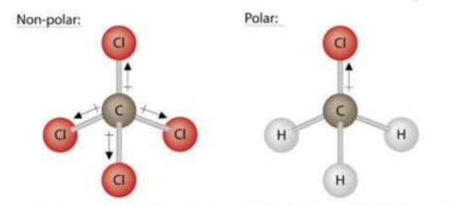
5
IC2-LO5
Same shape, different outer atoms
Both are tetrahedral.
CCl₄: four identical C–Cl dipoles cancel: nonpolar.
CH₃Cl: one C–Cl bond and three C–H bonds of different polarity do not cancel: polar.
CCl₄ and CH₃Cl, Figure 4.5.3 (Ball, The Basics of GOB Chemistry 4.5)
PHD115 · Ionic & Covalent II
Dr. NAM · Faculty of Pharmacy, UiTM Bertam, Penang
Notes:
Ball Figure 4.5.3.

Slide 94
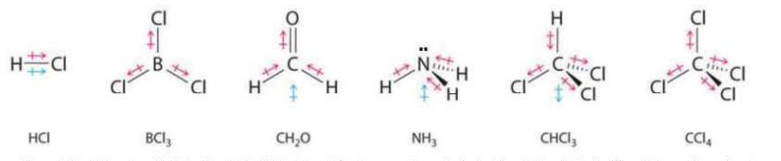
5
IC2-LO5
Molecules with polar bonds: a gallery
Figure 4.5.4 (Ball, The Basics of GOB Chemistry 4.5)
Red arrows are bond dipoles; blue arrows are the net molecular dipole.
Polar: HCl, CH₂O, NH₃, CHCl₃. Nonpolar (dipoles cancel by symmetry): BCl₃, CCl₄.
PHD115 · Ionic & Covalent II
Dr. NAM · Faculty of Pharmacy, UiTM Bertam, Penang
Notes:
Ball Figure 4.5.4.

Slide 95
5
IC2-LO5
Ionic vs molecular compounds
Property | Ionic compounds | Molecular compounds
Type of elements | metal and nonmetal | nonmetals only
Bonding | ionic: electrons transferred | covalent: electron pairs shared
Representative unit | formula unit | molecule
State at room temperature | solid | gas, liquid or solid
Water solubility | usually high | variable
Melting and boiling points | generally high | generally low
Electrical conductivity | good when molten or in solution | poor
Source: Ball Table 4.5.2. Covalent compounds are also softer and often more flammable.
PHD115 · Ionic & Covalent II
Dr. NAM · Faculty of Pharmacy, UiTM Bertam, Penang
Notes:
Ball 4.5 'Physical Properties of Molecular Compounds'.

Slide 96
5
IC2-LO5
Example 5.3 · Shape and polarity
Describe the shape of each molecule and say whether it is polar: (a) PCl₃ (b) CO₂
1
(a) P has 3 bonds + 1 lone pair: like NH₃, trigonal pyramidal. The P–Cl dipoles do not cancel: polar.
2
(b) C has two double bonds, counted as 2 groups with no lone pairs: linear. The opposite dipoles cancel: nonpolar.
PHD115 · Ionic & Covalent II
Dr. NAM · Faculty of Pharmacy, UiTM Bertam, Penang
Notes:
Ball Example 4.5.3.

Slide 97
5
IC2-LO5
Try it · Shape and polarity
(a) CBr₄ (b) BCl₃
Work it out, then check on the next slide.
PHD115 · Ionic & Covalent II
Dr. NAM · Faculty of Pharmacy, UiTM Bertam, Penang
Notes:
Ball Exercise 4.5.2.

Slide 98
5
IC2-LO5
Try it · Shape and polarity · answer
(a) CBr₄ (b) BCl₃
Answer
(a) 4 identical groups, no lone pair: tetrahedral, symmetrical, nonpolar.
(b) 3 identical groups, no lone pair: trigonal planar, symmetrical, nonpolar.
PHD115 · Ionic & Covalent II
Dr. NAM · Faculty of Pharmacy, UiTM Bertam, Penang
Notes:
Ball Exercise 4.5.2.

Slide 99
5
IC2-LO5
Key takeaways: molecules
A molecule has a definite molecular mass: add up all its atomic masses.
Simple molecular shapes can be predicted with VSEPR theory: count bonding groups and lone pairs on the central atom.
Polar molecules result from electronegativity differences in an unsymmetrical shape.
Dipoles that point directly opposite each other cancel.
PHD115 · Ionic & Covalent II
Dr. NAM · Faculty of Pharmacy, UiTM Bertam, Penang
Notes:
Ball 4.5 Key Takeaways.

Slide 100
5
IC2-LO5
Quick check
Which molecule is polar?
A CO₂
B CCl₄
C BF₃
D NH₃
PHD115 · Ionic & Covalent II
Dr. NAM · Faculty of Pharmacy, UiTM Bertam, Penang
Notes:
Answer D.

Slide 101
5
IC2-LO5
Quick check · answer
Which molecule is polar?
A CO₂
B CCl₄
C BF₃
D NH₃
Answer D. NH₃ is trigonal pyramidal (a lone pair on N), so its bond dipoles do not cancel. The other three are symmetrical and nonpolar.
PHD115 · Ionic & Covalent II
Dr. NAM · Faculty of Pharmacy, UiTM Bertam, Penang
Notes:
Answer D.

Slide 102

6
PART 6
Intermolecular forces
The attractions between molecules that decide boiling points and solubility.
IC2-LO6 · Ball 8.1
PHD115 · Ionic & Covalent II
Dr. NAM · Faculty of Pharmacy, UiTM Bertam, Penang
Notes:
Part 6 is from section 8.1 of the same book. It leads into Energy & Matters (phase changes).

Slide 103
6
IC2-LO6
Bonds inside, forces between
A covalent bond holds atoms together within a molecule. Intermolecular forces are weaker attractions between molecules.
Covalent bonds (intramolecular)
Intermolecular forces
Hold the atoms of one molecule together
Strong: broken only in chemical reactions
Example: the O–H bonds inside H₂O
Hold separate molecules close to each other
Much weaker: overcome when a substance melts or boils
Stronger forces → higher melting and boiling points
Three types: dispersion, dipole–dipole, hydrogen bonding
PHD115 · Ionic & Covalent II
Dr. NAM · Faculty of Pharmacy, UiTM Bertam, Penang
Notes:
Ball 8.1 introduction. When water boils, H₂O molecules separate; the O–H bonds do not break.

Slide 104
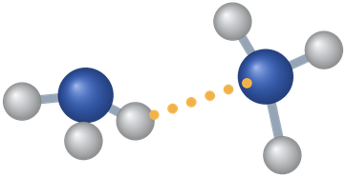
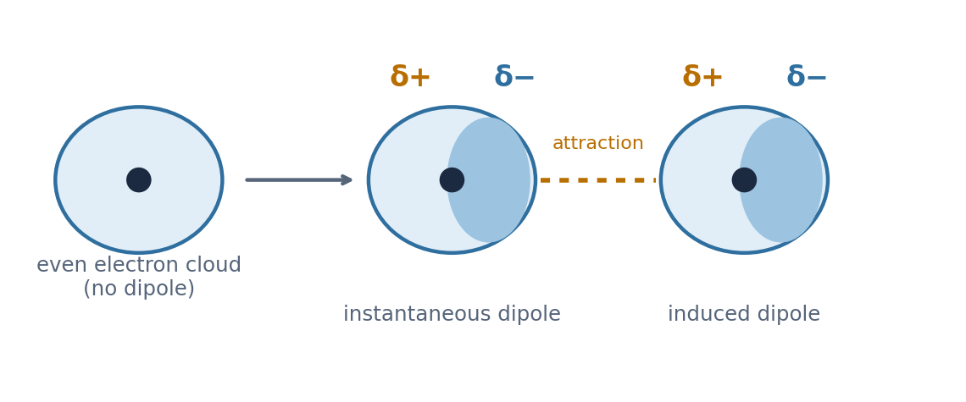
6
IC2-LO6
London dispersion forces
A momentary uneven electron cloud induces a dipole in a neighbour (Dr. NAM, after Ball 8.1)
Electrons move constantly, so for an instant a molecule's electron cloud can be uneven: a temporary (instantaneous) dipole. It induces a dipole in a neighbour, and the two attract.
Present in all molecules, polar or nonpolar. The only force between nonpolar molecules (H₂, CH₄, I₂).
Stronger in larger molecules with more electrons: at room temperature F₂ and Cl₂ are gases, Br₂ a liquid and I₂ a solid.
PHD115 · Ionic & Covalent II
Dr. NAM · Faculty of Pharmacy, UiTM Bertam, Penang
Notes:
Ball 8.1 'London dispersion forces'. Boiling points: F₂ −188 °C, Cl₂ −34 °C, Br₂ 59 °C, I₂ 184 °C.

Slide 105
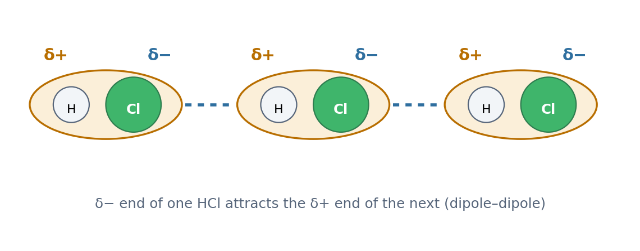
6
IC2-LO6
Dipole–dipole forces
Polar HCl molecules attract head to tail (Dr. NAM, after Ball 8.1)
Polar molecules have permanent dipoles (Part 4).
The δ− end of one molecule attracts the δ+ end of the next: a dipole–dipole force, in addition to dispersion.
So a polar molecule usually boils higher than a nonpolar one of similar size.
PHD115 · Ionic & Covalent II
Dr. NAM · Faculty of Pharmacy, UiTM Bertam, Penang
Notes:
Ball 8.1 'Dipole–dipole interactions'.

Slide 106
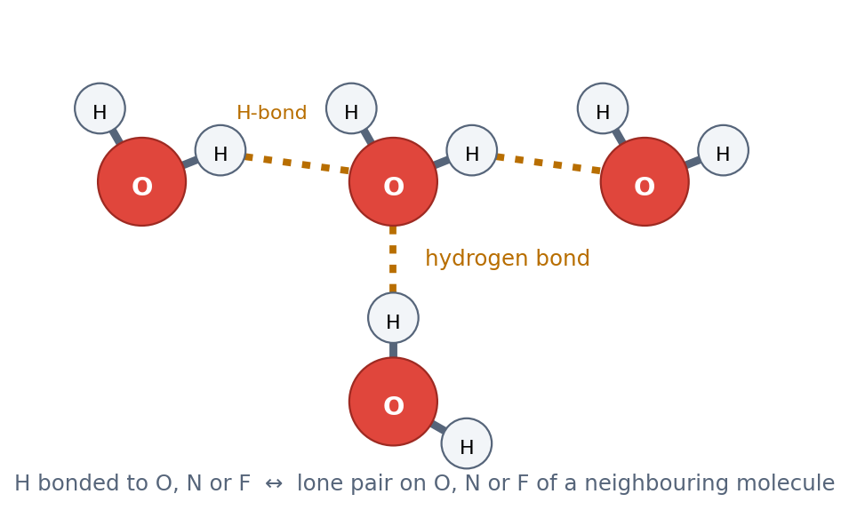
6
IC2-LO6
Hydrogen bonding
Hydrogen bonds between water molecules (Dr. NAM, after Ball 8.1)
An especially strong dipole–dipole attraction. It needs H bonded directly to N, O or F, attracted to a lone pair on N, O or F of another molecule.
N, O and F are small and very electronegative, so the H is strongly δ+.
The strongest intermolecular force. It is not a covalent bond: it is an attraction between molecules.
PHD115 · Ionic & Covalent II
Dr. NAM · Faculty of Pharmacy, UiTM Bertam, Penang
Notes:
Ball 8.1 'Hydrogen bonding'.

Slide 107
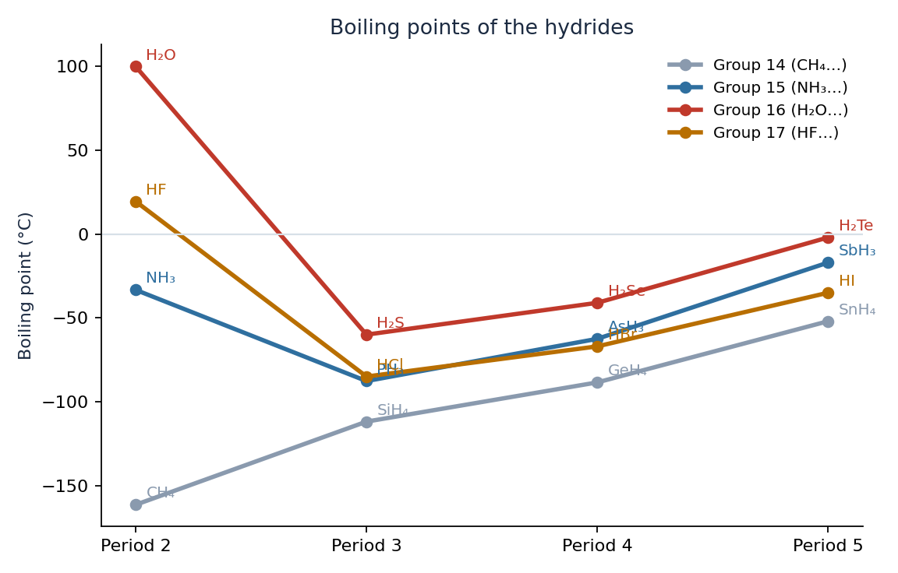
6
IC2-LO6
Evidence: boiling points of the hydrides
Down each group, boiling points rise: bigger molecules, stronger dispersion forces.
Group 14 (CH₄…) is nonpolar and follows the trend all the way.
H₂O, HF and NH₃ break the trend: far higher than expected because of hydrogen bonding. Without it, water would boil below −80 °C.
Normal boiling points (°C) of hydrides of groups 14 to 17 (Dr. NAM; standard data)
PHD115 · Ionic & Covalent II
Dr. NAM · Faculty of Pharmacy, UiTM Bertam, Penang
Notes:
Values: CH₄ −161.5, SiH₄ −112, GeH₄ −88.5, SnH₄ −52; NH₃ −33, PH₃ −88, AsH₃ −62.5, SbH₃ −17; H₂O 100, H₂S −60, H₂Se −41, H₂Te −2; HF 19.5, HCl −85, HBr −67, HI −35.

Slide 108
6
IC2-LO6
The three forces compared
Weakest → strongest (for molecules of similar size).
Dispersion
Dipole–dipole
Hydrogen bonding
Found in: all molecules
Cause: temporary dipoles
Only force in: H₂, O₂, CH₄, CO₂, CCl₄
Found in: polar molecules
Cause: permanent dipoles
Examples: HCl, CH₂O, CH₃Cl
Found in: H–N, H–O, H–F molecules
Cause: strongly δ+ H meets a lone pair
Examples: H₂O, NH₃, HF, ethanol
PHD115 · Ionic & Covalent II
Dr. NAM · Faculty of Pharmacy, UiTM Bertam, Penang
Notes:
Summary of Ball 8.1.

Slide 109
6
IC2-LO6
Example 6.1 · Strongest intermolecular force
What is the strongest intermolecular force in (a) CH₄ (b) HCl (c) H₂O (d) NH₃?
1
(a) CH₄ is nonpolar: dispersion only.
2
(b) HCl is polar, but H is bonded to Cl, not N, O or F: dipole–dipole.
3
(c) H is bonded to O: hydrogen bonding.
4
(d) H is bonded to N: hydrogen bonding.
PHD115 · Ionic & Covalent II
Dr. NAM · Faculty of Pharmacy, UiTM Bertam, Penang
Notes:
In the style of Ball 8.1 examples.

Slide 110
6
IC2-LO6
Try it · Rank by boiling point
Rank CH₄, H₂O and HCl from lowest to highest boiling point. Explain your order.
Work it out, then check on the next slide.
PHD115 · Ionic & Covalent II
Dr. NAM · Faculty of Pharmacy, UiTM Bertam, Penang
Notes:
Uses the data on the hydride chart.

Slide 111
6
IC2-LO6
Try it · Rank by boiling point · answer
Rank CH₄, H₂O and HCl from lowest to highest boiling point. Explain your order.
Answer
CH₄ HCl H₂O (−162 °C, −85 °C, 100 °C).
CH₄ has dispersion only; HCl adds dipole–dipole forces; H₂O has hydrogen bonds, the strongest.
PHD115 · Ionic & Covalent II
Dr. NAM · Faculty of Pharmacy, UiTM Bertam, Penang
Notes:
Uses the data on the hydride chart.

Slide 112
6
IC2-LO6
Why it matters in pharmacy
Like dissolves like: polar and hydrogen-bonding substances dissolve in water; nonpolar substances (fats, cholesterol) do not. Drugs that must dissolve in body fluids usually need polar groups.
Water's hydrogen bonds give it a high boiling point and make it an excellent solvent for many drugs and ions.
Hydrogen bonds hold the two strands of DNA together and help fold proteins into shape.
Drugs bind to their target proteins mainly through intermolecular forces, especially hydrogen bonds.
PHD115 · Ionic & Covalent II
Dr. NAM · Faculty of Pharmacy, UiTM Bertam, Penang
Notes:
Ball 4.5 notes that H-bonding and dipole–dipole substances are generally water soluble, dispersion-only ones generally insoluble.

Slide 113
6
IC2-LO6
Quick check
Which substance forms hydrogen bonds between its own molecules?
A CH₄
B H₂S
C HF
D CO₂
PHD115 · Ionic & Covalent II
Dr. NAM · Faculty of Pharmacy, UiTM Bertam, Penang
Notes:
Answer C.

Slide 114
6
IC2-LO6
Quick check · answer
Which substance forms hydrogen bonds between its own molecules?
A CH₄
B H₂S
C HF
D CO₂
Answer C. HF has H bonded directly to F, and F has lone pairs. In H₂S the H is bonded to S, which is not N, O or F.
PHD115 · Ionic & Covalent II
Dr. NAM · Faculty of Pharmacy, UiTM Bertam, Penang
Notes:
Answer C.

Slide 115
Summary: key rules
Covalent bond
shared pair · C 4 bonds, N 3, O 2, halogen 1, H 1
Covalent or ionic
nonmetals → covalent · metal + nonmetal → ionic
Naming
prefixes + -ide · N₂O₅ dinitrogen pentoxide
Lewis structure
count e⁻ → skeleton → octets → multiple bonds
Bond type (ΔEN)
0.4 nonpolar · 0.4–1.8 polar · > 1.8 ionic
VSEPR
2 linear · 3 planar · 4 tetrahedral · 3+1 pyramidal · 2+2 bent
Molecular polarity
polar bonds + unsymmetrical shape → polar
Intermolecular forces
dispersion dipole–dipole H-bond (H on N, O, F)
PHD115 · Ionic & Covalent II
Dr. NAM · Faculty of Pharmacy, UiTM Bertam, Penang
Notes:
Everything here appears in the summary page of the notes.

Slide 116
Before the next topic
1
Complete the post-lecture activity
2
Attempt the tutorial questions
3
Play the game to find your weak outcomes
4
Next topic: Energy & Matters
Adapted from The Basics of GOB Chemistry (Ball, Hill & Scott), LibreTexts, CC BY-NC-SA 3.0, sections 4.0–4.5 and 8.1. Linus Pauling photograph as reproduced in Ball 4.4. Part 6 diagrams and chart drawn by Dr. NAM. Shared under the same licence for non-commercial teaching.
PHD115 · Ionic & Covalent II
Dr. NAM · Faculty of Pharmacy, UiTM Bertam, Penang
Notes:
Point students to the study hub.

Slide 117
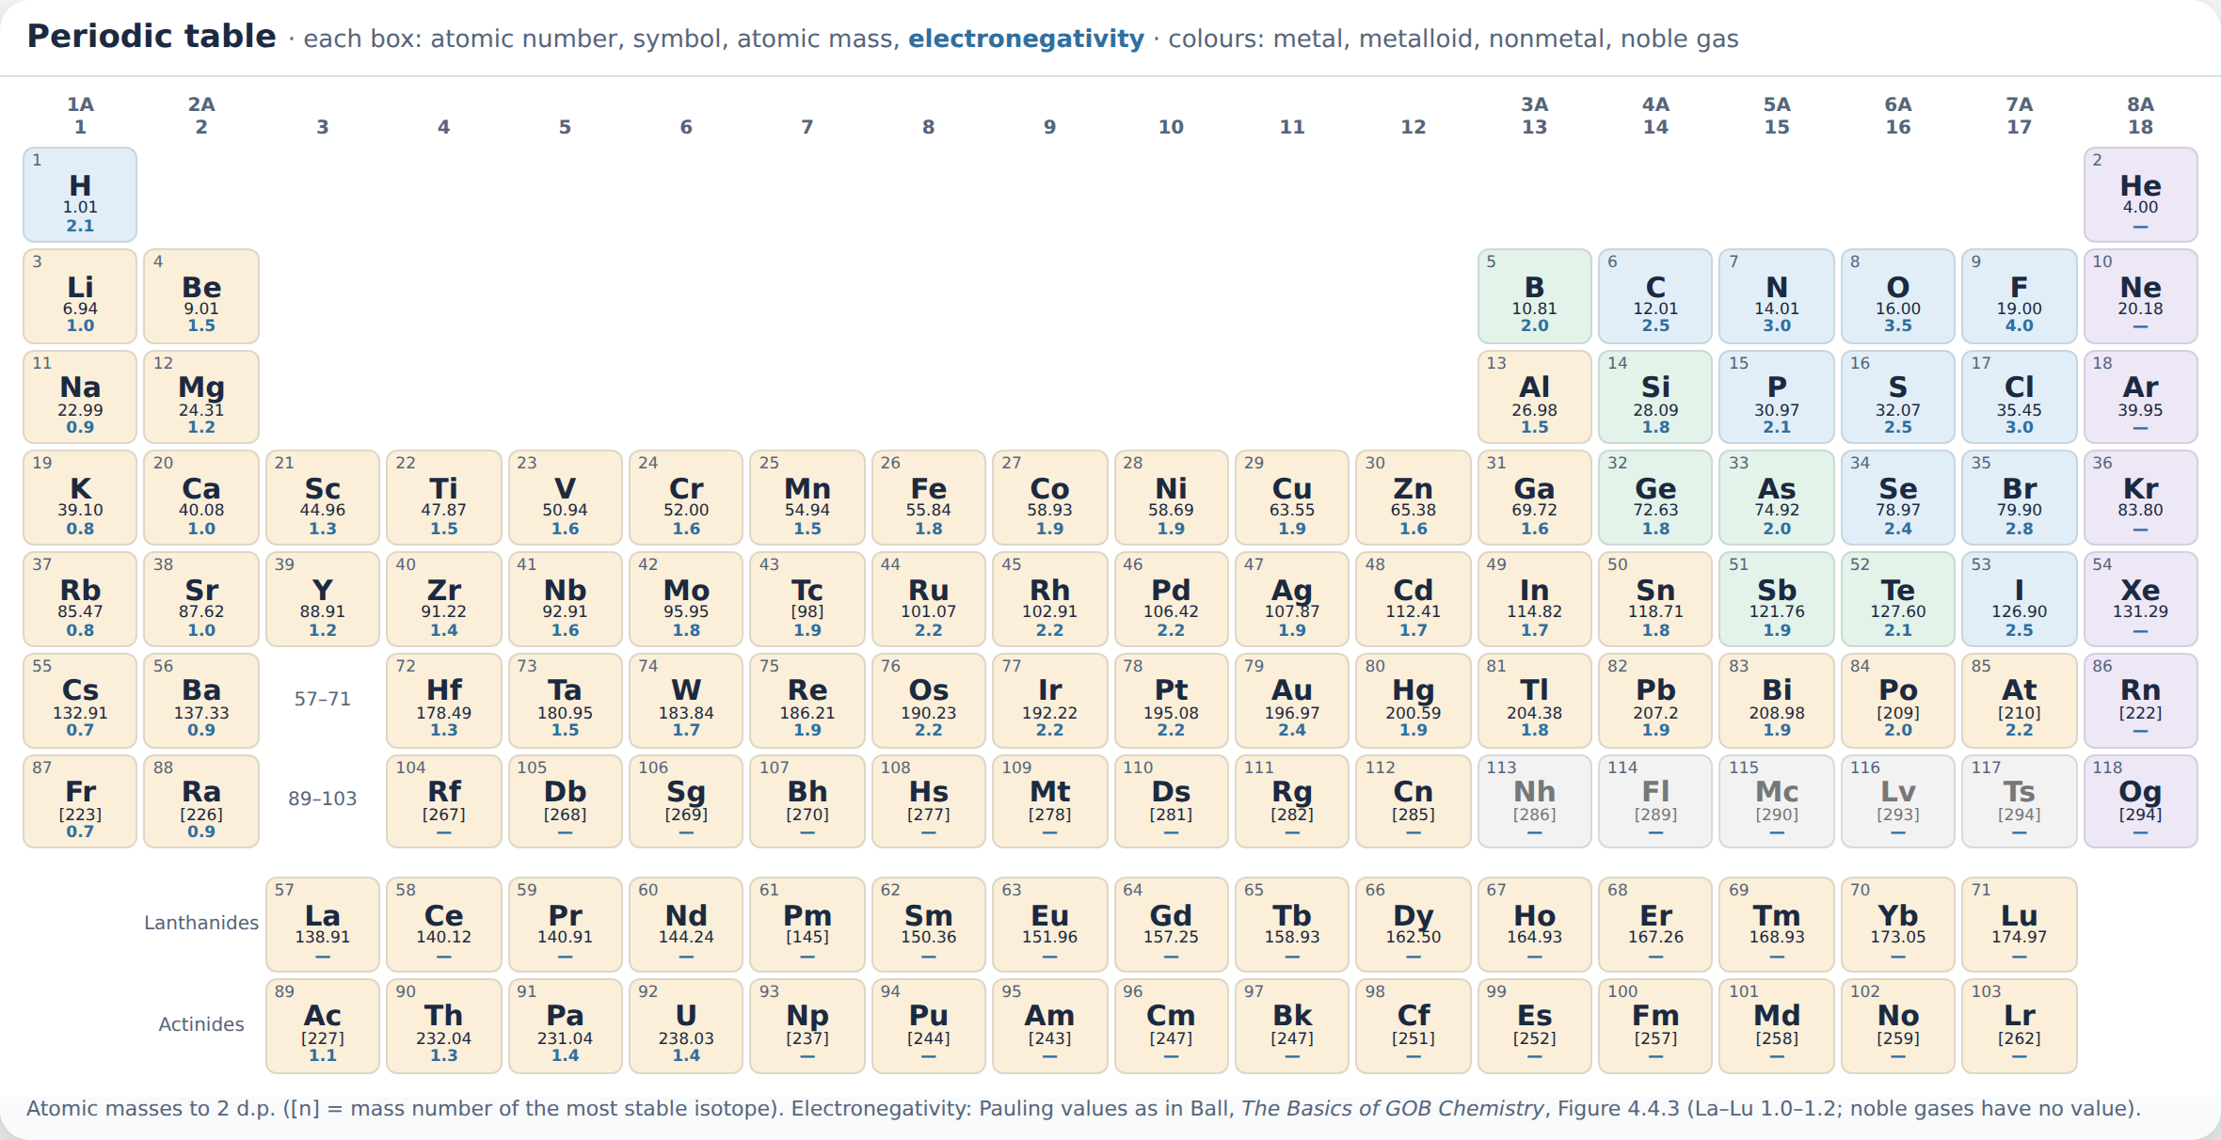
Appendix · Periodic table
PHD115 · Ionic & Covalent II
Dr. NAM · Faculty of Pharmacy, UiTM Bertam, Penang
Notes:
Reference periodic table: atomic masses to 2 d.p.; electronegativity values as in Ball Figure 4.4.3. In the interactive slides, press P or tap Periodic table to show it on any slide.

