Slide 1
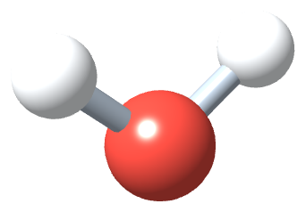
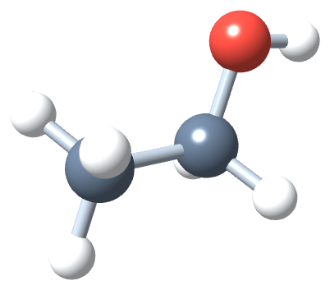
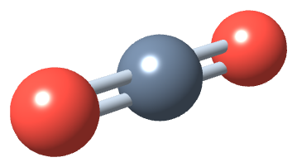
PHD115 Fundamentals of Chemistry
Energy & Matters
Dr. Nur 'Ainun Mokhtar (Dr. NAM) · Faculty of Pharmacy, UiTM Bertam, Penang
Core reference: Ball, Hill & Scott, The Basics of GOB Chemistry, chapter 7 (7.0–7.5)
PHD115 · Energy & Matters
Dr. NAM · Faculty of Pharmacy, UiTM Bertam, Penang
Notes:
This lecture follows sections 7.0 to 7.5 of the core reference in the book's own order: energy and its units, heat and temperature, phase changes, bond energies and chemical reactions, and the energy of biochemical reactions.

Slide 2
Learning outcomes
EM-LO1
EM-LO2
Define energy and heat, and convert between joules, calories and nutritional Calories
Convert between temperature scales and calculate heat gained or lost using q = mcΔT
EM-LO3
EM-LO4
Describe phase changes and calculate the energy involved using heats of fusion and vaporisation
Interpret the heating curve of water
EM-LO5
EM-LO6
Define bond energy, estimate ΔH from bond energies, and classify reactions as endothermic or exothermic
Relate energy changes to biochemical reactions such as glucose oxidation and ATP hydrolysis
PHD115 · Energy & Matters
Dr. NAM · Faculty of Pharmacy, UiTM Bertam, Penang
Notes:
These six outcomes are shared by the notes, pre- and post-lecture activities, tutorial, game and exam questions. Each question students meet carries one of these codes.

Slide 3
Lecture map
Part 1 · Energy and its units (Ball 7.0–7.1): energy, heat, joules and calories, food energy
Part 2 · Heat and temperature (Ball 7.2): temperature scales, body temperature, q = mcΔT
Part 3 · Phase changes (Ball 7.3): states of matter, heats of fusion and vaporisation, the heating curve
Part 4 · Bond energies and chemical reactions (Ball 7.4): bond energy, ΔH, endothermic and exothermic reactions
Part 5 · The energy of biochemical reactions (Ball 7.5): glucose, fats and proteins, ATP
PHD115 · Energy & Matters
Dr. NAM · Faculty of Pharmacy, UiTM Bertam, Penang
Notes:
The five parts follow the chapter exactly. Intermolecular forces are taught later, in Chemical Bonding.

Slide 4
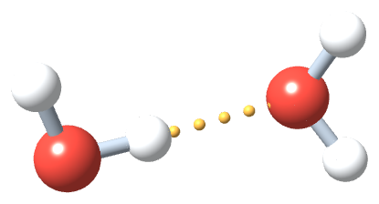
THINK FIRST
Steam at 100 °C burns worse than boiling water at 100 °C. Why?
Discuss with a partner for one minute.
PHD115 · Energy & Matters
Dr. NAM · Faculty of Pharmacy, UiTM Bertam, Penang
Notes:
Pairs discuss for one minute before the reveal. This is also a pre-class reflection question, so some students will have an answer ready.

Slide 5
THINK FIRST · ANSWER
Steam at 100 °C burns worse than boiling water at 100 °C. Why?
Condensing steam releases its heat of vaporisation (540 cal/g, 2260 J/g) onto the skin, on top of the heat the hot water itself gives. You will calculate this in Part 3.
PHD115 · Energy & Matters
Dr. NAM · Faculty of Pharmacy, UiTM Bertam, Penang
Notes:
Pairs discuss for one minute before the reveal. This is also a pre-class reflection question, so some students will have an answer ready.

Slide 6
1
PART 1
Energy and its units
What energy is, how heat is defined, and the units used in science, nutrition and pharmacy.
EM-LO1 · Ball 7.0–7.1
PHD115 · Energy & Matters
Dr. NAM · Faculty of Pharmacy, UiTM Bertam, Penang
Notes:
Part 1 corresponds to sections 7.0 and 7.1.

Slide 7
1
EM-LO1
Energy in living things: metabolism
Metabolism is the set of chemical reactions in cells that provides energy to keep cells alive. Some of that energy is released as heat.
Endotherms
Ectotherms
'Warm-blooded': use heat from metabolism to control body temperature
e.g. humans, birds, cats, dogs
Fever: body temperature rises when we are ill
Pant or sweat to lose excess heat
Some hibernate: controlled drop in metabolism and body temperature
'Cold-blooded': do not use metabolic heat to control body temperature
Depend on external energy such as sunlight
e.g. fish move to water of a different temperature
Energy available depends on metabolic rate
May also hibernate when energy is scarce
PHD115 · Energy & Matters
Dr. NAM · Faculty of Pharmacy, UiTM Bertam, Penang
Notes:
Ball 7.0 uses metabolism to show that energy and chemical reactions are closely linked, especially inside the body. Link to pharmacy: many drugs and diseases alter metabolism and therefore body temperature.

Slide 8
1
EM-LO1
Average body temperatures of selected endotherms
Endotherm | Body temperature (°C) | Body temperature (°F)
bird | up to 43.5 | up to 110
cat | 38.6 | 101.5
dog | 38.9 | 102
horse | 37.8 | 100.0
human | 37.0 | 98.6
pig | 39.2 | 102.5
Note
Humans sit at the low end. A dog's normal temperature would be a fever in a human, which matters when veterinary and human medicines are compared.
Source: Ball Table 7.0.1.
PHD115 · Energy & Matters
Dr. NAM · Faculty of Pharmacy, UiTM Bertam, Penang
Notes:
Ask students which animal has the highest body temperature and why that might matter for dosing or storage of veterinary products.

Slide 9
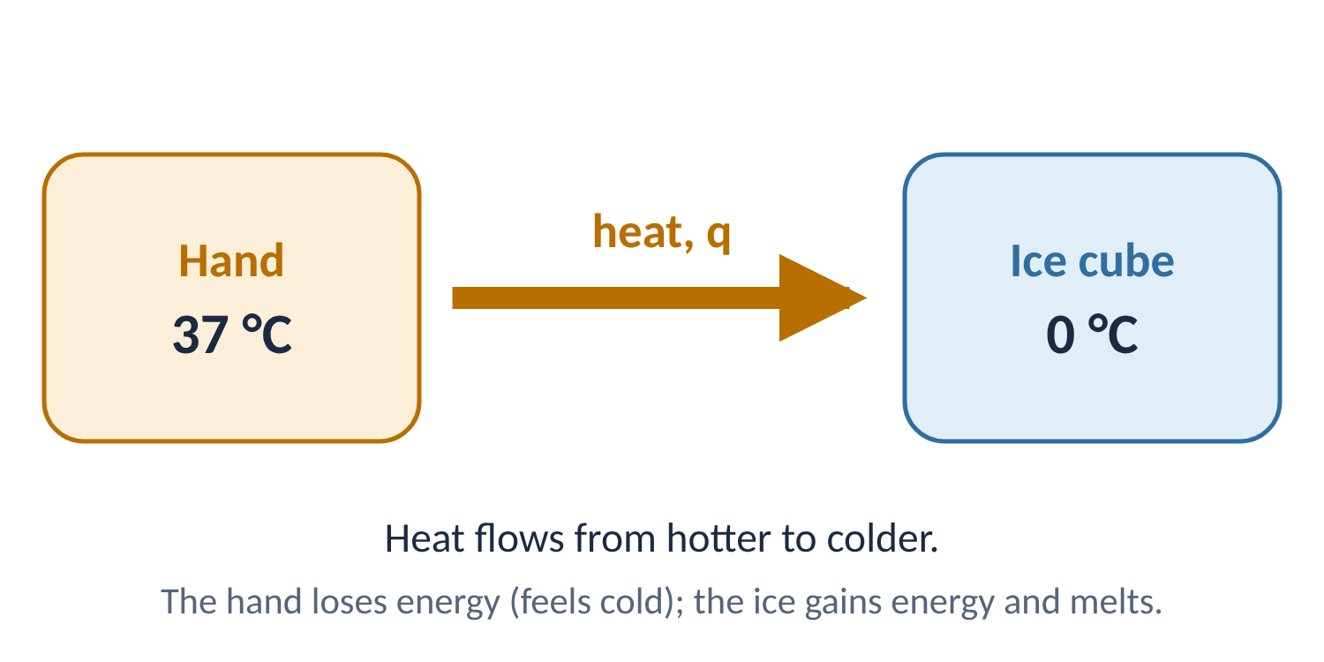
1
EM-LO1
Energy, work and heat
Energy is the ability to do work. The more energy available, the more work can be done.
Heat is the transfer of energy between objects because they have different temperatures.
Example: an ice cube held in the hand melts because heat flows from the hand to the ice. The hand loses energy, so it feels cold.
Energy, work and heat are closely related, so they share the same units.
Energy of motion is kinetic energy; stored energy, such as energy held in chemical bonds, is potential energy.
Remember: heat is energy in transit. An object contains energy; heat is what flows.
PHD115 · Energy & Matters
Dr. NAM · Faculty of Pharmacy, UiTM Bertam, Penang
Notes:
Stress the definition of heat as a transfer. Students often say an object 'has a lot of heat'. The kinetic and potential energy terms link forward to temperature (Part 2) and bond energy (Chemical Reactions II).

Slide 10
1
EM-LO1
Units of energy
1 cal = 4.184 J · 1 Cal = 1 kcal = 1000 cal = 4.184 kJ
joule (J) | SI unit of energy, work and heat. Tiny: about 4 J warms 1 mL of water by 1 °C
kilojoule (kJ) | 1000 J; common because most processes involve thousands of joules
calorie (cal) | originally the energy to warm 1 g of water by 1 °C; now defined as exactly 4.184 J
Calorie (Cal) | capital C: the nutritional calorie, equal to 1 kcal
The book works mostly in calories because health professionals use them. We show joules alongside.
PHD115 · Energy & Matters
Dr. NAM · Faculty of Pharmacy, UiTM Bertam, Penang
Notes:
Point out the capital-C Calorie trap on food labels. Malaysian labels show both kcal and kJ per serving, so students can check the conversion factor on any snack packet.

Slide 11
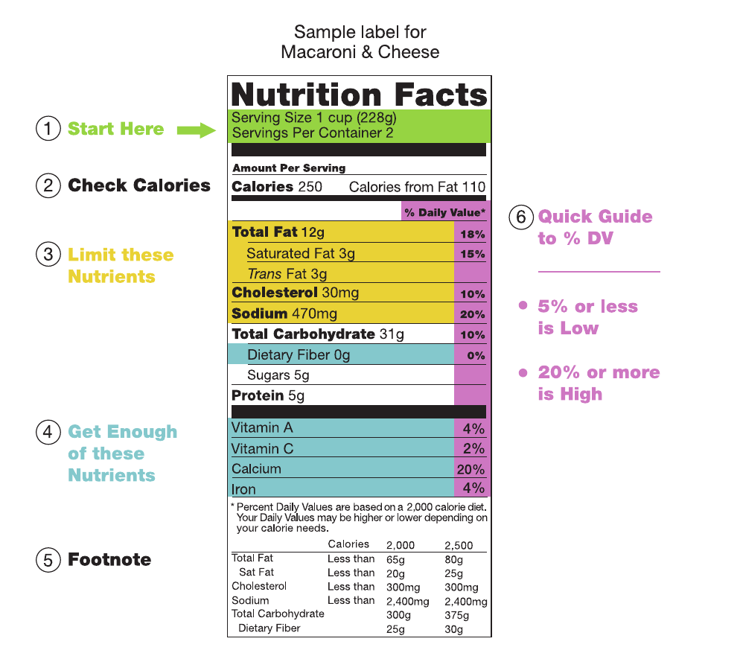
1
EM-LO1
Reading a food label
Food labels give energy in nutritional Calories (Cal), which are kilocalories (kcal).
A candy bar with 120 Cal provides 120 000 cal of energy.
This label: 250 Cal per 1-cup serving = 250 kcal = 1046 kJ.
Malaysian labels usually show energy in both kcal and kJ.
Label energy is calculated from fat, carbohydrate and protein content (next slide).
Sample nutrition facts label (US FDA, via Wikipedia), as in Ball, The Basics of GOB Chemistry Figure 7.1.1
PHD115 · Energy & Matters
Dr. NAM · Faculty of Pharmacy, UiTM Bertam, Penang
Notes:
Ball 7.1 Figure 1. Ask students to bring a snack wrapper and check its kcal-to-kJ ratio against 4.184.

Slide 12
1
EM-LO1
Example 1.1 · Energy in bread
A serving of bread provides 70.0 Cal. What is its energy content in calories and in joules?
1
70.0 Cal × 1000 cal/Cal = 70 000 cal (7.00 × 10⁴ cal)
2
70 000 cal × 4.184 J/cal = 292 880 J
3
= 2.93 × 10⁵ J = 293 kJ. Most of this energy comes from carbohydrates.
PHD115 · Energy & Matters
Dr. NAM · Faculty of Pharmacy, UiTM Bertam, Penang
Notes:
Ball 7.1 Example 1. Emphasise setting up conversion factors so units cancel.

Slide 13
1
EM-LO1
Try it · Energy in honey
One cup of honey contains 1030 Cal. What is its energy content in calories and in joules?
Work it out, then check on the next slide.
PHD115 · Energy & Matters
Dr. NAM · Faculty of Pharmacy, UiTM Bertam, Penang
Notes:
Ball 7.1 Exercise 1. Give students 90 seconds.

Slide 14
1
EM-LO1
Try it · Energy in honey · answer
One cup of honey contains 1030 Cal. What is its energy content in calories and in joules?
Answer
1030 Cal × 1000 = 1.03 × 10⁶ cal
1.03 × 10⁶ cal × 4.184 J/cal = 4.31 × 10⁶ J (4310 kJ)
PHD115 · Energy & Matters
Dr. NAM · Faculty of Pharmacy, UiTM Bertam, Penang
Notes:
Ball 7.1 Exercise 1. Give students 90 seconds.

Slide 15
1
EM-LO1
Where food energy comes from
Food energy is calculated from composition using average fuel values: fat 9 Cal/g; carbohydrate and protein 4 Cal/g; water and minerals 0 Cal/g.
8 oz (227 g) roast beef | Mass (g) | Fuel value (Cal/g) | Energy (Cal)
water | 97.5 | 0 | 0
protein | 58.7 | 4 | 235
fat | 69.3 | 9 | 624
carbohydrate | 0 | 4 | 0
minerals | 1.5 | 0 | 0
Total | 227.0 |  | about 900
Source: Ball Table 7.1.1. Fat is 31% of the mass but supplies about 73% of the energy.
PHD115 · Energy & Matters
Dr. NAM · Faculty of Pharmacy, UiTM Bertam, Penang
Notes:
Walk through one row: 58.7 g protein × 4 Cal/g = 235 Cal. Ask students why fat dominates the total.

Slide 16
1
EM-LO1
Composition and fuel value of common foods
Food (quantity) | Water % | Carb % | Protein % | Fat % | Cal/g | Calories
milk (1 cup) | 88 | 4.5 | 3.3 | 3.3 | 0.6 | 150
egg (1 large) | 75 | 2 | 12 | 12 | 1.6 | 80
butter (1 tbsp) | 16 | ~0 | ~0 | 79 | 7.1 | 100
apple (8 oz) | 84 | 15 | ~0 | 0.5 | 0.6 | 125
white bread (2 slices) | 37 | 48 | 8 | 4 | 2.6 | 130
brownie (40 g) | 10 | 55 | 5 | 30 | 4.8 | 190
hamburger (4 oz) | 54 | 0 | 24 | 21 | 2.9 | 326
fried chicken (1 drumstick) | 53 | 8.3 | 22 | 15 | 2.7 | 195
carrots (1 cup) | 87 | 10 | 1.3 | ~0 | 0.4 | 70
coffee (6 oz) | 100 | ~0 | ~0 | ~0 | ~0 | ~0
High water content means low energy per gram. Compare butter (7.1 Cal/g) with milk (0.6 Cal/g).
Source: Ball Table 7.1.2 (selected rows).
PHD115 · Energy & Matters
Dr. NAM · Faculty of Pharmacy, UiTM Bertam, Penang
Notes:
Ask: why does butter have the highest Cal/g? It is 79% fat and only 16% water.

Slide 17
1
EM-LO1
How much energy does the body need?
Energy in
Energy stored and used
Basic processes need about 67 Cal/h, or 1600 Cal/day, for an average 73 kg adult
This keeps body temperature, heartbeat, breathing muscles, cell reactions and nerve impulses going
Moderately active adult: 2500–3000 Cal/day
Athletes: up to 4000 Cal/day
Excess intake is stored, mostly as fat, the most compact energy store
When the diet falls short, stored fuels are mobilised and oxidised
Stored carbohydrate is used up before fat
Exercise raises energy use, but less than many people hope
PHD115 · Energy & Matters
Dr. NAM · Faculty of Pharmacy, UiTM Bertam, Penang
Notes:
Ball 7.1 'To Your Health'. Link to pharmacy practice: weight-management counselling and oral nutritional supplements are prescribed by energy content.

Slide 18
1
EM-LO1
Energy used during exercise
Values range from about 220 kcal/h (golf with a cart) to 1200 kcal/h (walking upstairs).
In kJ, multiply by 4.184: jogging uses about 3970 kJ/h.
Burning off a 190 Cal brownie takes about 12 minutes of jogging.
Anyone starting a new exercise regimen should consult a doctor first.
PHD115 · Energy & Matters
Dr. NAM · Faculty of Pharmacy, UiTM Bertam, Penang
Notes:
Quick mental maths: how long would you need to jog to burn the energy in a 190 Cal brownie? About 12 minutes.

Slide 19
1
EM-LO1
Quick check
A snack label states 250 kcal. What is this in kJ?
A 60 kJ
B 250 kJ
C 1046 kJ
D 1 046 000 kJ
PHD115 · Energy & Matters
Dr. NAM · Faculty of Pharmacy, UiTM Bertam, Penang
Notes:
Answer C.

Slide 20
1
EM-LO1
Quick check · answer
A snack label states 250 kcal. What is this in kJ?
A 60 kJ
B 250 kJ
C 1046 kJ
D 1 046 000 kJ
Answer C. 250 kcal × 4.184 kJ/kcal = 1046 kJ.
PHD115 · Energy & Matters
Dr. NAM · Faculty of Pharmacy, UiTM Bertam, Penang
Notes:
Answer C.

Slide 21
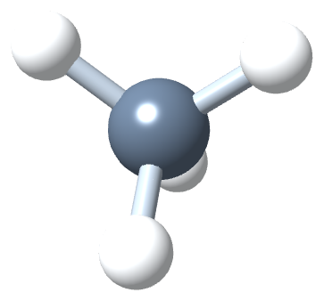
2
PART 2
Heat and temperature
How temperature is measured, what it means for the body, and how much heat changes a temperature.
EM-LO2 · Ball 7.2
PHD115 · Energy & Matters
Dr. NAM · Faculty of Pharmacy, UiTM Bertam, Penang
Notes:
Part 2 corresponds to section 7.2.

Slide 22
2
EM-LO2
Heat is not the same as temperature
A difference in temperature is what causes heat to flow.
Temperature
Heat (q)
How hot or cold an object is compared with another
Measures the average kinetic energy of the particles
Measured with a thermometer, in °C, °F or K
The flow of thermal energy between objects at different temperatures
Always flows from hotter to colder
Touching a hot object: energy flows into your fingers, so it feels hot
Holding ice: energy flows out of your hand, so it feels cold
PHD115 · Energy & Matters
Dr. NAM · Faculty of Pharmacy, UiTM Bertam, Penang
Notes:
Common misconception check: a large bath of warm water and a small cup of hot water. Which has the higher temperature? Which can transfer more heat?

Slide 23
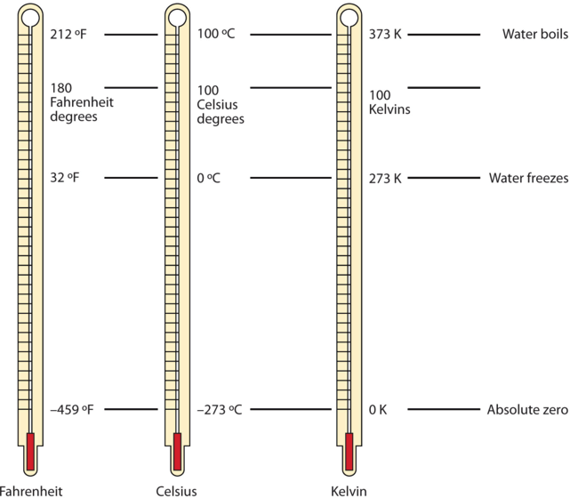
2
EM-LO2
Three temperature scales
Thermometers use liquids such as alcohol or mercury (a neurotoxin) that expand when heated and contract when cooled.
Landmark | Fahrenheit (°F) | Celsius (°C) | Kelvin (K)
absolute zero | −459.67 | −273.15 | 0
water freezes | 32 | 0 | 273.15
room temperature | 72 | 22 | 295
normal body temperature | 98.6 | 37.0 | 310.2
water boils | 212 | 100 | 373.15
Science uses Celsius and kelvin almost exclusively. Kelvin has no 'degrees': 295 K is 'two hundred ninety-five kelvin'.
Fahrenheit, Celsius and Kelvin compared (Ball, The Basics of GOB Chemistry Figure 7.2.1)
PHD115 · Energy & Matters
Dr. NAM · Faculty of Pharmacy, UiTM Bertam, Penang
Notes:
Kelvin degrees are the same size as Celsius degrees; the scale is only shifted by 273.15. 0 K is absolute zero, the lowest possible temperature. For most work, 273 is acceptable in place of 273.15.

Slide 24
2
EM-LO2
Converting between temperature scales
°C = (°F − 32) × 5/9 · °F = (9/5 × °C) + 32 · K = °C + 273.15
Fahrenheit | water freezes at 32 °F and boils at 212 °F (180 divisions)
Celsius | water freezes at 0 °C and boils at 100 °C (100 divisions)
Kelvin | same size degree as Celsius, starting at absolute zero
Temperature scales were introduced in Matters and Measurement. This is a short recap because the book uses them throughout this chapter.
PHD115 · Energy & Matters
Dr. NAM · Faculty of Pharmacy, UiTM Bertam, Penang
Notes:
Ask students to derive 5/9 from the ratio of 100 Celsius divisions to 180 Fahrenheit divisions.

Slide 25
2
EM-LO2
Example 2.1 · Converting temperatures
(a) What is 98.6 °F in °C? (b) What is 25.0 °C in °F?
1
(a) °C = (98.6 − 32) × 5/9 = 66.6 × 5/9 = 37.0 °C
2
(b) °F = (9/5 × 25.0) + 32 = 45.0 + 32 = 77.0 °F
PHD115 · Energy & Matters
Dr. NAM · Faculty of Pharmacy, UiTM Bertam, Penang
Notes:
Ball 7.2 Example 1.

Slide 26
2
EM-LO2
Example 2.2 · Room temperature
Normal room temperature is 72.0 °F. What is it in °C and in kelvin?
1
°C = (72.0 − 32) × 5/9 = 22.2 °C
2
K = 22.2 + 273.15 = 295.4 K, so room temperature is about 295 K
PHD115 · Energy & Matters
Dr. NAM · Faculty of Pharmacy, UiTM Bertam, Penang
Notes:
Ball 7.2 Example 2.

Slide 27
2
EM-LO2
Try it · Conversions
(a) Convert 0 °F to °C. (b) Convert 212 °C to °F.
Work it out, then check on the next slide.
PHD115 · Energy & Matters
Dr. NAM · Faculty of Pharmacy, UiTM Bertam, Penang
Notes:
Ball 7.2 Exercise 1.

Slide 28
2
EM-LO2
Try it · Conversions · answer
(a) Convert 0 °F to °C. (b) Convert 212 °C to °F.
Answer
(a) (0 − 32) × 5/9 = −17.8 °C
(b) (9/5 × 212) + 32 = 414 °F. Note: 212 °C, not 212 °F.
PHD115 · Energy & Matters
Dr. NAM · Faculty of Pharmacy, UiTM Bertam, Penang
Notes:
Ball 7.2 Exercise 1.

Slide 29
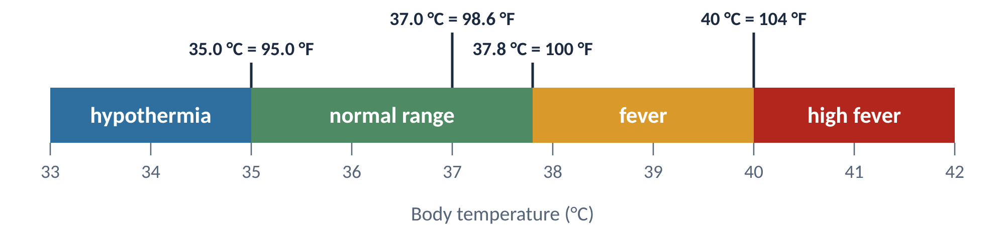
2
EM-LO2
Body temperature zones
Thresholds from Ball 7.2, converted to °C
Normal: 37.0 °C (98.6 °F), give or take about 0.5 °C
Fever: above 37.8 °C (100 °F) in adults; high fever from 40 °C (104 °F)
Hypothermia: below 35.0 °C (95.0 °F)
Children's fever thresholds are lower than adults'.
PHD115 · Energy & Matters
Dr. NAM · Faculty of Pharmacy, UiTM Bertam, Penang
Notes:
Use this scale before the detailed health slide. Ask students to place 38.5 °C and 34.2 °C on it.

Slide 30
2
EM-LO2
Health application: body temperature
Normal body temperature is 37.0 °C (98.6 °F), ± about 0.5 °C. The most reliable readings are under the tongue or rectal.
Too hot
Too cold
Fever: above 37.8 °C (100 °F) in adults
High fever: 40 °C (104 °F) or more: seek medical attention
Hyperthermia: body cannot regulate heat. Causes: infection, heat stroke, thyroid disorders, heart attack, injury, some cancer, arthritis and thyroid medicines
Symptoms: sweating, confusion, nausea, dizziness
Treatment: fluids, antipyretics such as paracetamol, ibuprofen, aspirin or naproxen, a cool bath
Hypothermia: below 35.0 °C (95.0 °F)
The body struggles to produce heat
Causes: cold exposure, diabetes, infection, thyroid dysfunction
Symptoms: shivering, confusion, sluggishness
Treatment: remove wet clothing, re-dress warmly, move about; seek medical attention
PHD115 · Energy & Matters
Dr. NAM · Faculty of Pharmacy, UiTM Bertam, Penang
Notes:
Ball 7.2 Health Application, with brand names replaced by generic drug names. Children's fever thresholds are lower. Ask: which antipyretic would you avoid in a child with a viral fever? (Aspirin, because of Reye's syndrome.)

Slide 31
2
EM-LO2
Heat transfer and temperature change
When a system gains or loses heat, its temperature usually changes (phase changes are the exception, Part 3).
More heat → bigger temperature change: q ∝ ΔT, where ΔT = T_{final} − T_{initial}
Bigger mass → more heat needed for the same change: q ∝ m × ΔT
The proportionality constant is the specific heat, c: the energy to change the temperature of 1 g of a substance by 1 °C
Every substance has its own c, in cal/g·°C or J/g·°C
Sign convention
Heat in: q and ΔT are positive.
Heat out: q and ΔT are negative.
PHD115 · Energy & Matters
Dr. NAM · Faculty of Pharmacy, UiTM Bertam, Penang
Notes:
Build the equation step by step on the board: q ∝ ΔT, then q ∝ mΔT, then q = mcΔT. 'Specific heat capacity' is the same thing; 'heat capacity' on its own is a different quantity.

Slide 32
2
EM-LO2
The heat equation
q = m × c × ΔT
q | heat transferred (cal or J)
m | mass of the sample (g)
c | specific heat (cal/g·°C or J/g·°C)
ΔT | T_{final} − T_{initial} (°C; a change of 1 °C equals a change of 1 K)
Keep units consistent: if c is in cal/g·°C, q comes out in cal.
PHD115 · Energy & Matters
Dr. NAM · Faculty of Pharmacy, UiTM Bertam, Penang
Notes:
Show how g and °C cancel to leave only the energy unit.

Slide 33
2
EM-LO2
Specific heats of selected substances
Substance | c (cal/g·°C) | c (J/g·°C) | Substance | c (cal/g·°C) | c (J/g·°C)
water, H₂O(l) | 1.00 | 4.184 | hexane, C₆H₁₄ | 0.394 | 1.648
hydrogen, H₂ | 3.419 | 14.31 | benzene, C₆H₆ | 0.251 | 1.050
ethanol, C₂H₆O | 0.578 | 2.418 | oxygen, O₂ | 0.219 | 0.916
ice, H₂O(s) | 0.492 | 2.059 | aluminium, Al | 0.215 | 0.900
steam, H₂O(g) | 0.488 | 2.042 | sodium chloride, NaCl | 0.207 | 0.866
aluminium oxide, Al₂O₃ | 0.305 | 1.276 | iron(III) oxide, Fe₂O₃ | 0.156 | 0.653
 |  |  | iron, Fe | 0.108 | 0.452
 |  |  | copper, Cu | 0.092 | 0.385
 |  |  | mercury, Hg | 0.033 | 0.138
Source: Ball Table 7.2.1; J values × 4.184.
PHD115 · Energy & Matters
Dr. NAM · Faculty of Pharmacy, UiTM Bertam, Penang
Notes:
Liquid water has one of the highest specific heats. Note that ice and steam are about half of liquid water, so the phase matters when choosing c.

Slide 34
2
EM-LO2
Comparing specific heats
Liquid water (4.184 J/g·°C) is among the highest: it warms and cools slowly.
Metals are low: copper warms about 10 times more than water for the same heat.
Ice and steam are about half of liquid water, so use the c for the right phase.
Specific heat can identify a substance (Example 2.4).
PHD115 · Energy & Matters
Dr. NAM · Faculty of Pharmacy, UiTM Bertam, Penang
Notes:
Data from Ball Table 7.2.1 converted to joules.

Slide 35
2
EM-LO2
Example 2.3 · Heating an iron block
How much heat is transferred when a 150.0 g block of iron is heated from 25.0 °C to 73.3 °C? Which way does the heat flow?
1
ΔT = 73.3 − 25.0 = 48.3 °C
2
q = m × c × ΔT = 150.0 g × 0.108 cal/g·°C × 48.3 °C
3
q = 782 cal (= 3.27 kJ). The temperature rose, so heat flowed into the iron.
PHD115 · Energy & Matters
Dr. NAM · Faculty of Pharmacy, UiTM Bertam, Penang
Notes:
Ball 7.2 Example 3.

Slide 36
2
EM-LO2
Try it · Cooling aluminium
How much heat is transferred when a 295.5 g block of aluminium is cooled from 128.0 °C to 22.5 °C? Which way does the heat flow?
Work it out, then check on the next slide.
PHD115 · Energy & Matters
Dr. NAM · Faculty of Pharmacy, UiTM Bertam, Penang
Notes:
Ball 7.2 Exercise 2.

Slide 37
2
EM-LO2
Try it · Cooling aluminium · answer
How much heat is transferred when a 295.5 g block of aluminium is cooled from 128.0 °C to 22.5 °C? Which way does the heat flow?
Answer
ΔT = 22.5 − 128.0 = −105.5 °C
q = 295.5 × 0.215 × (−105.5) = −6.70 × 10³ cal (−28.0 kJ). Negative: heat flows out of the aluminium.
PHD115 · Energy & Matters
Dr. NAM · Faculty of Pharmacy, UiTM Bertam, Penang
Notes:
Ball 7.2 Exercise 2.

Slide 38
2
EM-LO2
Example 2.4 · Identifying a metal
A 10.3 g reddish-brown metal gives off 71.7 cal as it cools from 97.5 °C to 22.0 °C. Find its specific heat and identify it.
1
ΔT = 22.0 − 97.5 = −75.5 °C; heat is given off, so q = −71.7 cal
2
c = q ÷ (m × ΔT) = −71.7 ÷ (10.3 × −75.5)
3
c = 0.0922 cal/g·°C (0.386 J/g·°C). Closest match: copper (0.092).
PHD115 · Energy & Matters
Dr. NAM · Faculty of Pharmacy, UiTM Bertam, Penang
Notes:
Ball 7.2 Example 4. Specific heat acts like a fingerprint for identifying a material.

Slide 39
2
EM-LO2
Try it · A crystal of salt
A 10.7 g crystal of NaCl starts at 37.0 °C and absorbs 147 cal. What is its final temperature? (c = 0.207 cal/g·°C)
Work it out, then check on the next slide.
PHD115 · Energy & Matters
Dr. NAM · Faculty of Pharmacy, UiTM Bertam, Penang
Notes:
Ball 7.2 Exercise 3.

Slide 40
2
EM-LO2
Try it · A crystal of salt · answer
A 10.7 g crystal of NaCl starts at 37.0 °C and absorbs 147 cal. What is its final temperature? (c = 0.207 cal/g·°C)
Answer
ΔT = q ÷ (m × c) = 147 ÷ (10.7 × 0.207) = 66.4 °C
T_{final} = 37.0 + 66.4 = 103.4 °C
PHD115 · Energy & Matters
Dr. NAM · Faculty of Pharmacy, UiTM Bertam, Penang
Notes:
Ball 7.2 Exercise 3.

Slide 41
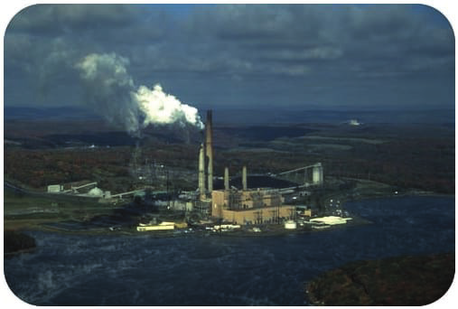
2
EM-LO2
Why water's high specific heat matters
Water absorbs a lot of heat for a small temperature rise, so it is used as a coolant. Power plants are often built beside lakes for this reason.
Coastal climates are milder than inland ones: the sea absorbs heat on hot days and releases it on cool days.
The body is mostly water, which helps keep body temperature steady.
Pharmacy: IV fluids are mostly water, so warming a litre for infusion takes a lot of energy (about 50 kJ from 25 °C to 37 °C).
A power plant beside a lake uses the water as a coolant (Ball, The Basics of GOB Chemistry Figure 7.2.2)
PHD115 · Energy & Matters
Dr. NAM · Faculty of Pharmacy, UiTM Bertam, Penang
Notes:
End of Part 2. The pharmacy example previews the post-lecture calculation.

Slide 42
2
EM-LO2
Quick check
Equal masses of water and copper absorb the same amount of heat. Which gets hotter?
A Water
B Copper
C Both the same
D Cannot tell
PHD115 · Energy & Matters
Dr. NAM · Faculty of Pharmacy, UiTM Bertam, Penang
Notes:
Answer B.

Slide 43
2
EM-LO2
Quick check · answer
Equal masses of water and copper absorb the same amount of heat. Which gets hotter?
A Water
B Copper
C Both the same
D Cannot tell
Answer B. Copper's specific heat (0.092 cal/g·°C) is about one tenth of water's, so the same heat gives about ten times the temperature rise.
PHD115 · Energy & Matters
Dr. NAM · Faculty of Pharmacy, UiTM Bertam, Penang
Notes:
Answer B.

Slide 44
3
PART 3
Phase changes
States of matter, the energy needed to change state, and why temperature stays constant while it happens.
EM-LO3 · EM-LO4 · Ball 7.3
PHD115 · Energy & Matters
Dr. NAM · Faculty of Pharmacy, UiTM Bertam, Penang
Notes:
Part 3 corresponds to section 7.3.

Slide 45
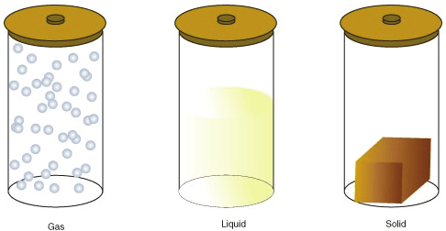
3
EM-LO3
States of matter
The amount of energy in the particles decides the state of matter.
The same mass of a substance as a gas, liquid and solid (Ball, The Basics of GOB Chemistry Figure 7.3.1)
Solid
Liquid
Gas
Particles lack the energy to move. Always in contact, in fixed positions.
Keeps its own shape and volume.
Particles are always in contact but have enough energy to change positions.
Takes the shape of its container, keeps its volume.
Particles have enough energy to move freely; they meet only when they collide.
Takes both the shape and volume of its container.
PHD115 · Energy & Matters
Dr. NAM · Faculty of Pharmacy, UiTM Bertam, Penang
Notes:
Ball 7.3 Figure: three containers holding the same mass in different states.

Slide 46
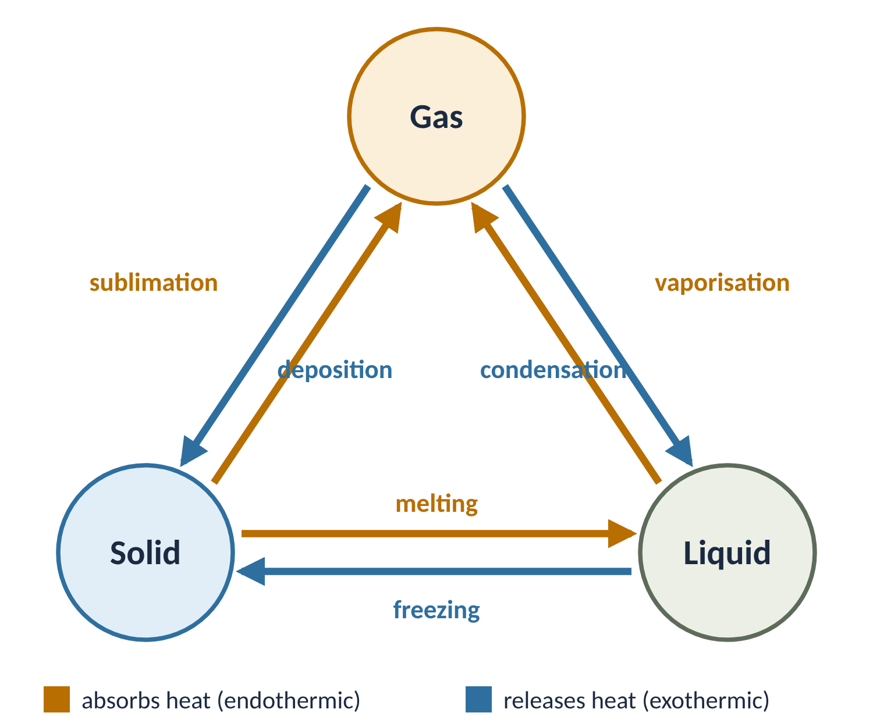
3
EM-LO3
Changes of state
Name | Change | Type
melting (fusion) | solid → liquid | endothermic
vaporisation | liquid → gas | endothermic
sublimation | solid → gas | endothermic
freezing | liquid → solid | exothermic
condensation | gas → liquid | exothermic
deposition | gas → solid | exothermic
Heat to melt a sample = heat released when it freezes; only the direction changes. Deposition added for completeness.
PHD115 · Energy & Matters
Dr. NAM · Faculty of Pharmacy, UiTM Bertam, Penang
Notes:
Adding heat makes particles move faster (endothermic); removing heat slows them (exothermic).

Slide 47
3
EM-LO3
Example 3.1 · Endothermic or exothermic?
Label each process: (a) water boiling (b) ice forming on a pond
1
(a) Endothermic. A pan of water must be heated on the stove to boil: heat is added.
2
(b) Exothermic. Heat is removed from the water as it freezes, like water in a freezer: heat leaves.
PHD115 · Energy & Matters
Dr. NAM · Faculty of Pharmacy, UiTM Bertam, Penang
Notes:
Ball 7.3 Example 1.

Slide 48
3
EM-LO3
Try it · Endothermic or exothermic?
Label each process: (a) water vapour condensing (b) gold melting
Work it out, then check on the next slide.
PHD115 · Energy & Matters
Dr. NAM · Faculty of Pharmacy, UiTM Bertam, Penang
Notes:
Ball 7.3 Exercise 1.

Slide 49
3
EM-LO3
Try it · Endothermic or exothermic? · answer
Label each process: (a) water vapour condensing (b) gold melting
Answer
(a) Exothermic (heat released)
(b) Endothermic (heat absorbed)
PHD115 · Energy & Matters
Dr. NAM · Faculty of Pharmacy, UiTM Bertam, Penang
Notes:
Ball 7.3 Exercise 1.

Slide 50
3
EM-LO3
Melting and boiling points
Melting point: the temperature at which a solid becomes a liquid (or a liquid becomes a solid)
Boiling point: the temperature at which a liquid becomes a gas (or a gas becomes a liquid)
At the melting or boiling point, two phases can coexist. At 0 °C, ice and water are both present; adding heat melts some ice, removing heat freezes some water.
Phase changes are isothermal: the temperature does not change until the change of state is complete.
All the heat added goes into changing the state, not into raising the temperature.
Isothermal
iso = same, thermal = temperature. Ice at 0 °C melts into water at 0 °C.
PHD115 · Energy & Matters
Dr. NAM · Faculty of Pharmacy, UiTM Bertam, Penang
Notes:
This is why the heating curve (Part 5) has flat sections.

Slide 51
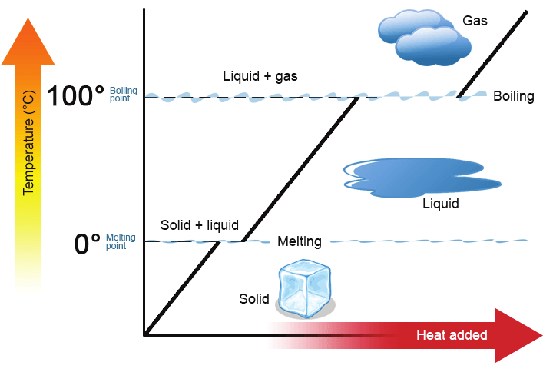
3
EM-LO4
The heating curve of water
Slopes: one phase warming up. Use q = mcΔT with the c for that phase (ice, water or steam).
Plateaus: a phase change at constant temperature. Use q = mΔH.
The plateau at 0 °C is melting; at 100 °C, boiling.
The boiling plateau is about 7 times longer because ΔH_{vap} (540 cal/g) ≫ ΔH_{fus} (79.9 cal/g).
Heat is still being added on a plateau; it goes into changing the state, not raising the temperature.
Heating curve for water (Ball Figure 7.3.2; CC BY 3.0, Community College Consortium for Bioscience Credentials)
PHD115 · Energy & Matters
Dr. NAM · Faculty of Pharmacy, UiTM Bertam, Penang
Notes:
Ball Figure 7.3.2. Ask students to point to where ice and water coexist.

Slide 52
3
EM-LO4
Quick check
On a heating curve, a flat segment means…
A the substance is cooling
B a phase change is happening at constant temperature
C no heat is being added
D the specific heat is zero
PHD115 · Energy & Matters
Dr. NAM · Faculty of Pharmacy, UiTM Bertam, Penang
Notes:
Answer B.

Slide 53
3
EM-LO4
Quick check · answer
On a heating curve, a flat segment means…
A the substance is cooling
B a phase change is happening at constant temperature
C no heat is being added
D the specific heat is zero
Answer B. Heat is still being added, but it goes into changing the state, not raising the temperature.
PHD115 · Energy & Matters
Dr. NAM · Faculty of Pharmacy, UiTM Bertam, Penang
Notes:
Answer B.

Slide 54
3
EM-LO3
Heats of fusion and vaporisation
q = m × ΔH_{fus} · q = m × ΔH_{vap}
ΔH_{fus} | heat of fusion: heat per gram (or per mole) to melt a solid at its melting point
ΔH_{vap} | heat of vaporisation: heat per gram (or per mole) to vaporise a liquid at its boiling point
m or n | use mass (g) with values per gram, or moles (n) with values per mole: q = n × ΔH
no ΔT | temperature does not change during the phase change
The same values give the heat released on freezing or condensing; only the sign changes.
PHD115 · Energy & Matters
Dr. NAM · Faculty of Pharmacy, UiTM Bertam, Penang
Notes:
Stress matching units: cal/g needs grams; kJ/mol needs moles.

Slide 55
3
EM-LO3
Heats of fusion and vaporisation
Substance | ΔH_{fus} (cal/g) | ΔH_{fus} (J/g) | ΔH_{vap} (cal/g) | ΔH_{vap} (J/g)
aluminium, Al | 94.0 | 393 | 2602 | 10 890
gold, Au | 15.3 | 64 | 409 | 1711
iron, Fe | 63.2 | 264 | 1504 | 6293
water, H₂O | 79.9 | 334 | 540 | 2260
sodium chloride, NaCl | 123.5 | 517 | 691 | 2891
ethanol, C₂H₅OH | 45.2 | 189 | 200.3 | 838
benzene, C₆H₆ | 30.4 | 127 | 94.1 | 394
For every substance, ΔH_{vap} is much larger than ΔH_{fus}. Separating particles completely takes far more energy than loosening them.
Source: Ball Table 7.3.1; J values × 4.184.
PHD115 · Energy & Matters
Dr. NAM · Faculty of Pharmacy, UiTM Bertam, Penang
Notes:
Water's ΔHvap is almost 7 times its ΔHfus. This explains the long boiling plateau on the heating curve.

Slide 56
3
EM-LO3
Vaporising takes far more energy than melting
For every substance, ΔH_{vap} is several times ΔH_{fus}.
Melting only loosens particles; vaporising separates them completely.
Water: 2260 J/g vs 334 J/g, almost 7 times more.
Aluminium (not shown) is extreme: ΔH_{vap} = 10 890 J/g.
PHD115 · Energy & Matters
Dr. NAM · Faculty of Pharmacy, UiTM Bertam, Penang
Notes:
Data from Ball Table 7.3.1.

Slide 57
3
EM-LO3
Example 3.2 · Melting ice
How much heat is needed to melt 55.8 g of ice at 0 °C? (ΔH_{fus} = 79.9 cal/g)
1
q = m × ΔH_{fus} = 55.8 g × 79.9 cal/g
2
q = 4.46 × 10³ cal (4.46 kcal)
3
In SI: 55.8 g × 334 J/g = 18.6 kJ
PHD115 · Energy & Matters
Dr. NAM · Faculty of Pharmacy, UiTM Bertam, Penang
Notes:
Ball 7.3 Example 2.

Slide 58
3
EM-LO3
Try it · Boiling water
How much heat is needed to vaporise 685 g of water at 100 °C? (ΔH_{vap} = 540 cal/g)
Work it out, then check on the next slide.
PHD115 · Energy & Matters
Dr. NAM · Faculty of Pharmacy, UiTM Bertam, Penang
Notes:
Ball 7.3 Exercise 2.

Slide 59
3
EM-LO3
Try it · Boiling water · answer
How much heat is needed to vaporise 685 g of water at 100 °C? (ΔH_{vap} = 540 cal/g)
Answer
q = 685 × 540 = 3.70 × 10⁵ cal (370 kcal)
In SI: 685 × 2260 J/g = 1.55 × 10⁶ J = 1550 kJ
PHD115 · Energy & Matters
Dr. NAM · Faculty of Pharmacy, UiTM Bertam, Penang
Notes:
Ball 7.3 Exercise 2.

Slide 60
3
EM-LO3
Sublimation: solid straight to gas
Each substance has a heat of sublimation, ΔH_{sub}. For water it is 620 cal/g (2590 J/g).
Dry ice (solid CO₂) sublimes at −78.5 °C. CO₂ is liquid only under high pressure. Dry ice is used for long-term preservation and shipping of medical samples.
Ice sublimes slowly even below 0 °C: frost disappears, and ice cubes in a freezer shrink.
Freezer burn: water sublimes from frozen food, leaving a dry, mottled surface. Reduce it by lower temperatures and tight wrapping.
Pharmacy: freeze-drying (lyophilisation) removes water from frozen injections and vaccines by sublimation under low pressure.
Carbon dioxide, CO₂. Solid CO₂ is dry ice.
PHD115 · Energy & Matters
Dr. NAM · Faculty of Pharmacy, UiTM Bertam, Penang
Notes:
The pharmacy example links to the post-lecture scenario.

Slide 61
3
EM-LO3
Quick check
Which pair of phase changes both release heat?
A Melting and boiling
B Freezing and condensation
C Sublimation and melting
D Boiling and sublimation
PHD115 · Energy & Matters
Dr. NAM · Faculty of Pharmacy, UiTM Bertam, Penang
Notes:
Answer B.

Slide 62
3
EM-LO3
Quick check · answer
Which pair of phase changes both release heat?
A Melting and boiling
B Freezing and condensation
C Sublimation and melting
D Boiling and sublimation
Answer B. Freezing and condensation remove heat from the substance, so they are exothermic.
PHD115 · Energy & Matters
Dr. NAM · Faculty of Pharmacy, UiTM Bertam, Penang
Notes:
Answer B.

Slide 63
4
PART 4
Bond energies and chemical reactions
Why reactions release or absorb energy, and how to estimate the energy change from the bonds that break and form.
EM-LO5 · Ball 7.4
PHD115 · Energy & Matters
Dr. NAM · Faculty of Pharmacy, UiTM Bertam, Penang
Notes:
Part 4 corresponds to section 7.4.

Slide 64
4
EM-LO5
Everything moves towards lower energy
Place a basketball halfway up a playground slide and let go: it rolls down, every time.
It moves to a lower gravitational potential energy.
It can move up the slide only if someone does work on it.
General rule from centuries of observation: all objects tend to move spontaneously to a position of minimum energy unless acted on by some other force or object.
Atoms in compounds behave the same way.
Think
Would the basketball ever roll up the slide on its own? Why not?
PHD115 · Energy & Matters
Dr. NAM · Faculty of Pharmacy, UiTM Bertam, Penang
Notes:
Ball 7.4 opening analogy. Ask the question on the side card before revealing the general rule.

Slide 65
4
EM-LO5
Bond energy
Atoms bond together because the bonded atoms have lower energy than the separate atoms.
When atoms combine to make a compound, energy is always given off, usually as heat.
Putting energy into a molecule can break its bonds. The energy needed to break a bond is its bond energy; the same amount is released when the bond forms.
Bond energy describes covalent bonds. For ions held by opposite charges, the term is lattice energy.
Multiple bonds are stronger: C–C about 80 kcal/mol, C=C about 145 kcal/mol (see bond length in Chemical Bonding).
Each bond type has a roughly constant value: all C–H bonds are about 100 kcal/mol.
PHD115 · Energy & Matters
Dr. NAM · Faculty of Pharmacy, UiTM Bertam, Penang
Notes:
Ball 7.4 'Bond Energy'. Stress that breaking bonds always costs energy and forming bonds always releases energy.

Slide 66
4
EM-LO5
Approximate bond energies
Bond | kcal/mol | kJ/mol | Bond | kcal/mol | kJ/mol
C–H | 100 | 418 | N–H | 93 | 389
C–O | 86 | 360 | H–H | 105 | 439
C=O | 190 | 795 | Br–Br | 46 | 192
C–N | 70 | 293 | Cl–Cl | 58 | 243
C–C | 85 | 356 | O–H | 110 | 460
C=C | 145 | 607 | O=O | 119 | 498
C≡C | 200 | 837 | H–Br | 87 | 364
 |  |  | H–Cl | 103 | 431
Source: Ball Table 7.4.1; kJ values × 4.184, rounded. These are averages over many molecules.
PHD115 · Energy & Matters
Dr. NAM · Faculty of Pharmacy, UiTM Bertam, Penang
Notes:
Students use this table for every ΔH calculation. It is given in exams.

Slide 67
4
EM-LO5
Enthalpy change from bond energies
ΔH ≈ Σ(bonds broken) − Σ(bonds formed)
bonds broken | bonds in the reactants; energy is added to break them
bonds formed | bonds in the products; energy is released as they form
≈ | approximate, because the table gives average bond energies
sign of ΔH | negative: exothermic (heat released) · positive: endothermic (heat absorbed)
When reactions occur, atoms rearrange their bonds. The new bonds never have exactly the same total energy, so every reaction has an energy change.
PHD115 · Energy & Matters
Dr. NAM · Faculty of Pharmacy, UiTM Bertam, Penang
Notes:
Energy changes in chemical reactions are usually measured as changes in enthalpy, ΔH.

Slide 68
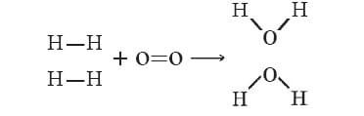
4
EM-LO5
Example 4.1 · Hydrogen burning to make water
Estimate ΔH for 2 H₂(g) + O₂(g) → 2 H₂O(g). (H–H 105, O=O 119, O–H 110 kcal/mol)
1
Bonds broken: 2 H–H = 2 × 105 = 210 kcal; 1 O=O = 119 kcal; total 329 kcal
2
Bonds formed: 4 O–H (two in each H₂O) = 4 × 110 = 440 kcal
Bonds broken and formed (Ball, The Basics of GOB Chemistry 7.4)
3
ΔH ≈ 329 − 440 = −111 kcal. Negative: the reaction is exothermic.
PHD115 · Energy & Matters
Dr. NAM · Faculty of Pharmacy, UiTM Bertam, Penang
Notes:
Ball 7.4 worked calculation.

Slide 69

4
EM-LO5
Heat as a product
Heat written on the product side (Ball, The Basics of GOB Chemistry 7.4)
The bonds in the products (440 kcal) are stronger than those in the reactants (329 kcal) by about 111 kcal.
The reaction releases more energy than it consumes; the excess is released as heat, so it is exothermic.
Two ways to write it: put + 111 kcal on the product side, or write 2 H₂ + O₂ → 2 H₂O with ΔH = −111 kcal.
An exothermic reaction always has a negative ΔH.
PHD115 · Energy & Matters
Dr. NAM · Faculty of Pharmacy, UiTM Bertam, Penang
Notes:
Ball 7.4, continuation of the H2 + O2 example.

Slide 70
4
EM-LO5
Example 4.2 · Hydrogen bromide
What is ΔH for H₂(g) + Br₂(g) → 2 HBr(g)? Is it exothermic or endothermic?
1
Reactant bonds (broken): 1 H–H = 105 kcal; 1 Br–Br = 46 kcal; total 151 kcal
2
Product bonds (formed): 2 H–Br = 2 × 87 = 174 kcal
3
ΔH ≈ 151 − 174 = −23 kcal
4
ΔH is negative, so the reaction is exothermic.
PHD115 · Energy & Matters
Dr. NAM · Faculty of Pharmacy, UiTM Bertam, Penang
Notes:
Ball Example 7.4.1, steps 1 to 5 combined.

Slide 71
4
EM-LO5
Try it · Hydrogen chloride
Using the bond energy table, find ΔH for H₂(g) + Cl₂(g) → 2 HCl(g). Is it exothermic or endothermic? Explain.
Work it out, then check on the next slide.
PHD115 · Energy & Matters
Dr. NAM · Faculty of Pharmacy, UiTM Bertam, Penang
Notes:
Ball Exercise 7.4.1. The book's question text says 'thermal decomposition of water', but the equation and answer are for H2 + Cl2 → 2HCl; the question has been reworded to match.

Slide 72
4
EM-LO5
Try it · Hydrogen chloride · answer
Using the bond energy table, find ΔH for H₂(g) + Cl₂(g) → 2 HCl(g). Is it exothermic or endothermic? Explain.
Answer
Broken: 1 H–H + 1 Cl–Cl = 105 + 58 = 163 kcal
Formed: 2 H–Cl = 2 × 103 = 206 kcal
ΔH ≈ 163 − 206 = −43 kcal. Negative, so exothermic.
PHD115 · Energy & Matters
Dr. NAM · Faculty of Pharmacy, UiTM Bertam, Penang
Notes:
Ball Exercise 7.4.1. The book's question text says 'thermal decomposition of water', but the equation and answer are for H2 + Cl2 → 2HCl; the question has been reworded to match.

Slide 73
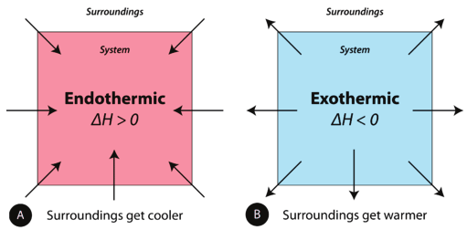
4
EM-LO5
Endothermic and exothermic reactions
Endothermic: energy is a reactant. Heat flows from the surroundings into the system (the reaction mixture), the enthalpy of the system increases, and ΔH is positive. The surroundings get cold.
Exothermic: heat is a product. Heat flows from the system into the surroundings, the enthalpy of the system decreases, and ΔH is negative. The surroundings get warm.
(A) Endothermic reaction. (B) Exothermic reaction (Ball, The Basics of GOB Chemistry Figure 7.4.1)
PHD115 · Energy & Matters
Dr. NAM · Faculty of Pharmacy, UiTM Bertam, Penang
Notes:
Link back to the instant cold pack from the pre-lecture activity: endothermic, so the pack feels cold.

Slide 74
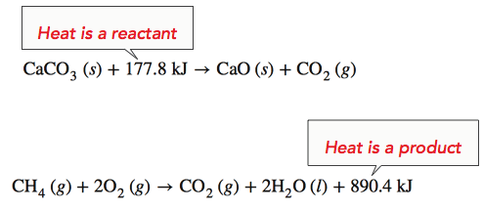
4
EM-LO5
Writing heat into an equation
Endothermic: when 1 mol of CaCO₃ decomposes into 1 mol CaO and 1 mol CO₂, 177.8 kJ is absorbed. Heat is written as a reactant; ΔH = +177.8 kJ.
Exothermic: burning 1 mol of methane releases 890.4 kJ. Heat is written as a product, or ΔH = −890.4 kJ.
Ball, The Basics of GOB Chemistry 7.4
PHD115 · Energy & Matters
Dr. NAM · Faculty of Pharmacy, UiTM Bertam, Penang
Notes:
Ball 7.4. Ask which reaction would warm the room: the methane combustion.

Slide 75
4
EM-LO5
Example 4.3 · Exothermic or endothermic?
(a) CH₄(g) + 2 O₂(g) → CO₂(g) + 2 H₂O(ℓ) + 213 kcal
(b) N₂(g) + O₂(g) + 45 kcal → 2 NO(g)
1
(a) Energy (213 kcal) is a product: energy is given off, so the reaction is exothermic.
2
(b) Energy (45 kcal) is a reactant: energy is absorbed, so the reaction is endothermic.
PHD115 · Energy & Matters
Dr. NAM · Faculty of Pharmacy, UiTM Bertam, Penang
Notes:
Ball Example 7.4.2.

Slide 76
4
EM-LO5
Try it · Exothermic or endothermic?
(a) H₂(g) + F₂(g) → 2 HF(g) + 130 kcal
(b) 2 C(s) + H₂(g) + 5.3 kcal → C₂H₂(g)
Work it out, then check on the next slide.
PHD115 · Energy & Matters
Dr. NAM · Faculty of Pharmacy, UiTM Bertam, Penang
Notes:
Ball Exercise 7.4.2.

Slide 77
4
EM-LO5
Try it · Exothermic or endothermic? · answer
(a) H₂(g) + F₂(g) → 2 HF(g) + 130 kcal
(b) 2 C(s) + H₂(g) + 5.3 kcal → C₂H₂(g)
Answer
(a) Exothermic: the energy (130 kcal) is produced.
(b) Endothermic: the energy (5.3 kcal) is absorbed to react.
PHD115 · Energy & Matters
Dr. NAM · Faculty of Pharmacy, UiTM Bertam, Penang
Notes:
Ball Exercise 7.4.2.

Slide 78
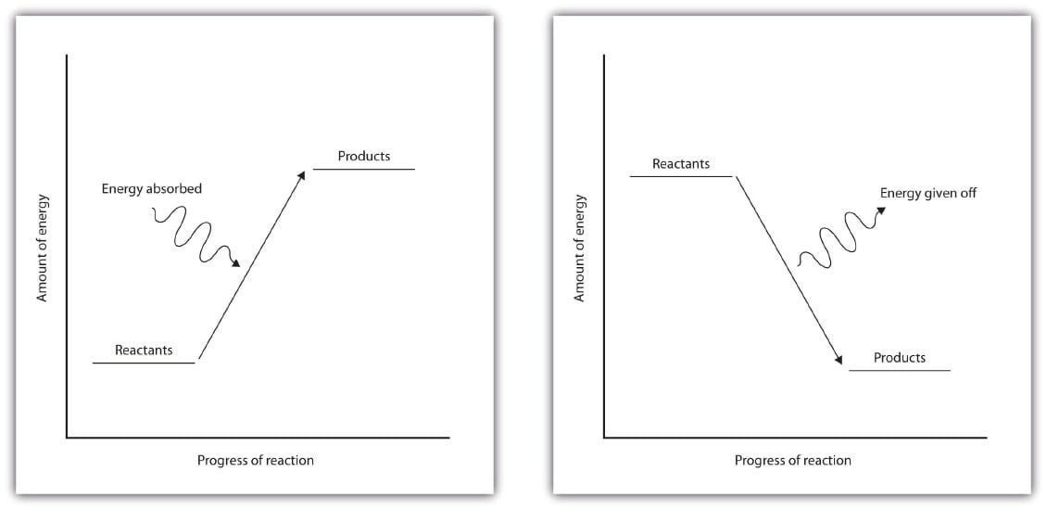
4
EM-LO5
Energy diagrams: uphill and downhill
Endothermic, 'uphill': reactants are lower in energy than products; the reactants have stronger bonds. They must absorb energy from the environment to become products.
Exothermic, 'downhill': products are lower in energy than reactants; the products have stronger bonds. Energy is given off, usually as heat (a few reactions give off light).
Strong bonds have lower potential energy than weak bonds.
Left: endothermic. Right: exothermic (Ball, The Basics of GOB Chemistry Figures 7.4.2 and 7.4.3)
PHD115 · Energy & Matters
Dr. NAM · Faculty of Pharmacy, UiTM Bertam, Penang
Notes:
Draw both diagrams on the board and label reactants, products and the energy arrow.

Slide 79
4
EM-LO5
Endothermic vs exothermic reactions
Endothermic reactions | Exothermic reactions
Heat is absorbed by reactants to form products | Heat is released
Heat is absorbed from the surroundings, which get cold | Heat is released to the surroundings, which feel hot
ΔH_{rxn} is positive | ΔH_{rxn} is negative
Bonds broken in the reactants are stronger than bonds formed in the products | Bonds formed in the products are stronger than bonds broken in the reactants
Reactants are lower in energy than products | Products are lower in energy than reactants
'Uphill' energy diagram | 'Downhill' energy diagram
Source: Ball Table 7.4.2.
PHD115 · Energy & Matters
Dr. NAM · Faculty of Pharmacy, UiTM Bertam, Penang
Notes:
A one-page comparison students should be able to reproduce.

Slide 80
4
EM-LO5
Key takeaways: bond energies
Atoms are held together by a certain amount of energy called bond energy.
Energy is required to break bonds. Energy is released when bonds form, because the atoms become more stable.
Reactions are exothermic or endothermic depending on whether they give off or absorb energy.
ΔH ≈ Σ(bonds broken) − Σ(bonds formed): negative is exothermic, positive is endothermic.
PHD115 · Energy & Matters
Dr. NAM · Faculty of Pharmacy, UiTM Bertam, Penang
Notes:
Ball 7.4 Key Takeaways.

Slide 81
4
EM-LO5
Quick check
A reaction has ΔH = +45 kcal. Which statement is correct?
A It releases heat and the surroundings warm up
B It absorbs heat and the surroundings get colder
C Its products are lower in energy than its reactants
D It has a 'downhill' energy diagram
PHD115 · Energy & Matters
Dr. NAM · Faculty of Pharmacy, UiTM Bertam, Penang
Notes:
Answer B.

Slide 82
4
EM-LO5
Quick check · answer
A reaction has ΔH = +45 kcal. Which statement is correct?
A It releases heat and the surroundings warm up
B It absorbs heat and the surroundings get colder
C Its products are lower in energy than its reactants
D It has a 'downhill' energy diagram
Answer B. A positive ΔH means an endothermic reaction: heat flows in from the surroundings.
PHD115 · Energy & Matters
Dr. NAM · Faculty of Pharmacy, UiTM Bertam, Penang
Notes:
Answer B.

Slide 83
5
PART 5
The energy of biochemical reactions
The reactions in the body follow the same energy rules as any other chemical reaction.
EM-LO6 · Ball 7.5
PHD115 · Energy & Matters
Dr. NAM · Faculty of Pharmacy, UiTM Bertam, Penang
Notes:
Part 5 corresponds to section 7.5.

Slide 84
5
EM-LO6
Oxidising glucose: the body's energy source
C₆H₁₂O₆(s) + 6 O₂(g) → 6 CO₂(g) + 6 H₂O(ℓ) + 670 kcal
glucose | C₆H₁₂O₆, a carbohydrate (sugar)
670 kcal | released per mole of glucose (about 2800 kJ): heat is a product, so it is exothermic
compact | 1 mol of glucose has a volume of only about 115 mL, so it is a compact source of energy
same rules | the chemistry of the body is complex, but it follows the same energy principles as other reactions
PHD115 · Energy & Matters
Dr. NAM · Faculty of Pharmacy, UiTM Bertam, Penang
Notes:
Ball 7.5, Equation 7.5.1.

Slide 85
5
EM-LO6
Example 5.1 · Checking the 4 kcal/g fuel value
Glucose releases 670 kcal per mole. Show that this is about 4 kcal per gram. (C = 12.01, H = 1.008, O = 16.00)
1
Molar mass of C₆H₁₂O₆ = 6(12.01) + 12(1.008) + 6(16.00) = 180.2 g/mol
2
670 kcal/mol ÷ 180.2 g/mol = 3.7 kcal/g
3
About 4 kcal/g, the fuel value used for all carbohydrates in Part 1.
PHD115 · Energy & Matters
Dr. NAM · Faculty of Pharmacy, UiTM Bertam, Penang
Notes:
The book invites students to verify this; it links Part 5 back to food energy in Part 1.

Slide 86
5
EM-LO6
The three main dietary energy sources
Carbohydrates, proteins and fats are the three main components of the human diet.
Carbohydrates
Proteins
Fats
Glucose and other sugars.
about 4 kcal/g
Building blocks of structural tissues such as muscle and skin.
about 4 kcal/g
Largely hydrocarbon chains.
about 9 kcal/g: even more energy per gram
PHD115 · Energy & Matters
Dr. NAM · Faculty of Pharmacy, UiTM Bertam, Penang
Notes:
Same fuel values as the food-label calculations in Part 1.

Slide 87
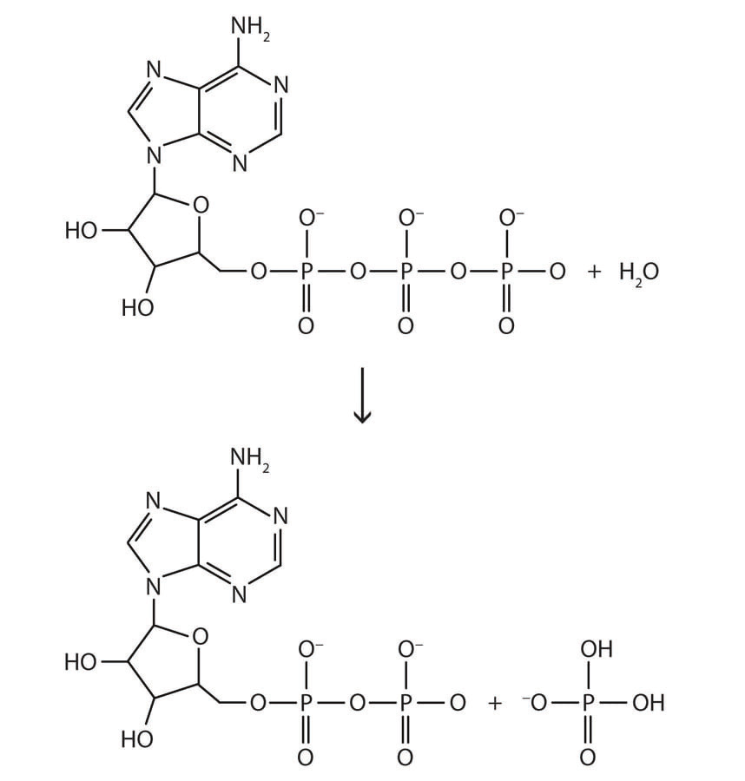
5
EM-LO6
ATP: the cell's energy currency
Adenosine triphosphate (ATP) is converted to adenosine diphosphate (ADP).
An O–P bond breaks, and an O–P bond and two O–H bonds form.
Under physiological conditions this gives off about 7.5 kcal per mole of ATP (about 31 kJ/mol).
Small compared with glucose, but enough to fuel other important reactions in our cells.
Even complex biological reactions obey the basic rules of chemistry.
ATP (top) converts to ADP (bottom) (Ball, The Basics of GOB Chemistry Figure 7.5.1)
PHD115 · Energy & Matters
Dr. NAM · Faculty of Pharmacy, UiTM Bertam, Penang
Notes:
Ball 7.5, Figure 7.5.1.

Slide 88
5
EM-LO6
Career focus: dietitian
A dietitian is a nutrition expert who communicates food-related information to the public.
Our diet supplies energy, vitamins, minerals and even water. Too much, too little, or the wrong foods can cause problems.
Dietitians make specific recommendations, e.g. diets for weight loss or for controlling diabetes.
Hospitals employ dietitians to plan patient menus; many also work with community organisations.
Pharmacy link: pharmacists work alongside dietitians, for example on parenteral nutrition and on drug–food interactions.
PHD115 · Energy & Matters
Dr. NAM · Faculty of Pharmacy, UiTM Bertam, Penang
Notes:
Ball 7.5 Career Focus, with a pharmacy link added.

Slide 89
5
EM-LO6
Quick check
Why is fat a more concentrated energy store than carbohydrate?
A Fat supplies about 9 kcal/g; carbohydrate about 4 kcal/g
B Fat contains more water
C Carbohydrate supplies no energy
D Fat is converted to ATP only
PHD115 · Energy & Matters
Dr. NAM · Faculty of Pharmacy, UiTM Bertam, Penang
Notes:
Answer A.

Slide 90
5
EM-LO6
Quick check · answer
Why is fat a more concentrated energy store than carbohydrate?
A Fat supplies about 9 kcal/g; carbohydrate about 4 kcal/g
B Fat contains more water
C Carbohydrate supplies no energy
D Fat is converted to ATP only
Answer A. Fats are largely hydrocarbon chains and supply about 9 kcal/g, more than twice carbohydrate's 4 kcal/g.
PHD115 · Energy & Matters
Dr. NAM · Faculty of Pharmacy, UiTM Bertam, Penang
Notes:
Answer A.

Slide 91
Summary: key equations and ideas
Energy units
1 cal = 4.184 J · 1 Cal = 1 kcal = 4.184 kJ
Temperature
°C = (°F − 32) × 5/9 · K = °C + 273.15
Heat, temperature change
q = m × c × ΔT
Heat, change of state
q = m × ΔH_{fus} · q = m × ΔH_{vap}
Heating curve
slopes: q = mcΔT · plateaus: q = mΔH
Heat of reaction
ΔH ≈ Σ(bonds broken) − Σ(bonds formed)
Sign of ΔH
negative: exothermic (heat out) · positive: endothermic (heat in)
Body energy
carbohydrate, protein ≈ 4 kcal/g · fat ≈ 9 kcal/g · ATP → ADP ≈ 7.5 kcal/mol
PHD115 · Energy & Matters
Dr. NAM · Faculty of Pharmacy, UiTM Bertam, Penang
Notes:
Everything here appears in the summary page of the notes.

Slide 92
Before the next topic
1
Complete the post-lecture activity (25 min)
2
Attempt the tutorial: 8 exam-style questions, 34 marks
3
Play Phase Quest to find your weak outcomes
4
Next topic: Chemical Reactions I
Adapted from The Basics of GOB Chemistry (Ball, Hill & Scott), LibreTexts, CC BY-NC-SA 3.0, sections 7.0–7.5. Shared under the same licence for non-commercial teaching.
PHD115 · Energy & Matters
Dr. NAM · Faculty of Pharmacy, UiTM Bertam, Penang
Notes:
Point students to the student hub.

