Slide 1
Module 5-C Curriculum
Notes:
Now we're shifting from mini lessons to more comprehensive curriculum options. These are full programs that typically span multiple weeks or an entire semester.

Slide 2
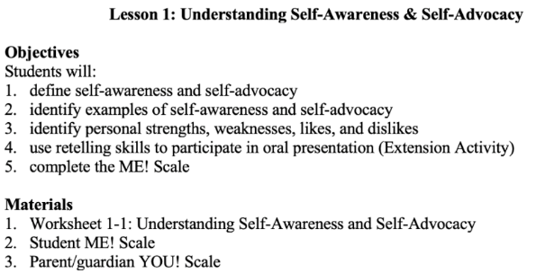
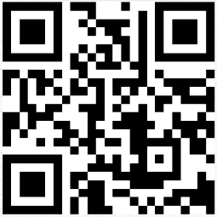
Me! Curriculum
10 units to teach self-awareness and self-advocacy (45-60 minutes each)
https://tinyurl.com/MeResource
Notes:
Let's start with the ME! Curriculum, which is a wonderful resource for teaching self-awareness and self-advocacy skills.
The ME! Curriculum consists of 10 units that teach self-awareness and self-advocacy. Each unit is designed to take about 45-60 minutes to complete, making them perfect for weekly or bi-weekly implementation.
What makes ME! Curriculum special:
It's specifically designed to help students understand their own special education services
Teaches students the vocabulary and concepts related to IEPs and transition planning
Builds foundational self-advocacy skills
Available for free through the link provided: https://tinyurl.com/MeResource
The 10 units cover topics such as:
Understanding what special education means
Learning about IEP terminology and acronyms (like FAPE, LRE, IEP, etc.)
Identifying personal strengths and challenges
Understanding accommodations and modifications
Developing self-advocacy strategies
Preparing to participate in IEP meetings
How to use it:
Implement one unit per week or every other week
Can be used in small group settings or one-on-one
Works well as part of a life skills or transition planning class
Great for middle school students who are just beginning to understand their disabilities
Can be adapted for high school students who need foundational knowledge
Key Connection: Remember the ME Assessment we talked about in Module 4? This curriculum actually includes that assessment as one of its components. Students complete the ME Student Scale to measure their understanding of their special education services, then work through the curriculum to build that knowledge.

Slide 3
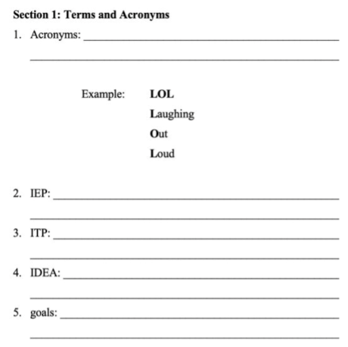
Screenshot of Me! Curriculum Worksheet
Notes:
Here's an example of a worksheet from the ME! Curriculum [show screenshot]. Notice how it breaks down complex special education terminology into student-friendly language. Students aren't just memorizing terms—they're learning what these concepts mean for THEIR education.
Developmental Appropriateness:
Upper Elementary (4th-5th): Can begin introducing ME! Curriculum concepts, focusing on simpler units
Middle School: Ideal age for full implementation
High School: Great for students who are new to self-advocacy or haven't had previous exposure to understanding their IEP
The ME! Curriculum is particularly valuable because many students attend their IEP meetings without really understanding what's being discussed. This curriculum demystifies the process and empowers students with knowledge.
Take a moment to scan the QR code or visit the link to preview the ME! Curriculum materials. Think about which units would be most beneficial for your students.

Slide 4
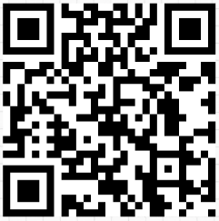
ChoiceMaker Curriculum
Choosing Educational Goals
Choosing Personal Goals
Choosing Employment Goals
Self-Directed IEP (Expressing Goals)
Take Action (Attaining IEP Goals)
https://tinyurl.com/choicemakercurriculum
Notes:
Now let's move to ChoiceMaker, one of the most well-researched and widely-used self-determination curricula.
ChoiceMaker was developed specifically to teach students to lead their own IEP meetings. It's structured around three main sections:
Choosing Goals
Expressing Goals (Self-Directed IEP)
Taking Action
Each section has multiple lessons that build on each other systematically.
Who is it for?
Middle and high school students
Students across ability levels (with appropriate modifications)
Can be taught in special education classes, transition classes, or advisory periods
Time commitment:
Approximately 15-30 minutes per lesson
2-3 times per week
Spans several months
Let me break down each section...

Slide 5
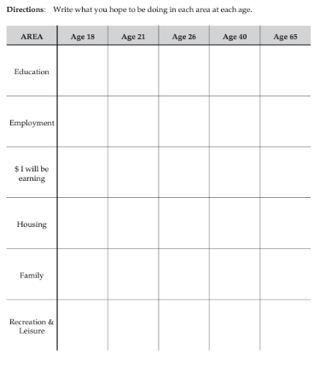
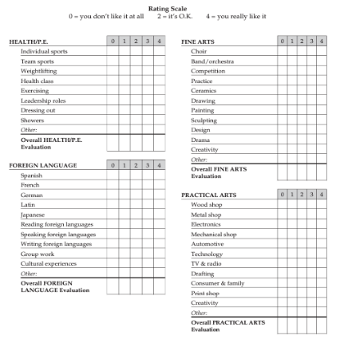
Choosing Goals(Part 1 of the ChoiceMaker)
Notes:
The first major section of ChoiceMaker is Choosing Goals, and this is Part 1 of the three-part ChoiceMaker curriculum.
Before students can lead their IEP meetings, they need to know what goals they're working toward. This section is broken down into three key areas:
Choosing Educational Goals
Choosing Employment Goals
Choosing Personal Goals
Why this matters: Students can't meaningfully participate in their IEP meetings if they don't know what they want. This section systematically teaches students to:
Identify their interests:
What do I like to do?
What am I good at?
What activities make me happy?
Identify their skills:
What can I do well?
What am I learning?
What do I need to improve?
Identify their limits (not limitations, but current limits):
What's hard for me right now?
What support do I need?
What am I working on?
Choose goals based on this self-knowledge:
What do I want to learn?
What do I want to improve?
What do I want to accomplish?
The curriculum uses worksheets, videos, and activities to teach these skills. Students aren't just thinking about goals abstractly—they're writing them down, evaluating them, and preparing to share them.
Let's look at each of the three goal areas in detail...

Slide 6
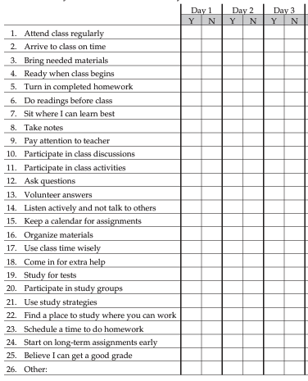
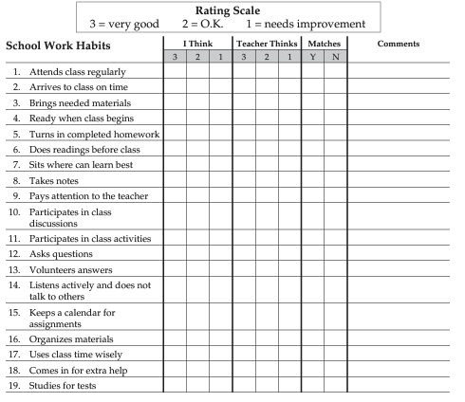
Choosing Education Goals: p. 10 & p. 13
Notes:
The Choosing Educational Goals section helps students think about their education across their entire lifespan—not just this year or next year, but well into adulthood.
Life Timeline Activity: One of the first activities has students think through different ages in their life:
At age 18
At age 21
At age 40
At age 65
For each age, students consider:
What will my education look like?
How much money do I want to be earning?
What will my family situation be?
What recreation and leisure activities will I enjoy?
Why this is powerful: This activity helps students see the BIG PICTURE. Their educational goals aren't isolated—they connect to their future employment, income, family life, and how they want to spend their free time.
These life timeline responses can be used directly when crafting post-secondary goals in the IEP. Instead of teachers guessing what students want, we have STUDENT-GENERATED data about their future vision.
Subject Rating Scales: Students also complete rating scales for different school subjects:
Health and PE
Foreign language
Fine arts (music, art, drama)
Practical arts (shop, home ec, technology)
Core academics
Students rate: Do I like this? Am I good at this? Do I want to learn more about this?
How to use this: These ratings inform the Course of Study section of the transition plan. Instead of adults deciding which electives students should take, STUDENTS are providing input on their interests and preferences.
School Work Habits - Self vs. Teacher Perception: Here's where it gets really interesting. Students complete a worksheet where they rate their own school work habits:
Do I turn in homework on time?
Do I pay attention in class?
Do I ask for help when I need it?
Do I complete assignments?
Then the TEACHER completes the same rating scale about the student.
Students then compare: What I think about myself vs. What my teacher thinks about me.
Do these perceptions match? If not, why not? This builds self-awareness and helps students understand how others perceive their work habits.
Self-Observation Activity: After comparing perceptions, students spend several days OBSERVING THEMSELVES. They carry a checklist throughout the day and mark:
Did I turn in my homework today? Yes or No
Did I pay attention in class? Yes or No
Did I ask for help when I needed it? Yes or No
At the end of the observation period, students reflect:
"I THOUGHT I did this, but when I actually tracked it, I realized I didn't do it as much as I thought."
"My teacher was right—I DO need to work on asking for help more often."
This builds accurate self-awareness, which is the foundation of self-determination.
Key Takeaway: Educational goals aren't just about grades—they're about understanding yourself as a learner, recognizing your preferences, and connecting your education to your future life goals.

Slide 7
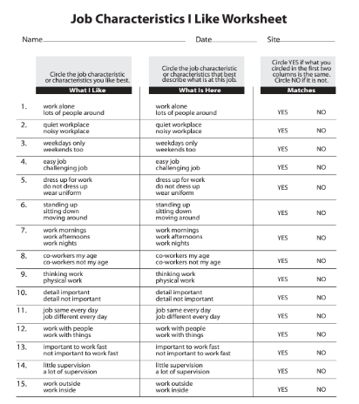
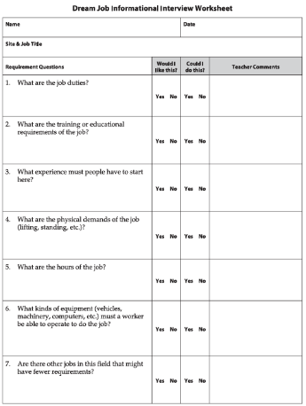
Choosing Employment Goals: p. 13 & p. 46
Notes:
The Choosing Employment Goals section is particularly helpful for students who struggle with the question "What do you want to do after high school?"
You know that student who says "I don't know" to every career-related question? This section is PERFECT for them.
Job Characteristics "I Like" Worksheet: This is one of my favorite tools in the entire ChoiceMaker curriculum. It simplifies career exploration by breaking it down into preferences.
Students answer questions like:
Do I like working alone or with lots of people around?
Do I like an easy job or a challenging job?
Do I like standing up, sitting down, or moving around?
Do I like thinking work (mental) or physical work?
Do I like being inside or outside?
Why this works: These questions don't require students to know specific job titles. They just need to know their own preferences. "I like being outside and moving around" gives us SO much information to work with.
There's also a second column where students can rate these characteristics for a CURRENT job or internship:
My current job has me working alone—do I like that or not?
My current job is mostly sitting down—do I prefer that or would I rather move around?
This helps students refine their preferences based on real experience.
Dream Job Informational Interview: Once students start identifying job interests, they complete a "Dream Job Informational Interview" worksheet. This guides students to research:
Job duties: What would I actually DO in this job?
Would I like doing these tasks?
Could I do these tasks?
Experience required: What experiences do people need to get this job?
Would I like gaining that experience?
Could I do what's required?
Hours and schedule: When would I work?
Morning, afternoon, evening, overnight?
Weekdays, weekends, flexible schedule?
Equipment needed: What equipment must I be able to operate?
Computers, machinery, vehicles, specialized tools?
Am I interested in learning to use this equipment?
This isn't just career exploration—it's REALISTIC career exploration. Students aren't just saying "I want to be a veterinarian" without understanding what that actually involves.
Connection to IEP: The employment goals section directly informs:
Post-secondary employment goals
Related services (Do they need job coaching? Transportation training?)
Course of study (What classes would help them reach this career goal?)
Key Takeaway: Employment goals become clearer when students understand their own preferences and have tools to explore careers realistically.

Slide 8
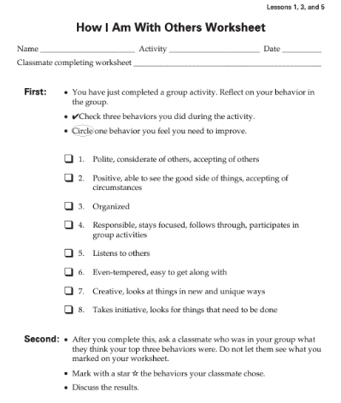
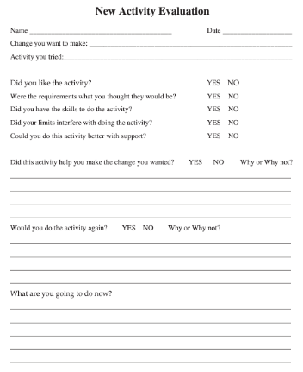
Choosing Personal Goals: p. 63 & p. 143
Notes:
The Choosing Personal Goals section focuses on social-emotional skills, relationships, and personal growth—areas that are often overlooked but critically important for success after high school.
"How I Am With Others" Worksheet: This activity combines GROUP WORK with SELF-REFLECTION. Here's how it works:
Step 1: Group Activity Students participate in a group activity (could be any collaborative task—building something, solving a problem, completing a project).
Step 2: Self-Reflection After the activity, students look at a list of social behaviors and check THREE things they feel they did well:
Was I polite?
Was I responsible?
Did I listen to others?
Was I helpful?
Did I stay on task?
Was I creative?
Did I cooperate?
Students might check: "I was polite, responsible, and I listened to others."
Step 3: Identify Growth Area Then students CIRCLE ONE behavior they feel they need to improve:
"I wasn't very creative during this activity—I could work on that."
Step 4: Peer Feedback Here's where it gets really valuable. Students ask a PARTNER from their group: "What do you think I did well in our group activity?"
The partner shares their perspective, and students put a STAR next to the behaviors their partner mentions.
Step 5: Comparison and Discussion Students then compare:
What I think I'm good at
What my partner thinks I'm good at
Do these match?
If they match—great! Accurate self-awareness.
If they don't match—that's a learning opportunity. Why might I think I'm good at listening but my partner didn't notice that? What could I do differently?
Why this is powerful:
It builds self-awareness about social skills
It teaches students to accept feedback
It helps students set realistic personal growth goals
It connects directly to workplace readiness (employers care about collaboration skills!)
New Activity Evaluation: The personal goals section also includes worksheets for trying new activities and evaluating them:
What did I try?
What did I like about it?
What was challenging?
Would I do this again?
What did I learn about myself?
This encourages students to step outside their comfort zones and build self-awareness through experience.
Connection to IEP: Personal goals inform:
Social-emotional IEP goals
Behavioral supports needed
Community participation goals (What groups or activities might this student enjoy?)
Independent living goals (Can they work with roommates? Handle conflict?)
Key Takeaway: Personal and social goals are just as important as academic and employment goals. Students need to understand themselves as PEOPLE, not just as students or workers.

Slide 9
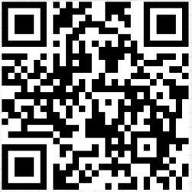
Self-Directed IEP (Part 2 of the ChoiceMaker: Expressing Goals)
11 lessons over the 11 steps
Each lesson includes around six to ten 45-minute sessions with accompanying videos, a student workbook, and a teacher manual
https://tinyurl.com/ZI-Expressinggoals
Notes:
Now we move to Part 2 of the ChoiceMaker curriculum: Self-Directed IEP, which focuses on Expressing Goals.
This is really a great part of the ChoiceMaker curriculum! This section is ALL about teaching students to actually LEAD their own IEP meetings.
What's included:
11 lessons that correspond to the 11 steps of a student-led IEP meeting
Each lesson includes around 6 to 10 mini sessions (45 minutes each)
Accompanying videos to model each step
Student workbook with activities and scripts
Teacher manual with lesson plans and facilitation guidance
All available for FREE through the link provided: https://tinyurl.com/ZI-Expressinggoals
Why this is powerful: Students don't just learn ABOUT leading IEP meetings—they actually PRACTICE each step systematically. By the time they finish this curriculum, they've rehearsed the entire IEP meeting process multiple times in a safe, supportive environment.
Structure: There's a lesson grouping for each of the 11 steps. Students work through each step individually, mastering one before moving to the next. This scaffolded approach ensures students feel confident and prepared.
The 11 steps take students from the very beginning of the meeting—stating the purpose—all the way through to working on their IEP goals throughout the entire year. Every critical component of an IEP meeting is covered.
Let's look at what those 11 steps are...

Slide 10
Self-Directed IEP Steps
Begin meeting by stating the purpose
Introduce everyone
Review past goals and performance
Ask for others' feedback
State your school and transition goals
Ask questions if you don't understand
Deal with differences in opinion
State what support you'll need
Summarize your goals
Close meeting by thanking everyone
Work on IEP goals all year
Notes:
Here are the 11 steps of a Self-Directed IEP that students learn through this curriculum:
Begin meeting by stating the purpose
"Thank you all for coming to my IEP meeting today..."
Students learn to open the meeting and set the tone
Introduce everyone
"I'd like to introduce everyone here today..."
Students practice learning who people are and their roles
Review past goals and performance
"Last year my goals were... Here's how I did..."
Students reflect on progress and growth
Ask for others' feedback
"What do you think about my progress?"
Students learn to invite input from team members
State your school and transition goals
"My goals for next year are..."
This is where the work from Part 1 (Choosing Goals) comes in!
Ask questions if you don't understand
"Can you explain what that means?"
Self-advocacy skill—knowing when you need clarification
Deal with differences in opinion
"I understand you think X, but I think Y because..."
Respectful disagreement and negotiation skills
State what support you'll need
"To reach my goals, I'll need help with..."
Identifying and requesting accommodations and services
Summarize your goals
"So my three main goals are..."
Ensures everyone is on the same page
Close meeting by thanking everyone
"Thank you all for being part of my team..."
Professional closing
Work on IEP goals all year
This isn't just about the meeting—it's about ongoing ownership
Students track progress and stay engaged throughout the year
Key Point: Each of these 11 steps has its own dedicated lesson with multiple 45-minute sessions. Students don't just hear about these steps—they PRACTICE them over and over again.
Students use scripts initially, then gradually fade the scripts as they become more comfortable. By the time of their actual IEP meeting, they've done this so many times that it feels natural.

Slide 11
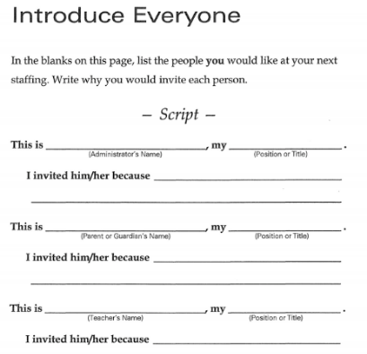
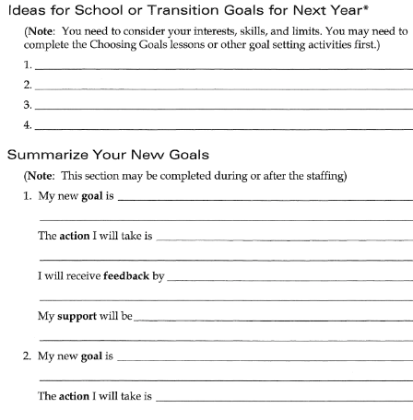
IEP Script from Self-Directed IEP Student Workbook
Notes:
Here's an example of what the IEP script looks like from the Self-Directed IEP Student Workbook.
This script helps students work through each section of the IEP meeting with specific prompts and sentence starters. Let's look at what students practice:
Introduction to everyone: "Hello, my name is ___________. Thank you for coming to my IEP meeting today. I invited you because __________."
Students fill in WHY they invited each person. Maybe:
"I invited my math teacher because I want to improve in math"
"I invited my vocational rehab counselor because I need help finding a job"
"I invited my mom because she supports me at home"
Their transition goals for next year: "After high school, I want to ___________." "Next year, my goals are ___________."
Students practice articulating their post-secondary goals clearly and confidently.
Summary of their new goals: "My three main goals for this year are:
___________"
What support they need: "To reach these goals, I will need help with ___________."
Closing: "Thank you all for being part of my team. I'm looking forward to working on these goals this year."
Why scripts are valuable:
They give students a starting point when they're nervous
They ensure all important information gets covered
They can be customized to each student's situation
They can be faded over time as students gain confidence
Progression:
First practice: Students read directly from the script
Second practice: Students use the script as a guide but add their own words
Third practice: Students might just have bullet points
Actual IEP meeting: Students lead naturally, maybe with a note card for key points
Differentiation:
Some students may always use a script—and that's OK!
Some students may record a video ahead of time to play at the meeting
Some students may have a peer or adult read portions while they contribute what they can
The goal is meaningful participation at whatever level the student can manage
The key is that students are prepared, confident, and ready to be active participants—or leaders—in their own IEP meetings.

Slide 12
Take Action(Part 3 of the ChoiceMaker Curriculum)
Make a goal
Set a goal (with performance criteria)
Explain motivation for goals
Break goals down into smaller parts
Monitor progress toward goals
Adjust goals
Accomplish goals
Notes:
The third section is Taking Action.
Goals are great, but goals without action are just wishes. This section teaches students to:
Break down big goals into smaller steps:
If my goal is "get a job," what are the small steps?
Apply for jobs, create a resume, practice interviewing, etc.
Monitor their progress:
How will I know if I'm making progress?
What does success look like at each step?
Adjust when things aren't working:
What do I do if I'm stuck?
Who can help me?
Do I need to change my approach?
Self-advocate when they need support:
How do I ask for help?
How do I explain what I need?
Students complete action plans, track their progress, and reflect on what's working and what's not.
The beauty of ChoiceMaker: By the end of the curriculum, students don't just understand self-determination in theory they've PRACTICED IT. They've set goals, expressed them in mock IEP meetings, and taken action toward achieving them.

Slide 13
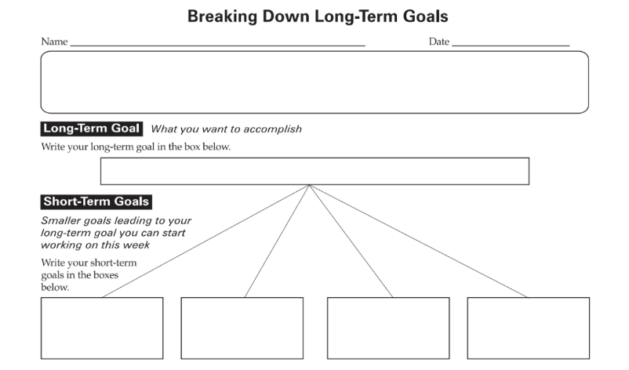
Screenshot 1 from Take Action
Notes:
Here's an example of one of the worksheets from the Take Action section of ChoiceMaker. This is the Breaking Down Long-Term Goals Worksheet.
How it works:
At the top of the worksheet, there's a box where students write their LONG-TERM GOAL. This is the big, overarching thing they want to accomplish.
Maybe their long-term goal is:
"Graduate from high school"
"Get a job in the medical field"
"Live independently"
"Go to college"
Then, below that top box, the worksheet has spaces for FOUR SHORT-TERM GOALS. Students break that big long-term goal down into four smaller, more manageable pieces.
For example, if the long-term goal is "Get a job in the medical field," the four short-term goals might be:
Complete high school health sciences courses
Get CPR certified
Complete a medical internship or volunteer at a hospital
Apply for entry-level medical positions
Then students order those short-term goals: Which one needs to happen first? Second? Third? Fourth?
This teaches students that big goals don't just happen—they happen through a series of smaller, sequential steps. You can't apply for medical positions before you have the skills and experience. You need to build toward that big goal systematically.
What else happens on this worksheet: Students also think through:
Timeline: When will I accomplish each short-term goal?
Dependencies: Does one goal need to be completed before another can start?
Resources needed: What do I need to accomplish each short-term goal?
This worksheet visually shows the FLOW from long-term goal → short-term goals → ordered action steps.
It takes something that might feel overwhelming ("I want to get a job in the medical field—where do I even start?!") and makes it concrete and actionable.

Slide 14
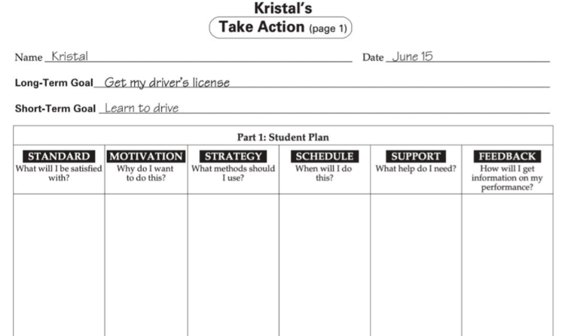
Screenshot 2 from Take Action
Notes:
Now let's look at the second worksheet example. This shows how students take ONE of those short-term goals and create a complete Student Plan for achieving it.
The Process:
First, students have already identified their long-term goal (from the previous worksheet).
Then they've chosen ONE of their short-term goals to focus on. Let's use the example from the worksheet: Learning to drive.
Now students work through a detailed planning process by answering specific questions:
1. What am I going to be satisfied with? "I'm going to be satisfied when I learn to drive."
This is the concrete outcome—what does success look like for this short-term goal?
2. Why do I want to do this? "I want to get my driver's license and be more independent."
Students articulate their MOTIVATION. This is crucial because when things get hard, remembering WHY you want something helps you persist.
In this case: "I want to be more independent and not rely on others for rides."
3. What method should I use? "I'm going to take a driver's ed class with my school."
Or maybe: "I'm going to take private driving lessons."
Students identify the STRATEGY or APPROACH they'll use to accomplish this goal.
4. When will I do this? "I'm going to do this next semester."
Specific timeline. Not "someday" or "eventually"—NEXT SEMESTER. This creates accountability.
5. What help do I need? "I need my teacher, I need my parents, I need DRS to help me."
Students identify their SUPPORT SYSTEM. Who needs to be involved? What resources do they need?
Teacher: To help me enroll in driver's ed
Parents: To practice with me and help pay for the class
DRS (Division of Rehabilitation Services): Might provide adaptive equipment if needed
6. How will I get information on my performance? How am I going to evaluate it? "I'll know I've learned how to drive when I pass driver's ed and get my license."
This is the MEASUREMENT piece. How will I know I've succeeded? What's the evidence?
Why This Student Plan Format is So Powerful:
This isn't vague goal-setting. Students are answering:
WHAT (the goal)
WHY (the motivation)
HOW (the method)
WHEN (the timeline)
WHO (the support)
HOW WILL I KNOW (the measurement)
This is the EXACT process students will use for ANY goal—academic, employment, independent living, or community participation.
Examples of other short-term goals students might create Student Plans for:
"Improve my reading grade from a C to a B"
"Complete my job application portfolio"
"Learn to use public transportation independently"
"Save $500 for post-secondary expenses"
Each one would go through this same structured planning process.
Connection to the IEP:
Do you see how this directly connects to IEP goals? Students who go through this process can:
Articulate their goals clearly
Explain WHY the goal matters to them (motivation = engagement)
Identify what support they need (self-advocacy)
Monitor their own progress (self-evaluation)
By the time students get to their IEP meeting, they're not passively listening to adults talk about goals—they're PREPARED to discuss their goals, their progress, and what they need to succeed.
Key Takeaway: The Take Action section of ChoiceMaker transforms students from goal-receivers to goal-setters and goal-achievers. They're not just choosing goals (Part 1) and expressing them (Part 2)—they're actually DOING something about them (Part 3).

Slide 15
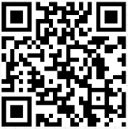
ChoiceMaker Break
https://tinyurl.com/choicemakercurriculum
You have 10 minutes to go explore the ChoiceMaker Curriculum.
Share your favorite part with your group (Choosing Goals, Self-Directed IEP, or Take Action). How could you use one of the activities in that part in your own classroom? How could you practice goal setting in your own life?
Notes:
Now pause the video and spend about 7-10 minutes exploring the ChoiceMaker curriculum. You can access it through the QR code or link provided.
Focus on one section that interests you most:
Choosing Goals - How students identify their interests, skills, and limits
Self-Directed IEP - The 11 steps of leading an IEP meeting
Taking Action - Breaking down goals and monitoring progress
As you explore, think about:
How could you use one of these activities in your own classroom?
Which students would benefit most from this curriculum?
What resources or support would you need to implement it?
You might even practice the goal-setting framework for yourselfâ€”set a personal or professional goal using the ChoiceMaker process. This will help you better understand how to facilitate it with students.
Resume the video when you've finished exploring.

Slide 16
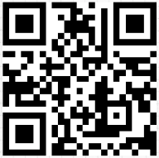
Self-Determined Learning Model for Instruction (SDLMI)
15 minutes 2 times a week (or 15-30 minutes for students with more significant support needs)
Authors suggest infusing key words and prompts throughout academics to think about goals during other key instructional times
https://tinyurl.com/ZI-SDLMI
Notes:
The Self-Determined Learning Model of Instruction SDLMI is another evidence-based curriculum for teaching self-determination.
Key features:
15 minutes, twice a week (or 15-30 minutes for students with more significant support needs)
FREE curriculum
Very similar structure to ChoiceMaker
Focuses on goal-setting and attainment
SDLMI has three phases:
Set a goal
Take action
Adjust the goal
What I love about SDLMI is that it's designed to be infused across academics. The goal students work on can be:
Academic (improve my reading fluency)
Behavioral (reduce off-task behavior)
Social (make two new friends)
Transition-related (research three colleges)
You're not adding a separate class you're adding a framework for how students approach ANY goal.

Slide 17
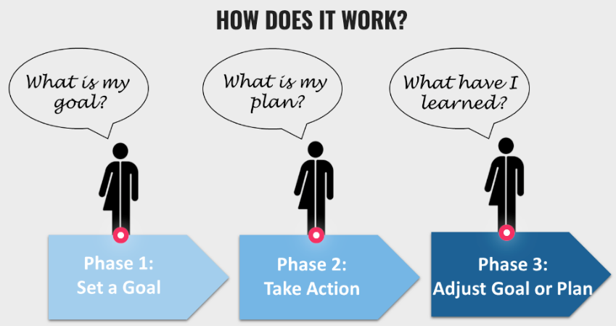
Self-Determined Learning Model for Instruction (SDLMI) Phases
Notes:
Phase 1: Set a Goal
In this phase, students answer three questions:
Question 1: What do I want to learn or improve?
Students identify an area of interest or need
Maybe they want to improve in a specific class
Maybe they want to learn a new skill
Question 2: What do I know about it now?
Students assess their current level
What can I already do?
What do I understand?
What's still confusing?
Question 3: What must change for me to learn what I don't know?
Students identify gaps
What's missing?
What needs to happen?

Slide 18
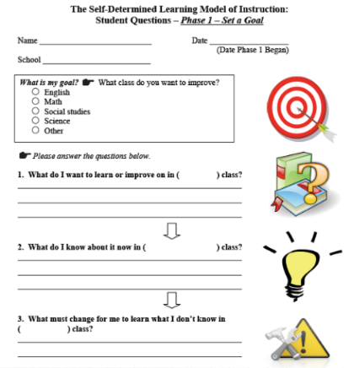
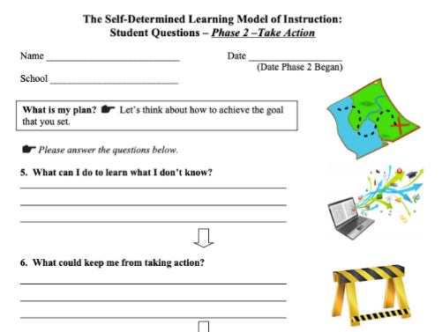
Self-Determined Learning Model for Instruction (SDLMI) Screenshots
Notes:
Here's an example two different worksheets, one from phase 1 and one from phase 2.
In Phase 1: Student identifies: "I want to improve in math class"
Current knowledge: "I'm good at addition and subtraction, but I struggle with word problems"
What must change: "I need to practice word problems more and learn strategies for breaking them down"
This is VERY scaffolded. Students aren't just vaguely saying "I want to do better." They're being specific and analytical.
Now students answer three MORE questions:
Question 1: What can I do to learn what I don't know?
Students identify specific actions
"I can practice three word problems every day"
"I can ask my teacher to show me a strategy"
"I can work with a peer tutor"
Question 2: What could keep me from taking action?
Students identify potential barriers
"I might forget to practice"
"I might not understand the teacher's explanation"
"I might get frustrated and give up"
Question 3: What can I do to remove those barriers?
Students problem-solve
"I can set a reminder on my phone"
"I can ask for the explanation to be written down"
"I can take breaks when I'm frustrated"
Here's an example worksheet from Phase 2:
Student writes: "I can practice word problems during bell ringer time and ask my teacher for help when I'm stuck."
Potential barriers: "I might not understand what the problem is asking."
Solution: "I can underline key words and rewrite the problem in my own words first."
Notice how this teaches META-COGNITION thinking about thinking, planning about planning. These are executive functioning skills that benefit students across ALL areas.
The final phase is about reflection and adjustment. Students answer:
Question 1: What actions did I take?
Students document what they actually did
Did I follow my plan?
What did I do consistently?
What did I skip?
Question 2: What barriers did I experience?
Students identify what got in the way
Were the barriers I predicted accurate?
Were there unexpected barriers?
Question 3: What will I do next?
Students adjust their approach
Keep doing what's working
Change what's not working
Set a new goal OR continue with the same goal using a new strategy
This phase teaches students that goals aren't staticâ€”they evolve. And that's OKAY. We don't expect perfection; we expect growth and adjustment.
The cycle repeats: After Phase 3, students go back to Phase 1 with a new or adjusted goal. SDLMI is ongoing throughout the semester or year.
Why SDLMI works:
Students are working on goals that matter to THEM
The structure is predictable and repetitive
It builds executive functioning skills
It's applicable to any content area
It's FREE!

Slide 19
Interactive Application Activity 🎉
SDLMI Goal-Setting Practice
Notes:
Now it's time to experience SDLMI firsthand. Pause the video here and work through Phase 1 of SDLMI with a personal or professional goal.
Here's your task:
Identify a goal - Something you want to learn or improve professionally
Maybe it's "Involve students more in IEP meetings"
Maybe it's "Improve my classroom management"
Maybe it's "Learn to use a new assistive technology"
Complete the Phase 1 questions:
What do you want to learn or improve?
What do you know about it now?
What must change for you to learn what you don't know?
Reflect on the process:
What did you realize about your current knowledge or skills?
What needs to change?
How could you use this same process with your students?
Why are we doing this?
Because the best way to understand how SDLMI works is to USE it yourself. You'll be able to better explain it to students, better facilitate it in your classroom, and better understand the reflection process if you've experienced it.
You can use the SDLMI Phase 1 worksheet found at the bottom of your comprehensive curricula notes in this module. Takee 7-10 minutes to work through this activity, then resume the video.

Slide 20
Pause for Reflection - Daily, Weekly, Monthly, Yearly Implementation
What could you do DAILY?
What could you do WEEKLY?
What could you do MONTHLY?
What should happen YEARLY?
Notes:
We've just shared a LOT of resources mini lessons, bell ringers, and comprehensive curricula. Before we move forward, let's pause and think strategically about implementation.
I want you to think about what activities could work on different timescales:
What could you do DAILY?
Bell ringers (5 minutes)
Goal progress check-ins (2 minutes)
Choice-making opportunities embedded in instruction
What could you do WEEKLY?
SDLMI lessons (15 minutes, twice a week)
ChoiceMaker activities (20-30 minutes)
One mini lesson like the Strength-Based Bingo or Treasure Map
What could you do MONTHLY?
Update one-pagers
Have students reflect on progress toward IEP goals
Do a more intensive mini lesson like podcasts or literature activities
Student-led goal-setting conferences
What should happen YEARLY?
Comprehensive transition assessments
Create new one-pagers at the start of the year
Major goal-setting activities (setting annual IEP goals with student input)
Practice or actual student-led IEP meetings
Be realistic. Don't try to do everything. Pick what feels sustainable. You can always add more later.
Take a minute right now to jot down:
ONE thing you'll do daily or weekly
ONE thing you'll do monthly
ONE thing you'll do yearly
Then using that information, complete the Classroom Implementation Activity found in the notes and activities section of your module. You may also use the Word document version that can be found in the Accessible Activities section of this module.

Slide 21

Module 5 Complete
Next Step: Complete Module 5 Quiz
Notes:
Congratulations! You've completed Module 5, which covered all the practical tools and resources for teaching self-determination skills—mini lessons like the Strength-Based Bingo and Transition Treasure Map, bell ringers across multiple topic areas, and comprehensive curricula like ChoiceMaker and SDLMI.
You've also created your own classroom implementation plan with specific activities, timelines, and SMART goals. Before moving on to Module 6, you will need to complete the Module 5 Quiz. This assessment will ask you to match activities to appropriate grade levels, identify which tools fit specific scenarios, and demonstrate your understanding of implementation strategies. When you complete the quiz, move on to Module 6 which will help you build school-wide support, engage families, and create sustainable systems for student involvement.

