Slide 1
Module 4-A: Academic Performance-Assessment Tools & Self-Determination

Slide 2
Many students with disabilities cannot learn the skills and behaviors associated with self-determination on their own, but they still have a desire to master the skills-this is only possible through the guidance of teachers.
Campbell-Whatley, 2008

Slide 3
How do you teach students to be involved in their IEPs?
Being Purposeful
In planning meaningful ways to get involved
In creating your own resources
In embedding activities into existing academic lessons
Make gradual steps toward full involvement and leading the IEP meeting
2
Use a variety of pre-made tools to engage students
3
Start with small changes to engage students in the process and let their voices be heard in the meeting
1

Slide 4
One Shot Activities

Slide 5
Transition Assessments
Results from interest inventories, exploration tools, and skills assessments provide evidence of student’s SPIN (strengths, preferences, interests, and needs)

Slide 6
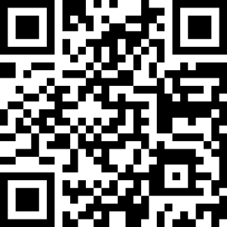
Transition Interview Generator
Students complete the survey to generate a list of customized transition interview questions to be used as an informal assessment to create their transition plan.
tinyurl.com/TransIntervGener

Slide 7
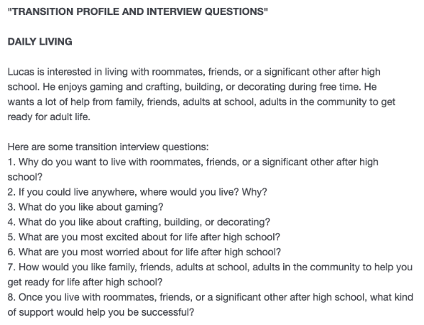
TIG Screenshot
Students complete the 20 questions (10-20) minutes to generate individualized transition-based interview questions!

Slide 8
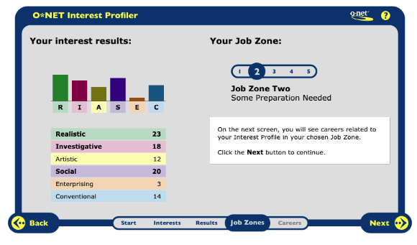
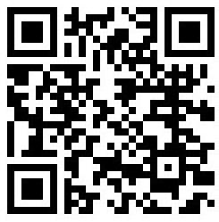
O*NET Interest Profiler
tinyurl.com/OnetMyNextMove

Slide 9
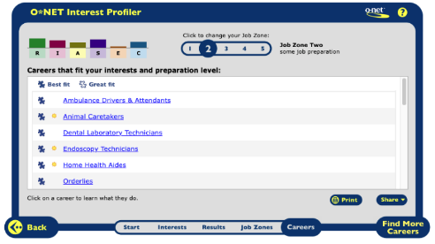
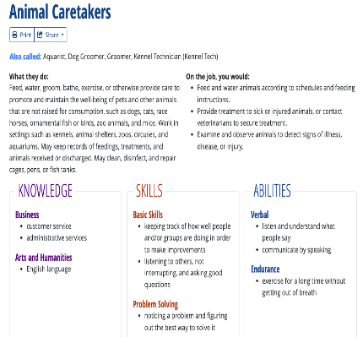
O*NET Interest Profiler Screenshots

Slide 10
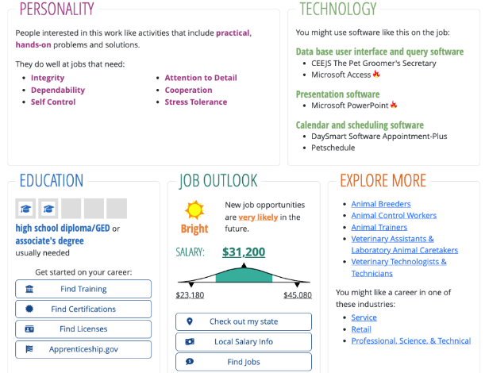
O*NET Interest Profiler Screenshots 2

Slide 11

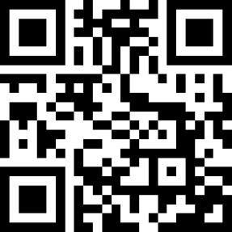
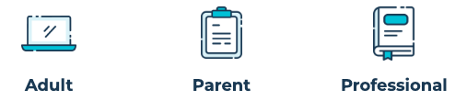
OK College Start
www.okcollegestart.org

Slide 12
OK College Start: College Finder
Other Filters:
Admissions
Cost and Financial Aid
Academics
Student Body
Sports
Campus Live & Services
Filter results by Key Facts:
Location
School Type
Public/Private
School Setting
School Size
Academic Calendar
Historically Black
www.okcollegestart.org

Slide 13
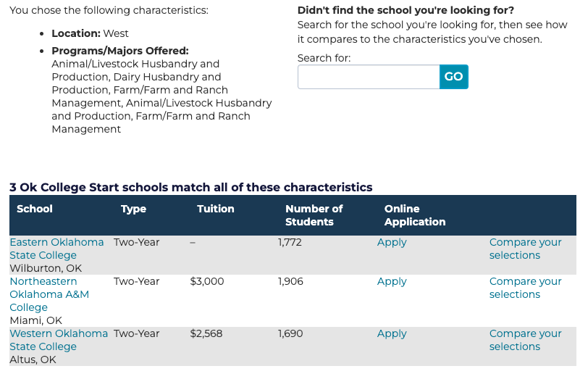
OK College Start Screenshot of results

Slide 14
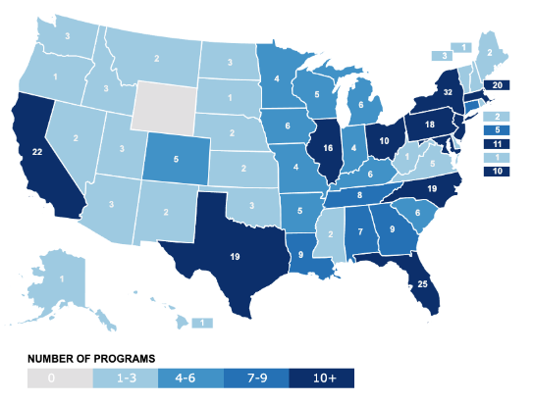
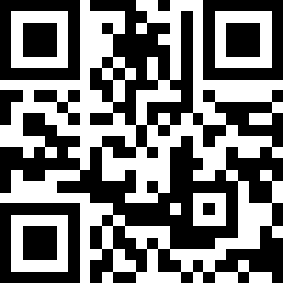
Think College
thinkcollege.net/college-search

Slide 15
Think College-College Search
College Finder for 340 postsecondary education programs for students with intellectual disabilities
Filter results by:
Location (state)
Program features
Disability
Public or private
Type of school
Length of program
thinkcollege.net/college-search

Slide 16
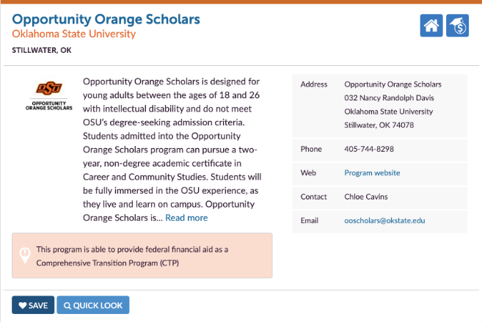
Screenshot of OOS

Slide 17
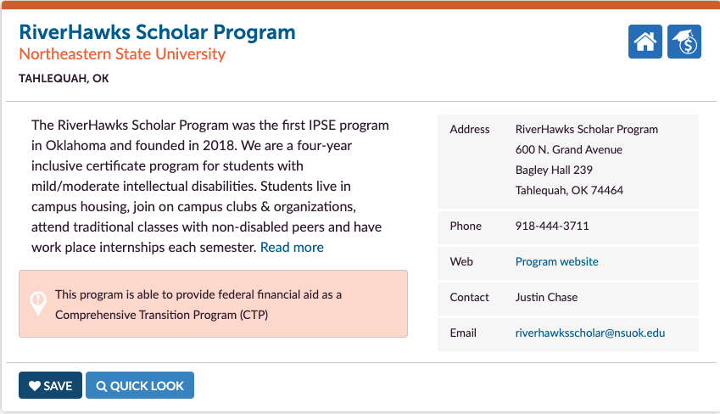
Screenshot of RiverHawks

Slide 18
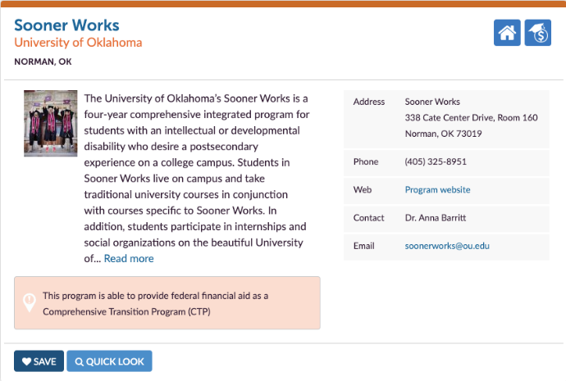
Screenshot of Sooner Works

Slide 19
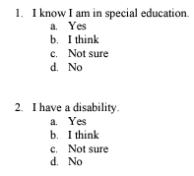
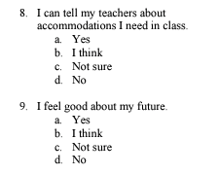
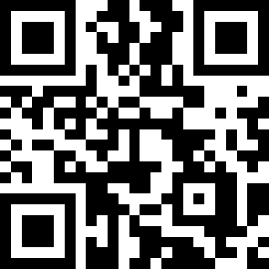
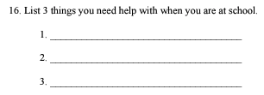
Me! Scale Pre-Assessment
tinyurl.com/MeScalePre

Slide 20

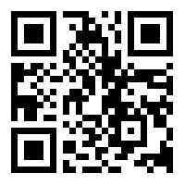
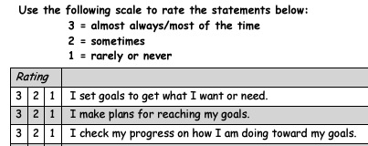

Self-Determination Checklist
tinyurl.com/SelfDetChcklist

Slide 21
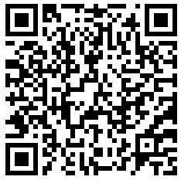
ARC’s Self-Determination Scale
https://tinyurl.com/ARCSDZC

Slide 22
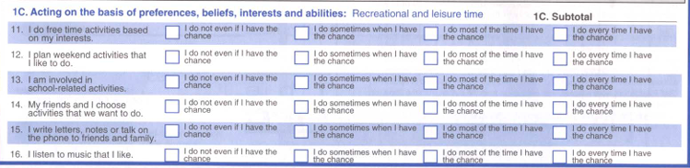
ARC’s Self-Determination Scale Section 1: Autonomy

Slide 23
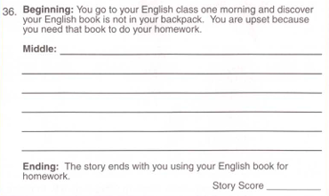
ARC’s Self-Determination Scale Section 2: Self-Regulation

Slide 24
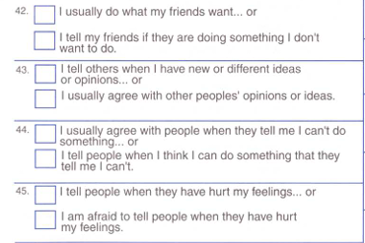
ARC’s Self-Determination Scale Section 3: Psychological Empowerment

Slide 25
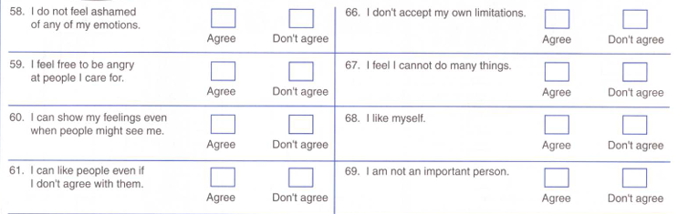
ARC’s Self-Determination Scale Section 4: Self-Realization

Slide 26
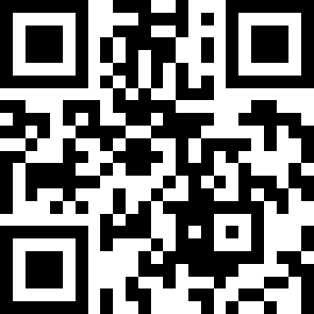
AIR Self-Determination Scale
Paper/Pencil Version
https://tinyurl.com/ZI-assessments

Slide 27
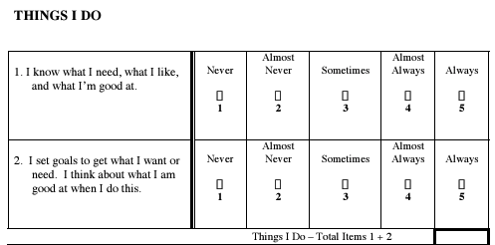
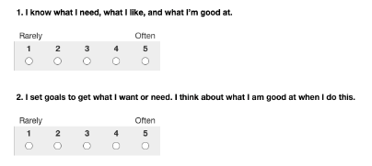
AIR Self-Determination Scale Student Version Screenshots

Slide 28
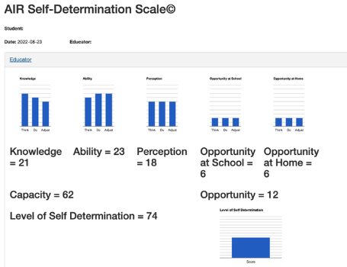
AIR Self-Determination Scale Results Screenshot

Slide 29
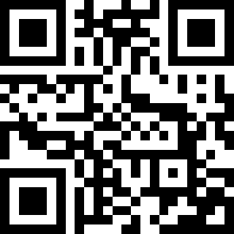
TAGG-Transition Assessment Goal Generator
https://tinyurl.com/ZI-assessments

Slide 30
Transition Assessment and Goal Generator (TAGG) Assessment Suite (Professional, Family & Student Versions)
TAGG HS: For students in high school (9th – 12th grade) who anticipate competitive employment and regular admission into post-secondary education options.
TAGG A: For students in high school (9th – 12th grade, 18+ programs) who do not anticipate either competitive employment of regular admission into post-secondary education options.
https://tagg.ou.edu/tagg/

Slide 31
TAGG Results
Norm-based profile for each construct
Lists areas of greatest & relative strengths and needs
Drafts present levels of performance statement
Provides suggested annual transition goals
$3 per credit (student, family, and professional versions)
Free credits can be obtained from the Oklahoma State Department of Education.
Contact Claudia Beckner Claudia.beckner@sde.ok.gov
TAGG training available! Contact tagg@ou.edu for more information.
NOTE: TAGG-A currently only shows professional version results

Slide 32
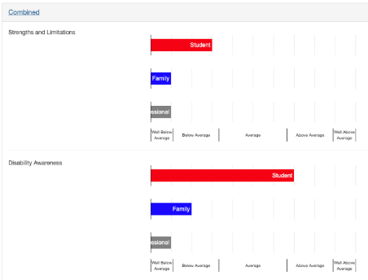
TAGG Results Sample Screenshot 1

Slide 33
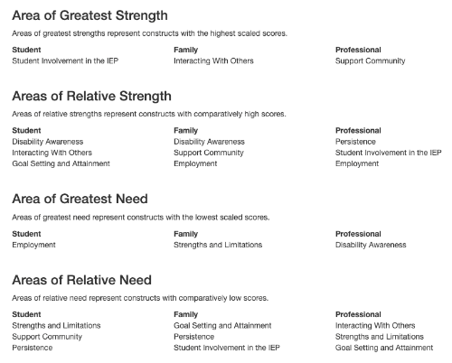
TAGG Results Sample Screenshot 2

Slide 34
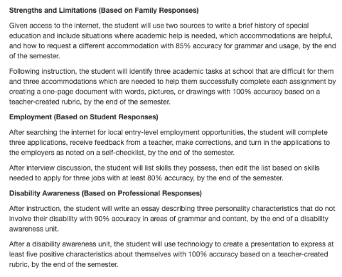
TAGG Results Sample Screenshot 3

Slide 35
TAGG Assessment Suite (Professional, Family & Student Versions)
TAGG MS: For students in middle school/junior high (estimated ages ranging from 11 to 15 years across grades 6, 7, and 8) and centered on the non-academic skills associated with high school success.
https://tagg.ou.edu/tagg/

Slide 36
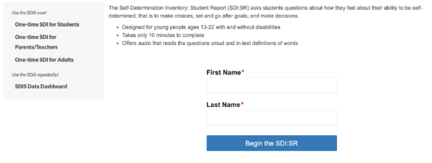
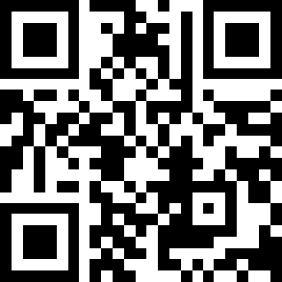
Self-Determination Inventory
Free 1 time use!! Be sure to save results.
tinyurl.com/SDI4students

Slide 37
SDI Break
You have 10 minutes to go take the SDI yourself.
When done, reflect on your results and your thoughts on the assessment.
Which of the other assessments (interview tools, interest inventories, exploration tools, or skills assessments) could you see yourself using to evaluate students as a one-shot activity?

Slide 38
Assessment Review
Assessment Tool Selection and Planning Activity

