Slide 1
Module 5-A: Mini Lessons & Lesson Packages

Slide 2
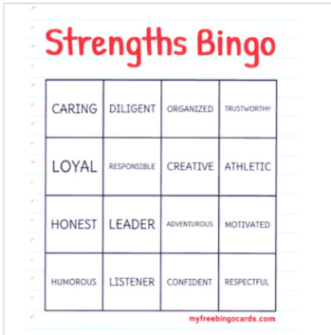
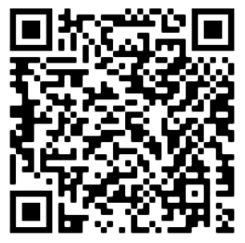
Strength-Based Lesson & Bingo
(Pratt & Driffill, 2020)
https://tinyurl.com/StrengthsZC

Slide 3
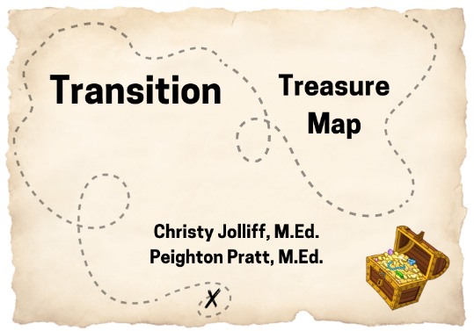
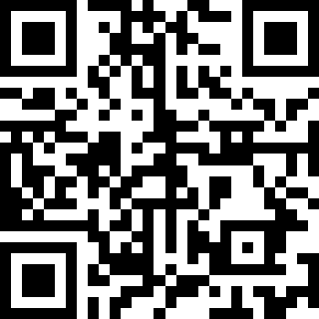
Transition Treasure Map
(Jolliff & Pratt, 2023)
https://tinyurl.com/TransitionTrsrMap

Slide 4
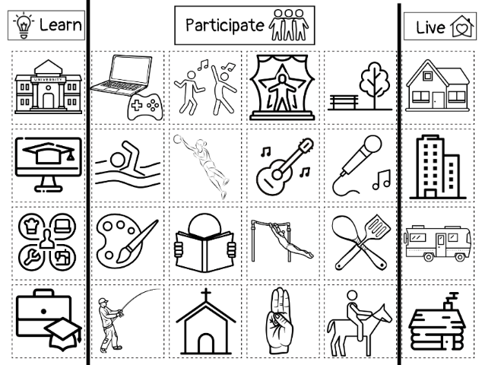
Transition Treasure Map Screenshot Without Words

Slide 5
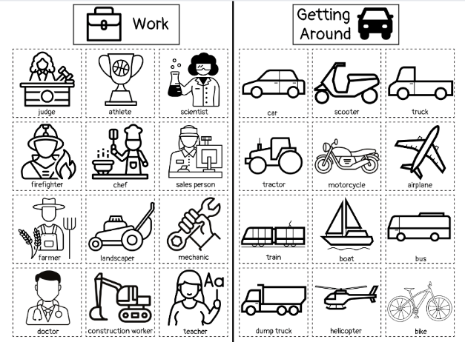
Transition Treasure Map Screenshot With Words

Slide 6
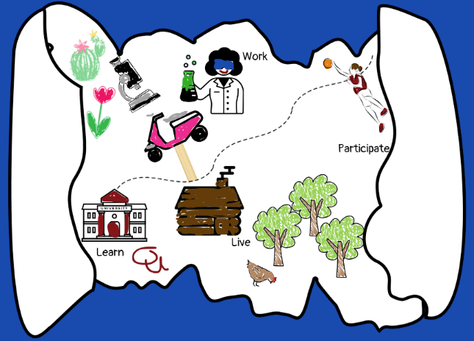
Transition Treasure Map Screenshot Example

Slide 7
Utilizing Literature, Media, and Film in Mini Lessons
Plan for it!
How does the academic skill you are working on relate to self-determination skills (like self-advocacy, self-awareness, disability awareness, problem-solving, goal setting)?
Ideas
Read aloud (small group or whole group)
Student book reports
Fast finisher work

Slide 8
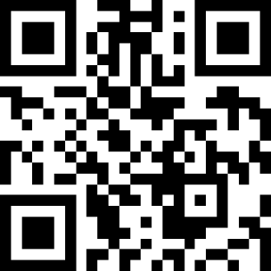
Tying the Knot: Self-Determination & Literature
FREE resource to connect literature to self-determination skills (self-advocacy, choice-making, conflict resolution, and persistence) within grade clusters
Links to read-aloud versions of included works (or Amazon for purchasing options of chapter books)
https://tinyurl.com/TKSDL-TPT

Slide 9
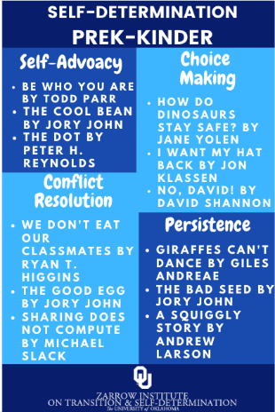
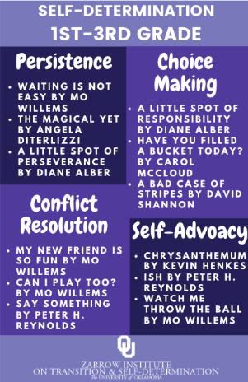
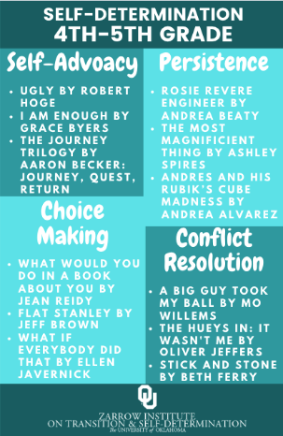
Tying the Knot: Self-Determination & Literature Screenshots 1

Slide 10
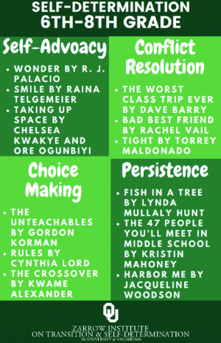

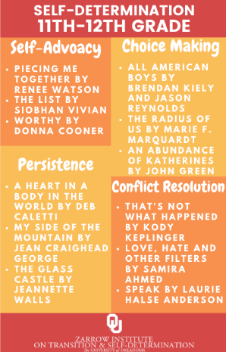
Tying the Knot: Self-Determination & Literature Screenshots 2

Slide 11
Activity Time 🎉
What is a book or short story you could use to teach a specific self-determination skill?

Slide 12
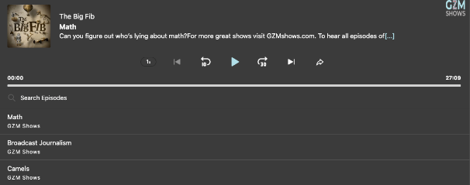
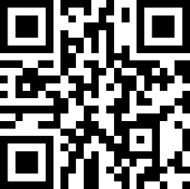
The Big Fib Podcast & Show
Two experts on a particular topic, one is genuine, the other is a liar. The ‘host’ works to ask insightful questions and weigh evidence to determine the fake news.
https://tinyurl.com/bigfib

Slide 13
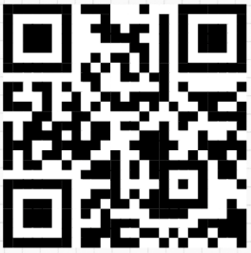
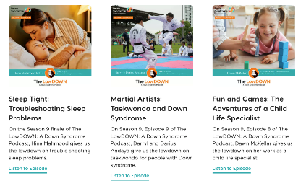
The LowDOWN Podcast
Features individuals with Down Syndrome, their parents, and experts in the field to address topics like health, development, advocacy, and employment
https://tinyurl.com/LowDOWNpod

Slide 14

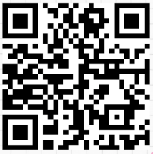
Disability Visibility Podcast
Alice Wong amplifies the voices of people with disabilities to promote an understanding of disability culture and rights with engaging discussions about disability identity, advocacy, accessibility, and societal perceptions
https://tinyurl.com/disabilityvisibility

Slide 15
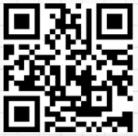
TAGG HS Lesson Plans
Units for each of the 8 constructs of the TAGG-HS (each unit contains 5 individual lessons)
Persistence
Strengths & Limitations
Disability Awareness
Support Community
Interacting with Others
Employment
Goal Setting
Student Involvement in the IEP
https://tinyurl.com/TAGGLP

Slide 16
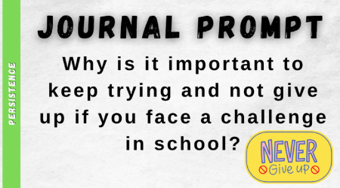
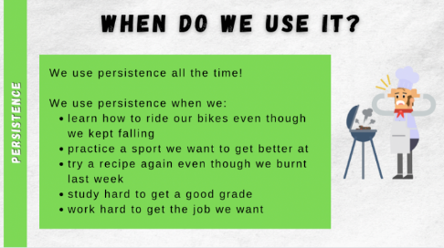
TAGG HS Lesson Plans Screen shot 1

Slide 17
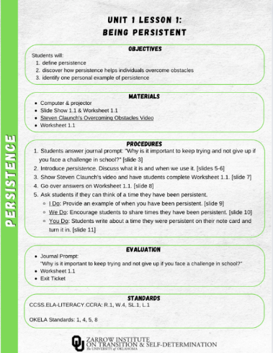
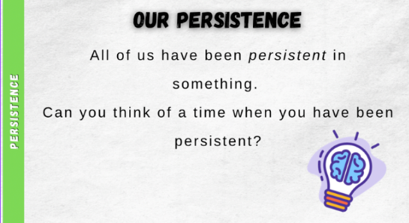
TAGG HS Lesson Plans Screen shot 2

Slide 18
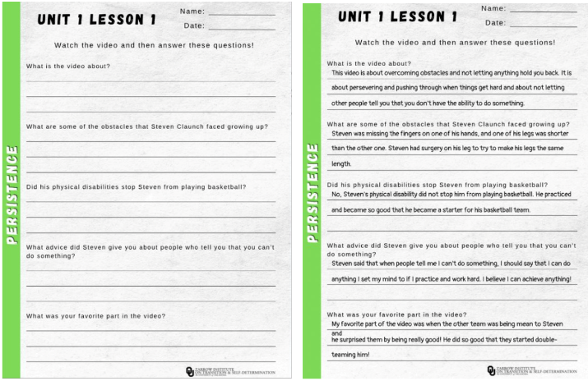
TAGG HS Lesson Plans Screen shot 3

Slide 19
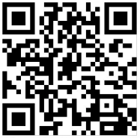
Skills to Pay the Bills Lessons
6 Lessons
Communication*
Enthusiasm and Attitude*
Teamwork
Networking
Problem Solving and Critical Thinking*
Professionalism*
*Denotes link to skills needed for student involvement
https://tinyurl.com/skills4thebills

Slide 20
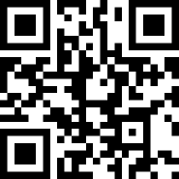
Example Video on Communication
https://tinyurl.com/skills4thebillsvideos

Slide 21
Interactive Activity

