Slide 1
Module 5-B Bell Ringers

Slide 2
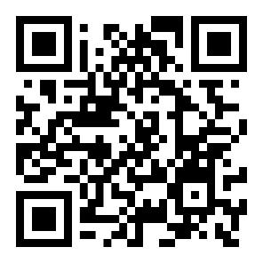
Bell Ringers in the Classroom
Select a level and topic that fits your students
Use at the beginning of class or as an exit ticket
Could be used to facilitate group discussions or as journal writing prompts
https://tinyurl.com/1pagerBR

Slide 3
Implementing a Bell Ringer Routine
Introduce the routine: Use the ‘I do, We do, You do’ method to model how/when students are expected to complete the bell ringers
Display the prompt slide: instruct students to read the prompt and respond in their journal, on paper, on an online document, or to their neighbor
Monitor students and assist as needed: Use a timer, visual, or verbal cue to alert students when time is up. Invite students to share their thoughts in group discussion.
Reflect: on student engagement, discussion depth, and routine effectiveness to determine needed adjustments

Slide 4
Intro to Transition Bell Ringers (with and without visuals)
Features
Sentence starters/prompts
A mean Flesch-Kincaid Grade Level of 1.89 (and 2.43 for the prompts)
Categories
All About Me
Taking Care of Myself
Understanding Money
Who I Want to Be
Would You Rather?
What Should You Do? (Scenarios)
Relationships with Others

Slide 5
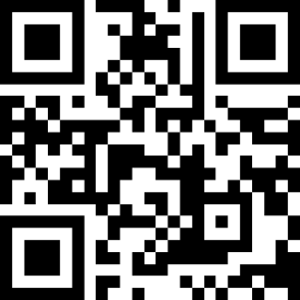
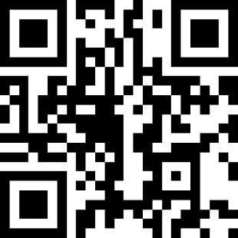
Intro to Transition Bell Ringers
https://tinyurl.com/ZIITbellringersv
Without Visuals
With Visuals
https://tinyurl.com/ZIITbellringers

Slide 6
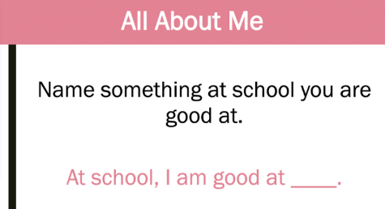
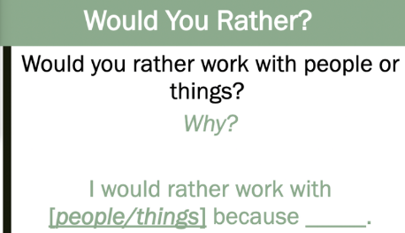
Screenshots of Intro to Transition Bell Ringers (without visuals)

Slide 7
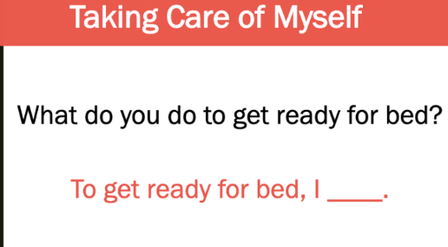
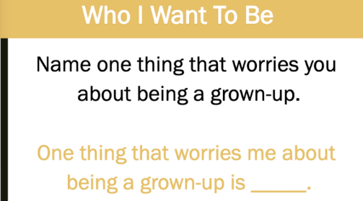
Screenshots 2 of Intro to Transition Bell Ringers (without visuals)

Slide 8
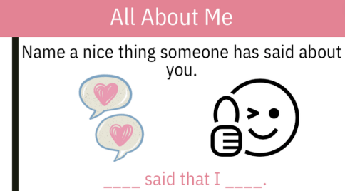
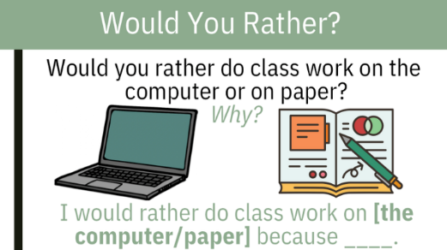
Screenshots of Intro to Transition Bell Ringers (with visuals)

Slide 9
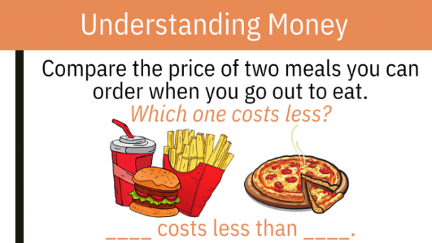
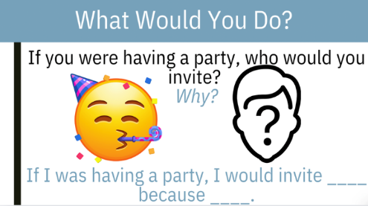
Screenshots 2 of Intro to Transition Bell Ringers (with visuals)

Slide 10
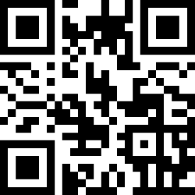
Early Transition Bell Ringers
Categories
All About Me
Taking Care of Myself
Understanding Money
Who I Want to Be
Would You Rather?
What Should You Do? (Scenarios)
Relationships with Others
Features
A range Flesch-Kincaid Grade Level of 0 to 6.42 with a mean of 2.08
https://tinyurl.com/ZIETbellringers

Slide 11
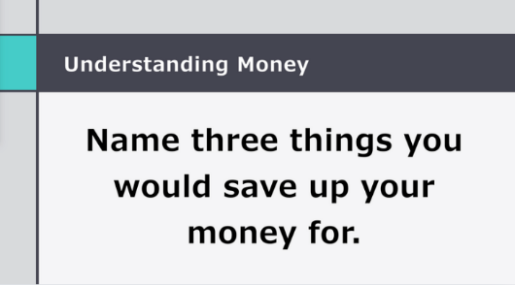
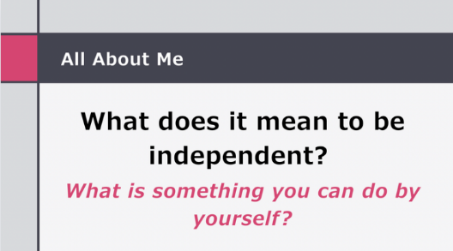
Screenshots of Early Transition Bell Ringers

Slide 12
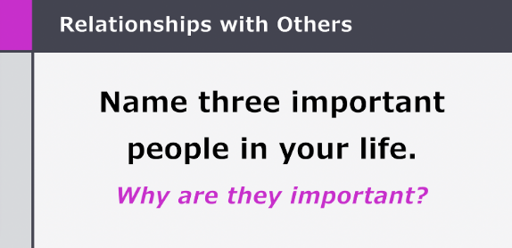
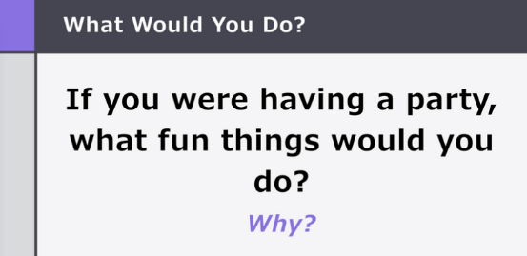
Screenshots 2 of Early Transition Bell Ringers

Slide 13
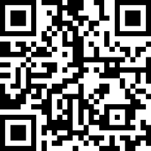
Me! Bell Ringers (AKA Transition Bell Ringers)
Categories
Self-Awareness
Disability Awareness
Postsecondary Goals
Self-Directed IEP
Features
Read-aloud option
Spanish version available
https://tinyurl.com/ZIMEbellringers

Slide 14
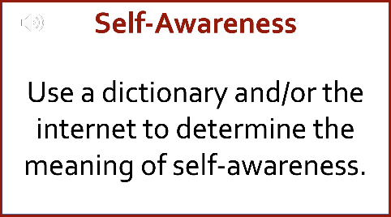
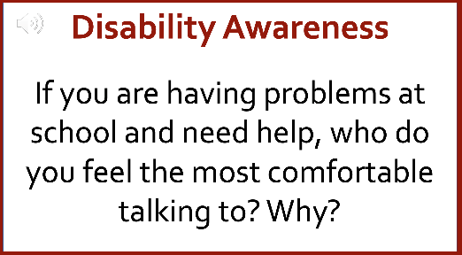
Screenshots of Me! Bell Ringers

Slide 15
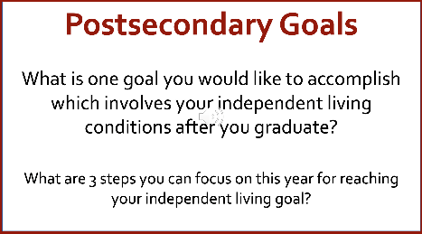
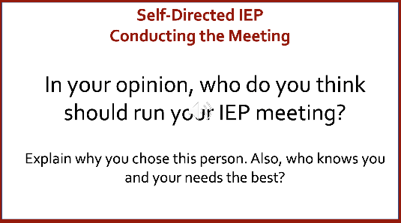
Screenshots 2 of Me! Bell Ringers

Slide 16
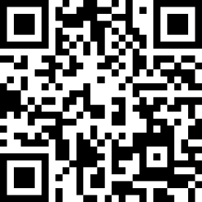
Fundamental Bell Ringers
Categories
How I See Myself
Disability Information
IEP (Individualized Education Program)
Improvement Skills
My Future
Features
Read-aloud option
Adapted version available
https://tinyurl.com/ZIFbellringers

Slide 17
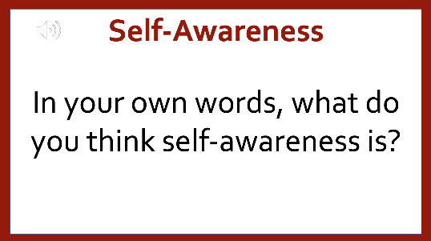
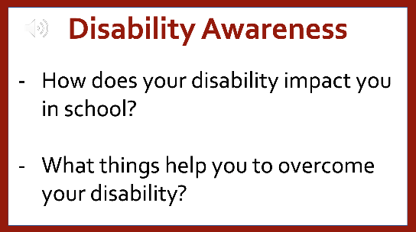
Screenshots of Fundamental Bell Ringers

Slide 18
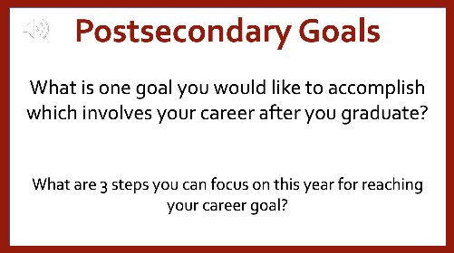
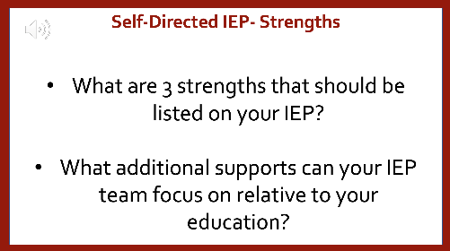
Screenshots of Fundamental Bell Ringers 2

Slide 19
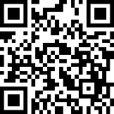
Financial Literacy Bell Ringers (AKA Math Bell Ringers)
Categories
Earning an Income
Taxes
Financial Service Providers
Managing a Bank Account
Savings & Investing
Retirement Planning
Borrowing Money
Credit Cards & Online Shopping
Fraud & Identity Theft
Renting Vs. Buying
Risk Management & Insurance
Bankruptcy
Future Planning
Features
Read-aloud option
https://tinyurl.com/ZIFLbellringers

Slide 20
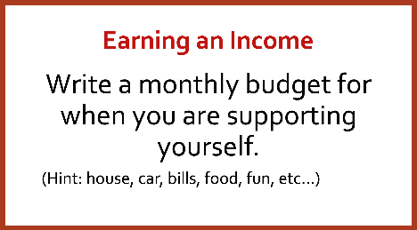
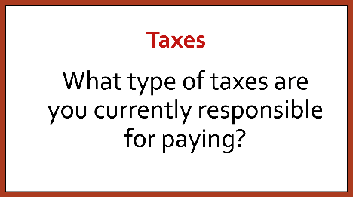
Screenshots of Personal Financial Literacy Bell Ringers

Slide 21
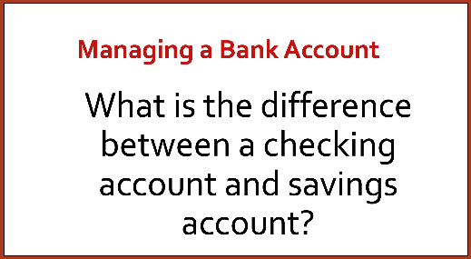
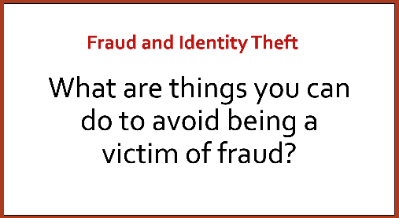
Screenshots of Personal Financial Literacy Bell Ringers 2

Slide 22
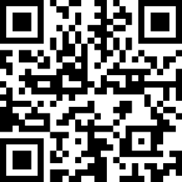
Daily & Independent Living Bell Ringers
Categories
Daily Living Skills/Being Independent
Housing
Health & Medical
Self-Care
Career & Employment
Transportation
Features
Read-aloud option
https://tinyurl.com/bellringersALL

Slide 23
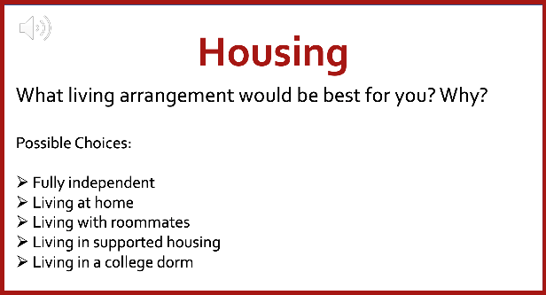
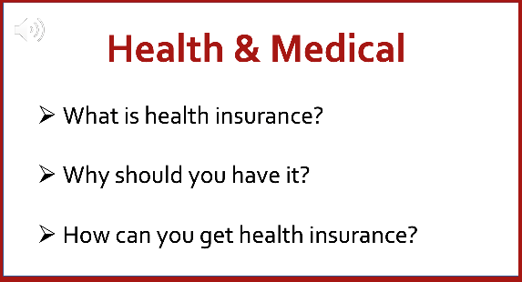
Screenshots of Daily & Independent Living Bell Ringers

Slide 24
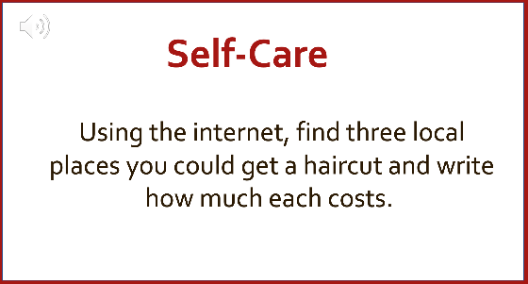
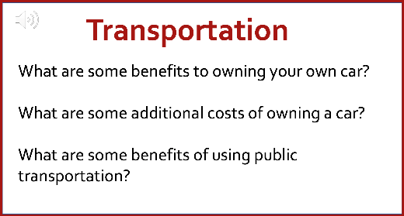
Screenshots of Daily & Independent Living Bell Ringers 2

Slide 25
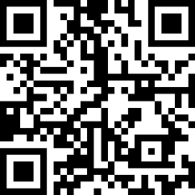
Social Skills Bell Ringers
Categories
Self-concept
Self-esteem
Friendship
Consequences
Feelings
Self-awareness
Teamwork
Self-control
https://tinyurl.com/ZISSbellringers
Features
Built-in graphic organizers
Definitions and videos

Slide 26
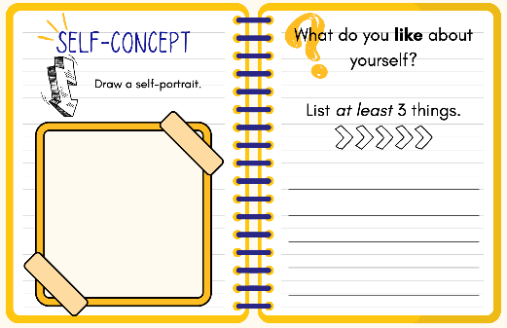
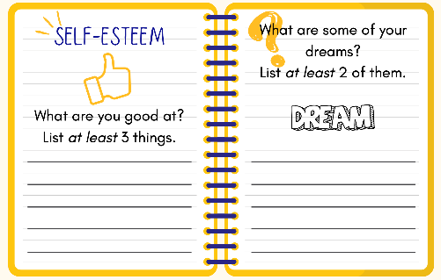
Screenshots of Social Skills Bell Ringers

Slide 27
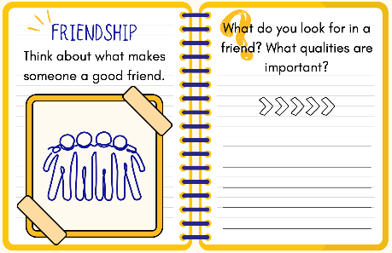
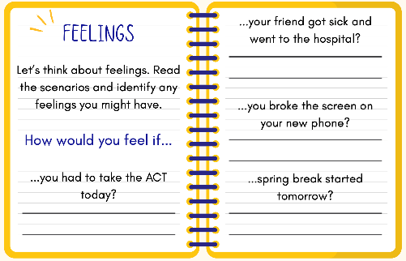
Screenshots of Social Skills Bell Ringers 2

Slide 28
Interactive Activity 🎉
Which Bell Ringer resource could you start implementing with your students right away?

Slide 29
Time for a 🧠Break
Self-Determination Vocabulary Word Scramble

