Slide 1
Module 4-B: Academic Performance-IEP Presentation Tools

Slide 2
One-Pagers
Complete online or on paper
Choose categories that capture the student’s SPIN, annual goals, and aspirations for after high school
Use as a get-to-know-you activity, something to give to teachers, or present at IEP meetings
Incorporate pictures and simplified language when needed

Slide 3
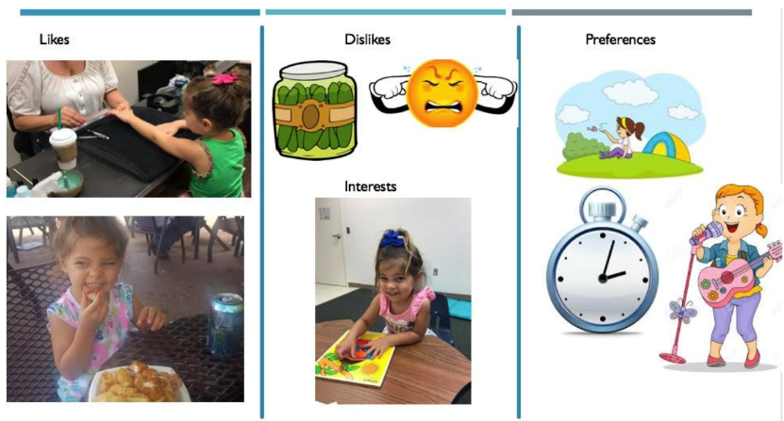
One-Pager Example-1

Slide 4
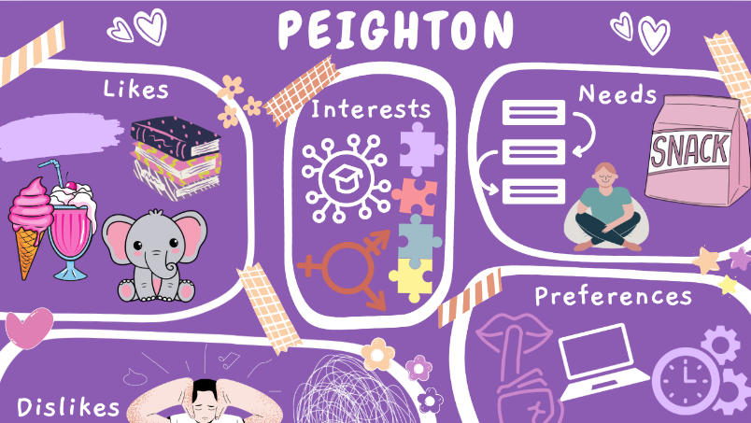
One-Pager Example-2

Slide 5

One-Pager Example 3

Slide 6
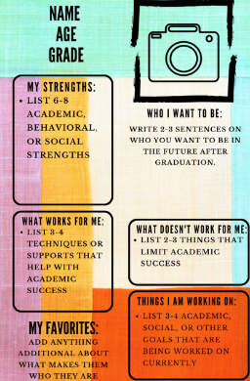
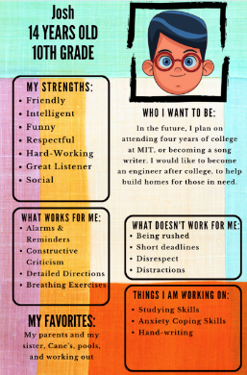
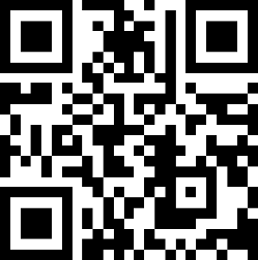
HS One-Pager Template
https://tinyurl.com/HS1Pager

Slide 7
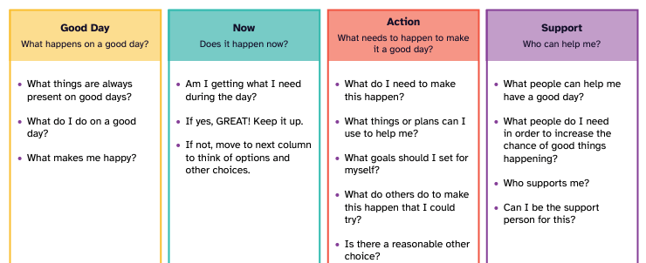
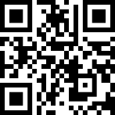
Good Day Plan One-Pager and Implementation Guide
https://tinyurl.com/GDPlanImpl

Slide 8
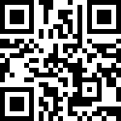
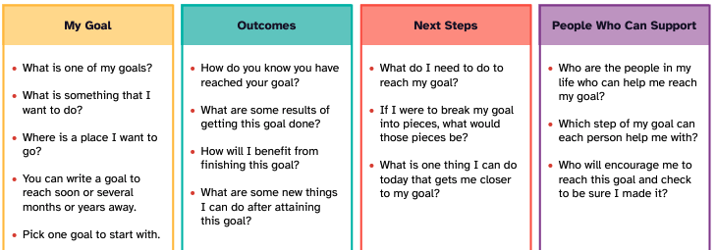
Goal Plan One-Pager and Implementation Guide
https://tinyurl.com/Goalonepager

Slide 9
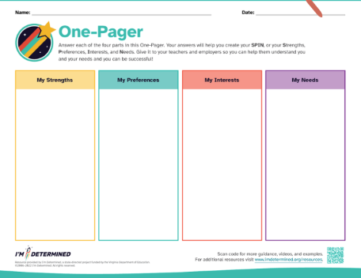
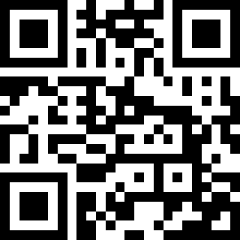
One-Pager Template and Implementation Guide
https://tinyurl.com/IDonepager

Slide 10
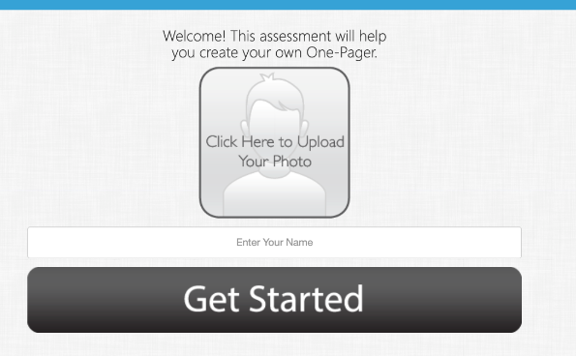
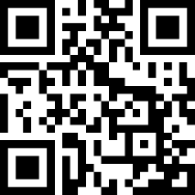
I’m Determined One-Pager APP
https://tinyurl.com/OPappID

Slide 11
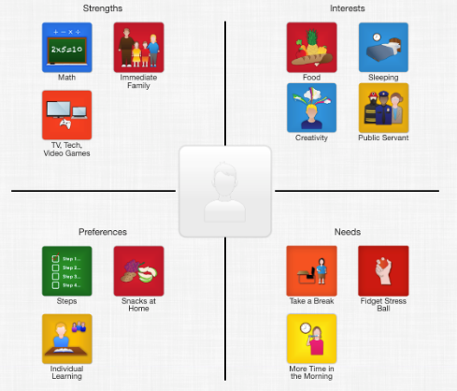
I’m Determined One-Pager APP example screenshot

Slide 12

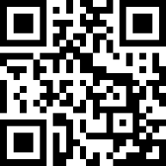
One-Pager Break
https://tinyurl.com/OPappID
You have 10 minutes to go make your own SPIN one-pager.
When done, submit your one-pager using the link at the bottom of page 5 on your module notes.

Slide 13
IEP Scripts & PowerPoints
While IEPs are inherently individualized templates and scripts can be used as a starting point to introduce student involvement in the IEP
Customizing and personalizing scripts and presentations can be used to highlight individual goals, SPIN, and other aspects of the IEP

Slide 14
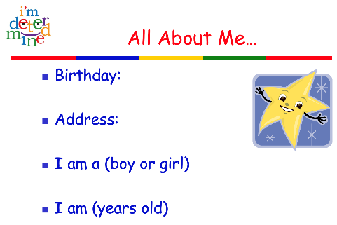
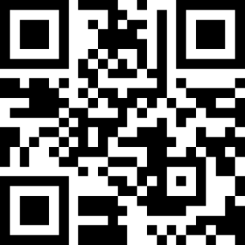
I’m Determined PowerPoint IEP Template-Preschool
https://tinyurl.com/IDpreschool

Slide 15
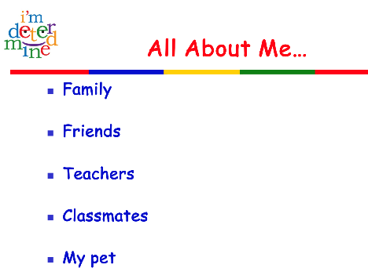
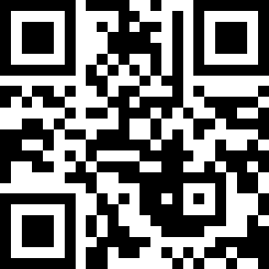
I’m Determined PowerPoint IEP Template-Elementary
https://tinyurl.com/IDelement

Slide 16
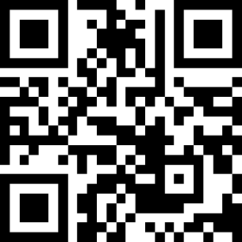
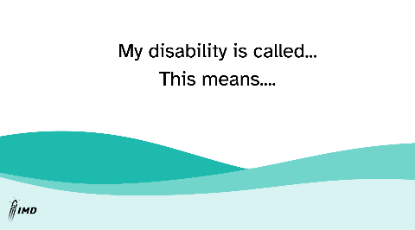
I’m Determined PowerPoint IEP Template-Secondary
https://tinyurl.com/IDsecondary

Slide 17
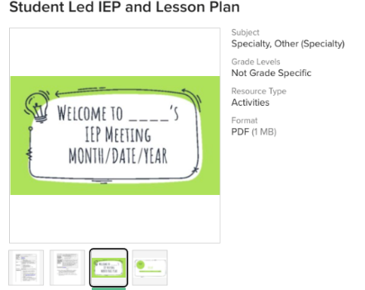
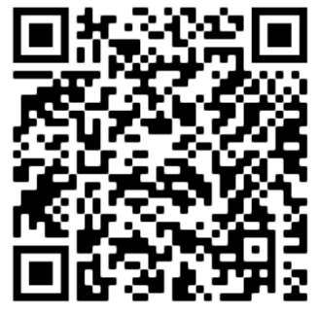
Student-Led IEP Lesson & Activity (Pratt & Driffill, 2020)
https://tinyurl.com/ZCiepTPT

Slide 18
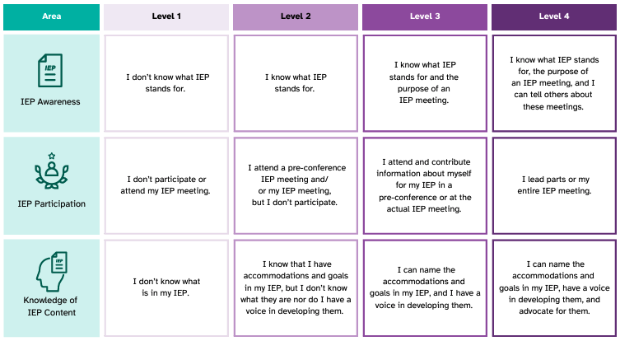
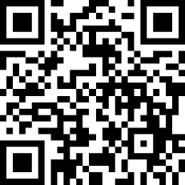
Rubric for IEP Participation
https://tinyurl.com/IEPparticipationR

Slide 19
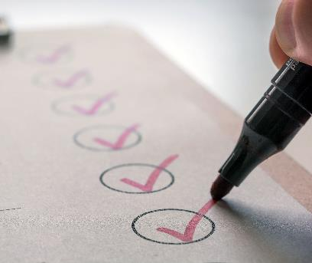
Module 4 Complete
Next step: Complete Module 4 Quiz

