Slide 1
XAI: Shap Dashboard
Project Presentation Visual Analytics
Max Kackdeck
Garvin Märvin
Mäbian der Gäbian
1

Slide 2
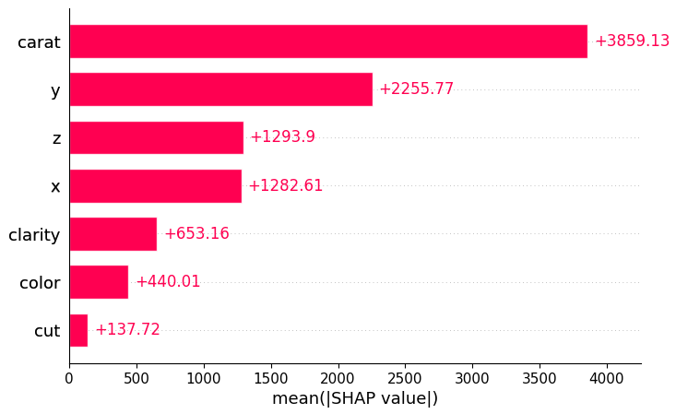
Shap
SHAP is a model-agnostic approach to explain the output of any machine learning model.

Slide 3
Methodology
Looked at best practices for implementation
Selected Tools:
Python + Libraries: Dash, Plotly, Shap, Sklearn, Bootstrap
Git as VCS

Slide 4
Evaluation
The evaluation was done by showing students the dashboard and getting their feedback
Feedback:
Positive:
Pleasant modern style
No information overload

Slide 5
Evaluation
Negative Points:
Using a similar colour palette for colouring both the data plots and the SHAP-Plots might confuse the user
The “?”-tooltips should be better visible
Dimensionality-Reduction-Plot should be explained more visibly
The SHAP-Plots should be explained by more visible information by using plot titles

Slide 6
Conclusion
Wohä

