Slide 1
AI 854 · LECTURE 4
What does an average hide?
One case, five questions
Data Analysis and Visualization

Slide 2
THE SEASON
PSL 2017: five teams, one final
The 2017 Pakistan Super League. Matches in Dubai and Sharjah, the final in Lahore.
Two of the five teams are our case: Peshawar Zalmi and Quetta Gladiators.
We start with the season. The statistics come later, and they will answer a question the season raises.
AI 854 · Lecture 4

Slide 3
THE SEASON
The two teams' seasons
 | Matches | Won | Lost | No result
Peshawar Zalmi | 11 | 6 | 4 | 1
Quetta Gladiators | 10 | 5 | 4 | 1
Nearly identical records. Peshawar won the final.
Predict: in a T20 season, how close do you expect the final scores to be?
AI 854 · Lecture 4

Slide 4
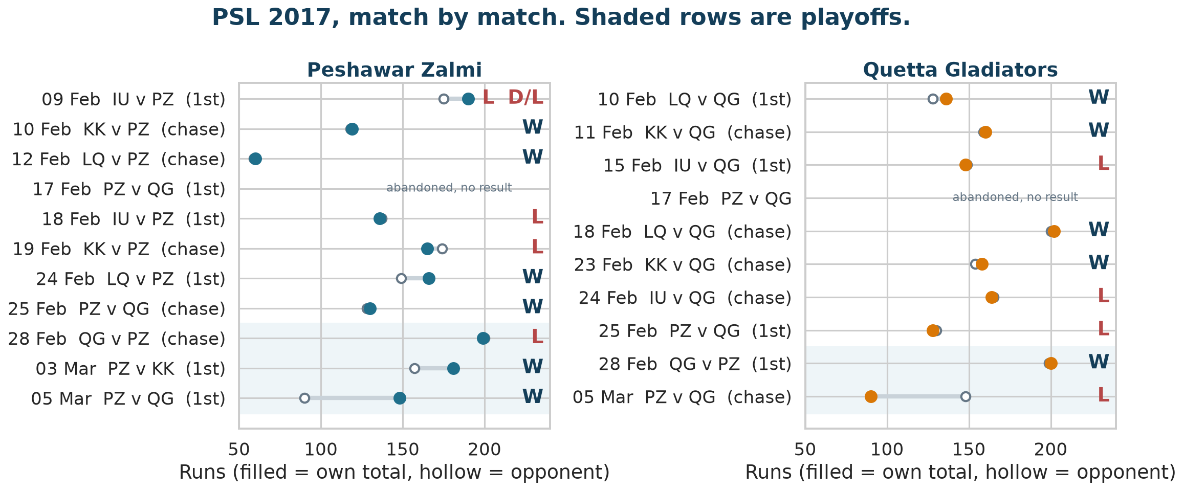
THE SEASON
Every match, both teams
Filled dot: own total. Hollow dot: opponent's total. A short line is a close game.
AI 854 · Lecture 4

Slide 5
THE SEASON
A season of small margins
Of the 9 decided games Peshawar played, 5 finished with totals within five runs. For Quetta it was 7 of 9.
Peshawar chased 60 and beat Lahore's 59.
Peshawar chased 119 against Karachi's 118.
Quetta chased 160 against Karachi's 159.
Quetta beat Peshawar 200 to 199 in a playoff.
When games end this close, a few overs decide them. Which overs?
AI 854 · Lecture 4

Slide 6
THE SEASON
Three meetings in nine days
Date | Stage | First innings | Second innings | Winner
25 Feb | League | Quetta 128 | Peshawar 130 | Peshawar
28 Feb | Playoff | Quetta 200 | Peshawar 199 | Quetta, by one run
5 Mar | Final, Lahore | Peshawar 148 | Quetta 90 | Peshawar
They also met on 17 February; that game was abandoned. Peshawar won 2 of the three completed meetings, Quetta 1.
AI 854 · Lecture 4

Slide 7
THE SEASON
How each team batted
 | Batted first | Chased
Peshawar | 6 | 5
Quetta | 4 | 5
Batting first, a team sets a total. Chasing, it plays against a target it can see. The same 12-run over means different things in the two situations.
The last five overs (16 to 20) are the death overs. They are where the margins above are made.
AI 854 · Lecture 4

Slide 8
THE SEASON
The tempting explanation
Peshawar won the final and two of the three meetings. It is natural to say:
“
Peshawar must have been the better team in the death overs.
We test that with the 81 complete death overs the two teams batted in 2017.
Data: Cricsheet PSL archive (357 matches, 13,336 complete overs); Cricsheet: https://cricsheet.org/downloads/
AI 854 · Lecture 4

Slide 9
THE SEASON
The five questions
Do two teams with the same average score the same way?
1
What exactly differs between two distributions?
2
How many independent observations do we really have?
3
How sure are we?
4
What can we defend?
5
Board: keep these five lines visible all class.
AI 854 · Lecture 4

Slide 10
ACT 1
Same average
Do two teams with the same average score the same way?

Slide 11
ACT 1 · SAME AVERAGE
The claim under test
“
In the death overs, Peshawar and Quetta scored about the same.
 | Overs | Mean runs per over
Peshawar | 44 | 9.32
Quetta | 37 | 9.08
Commit: is the sentence (A) true, (B) misleading, or (C) impossible to judge?
AI 854 · Lecture 4

Slide 12
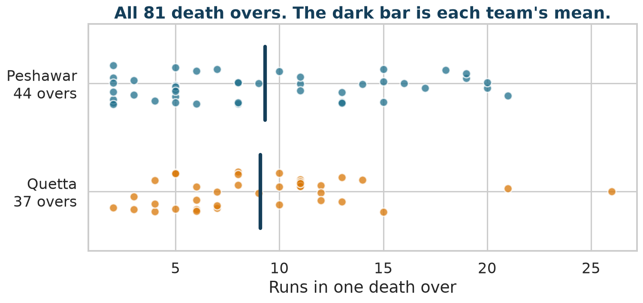
ACT 1 · SAME AVERAGE
Look at every over
AI 854 · Lecture 4

Slide 13
ACT 1 · SAME AVERAGE
What the average did not say
 | 4 runs or fewer | 15 runs or more | Highest over
Peshawar (44 overs) | 10 | 11 | 21
Quetta (37 overs) | 6 | 3 | 26
Same mean. Peshawar has more overs at both ends. Quetta's largest over is bigger.
Claim v1: the means agree, so the death overs do not explain the final. The first half is true. The second half is unproven.
Question 2: if the mean is not what differs, what is?
AI 854 · Lecture 4

Slide 14
ACT 2
What exactly differs?
What exactly differs between two distributions?

Slide 15
ACT 2 · WHAT EXACTLY DIFFERS?
A distribution is every value
A distribution is which values occurred and how often.
A summary is one answer to one question about it.
mean: what total should I expect?
median: what does a typical over look like?
quantile: how good or bad can it get?
tail rate: how often does it cross a line?
Different questions, different summaries.
AI 854 · Lecture 4

Slide 16
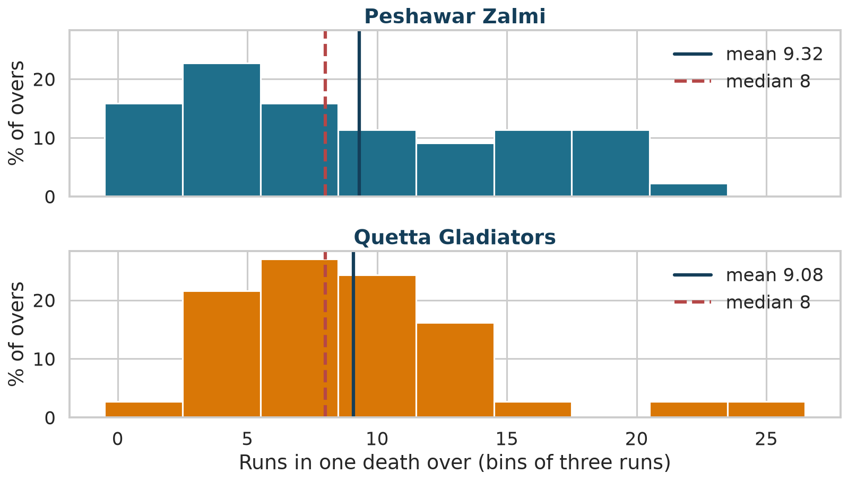
ACT 2 · WHAT EXACTLY DIFFERS?
The histogram
Same bins for both teams, drawn as a percentage because the teams have different numbers of overs.
AI 854 · Lecture 4

Slide 17
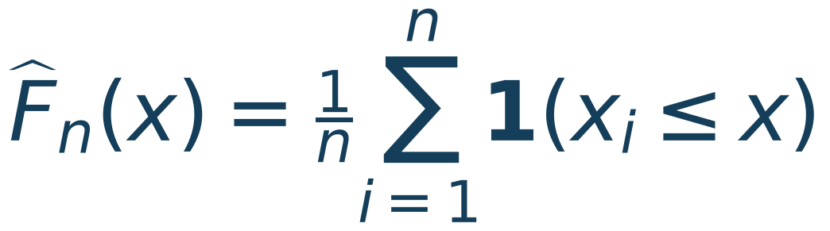
ACT 2 · WHAT EXACTLY DIFFERS?
The histogram depends on its bins
Change the bin width and the shape changes. So we use a picture with no bins.
The ECDF answers: what fraction of overs scored at most x runs?
AI 854 · Lecture 4

Slide 18
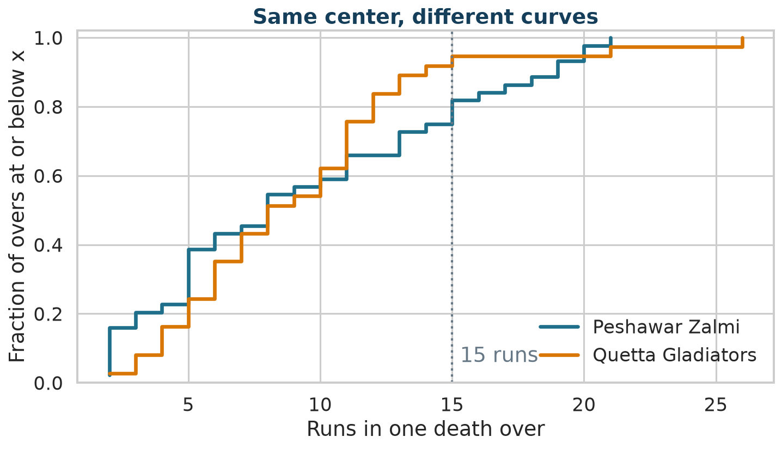
ACT 2 · WHAT EXACTLY DIFFERS?
The ECDF
Peshawar's curve starts higher (more low overs) and ends lower (more high overs). The curves cross.
AI 854 · Lecture 4

Slide 19
ACT 2 · WHAT EXACTLY DIFFERS?
Reading an ECDF
A vertical gap at x is a difference in "at most x" frequencies.
At x = 14, the gap is the difference in the share of overs above 14.
Crossing curves mean neither team is simply "higher": which team is better depends on which part of the distribution you care about.
AI 854 · Lecture 4

Slide 20
ACT 2 · WHAT EXACTLY DIFFERS?
ML BRIDGE
Bridge: a summary is a choice of loss
For a constant guess c:
Squared error, absolute error and pinball loss: you already choose these when you train a model. Choosing a summary is choosing what you refuse to lose.
AI 854 · Lecture 4

Slide 21
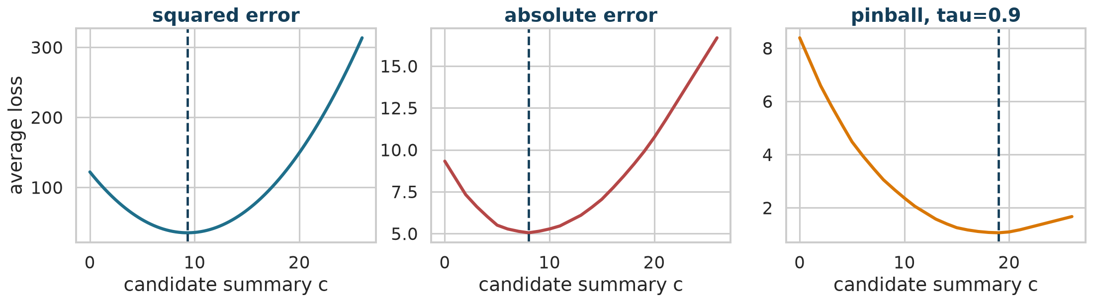
ACT 2 · WHAT EXACTLY DIFFERS?
The loss minimizers, live
For Peshawar: squared error is minimized at 9.3 (the mean is 9.32), absolute error at 8 (the median is 8), pinball at 0.9 near 19 (the 90th percentile is 19 by the inverse-CDF rule).
AI 854 · Lecture 4

Slide 22
ACT 2 · WHAT EXACTLY DIFFERS?
Skew and pooling
Skew is a long tail on one side. It pulls the mean away from the median.
 | Mean | Median | SD | Skew
Peshawar | 9.32 | 8 | 6.00 | 0.44
Quetta | 9.08 | 8 | 4.92 | 1.31
Quetta's skew comes largely from two overs: 21 and 26. One extreme value should not be read as a heavy tail.
AI 854 · Lecture 4

Slide 23
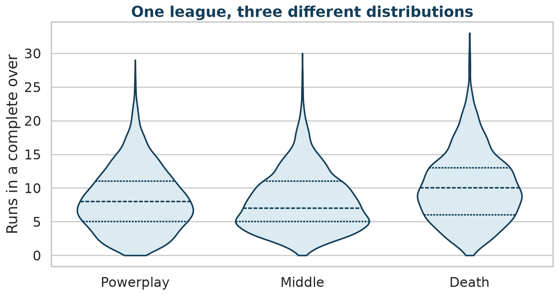
ACT 2 · WHAT EXACTLY DIFFERS?
Pooling hides structure
All 13,336 complete overs. Mean runs: powerplay 8.23, middle 7.99, death 10.11. A league-wide average mixes three different situations.
AI 854 · Lecture 4

Slide 24
ACT 2 · WHAT EXACTLY DIFFERS?
A new scale asks a new question
 | Raw mean | Back-transformed log mean
Peshawar | 9.32 | 7.53
Quetta | 9.08 | 8.04
Peshawar minus Quetta | +0.24 | -0.51
On the raw scale Peshawar is slightly ahead. On the log scale Quetta is. Neither is wrong. They answer a runs question and a ratio question.
AI 854 · Lecture 4

Slide 25
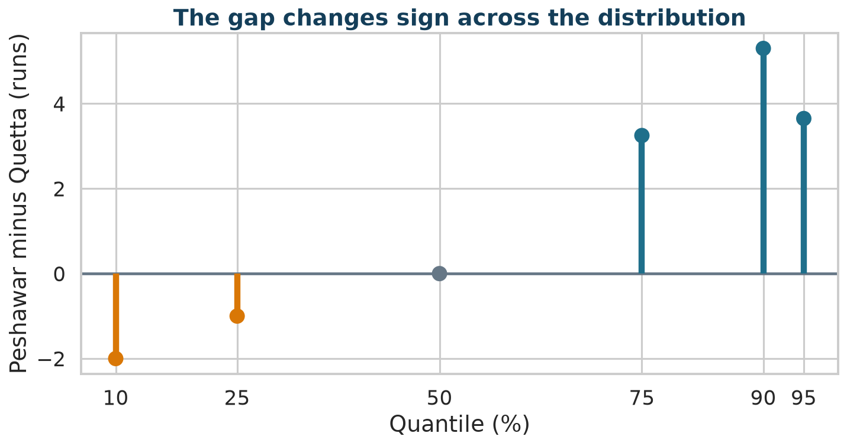
ACT 2 · WHAT EXACTLY DIFFERS?
Quantile profile
Quantile | 10th | 25th | 50th | 75th | 90th
Peshawar minus Quetta | -2.0 | -1.0 | +0.0 | +3.25 | +5.30
Lower than Quetta at the bottom, equal at the median, higher at the top. A single mean difference cannot describe that.
AI 854 · Lecture 4

Slide 26

ACT 2 · WHAT EXACTLY DIFFERS?
Tail rate
The tail rate is a decision question: how often does an over reach at least c runs?
At c = 15: Peshawar 25.0% (11 of 44), Quetta 8.1% (3 of 37).
The archive gap is +16.9 percentage points.
AI 854 · Lecture 4

Slide 27
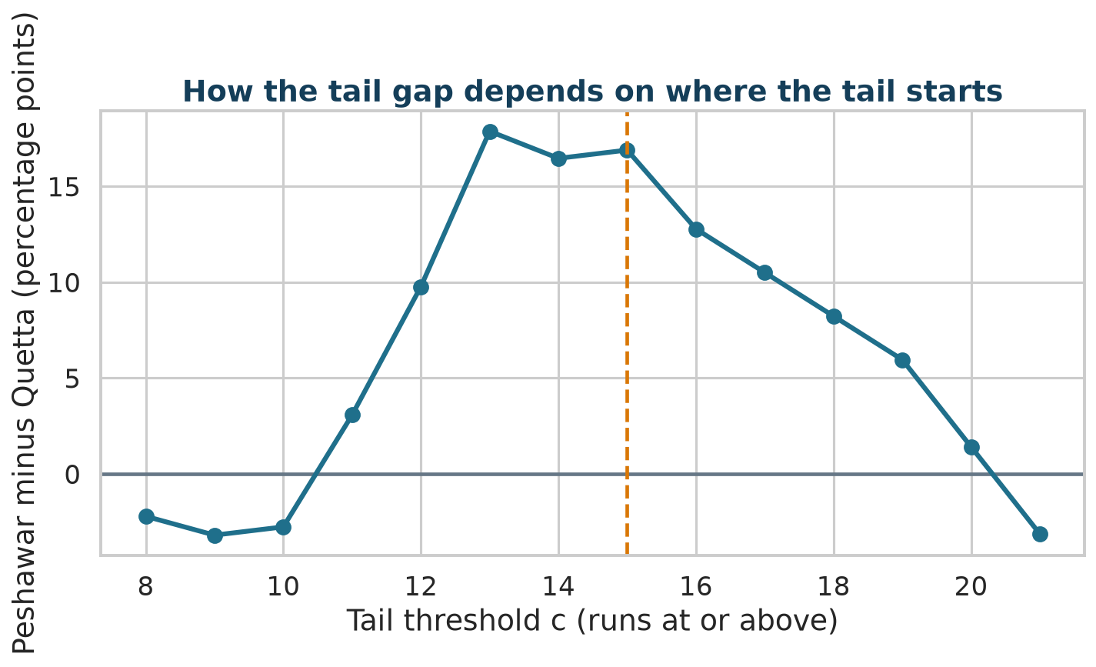
ACT 2 · WHAT EXACTLY DIFFERS?
Where does the tail begin?
The gap depends on the line you draw. The ECDF already showed every threshold at once.
AI 854 · Lecture 4

Slide 28
ACT 2 · WHAT EXACTLY DIFFERS?
CLASS ACTIVITY
Checkpoint 1
Which sentence do the 81 overs support so far?
Peshawar and Quetta score identically.
1
Peshawar scores more per over.
2
Same mean and median, but Peshawar has more low overs and more 15-plus overs in this archive.
3
Peshawar has a more explosive strategy.
4
AI 854 · Lecture 4

Slide 29
ACT 2 · WHAT EXACTLY DIFFERS?
The effect-size family
Question | Estimand | Value
Expected difference | mean | +0.24 runs
Typical over | median | +0.00 runs
High-scoring capacity | 90th percentile | +5.30 runs
Frequency above 15 | tail rate | +16.9 pp
Random over vs random over | probability of superiority θ | 0.493
AI 854 · Lecture 4

Slide 30
ACT 2 · WHAT EXACTLY DIFFERS?
ML BRIDGE
Bridge: probability of superiority is AUC
If you tried to guess the team from an over's run count, θ is the AUC of that classifier (Mann–Whitney U). Cliff's delta is 2θ − 1 = -0.015.
θ= 0.493 means the run count alone cannot separate the two teams.
Week 10 will build ROC curves from this idea.
AI 854 · Lecture 4

Slide 31
ACT 2 · WHAT EXACTLY DIFFERS?
Tail gap and θ do not contradict
The tail gap and θ do not contradict each other.
The tail gap looks at a small slice of the distribution (15 and above).
θ looks at every pair of overs.
A distribution can differ strongly in a corner and hardly at all in a global ordering.
Different estimands, different answers.
AI 854 · Lecture 4

Slide 32
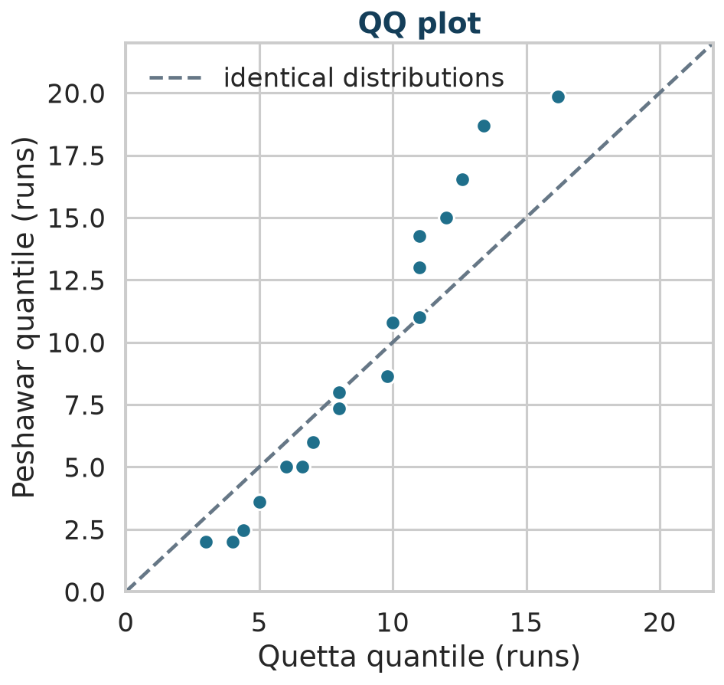
ACT 2 · WHAT EXACTLY DIFFERS?
QQ plot
Points on the dashed line mean identical quantiles. Peshawar is below the line at the bottom and above it at the top.
AI 854 · Lecture 4

Slide 33
ACT 2 · WHAT EXACTLY DIFFERS?
ML BRIDGE
Bridge: comparing real and generated data
The same tools check a generative model against real data:
ECDF and QQ plots show where the generated distribution departs.
Tail rate checks whether rare, large values are reproduced.
A matching mean is the easy test and proves little.
"What exactly differs?" is the question in both settings.
AI 854 · Lecture 4

Slide 34
ACT 2 · WHAT EXACTLY DIFFERS?
CLAIM LEDGER
Claim v2
Same mean and same median. In this archive Peshawar has more very low overs and more overs of 15 or more.
This claim treated the 81 overs as 81 independent pieces of evidence.
Question 3: are they?
AI 854 · Lecture 4

Slide 35
ACT 3
How many observations do we really have?
How many independent observations do we really have?

Slide 36
ACT 3 · HOW MANY OBSERVATIONS DO WE REALLY HAVE?
CLASS ACTIVITY
Count the matches
 | Count
Over rows | 81
Team-match clusters | 20
Distinct matches | 17
Matches where both teams appear | 3
The largest cluster is 5 overs.
Predict: how many independent observations do you think we have?
AI 854 · Lecture 4

Slide 37
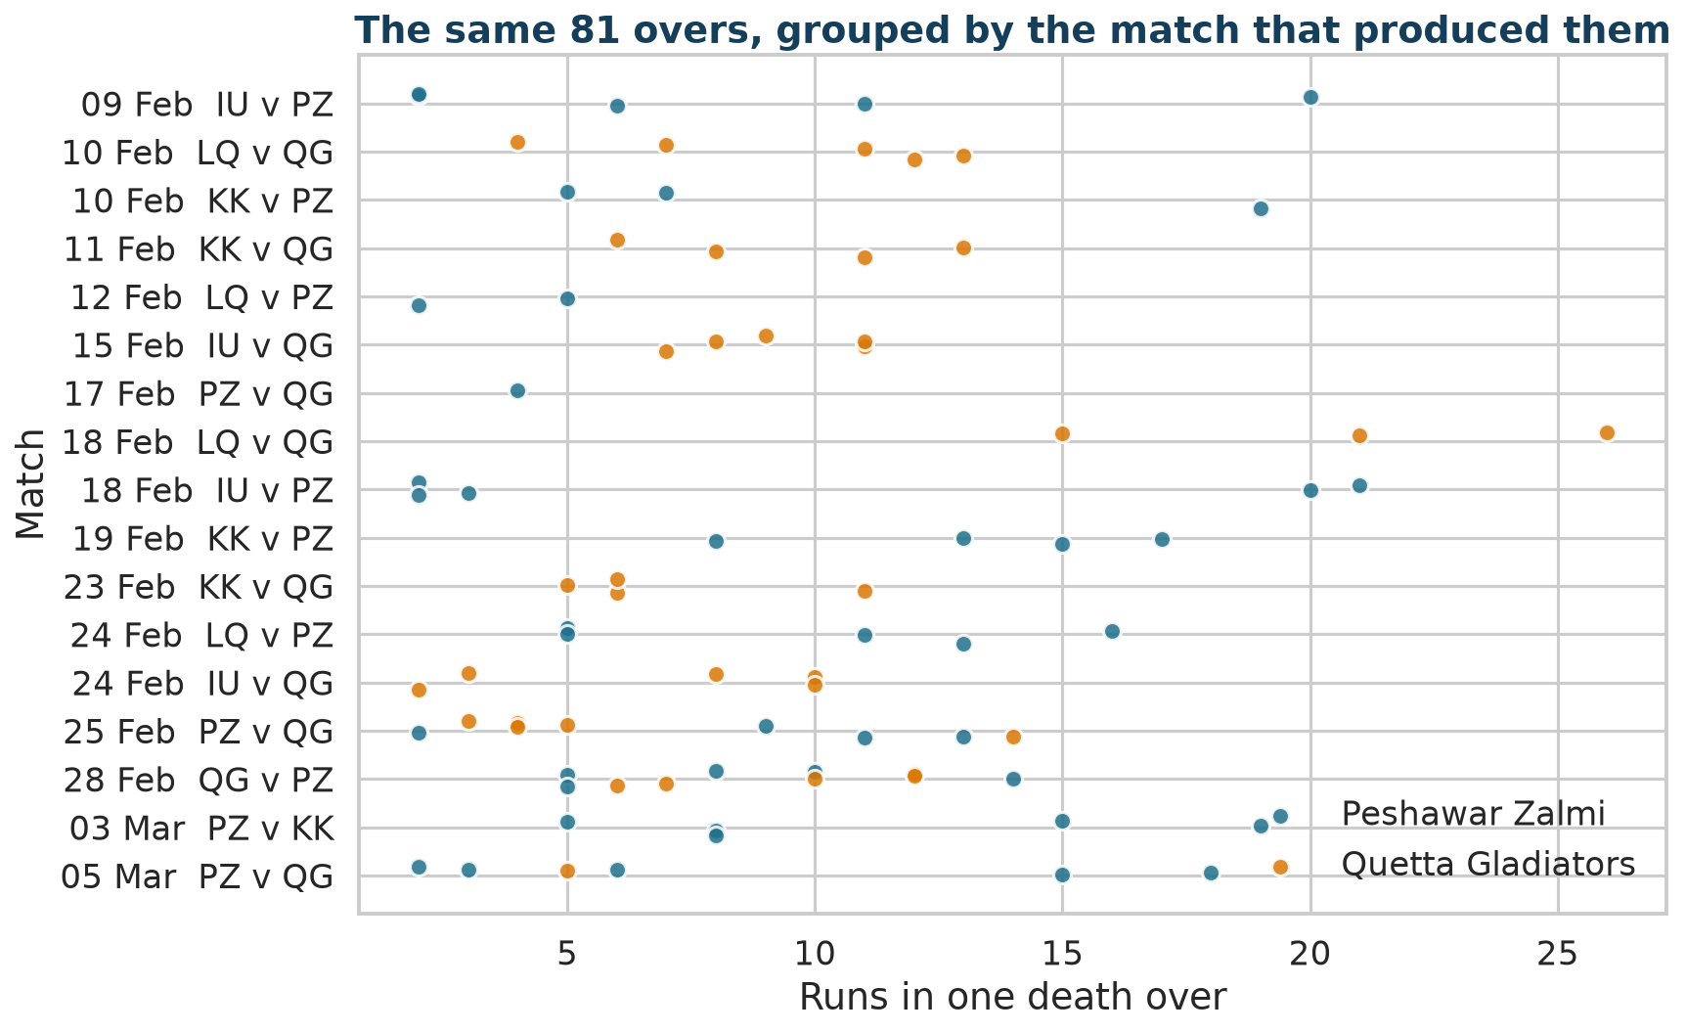
ACT 3 · HOW MANY OBSERVATIONS DO WE REALLY HAVE?
The same overs, grouped by match
Overs in the same match share a pitch, weather, a target and wickets already lost.
AI 854 · Lecture 4

Slide 38
ACT 3 · HOW MANY OBSERVATIONS DO WE REALLY HAVE?
Hierarchy
Season
Match
Innings
Over
Delivery
The unit of observation (an over) is not necessarily the unit of independence (probably a match).
AI 854 · Lecture 4

Slide 39
ACT 3 · HOW MANY OBSERVATIONS DO WE REALLY HAVE?
ML BRIDGE
Bridge: group leakage
Machine learning | Statistics
Random split puts one group's rows in train and test | Treating one match's overs as independent
Score is too optimistic | Interval is too narrow
Fix: GroupKFold | Fix: resample the group
Name for the second column: pseudoreplication.
AI 854 · Lecture 4

Slide 40
ACT 3 · HOW MANY OBSERVATIONS DO WE REALLY HAVE?
Can the data show the dependence?
Share of variation explained by match: 0.28. Expected if match labels were random: 0.20. Permutation p-value: 0.10.
Match explains a bit more than chance would, but 81 rows cannot prove it.
Absence of proof is not proof of independence. The reason to respect matches is how the data were generated.
AI 854 · Lecture 4

Slide 41
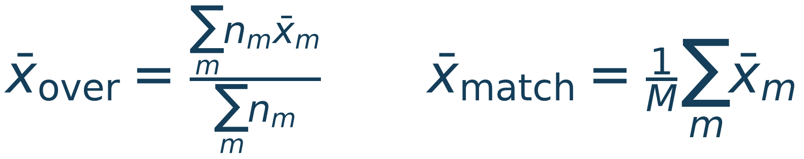
ACT 3 · HOW MANY OBSERVATIONS DO WE REALLY HAVE?
Which observations get equal weight?
Over-weighted: describes a randomly chosen over.
Match-weighted: describes a randomly chosen match.
A match with five overs counts five times as much as a match with one.
AI 854 · Lecture 4

Slide 42
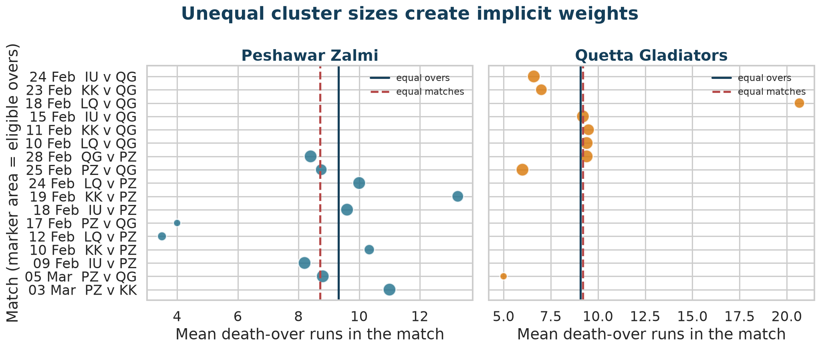
ACT 3 · HOW MANY OBSERVATIONS DO WE REALLY HAVE?
The weights, visible
Marker area is the number of eligible overs.
AI 854 · Lecture 4

Slide 43
ACT 3 · HOW MANY OBSERVATIONS DO WE REALLY HAVE?
The sign reversal
Target | Peshawar | Quetta | Difference
Mean, equal overs | 9.32 | 9.08 | +0.24
Mean, equal matches | 8.71 | 9.20 | -0.48
15-plus %, equal overs | 25.0 | 8.1 | +16.9
15-plus %, equal matches | 22.1 | 11.1 | +11.0
Both mean differences are small next to the spread of overs. The lesson is not a discovery. It is that an aggregate hides a weighting rule.
AI 854 · Lecture 4

Slide 44
ACT 3 · HOW MANY OBSERVATIONS DO WE REALLY HAVE?
Which target fits which question?
Question | Weight
What happens in a randomly chosen death over? | equal overs
What happens in a randomly chosen match? | equal matches
What does the team's typical match look like? | equal matches
What run total should a scoring model expect per over? | equal overs
State the question, then choose the weight.
AI 854 · Lecture 4

Slide 45
ACT 3 · HOW MANY OBSERVATIONS DO WE REALLY HAVE?
CLAIM LEDGER
Claim v3
In this archive Peshawar has the higher rate of 15-plus overs. The mean difference changes sign with the weighting rule. Only 17 matches produced the data.
Question 4: if the match is the real unit, how sure can we be about the tail gap?
AI 854 · Lecture 4

Slide 46
ACT 3 · HOW MANY OBSERVATIONS DO WE REALLY HAVE?
CLASS ACTIVITY
Break checkpoint
Write down before the break:
Which interval for the tail gap will be wider: over-level or match-level?
1
By how many percentage points?
2
Will the match-level interval include zero?
3
AI 854 · Lecture 4

Slide 47
ACT 4
How sure are we?
How sure are we?

Slide 48
ACT 4 · HOW SURE ARE WE?
What a bootstrap imitates
An interval imitates a repetition of the study. The bootstrap repeats it by redrawing from the data we have.
Every bootstrap must answer: what is the unit being redrawn?
IID over bootstrap: the over.
Match-cluster bootstrap: the match.
AI 854 · Lecture 4

Slide 49
ACT 4 · HOW SURE ARE WE?
Two resampling designs
IID bootstrap
draw overs one by one; matches are ignored
Match-cluster bootstrap
draw 17 matches with replacement;
each drawn match brings all its overs, for both teams
The team's rate is recomputed on every redraw. A team may appear in more or fewer of the drawn matches; that variation is part of the uncertainty.
AI 854 · Lecture 4

Slide 50
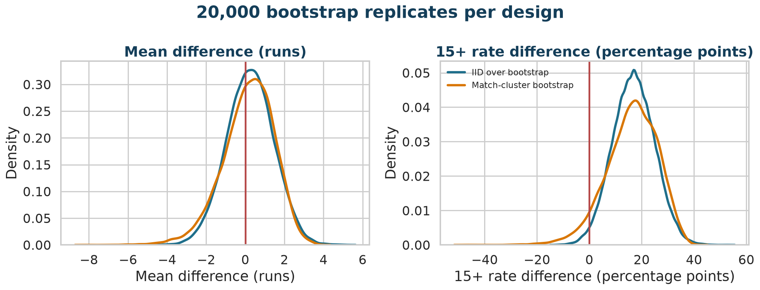
ACT 4 · HOW SURE ARE WE?
The bootstrap distributions
20,000 replicates per design, seed 854.
AI 854 · Lecture 4

Slide 51
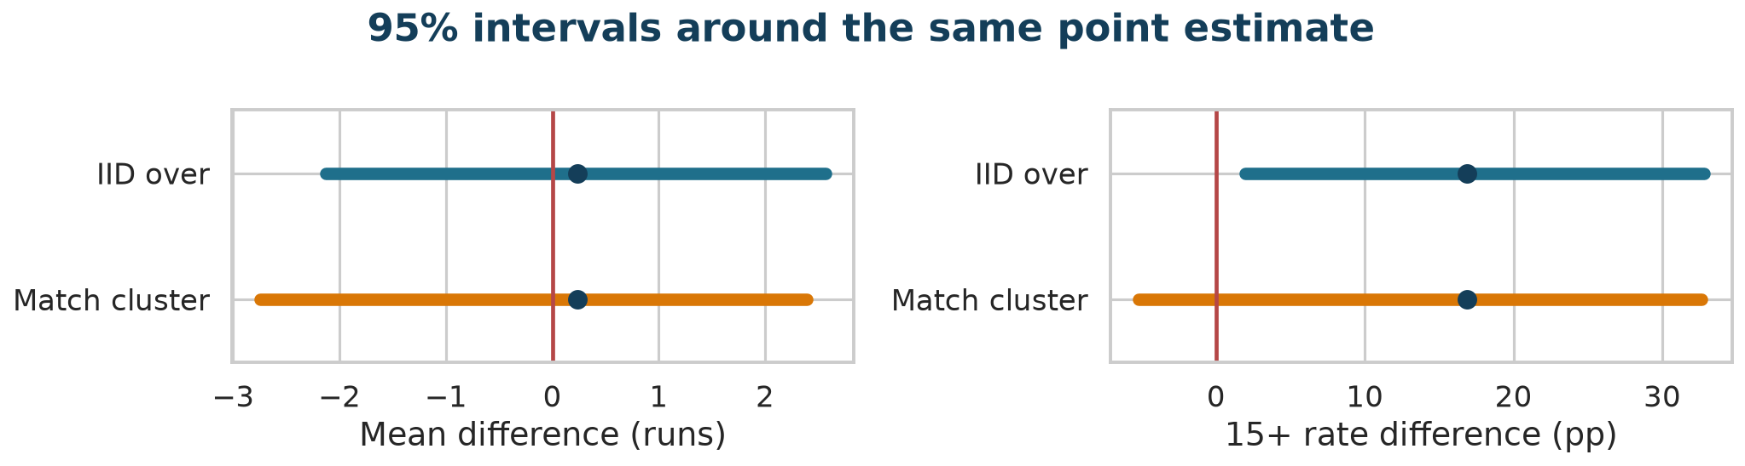
ACT 4 · HOW SURE ARE WE?
The intervals
Estimand | IID over | Match cluster
Mean difference (runs) | -2.13 to +2.57 | -2.74 to +2.39
15-plus gap (pp) | +2.0 to +32.8 | -5.2 to +32.7
AI 854 · Lecture 4

Slide 52
ACT 4 · HOW SURE ARE WE?
How to read the result
The tail-gap interval widens from 30.8 to 37.9 percentage points. Its lower end moves from +2.0 to -5.2.
The correct question is how wide, not "does it touch zero."
An interval that contains zero does not show the teams are equal. It shows the data cannot exclude a range of values.
AI 854 · Lecture 4

Slide 53
ACT 4 · HOW SURE ARE WE?
A classical cross-check
Fisher's exact test on the raw counts, 11 of 44 versus 3 of 37 overs at 15 runs or more, treating overs as independent:
p= 0.075.
Even the naive test was borderline. The honest reading is:
the data lean toward a Peshawar tail gap; the uncertainty is large under either design, and larger when the match is the unit.
AI 854 · Lecture 4

Slide 54
ACT 4 · HOW SURE ARE WE?
What a 95% interval does not mean
It is not a 95% probability that the true value lies inside this one interval.
It does not say the effect is causal.
It does not say the effect will appear in another season.
With 17 matches, even the cluster bootstrap is approximate. Few clusters make percentile intervals too optimistic.
AI 854 · Lecture 4

Slide 55
ACT 4 · HOW SURE ARE WE?
Analyst choices
Death phase starts at over | Mean difference | 15-plus gap (pp)
14 | -0.00 | +7.3
15 | +0.41 | +15.3
16 | +0.24 | +16.9
17 | +0.42 | +17.1
The tail gap stays positive; the mean gap moves and nearly vanishes. Full robustness work (specification curves, influence, alternative explanations) is Week 14. This slide is the reason it exists.
AI 854 · Lecture 4

Slide 56
ACT 4 · HOW SURE ARE WE?
CLAIM LEDGER
The claim ladder
Rung | Statement | Supported here?
Archive description | Peshawar reached 15+ more often in these overs | yes, exact
Distributional detail | Same mean and median; more low and more high overs | yes, exact
Process inference | Peshawar would repeat a higher 15+ rate in new matches | weak; interval wide
Generalization | The pattern holds across seasons | not tested
Causal explanation | Its strategy causes explosive overs | not supported
Language stops where the design stops.
AI 854 · Lecture 4

Slide 57
ACT 5
What can we defend?
What can we defend?

Slide 58
ACT 5 · WHAT CAN WE DEFEND?
CLASS ACTIVITY
Anonymous evidence audit
Two anonymous groups, Group A and Group B, have similar averages in a phase of play. An analyst claims Group A has a reliably more explosive strategy.
Groups of three:
Analyst: states the original claim.
Auditor: identifies the estimand and the dependence problem.
Reviewer: decides which claim survives.
Materials: evidence_pack.md. Team names stay hidden until the end.
AI 854 · Lecture 4

Slide 59
ACT 5 · WHAT CAN WE DEFEND?
The analyst's claim
“
Group A and Group B have almost equal means, but Group A has a much stronger upper tail. Its 15-plus rate is 25.0% versus 8.1%, and an over-level bootstrap interval is +2.0 to +32.8 percentage points. Group A therefore has a reliably more explosive death-over strategy.
AI 854 · Lecture 4

Slide 60
ACT 5 · WHAT CAN WE DEFEND?
CLASS ACTIVITY
Phase 1 · Audit (6 min)
Mark on the exhibits:
the exact archive fact;
1
the estimand implied by the headline;
2
the hidden weighting rule;
3
the independence assumption behind the first interval;
4
the strongest unsupported phrase.
5
AI 854 · Lecture 4

Slide 61
ACT 5 · WHAT CAN WE DEFEND?
CLASS ACTIVITY
Phase 2 · Redesign (8 min)
Choose and justify:
equal-over or equal-match target;
1
IID or match-cluster resampling;
2
a tail threshold policy;
3
one global effect (for example θ);
4
two sensitivity checks.
5
AI 854 · Lecture 4

Slide 62
ACT 5 · WHAT CAN WE DEFEND?
CLASS ACTIVITY
Phase 3 · Rewrite (5 min)
Three sentences:
the exact archive description;
1
the unit-aware process inference;
2
the limitation that blocks a causal strategy claim.
3
Then two groups defend their weighting rule for six minutes.
AI 854 · Lecture 4

Slide 63
ACT 5 · WHAT CAN WE DEFEND?
Teams revealed
Group A: Peshawar Zalmi
Group B: Quetta Gladiators
The conclusion should not depend on reputation, memory or team preference.
AI 854 · Lecture 4

Slide 64
ACT 5 · WHAT CAN WE DEFEND?
Model answer
Archive. In the 2017 complete overs 16 to 20, 11 of 44 Peshawar overs and 3 of 37 Quetta overs reached 15 runs, a gap of 16.9 percentage points, with equal medians and θ= 0.49.
Inference. The 17 matches lean toward a Peshawar tail gap, but the match-cluster interval (-5.2 to +32.7 pp) is wide and the evidence for a repeatable difference is weak.
Boundary. Opponent, venue, wickets, target and personnel are uncontrolled, so no causal strategy claim follows.
AI 854 · Lecture 4

Slide 65
ACT 5 · WHAT CAN WE DEFEND?
Causal boundary
The comparison does not control:
opposing bowlers;
batter quality;
venue and pitch;
team selection;
wickets remaining;
strategic intent.
chase target;
A team label is not a treatment assignment.
AI 854 · Lecture 4

Slide 66
ACT 5 · WHAT CAN WE DEFEND?
Answer to the case
Do two teams with the same average score the same way?
Not necessarily. Here they share a mean and a median but differ in the tails. Whether that difference is a stable team property is a separate question that these 17 matches answer weakly.
AI 854 · Lecture 4

Slide 67
ACT 5 · WHAT CAN WE DEFEND?
CLASS ACTIVITY
Exit ticket
Complete all five statements:
My estimand is ...
1
My independent unit is ...
2
My interval assumes ...
3
My strongest defensible claim is ...
4
One analyst choice that could change it is ...
5
AI 854 · Lecture 4

Slide 68
ACT 5 · WHAT CAN WE DEFEND?
After class
Read the executed notebook notebook.ipynb from top to bottom. Every number on these slides is computed there.
Post-class task: choose one comparison from team_phase_summary.csv or team_season_summary.csv. Report one center effect, one tail or quantile effect, one unit-aware interval and a claim ladder with a causal boundary. Use at most two figures.
Project checkpoint for next week: a broad domain, two candidate datasets, your unit of observation, the likely dependence structure and one primary estimand.
AI 854 · Lecture 4

Slide 69
FINAL SYNTHESIS
The average was only the first clue.
It told us what the two teams shared. The dots showed where they differed. The estimand said what we meant by "differ." The match count said how much evidence we had. The interval said how sure we could be.
Next week: can a mathematically correct chart still mislead?

