Slide 1
CS-808
Tools and Techniques
for Data Science
Lecture 1 | Data science as a complete workflow
Dr. Muhammad Farrukh Qureshi
Associate Professor, EPE, PNEC, NUST

Slide 2
A Document contains 31 pollution readings
What must happen before a public alert can rely on it?
1
Write one risk
2
Write one next step
Think about the data, the people, or the decision.
What would you verify or build first?
CS-808 Tools and Techniques for Data Science
02

Slide 3
Today’s 180-minute route
00-10
Opening question
10-50
Course purpose, boundaries, and tools
50-75
Data-science questions and workflow
75-112
Islamabad air-quality source case
112-127
Source-audit activity
127-142
Break
142-160
AQI patterns and weather integration
160-176
Problem framing and discussion
176-180
Recap and exit ticket
CS-808 Tools and Techniques for Data Science
03

Slide 4
Course purpose
CS-808 develops the practical workflow that connects a question and raw data to an evaluated, documented data product.
The course treats tools as parts of a system. Each tool must solve a workflow problem, preserve evidence, and support another person who needs to reproduce the work.
CS-808 Tools and Techniques for Data Science
04

Slide 5
Course learning outcomes
Frame a real problem as an answerable data-science question
Acquire, document, validate, transform, and query data
Build reproducible projects and leakage-safe pipelines
Select validation procedures and metrics that match the intended use
Deliver a small data product with documented limitations
CS-808 Tools and Techniques for Data Science
05

Slide 6
The work students will produce
01
02
03
04
Documented raw data
Validated data
Executable analysis
Usable product
Source, license, collection method, and unchanged files
Schema, quality checks, missingness, and transformation record
Queries, features, models, validation, and tests
Interface, documentation, limitations, and demonstration
The semester project preserves the chain from source evidence to final behavior.
CS-808 Tools and Techniques for Data Science
06

Slide 7
CS-808 and AI-854
Tools and Techniques compared with Data Analysis & Visualization
CS-808
Data Analysis & Visualization
Acquisition and provenance
Project structure and environments
Repeatable cleaning and SQL logic
Pipelines, testing, and validation implementation
Experiment tracking and product delivery
Substantive analytical questions
Patterns, comparisons, and uncertainty
Choice of visual encoding
Interpretation of model behavior
Clear analytical communication
One domain or dataset may support both courses, but the assessed products must differ.
CS-808 Tools and Techniques for Data Science
07

Slide 8
Sixteen-week course journey
Weeks 1-4
Workflow foundations
Questions, environments, data contracts, acquisition
Weeks 5-8
Reliable data work
Cleaning, SQL, diagnostic exploration, project architecture
Weeks 9-12
Model workflows
Features, pipelines, evaluation, text representations
Weeks 13-16
Delivery
Scale, experiment tracking, data products, demonstrations
CS-808 Tools and Techniques for Data Science
08

Slide 9
Core tools
Used throughout the course
Python and Jupyter
SQL with SQLite or DuckDB
Executable reasoning, notebooks, scripts, and reusable code
Relational thinking, joins, aggregation, and reproducible queries
NumPy and pandas
Git and GitHub
Arrays, tables, transformations, and quality checks
Version history, collaboration, releases, and traceability
Matplotlib, Seaborn, and scikit-learn connect diagnostic visualization with model pipelines.
CS-808 Tools and Techniques for Data Science
09

Slide 10
Additional tools
Introduced when the workflow needs them
Requests and Beautiful Soup for acquiring web data
Orange Data Mining for selected visual workflow demonstrations
pytest or assertions for executable quality checks
MLflow or a lightweight equivalent for experiment records
Streamlit, FastAPI, or a command-line interface for delivery
Parquet for typed, efficient columnar storage
Tool choice follows the problem, data scale, collaboration needs, and delivery context.
CS-808 Tools and Techniques for Data Science
10

Slide 11
LEARNING DESIGN
Course learning pattern
Short concept blocks
Instructor live builds
Student challenges
Each week connects a decision to an implementation task.
Students compare approaches, inspect failures, and submit a small piece of the semester workflow.
Questions and failed attempts belong in the classroom.
CS-808 Tools and Techniques for Data Science
11

Slide 12
Data science as coordinated practice
A data-science result connects four things:
01
Question
What needs to be understood or decided?
02
Evidence
Which observations could answer it?
03
Method
How will the evidence be transformed and evaluated?
04
Use
Who receives the result, and what will they do?
CS-808 Tools and Techniques for Data Science
12

Slide 13
An answerable data-science problem
Decision or knowledge need
Intended user
Unit of observation
Outcome or target
Available evidence
Success criterion
Cost of an incorrect result
Vague request
“Predict pollution.”
Answerable version
“Estimate tomorrow’s Islamabad PM2.5 category for a public advisory.”
CS-808 Tools and Techniques for Data Science
13

Slide 14
Different questions require different evidence
Exploratory
When and how does PM2.5 vary?
Predictive
What will tomorrow’s category be?
Inferential
How does humidity relate to PM2.5 after accounting for season?
Decision-oriented
When should an advisory be issued?
CS-808 Tools and Techniques for Data Science
14

Slide 15
Data-science workflow
01
02
03
04
05
06
Frame
Acquire
Understand
Prepare
Evaluate
Deliver
Question and success
Source and rights
Meaning and quality
Structure and features
Evidence and failure
Product and use
Each stage creates evidence that later stages depend on.
A defect discovered late should send the team back to the stage that created it.
CS-808 Tools and Techniques for Data Science
15

Slide 16
Why the workflow loops
A chart exposes a missing month.
Users cannot act on the output.
Return to acquisition and provenance.
Return to the decision and product design.
Winter model failure
Source format changes
Reconsider splitting, features, and data coverage.
Update extraction rules and validation tests.
Iteration records learning. Repetition without records loses it.
CS-808 Tools and Techniques for Data Science
16

Slide 17
Analysis output and data product
Analysis output
Data product
A notebook, table, chart, model score, or written conclusion
A repeatable way for an intended user to provide input, receive output, understand limits, and make a decision
An accurate model can still produce an unusable or harmful product.
CS-808 Tools and Techniques for Data Science
17

Slide 18
Islamabad ambient air-quality reports
The source
The working files
Pakistan Environmental Protection Agency publishes monthly reports as PDFs.
Two CSV files preserve daily temperature, humidity, NO2, SO2, and PM2.5 observations for 2020-2023.
Case question
Could these files support a trustworthy daily air-quality advisory for Islamabad?
CS-808 Tools and Techniques for Data Science
18

Slide 19
The official page provides provenance
Ambient Air Quality Reports
PRIMARY
SOURCE
Monthly files are grouped by year. The page currently lists reports for 2018 - 2026.
Provenance still needs local records: exact filenames, access date, extraction method, and transformations.
CS-808 Tools and Techniques for Data Science
19

Slide 20
PDF formats create different ingestion problems
01
02
03
Scanned pages
Searchable table
Measurements plus AQI
No selectable text
OCR can distort rows
Manual transcription may be safer
Text can be extracted
Columns still need reconstruction
Units need preservation
Two row meanings
Schema changed
Category logic must be retained
One extractor cannot safely assume every monthly report has the same structure.
CS-808 Tools and Techniques for Data Science
20

Slide 21
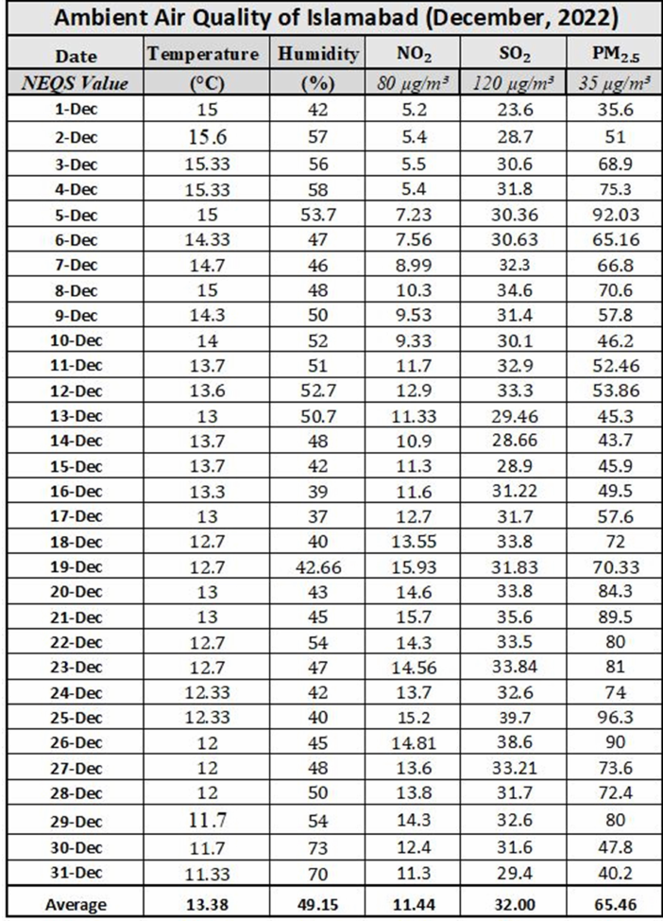
Scanned PDF with no extractable text
Observed behavior
pypdf and pdfplumber returned no usable table text from either page.
Workflow consequences
Change the extraction tool
Make uncertainty visible
Compare every accepted row with the image
CS-808 Tools and Techniques for Data Science
21

Slide 22
OCR returned text, but not a trustworthy table
Extraction
Rendered each page as an image and applied Tesseract OCR.
Observed failure
Dates, decimals, chemical labels, and column alignment were corrupted.
Decision
Do not silently promote uncertain OCR text into measurements.
Fallback: manual transcription → second-person or source-row check → provenance note
CS-808 Tools and Techniques for Data Science
22

Slide 23
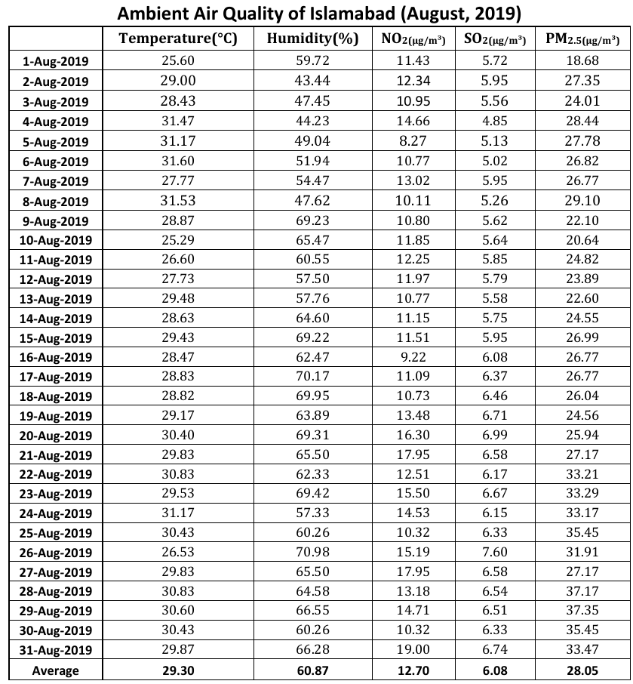
Searchable text still needs structure
Observed behavior
Text is extractable, but cell boundaries and reading order still require reconstruction.
Validation questions
Did each date retain five measurements?
Did the Average row enter the daily table?
Were units preserved outside the CSV?
CS-808 Tools and Techniques for Data Science
23

Slide 24
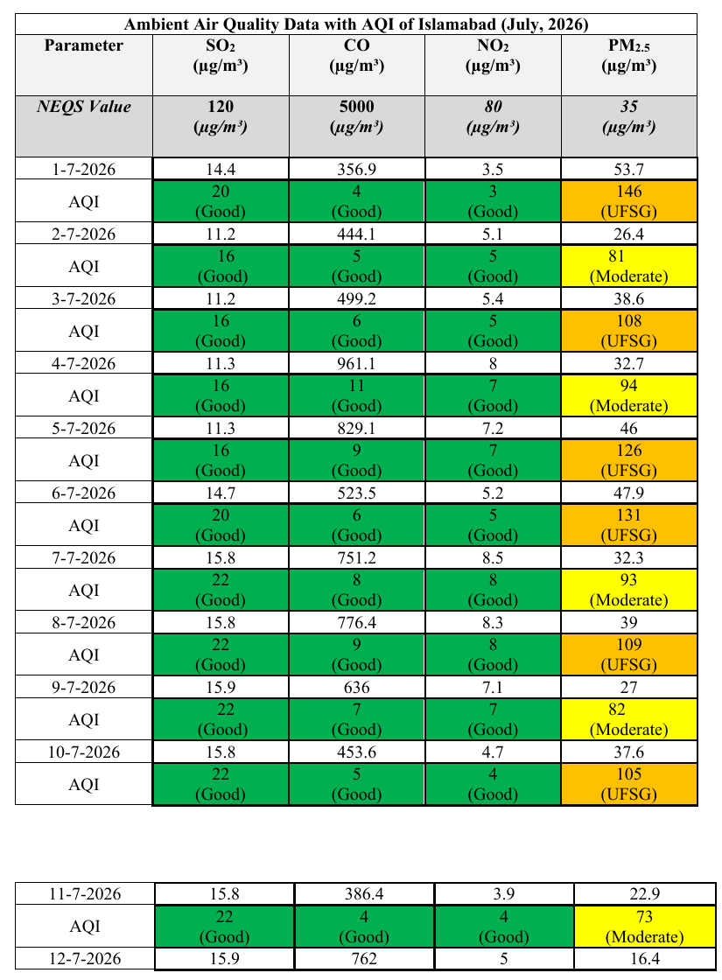
AQI rows change the table structure
Schema changes
Temperature and humidity disappear
CO appears
Each date has concentration and AQI rows
Category colors carry meaning
The table continues across three pages
The extraction must preserve values and row meaning.
CS-808 Tools and Techniques for Data Science
24

Slide 25
Source audit
Your group receives one PDF type. Decide what must be checked before its rows enter a trusted dataset.
Identify what one row means and which units belong to each value
Choose an extraction approach and name its likely failure
Specify three validation checks that compare output with the source
Decide when manual transcription is more responsible than automated extraction
Record one provenance detail the CSV alone cannot preserve
CS-808 Lecture 1
25

Slide 26
Break
15 minutes
Return ready to turn extracted rows into evidence.

Slide 27
The CSV reproduces a visible December pattern
Daily PM2.5 concentration, Islamabad, December 2022
31 daily rows
PM2.5 exceeds the displayed 35 µg/m³ value on most days.
A matching shape does not prove every row was transcribed correctly.
CS-808 Tools and Techniques for Data Science
27

Slide 28
Concentration is measured; AQI is derived
PM2.5 concentration
Air Quality Index
Measured mass concentration, reported here in µg/m³.
Derived from documented breakpoints and calculation rules.
The 2020-2022 CSV has concentrations only. We use a provisional PM2.5-based AQI for exploration; not as an official historical AQI.
CS-808 Tools and Techniques for Data Science
28

Slide 29
Winter months look worse
Mean monthly provisional PM2.5 AQI ± 1 SD across 2020, 2021, and 2022
Jan 135 ± 16
Dec 153 ± 23
Bars above 100 are colored red; 51–100 amber.
CS-808 Tools and Techniques for Data Science
29

Slide 30
Do temperature and humidity relate to AQI?
Daily observations, 2020–2022; correlation describes association, not cause
CS-808 Tools and Techniques for Data Science
30

Slide 31
The latest AQI PDF has no temperature or humidity
What does an absent column mean?
Not measured?
Measured, not published?
Not relevant?
The instrument or reporting process may not have recorded it.
The values may exist elsewhere but are outside this report.
Absence is not evidence that weather has no relationship with pollution.
Missingness is a data-generating-process question before it is a coding problem.
CS-808 Tools and Techniques for Data Science
31

Slide 32
Add daily weather from Meteostat
Join external hourly weather to the July 2026 AQI rows by Islamabad local date
1
Fetch
2
Aggregate
3
Join
744 hourly rows
Islamabad Airport (41571)
→
24 hourly values →
daily mean temperature + RH
→
31 AQI dates →
31 enriched daily rows
Provenance warning
Weather is external contextual/model data from dwd_mosmix at a station about 8.9 km away, not the EPA instrument. Preserve provider, station, time zone, attribution, and join rule in the CSV.
CS-808 Tools and Techniques for Data Science
32

Slide 33
Problem-framing canvas
Could these files plus external weather support a trustworthy Islamabad air-quality advisory?
Name the intended user and the decision the advisory would support
Define the observation and the required prediction or summary
Separate measured, derived, externally sourced, and missing fields
Choose one success criterion and one validation design
Name one harmful consequence and one provenance limitation
CS-808 Lecture 1
33

Slide 34
Share, compare, and challenge assumptions
Two group reports
Instructor synthesis
Two minutes per group
Two minutes
Does the seasonal plot answer the question?
What could explain the contradictory one-month pattern?
Which limitation must travel with the merged CSV?
CS-808 Tools and Techniques for Data Science
34

Slide 35
Complete workflow
A reliable data product connects an answerable question to documented evidence through a reproducible process, then communicates a result that an intended user can apply responsibly.
Today: failed extraction → changed tool → validated rows → provisional AQI → external weather → qualified interpretation
CS-808 Tools and Techniques for Data Science
35

Slide 36
Submit before leaving
1
When should manual transcription replace OCR?
2
Why is the historical AQI in our plot called provisional?
3
Name one limitation introduced by the Meteostat join.
Also rate your confidence from 1 to 5 in Python, statistics, SQL, and Git.
CS-808 Tools and Techniques for Data Science
36

