Slide 1
CS-808 · LECTURE 2
What does PM2.5 tell us?
From raw daily files to a reproducible, provisional AQI dashboard
Dr. Muhammad Farrukh Qureshi · CS-808 Tools and Techniques for Data Science
1

Slide 2
What does the measurement mean?
PM2.5 is a mass concentration of fine particles, in µg/m³.
AQI is an index calculated with a named conversion scheme and averaging period. It is derived, not measured.
Today's claim: a provisional PM2.5-based index from working daily data, under a fixed US EPA 2024 scheme.
Not official historical Pakistan AQI, not a multipollutant AQI, and not a live service.
Question → data → rule → tests → comparison → dashboard → reproducible export.
2

Slide 3
The Python we will actually use
Names and values; lists and NumPy arrays.
Indexing and Boolean masks.
A short loop.
DataFrame columns.
Stored versus recalculated results.
Explain the input, the intermediate object and the output before combining operations.
3

Slide 4
Coverage is evidence
What the files contain
What is missing
Two input files.
1,154 usable daily observations.
40 wholly blank records removed from the 2023 file.
2020: 365 of 366 days. 31 October is absent.
2021 and 2022: 365 days each.
2023: January–February only, 59 days.
Preserve source rows, original text, parsed values and missing dates. A plausible row count does not establish complete coverage.
4

Slide 5
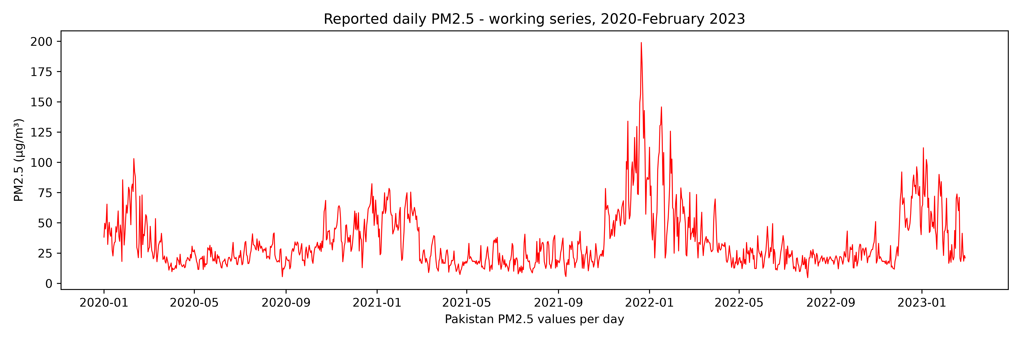
Inspect concentration first
Mean, median and peaks first.
Daily series before any index.
Missing measurements are not zeros.
Reported daily PM2.5, working series, 2020–February 2023.
5

Slide 6
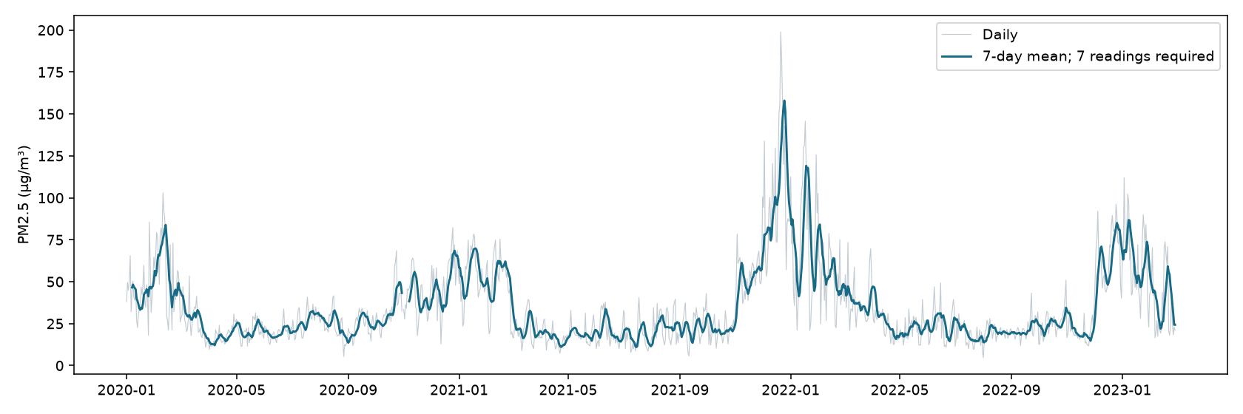
Seven readings are seven days only after calendar alignment
A 7-day rolling mean requires 7 readings.
Align to the calendar before rolling.
Smoothing is not forecasting.
Daily PM2.5 with a calendar-aware 7-day mean.
6

Slide 7
Concentration becomes an index
1. Truncate the concentration 35.49 → 35.4
2. Select its breakpoint interval [C_L, C_H] → [I_L, I_H]
3. Interpolate linearly
I = (I_H − I_L) / (C_H − C_L) × (C − C_L) + I_L
4. Round the index 35.9 µg/m³ → 102
Build one reusable function only after each component has been demonstrated.
Test boundaries, missing inputs, negatives, unsupported ranges and monotonicity.
Source: US EPA, Technical Assistance Document for the Reporting of Daily Air Quality (AirNow).
7

Slide 8
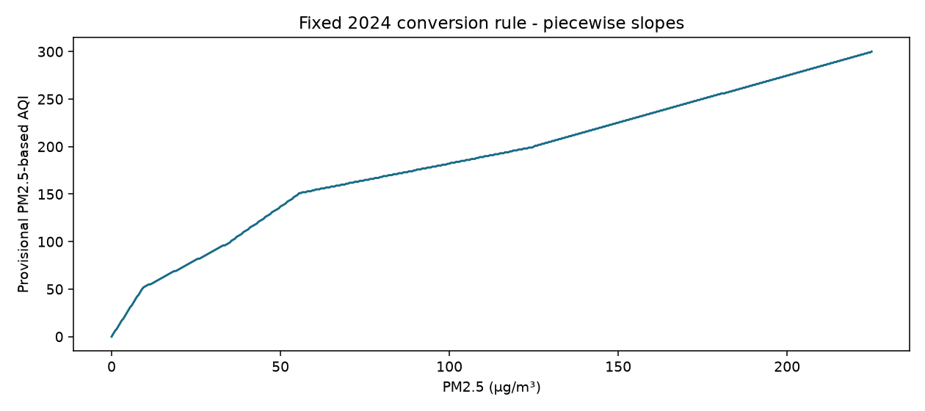
The conversion rule is piecewise linear
Each breakpoint interval has its own slope.
A small concentration change near a breakpoint can change the category.
Fixed 2024 US EPA PM2.5 breakpoints.
8

Slide 9
Break
Next: what changes when the rule or the comparison window changes?
9

Slide 10
Rules are part of the result
Same concentration + different breakpoint table → possibly a different index and category.
Compare the legacy table with the fixed 2024 table while holding rounding constant.
Record the scheme explicitly. Do not claim the retrospective index was officially reported at the time.
Lecture 1's downward final rounding is a separate issue.
10

Slide 11
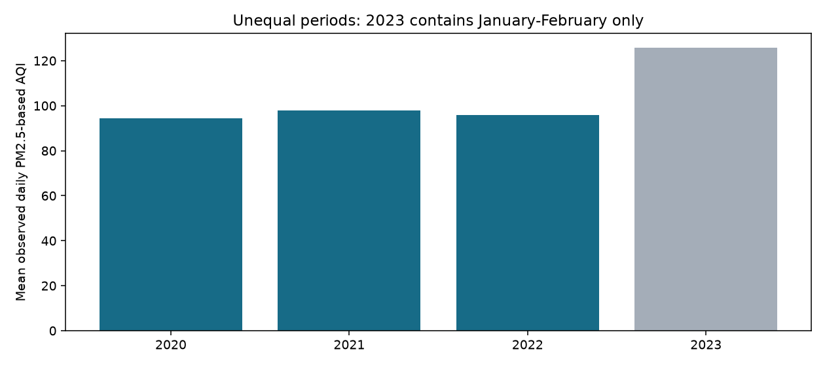
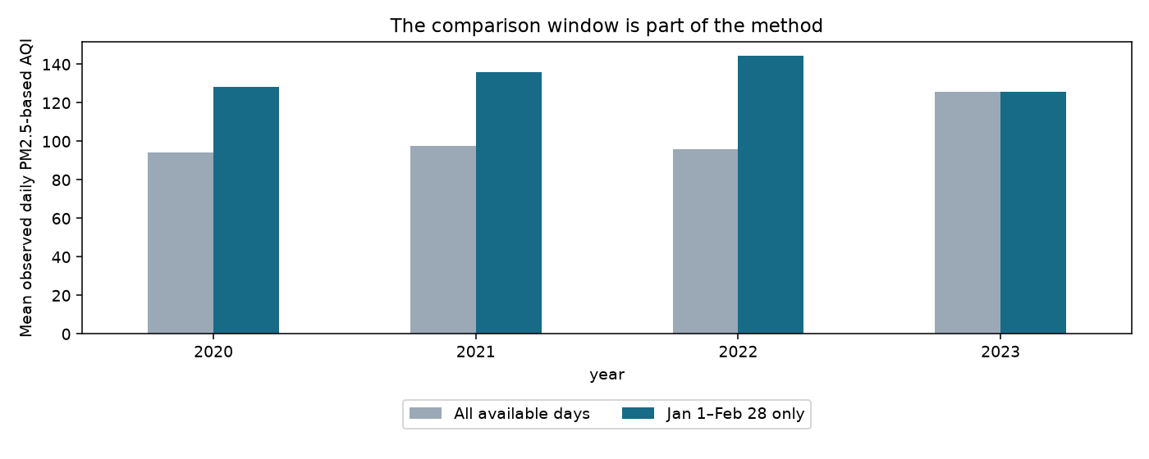
Compare like periods
Restrict every year to 1 January–28 February (59 days each) and the apparent ordering changes.
11

Slide 12
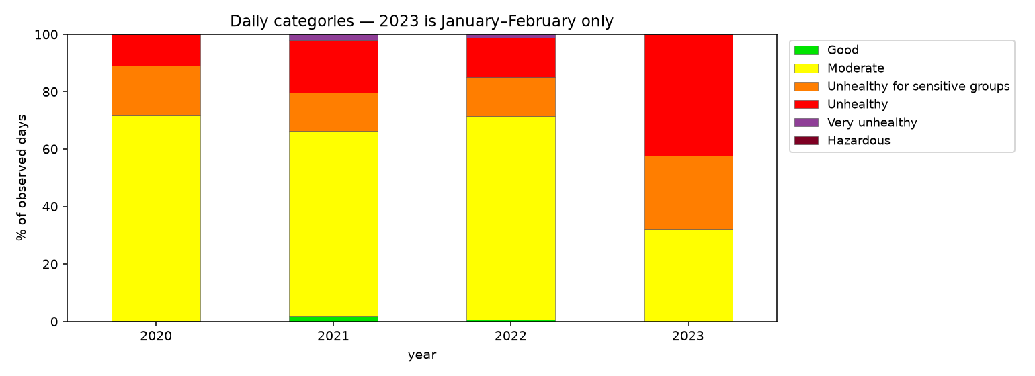
Category shares use observed days as the denominator
Annual mean of available daily indices is descriptive, not an official annual AQI.
Normalising counts does not remove seasonal selection: 2023 is winter only.
Daily categories by year; 2023 contains January–February only.
12

Slide 13
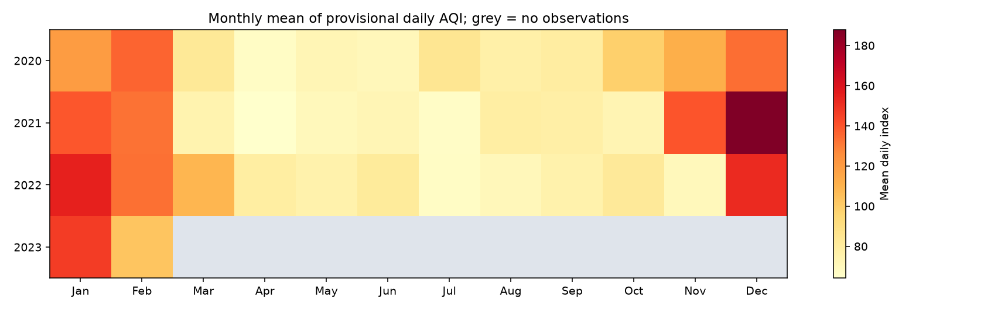
What does seasonality reveal?
Daily table → year-month groups → year-by-month matrix.
Grey cells are missing, not low pollution.
Monthly mean of provisional daily AQI.
13

Slide 14
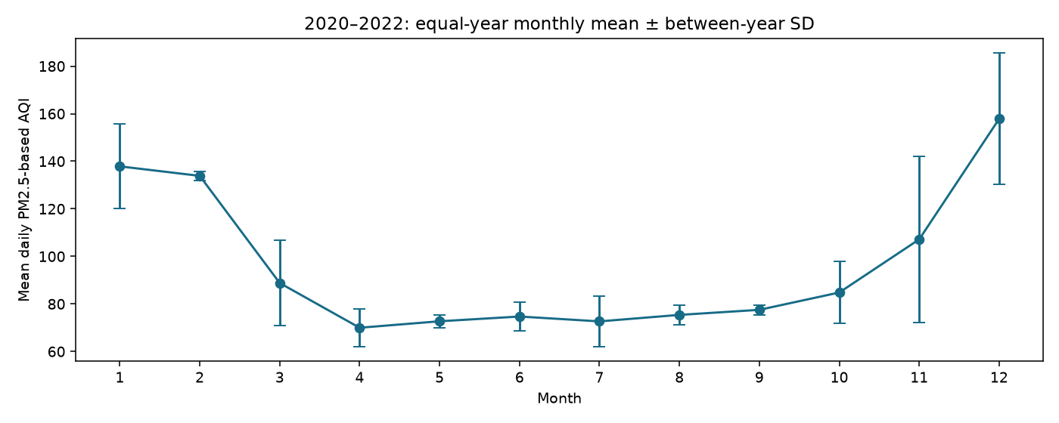
Define the statistic before the order of operations
Equal-year means and pooled daily means use different weights.
Error bars summarise three yearly monthly means.
mean(f(C)) ≠ f(mean(C)) in general.
2020–2022 equal-year monthly mean ± between-year SD.
14

Slide 15
Make the result usable
Plotly: hover, zoom, year selector, monthly summary, category counts.
Four traces per year; a visibility mask selects one year's four traces.
Coverage and method labels travel with the chart.
Python computes → HTML/JavaScript displays. GitHub Pages serves the static export; it does not run a Python server.
Live dashboard: https://drfarrukh.github.io/teaching/courses/tools-and-tech-in-data-science/lectures/lecture-02/dashboard/
15

Slide 16
Rebuild, then publish
Save raw-input hashes, derived daily data, the coverage audit and breakpoint tables.
Record the comparison-window policy, the rounding rule and package versions.
Restart and run all → regenerate docs/ → inspect the dashboard → publish with GitHub Pages.
A hash identifies file bytes; it does not establish that a measurement is true.
16

Slide 17
An index is a method, not a measurement.
What was measured, and over what period?
Which rule turned it into an index?
Are the periods we compare alike?
Can someone else rebuild the dashboard?
17

