Slide 1
CS-808 · LECTURE 3
Can airport weather fill the gaps?
Relational data, SQL and pandas for an evidence-based data substitution in Islamabad air-quality records
Dr. Muhammad Farrukh Qureshi · CS-808 Tools and Techniques for Data Science
1

Slide 2
The story
The Pak-EPA record
A second weather series
PM2.5 and other pollutants, 2018–2026.
Temperature and humidity are present in earlier reports but disappear from later ones.
Meteostat station 41571, Islamabad Airport.
Can it fill the missing EPA weather fields?
A strong correlation between two weather series does not prove that individual days agree or that substitution is valid.
2

Slide 3
Begin with the measurement question
Where did these temperature and humidity readings come from?
Pak-EPA publications describe a fixed monitor in H-8/2; the weather series comes from the airport station.
Decision question: are airport values close enough to EPA values, on days where both exist, to use as a documented, provisional proxy?
Four tests: coverage → date match → agreement → effect on analysis.
Exact Pak-EPA sensor coordinates and measurement protocol are not in the teaching CSVs.
3

Slide 4
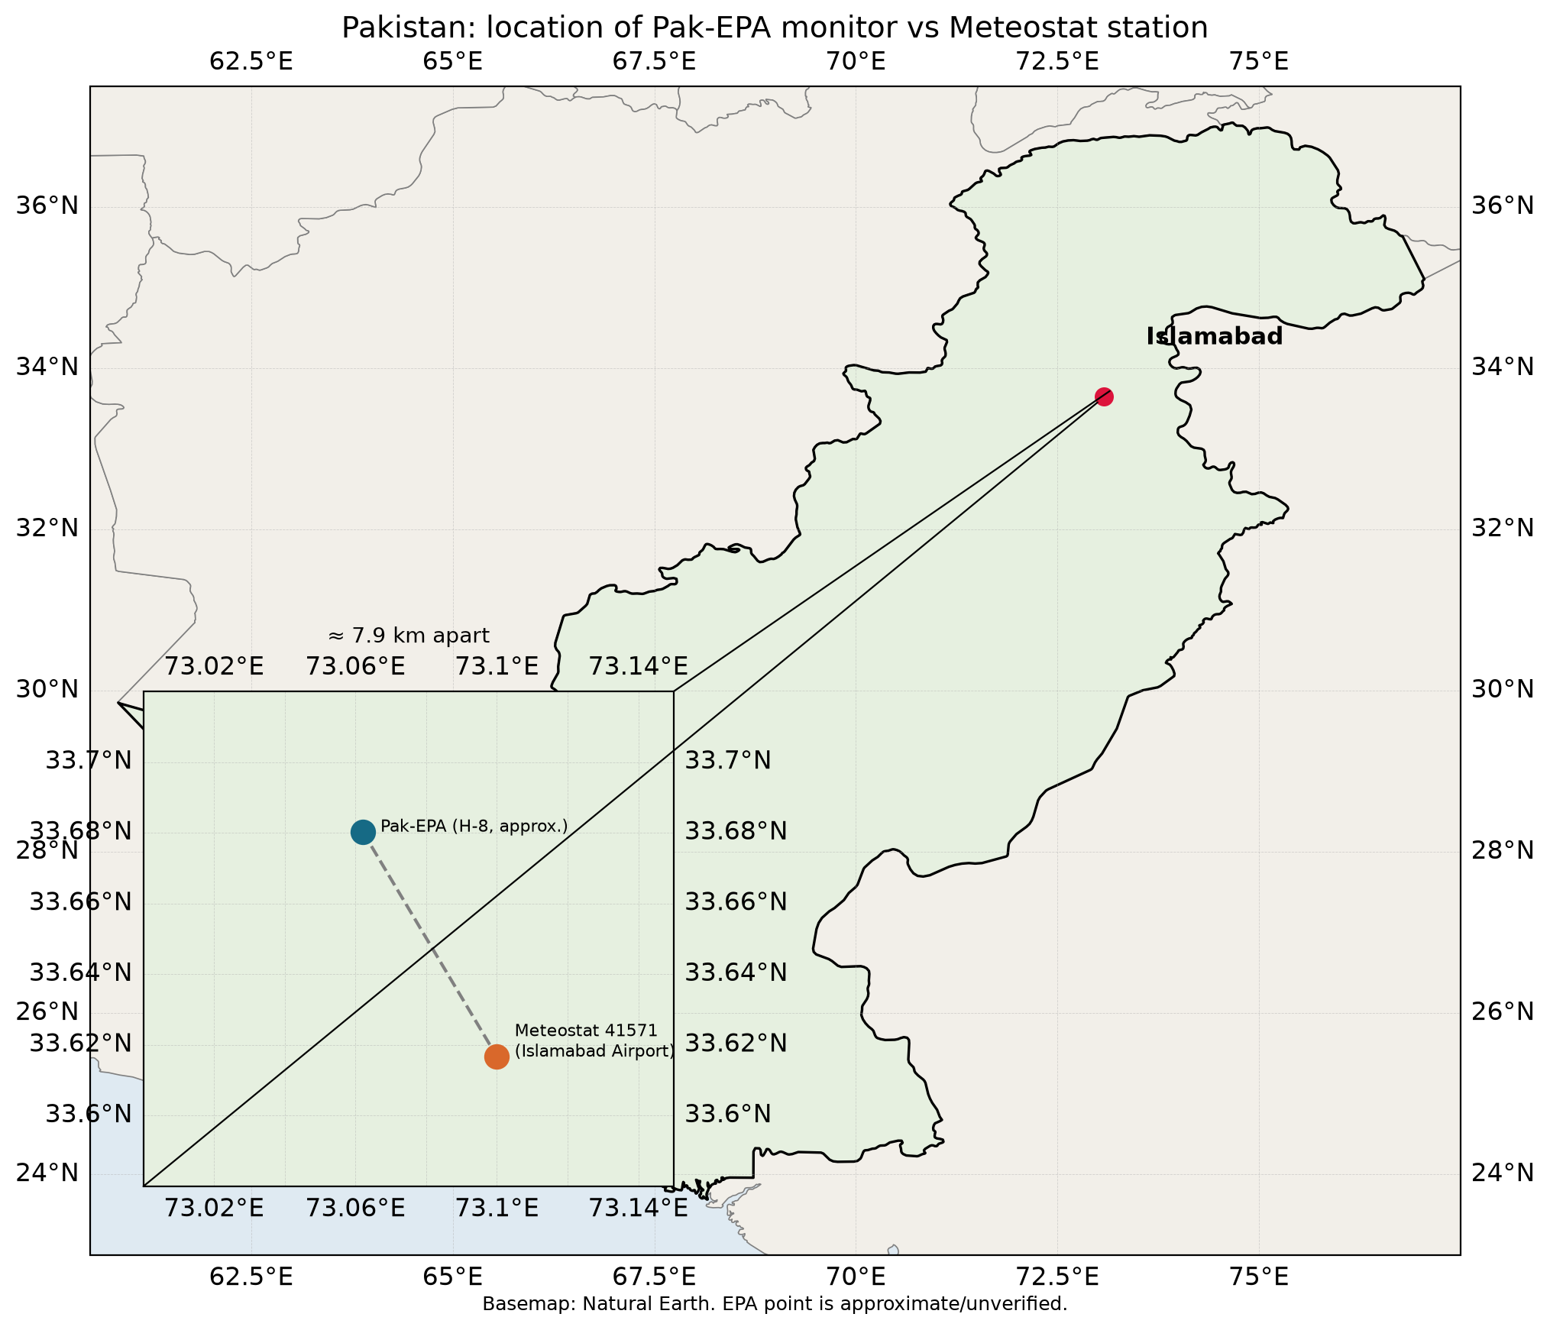
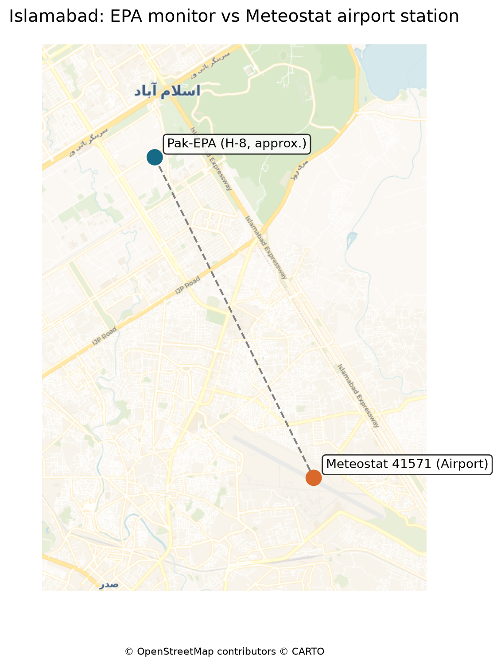
Two locations: will their daily weather agree?
About 7.9 km between plotted points. The H-8 point is approximate, so the distance is illustrative. Basemap © OpenStreetMap contributors © CARTO.
4

Slide 5
Relational data and SQL
Tables, grain, keys and joins
5

Slide 6
Table, grain, key, join
Table: rows and named columns. Grain: what one row represents.
epa_daily: one air-quality record per reported date. weather_daily: one Meteostat record per reported date.
Candidate key: date should be unique in each file. A CSV does not enforce a primary key; we check it.
Join: pair rows when epa_daily.date = weather_daily.date. NULL means absent, not zero.
6

Slide 7
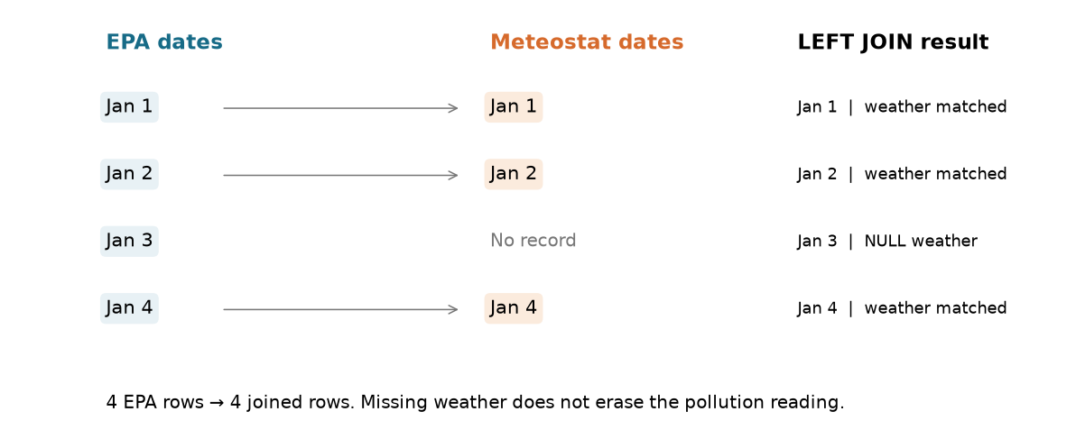
Predict the LEFT JOIN before running it
EPA: Jan 1, 2, 3, 4.
Weather: Jan 1, 2, 4.
Why does the Jan 3 row survive?
An INNER JOIN would drop it.
7

Slide 8
The SQL we need
SELECT e.date, e.pm25_ug_m3, w.meteostat_temperature_c
FROM epa_daily AS e
LEFT JOIN weather_daily AS w
ON e.date = w.date
WHERE e.pm25_ug_m3 > 50
ORDER BY e.date;
SELECT chooses columns, FROM names the table, WHERE filters rows, ORDER BY sorts.
COUNT(*) counts rows; AVG ignores missing values; GROUP BY changes the output grain.
DuckDB runs SQL directly on the two CSV files, in memory.
8

Slide 9
What changed in the EPA file?
Coverage before analysis
9

Slide 10
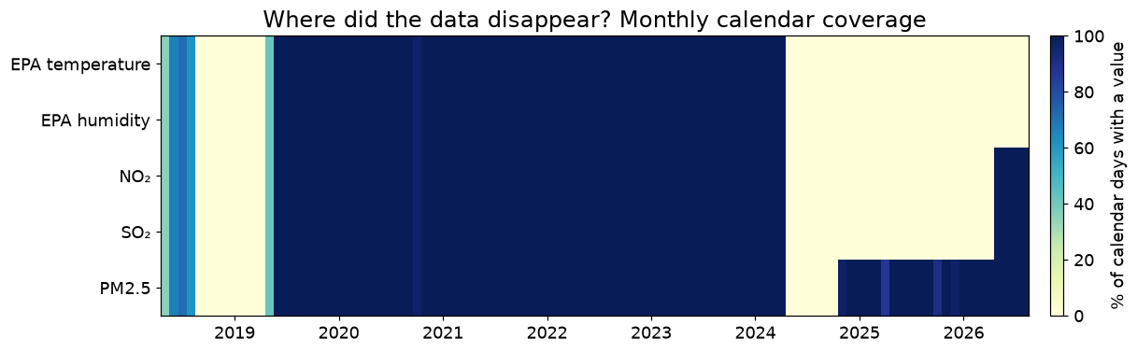
Where did the data disappear?
EPA temperature and humidity have no values in 2025 or 2026.
Fields disappear together.
Blank weather is a different problem from a missing date.
Share of calendar days with a reported value, by month.
10

Slide 11
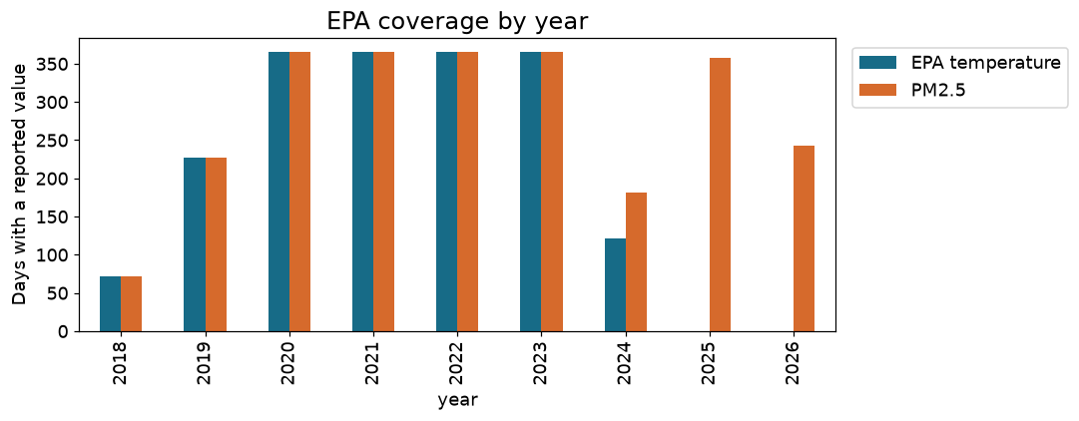
Counts, not percentages of a complete year
2018, 2019, 2024 and 2026 have partial date coverage.
PM2.5 has 15 blank values.
Missing weather and missing pollutant are different problems.
11

Slide 12
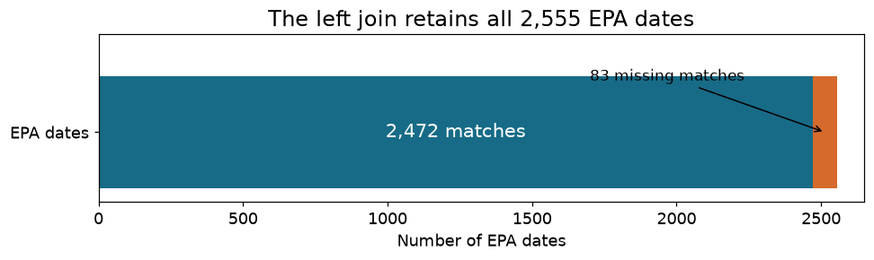
A left join keeps every EPA date
2,555 EPA dates in, 2,555 rows out.
A left join does not add weather-only dates.
validate="one_to_one" checks that dates are unique on both sides.
83 EPA dates have no weather match.
12

Slide 13
Do the two weather sources agree?
1,797 days where both sources recorded temperature and humidity
13

Slide 14
Three different kinds of evidence
What each measures
What we found
Correlation: do warmer days in one series tend to be warmer in the other? It does not measure equality.
Bias: mean Meteostat − EPA difference.
MAE: the typical size of a daily disagreement.
Temperature: r = 0.927, MAE 2.33 °C, bias −0.75 °C.
Humidity: r = 0.645, MAE 10.87 percentage points, bias +2.73.
There is no universal threshold that makes two stations interchangeable.
14

Slide 15
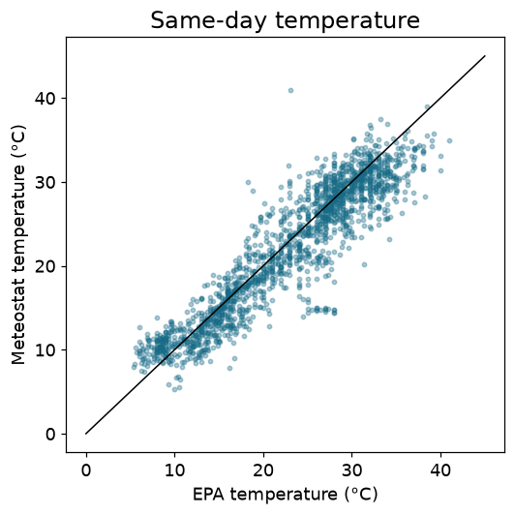
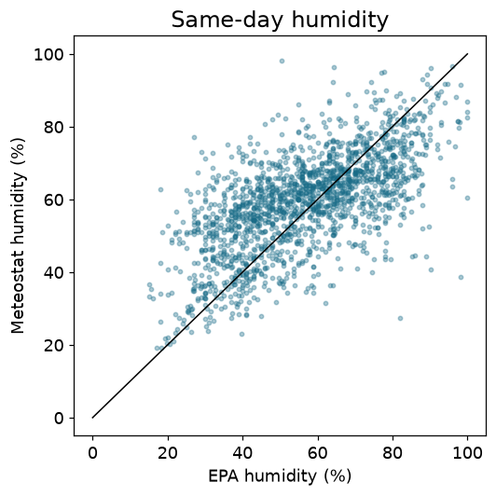
Do individual days sit near the equal-value line?
The diagonal is exact agreement. Wide scatter means substitution error even when the correlation is positive.
15

Slide 16
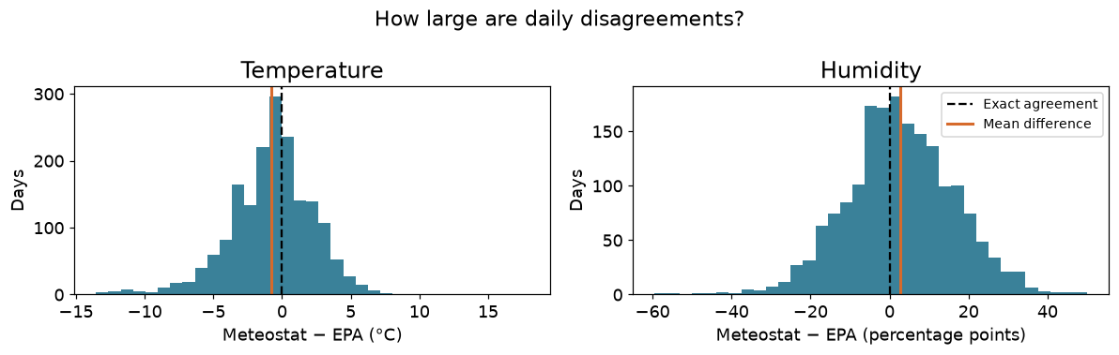
How large are daily disagreements?
Zero is exact agreement. A single average bias does not describe how far individual days lie from zero.
16

Slide 17
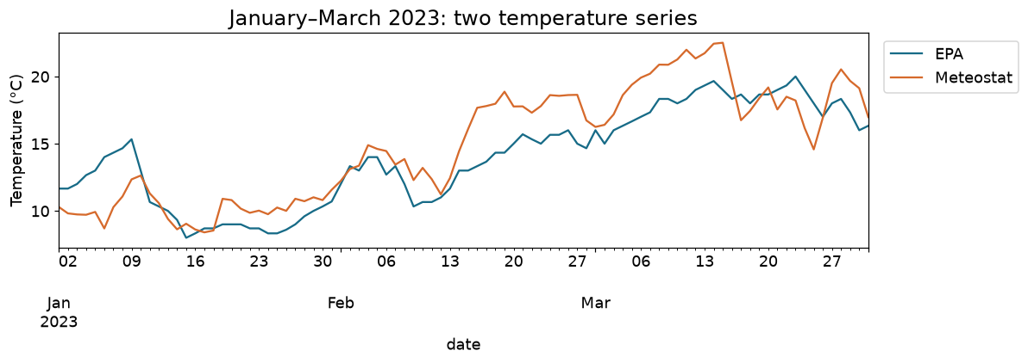
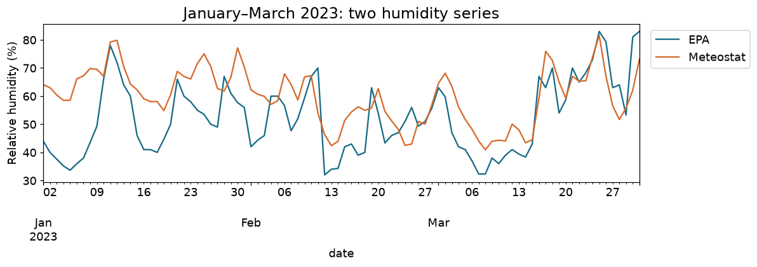
What happens over time?
January–March 2023. Temperature tracks fairly closely; humidity shows much larger daily differences.
17

Slide 18
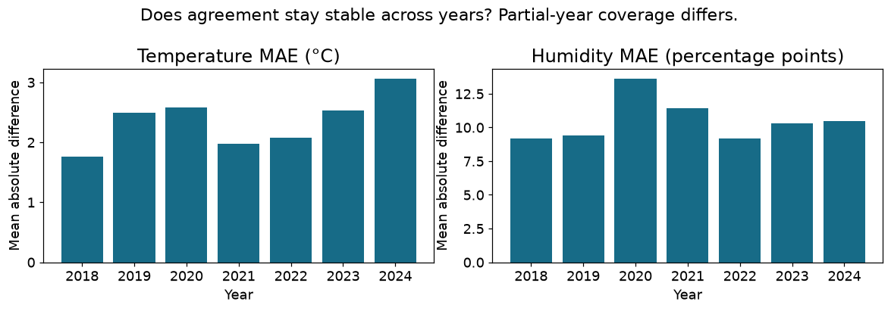
Does agreement stay stable across years?
The error changes by year, which limits confidence when carrying an early relationship into later missing periods.
18

Slide 19
Build a transparent candidate fill
Keep the original; label the source of every value
19

Slide 20
Fill gaps without hiding the assumption
# pandas
joined['temperature_candidate_c'] = joined.epa_temperature_c.combine_first(
joined.meteostat_temperature_c)
-- SQL
COALESCE(e.epa_temperature_c, w.meteostat_temperature_c)
AS temperature_candidate_c
Use EPA when it exists, Meteostat only when EPA is missing, and record which one was used.
The column name says candidate so that the assumption stays visible.
20

Slide 21
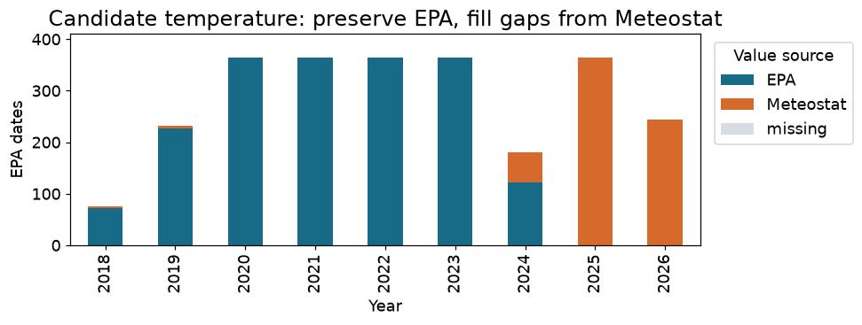
The source of weather changes over time
2025–2026 values come entirely from Meteostat.
Preserve provenance when interpreting any long-term trend.
21

Slide 22
Did the substitution change the analysis?
Two comparisons, two different questions
22

Slide 23
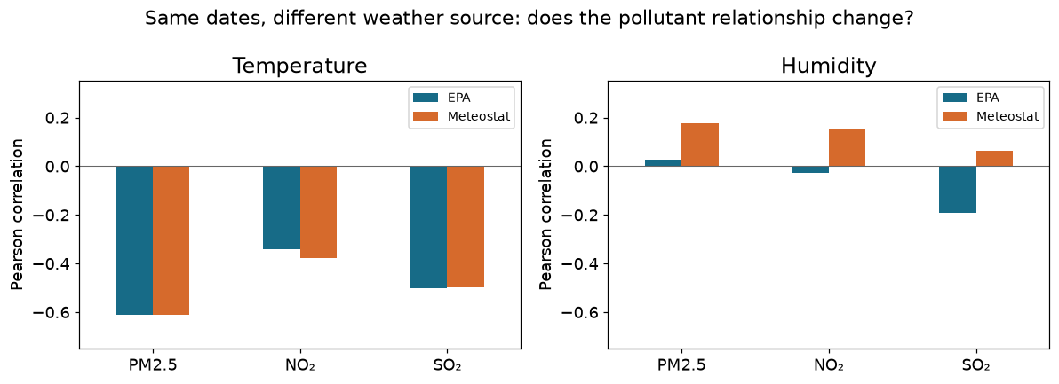
Same dates, different weather source
Uses only dates where the pollutant and both weather sources exist.
Isolates the choice of weather series.
Humidity can change the association even without new days.
23

Slide 24
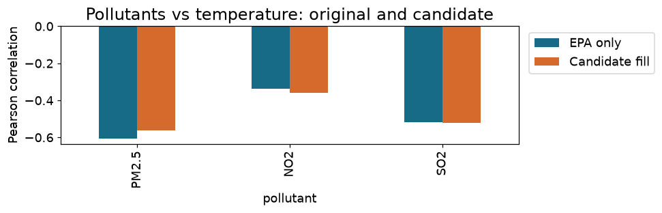
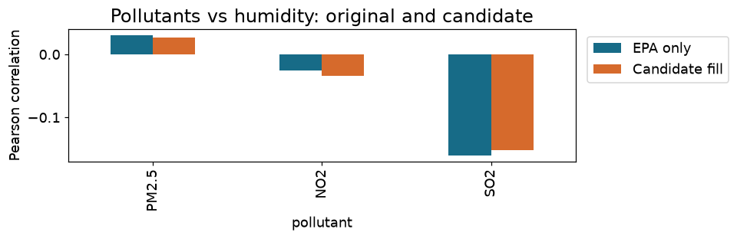
Original versus candidate-filled sample
The candidate sample also adds later dates, so a change here is not a clean test of replacement accuracy. Correlation is association, not cause.
24

Slide 25
Decision
Meteostat temperature is promising for exploratory gap filling, subject to the observed daily errors and the station-location limitation.
Meteostat humidity requires stronger caution because same-day agreement is weaker.
Preserve original EPA readings, mark substituted values, and report results with and without the candidate fill.
25

Slide 26
Check your understanding
What is the grain and key of each input table?
Why does a left join produce 2,555 rows and 83 missing weather matches?
Why can correlation be high even when daily temperatures differ by several degrees?
What does COALESCE(EPA, Meteostat) do, and why keep a source label?
Why compare pollutant correlations on both identical days and the expanded sample?
26

