Slide 1
CS-808 · LECTURE 4
Data acquisition
and data quality
Why did local apples and imported iPhones
both become expensive?
Dr. Farrukh Qureshi · Evidence cut-off: 2026-10-01
1

Slide 2
The puzzle: two very different products
Locally grown apple
Imported iPhone
Roughly Rs100/kg a few years ago, around Rs300/kg now?
Which variety, market, season and dates?
Flagships feel far more expensive in Pakistan.
US price, rupee, then domestic additions.
Opening apple numbers are illustrative observations. Their exact history remains to be tested.
2

Slide 3
What people say caused it
Currency / foreign price
Political / programme policy
The rupee collapsed. Imported goods track USD.
PTI-period inflation, IMF conditions, fuel prices and subsidies.
Global / domestic shocks
The local-product objection
COVID, floods, and the 2026 conflict / oil shock.
If apples are grown here, why would USD or oil matter?
Candidate explanations to investigate. None is adopted as a conclusion here.
3

Slide 4
Four layers that must stay separate
REPORTED CLAIM
Who attributed what to whom?
DOCUMENTED POLICY / EVENT
What does the primary record establish?
OBSERVED DATA
Which measured variable moved, in what period?
INTERPRETATION
What follows, and where must we stop?
News records explanations. A primary document or measurement tests a different part of the claim.
4

Slide 5
Define the claim and the evidence that could change it
Claim | Evidence we would need | What would weaken it?
iPhone floor rose | US price and matched-date FX | A smaller computed product
Apples tripled | Matched apple-specific prices | Different varieties / seasons / markets
Policy caused all inflation | Identified policy effect and counterfactual | Other shocks moving at the same time
War passed into prices | Dated reports, oil, fuel policy, CPI | Mismatch in timing / benchmark / exposure
10 candidate claims are preserved with supporting and weakening evidence in the notebook matrix.
5

Slide 6
The question determines the source
Needed evidence | Source class | Acquisition
Who said what? | News / archive | RSS, permitted article HTML
Programme / price decision | IMF / government | PDF / primary web page
Inflation baskets | PBS | SDMX feed + PDF
Oil / currency | FRED–EIA / SBP | CSV / official tables
US product price | Apple Newsroom | Primary HTML
Apple-specific history | Matched market observations | Suitable panel still needed
Choose the most direct permitted method. Use a browser when the required data need it.
6

Slide 7
During the PTI period: competing explanations
Government attribution
Opposition and response
Imran Khan pointed to global shocks.
Dawn, 8 Nov 2021 (N01).
The speaker’s explanation is a claim.
Asif / Gilani challenged policy performance. Waseem pointed to world fuel prices.
Tribune, 6 Nov 2021 (N02).
We record attribution before testing it. The lecture does not adopt either political explanation.
7

Slide 8
Acquire news: replay a saved RSS response
GET https://feeds.bbci.co.uk/news/world/rss.xml
item → title, link, pubDate, description
pubDate → UTC timestamp
save permitted snapshot + retrieval record + SHA-256
Why a feed?
Structured item metadata.
Rolling coverage.
No assumption that it contains historical claims.
Normal notebook execution uses saved evidence. Live requests require an intentional, permitted collection.
8

Slide 9
HTTP success is not a quality verdict
200
314 days
87
A successful response can contain stale data.
Age of a stale feed in the saved collection log.
Placeholder authors in the retained feed sample.
Audit the meaning
Placeholder ≠ null. Retrieval time ≠ publication time. Repeated stories ≠ independent evidence.
Back off on 429. A 403 means stop and record the access limitation.
9

Slide 10
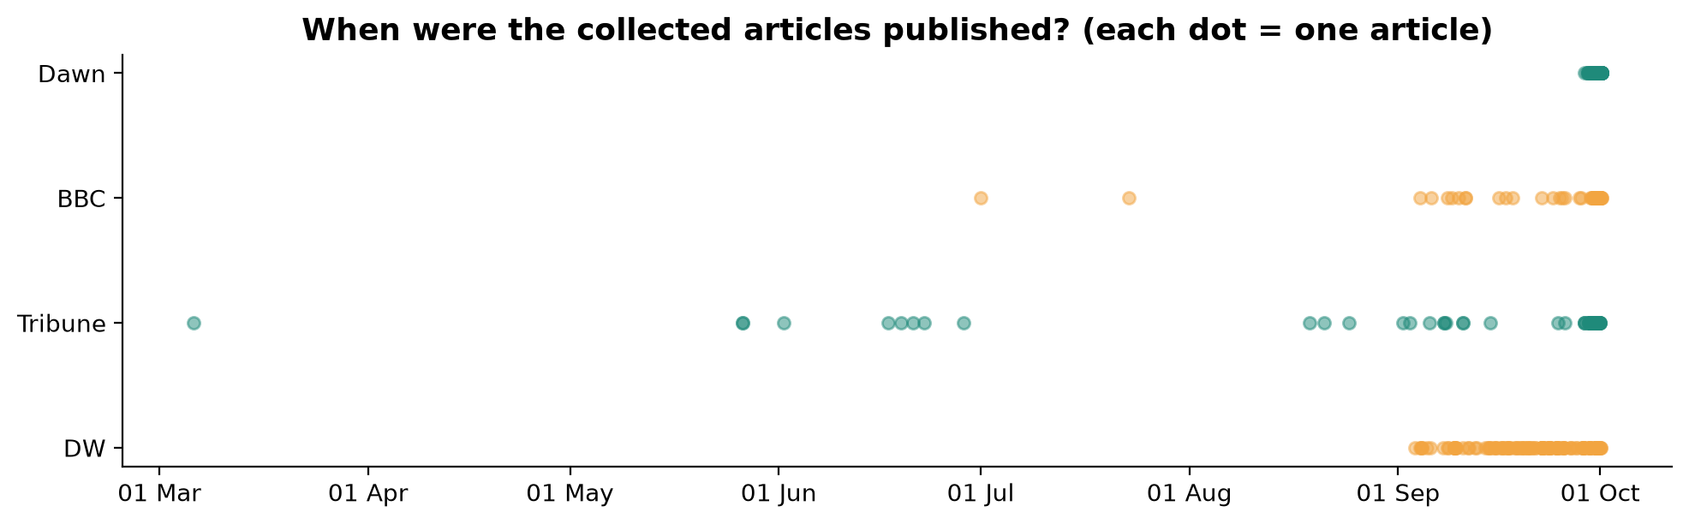
A rolling feed cannot answer a historical question
Missing years are missing rows. Archive reporting is acquired and labelled separately.
10

Slide 11
From a public explanation to an official record
News: public attribution
Primary: policy evidence
“IMF-linked measures raised prices” needs a specific channel.
Record the speaker, article date and interpretation.
Locate subsidy, tariff, revenue or FX clauses.
Separate staff analysis, authorities’ commitments and implementation.
Acquire → audit → reconcile. A document can verify a commitment without estimating its inflation effect.
11

Slide 12
Inflation needs a structured measurement
PBS SDMX
Series: indicator, unit, base period
Observation: month, index value
key = month × series
YoY = (index / index 12 months earlier − 1) × 100
Quality checks
13 series
50 observed months
Expected months?
Duplicate keys?
Index, rate or rupees?
The notebook reparses the preserved XML and reconciles it with the tidy table.
12

Slide 13
The PDF is newer than the feed
Feed
Official September PDF
Last month: 2026-08
Multi-category monthly indices.
Check expected month rows.
General inflation: 10.3% YoY
Tables and narrative have newer data.
Preserve physical page locators.
Keep vintages explicit. Do not paste a new headline into an older complete multi-series feed.
13

Slide 14
Preserve the evidence before transforming it
RAW
acquired evidence
INTERIM
parsed / extracted
DERIVED
figures / findings
›
›
Provenance record
URL · publisher · retrieval time · observation period · request/status · file · parser/method · SHA-256 · limitations
41 source records checked in the notebook. A matching checksum detects changes, not factual truth.
14

Slide 15
Six quality questions recur throughout
Completeness
Validity
Expected rows and values?
Right units, ranges and meaning?
Uniqueness
Consistency
Duplicate keys or stories?
Same definition, period and product?
Timeliness
Representativeness
Current observation or stale response?
Does it measure our item / population?
Apply these after each acquisition. Cleaning follows evidence and a stated rule.
15

Slide 16
2018–2026: context, with dated source roles
Period | Context marker
2018 | PTI government period begins (August)
2019 | 3 Jul: 39-month EFF approved, about US$6bn
2020 | Mar–Jun: COVID response; SBP rate cuts
2021 | Nov: competing public inflation explanations
2022 | 1 Mar fuel cut; 10 Apr no-confidence; Jun subsidy reversal; floods
2023 | 12 Jul: nine-month SBA, about US$3bn
2024 | 25 Sep: 37-month EFF approved, about US$7bn (release 27 Sep)
2025 | Low inflation in the observed PBS monthly window
2026 | 28 Feb conflict; 7 Mar/3 Apr fuel changes; Sep Apple launch
Events are context markers, not estimated causal effects. 2026 is an incomplete year.
16

Slide 17
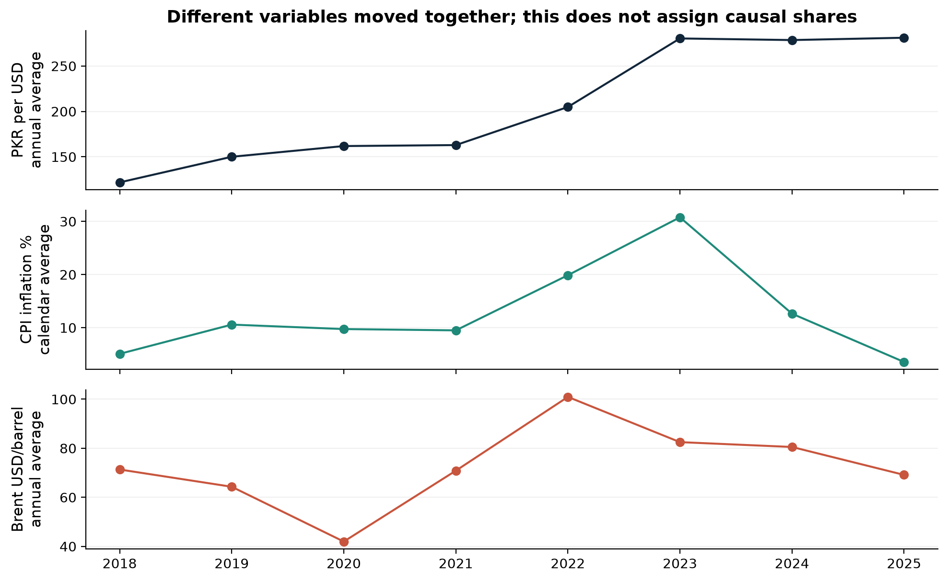
Currency, general inflation and oil moved together
World Bank calendar-year data and FRED/EIA annual oil means. Launch-date FX is a separate methodology.
17

Slide 18
How much was government policy responsible?
What we can document
What data cannot isolate
Specific price/subsidy decisions.
Exchange-rate and commodity movements.
What speakers blamed or defended.
The counterfactual without the policy.
A share of total inflation assigned to PTI, the IMF or any other government.
Calendar data straddle transitions. COVID, global prices, currency and domestic policies overlapped.
18

Slide 19
iPhone: verify the actual US launch offer
Availability | Model | Entry storage | US start price
2019-09-20 | iPhone 11 Pro Max | 64GB | $1,099
2021-09-24 | iPhone 13 Pro Max | 128GB | $1,099
2023-09-22 | iPhone 15 Pro Max | 256GB | $1,199
2026-09-18 | iPhone 18 Pro Max | 256GB | $1,299
Apple Newsroom primary sources. Entry-tier product family, with changing storage and hardware.
19

Slide 20
iPhone: match every exchange rate to the same event
Model year | US availability = FX date | SBP PKR per USD
2019 | 2019-09-20 | 156.0798
2021 | 2021-09-24 | 169.0810
2023 | 2023-09-22 | 291.7629
2026 | 2026-09-18 | 277.2522
USD READY M2M weighted closing interbank rate on each US availability date. All four dates are business days.
20

Slide 21
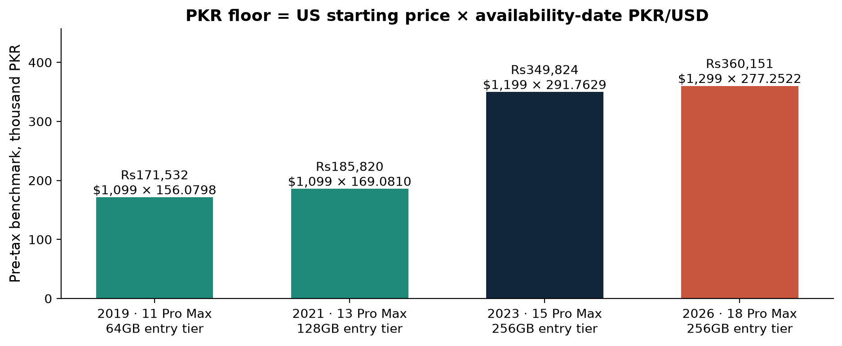
The imported pre-tax floor is a product
2019→2026: US price +18.2%, PKR/USD +77.6%, floor +110.0%.
21

Slide 22
iPhone: what is quantified, what remains open
Quantified inputs
Still unverified
2019→2026: US base price +18.2%; PKR/USD +77.6%; pre-tax floor +110.0%. 2023→2026 floor +3.0% despite a lower PKR/USD rate.
Both USD launch price and FX changed.
Exact current Pakistan PTA / FBR addition.
Retail margins, freight and transaction price.
No unofficial tax number enters the verdict.
The benchmark is reproducible. It is not an observed Pakistani retail price.
22

Slide 23
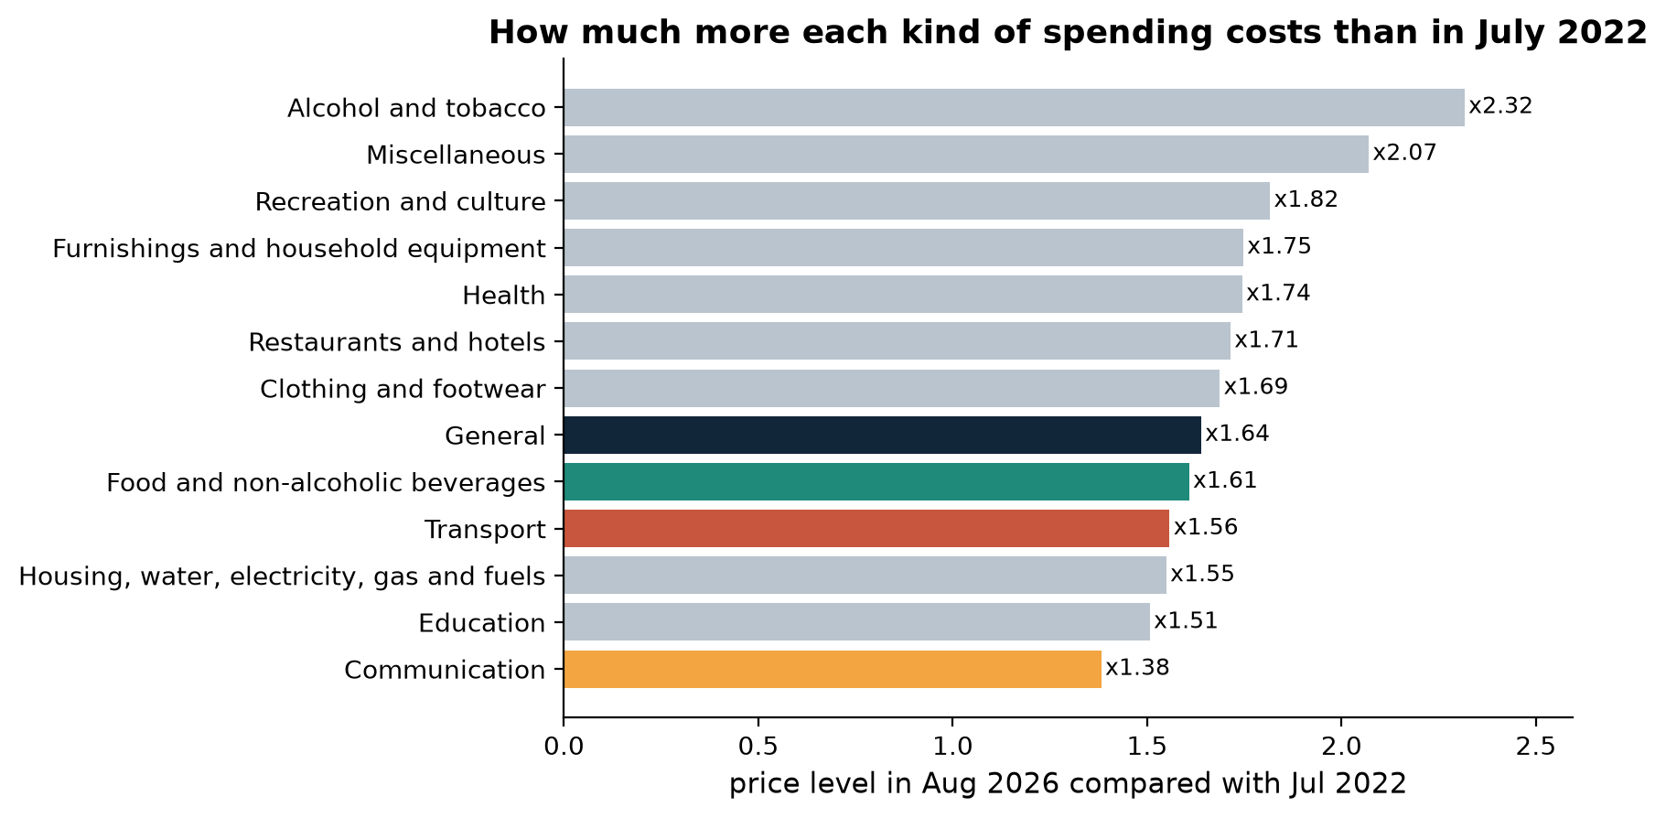
Local production does not identify every cost
PBS category price levels, Jul 2022→Aug 2026. Broad baskets do not identify the costs of a specific apple.
23

Slide 24
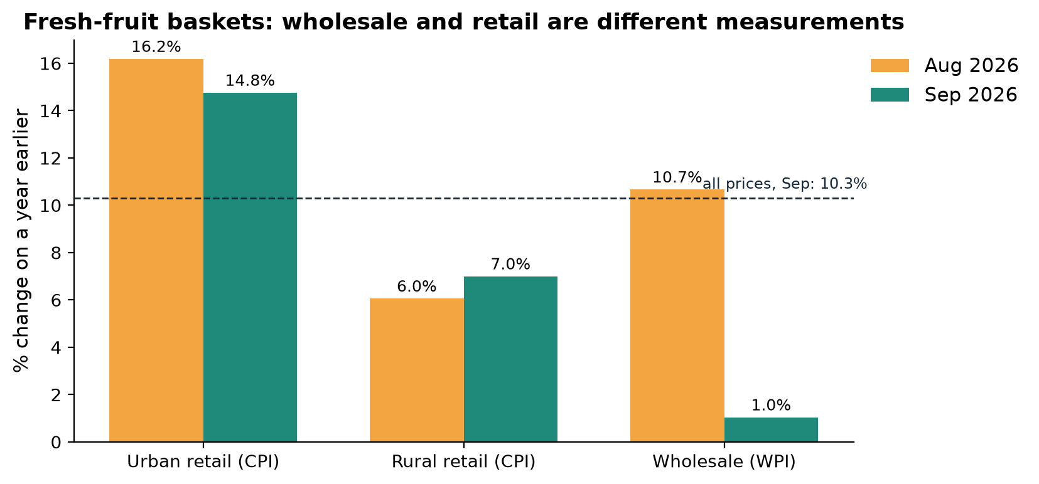
Fresh fruit: retail and wholesale differ
Official PBS PDF baskets, not apples. Different coverage/weights also prevent interpreting the gap as a margin.
24

Slide 25
Possible apple channels need their own evidence
Measurements available
Evidence still needed
September electricity: 32.5% YoY.
Transport and food indices moved.
Those are category observations.
Apple-specific transport, energy, storage and retail costs.
Input exposure, supply and market coverage.
No imported-input share is assumed.
Possible channels are hypotheses until measured. A local product can face downstream costs.
25

Slide 26
Flood reporting meets a damage assessment
Contemporary news
Joint official PDNA
Dawn and Reuters reported food-supply disruption.
Local traders describe roads and supply conditions.
N09 / N10, Aug 2022.
Agriculture and transport damage documented.
Affected-area assessment.
No apple-specific retail-price effect.
Do not turn reported local prices or aggregate assessed damages into an apple-price coefficient.
26

Slide 27
When people say “the IMF made prices rise”
What the reporting said
What we must test
2019: programme policy commitments reported.
2022: Miftah linked subsidy reversal to IMF support.
N03 / N04 / N07 / N08.
Which subsidy, energy, tax, levy or FX channel?
Commitment or implementation?
Staff analysis or authorities’ memorandum?
A reported attribution becomes a list of specific document and measurement questions.
27

Slide 28
What the IMF documents actually establish
Channel | Documented policy / commitment
Subsidy reversal | Authorities’ MEFP ¶8(a): reports June 2022 fuel and blanket power subsidy reversal
Oil-price pass-through | commitment to pass international oil changes through
Energy tariffs | tariff adjustment / cost recovery with protected consumers
Exchange-rate regime | Programme policy: market-determined rate; no fixed rupee value is specified
Revenue / levy | Revenue commitments include fuel taxation; distinguish target, law, notification and effective rate
2019 EFF release + 2022 staff report / MEFP. Commitments, implementation and causal effects are separate.
28

Slide 29
A fuel-policy decision we can calculate
159.86
149.86
-10.00
Old petrol price, Rs/litre
New petrol price, Rs/litre
Change, Rs/litre
Date matters
Announced 2022-02-28. Effective 2022-03-01. Computed change -6.3%.
June subsidy reversal is documented in the authorities’ MEFP. This arithmetic does not measure a share of CPI.
29

Slide 30
Reconcile period and vintage before judging sources
“2025” measurement | Published | Recomputed from PBS
World Bank: Jan–Dec | 3.5% | 3.5%
IMF: Jul 2024–Jun 2025 | 4.5% | 4.5%
Projection check
May 2026 report overlaps Apr–Jun. Full FY27 cannot be checked using only Jul–Aug.
Same year label ≠ same period. Observation ≠ projection. Announcement date ≠ effective date.
30

Slide 31
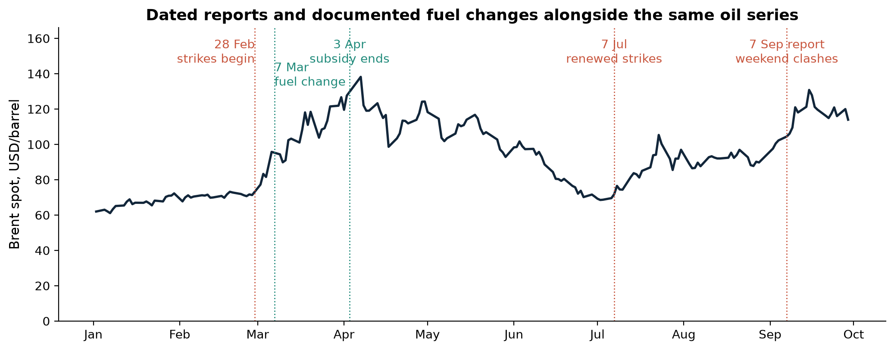
2026: event reports, oil and domestic fuel decisions
Red: reported conflict timing. Green: fuel changes described in the May IMF report. Context is not a causal estimate.
31

Slide 32
Audit the oil series before drawing the line
DCOILBRENTEU
Audit result
Crude Oil Prices: Brent – Europe
EIA Spot Prices, via FRED
Daily, USD/barrel, not seasonally adjusted
Not a contract-specific futures quote.
6 missing 2026 values
0 duplicate dates
2-day observation lag
Missing quote ≠ zero.
No invented daily fill.
A futures comparison needs matching contract, date, time and units. Non-trading dates are not simply null rows.
32

Slide 33
From oil to Pakistan fuel: a documented channel
May IMF report
Then observe PBS transport
7 Mar: initial 20% fuel increase.
3 Apr: subsidy unwound, petrol +18%, diesel +55%.
FX around PKR280/USD.
Feb: 0.4% YoY
Mar: 12.5%
Apr: 29.9%
Aug: 20.2%
YoY rates include base effects.
Source role: IMF staff document describes measures; PBS supplies observed basket indices.
33

Slide 34
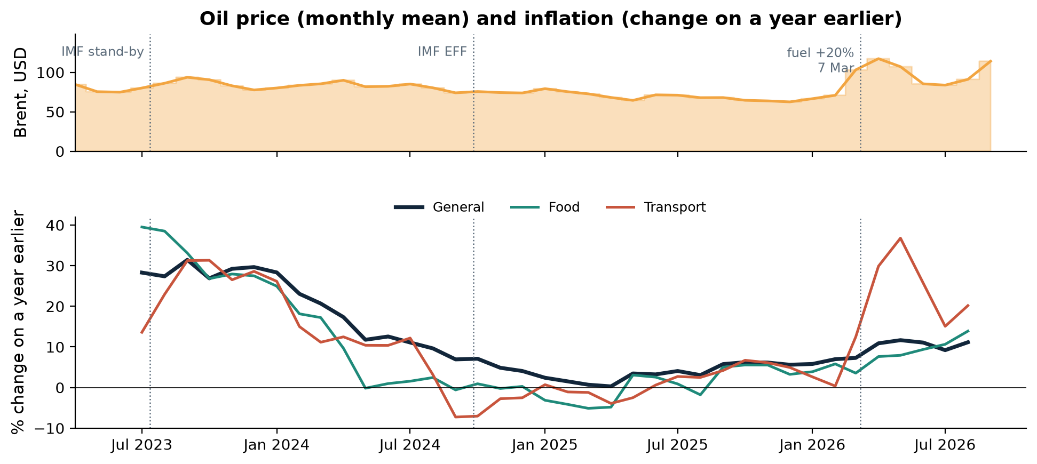
Oil, transport, food and headline prices
Separate scales and periods. Missing first-year YoY values reflect the required comparison window.
34

Slide 35
Scoreboard: imported versus local
Claim | Verdict | Evidence / source | Limit
I1 Imported floor rose | SUPPORTED BY ARITHMETIC | Apple / SBP: calculated floor rose | Entry storage changes; pre-tax benchmark only
I2 FX alone explains phone | PARTLY SUPPORTED | Apple: dollar price also changed | Exact Pakistan additions unverified
A1 Apples exactly tripled | NOT TESTABLE WITH CURRENT DATA | PBS: fresh-fruit baskets | No matched apple-specific price panel
A2 Local goods insulated | NOT ESTABLISHED | PBS: food, energy, transport moved | No apple cost accounts or causal shares
Full evidence, source records, periods and limitations are retained in the generated matrix.
35

Slide 36
Scoreboard: public / policy explanations
Claim | Verdict | Evidence / source | Limit
P1 All inflation = policy | NOT ESTABLISHED | News / WB / SBP: overlapping changes | No counterfactual or political blame share
M1 IMF-specific channels | PARTLY SUPPORTED | IMF: subsidy, tariff, tax, FX clauses | Commitment ≠ implementation ≠ CPI effect
F1 Fuel decision changed price | SUPPORTED BY DIRECT MEASUREMENT | PID: official petrol-price reduction | Direct price change ≠ contribution to CPI
Full evidence, source records, periods and limitations are retained in the generated matrix.
36

Slide 37
Scoreboard: overlapping shocks
Claim | Verdict | Evidence / source | Limit
S1 COVID contribution | PARTLY SUPPORTED | SBP / news: pandemic response documented | Product-specific contribution not isolated
S2 Flood supply disruption | PARTLY SUPPORTED | Joint PDNA / news: supply damage | Aggregate assessment ≠ apple-price effect
W1 2026 oil transmission | CONSISTENT WITH OBSERVATIONAL TIMING | FRED / IMF / PBS: timing aligns | No identified oil→food causal share
Full evidence, source records, periods and limitations are retained in the generated matrix.
37

Slide 38
So why did both become expensive?
Imported iPhone
Locally grown apples
Foreign entry price × exchange rate.
Then domestic duties, freight and margins.
Both verified inputs changed across actual generations.
Domestic baskets and downstream costs moved.
Supply disruption is documented.
Exact apple history and cost shares need additional measurements.
There is no single explanation for every product and period. Earlier shocks overlapped; 2026 timing supports an energy channel.
38

Slide 39
What the evidence can and cannot say
Can establish
Cannot establish here
Verified source inputs and a calculated floor.
Defined basket movements.
Documented policy changes.
Who attributed what to whom.
Exact apple threefold history.
Current phone tax / retail addition.
Retail margin from basket gaps.
Political or oil causal shares.
Stopping at the measurement boundary is part of a good audit.
39

Slide 40
Acquire responsibly and make it reproducible
Use the most direct permitted source and method.
Check terms / robots, identify the client, pace and cache.
Respect 429 / 403 and access controls.
Keep allowed metadata, snapshots, provenance and checksums.
No full copyrighted news articles, credentials or access-control bypasses.
40

Slide 41
Browser demo: acquire, then audit the catalogue
Permitted page
inspect fields
Pagination
expected keys
Raw snapshot
provenance
Checks
refused claims
›
›
›
python demo_browser.py
Saved replay: demo_output/books_catalogue.csv
Quality report + provenance + screenshot evidence
Inspect encoding, duplicate URLs, missing expected rows, price strings and constant fields.
41

Slide 42
Assignment 1: a defensible acquisition audit
Deliverable
Evidence and decision
Main report: at most 5 pages.
≥8 checks across all six dimensions.
Expected missing rows, not only nulls.
Code annex runs offline.
Raw snapshot + provenance + SHA-256.
Fit / Fit with caveats / Not fit.
Specific refused claim.
News option is source quality.
The full specification and the starter kit are published with this lecture.
42

Slide 43
Different claims require
different evidence.
Where did it come from? Is it current?
Does it measure the thing we mean?
Can we reproduce it?
What are we allowed to conclude?
43

Slide 44
Backup material
Use only when the discussion needs it.
The main investigation is complete.
A

Slide 45
iPhone inputs and computed floor
Model / storage | USD | PKR/USD | PKR floor
2019 iPhone 11 Pro Max 64GB | 1,099 | 156.0798 | 171,532
2021 iPhone 13 Pro Max 128GB | 1,099 | 169.0810 | 185,820
2023 iPhone 15 Pro Max 256GB | 1,199 | 291.7629 | 349,824
2026 iPhone 18 Pro Max 256GB | 1,299 | 277.2522 | 360,151
Mechanical pre-tax benchmark, not Pakistan retail or verified current PTA/FBR tax. Entry storage changes; no constant-quality interpretation.
A1

Slide 46
Forecast vintage and partial periods
Statement / period | Observed comparison | Limit
May report: FY26 Q4 above 10% | 11.2% mean YoY | Publication overlaps Apr–Jun
FY27 projection 8.4% | 10.2% Jul–Aug mean | Only two months; full year unknown
Mean of monthly YoY rates is not the same calculation as fiscal-year average-index inflation.
A2

Slide 47
A locally assembled car: a question for another audit
Domestic assembly does not identify input origin
To test exchange-rate exposure, acquire component sourcing, freight, energy and duties evidence for the same model and period.
This is an optional comparison, not a measured automotive finding or another main case study.
Hypothesis only. No unsourced imported-component share is asserted.
A3

