Slide 1
Backpropagation, Initialization, and Stable Training
SE-801 Artificial Neural Networks
Lecture 6
Dr. Muhammad Farrukh Qureshi
PNEC, NUST

Slide 2
The Deep Learning Training Paradox
SE-801: Lecture 6 (v2 Slides) | Slide 2 of 42
• In Lecture 5, we saw that stacked nonlinear layers form universal function approximators.
• Yet historically, networks deeper than 2 or 3 layers refused to learn with gradient descent.
• Mathematical expressivity means nothing if gradient signals cannot propagate backwards across layers.

Slide 3
Learning Outcomes for Today
SE-801: Lecture 6 (v2 Slides) | Slide 3 of 42
• Derive reverse-mode automatic differentiation on forward computational graphs.
• Formulate exact matrix backpropagation equations and track tensor dimensions for batches.
• Diagnose gradient pathologies: vanishing gradients, exploding gradients, and symmetry collapse.
• Derive variance-preserving initializations (Xavier/Glorot and He/Kaiming).
• Implement inverted dropout and enforce the model.train() vs model.eval() contract.

Slide 4
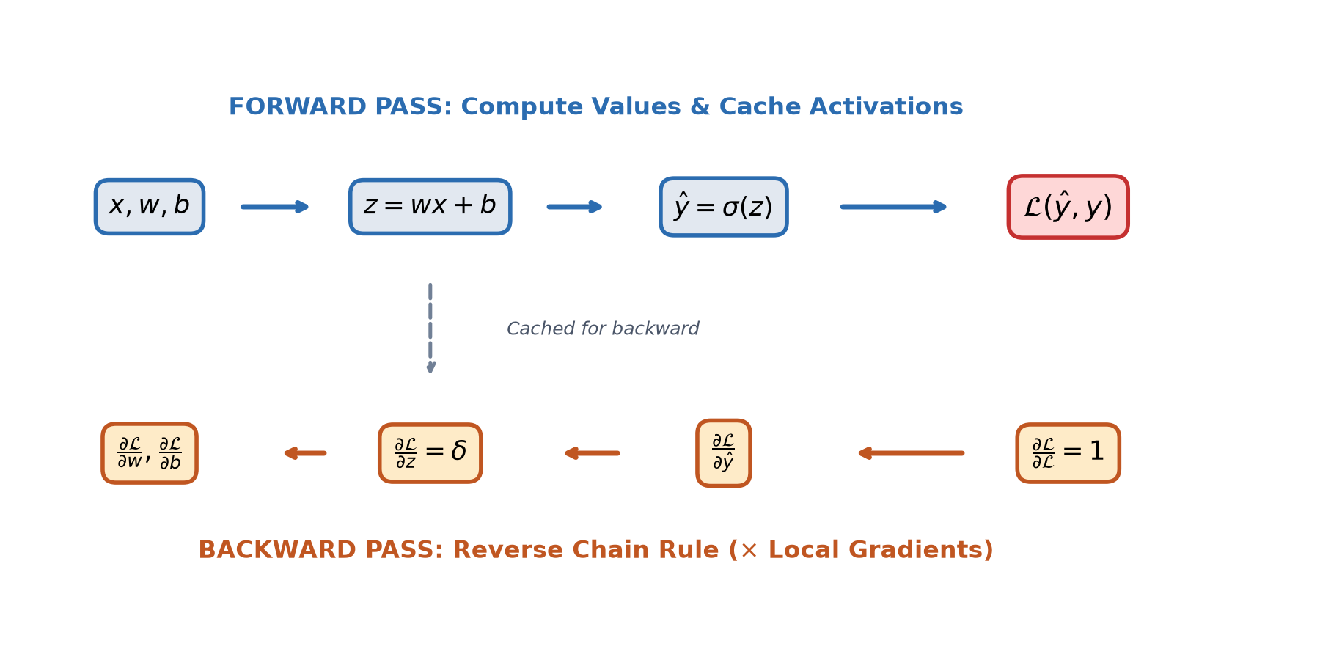
Computational Graphs: Forward vs Backward
SE-801: Lecture 6 (v2 Slides) | Slide 4 of 42
• Every mathematical expression in PyTorch is represented as a directed acyclic graph (DAG).
• Forward pass: Computes output activations and evaluates the objective loss scalar.
• Backward pass: Reverses direction, propagating gradients via local chain rules.
• Crucial memory cost: Intermediate activations must be cached in memory during forward pass.

Slide 5
Scalar Example: Logistic Loss Computational Graph
SE-801: Lecture 6 (v2 Slides) | Slide 5 of 42
• Function: L = ln(1 + exp(-z)) where z = w*x + b.
• Intermediate nodes: z -> -z -> exp(-z) -> 1 + exp(-z) -> ln(·).
• Each node computes a local scalar derivative.
• PyTorch creates dynamic graphs during execution and frees intermediate nodes after backward().

Slide 6
The Scalar Chain Rule Trace
SE-801: Lecture 6 (v2 Slides) | Slide 6 of 42
• Forward evaluation (x=1.5, w=0.8, b=-0.4): z = 0.8, L = 0.3711.
• dL/dz = sigma(z) - 1 = 0.6900 - 1 = -0.3100.
• dL/dw = (dL/dz) * x = -0.3100 * 1.5 = -0.4650.
• dL/db = (dL/dz) * 1 = -0.3100.
• Autograd verification: PyTorch produces identical values to machine precision.

Slide 7
Moving to Vectorized Batch Computations
SE-801: Lecture 6 (v2 Slides) | Slide 7 of 42
• Training on single examples is slow and introduces high variance into gradient updates.
• In batch mode, N independent examples pass through the network simultaneously.
• Input X has shape [N, d_in]; Hidden preactivations Z1 have shape [N, d_h].
• Batch matrix operations leverage parallel tensor hardware.

Slide 8
Two-Layer MLP Forward Formulation
SE-801: Lecture 6 (v2 Slides) | Slide 8 of 42
• Z1 = X @ W1 + b1 [N, d_h]
• H1 = relu(Z1) [N, d_h]
• Z2 = H1 @ W2 + b2 [N, d_out]
• P = softmax(Z2) [N, d_out]

Slide 9
The Mean Cross-Entropy Loss Objective
SE-801: Lecture 6 (v2 Slides) | Slide 9 of 42
• Loss L = -(1/N) * sum_i ln(P_{i, y_i}).
• Log-sum-exp trick: Compute ln(sum(exp(z_j))) stably by subtracting max(z).
• Cross-entropy penalizes confident incorrect predictions with large error gradients.

Slide 10
Derivation: Output Layer Error Signal
SE-801: Lecture 6 (v2 Slides) | Slide 10 of 42
• Let error tensor Delta2 = dL / dZ2.
• For sample i and class k: dL/dZ2_{i,k} = (1/N) * (P_{i,k} - I(y_i == k)).
• Matrix form: Delta2 = (P - Y_onehot) / N [N, d_out].
• Intuition: The error signal is simply predicted probability minus truth, scaled by 1/N.

Slide 11
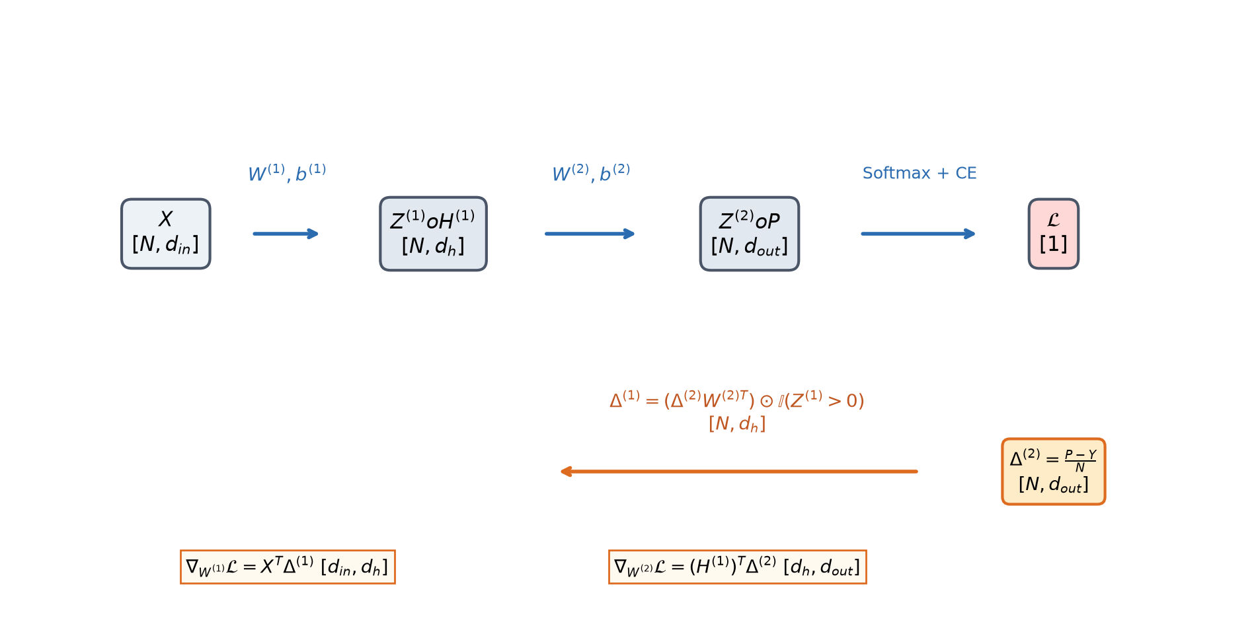
Derivation: Output Weight and Bias Gradients
SE-801: Lecture 6 (v2 Slides) | Slide 11 of 42
• dL/dW2 = (H1)^T @ Delta2 [d_h, d_out]
• dL/db2 = sum(Delta2, dim=0) [d_out]
• Check dimensions: [d_h, N] @ [N, d_out] = [d_h, d_out].
• The shape matches W2 exactly, summing outer products across all N samples.

Slide 12
Derivation: Hidden Layer Error Backpropagation
SE-801: Lecture 6 (v2 Slides) | Slide 12 of 42
• dL/dH1 = Delta2 @ (W2)^T [N, d_h]
• Delta1 = dL/dZ1 = (dL/dH1) * (Z1 > 0) [N, d_h]
• The Hadamard product (*) applies the local derivative of ReLU.
• Gradients pass through active units unattenuated; blocked completely if Z1 <= 0.

Slide 13
Derivation: First Layer Parameter Gradients
SE-801: Lecture 6 (v2 Slides) | Slide 13 of 42
• dL/dW1 = X^T @ Delta1 [d_in, d_h]
• dL/db1 = sum(Delta1, dim=0) [d_h]
• Dimension alignment: [d_in, N] @ [N, d_h] = [d_in, d_h].
• Matches the dimension of W1 precisely.

Slide 14
Mathematical Verification: Scratch vs Autograd
SE-801: Lecture 6 (v2 Slides) | Slide 14 of 42
• In our double-precision benchmark, we compared scratch formulas against autograd:
• Max error on W1 gradient: 1.21e-16
• Max error on W2 gradient: 1.94e-16
• Max error on bias vectors: < 1.11e-16
• Conclusion: Autograd performs exact symbolic chain rule arithmetic.

Slide 15
The Vanishing Gradient Problem
SE-801: Lecture 6 (v2 Slides) | Slide 15 of 42
• What happens when a network has 10 or 20 layers?
• The gradient at layer 1 is a product of L Jacobian matrices.
• If terms in this product are consistently smaller than 1, gradients decay exponentially.
• Early layers stop learning, remaining frozen near initial random weights.

Slide 16
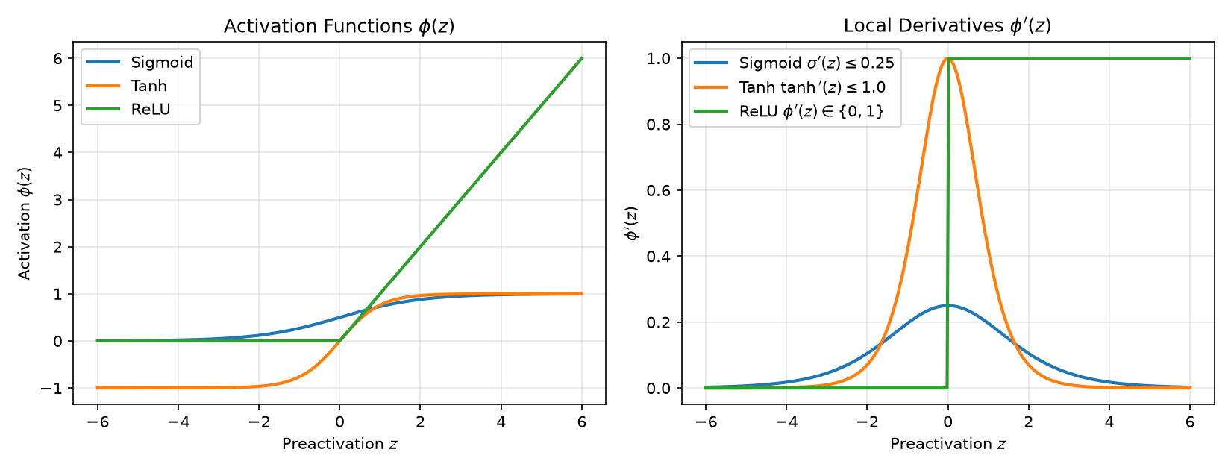
The Saturation Trap of Sigmoidal Activations
SE-801: Lecture 6 (v2 Slides) | Slide 16 of 42
• Sigmoid derivative: sigma prime(z) <= 0.25 (maximum at z=0).
• Tanh derivative: tanh prime(z) <= 1.0 (maximum at z=0).
• When preactivations |z| are large, derivatives vanish to zero.
• In a 10-layer Sigmoid network, gradient norm shrinks by (0.25)^10 ≈ 10^-6.

Slide 17
Why ReLU Changed Deep Learning
SE-801: Lecture 6 (v2 Slides) | Slide 17 of 42
• Rectified Linear Unit: relu(z) = max(0, z).
• Derivative: phi prime(z) = 1 for all z > 0.
• Advantage: No gradient saturation for positive activations.
• Dying ReLU risk: If a neuron always produces negative preactivations, its gradient is permanently 0.

Slide 18
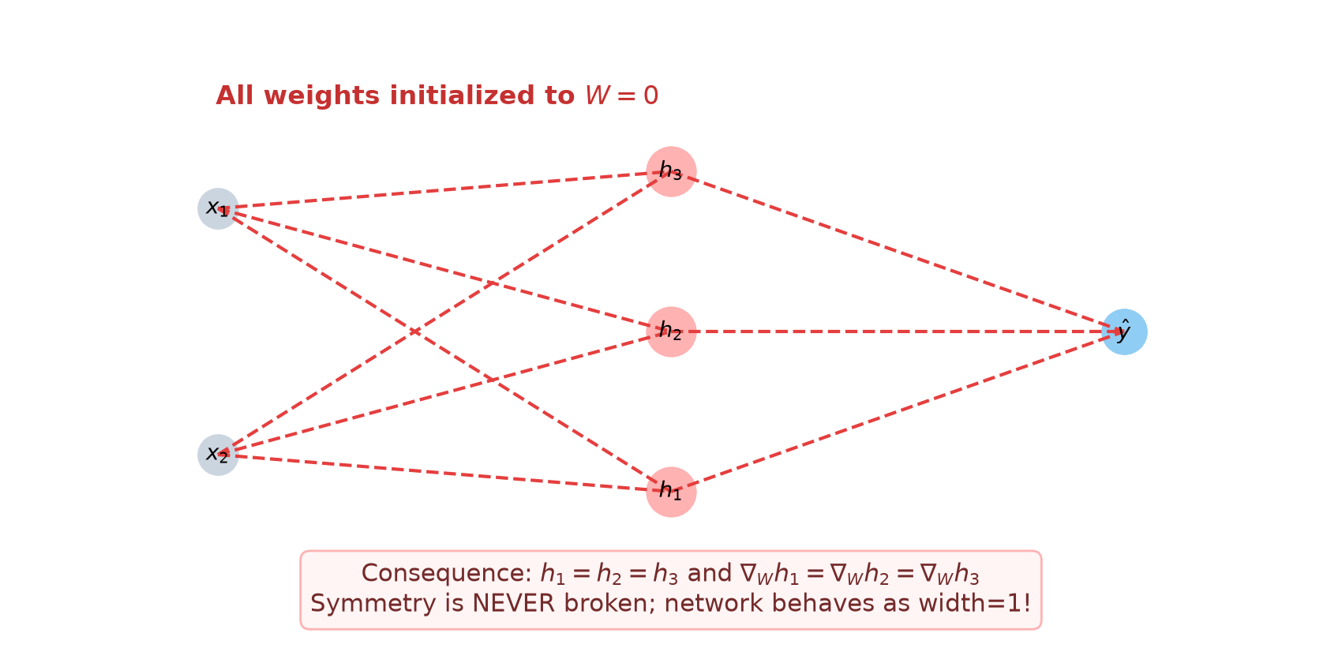
Symmetry Collapse Under Zero Initialization
SE-801: Lecture 6 (v2 Slides) | Slide 18 of 42
• What if all weights and biases are initialized to zero?
• In the forward pass, all hidden neurons compute identical values.
• In the backward pass, all hidden neurons receive identical gradients.
• Symmetry is never broken: regardless of width, the layer acts as 1 neuron.
• Rule: Weights must be initialized with random asymmetries.

Slide 19
Naive Random Initialization Pitfalls
SE-801: Lecture 6 (v2 Slides) | Slide 19 of 42
• Why not standard Gaussian N(0, 1)?
• For y = sum_j w_j * x_j with d_in = 256: Var(y) = 256 * 1 * 1 = 256.
• After 4 layers: variance explodes to 256^4 ≈ 4.3 * 10^9 (Exploding signals / NaNs).
• If std = 0.01: variance collapses to 0.025^4 ≈ 10^-7 (Signal starvation).

Slide 20
Coffee & Calculation Break
20 minutes
Resume with variance-preserving initialization and dropout.

Slide 21
The Principle of Variance Preservation
SE-801: Lecture 6 (v2 Slides) | Slide 21 of 42
• Goal: Keep activation variance stable forward, and gradient variance stable backward.
• Var(y^[l]) = Var(y^[l-1]) across all layers.
• For a linear layer with zero-mean inputs: Var(y) = d_in * Var(w) * Var(x).
• Forward stability requires Var(w) = 1 / d_in.
• Backward stability requires Var(w) = 1 / d_out.

Slide 22
Xavier / Glorot Initialization (2010)
SE-801: Lecture 6 (v2 Slides) | Slide 22 of 42
• Harmonic compromise for symmetric activations (Linear, Tanh):
• Var(w) = 2 / (d_in + d_out).
• Normal: W ~ N(0, 2 / (d_in + d_out)).
• Uniform: W ~ U(-sqrt(6/(d_in+d_out)), sqrt(6/(d_in+d_out))).
• Works well for Tanh, but allows variance to shrink under ReLU.

Slide 23
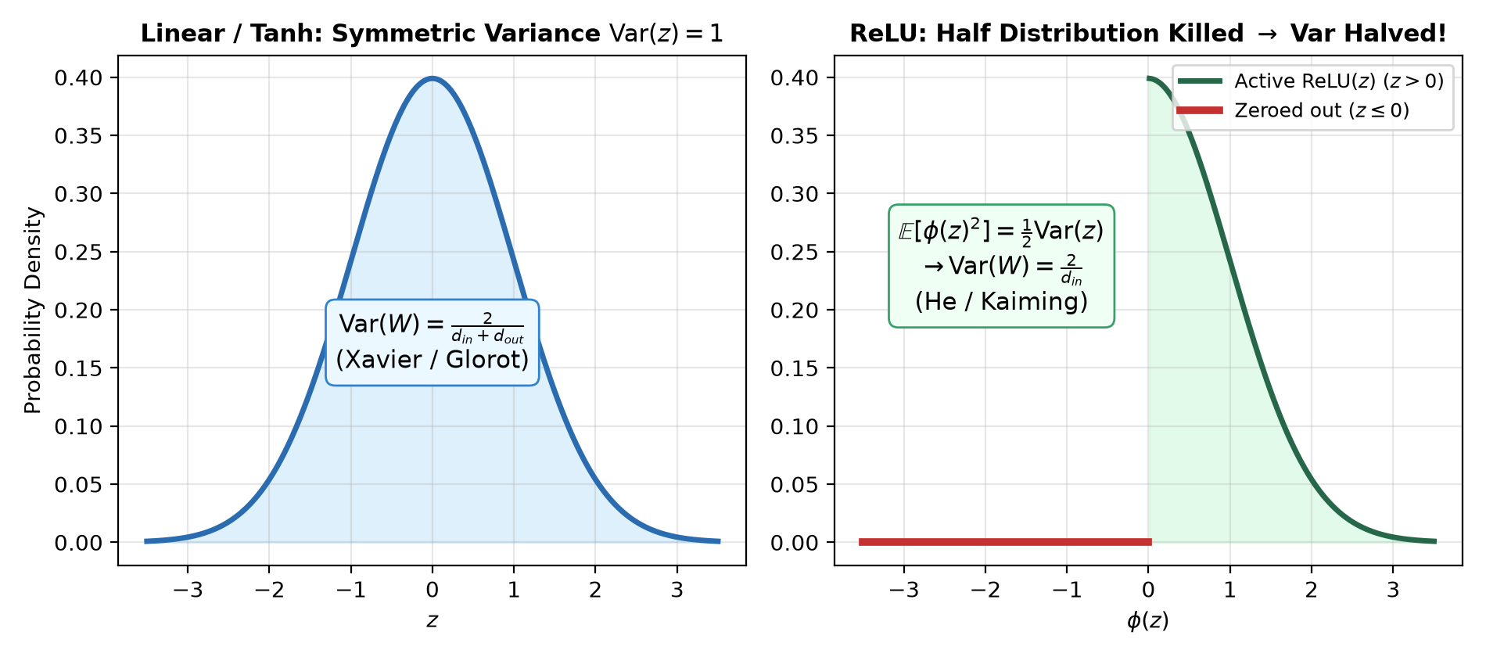
Why ReLU Requires Kaiming / He Initialization
SE-801: Lecture 6 (v2 Slides) | Slide 23 of 42
• ReLU zeroes out negative preactivations: relu(z) = max(0, z).
• For symmetric zero-mean preactivations, exactly half the distribution is removed.
• E[(relu(z))^2] = 0.5 * Var(z).
• Propagating through Linear + ReLU halves the signal variance!
• To compensate, weight variance must be doubled: Var(w) = 2 / d_in.

Slide 24
Kaiming (He) Normal Initialization (2015)
SE-801: Lecture 6 (v2 Slides) | Slide 24 of 42
• Formula: Var(w) = 2 / d_in, std = sqrt(2 / d_in).
• In PyTorch: nn.init.kaiming_normal_(linear.weight, nonlinearity="relu").
• nn.init.zeros_(linear.bias).
• This principled scaling enabled training of 50-layer and 100-layer deep networks.

Slide 25
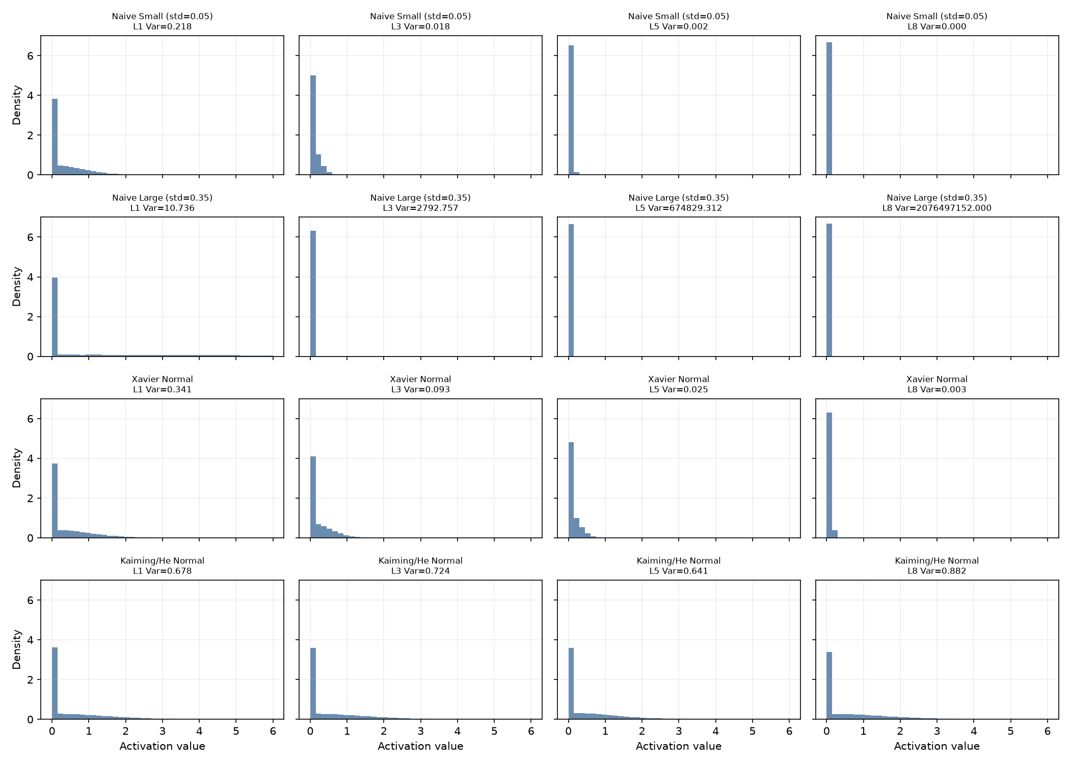
Empirical Verification: Variance Across 8 Layers
SE-801: Lecture 6 (v2 Slides) | Slide 25 of 42
• We evaluated activation distributions across 8 layers (width 256):
• Naive Small (0.05): Variance collapses to 0 by layer 3 (signal dead).
• Naive Large (0.35): Variance explodes to > 100.
• Xavier Normal: Variance steadily decays under ReLU.
• Kaiming Normal: Preserves stable variance across all 8 layers.

Slide 26
Regularization: Overfitting in Deep MLPs
SE-801: Lecture 6 (v2 Slides) | Slide 26 of 42
• As depth and width grow, parameter capacity expands rapidly.
• Overparameterized networks can memorize training noise.
• Weight decay (L2) shrinks weight norms.
• Dropout (Srivastava et al., 2014) regularizes by preventing feature co-adaptation.

Slide 27
The Dropout Intuition: Co-Adaptation Prevention
SE-801: Lecture 6 (v2 Slides) | Slide 27 of 42
• Without regularization, hidden units can form fragile interdependent relationships.
• Dropout randomly masks hidden units during each training iteration with probability p.
• Each unit must learn robust features that function alongside random subsets of peers.
• Equivalent to an implicit ensemble over 2^d subnetworks.

Slide 28
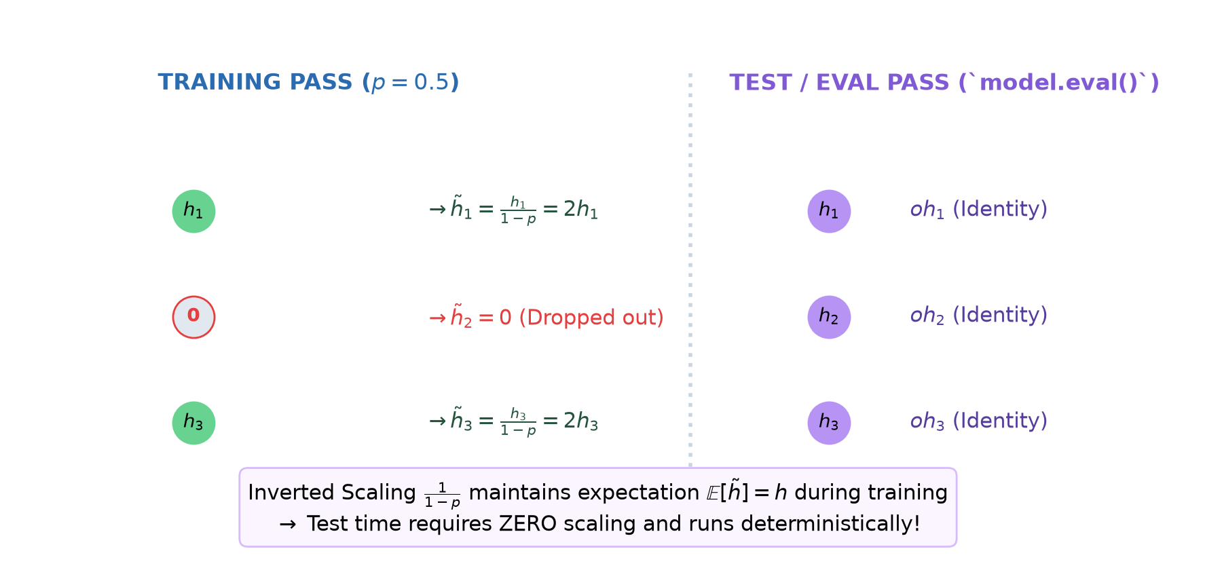
Inverted Dropout Formulation
SE-801: Lecture 6 (v2 Slides) | Slide 28 of 42
• During training: mask ~ Bernoulli(1 - p).
• h_train = (h * mask) / (1 - p).
• Expectation is preserved during training: E[h_train] = h.
• Consequence: Inference pass requires zero scaling — exactly identity: h_eval = h.

Slide 29
The PyTorch Training vs Evaluation Contract
SE-801: Lecture 6 (v2 Slides) | Slide 29 of 42
• Dropout behaves fundamentally differently in training vs inference:
• Training: Random Bernoulli masking with 1/(1-p) scaling.
• Evaluation: Pure identity mapping (deterministic).
• Must explicitly toggle: model.train() before training, model.eval() before testing.

Slide 30
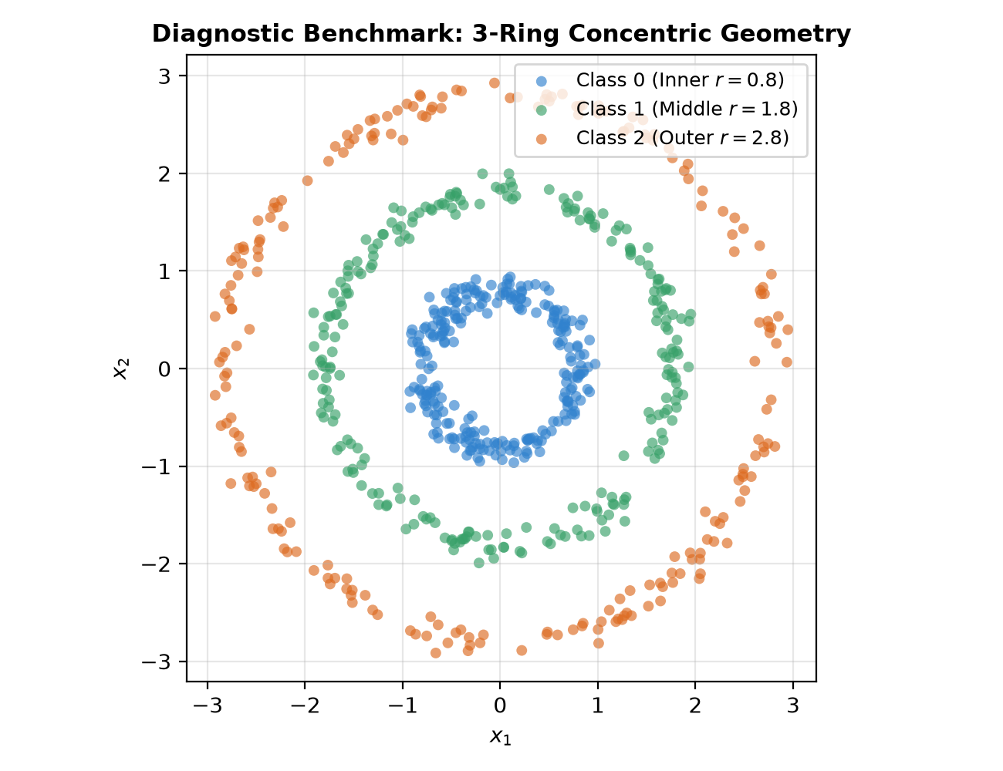
The Diagnostic Benchmark: 3-Ring Concentric Data
SE-801: Lecture 6 (v2 Slides) | Slide 30 of 42
• 2D nonlinear classification benchmark.
• 3 concentric circular rings (radii 0.8, 1.8, 2.8) with Gaussian jitter.
• 1,200 total samples: 720 train (60%), 240 val (20%), 240 test (240).
• Balanced classes: requires a nonlinear multi-layer architecture.

Slide 31
The DeepMLP Architecture
SE-801: Lecture 6 (v2 Slides) | Slide 31 of 42
• 4-layer fully connected network: 2 -> 64 -> 64 -> 64 -> 3.
• Total parameters: 8,707 trainable weights and biases.
• Controlled protocol: identical split, SGD optimizer, lr = 0.03, batch size 64, 80 epochs budget.

Slide 32
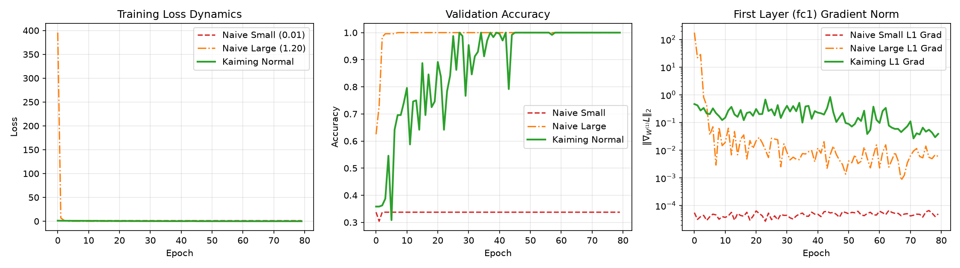
Diagnostic Comparison: Small vs Large vs Kaiming
SE-801: Lecture 6 (v2 Slides) | Slide 32 of 42
• Naive Small (0.01): Val accuracy stuck at 33.75% (chance).
• Naive Large (1.20): Rapid descent, reaches 100.0% val accuracy.
• Kaiming Normal: Stable descent, reaches 100.0% val accuracy with well-conditioned gradients.

Slide 33
Examining First-Layer Gradient Flow
SE-801: Lecture 6 (v2 Slides) | Slide 33 of 42
• Why did Naive Small fail?
• First-layer gradient norm ||dL/dW1|| remained stuck at 1.8e-05 throughout all 80 epochs.
• Downstream weights were too small to backpropagate error signals.
• Lesson: Training does not fail because SGD broke; it fails because gradients starved!

Slide 34
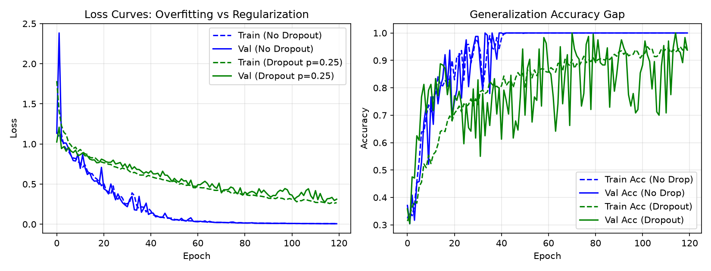
Regularization Results: With vs Without Dropout
SE-801: Lecture 6 (v2 Slides) | Slide 34 of 42
• No-Dropout (p=0): Train loss 0.0031, Test accuracy 100.0%.
• With Inverted Dropout (p=0.25): Train loss 0.2845, Test accuracy 94.17%.
• On clean low-dimensional synthetic data, dropout adds variance.
• On high-dimensional noisy data, dropout closes the train/val generalization gap.

Slide 35
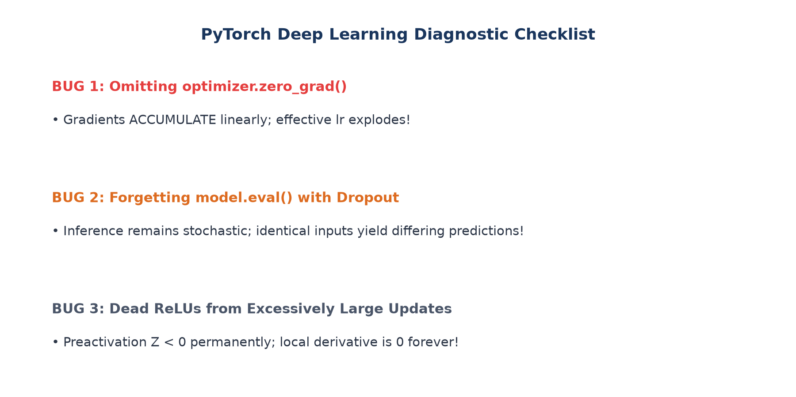
Diagnostic Debugging: Bug 1 — Missing zero_grad()
SE-801: Lecture 6 (v2 Slides) | Slide 35 of 42
• In PyTorch, loss.backward() accumulates gradients into .grad by default.
• If optimizer.zero_grad() is omitted, gradient norms grow linearly: 0.40 -> 0.79 -> 1.19 -> 1.59.
• Effective learning rate unintentionally explodes with every batch!

Slide 36
Diagnostic Debugging: Bug 2 — Forgetting model.eval()
SE-801: Lecture 6 (v2 Slides) | Slide 36 of 42
• If model.eval() is omitted during testing with dropout:
• Dropout remains active: passing the same test batch 3 times gives 3 different prediction vectors!
• Fix: Always set model.eval() and wrap with torch.no_grad().

Slide 37
Diagnostic Debugging: Bug 3 — Dead ReLUs
SE-801: Lecture 6 (v2 Slides) | Slide 37 of 42
• If a large negative update pushes preactivations negative for all inputs: Z < 0.
• Then relu prime(Z) = 0 for all samples, permanently freezing that neuron.
• Remedies: Lower learning rate, proper Kaiming initialization, or Leaky ReLU.

Slide 38
Final Frozen Test Set Evaluation
SE-801: Lecture 6 (v2 Slides) | Slide 38 of 42
• Naive Small Init (0.01): Test Loss = 1.1089, Test Acc = 26.67% (Failure).
• Naive Large Init (1.20): Test Loss = 0.0047, Test Acc = 100.00%.
• Kaiming Normal (No Drop): Test Loss = 0.0194, Test Acc = 100.00%.
• Kaiming Normal (Dropout 0.25): Test Loss = 0.3268, Test Acc = 94.17%.

Slide 39
Summary of Practical Deep Learning Rules
SE-801: Lecture 6 (v2 Slides) | Slide 39 of 42
• 1. Always use Kaiming initialization for ReLU networks (or Xavier for Tanh).
• 2. Never initialize weights to constant values or zeros.
• 3. Always call optimizer.zero_grad() before loss.backward().
• 4. Always toggle between model.train() and model.eval().
• 5. Monitor gradient norms across layers when deep models fail to train.

Slide 40
Looking Ahead: Week 7 Optimization Algorithms
SE-801: Lecture 6 (v2 Slides) | Slide 40 of 42
• Today we fixed gradient propagation and initialization.
• Next week: Optimizers beyond basic SGD (Momentum, RMSprop, Adam).
• Learning rate schedules and optimization paths across complex loss landscapes.

Slide 41
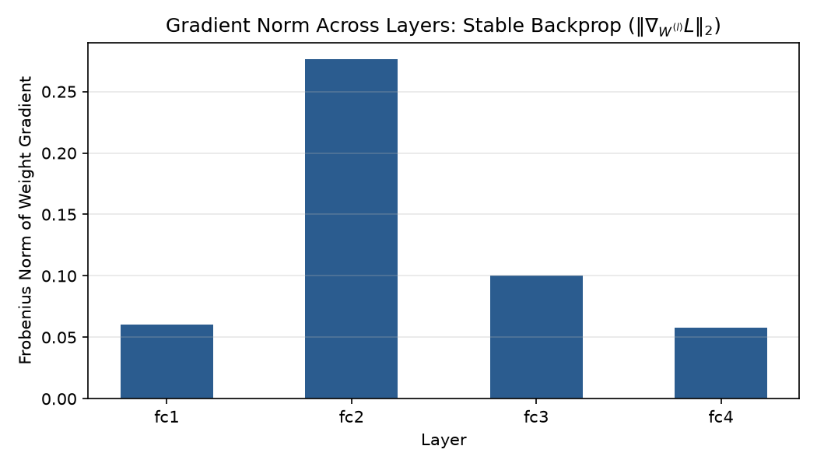
Reserve: Layer-by-Layer Gradient Flow Bar Chart
SE-801: Lecture 6 (v2 Slides) | Slide 41 of 42
• Healthy backpropagation maintains balanced gradient norms across all layers.
• Kaiming initialization provides balanced gradient flow from fc4 back to fc1.

Slide 42
Reserve: Leaky ReLU and Parametric ReLU (PReLU)
SE-801: Lecture 6 (v2 Slides) | Slide 42 of 42
• Leaky ReLU: max(alpha * z, z) where alpha ≈ 0.01.
• Provides small nonzero gradient (alpha) when z <= 0, preventing dead neurons.
• PReLU: Treats alpha as a learnable parameter updated via backpropagation.

