Slide 1
SE-801 Artificial Neural Networks
Convolutional neural-network
0 | 0 | 1 | 1 | 1
0 | 0 | 1 | 1 | 1
0 | 0 | 1 | 1 | 1
0 | 0 | 1 | 1 | 1
0 | 0 | 1 | 1 | 1
fundamentals
Local structure, shared parameters, and controlled evidence
local pattern
Lecture 10 Dr. Muhammad Farrukh Qureshi PNEC, NUST

Slide 2
Learning outcomes
Compute a two-dimensional cross-correlation by hand
Calculate output shapes and trainable parameters
Trace tensors through a compact CNN
Explain locality, parameter sharing, and translation structure
Evaluate a CNN against a controlled baseline
SE-801 | Lecture 10 | 2
Convolutional neural-network fundamentals

Slide 3
The learning system remains unchanged
data
model
logits
loss
gradient
update
evaluation
The model changes. The scientific chain does not.
SE-801 | Lecture 10 | 3
Convolutional neural-network fundamentals

Slide 4
Images have spatial structure
0 | 0 | 0 | 0 | 1 | 0 | 0 | 0
0 | 0 | 0 | 0 | 1 | 0 | 0 | 0
1 | 1 | 1 | 1 | 1 | 1 | 1 | 1
0 | 0 | 0 | 0 | 1 | 0 | 0 | 0
0 | 0 | 0 | 0 | 1 | 0 | 0 | 0
0 | 0 | 0 | 0 | 1 | 0 | 0 | 0
0 | 0 | 0 | 0 | 1 | 0 | 0 | 0
0 | 0 | 0 | 0 | 1 | 0 | 0 | 0
Nearby pixels often describe the same local pattern
A useful pattern can occur at many positions
Channels carry aligned measurements at each location
Flattening discards the explicit neighbourhood structure
H × W neighbourhoods remain explicit
SE-801 | Lecture 10 | 4
Convolutional neural-network fundamentals

Slide 5
A dense layer scales with image area
Input: 224 × 224 × 3 = 150,528 values
Dense output: 1,000 units
Weights alone: 150,528,000
The layer learns separate weights for every location
SE-801 | Lecture 10 | 5
Convolutional neural-network fundamentals

Slide 6
Locality and parameter sharing
0 | 0 | 0 | 0 | 0 | 0 | 0
0 | 0 | 0 | 0 | 0 | 0 | 0
0 | 0 | 1 | 1 | 1 | 0 | 0
0 | 0 | 1 | 1 | 1 | 0 | 0
0 | 0 | 1 | 1 | 1 | 0 | 0
0 | 0 | 0 | 0 | 0 | 0 | 0
0 | 0 | 0 | 0 | 0 | 0 | 0
A small kernel reads one neighbourhood at a time
The same kernel is reused at every valid location
Each output value measures local agreement with that kernel
3 × 3 kernel
SE-801 | Lecture 10 | 6
Convolutional neural-network fundamentals

Slide 7
Two-dimensional cross-correlation
Place the kernel over one input patch
0 | 0 | 1
0 | 1 | 1
0 | 1 | 1
1 | -1
1 | -1
one output
×
sum
Multiply corresponding entries
Sum the products to produce one output value
Move the kernel and repeat
SE-801 | Lecture 10 | 7
Convolutional neural-network fundamentals

Slide 8
Student calculation: one output value
0 | 0
0 | 1
1 | -1
1 | -1
×
= ?
Write all four products before summing
SE-801 | Lecture 10 | 8
Convolutional neural-network fundamentals

Slide 9
One complete cross-correlation
0 | 0 | 1 | 1 | 1
0 | 0 | 1 | 1 | 1
0 | 0 | 1 | 1 | 1
0 | 0 | 1 | 1 | 1
0 | 0 | 1 | 1 | 1
0 | -2 | 0 | 0
0 | -2 | 0 | 0
0 | -2 | 0 | 0
0 | -2 | 0 | 0
1 | -1
1 | -1
manual result = F.conv2d result
kernel
input
output
SE-801 | Lecture 10 | 9
Convolutional neural-network fundamentals

Slide 10
The kernel values are learned parameters
A hand-designed edge kernel demonstrates the operation
A CNN learns kernels from the task loss
Backpropagation accumulates evidence from every location where a shared kernel was used
SE-801 | Lecture 10 | 10
Convolutional neural-network fundamentals

Slide 11
Output size for one spatial dimension
nₒᵤₜ = floor((n + 2p − d(k − 1) − 1) / s) + 1
n: input size k: kernel size
p: padding s: stride d: dilation
SE-801 | Lecture 10 | 11
Convolutional neural-network fundamentals

Slide 12
Student calculation: four output sizes
1 | 28, kernel 3, padding 0, stride 1 | ?
2 | 28, kernel 3, padding 1, stride 1 | ?
3 | 28, kernel 5, padding 2, stride 2 | ?
4 | 16, kernel 3, padding 1, stride 2 | ?
SE-801 | Lecture 10 | 12
Convolutional neural-network fundamentals

Slide 13
Output-size answers
26
28
14
8
Substitute before simplifying
SE-801 | Lecture 10 | 13
Convolutional neural-network fundamentals

Slide 14
Padding controls boundary treatment
border values 1
border values 3
border values 2
border values 4
Without padding, border pixels participate in fewer patches
Padding can preserve spatial size
Padding values become part of the model's boundary assumption
SE-801 | Lecture 10 | 14
Convolutional neural-network fundamentals

Slide 15
Stride controls sampling density
sampled positions 1
sampled positions 3
sampled positions 2
sampled positions 4
Stride 1 evaluates neighbouring kernel positions
Larger stride reduces spatial resolution
Downsampling can lower compute but may discard small features
SE-801 | Lecture 10 | 15
Convolutional neural-network fundamentals

Slide 16
Channels change the kernel shape
channel mixing 1
channel mixing 3
channel mixing 2
channel mixing 4
Input tensor: batch × input channels × height × width
One output channel uses one kernel slice per input channel
The channel responses are summed before adding one bias
Multiple output channels learn different feature maps
SE-801 | Lecture 10 | 16
Convolutional neural-network fundamentals

Slide 17
Student calculation: multichannel output
CALCULATE
Input shape: [8, 3, 32, 32]
Layer: Conv2d(3, 16, kernel_size=3, padding=1)
Find the output shape
Find the number of trainable parameters
Show shapes and substitutions, not only final numbers
SE-801 | Lecture 10 | 17
Convolutional neural-network fundamentals

Slide 18
Convolution parameter count
parameters = C_out × (C_in × kH × kW + 1)
weights = output channels × input channels × kernel height × kernel width
biases = output channels when bias is enabled
Spatial input size changes compute and activation memory, not the kernel parameter count
SE-801 | Lecture 10 | 18
Convolutional neural-network fundamentals

Slide 19
Student calculation: two convolution layers
CALCULATE
Layer 1: Conv2d(1, 8, 3, padding=1)
Layer 2: Conv2d(8, 12, 3, padding=1)
Calculate each layer's parameters and the total
Show shapes and substitutions, not only final numbers
SE-801 | Lecture 10 | 19
Convolutional neural-network fundamentals

Slide 20
Translation equivariance
shifted feature map 1
shifted feature map 3
shifted feature map 2
shifted feature map 4
A shifted input tends to produce a shifted feature map
Shared kernels preserve the identity of a local detector
Boundary effects and downsampling make the relationship approximate in practical networks
SE-801 | Lecture 10 | 20
Convolutional neural-network fundamentals

Slide 21
Pooling and invariance
local summary 1
local summary 3
local summary 2
local summary 4
Max pooling retains the strongest value in each window
Average pooling retains the local mean
Pooling reduces resolution and can make small shifts less consequential
Aggressive pooling can remove information
SE-801 | Lecture 10 | 21
Convolutional neural-network fundamentals

Slide 22
Student calculation: max pooling
1 | 3 | 2 | 0
4 | 6 | 5 | 1
0 | 2 | 7 | 8
1 | 3 | 4 | 9
? | ?
? | ?
2 × 2 max pool, stride 2
SE-801 | Lecture 10 | 22
Convolutional neural-network fundamentals

Slide 23
Receptive field
input influence 1
input influence 3
input influence 2
input influence 4
A unit's receptive field is the input region that can affect it
Stacked local layers expand the receptive field
Stride increases the spacing between neighbouring receptive fields
SE-801 | Lecture 10 | 23
Convolutional neural-network fundamentals

Slide 24
Break
20 minutes
After the break: PyTorch, controlled evidence, and debugging

Slide 25
The `Conv2d` contract
Input: [N, C_in, H, W]
Weights: [C_out, C_in / groups, kH, kW]
Bias: [C_out]
Output: [N, C_out, H_out, W_out]
SE-801 | Lecture 10 | 25
Convolutional neural-network fundamentals

Slide 26
Manual and framework results agree
The loop implementation and `F.conv2d` use the same input and kernel
Maximum absolute difference: 0.0
Shape and numerical equivalence provide a focused implementation check
SE-801 | Lecture 10 | 26
Convolutional neural-network fundamentals

Slide 27
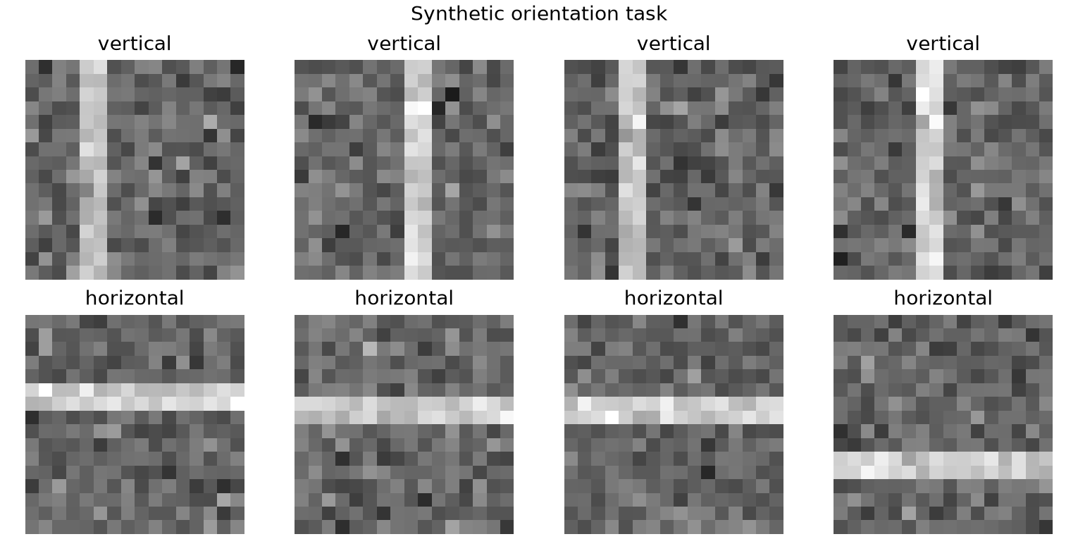
Synthetic orientation task
Class 0 contains a vertical bar
Class 1 contains a horizontal bar
Noise and intensity vary independently
Training positions and shifted test positions do not overlap
SE-801 | Lecture 10 | 27
Convolutional neural-network fundamentals

Slide 28
Controlled evaluation protocol
train
validation
shifted test
800
central positions
200
central positions
200
boundary positions
The test set answers the deployment-shift question
SE-801 | Lecture 10 | 28
Convolutional neural-network fundamentals

Slide 29
Two models with similar parameter budgets
MLP
flatten → 4 hidden → 2 logits
1,038 parameters
CNN
local kernels → global pooling → 2 logits
982 parameters
Both use the same split, loss, epoch budget, and checkpoint rule
SE-801 | Lecture 10 | 29
Convolutional neural-network fundamentals

Slide 30
Student calculation: CNN shape trace
1 | Input: [2, 1, 16, 16] | ?
2 | Conv2d(1, 8, 3, padding=1) | ?
3 | MaxPool2d(2) | ?
4 | Conv2d(8, 12, 3, padding=1) | ?
5 | AdaptiveAvgPool2d((1,1)), flatten, Linear(12,2) | ?
SE-801 | Lecture 10 | 30
Convolutional neural-network fundamentals

Slide 31
CNN shape trace
[2,1,16,16]
[2,8,16,16]
[2,8,8,8]
[2,12,8,8]
[2,12,1,1]
[2,2]
input conv pool conv global pool logits
SE-801 | Lecture 10 | 31
Convolutional neural-network fundamentals

Slide 32
Validation accuracy alone misses the shift
MLP
100%
CNN
100%
Predict performance at unseen boundary positions
SE-801 | Lecture 10 | 32
Convolutional neural-network fundamentals

Slide 33
The shifted test separates the models
The MLP fitted central locations but did not transfer to unseen boundary positions
The CNN reused local orientation detectors across the image
SE-801 | Lecture 10 | 33
Convolutional neural-network fundamentals

Slide 34
Learning curves support the diagnosis
Both validation curves converge
The validation distribution contains only central bar positions
A learning curve cannot reveal an unmeasured deployment shift
MLP
CNN
SE-801 | Lecture 10 | 34
Convolutional neural-network fundamentals

Slide 35
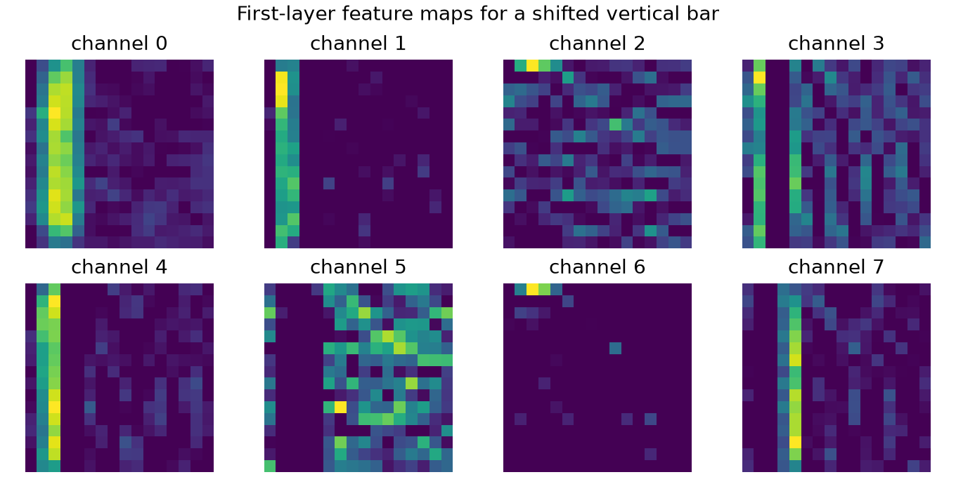
Feature maps retain spatial evidence
Different channels respond to different learned patterns
The activation remains indexed by spatial location
A feature map is evidence for interpretation, not a complete explanation
SE-801 | Lecture 10 | 35
Convolutional neural-network fundamentals

Slide 36
One-dimensional convolution uses the same logic
The kernel slides over time rather than height and width
Input channels can represent sensors, electrodes, or frequency bands
Local temporal patterns can be reused across a recording
Valid evaluation may require subject-wise or session-wise splits
SE-801 | Lecture 10 | 36
Convolutional neural-network fundamentals

Slide 37
Common implementation errors
Wrong axis order: NHWC supplied where NCHW is expected
Incorrect flatten size after convolution or pooling
Softmax applied before `CrossEntropyLoss`
Validation or test data used to tune the architecture
A claimed invariant property without a shifted evaluation set
SE-801 | Lecture 10 | 37
Convolutional neural-network fundamentals

Slide 38
Concept check
CALCULATE
Why does parameter sharing reduce parameters?
What is the output of Conv2d(3,16,3,padding=1) for [8,3,32,32]?
How many parameters does that layer contain?
How do equivariance and invariance differ?
What split would test translation transfer?
Show shapes and substitutions, not only final numbers
SE-801 | Lecture 10 | 38
Convolutional neural-network fundamentals

Slide 39
Lecture synthesis
Convolution encodes locality and parameter sharing
Padding, stride, channels, and pooling determine tensor shapes
Parameter counts depend on channel counts and kernel size
Controlled shifts test whether the intended inductive bias helps
SE-801 | Lecture 10 | 39
Convolutional neural-network fundamentals

Slide 40
Project checkpoint
State the structure your model assumes
Show every tensor shape through the first forward pass
Compare against a simpler baseline under the same split
Report parameters and one failure mode
SE-801 | Lecture 10 | 40
Convolutional neural-network fundamentals

Slide 41
Reserve: grouped and depthwise convolution
OPTIONAL
Groups restrict which input channels connect to which outputs
Depthwise convolution uses one spatial kernel per input channel
A pointwise 1 × 1 convolution can then mix channels
Efficiency gains depend on hardware and implementation
SE-801 | Lecture 10 | 41
Convolutional neural-network fundamentals

Slide 42
Reserve: general receptive-field recurrence
OPTIONAL
jump_l = jump_(l-1) × stride_l
receptive_l = receptive_(l-1) + (kernel_l - 1) × dilation_l × jump_(l-1)
Start with jump 1 and receptive field 1 at the input
SE-801 | Lecture 10 | 42
Convolutional neural-network fundamentals

