Slide 1
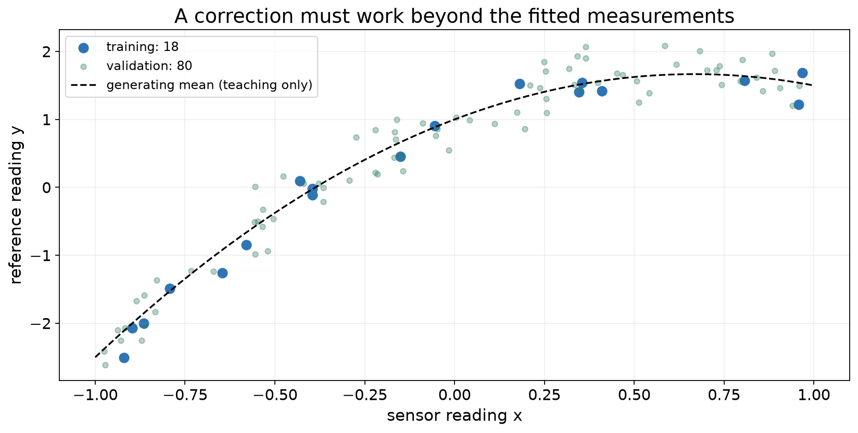
SE-801 · ARTIFICIAL NEURAL NETWORKS
Generalization
and regularization
When does a learned correction work on new data?
Lecture 3 · Dr. Muhammad Farrukh Qureshi · PNEC, NUST

Slide 2
LECTURE 3 / 2
OPENING PROBLEM
Learning objectives
01
Read training and validation evidence.
02
Derive and implement an L2-regularized update.
03
Choose a split that matches the intended use.
04
Report a baseline, variability, and the limits of a claim.
SE-801 · Artificial Neural Networks · Generalization and regularization
2

Slide 3
LECTURE 3 / 3
OPENING PROBLEM
From training code to scientific evidence
Define
→
Fit
→
Check code
→
Evaluate claim
Lecture 1: data → prediction → loss → gradient → update
Lecture 2: repeat the updates; implement and check
Lecture 3: evaluate the claim on appropriate new data
SE-801 · Artificial Neural Networks · Generalization and regularization
3

Slide 4
IN-CLASS CALCULATION
Model selection: a first calculation
Candidate A
Training residuals: 0, 0, 0 Validation residuals: 2, −2
Candidate B
Training residuals: 0.5, −0.5, 0 Validation residuals: 0.5, −0.5
Find all four MSEs. Which candidate should proceed?
SE-801 · Artificial Neural Networks · Generalization and regularization
4

Slide 5
WORKED EXAMPLE
Validation can reverse the ranking
A: training MSE = 0 validation MSE = 4
B: training MSE = 1/6 validation MSE = 0.25
Choose B using validation. A final test estimate is still missing.
SE-801 · Artificial Neural Networks · Generalization and regularization
5

Slide 6
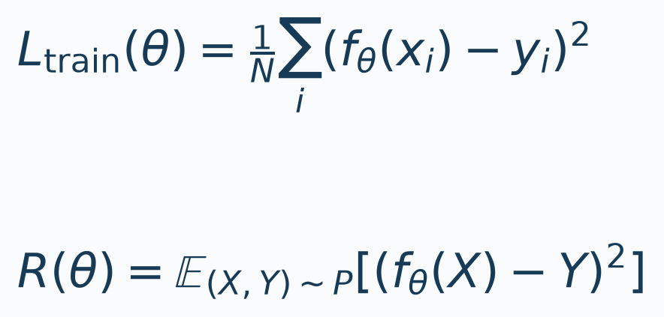
LECTURE 3 / 6
EVIDENCE AND POPULATION
Training loss and population risk
• The fitted sample is available. The target population must be named.
• A representative, independent test set estimates risk with uncertainty.
SE-801 · Artificial Neural Networks · Generalization and regularization
6

Slide 7
LECTURE 3 / 7
EVIDENCE AND POPULATION
Roles of training, validation, and test data
TRAIN
Fit model parameters and preprocessing
VALIDATE
Choose degree, λ, learning rate, and stopping
TEST
Evaluate the frozen pipeline once
SE-801 · Artificial Neural Networks · Generalization and regularization
7

Slide 8
LECTURE 3 / 8
EVIDENCE AND POPULATION
Sensor-calibration data
18 training · 80 validation · 200 sealed test observations
SE-801 · Artificial Neural Networks · Generalization and regularization
8

Slide 9
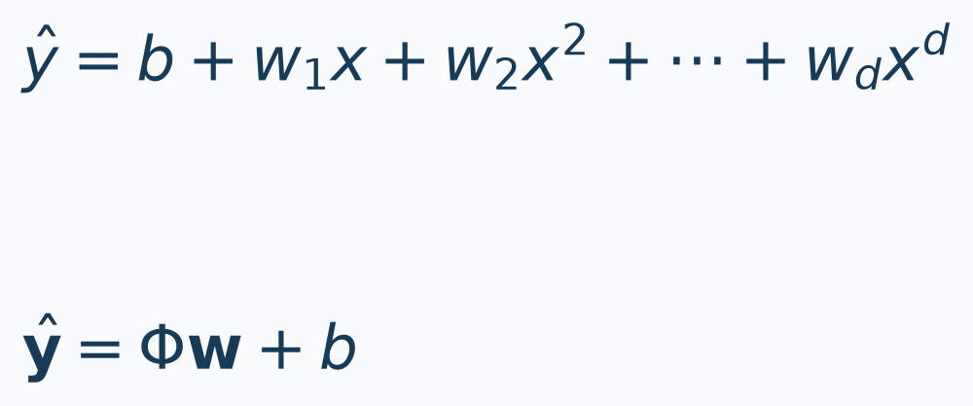
LECTURE 3 / 9
MODEL CAPACITY
Polynomial regression
• Nonlinear in the input x. Linear in the learned coefficients.
• Φ: [N,d] w: [d,1] b: [1] predictions: [N,1]
SE-801 · Artificial Neural Networks · Generalization and regularization
9

Slide 10
LECTURE 3 / 10
MODEL CAPACITY
Constructing polynomial features
• Degree 3: φ(x) = [x, x², x³]
• For x = 0: [0, 0, 0]
• For x = 2: [2, 4, 8]
• The intercept b is separate from these three features.
SE-801 · Artificial Neural Networks · Generalization and regularization
10

Slide 11
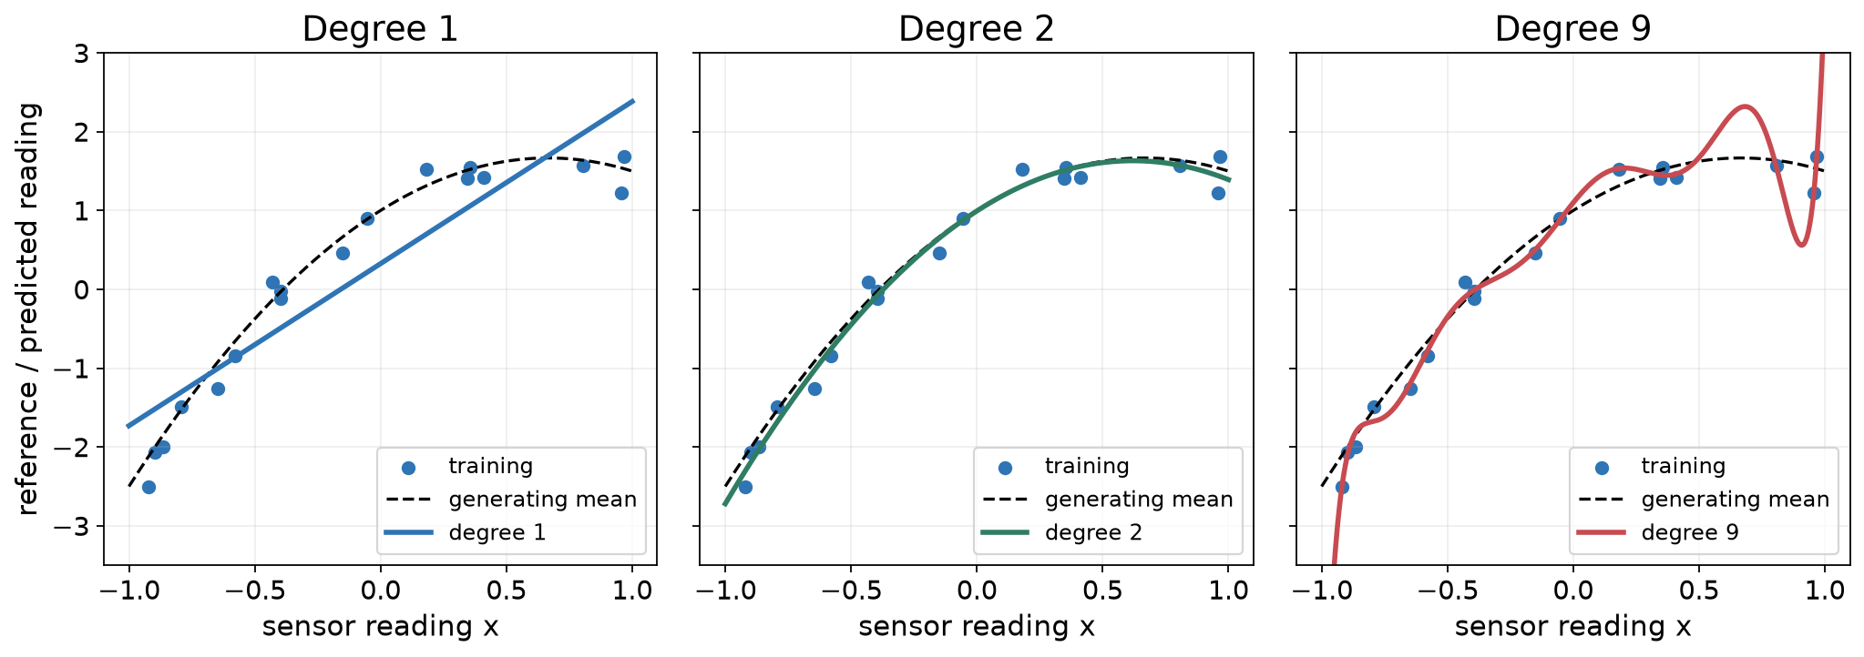
LECTURE 3 / 11
MODEL CAPACITY
Comparing polynomial degrees
SE-801 · Artificial Neural Networks · Generalization and regularization
11

Slide 12
LECTURE 3 / 12
MODEL CAPACITY
Training and validation results
Degree | Training MSE | Validation MSE
1 | 0.3263 | 0.3091
2 | 0.0259 | 0.0721
3 | 0.0256 | 0.0738
5 | 0.0252 | 0.0781
9 | 0.0082 | 0.2933
12 | 0.0051 | 0.1446
Selected degree: 2
SE-801 · Artificial Neural Networks · Generalization and regularization
12

Slide 13
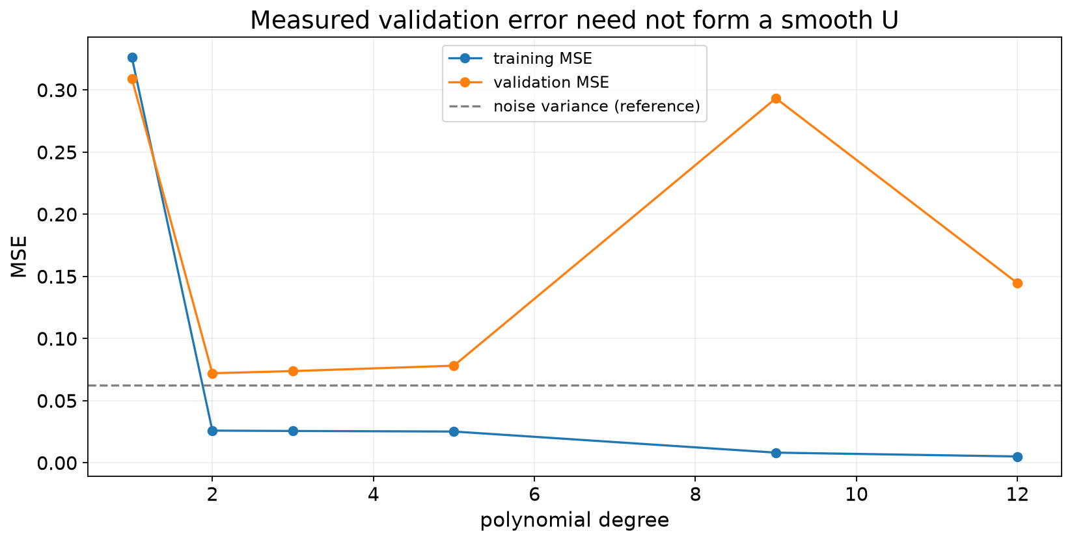
LECTURE 3 / 13
MODEL CAPACITY
Error versus model degree
SE-801 · Artificial Neural Networks · Generalization and regularization
13

Slide 14
LECTURE 3 / 14
MODEL CAPACITY
Interpreting error patterns
Both errors are high
Training is low; validation is worse
• Check optimization
• Check model capacity
• Inspect data and features
• Check overfitting
• Check population mismatch
• Audit leakage
SE-801 · Artificial Neural Networks · Generalization and regularization
14

Slide 15
LECTURE 3 / 15
MODEL SELECTION
Model-selection protocol
Define claim
→
Split
→
Fit preprocessing
→
Fit candidates
→
Validate
→
Freeze
→
Test
Define claim → split → fit preprocessing on training
Fit candidates on training → choose with validation
Freeze preprocessing + fitted model → evaluate test
SE-801 · Artificial Neural Networks · Generalization and regularization
15

Slide 16
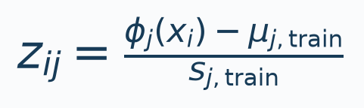
LECTURE 3 / 16
MODEL SELECTION
Fit preprocessing on training data
• Compute each feature's μ and s on training data.
• Apply the same transformation to validation and test.
• Equal coefficient penalties depend on feature units.
SE-801 · Artificial Neural Networks · Generalization and regularization
16

Slide 17
LECTURE 3 / 17
MODEL SELECTION
Validation is part of development
• Trying more recipes spends validation information.
• A lucky minimum can overstate the winner's performance.
• Keep test evidence outside the development loop.
SE-801 · Artificial Neural Networks · Generalization and regularization
17

Slide 18
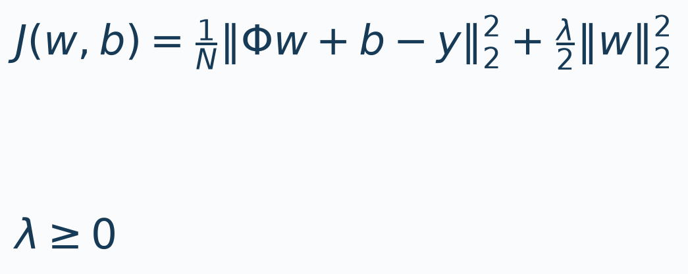
LECTURE 3 / 18
REGULARIZATION
L2 regularization
Keep the data loss from Lecture 2. Penalize w; leave b unpenalized.
SE-801 · Artificial Neural Networks · Generalization and regularization
18

Slide 19
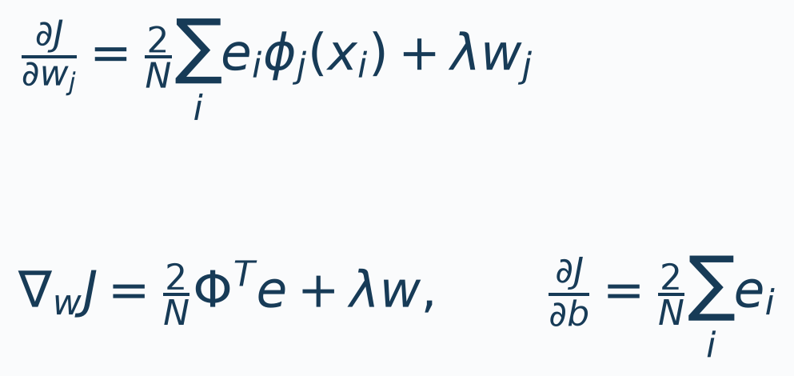
LECTURE 3 / 19
REGULARIZATION
Gradient of the regularized objective
Residual e = Φw + b − y. Compute both gradients at current parameters.
SE-801 · Artificial Neural Networks · Generalization and regularization
19

Slide 20
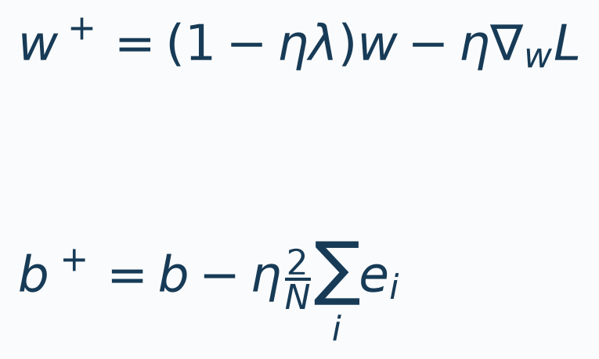
LECTURE 3 / 20
REGULARIZATION
The SGD update
For ordinary SGD without momentum:
SE-801 · Artificial Neural Networks · Generalization and regularization
20

Slide 21
IN-CLASS CALCULATION
Worked calculation
Φ = I₂ y = [1, 2]ᵀ
w = [2, −1]ᵀ b = 0.5
λ = 0.2 η = 0.1
Find residuals, MSE, penalty, gradients, and the new parameters.
Take five minutes. Explain your result to a partner.
SE-801 · Artificial Neural Networks · Generalization and regularization
21

Slide 22
WORKED EXAMPLE
Worked calculation: solution
e = [1.5, −2.5]ᵀ
MSE = 4.25 penalty = 0.50 J = 4.75
∇wJ = [1.9, −2.7]ᵀ ∂J/∂b = −1
w⁺ = [1.81, −0.73]ᵀ b⁺ = 0.6
SE-801 · Artificial Neural Networks · Generalization and regularization
22

Slide 23
BREAK
Break
Before continuing: if some regularization helps, must more help more?
23

Slide 24
LECTURE 3 / 24
IMPLEMENTATION AND EVALUATION
Implementing the derived update
• e = Z @ w + b − y
• grad_w = (2/N) * Z.T @ e + λ*w
• grad_b = 2 * mean(e)
• w = w − η*grad_w
• b = b − η*grad_b
SE-801 · Artificial Neural Networks · Generalization and regularization
24

Slide 25
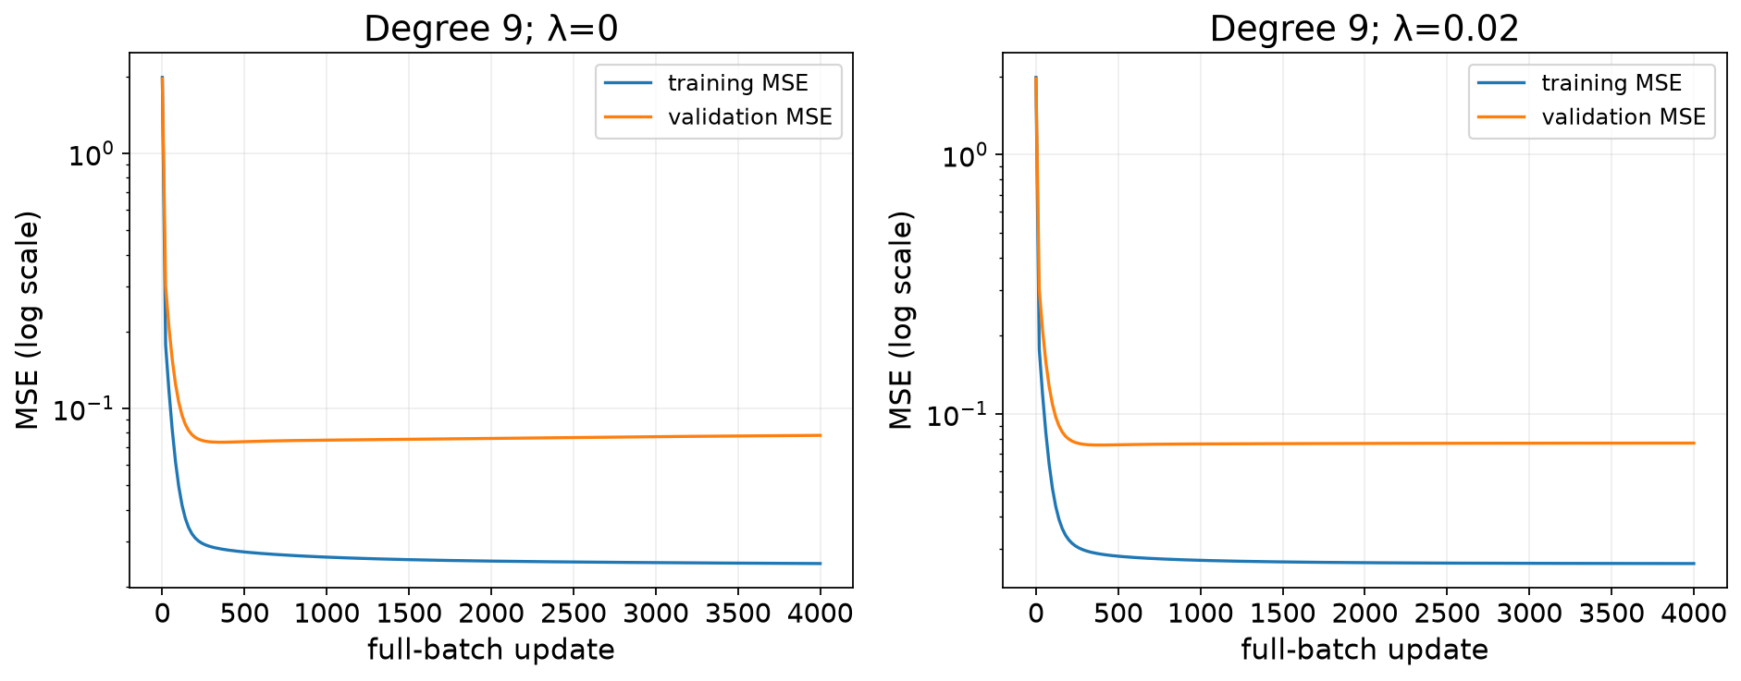
LECTURE 3 / 25
IMPLEMENTATION AND EVALUATION
Training and validation curves
SE-801 · Artificial Neural Networks · Generalization and regularization
25

Slide 26
LECTURE 3 / 26
IMPLEMENTATION AND EVALUATION
Compare the same metric across splits
Prediction metrics
Optimization objective
• Training MSE
• Validation MSE
• Same definition on both splits
• J = training MSE + penalty
• Used to fit parameters
• Do not plot as validation MSE
SE-801 · Artificial Neural Networks · Generalization and regularization
26

Slide 27
LECTURE 3 / 27
IMPLEMENTATION AND EVALUATION
PyTorch implementation
• optimizer = torch.optim.SGD([
• {"params": [net.weight], "weight_decay": lam},
• {"params": [net.bias], "weight_decay": 0.0},
• ], lr=eta, momentum=0.0)
• Backpropagate MSE only.
SE-801 · Artificial Neural Networks · Generalization and regularization
27

Slide 28
LECTURE 3 / 28
IMPLEMENTATION AND EVALUATION
Numerical equivalence check
METHOD 1
METHOD 2
METHOD 3
Explicit analytic gradient
Autograd with an explicit L2 penalty
SGD weight_decay on weights only
With matching precision, initialization, loss reduction, and updates, all three agree.
SE-801 · Artificial Neural Networks · Generalization and regularization
28

Slide 29
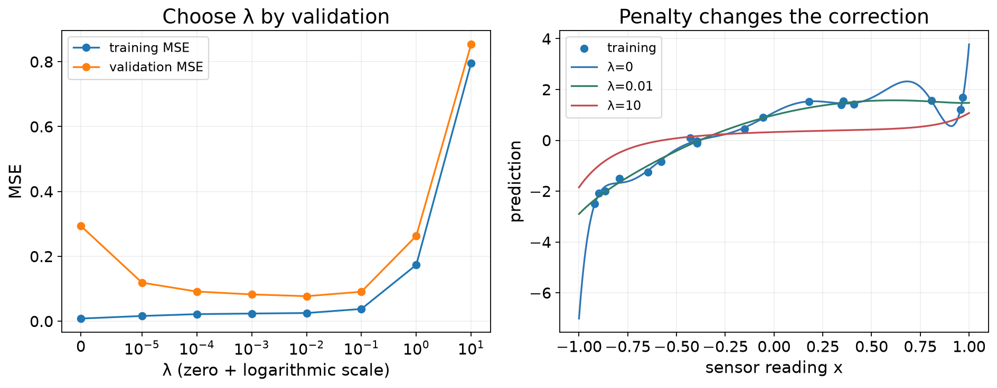
LECTURE 3 / 29
IMPLEMENTATION AND EVALUATION
Selecting the regularization strength
SE-801 · Artificial Neural Networks · Generalization and regularization
29

Slide 30
LECTURE 3 / 30
IMPLEMENTATION AND EVALUATION
Exercise: choose λ by validation
λ | Training MSE | Validation MSE
0 | 0.01 | 0.30
0.01 | 0.04 | 0.08
0.1 | 0.12 | 0.15
10 | 0.90 | 1.10
Select λ = 0.01: lowest validation MSE. Illustrative teaching values, not notebook outputs; strong regularization (λ = 10) underfits.
SE-801 · Artificial Neural Networks · Generalization and regularization
30

Slide 31
LECTURE 3 / 31
IMPLEMENTATION AND EVALUATION
Final evaluation on test data
SELECTED MODEL
INTERPRETATION
Degree-2 polynomial
• Baseline test MSE: 1.89395
• Population: fresh IID calibration readings
• Input range: x ∈ [−1, 1]
TEST MSE
TEST RMSE
0.08549
0.29238
This evidence does not establish performance on a new wearer.
SE-801 · Artificial Neural Networks · Generalization and regularization
31

Slide 32
LECTURE 3 / 32
IMPLEMENTATION AND EVALUATION
Baseline: predict the training mean
• Training targets [1, 2, 3] → constant prediction c = 2.
• Test targets [2, 4]: baseline MSE = ((2 − 2)² + (2 − 4)²) / 2 = 2, RMSE = √2.
• Computing c from the test targets would fit the baseline on the data meant to evaluate it.
• If the test result disappoints, report it. Further revisions start a new development cycle, and the old test becomes development evidence.
SE-801 · Artificial Neural Networks · Generalization and regularization
32

Slide 33
LECTURE 3 / 33
LEAKAGE AND DATA SPLITS
Preprocessing leakage
• Training readings: [0, 2] held-out reading: [10]
• Training mean = 1 pooled mean = 4
• Correct centred training readings: [−1, 1]
• Pooled-centred training readings: [−4, −2]
SE-801 · Artificial Neural Networks · Generalization and regularization
33

Slide 34
LECTURE 3 / 34
LEAKAGE AND DATA SPLITS
Match the split to deployment
Known wearers
New measurements
New wearers
Hold out complete subjects
New sessions
Hold out sessions and audit identities
Future use
Respect chronology and prediction horizon
SE-801 · Artificial Neural Networks · Generalization and regularization
34

Slide 35
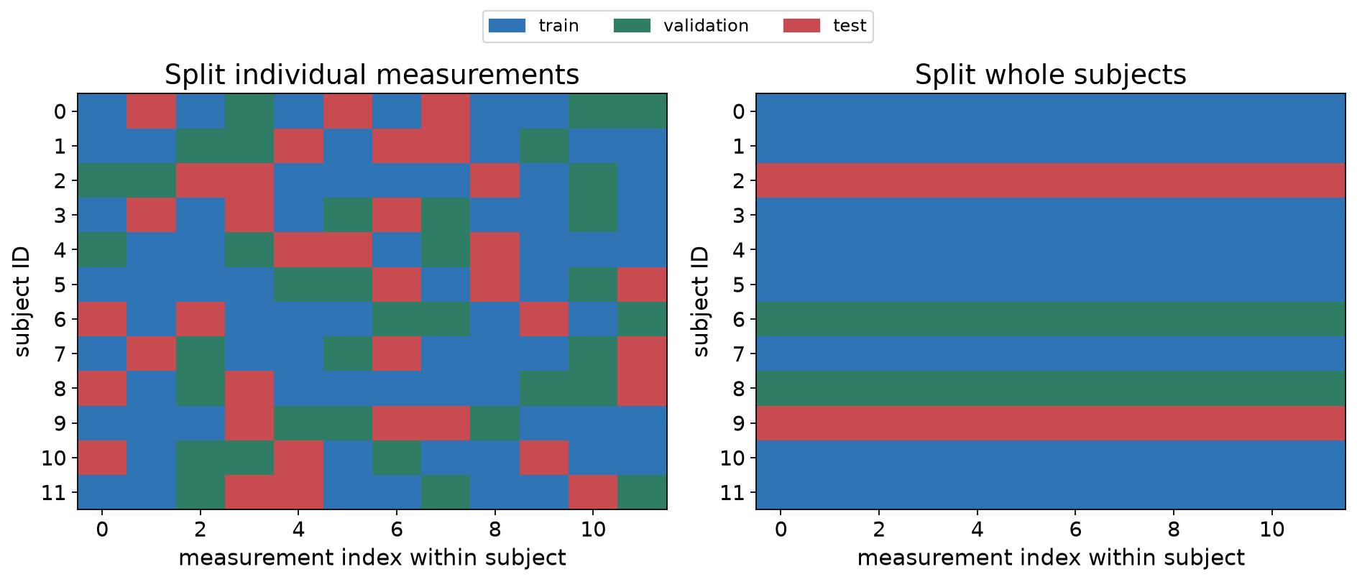
LECTURE 3 / 35
LEAKAGE AND DATA SPLITS
Random-row and grouped splits
SE-801 · Artificial Neural Networks · Generalization and regularization
35

Slide 36
LECTURE 3 / 36
LEAKAGE AND DATA SPLITS
Audit grouped splits
• Record train, validation, and test subject IDs.
• Check all three pairwise intersections are empty.
• Check every intended row belongs to exactly one split.
• Fit preprocessing using training subjects only.
SE-801 · Artificial Neural Networks · Generalization and regularization
36

Slide 37
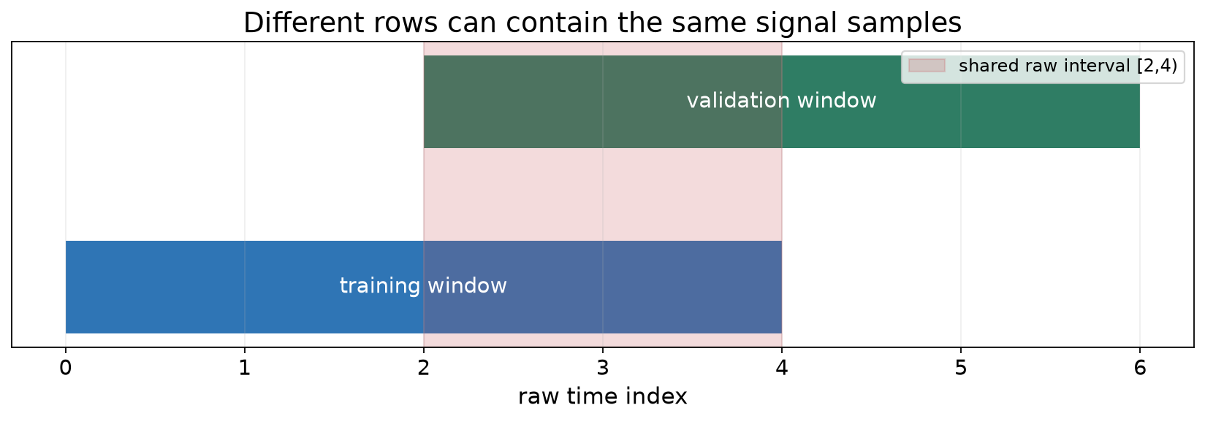
LECTURE 3 / 37
LEAKAGE AND DATA SPLITS
Overlapping windows
SE-801 · Artificial Neural Networks · Generalization and regularization
37

Slide 38
LECTURE 3 / 38
LEAKAGE AND DATA SPLITS
Split before constructing windows
• Split raw groups or time blocks before window extraction.
• Discard boundary-crossing windows.
• Choose a gap from input history, label horizon, and dependence.
• For new-person claims, keep every session of a person together.
SE-801 · Artificial Neural Networks · Generalization and regularization
38

Slide 39
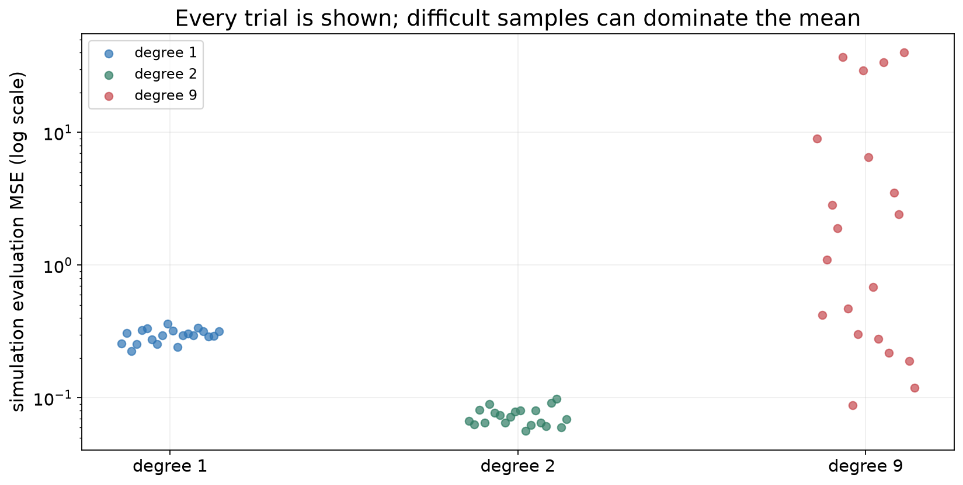
LECTURE 3 / 39
REPORTING UNCERTAINTY
Variation across repeated datasets
SE-801 · Artificial Neural Networks · Generalization and regularization
39

Slide 40
LECTURE 3 / 40
REPORTING UNCERTAINTY
Mean ± SD: state what was repeated
• Scores [1, 2, 3]: mean = 2; sample SD = 1 (squared deviations sum to 2, divided by n − 1 = 2).
• The SD describes variation. It is not a 95% interval.
• Initialization or minibatch seed varies → training randomness on fixed data.
• Independently sampled datasets vary → variation across simulated data draws.
• Held-out subjects vary → heterogeneity across evaluated subjects.
• Keep every run: rare failures can dominate mean ± SD. Do not choose the best seed.
SE-801 · Artificial Neural Networks · Generalization and regularization
40

Slide 41
LECTURE 3 / 41
REPORTING UNCERTAINTY
Report what varied
Spread across runs
Confidence interval
• Describe with mean and sample SD
• State what changed
• Report the number of runs
• Name the estimand
• Use the independent sampling unit
• State what uncertainty is excluded
SE-801 · Artificial Neural Networks · Generalization and regularization
41

Slide 42
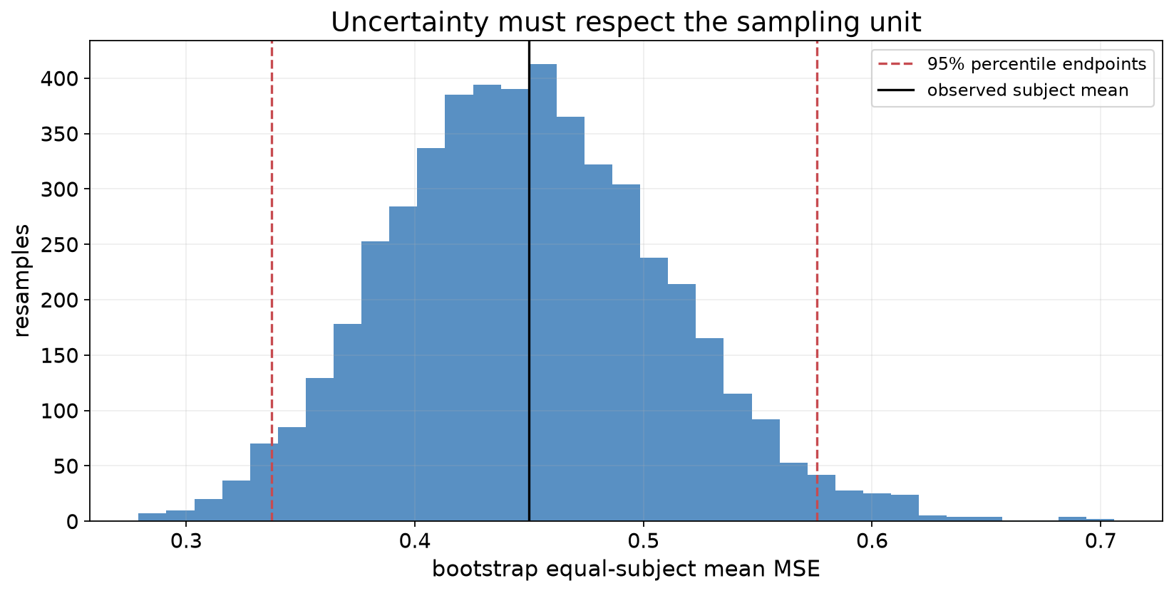
LECTURE 3 / 42
REPORTING UNCERTAINTY
Uncertainty across subjects
SE-801 · Artificial Neural Networks · Generalization and regularization
42

Slide 43
LECTURE 3 / 43
SYNTHESIS
Evaluation protocol
Define claim
→
Split
→
Fit
→
Validate
→
Freeze
→
Test
→
Report
Claim → split → baseline → fit
→ validate → freeze → test → report
A small score is meaningful only with its evaluation protocol.
SE-801 · Artificial Neural Networks · Generalization and regularization
43

Slide 44
LECTURE 3 / 44
SYNTHESIS
Week 3 project milestone
Teams of 2–3
• Prediction target
• Data access
• What counts as a new unit
• Proposed split
• Baseline
• Main technical risk
Submit three candidate areas
Choose one preferred candidate and explain feasibility.
Two-page proposal: Week 5 · Assignment 1: due Week 7
SE-801 · Artificial Neural Networks · Generalization and regularization
44

Slide 45
IN-CLASS CALCULATION
Exit ticket
1. Degree 9 wins on training MSE. What evidence remains?
2. w=2, data gradient=−0.4, λ=0.1, η=0.05: find w⁺.
3. Why can disjoint row IDs still leak information?
4. Do initialization seeds measure future-subject uncertainty?
Three minutes individually; then explain your reasoning.
SE-801 · Artificial Neural Networks · Generalization and regularization
45

Slide 46
LECTURE 3 / 46
SYNTHESIS
Reading and preparation
• D2L 3.6: Generalization · 3.7: Weight Decay
• Selected discussion from D2L 4.6–4.7
• Derive the L2 update; repeat the hand example with λ=0.
• Next: categorical targets, softmax, and cross-entropy.
SE-801 · Artificial Neural Networks · Generalization and regularization
46

Slide 47
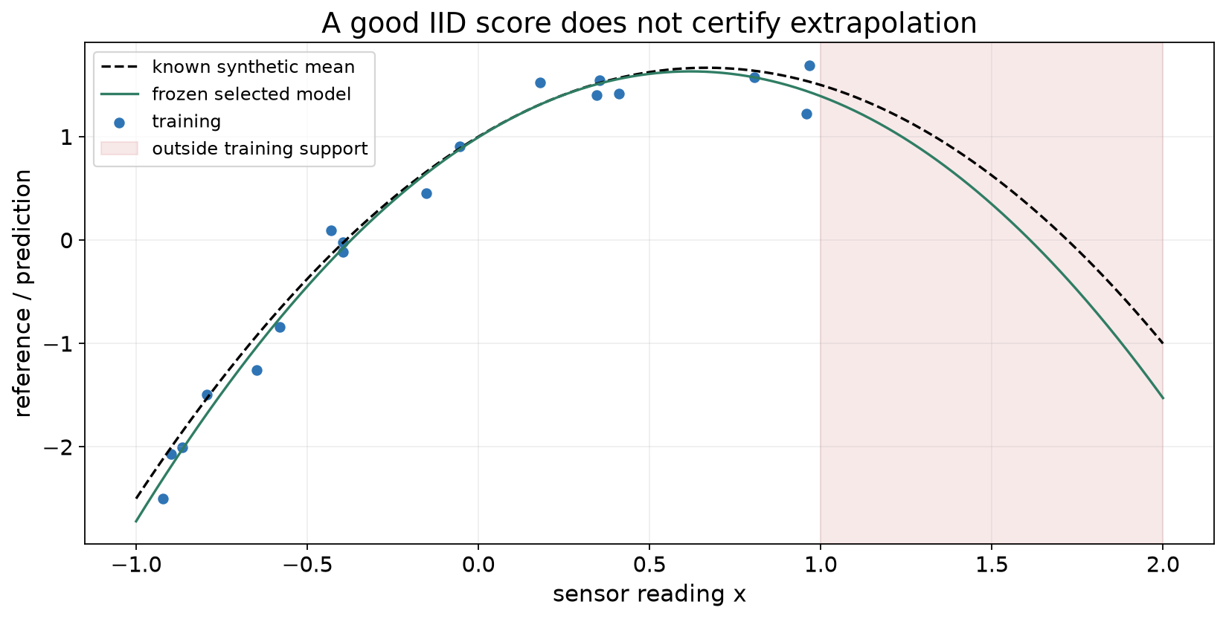
LECTURE 3 / 47
OPTIONAL RESERVE
Beyond the training range
SE-801 · Artificial Neural Networks · Generalization and regularization
47

Slide 48
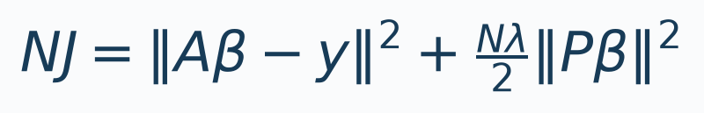
LECTURE 3 / 48
OPTIONAL RESERVE
Ridge-regression reference
• A = [1,Z], β = [b;w], P = [0,I]. Multiply J by N.
• Add penalty rows √(Nλ/2) P and zero targets.
• Solve the augmented least-squares problem without an inverse.
SE-801 · Artificial Neural Networks · Generalization and regularization
48

