Slide 1
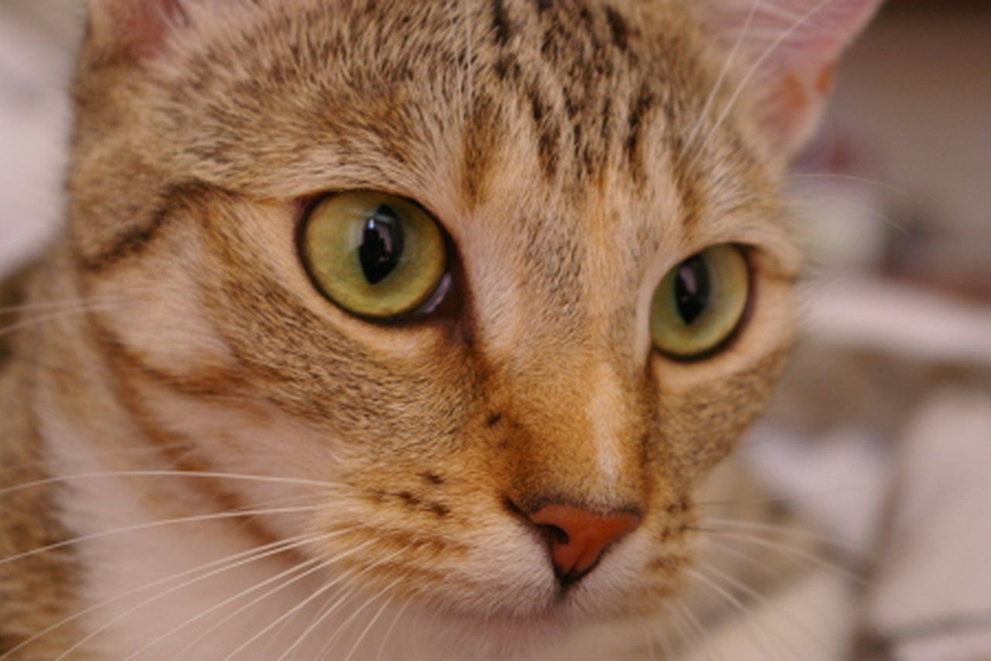
What do you see?
Notes:
Ask the audience before revealing the next slide.

Slide 2
Cat · Fur · Eyes · Whiskers…
2 / 68
Notes:
Human perception supplies semantic meaning; the next slides reveal numerical representation.

Slide 3

01 / IMAGE AS DATA
A photograph is a grid of pixels
Photograph
24 × 16 samples; nearest-neighbour enlargement
Zoom in: each cell is one pixel.
3 / 68
Notes:
A digital photograph is a rectangular array of pixel values.

Slide 4
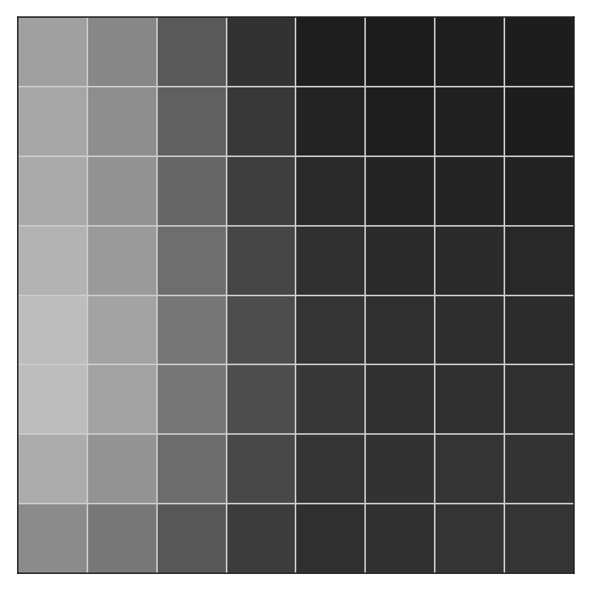
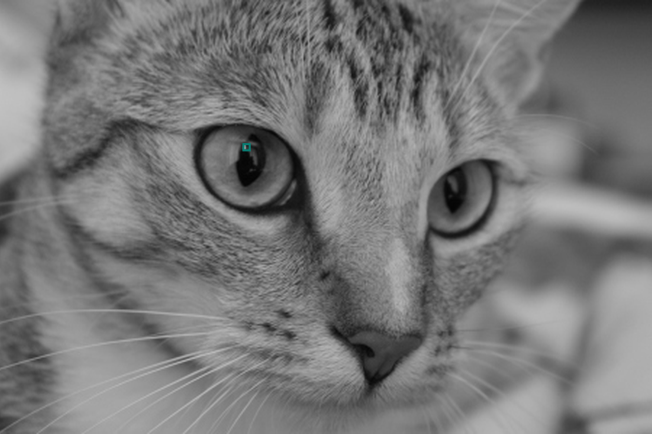
01 / IMAGE AS DATA
A small patch of the image
The same 8 × 8 pixel patch, shown three ways.
4 / 68
Notes:
The three grid slides deliberately remain separate for the presenter to merge. All numbers come from the same original 8x8 crop; coordinates are in evidence/classical.json.

Slide 5
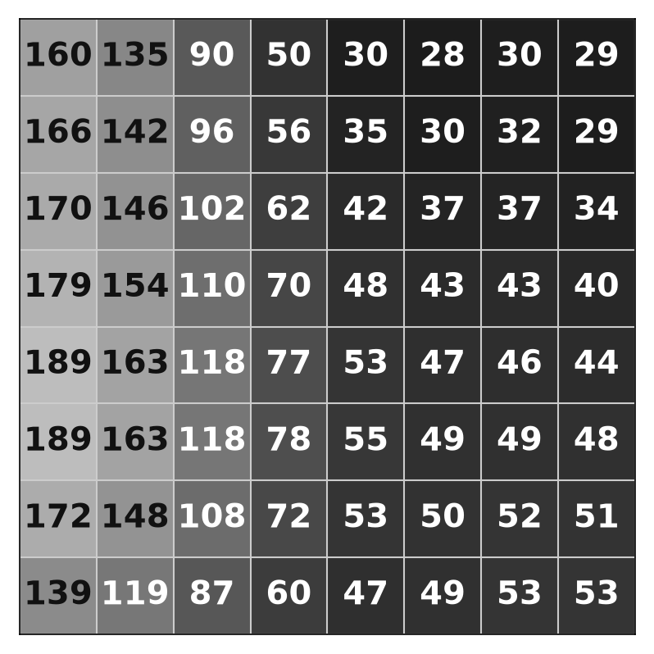
01 / IMAGE AS DATA
Each pixel has a brightness value
The same 8 × 8 pixel patch, shown three ways.
5 / 68
Notes:
The three grid slides deliberately remain separate for the presenter to merge. All numbers come from the same original 8x8 crop; coordinates are in evidence/classical.json.

Slide 6
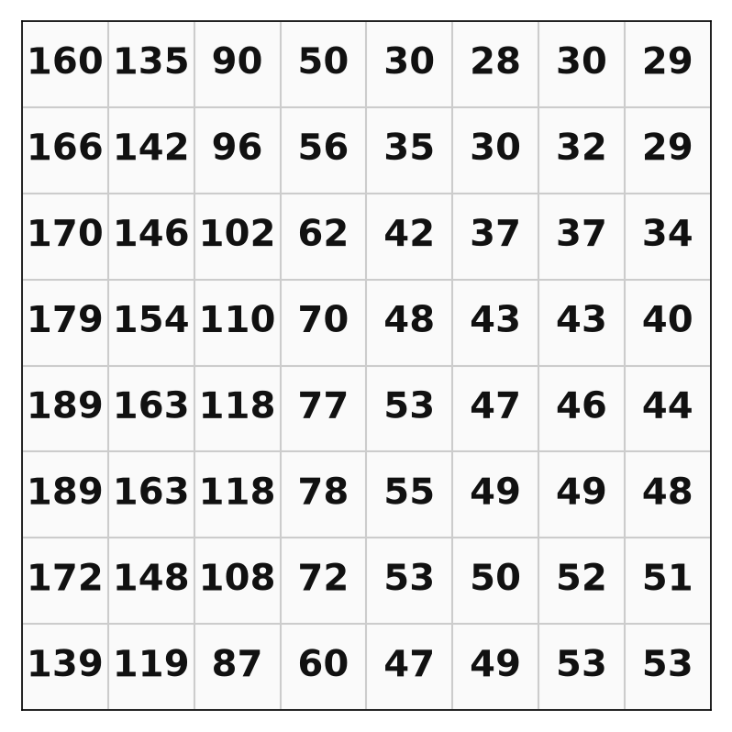
01 / IMAGE AS DATA
The image is a matrix of numbers
The same 8 × 8 pixel patch, shown three ways.
6 / 68
Notes:
The three grid slides deliberately remain separate for the presenter to merge. All numbers come from the same original 8x8 crop; coordinates are in evidence/classical.json.

Slide 7
01 / IMAGE AS DATA
0 is black. 255 is white.
8-bit grayscale has 256 possible intensity levels.
0
128
255
Black
Mid-grey
White
7 / 68
Notes:
Ask what pixel value would be white, black, mid-gray.

Slide 8



01 / IMAGE AS DATA
What changes when resolution changes?
Same photograph. Fewer samples. Less detail.
16 pixels wide
48 pixels wide
512 pixels wide
Coarse structure only
Recognizable outline
Fine visual details
8 / 68
Notes:
Optional: discuss pixels versus information; more pixels do not automatically mean better recognition.
Flex/optional — drop this slide first if time runs short.

Slide 9
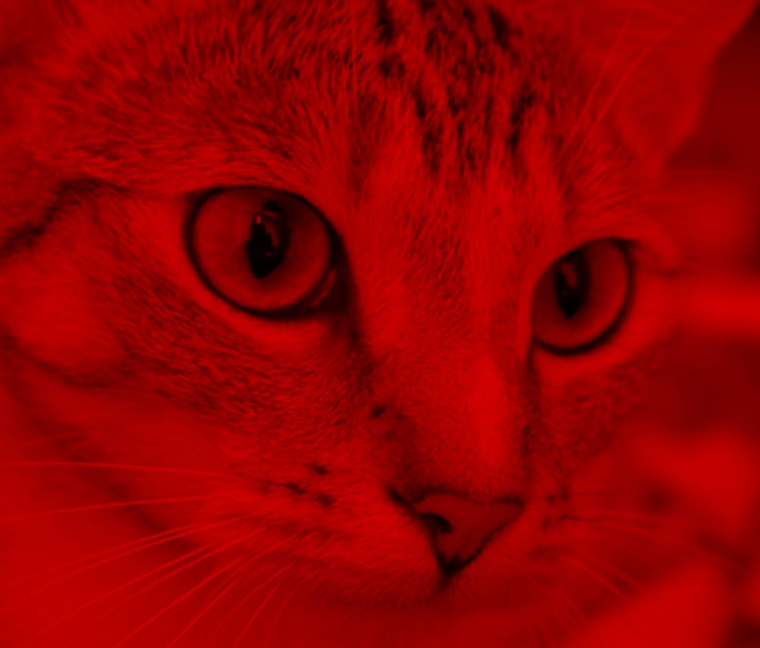
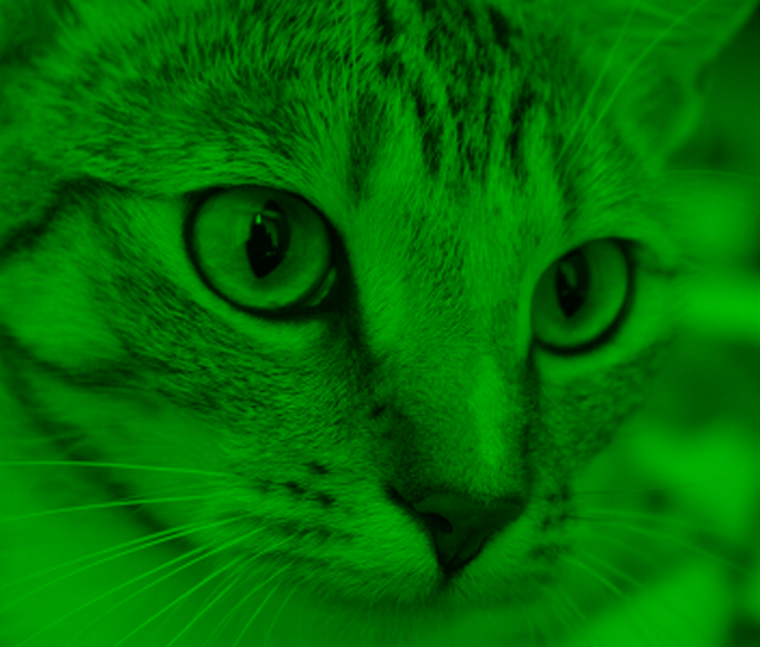
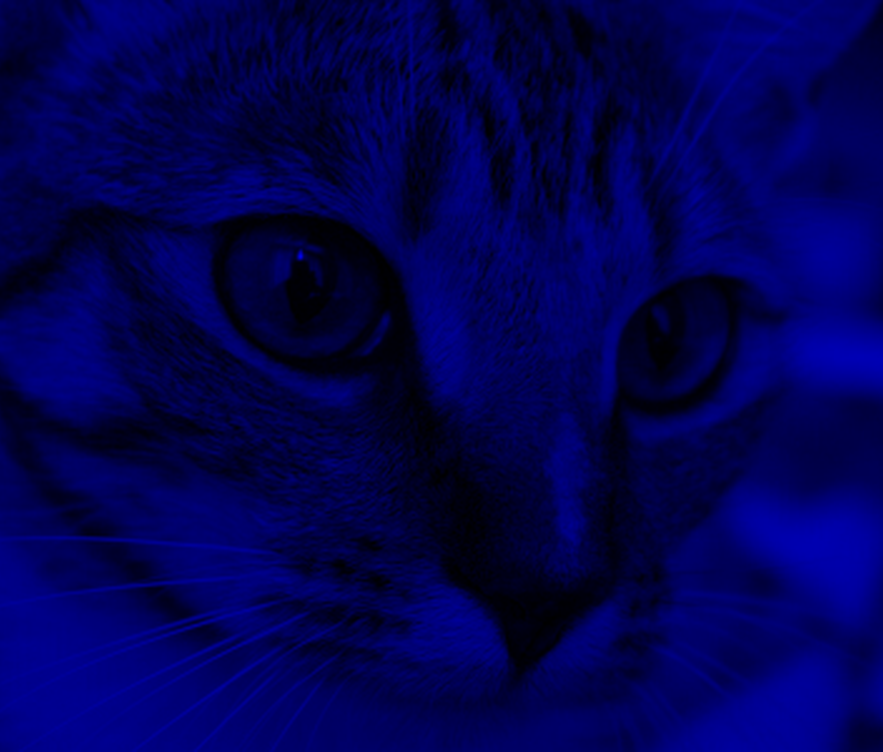
01 / IMAGE AS DATA
Colour = three channels, not one.
Red, green and blue intensities form one RGB image.
Red channel
Green channel
Blue channel
R intensity only
G intensity only
B intensity only
9 / 68
Notes:
RGB channels: each pixel stores three intensities, not an object label.

Slide 10
01 / IMAGE AS DATA
Models require consistent inputs.
Resize, scale numerical values and form batches.
01
02
03
04
05
READ IMAGE
RESIZE
NORMALIZE
BATCH
MODEL
Image preprocessing should match the pretrained model weights.
10 / 68
Notes:
Optional if pre-processing is covered in lab: compare source image and resized array.
Flex/optional — drop this slide first if time runs short.

Slide 11
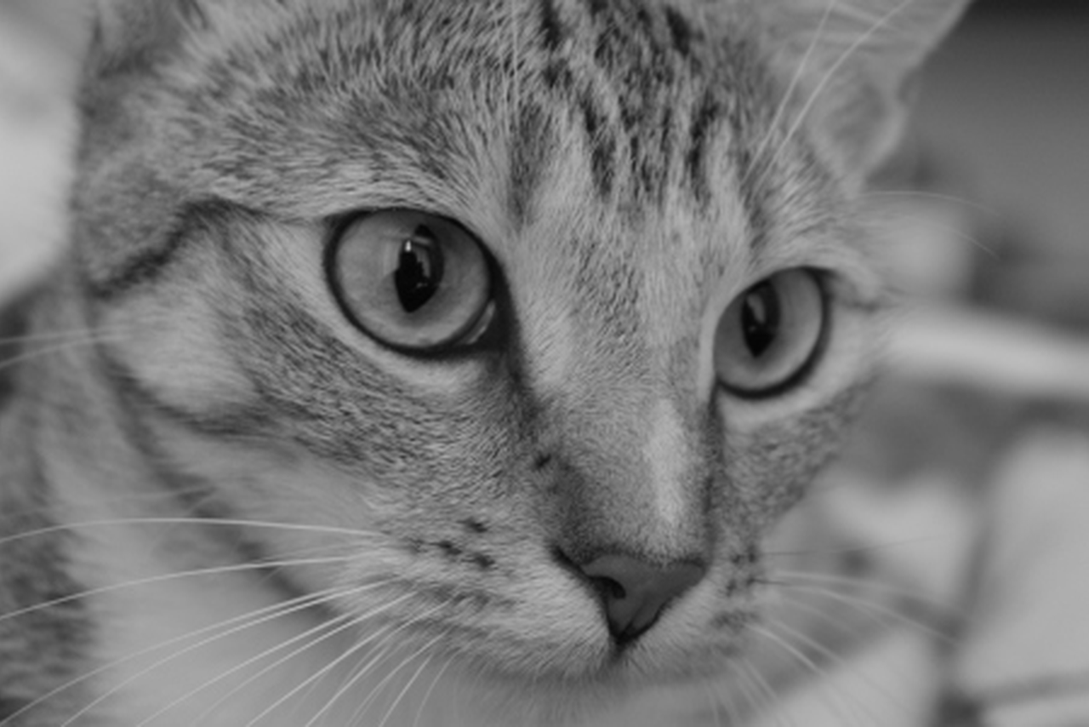
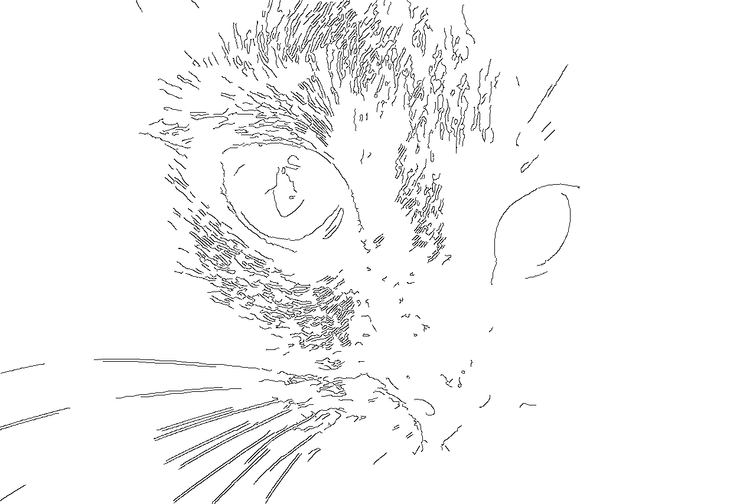
01 / IMAGE AS DATA
All three are numbers to the model.
Full colour, grayscale and edge maps — same scene, different arrays.
Full-colour photograph
Grayscale intensities
Edge-response image
11 / 68
Notes:
Poll: which of these three would a model do best from? Land the point that all three are numeric arrays — the model never sees a “picture”.

Slide 12
02 / CLASSICAL COMPUTER VISION
Before deep learning,
we processed images.
Filters · thresholds · contours · templates
12 / 68
Notes:
Transition slide: link the previous visuals to the upcoming question.

Slide 13
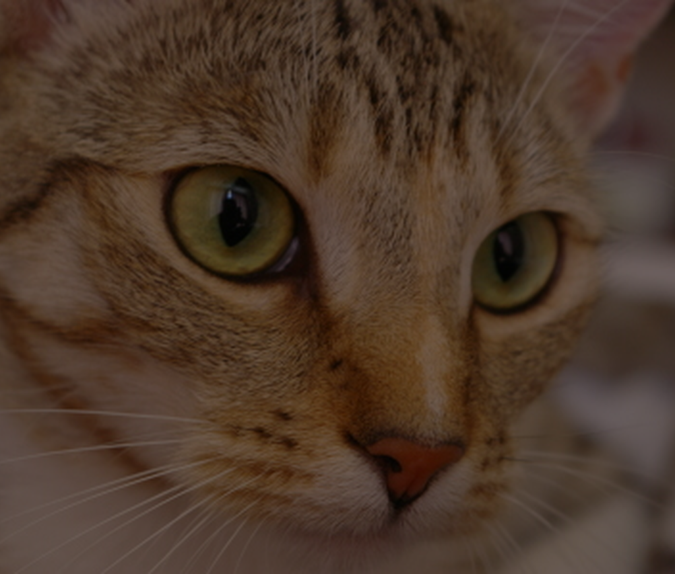
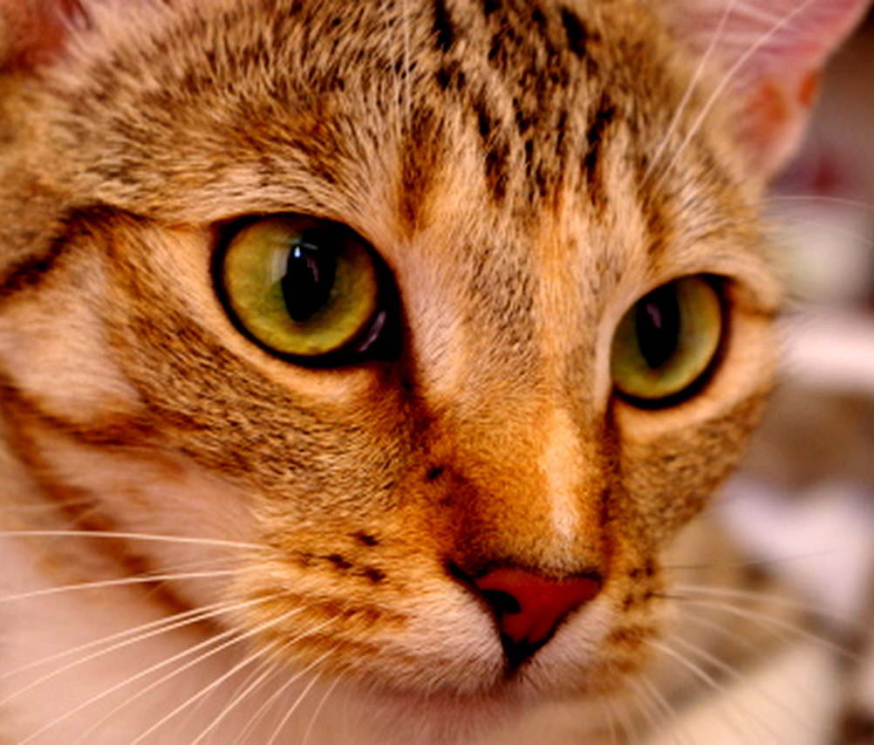
02 / CLASSICAL VISION
Brightness and contrast change pixels.
Useful preprocessing ≠ object understanding.
Lower brightness
Original
Higher contrast
13 / 68
Notes:
Live analogy: brightening is numerical transformation, not learning.

Slide 14


02 / CLASSICAL VISION
Smoothing can remove noise.
A filter combines neighboring pixel values.
NOISY / HIGH DETAIL
SMOOTHED / LESS DETAIL
14 / 68
Notes:
Describe the trade-off: smoothing reduces noise while weakening edges.

Slide 15
02 / CLASSICAL VISION
Edges mark rapid changes.
A classical edge detector is not a cat detector.
ORIGINAL RGB IMAGE
CANNY EDGE MAP
15 / 68
Notes:
Edge response highlights intensity transitions, not semantic interpretation.

Slide 16
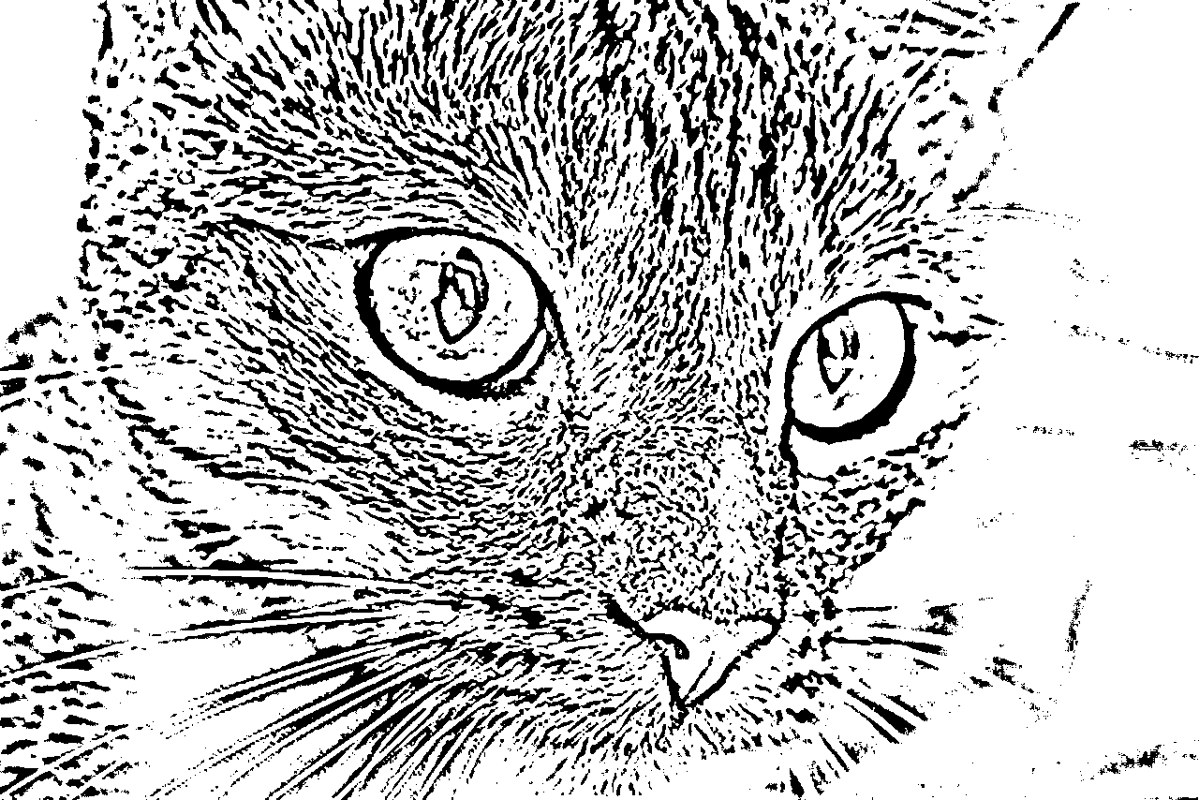
02 / CLASSICAL VISION
Thresholding makes a pixel decision.
A numerical rule converts grayscale into a binary mask.
GRAYSCALE VALUES
BINARY RESULT
16 / 68
Notes:
Thresholding produces a binary mask. Adjustable threshold changes which pixels are selected.

Slide 17

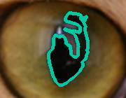
02 / CLASSICAL VISION
Contours describe boundaries
Enlarged cat-eye crop: threshold dark pixels, then trace the boundary.
Thresholded region
Contour of the largest dark region
A boundary is geometry—not an object identity.
17 / 68
Notes:
Contours connect candidate edge boundaries. They may not correspond to whole semantic objects.
Flex/optional — drop this slide first if time runs short.

Slide 18
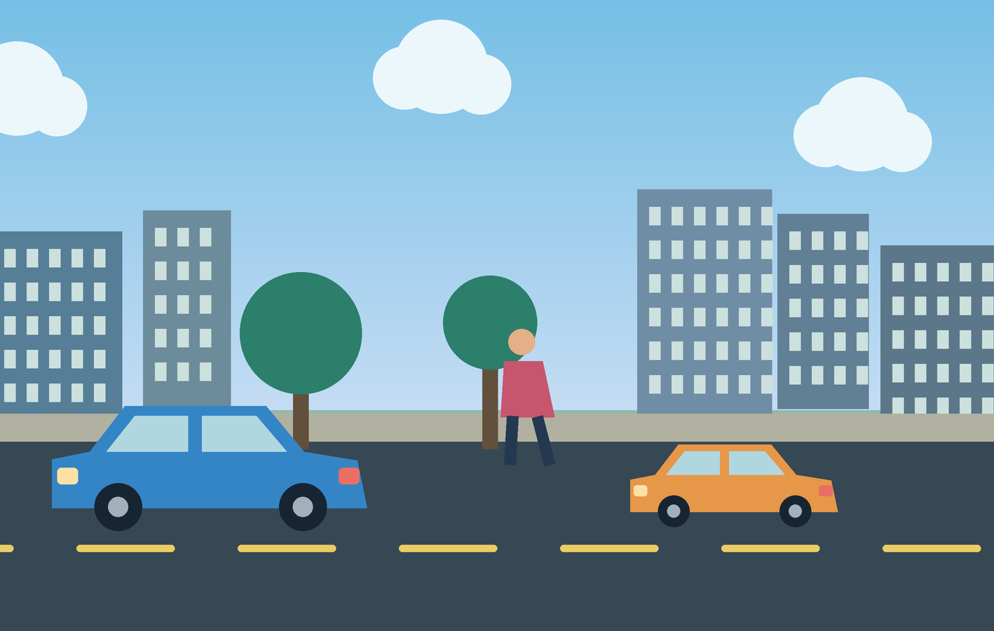

02 / CLASSICAL VISION
Colour thresholds isolate regions.
A simple rule can find orange regions—until lighting changes.
STREET SCENE
ORANGE-REGION FILTER
18 / 68
Notes:
Thresholding based on colour can isolate an orange car if colours separate well. But lighting breaks fixed thresholds.

Slide 19
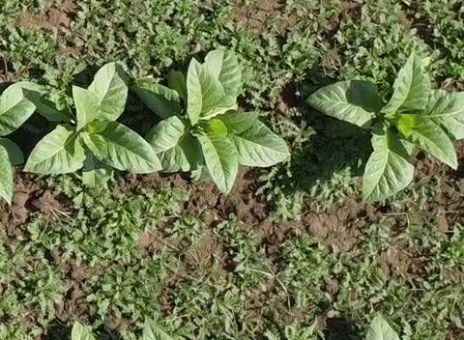
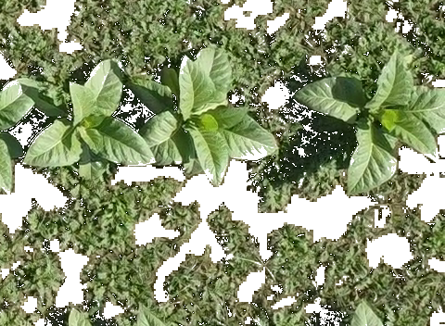
02 / CLASSICAL VISION
A colour rule applied to a photograph
Field photograph
Pixels selected by a green HSV range
Green pixels can belong to crops or weeds.
19 / 68
Notes:
HSV range is documented in evidence/classical.json. This is colour thresholding, not a weed recognition model. Lighting and shared colours are limitations.

Slide 20
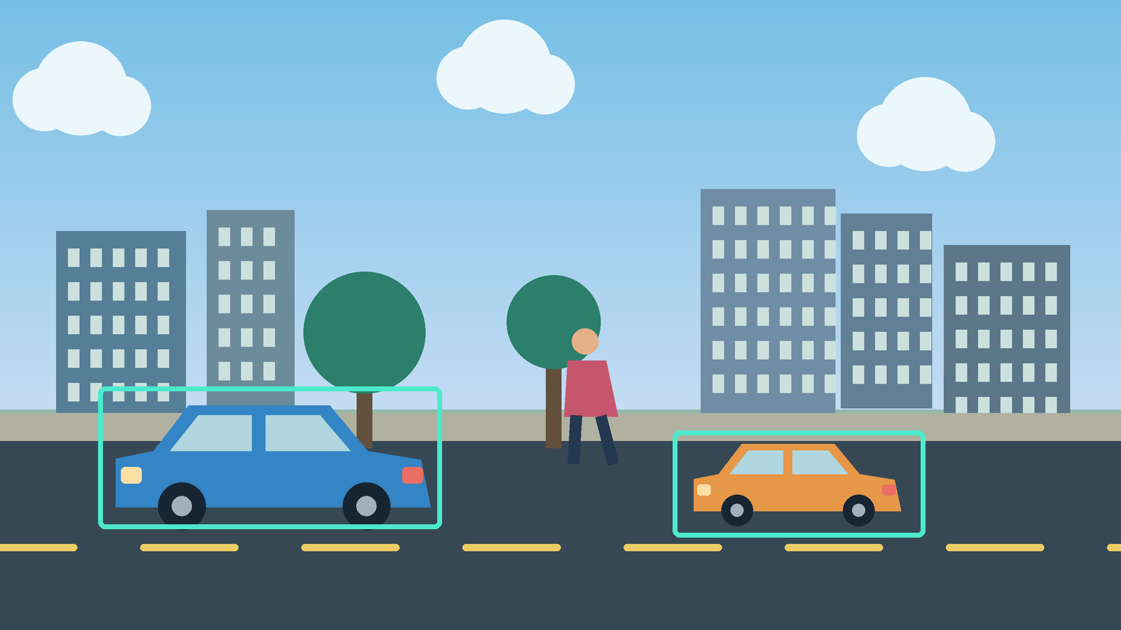
02 / CLASSICAL VISION
Template matching searches for a pattern.
A reference patch is compared across candidate image locations.
Known pattern
→ scan image
→ locate matches
20 / 68
Notes:
Template matching: slide a known reference pattern over an image to identify close matches; boxes are illustrative.
Flex/optional — drop this slide first if time runs short.

Slide 21
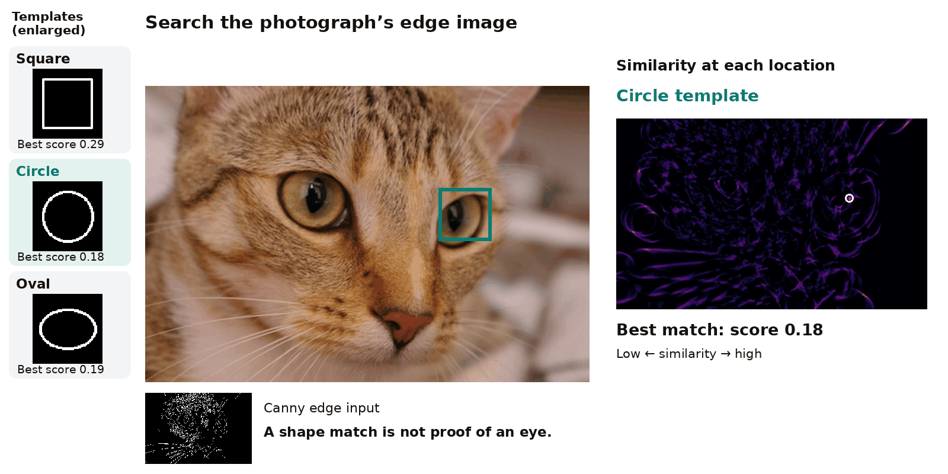
02 / CLASSICAL VISION
Can simple shapes find the eyes?
Template → sliding search → similarity map → best match
21 / 68
Notes:
Square, circle and oval outlines search the entire Canny edge image at one fixed scale. Animation samples candidate positions; each score comes from the computed normalized-correlation response map. Circle overlaps an eye here; square/oval can select non-eye regions. No eye detector, hand-selected best location or probability of correctness is claimed. A fixed geometric template cannot reliably find all eyes under changes in scale, pose or illumination.

Slide 22
02 / CLASSICAL VISION
The classic computer vision pipeline
Engineered features + designed decision rules.
01
02
03
04
05
CAPTURE
ENHANCE
EXTRACT FEATURES
MATCH / RULES
DECISION
Excellent when environments are controlled and rules are interpretable.
22 / 68
Notes:
Emphasize strengths of classical methods when controlled lighting and shapes suffice.

Slide 23

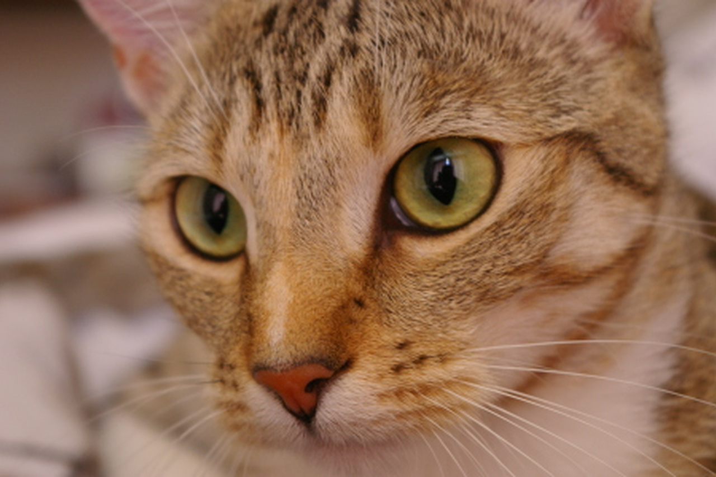

02 / CLASSICAL VISION
The same scene can look different
Poor lighting
Horizontal flip
Sensor noise
23 / 68
Notes:
The middle photograph is mirrored horizontally, as requested. All panels retain the same scene.

Slide 24
02 / CLASSICAL VISION
Instead of handcrafting every rule...
What if the system learns useful visual features from examples?
DATA + LABELS → LEARNED FEATURES → PREDICTIONS
This is the motivation for deep visual learning.
24 / 68
Notes:
Transition: learned representations can adapt to patterns in training examples.

Slide 25
03 / CORE COMPUTER VISION TASKS
One image.
Three different questions.
Classification · Object detection · Segmentation
25 / 68
Notes:
Transition slide: link the previous visuals to the upcoming question.

Slide 26
Classification: what is in this image?
Cat
26 / 68
Notes:
Classification identifies content; the output does not describe location.

Slide 27
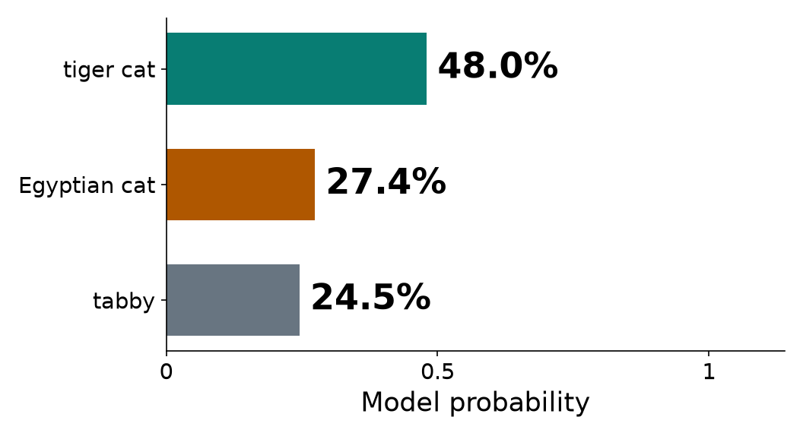
03 / CLASSIFICATION
A classifier produces class scores
MobileNetV3-Small · ImageNet-1K
Input image
Top three predicted ImageNet categories
A score does not supply an object location.
27 / 68
Notes:
These probabilities are schematic for instructional purposes, not actual model output.

Slide 28
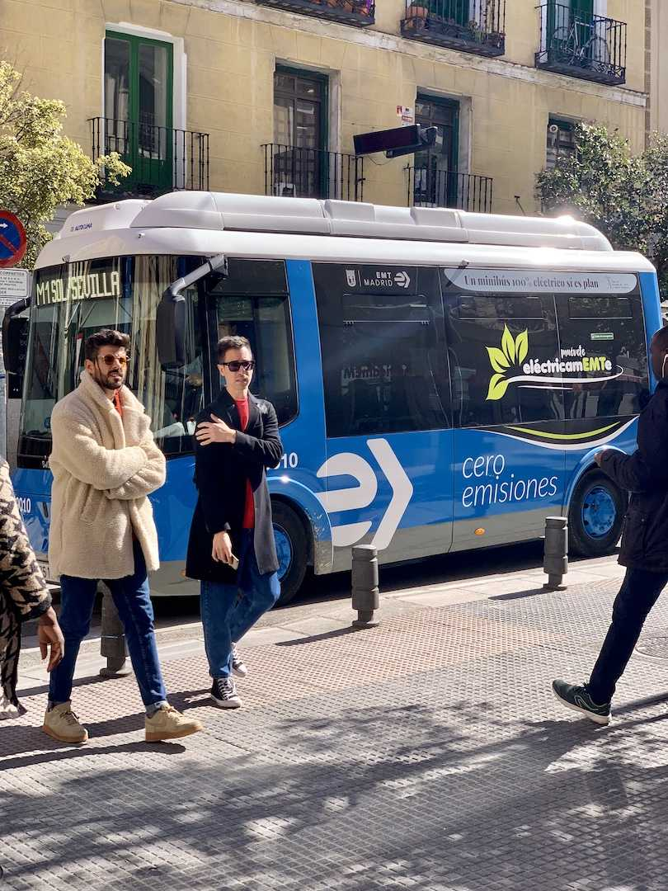
03 / CLASSIFICATION
Single-label versus multi-label
Single label: cat
Multiple image labels: bus + person
Multi-label classification reports presence—not boxes or counts.
28 / 68
Notes:
These are image-level annotation examples, not claimed multi-label inference. Bus and person are two categories; three people do not create three distinct class labels.

Slide 29
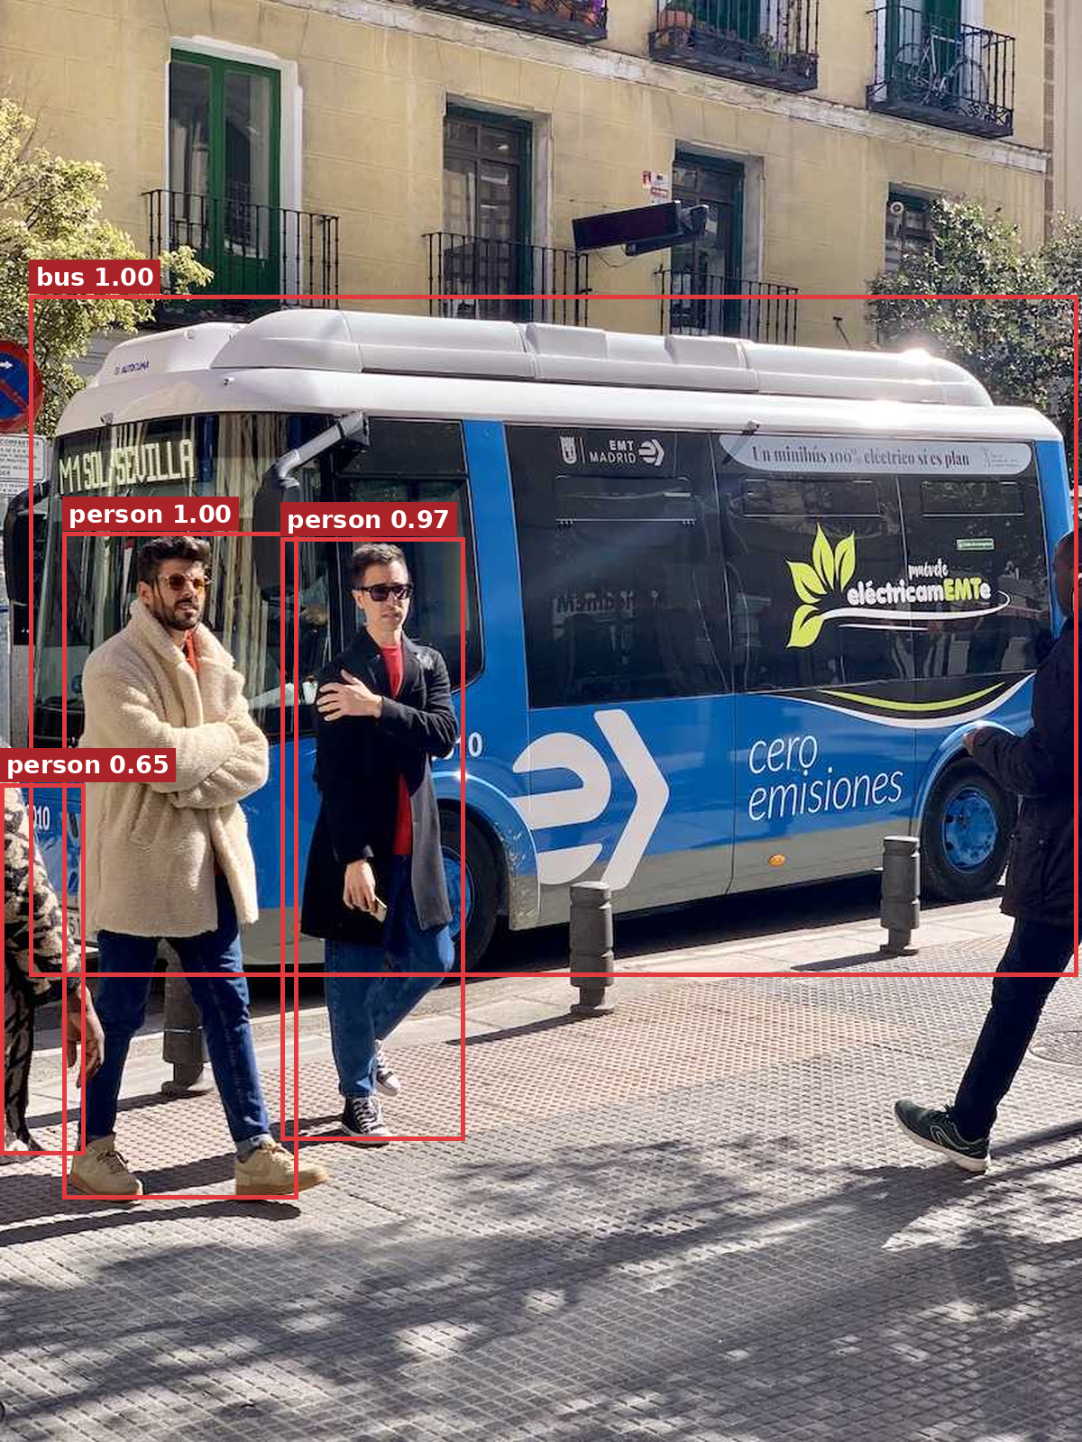
03 / DETECTION
Detection: what objects—and where?
Faster R-CNN MobileNetV3-320 · score threshold 0.55
Class labels + bounding boxes; multiple instances can share a class.
29 / 68
Notes:
Detection adds location. Bounding boxes are drawn examples, not measured model predictions.

Slide 30
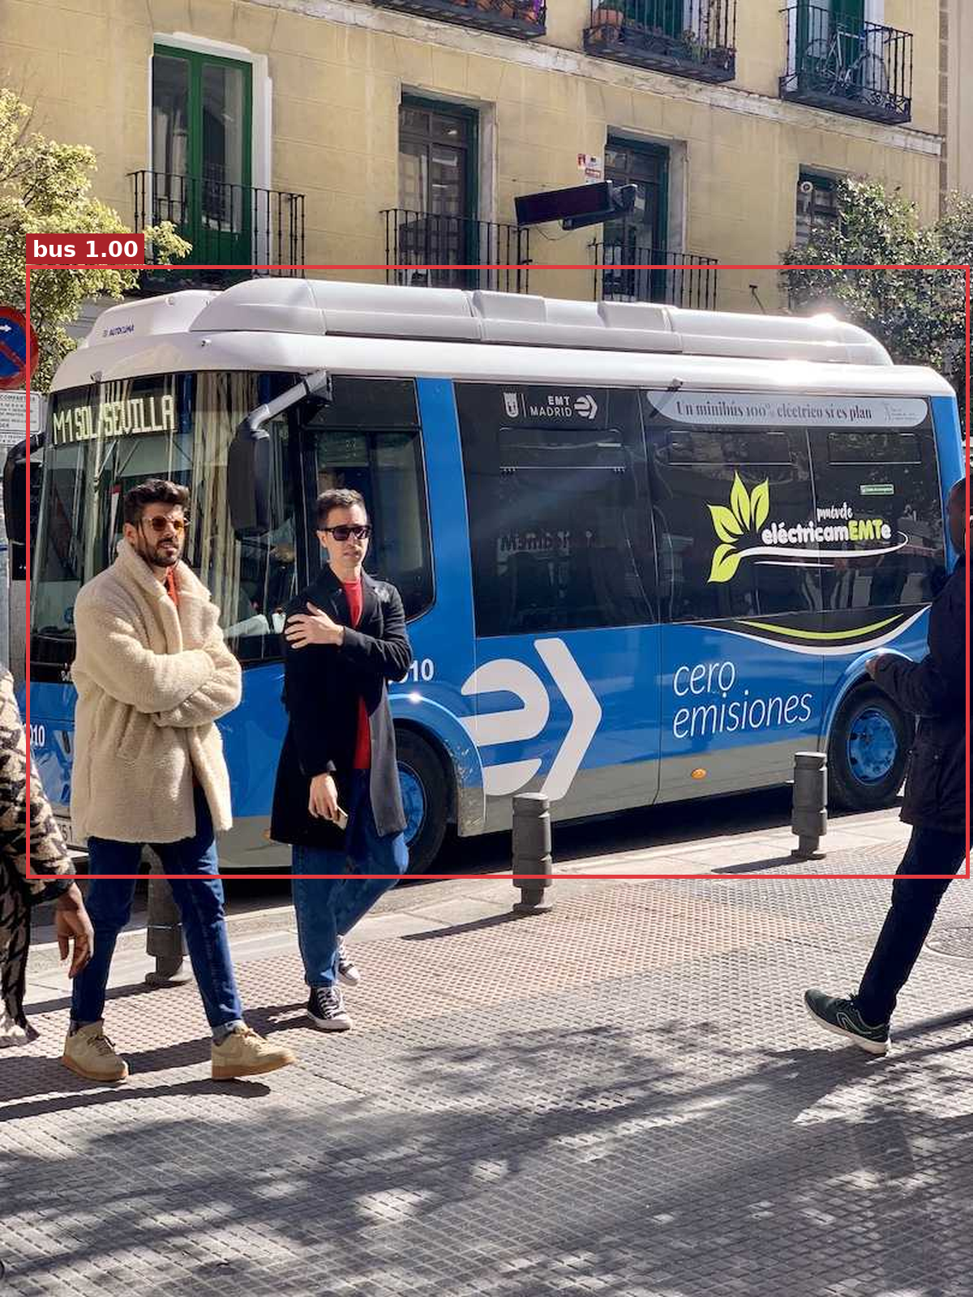
03 / DETECTION
One detection, three components
Bus · score 0.995 · [x₁, y₁, x₂, y₂] = [22, 221, 807, 732]
30 / 68
Notes:
Only the predicted bus box is shown. Coordinates refer to the original image, with origin at the upper-left. A model score is not calibrated proof of correctness.

Slide 31
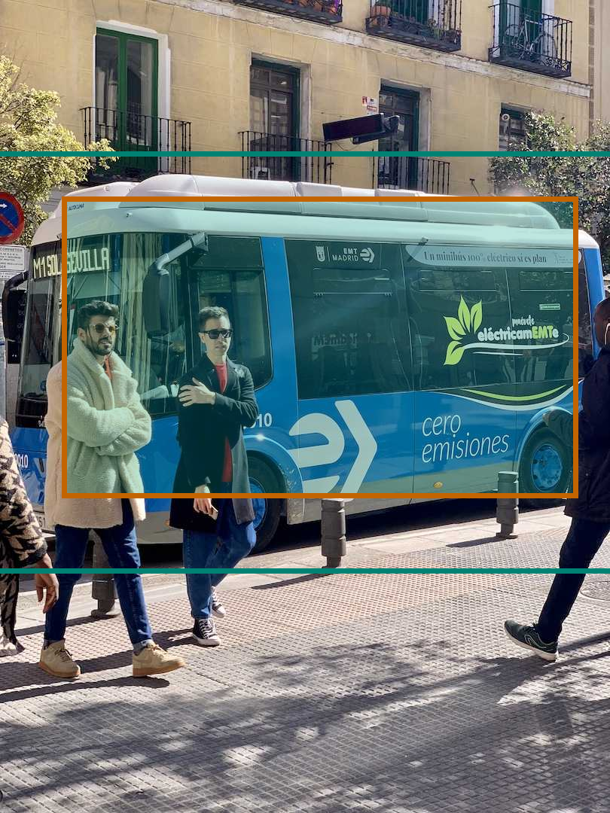
03 / DETECTION
Teal: box A · Orange: box B · Shading: overlap
IoU = overlap area / union area = 0.58
Two illustrative boxes; not a ground-truth evaluation
31 / 68
Notes:
Box A and box B are deterministic teaching rectangles, not human ground truth. Their coordinates and executed IoU calculation are preserved in manifest.json.

Slide 32
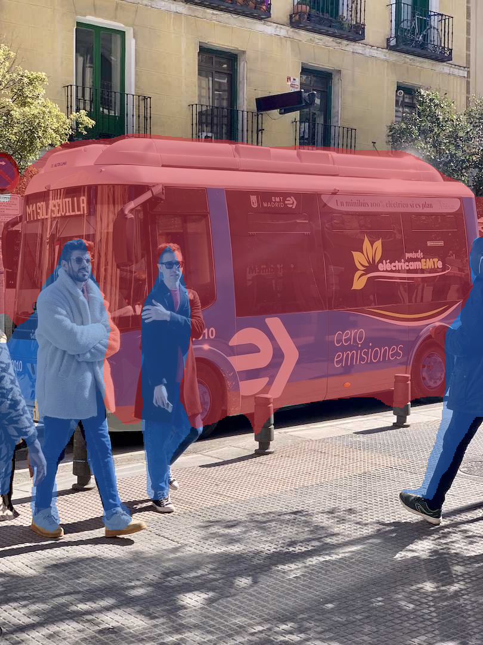
03 / SEGMENTATION
Input
Predicted class mask
Segmentation: which pixels belong to each class?
32 / 68
Notes:
DeepLabV3 MobileNetV3 inference. Bus is red and person is blue; background is left unpainted. These are predicted labels, not annotations.

Slide 33
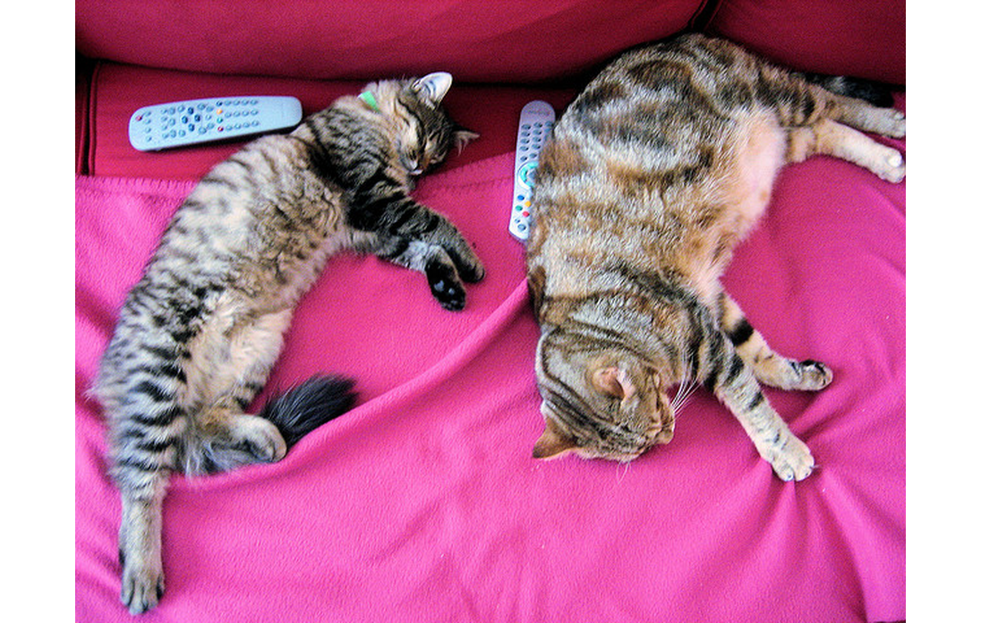
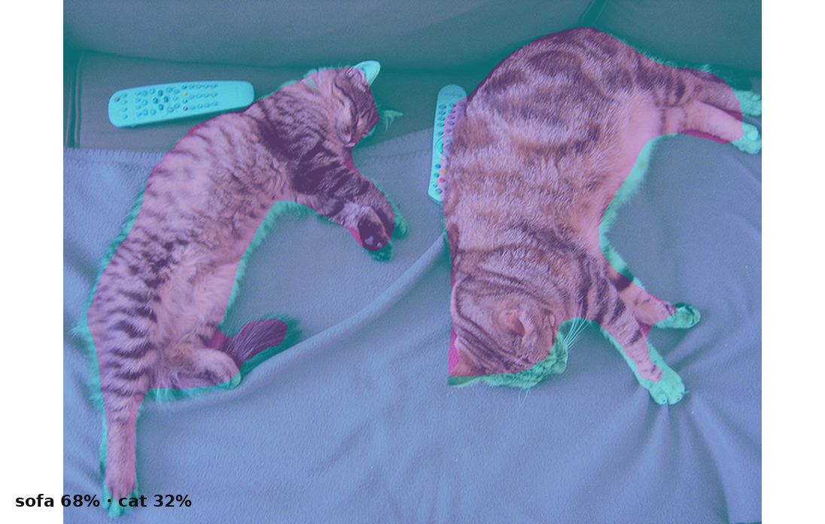
03 / SEGMENTATION
Semantic segmentation labels each pixel.
All pixels of one class receive the same category label.
IMAGE
PREDICTED CLASS MAP
33 / 68
Notes:
Semantic: both cars share class color. The background is another class/implicit category.

Slide 34

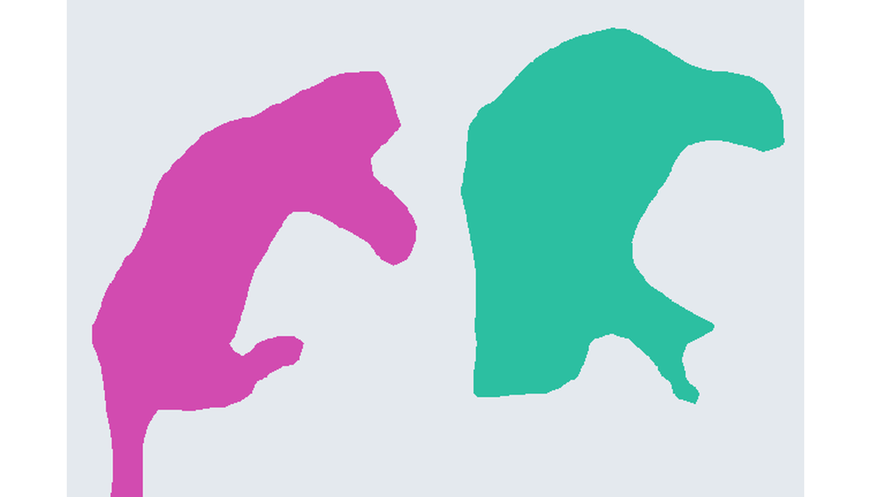
03 / SEGMENTATION
Semantic classes versus separate instances
Semantic category: cat
Connected components of this mask
Illustration of instance separation—not an instance-model prediction.
34 / 68
Notes:
Right panel is connected-component post-processing of a semantic cat mask, not inference from an instance-segmentation network. It illustrates the desired instance distinction only; touching cats could merge.

Slide 35
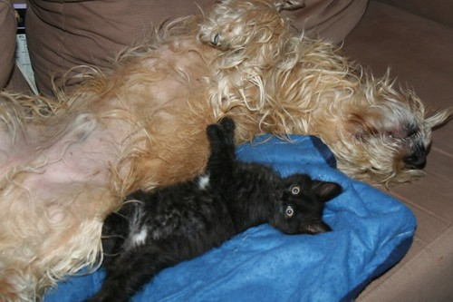
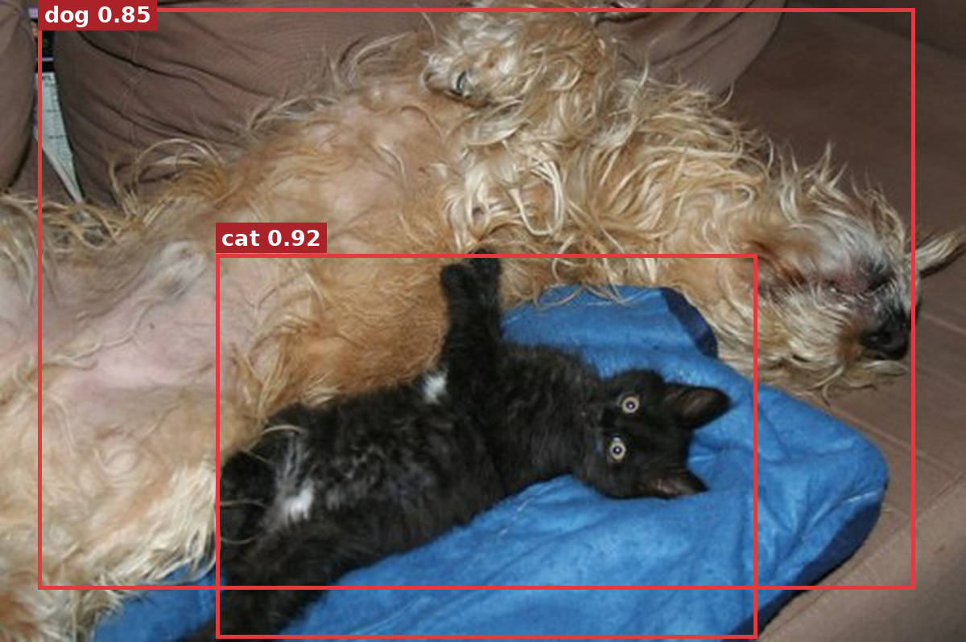
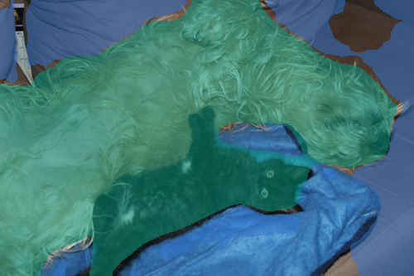
03 / CORE TASKS
One photograph. Three outputs.
Classification: dog
Detection
Segmentation
Whole-image category · Object boxes · Pixel labels
35 / 68
Notes:
This is the key synthesis slide. Ask students: identify each of three output types.

Slide 36

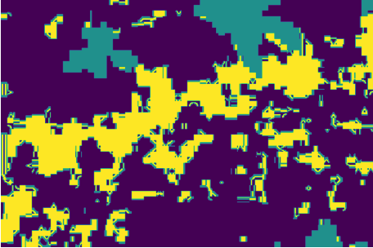
03 / LABELS
The task determines the annotation
Class label: cat
Bounding-box annotation
Pixel-mask annotation
Training labels are supplied targets—not the model’s predictions.
36 / 68
Notes:
Image-level cat label and teaching rectangle are manually defined. Pixel-mask panel is cropped from the user-supplied figure labelled Ground truth (Segmented_weed.png). Class colour names were not supplied; do not guess them.

Slide 37
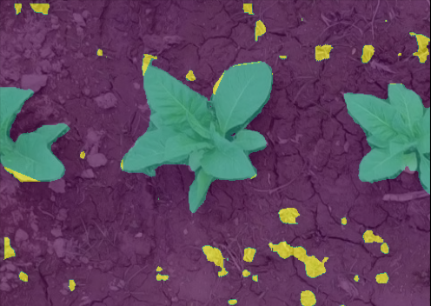
03 / APPLICATIONS
From field photograph to segmentation
Field photograph
Supplied segmentation overlay
Pixel labels can support vegetation mapping.
37 / 68
Notes:
User-supplied weed assets. Colours encode the supplied classes; the class-name legend and model provenance were not supplied. Do not report an mIoU from the embedded figure without its evaluation record.

Slide 38
03 / CHOOSING THE TASK
Match the task to the output you need.
Each scenario asks for a different kind of answer.
?
?
?
Identify the species
Count the cars
Measure damaged area
Given one photograph, name the animal.
Find every car in a traffic image.
Mark every pixel of a defect.
38 / 68
Notes:
Run the three scenarios as a quick quiz; let the room commit to an answer before you name the task type. Mapping: name the species → classification, count the cars → detection, mark every pixel → segmentation.

Slide 39
04 / DEEP VISUAL LEARNING
How does a neural network
learn to see?
From handcrafted filters to learned representations
39 / 68
Notes:
Transition slide: link the previous visuals to the upcoming question.

Slide 40
04 / FEATURE LEARNING
Classical ML versus deep learning
The defining difference: who designs the features?
TRADITIONAL PIPELINE
DEEP LEARNING
image → manual features → classifier
image → learned features → prediction
An engineer specifies edges, texture or shape descriptors.
Model parameters are optimized from labelled examples.
40 / 68
Notes:
Compare engineer-designed feature pipeline and learned feature pipeline; neither universally dominates.

Slide 41
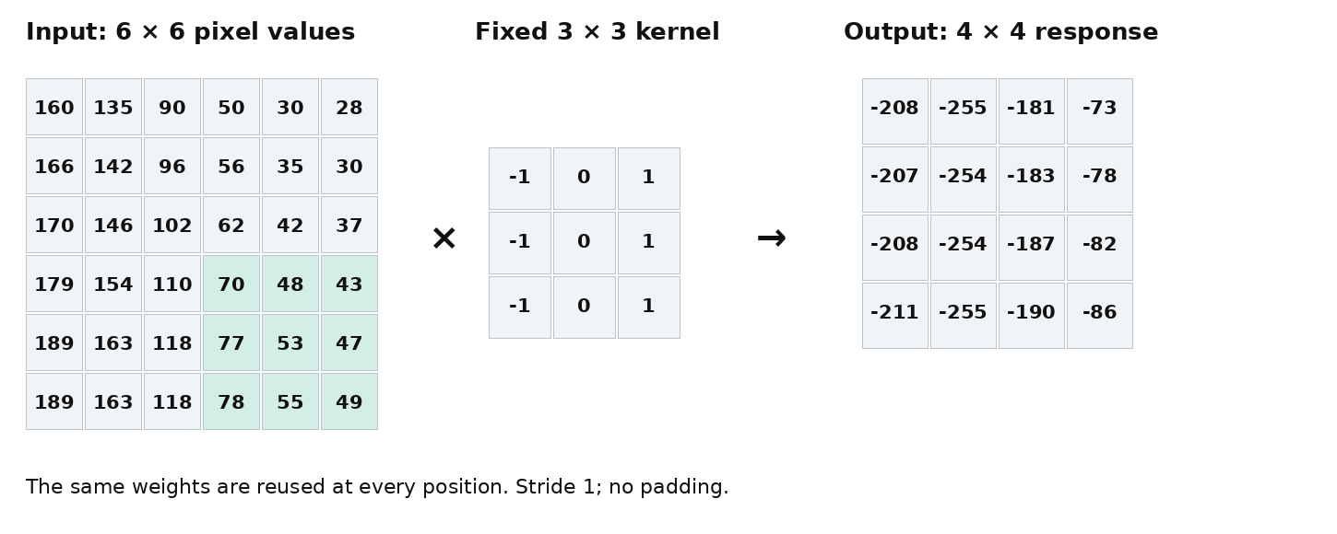
04 / CNN BASICS
A kernel moves across a pixel grid
41 / 68
Notes:
Animated fixed edge-kernel calculation; not a learned CNN kernel. The first frame includes a completed output for static export.

Slide 42
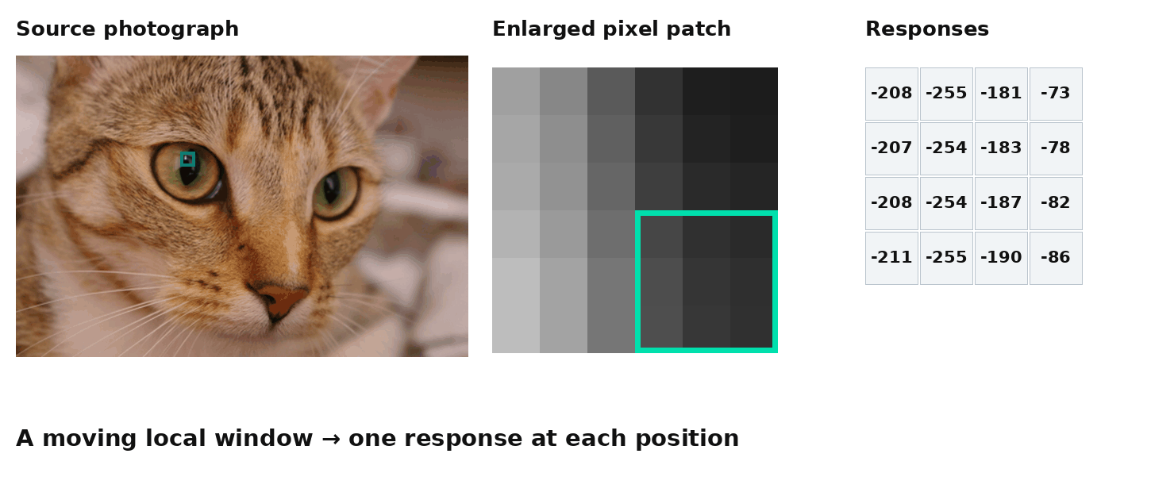
04 / CNN BASICS
The same window moves across the photograph
42 / 68
Notes:
Animated fixed edge-kernel calculation; not a learned CNN kernel. The first frame includes a completed output for static export.

Slide 43
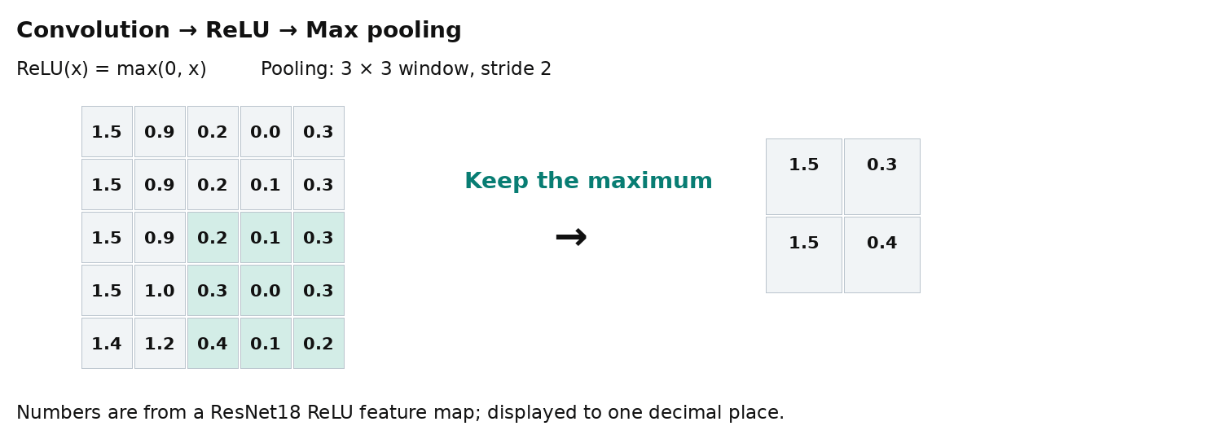
04 / CNN BASICS
ReLU and max pooling transform responses
43 / 68
Notes:
Merged ReLU and pooling. Values come from a pretrained ResNet18 ReLU channel. Actual architecture uses 3x3 max pooling, stride2, padding1; an aligned interior patch is displayed. Negative inputs become zero through ReLU. GIF first frame contains the complete pooled output.

Slide 44
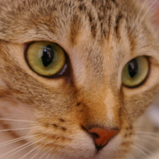
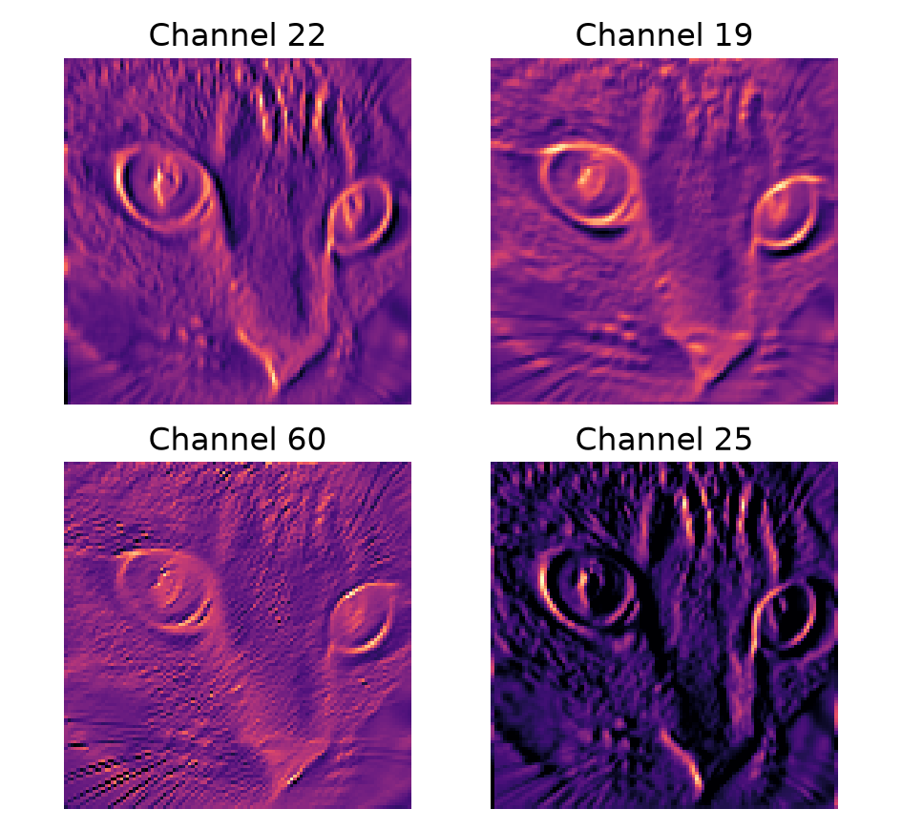
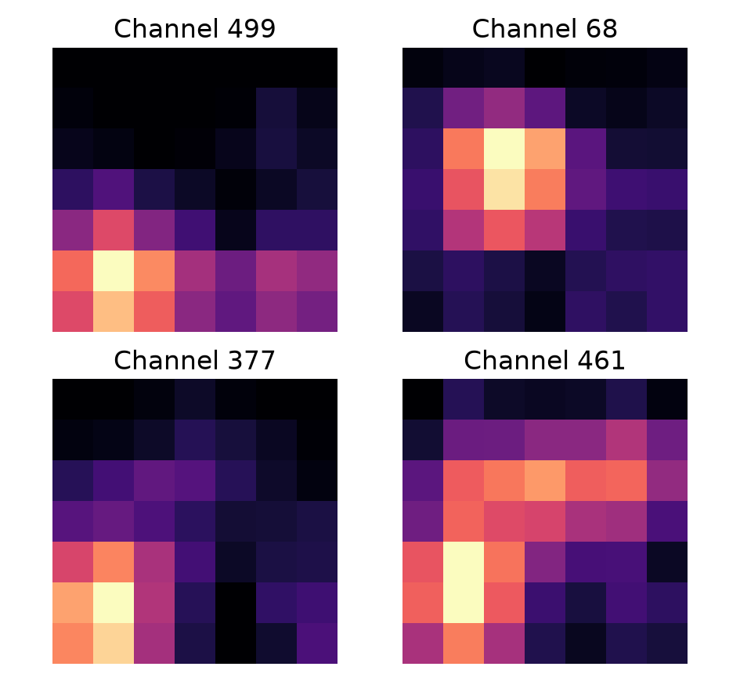
04 / LEARNED FEATURES
Feature maps from a pretrained CNN
ResNet18 · same input, different numerical responses
Model input: 224 × 224
Early layer: ReLU
Deeper layer: layer4
Selected channels; each display independently scaled for visibility.
44 / 68
Notes:
Four channels with highest spatial variance are shown in each layer. These are measured activations, not explanations of semantic concepts. Per-channel min-max scaling prevents intensity comparisons across channels/layers. All tensors and selection IDs are saved.

Slide 45
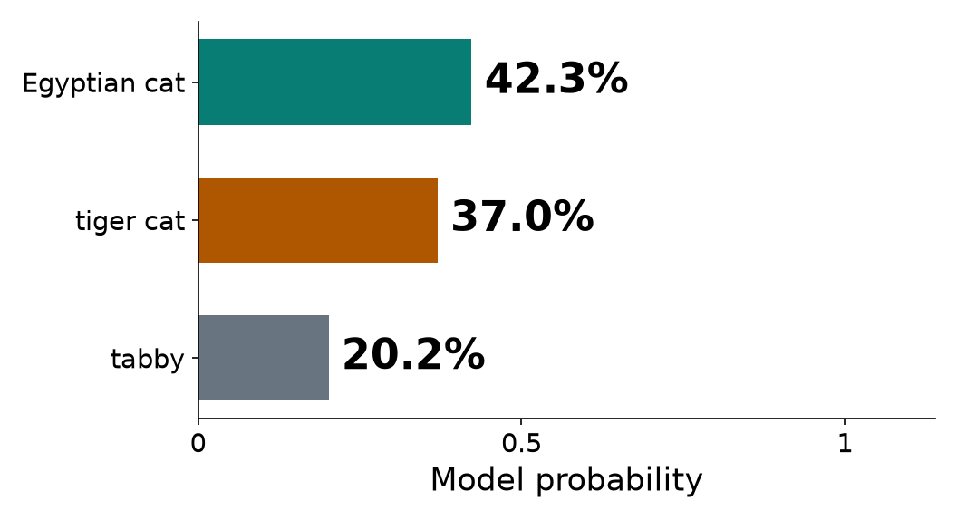
04 / CLASSIFICATION
From feature maps to a cat prediction
ResNet18 · ImageNet-1K
Input image
Feature maps → pooled vector
Class probabilities
512 pooled features → learned linear weights → 1,000 class scores
45 / 68
Notes:
512-channel layer4 features are global-average-pooled and passed to the ImageNet linear head, then softmax. Selected maps alone do not explain the prediction. Reconstructing logits from the saved pooled vector and head agrees within 1e-5. Cat probability grouping is separate from top-one breed prediction.

Slide 46
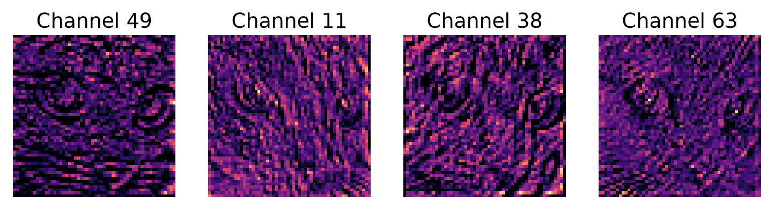
04 / FEATURE INTERPRETATION
Feature maps are responses—not named parts
Different channels respond differently
Maps alone do not explain a decision
46 / 68
Notes:
Do not name a channel “eye” or “fur” without evidence. These are selected layer1 activations, independently scaled, with channel IDs saved in the manifest.

Slide 47
04 / CNN BASICS
A CNN has two conceptual stages.
Feature extractor + task-specific output head.
01
02
03
04
05
INPUT IMAGE
CONV BLOCKS
FEATURE MAPS
TASK HEAD
OUTPUT
You can change the task by changing what the head predicts.
47 / 68
Notes:
A CNN typically has a feature extractor followed by a classifier/task head.

Slide 48
04 / TRAINING
Training is a repeated correction loop.
The model adjusts parameters to reduce prediction error.
01
02
03
04
05
EXAMPLE + LABEL
FORWARD PASS
PREDICTION
LOSS
UPDATE WEIGHTS
Repeat over many examples and epochs.
48 / 68
Notes:
Cycle: data and labels, prediction, loss, optimizer update. If class has training lab, keep short.

Slide 49
04 / TRAINING
Learning curves help inspect progress
Loss and accuracy measure different aspects of learning.
49 / 68
Notes:
Historical scratch run: 6000 training images, 900 test images, 5 epochs. Test accuracy was reported each epoch; teach a separate validation set for model selection. Curves are native editable charts using parsed executed-notebook outputs.

Slide 50
04 / EVALUATION
Separate training, validation and test
Training
Validation
Test
Fit the model’s parameters.
Choose settings and inspect progress.
Evaluate once decisions are fixed.
Do not use test results to choose the model.
50 / 68
Notes:
The supplied historical notebook reports test accuracy each epoch. Repeated reporting alone is not proof of tuning leakage, but a robust workflow separates validation from final testing. No lab code is changed in this deck task.

Slide 51
04 / UNIFIED VIEW
Same backbone concept; different output heads.
Classification, detection and segmentation require different predictions.
Classifier
CLASS SCORES
VISUAL
BACKBONE
Detector
BOXES + LABELS
Segmenter
PIXEL MASKS
51 / 68
Notes:
The backbone is shared idea, but pretrained weights are not necessarily the same across three released models.

Slide 52
05 / FROM CONCEPTS TO IMPLEMENTATION
Three compact model
examples.
Representative architectures—not claims of 2026 state of the art
52 / 68
Notes:
Transition slide: link the previous visuals to the upcoming question.

Slide 53
05 / MODEL EXAMPLES
MobileNetV3-Small
Classification · ImageNet-1K
53 / 68
Notes:
MobileNetV3-Small IMAGENET1K_V1 weights were downloaded with user authorization and verified by checkpoint hash. The chart displays measured top-three class probabilities.

Slide 54
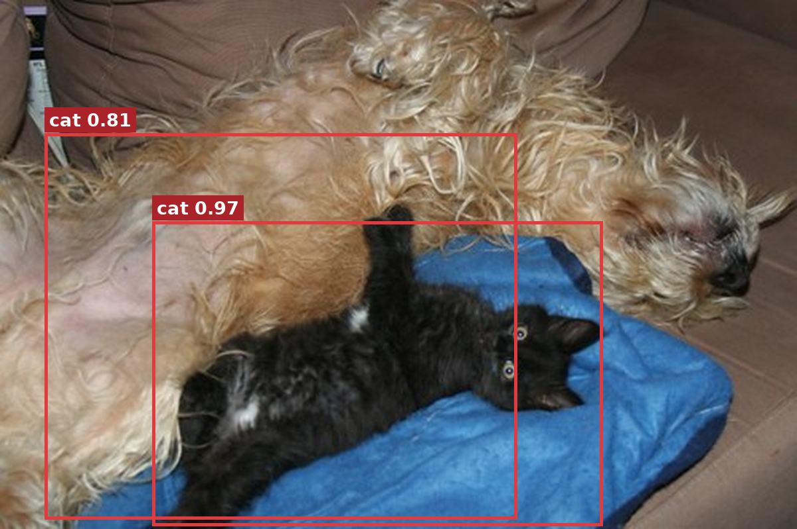
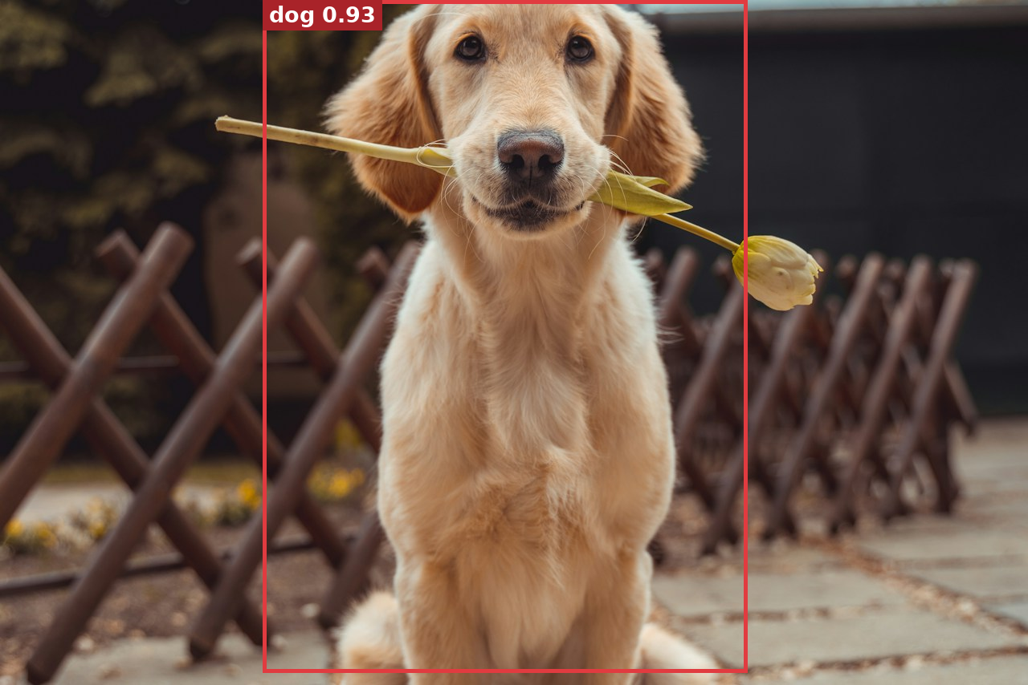
05 / MODEL EXAMPLES
SSDLite320 + MobileNetV3-Large
Cat–dog photograph
Dog photograph
The compact detector can miss or mislabel objects.
54 / 68
Notes:
SSDLite COCO_V1, threshold0.55. On this cat–dog photo the model returns two cat-labelled boxes: disclose the wrong label; do not replace the output with Faster R-CNN detections.

Slide 55
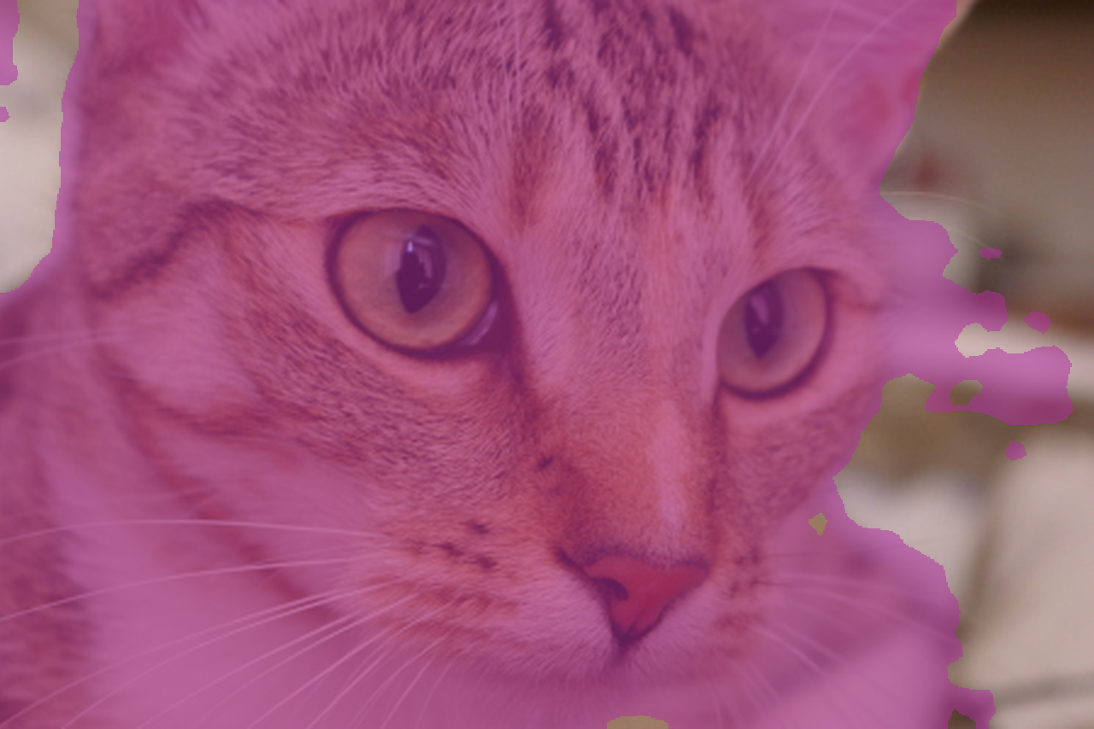
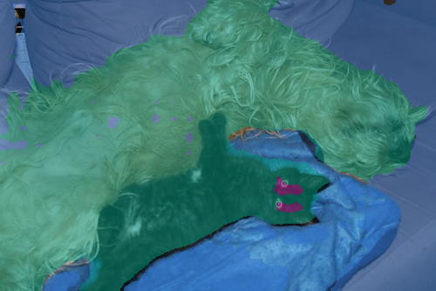
05 / MODEL EXAMPLES
LR-ASPP + MobileNetV3-Large
Cat photograph
Cat–dog photograph
One category per pixel, within the supported label set.
55 / 68
Notes:
LRASPP COCO_WITH_VOC_LABELS_V1. Purple=cat, green=dog, blue=sofa; background remains unpainted. Compact model outputs are not DeepLab outputs.

Slide 56
05 / TRANSFER LEARNING
Reuse visual knowledge. Adapt the final head.
Pretraining can reduce the data and optimization needed for a new task.
01
02
03
04
05
PRETRAINED MODEL
REUSE FEATURES
REPLACE HEAD
YOUR LABELS
NEW TASK
Beginner workshop: freeze backbone and train only the classifier head.
56 / 68
Notes:
Transfer learning: pretrained network reused. Backbone frozen in beginner lab, classifier head trained on target dataset.

Slide 57
06 / LAB AND MODEL OUTPUTS
Train a model.
Inspect its outputs.
Recorded lab training, then pretrained models on our photographs.
57 / 68
Notes:
This section combines existing notebook results with newly executed pretrained inference. Training is not rerun. Model names distinguish the examples from the compact architectures in section05.

Slide 58
06 / TRAINING
Train a small CNN from scratch
CIFAR-10 subset: airplane · cat · dog
5 epochs · 6,000 training images · 900 test images · 71.8% test accuracy
58 / 68
Notes:
Historical executed-notebook results. Architecture: three conv/ReLU/max-pool blocks (3→16→32→64 channels), then classifier. Timings omitted because this slide is not a portable speed benchmark.

Slide 59
06 / TRANSFER LEARNING
Transfer learning performed better here
71.8% → 84.9% test accuracy; different models and epoch budgets.
59 / 68
Notes:
Historical run: scratch5epochs versus pretrained ResNet18 with frozen backbone and replacement3-class head3epochs. Only1539 headparameters trainable. Useful demonstration, not a controlled claim that transfer learning always wins.

Slide 60
06 / ERROR ANALYSIS
Where the classifier still errs
Frozen ResNet18 + trained head · 900 test images
True ↓
Predicted →
Airplane
Cat
Dog
76%
Airplane
291
8
1
of errors confuse cats and dogs
Cat
17
231
52
Dog
7
51
242
Rows = reference labels. Columns = predicted labels.
60 / 68
Notes:
Read one row to show how to use the matrix: 291/300 airplanes right. Cats and dogs trade mistakes (52 + 51). Prompt: which class would you collect more data for?

Slide 61
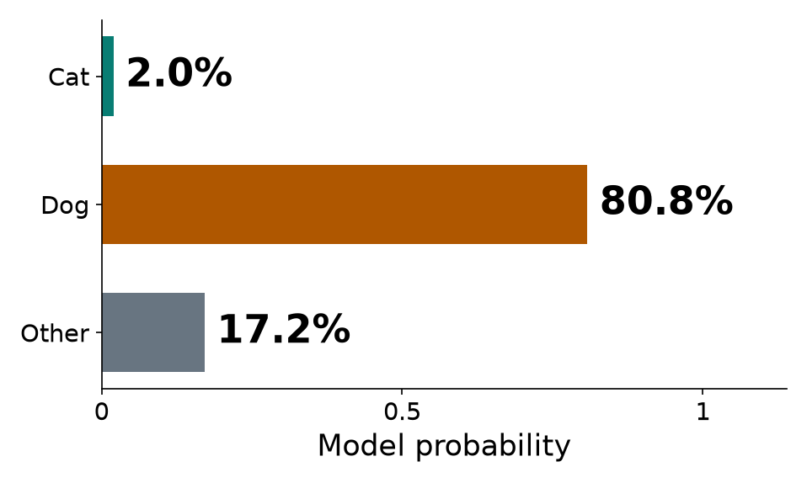
06 / CLASSIFICATION
One top prediction for the whole image
MobileNetV3-Large · ImageNet-1K
Cat and dog are both present
Probability grouped by ImageNet categories
Dog 80.8% · Cat 2.0% · Other 17.2%
61 / 68
Notes:
This is a single-label ImageNet classifier; one top prediction is a decision rule, not a limitation of all classifiers. Grouped cat/dog probabilities include their respective ImageNet classes and the remaining “other” probability mass. Size does not guarantee which object wins.

Slide 62
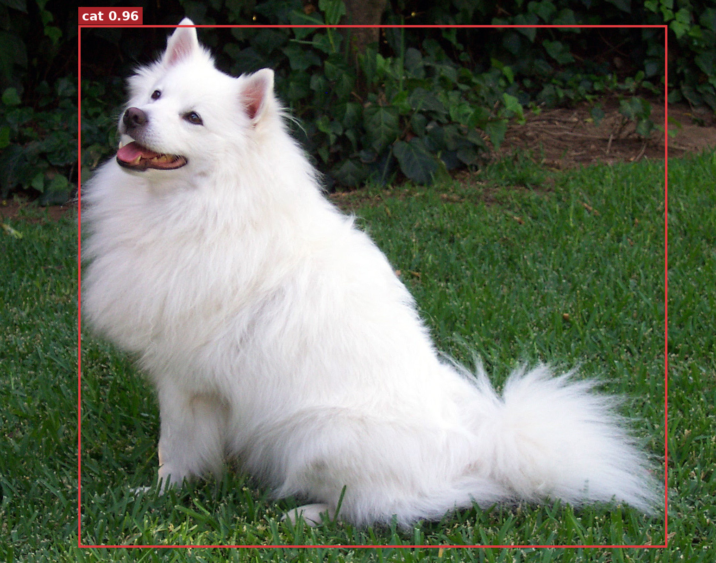
06 / DETECTION
Confidence is not correctness
Faster R-CNN MobileNetV3-320 · score threshold 0.55
Cat and dog found
Dog incorrectly labelled cat
A high-scoring prediction can still be wrong.
62 / 68
Notes:
Wins first (dog 1.00; cat + dog together). Then the surprises: the Samoyed called “cat” 0.96 while the classifier says Samoyed; toy breeds called “teddy bear” and “sheep”. Prompt: did the model fail, or is the label set wrong?

Slide 63
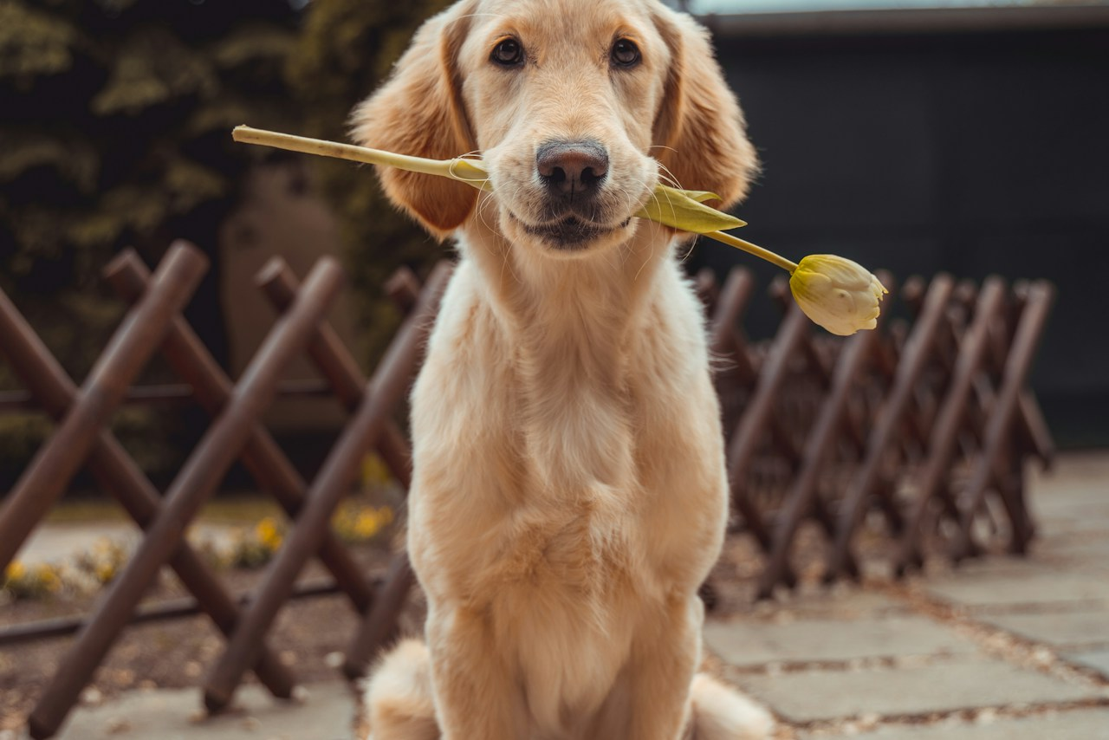
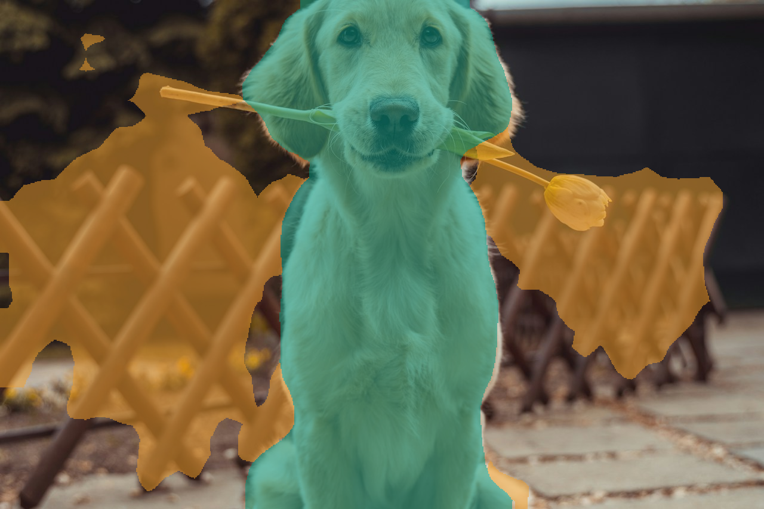
06 / SEGMENTATION
Pixel labels can also be wrong
DeepLabV3 + MobileNetV3 · 20 foreground categories + background
Input photograph
Green = dog; orange = predicted chair
Part of the fence is mislabelled as chair—not a correct interpretation.
63 / 68
Notes:
Coverage numbers are the story: cat 80%, sofa + cat, the fence read as “chair”. Remind: only 21 VOC classes — the labels are the ceiling.

Slide 64
06 / THREE OUTPUTS
One photograph, three different answers
Classify: dog
Detect: cat + dog
Segment: pixel categories
Image category · Object locations · Pixel regions
64 / 68
Notes:
Classification: MobileNetV3-Large. Detection: Faster R-CNN MobileNetV3-320. Segmentation: DeepLabV3 MobileNetV3. Each model uses its own weights’ transforms and supported labels; compare output types, not a shared architecture.

Slide 65
07 / HANDOFF
Now you will build a working classifier.
The lab engineer leads the coding and model training.
01
02
03
04
05
OPEN COLAB
LOAD DATA
TRAIN CNN
EVALUATE
TRY NEW IMAGE
One complete hands-on workflow beats three unfinished model trainings.
65 / 68
Notes:
Hand over to lab engineer now. Practical focus is classification training with one dataset, avoid training all three in two hours.

Slide 66

07 / LAB OUTPUTS
Prediction, learning curve, error analysis
True ↓
Predicted →
Airplane
Cat
Dog
Airplane
291
8
1
Cat
17
231
52
Cat 99.7%
Dog
7
51
242
Recorded notebook prediction
All three outputs come from the same recorded ResNet18 lab run.
66 / 68
Notes:
Prediction is an external example photograph, not a claimed held-out test example. Values cat99.7%,dog0.2%,airplane0.1% are parsed from executed-notebook stdout. Curve and matrix are from that same trained3-class head. No trained checkpoint was supplied, so no claim of rerunning that head is made.

Slide 67
07 / TAKEAWAYS
Choose the output your problem needs
Pixels are numbers
Tasks define outputs
Inspect errors
Preprocessing must match the model.
Categories, boxes or pixel labels.
Confidence is not correctness.
In the lab: build a classifier, evaluate it, then inspect its mistakes.
67 / 68

Slide 68
FURTHER READING
References and image sources
Szeliski (2022). Computer Vision: Algorithms and Applications, 2nd ed. · szeliski.org/Book
Howard et al. (2019). Searching for MobileNetV3. ICCV.
He et al. (2016). Deep Residual Learning for Image Recognition. CVPR.
Liu et al. (2016). SSD: Single Shot MultiBox Detector. ECCV.
Torchvision model documentation · docs.pytorch.org/vision
Photographs: scikit-image; Unsplash; COCO/Flickr; PyTorch Hub; supplied weed images.
File-level source notes: code/assets/CREDITS.md and code/v4_tools/README.md
68 / 68
Notes:
Attribution is based on existing supplied credits, not an independent license audit. Weed image model/class provenance and bus original-photographer details remain to be confirmed before public redistribution.

