Slide 1
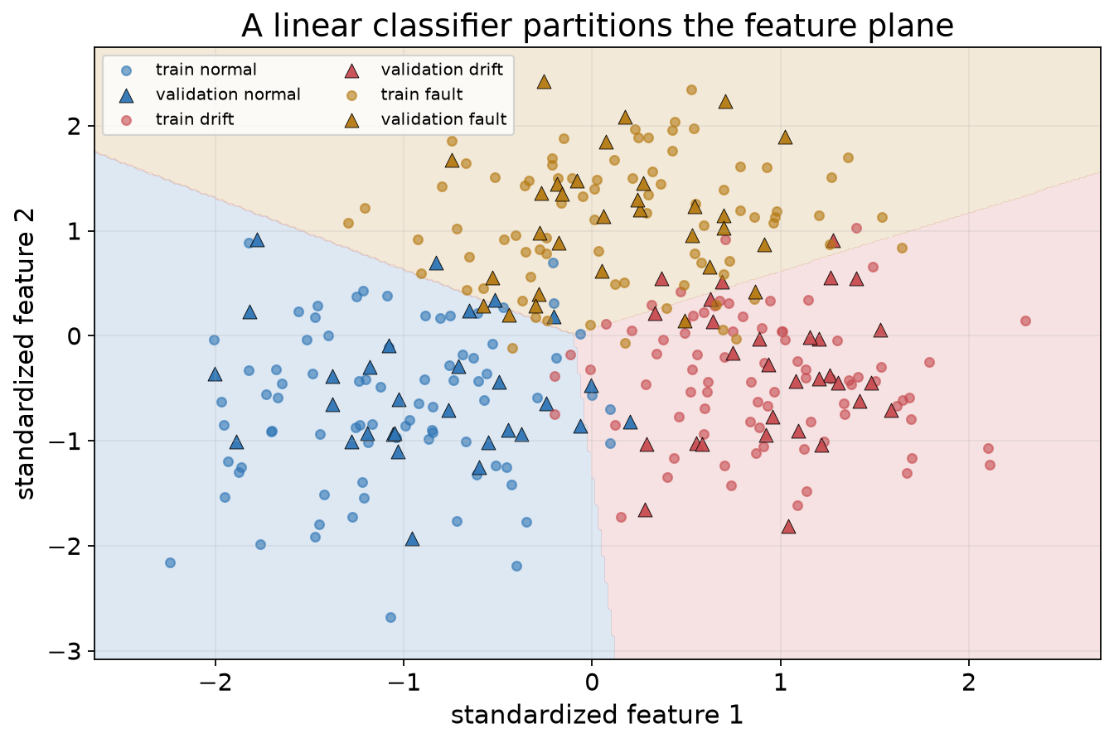
SE-801 · ARTIFICIAL NEURAL NETWORKS
Linear classification,
softmax, and cross-entropy
How does a model produce and learn categorical predictions?
Lecture 4 · Dr. Muhammad Farrukh Qureshi · PNEC, NUST

Slide 2
LECTURE 4 / 2
01 · FOUNDATIONS
What we should be able to explain
01
Turn class scores into probabilities with softmax.
02
Derive negative log-likelihood and cross-entropy.
03
Implement a stable loss from tensor operations.
04
Verify the p minus one-hot gradient with autograd.
05
Train and select a linear classifier honestly.
06
Read a confusion matrix and class-sensitive metrics.
SE-801 · Artificial Neural Networks · Linear classification, softmax, and cross-entropy
2

Slide 3
LECTURE 4 / 3
01 · FOUNDATIONS
Where we are: from regression to categories
Read data
→
Score classes
→
Loss on true class
→
Gradient
→
Update
• Lecture 1: data → prediction → loss → gradient → update.
• Lecture 2: repeat the updates; implement and check.
• Lecture 3: separate training evidence from new-data evidence.
• Lecture 4: the target is a category, so the output and loss change.
SE-801 · Artificial Neural Networks · Linear classification, softmax, and cross-entropy
3

Slide 4
IN-CLASS CALCULATION
Calculate: from logits to a decision
• O = XW + b
• X: [N,2] W: [2,3] b: [3] O: [N,3]
• One row of logits: [2, 1, −1]
Which class wins? Do the logits sum to one?
Add 10 to every logit: what changes?
TRY IT Two minutes individually, then compare with a partner.
SE-801 · Artificial Neural Networks · Linear classification, softmax, and cross-entropy
4

Slide 5
WORKED SOLUTION
Checked: logits score classes
• argmax chooses class 0, “normal”.
• The logits sum to 2 — they are not probabilities.
• softmax([2, 1, −1]) = [0.705, 0.260, 0.035], sum 1.
• Adding a constant to every logit changes nothing.
Unrestricted scores decide; softmax converts them to probabilities.
THINK Could two rows rank their classes differently in logits and probabilities?
SE-801 · Artificial Neural Networks · Linear classification, softmax, and cross-entropy
5

Slide 6
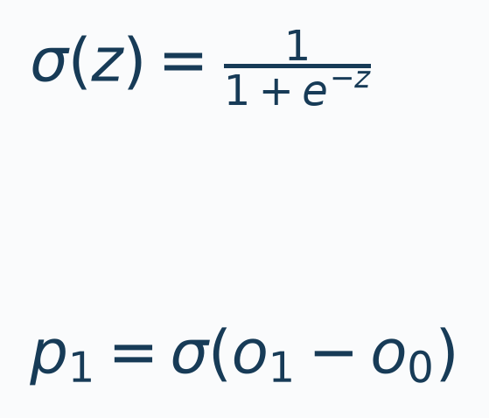
LECTURE 4 / 6
02 · BINARY BRIDGE
The two-class bridge: sigmoid
• One binary logit z: σ(z) gives the probability of class 1.
• Probability 0.5 corresponds to logit 0.
• For two logits, only the difference o₁−o₀ decides.
SE-801 · Artificial Neural Networks · Linear classification, softmax, and cross-entropy
6

Slide 7
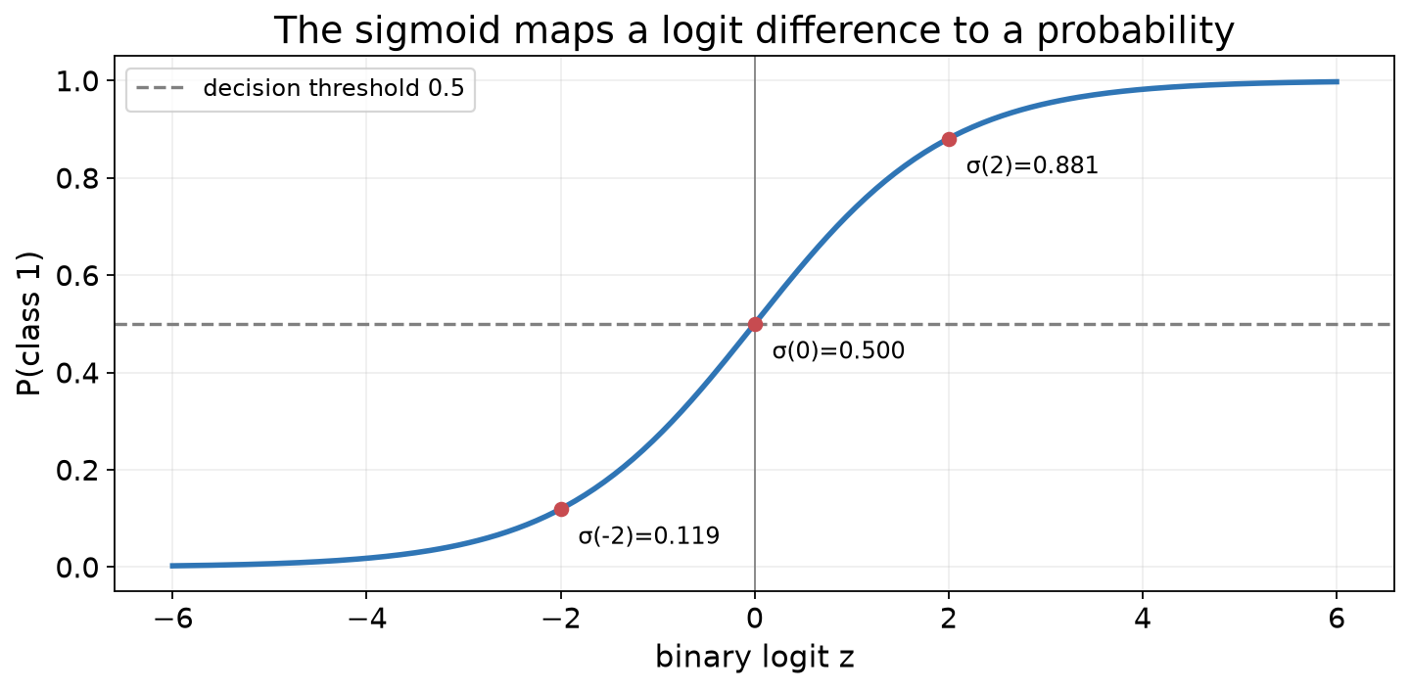
LECTURE 4 / 7
02 · BINARY BRIDGE
Sigmoid: a smooth threshold
• σ(−2) = 0.119 · σ(0) = 0.5 · σ(2) = 0.881
• The slope is largest at zero and vanishes in the tails.
• Later lectures will show why saturation slows learning.
SE-801 · Artificial Neural Networks · Linear classification, softmax, and cross-entropy
7

Slide 8
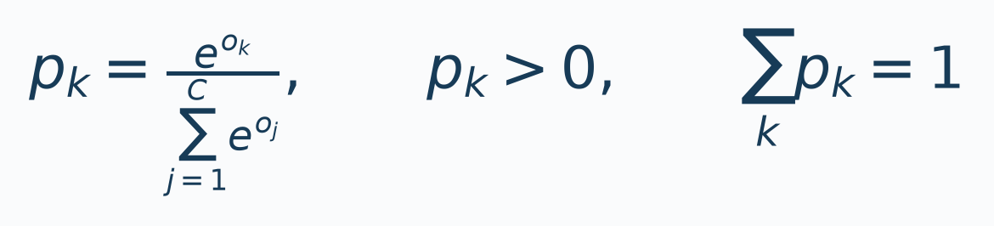
LECTURE 4 / 8
03 · SOFTMAX & TARGETS
Multiclass softmax
• Divide each exponentiated score by the sum over classes.
• Every probability is positive; each row sums to one.
• Softmax is shift-invariant and preserves the ranking.
SE-801 · Artificial Neural Networks · Linear classification, softmax, and cross-entropy
8

Slide 9
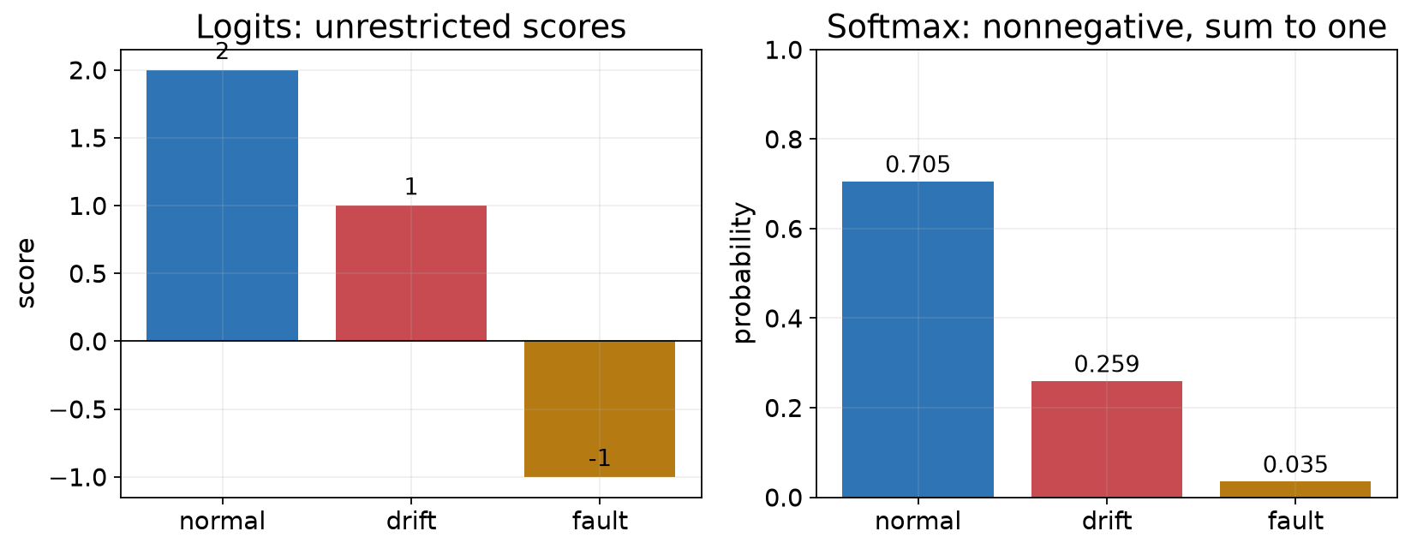
LECTURE 4 / 9
03 · SOFTMAX & TARGETS
From scores to probabilities
• softmax([2, 1, −1]) = [0.705, 0.260, 0.035]
• The winning class and its ranking are unchanged.
• Probabilities are needed for losses and reporting, not for argmax.
SE-801 · Artificial Neural Networks · Linear classification, softmax, and cross-entropy
9

Slide 10
IN-CLASS CALCULATION
Calculate: softmax by hand
• Logits: [ln 2, ln 1, ln 1]
• Exponentiate: [2, 1, 1]
• Sum: 4
Write p₀, p₁, p₂ and the one-hot target for class 0.
TRY IT Three minutes; keep four decimal places.
SE-801 · Artificial Neural Networks · Linear classification, softmax, and cross-entropy
10

Slide 11
WORKED SOLUTION
Checked: softmax by hand
• p = [2/4, 1/4, 1/4] = [0.5, 0.25, 0.25], sum 1.
• One-hot target for class 0: [1, 0, 0].
• Index target 0 identifies the same class.
CrossEntropyLoss accepts the index form: a long tensor of shape [N].
THINK When is a one-hot row more convenient than an index?
SE-801 · Artificial Neural Networks · Linear classification, softmax, and cross-entropy
11

Slide 12
LECTURE 4 / 12
03 · SOFTMAX & TARGETS
Targets: indices and one-hot rows
• Class index: y ∈ {0, 1, 2}, shape [N], dtype long.
• One-hot row: q ∈ {0,1}³, shape [N,3].
• ℓ = −Σ_k q_k ln p_k applies to both encodings.
• An index is a lookup key, not an ordinal measurement.
SE-801 · Artificial Neural Networks · Linear classification, softmax, and cross-entropy
12

Slide 13
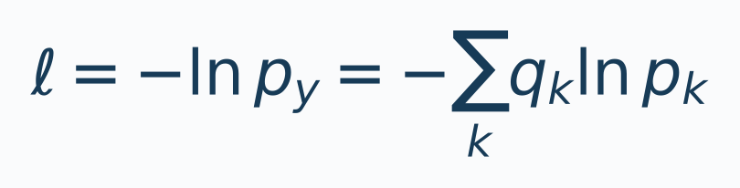
LECTURE 4 / 13
04 · CROSS-ENTROPY
Negative log-likelihood and cross-entropy
• Take the true-class probability, log it, and negate.
• Confident and correct gives near-zero loss.
• Confident and wrong gives a very large loss.
SE-801 · Artificial Neural Networks · Linear classification, softmax, and cross-entropy
13

Slide 14
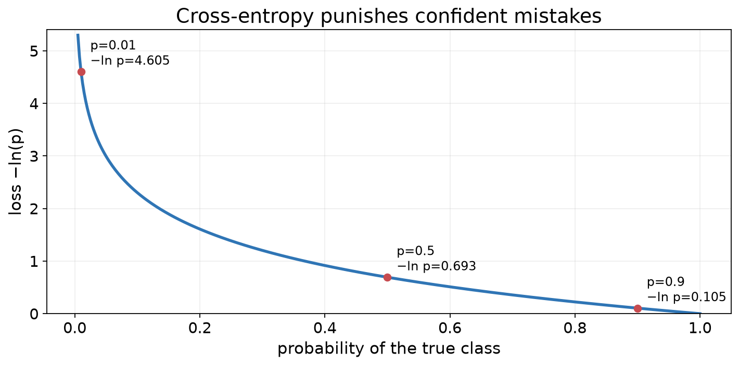
LECTURE 4 / 14
04 · CROSS-ENTROPY
The loss curve −ln p
• −ln(0.5) = 0.693 · −ln(0.01) = 4.605
• The curve is large near p = 0 and approaches zero at p = 1.
• The gradient is steepest for confident mistakes.
SE-801 · Artificial Neural Networks · Linear classification, softmax, and cross-entropy
14

Slide 15
IN-CLASS CALCULATION
Calculate: cross-entropy by hand
• True-class probabilities: 0.9, 0.5, 0.01
Compute −ln p for each case.
Rank the losses from smallest to largest.
Which prediction still has the correct argmax?
TRY IT Four minutes; ln 2 ≈ 0.693 is a useful anchor.
SE-801 · Artificial Neural Networks · Linear classification, softmax, and cross-entropy
15

Slide 16
WORKED SOLUTION
Checked: cross-entropy values
• −ln(0.9) = 0.105 · −ln(0.5) = 0.693 · −ln(0.01) = 4.605
• The loss separates predictions that share a winning label.
• Accuracy is piecewise constant; cross-entropy supplies a gradient.
A confident wrong prediction is expensive by design.
THINK Two rows both predict class 0 with p_true = 0.55 and 0.95. Which loss is smaller?
SE-801 · Artificial Neural Networks · Linear classification, softmax, and cross-entropy
16

Slide 17
LECTURE 4 / 17
05 · NUMERICAL STABILITY
Numerical stability: subtract the row maximum
• exp(1000) overflows, yet softmax([1000, 999, 995]) is well defined.
• Subtract m = max_j o_j from every logit: probabilities are unchanged.
• Exponentials then lie in (0, 1].
• A naive exp(logits)/sum(exp(logits)) can produce inf/inf = NaN.
SE-801 · Artificial Neural Networks · Linear classification, softmax, and cross-entropy
17

Slide 18
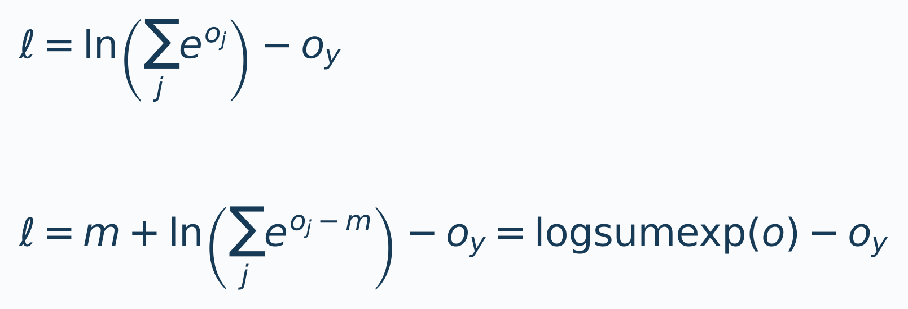
LECTURE 4 / 18
05 · NUMERICAL STABILITY
The log-sum-exp form
• Combine the shift identity with the logarithm.
• Stable loss: logsumexp(o) − o_y.
• torch.logsumexp and nn.CrossEntropyLoss use stable forms.
SE-801 · Artificial Neural Networks · Linear classification, softmax, and cross-entropy
18

Slide 19
LECTURE 4 / 19
05 · NUMERICAL STABILITY
A stable scratch implementation
• chosen = logits.gather(1, targets[:, None]).squeeze(1)
• loss = mean(logsumexp(logits, dim=1) − chosen)
• logits: [N, C] chosen: [N] loss: scalar
• Keeps logits in the graph; matches the framework exactly.
SE-801 · Artificial Neural Networks · Linear classification, softmax, and cross-entropy
19

Slide 20
BREAK
Break
Before continuing: predict the sign of the gradient for the true class.
20

Slide 21
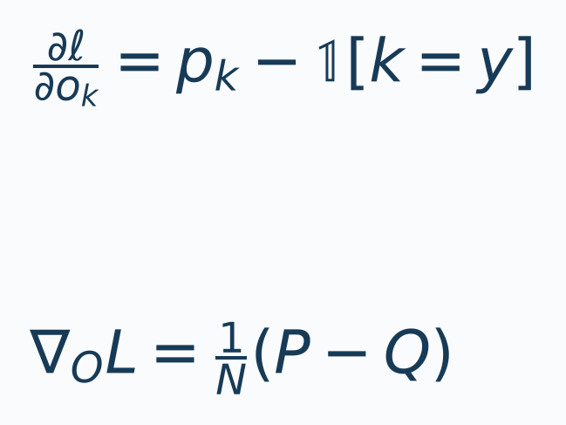
LECTURE 4 / 21
06 · GRADIENT
The gradient is probability minus target
• For one example, ∂ℓ/∂o_k = p_k − 1[k = y].
• The mean batch loss divides each example by N.
• Over-weighted classes get positive gradients; the true class gets a negative one.
• One step raises the true-class logit relative to its competitors.
SE-801 · Artificial Neural Networks · Linear classification, softmax, and cross-entropy
21

Slide 22
WORKED SOLUTION
Checked: gradient by hand
• Gradient = [−0.5, +0.25, +0.25].
• The entries sum to zero for every example.
• A perfect prediction p = [1, 0, 0] gives a zero gradient.
Autograd matches the derivation exactly.
THINK What gradient would a perfect prediction give? What does that imply for training?
SE-801 · Artificial Neural Networks · Linear classification, softmax, and cross-entropy
22

Slide 23
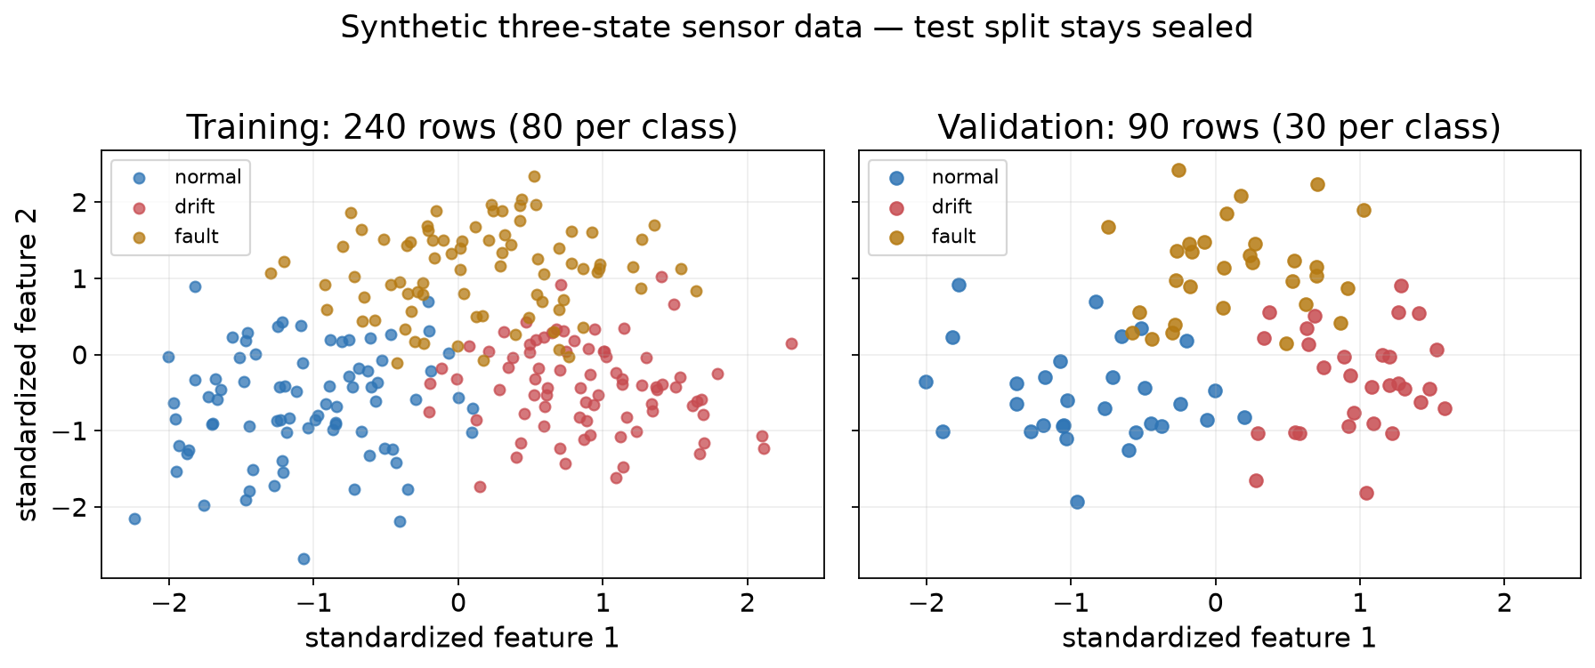
LECTURE 4 / 23
07 · DATA & MODEL
A compact three-state dataset
• Two standardized features imitate a vibration-window problem.
• Train: 240 rows (80 per class); validation: 90; test: 90.
• Three independent seeded draws; the test split stays sealed.
• Training-only means and standard deviations scale every split.
SE-801 · Artificial Neural Networks · Linear classification, softmax, and cross-entropy
23

Slide 24
LECTURE 4 / 24
07 · DATA & MODEL
Protocol: split first, scale on training
Draw splits
→
Scale on train
→
Fit weights
→
Select epoch
→
Freeze
→
Test once
• Draw three independent splits before any fitting.
• Fit feature scaling on training rows only.
• Fit weights on training; choose the checkpoint on validation.
• Freeze the pipeline; open the test split once.
SE-801 · Artificial Neural Networks · Linear classification, softmax, and cross-entropy
24

Slide 25
LECTURE 4 / 25
07 · DATA & MODEL
The linear classifier: shapes and loss
• nn.Linear(2, 3) stores weight shape [3, 2], the transpose of W:[2,3].
• The forward pass returns raw logits of shape [N, 3].
• The loss is the mean cross-entropy over the batch.
• SGD updates six weights and three biases.
SE-801 · Artificial Neural Networks · Linear classification, softmax, and cross-entropy
25

Slide 26
LECTURE 4 / 26
08 · TRAIN & SELECT
Training loop with checkpoint selection
• shuffle → zero_grad → logits → CrossEntropyLoss → backward → step
• After each epoch: model.eval() and torch.no_grad().
• Measure the same loss and accuracy on training and validation.
• Retain the epoch with the lowest validation cross-entropy.
SE-801 · Artificial Neural Networks · Linear classification, softmax, and cross-entropy
26

Slide 27
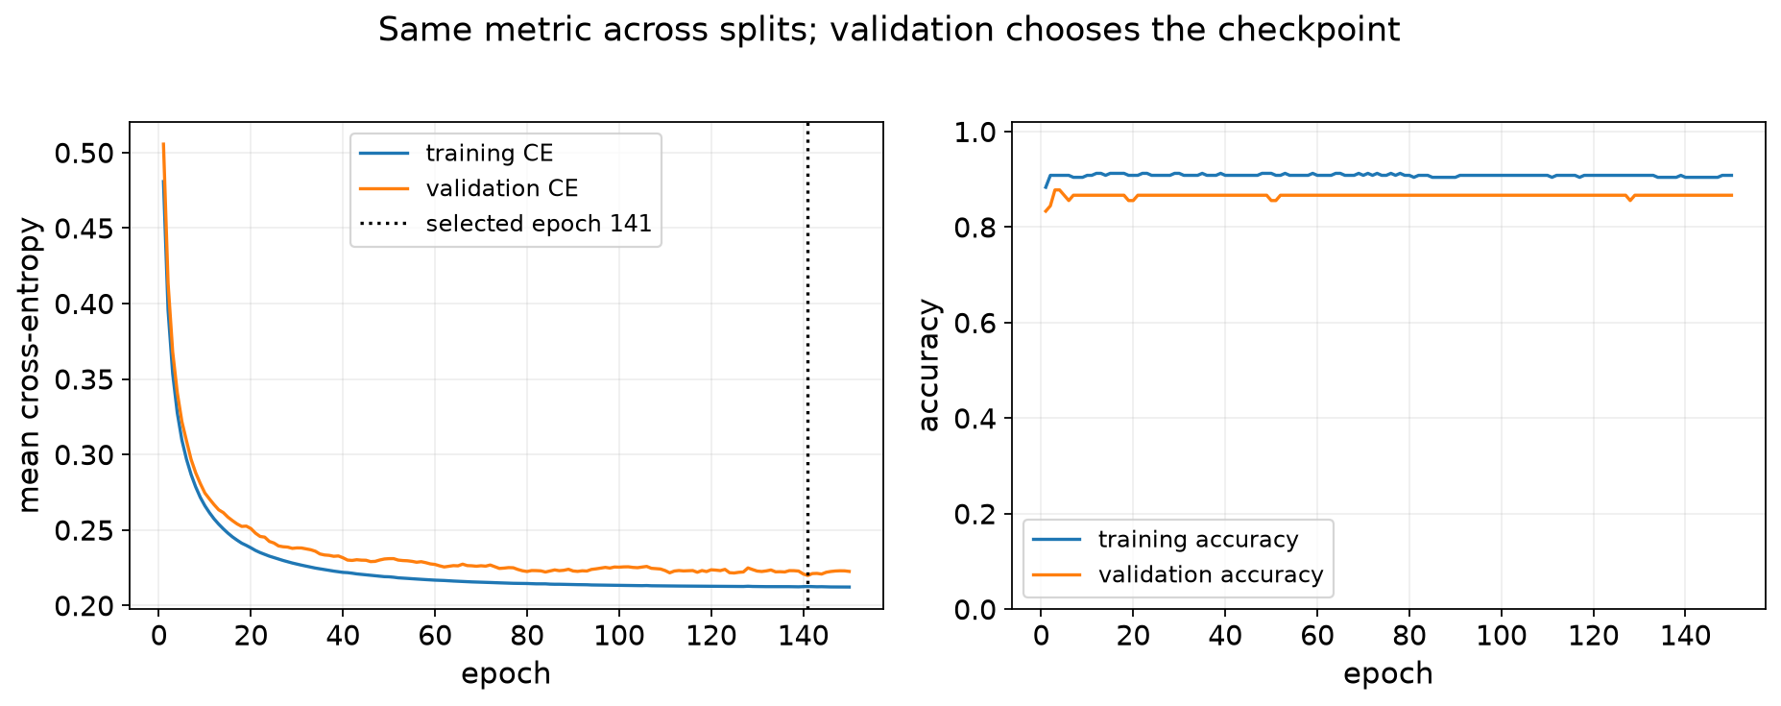
LECTURE 4 / 27
08 · TRAIN & SELECT
Learning curves are evidence
• Training and validation cross-entropy fall quickly, then flatten.
• Accuracy saturates because argmax is insensitive to small logit changes.
• Selected epoch 141 of 150 (validation cross-entropy 0.2198) sits on a noisy plateau: selection is sample-dependent.
• Validation accuracy 0.867, training accuracy 0.908 in this run.
SE-801 · Artificial Neural Networks · Linear classification, softmax, and cross-entropy
27

Slide 28
LECTURE 4 / 28
08 · TRAIN & SELECT
Train, validate, test: three jobs
• TRAIN fits weights and training-only scaling.
• VALIDATE selects the checkpoint and any hyperparameters.
• TEST scores the frozen model exactly once.
• A small validation set makes the selected epoch noisy.
SE-801 · Artificial Neural Networks · Linear classification, softmax, and cross-entropy
28

Slide 29
LECTURE 4 / 29
09 · INFERENCE
Probabilities, argmax, and a baseline
• argmax of logits equals argmax of softmax probabilities.
• Apply softmax only when probabilities are requested.
• Training-majority baseline: 30/90 = 0.333 validation accuracy.
• The classifier reaches 0.867 on the same 90 rows.
SE-801 · Artificial Neural Networks · Linear classification, softmax, and cross-entropy
29

Slide 30
LECTURE 4 / 30
09 · INFERENCE
The learned decision regions
• Each class occupies a half-plane; three pairwise boundaries meet at a point.
• Errors cluster near the boundaries, where classes overlap.
• A linear model cannot carve a curved region around the fault cluster.
SE-801 · Artificial Neural Networks · Linear classification, softmax, and cross-entropy
30

Slide 31
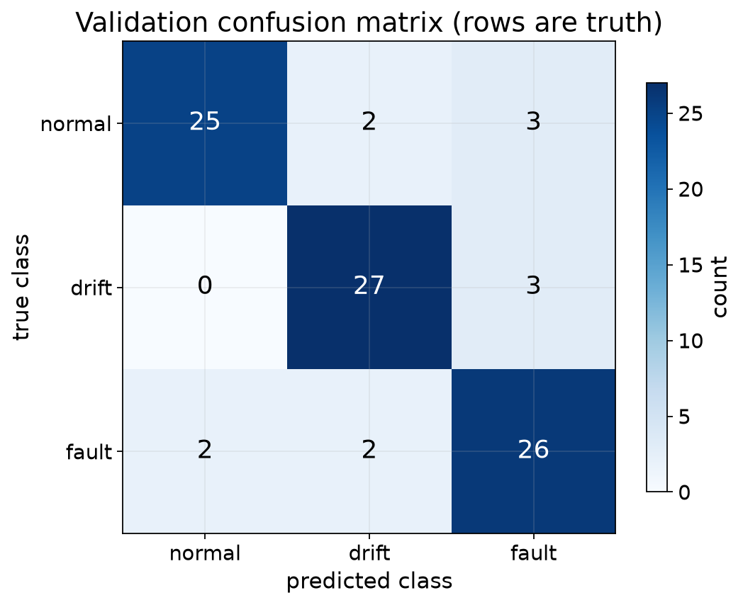
LECTURE 4 / 31
10 · METRICS
Confusion matrix: rows are true classes
• Rows: true class. Columns: predicted class.
• The diagonal counts correct decisions.
• Off-diagonal cells name the specific mistake.
• Validation recalls: normal 0.833 · drift 0.900 · fault 0.867.
SE-801 · Artificial Neural Networks · Linear classification, softmax, and cross-entropy
31

Slide 32
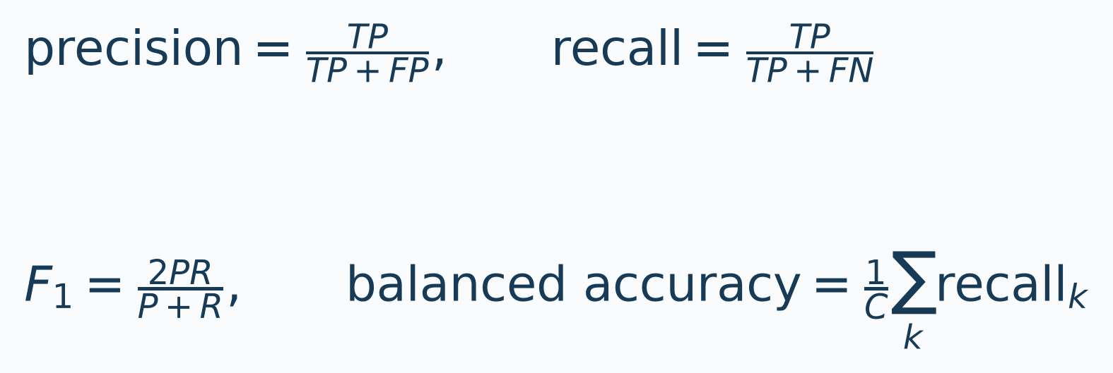
LECTURE 4 / 32
10 · METRICS
Precision, recall, F1, balanced accuracy
• Rows are true classes; columns are predicted classes.
• TP = C_kk, FN = row sum − TP, FP = column sum − TP.
• Balanced accuracy averages recalls; macro F1 averages class F1 values.
• A zero denominator sets that metric to zero in this lecture.
SE-801 · Artificial Neural Networks · Linear classification, softmax, and cross-entropy
32

Slide 33
LECTURE 4 / 33
10 · METRICS
Reading the validation matrix
Class | Precision | Recall | F1 | Support
normal | 0.926 | 0.833 | 0.877 | 30
drift | 0.871 | 0.900 | 0.885 | 30
fault | 0.812 | 0.867 | 0.839 | 30
Accuracy 0.867, balanced accuracy 0.867, macro F1 0.867.
SE-801 · Artificial Neural Networks · Linear classification, softmax, and cross-entropy
33

Slide 34
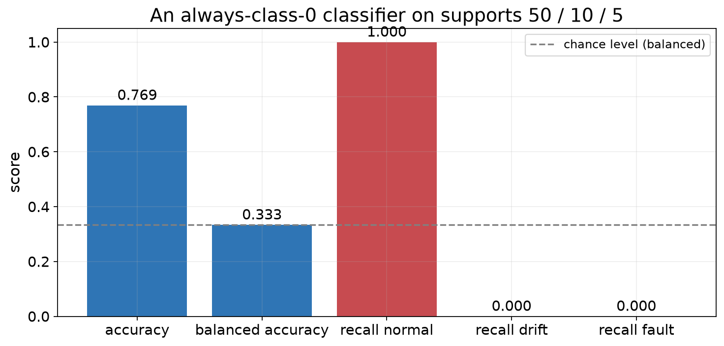
LECTURE 4 / 34
11 · IMBALANCE
Accuracy can hide a missed class
• Invented matrix with supports 50, 10, and 5; the model always predicts class 0.
• Accuracy 50/65 = 0.769 looks respectable.
• Recalls: 1.000, 0.000, 0.000.
• Balanced accuracy 0.333 exposes the failure.
SE-801 · Artificial Neural Networks · Linear classification, softmax, and cross-entropy
34

Slide 35
LECTURE 4 / 35
11 · IMBALANCE
Choose a metric that matches the cost
• Missing a fault may cost more than a false alarm.
• Report per-class recall with support, not accuracy alone.
• Balanced accuracy and macro F1 summarize across classes.
• State the metric, its definition, and the zero-denominator convention.
SE-801 · Artificial Neural Networks · Linear classification, softmax, and cross-entropy
35

Slide 36
LECTURE 4 / 36
12 · FROZEN TEST
Freeze the recipe; open the test once
• Scaling, weights, checkpoint, and decision rule are frozen.
• The test split is opened exactly once.
• 90 independent synthetic draws from the same generator.
• This says nothing about other machines, sessions, or loads.
SE-801 · Artificial Neural Networks · Linear classification, softmax, and cross-entropy
36

Slide 37
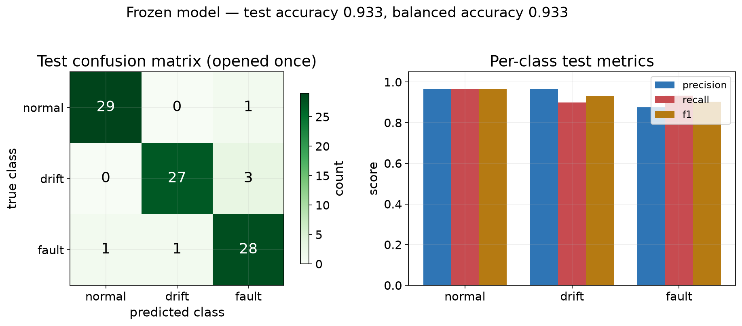
LECTURE 4 / 37
12 · FROZEN TEST
Final held-out test report
REPORT
Test accuracy 0.933 · balanced accuracy 0.933 · macro F1 0.934
Test mean cross-entropy 0.172 · majority baseline 0.333
Population: fresh IID rows from the same synthetic generator.
Scope: same synthetic generator only.
SE-801 · Artificial Neural Networks · Linear classification, softmax, and cross-entropy
37

Slide 38
LECTURE 4 / 38
13 · SYNTHESIS
Common errors to avoid
Implementation errors
Evaluation errors
• Softmax before CrossEntropyLoss
• Labels treated as ordinal numbers
• Naive exp() overflow in the loss
• Scaling fitted on all splits
• Epoch selected on test
• Accuracy reported alone
• Test set reused for tuning
• Claim beyond the sampled population
SE-801 · Artificial Neural Networks · Linear classification, softmax, and cross-entropy
38

Slide 39
LECTURE 4 / 39
13 · SYNTHESIS
A probability is not a promise
• A probability is a model output, not a frequency by construction.
• Temperature scaling changes confidence but not the decision.
• Calibration is checked against outcomes on held-out data.
• Predicting 0.8 does not mean that 8 of 10 such cases are correct.
SE-801 · Artificial Neural Networks · Linear classification, softmax, and cross-entropy
39

Slide 40
LECTURE 4 / 40
14 · CHECK & PREP
Ungraded concept check
• Regression versus classification, softmax, and cross-entropy.
• One derivation, one shape question, one hand calculation.
• One confusion matrix and its class-sensitive metrics.
• No marks; use it to find gaps before Lecture 5.
SE-801 · Artificial Neural Networks · Linear classification, softmax, and cross-entropy
40

Slide 41
LECTURE 4 / 41
14 · CHECK & PREP
Exit ticket: answer without the notebook
1. Logits [2, 1, −1], true class 1: name the prediction and write the stable loss.
2. Why do raw logits go into CrossEntropyLoss, not softmax probabilities?
3. High accuracy, zero recall for a rare fault class: name a revealing metric.
4. State the jobs of the training, validation, and test splits.
TRY IT Three minutes individually; then explain your reasoning.
SE-801 · Artificial Neural Networks · Linear classification, softmax, and cross-entropy
41

Slide 42
LECTURE 4 / 42
14 · CHECK & PREP
Reading and preparation
• D2L Chapter 4, Sections 4.1–4.5.
• Re-derive softmax, cross-entropy, and the p minus one-hot gradient.
• Practice: one confusion matrix with its per-class metrics.
• Next: what can an affine classifier not represent?
SE-801 · Artificial Neural Networks · Linear classification, softmax, and cross-entropy
42

Slide 43
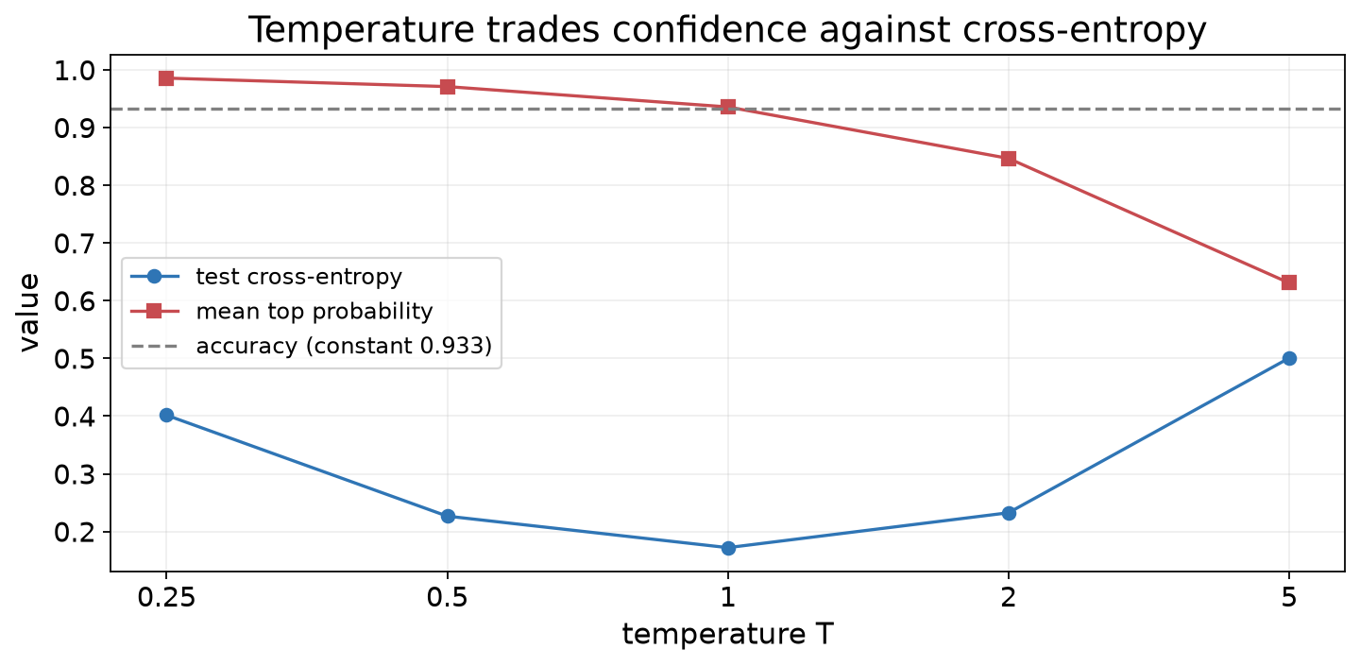
LECTURE 4 / 43
RESERVE · OPTIONAL
Reserve: temperature changes confidence
• Dividing logits by T > 0 never changes the prediction.
• Small T sharpens probabilities; large T softens them.
• Cross-entropy has a minimum near T = 1 for this model.
• Accuracy is constant at 0.933 across the whole sweep.
SE-801 · Artificial Neural Networks · Linear classification, softmax, and cross-entropy
43

Slide 44
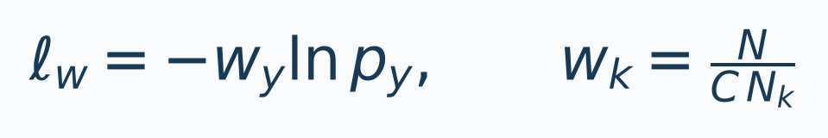
LECTURE 4 / 44
RESERVE · OPTIONAL
Reserve: weighting the loss for rare classes
• Multiply each example's loss by its class weight.
• A common choice: w_k = N / (C·N_k).
• Supports 50/10/5 give weights ≈ 0.433, 2.167, 4.333.
• Weights change the objective; report unweighted metrics too.
SE-801 · Artificial Neural Networks · Linear classification, softmax, and cross-entropy
44

