Slide 1
CASA An all-in-one solution
BB-31 Eddie, Felix and Savio

Slide 2
Create an app that can help people deal with extreme weather
App that help you prepare before the event
App that helps you after the event
Define the problem and question
Persona
Insights from survey
Our Solution - CASA

Slide 3





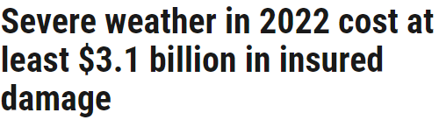
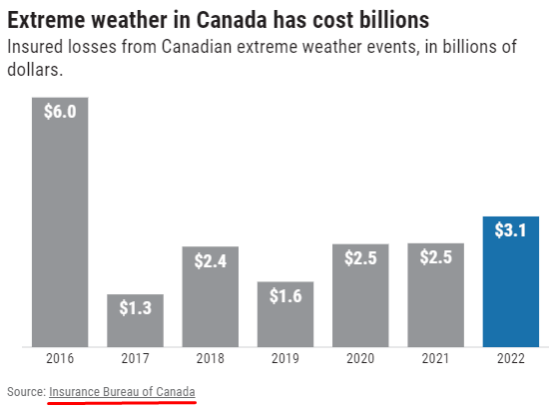


Where will you be when extreme weather hits?

Slide 4
We wanted to create an app that can help you before the event happens and after the event has happened

Slide 5
How can we create an app that helps people fortify their place of residence before an event is about to take place

