Slide 1

LockEssential
A Secured & Encrypted Personal Information Manager.
www.lockessential.com

Slide 2

Are you thinking same like us?
Notes:
https://www.1001freedownloads.com/free-clipart/question-guy

Slide 3
We have to use
Passwords
PIN Codes
ID Numbers
Everywhere…
Notes:
https://www.1001freedownloads.com/free-clipart/question-guy

Slide 4
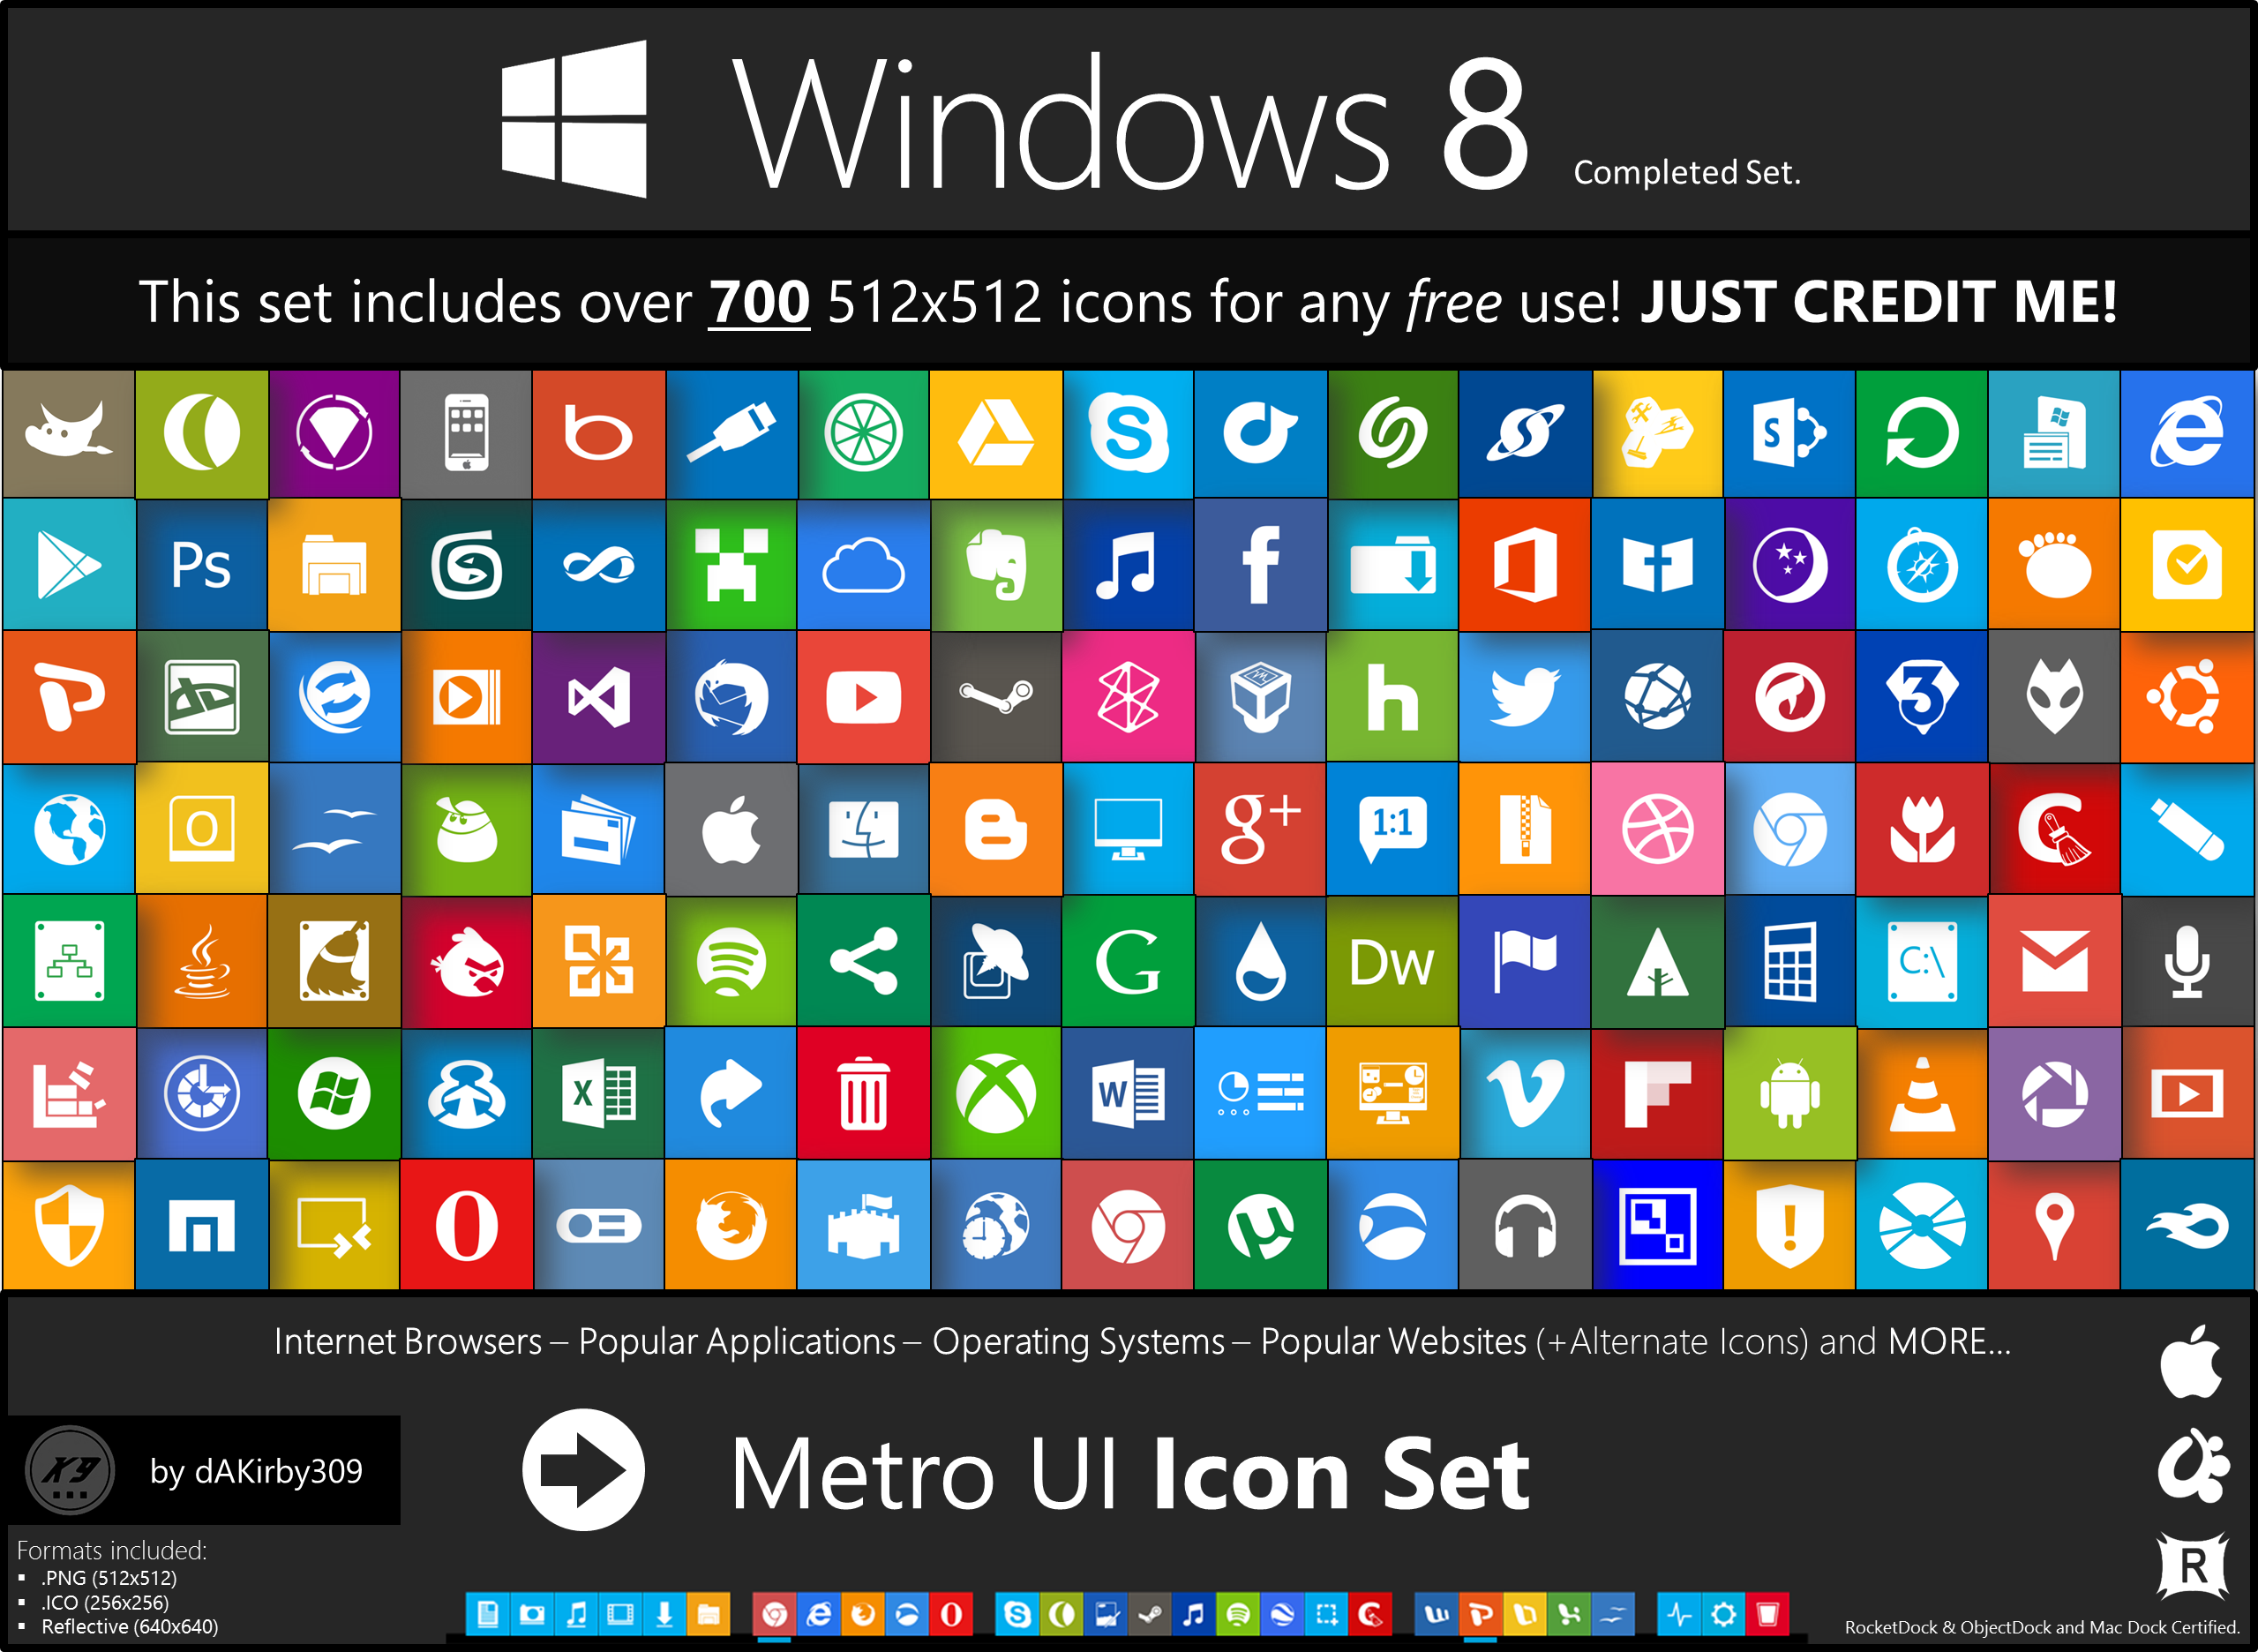
where not…???
Notes:
http://www.topdesignmag.com/10-popular-free-to-download-icon-sets-for-web-designers/
http://dakirby309.deviantart.com/art/Metro-UI-Icon-Set-725-Icons-280724102

Slide 5
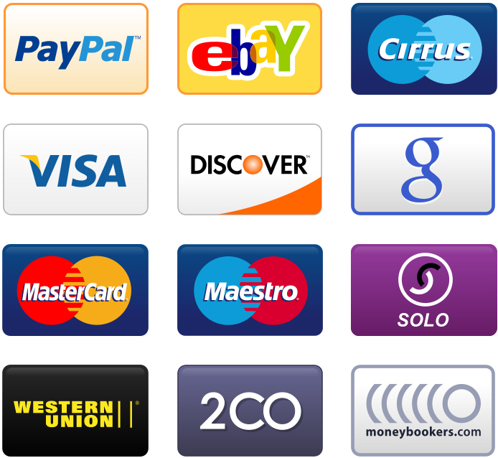
On top of that we have to manage very sensitive
Financial accounts
Notes:
https://www.1001freedownloads.com/free-clipart/question-guy
https://www.smashingmagazine.com/wp-content/uploads/2010/10/large-preview.jpg

Slide 6
So,
How are we Managing these now?
Notes:
https://www.1001freedownloads.com/free-clipart/question-guy

Slide 7
Using Same Password/code everywhere?
Wrong
Notes:
https://www.1001freedownloads.com/free-clipart/question-guy

Slide 8
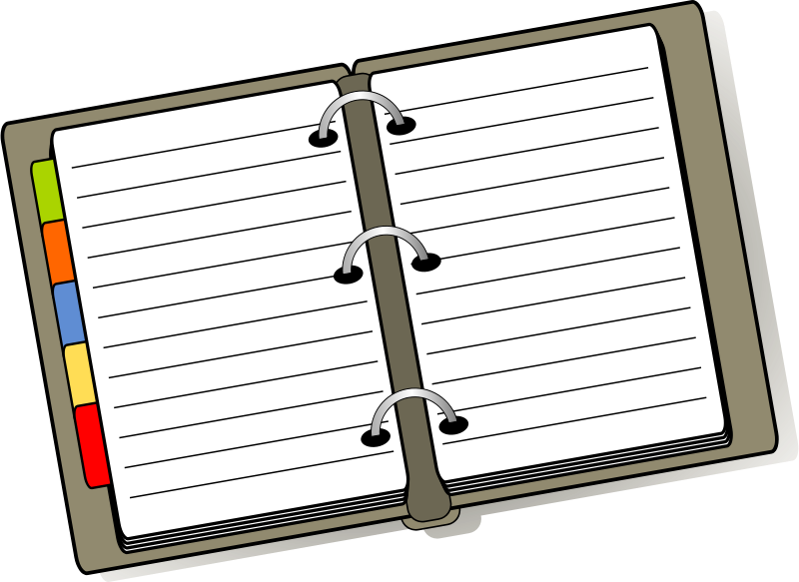

Using Notepad/Diary to save
Wrong
Notes:
https://www.1001freedownloads.com/free-clipart/question-guy
https://www.1001freedownloads.com/free-clipart/diary-5
https://www.1001freedownloads.com/free-clipart/notepad-page

Slide 9
Using
Word Excel
to save?
Wrong
Notes:
https://www.1001freedownloads.com/free-clipart/question-guy

Slide 10
Here comes lock essential
Your personal information manager
Simple to use
Open Source
Free
Notes:
https://www.1001freedownloads.com/free-clipart/question-guy

Slide 11

How it secures data?
AES encryption
SSL encryption
Client side + server side
4 layer protection
Notes:
https://www.1001freedownloads.com/free-clipart/question-guy

Slide 12
Features
Password generator
Responsive design, no need mobile app
Community devcenter
Notes:
https://www.1001freedownloads.com/free-clipart/question-guy

Slide 13
Features
Information managing is one side of the coin. Have idea of next generation password system??
Share in devcenter
Notes:
https://www.1001freedownloads.com/free-clipart/question-guy

