Slide 1


Slide 2
Neutrophil count in bronchoalveolar lavage fluid versus Pneumonia severity index as a predictor of mortality in ventilator-associated pneumonia
Thesis submitted by
Ahmad Fayed
In partial fulfillment of Master Degree
in Critical Care Medicine
Faculty of medicine - cairo university
2020

Slide 3
Supervisors
Prof. Dr. Ashraf Wadie Andraos
Professor of Critical Care – Cairo University
Prof. Dr. Raef Hosny Emam
Professor of Pulmonology – Cairo University
Dr. Waleed Kamel Mohamed
Lecturer of Critical Care – Cairo University

Slide 4
Introduction

Slide 5
Ventilator-associated pneumonia (VAP) is one of the most frequent infections with high mortality rates in intensive care units (ICUs) and the prediction of outcome is important in the decision-making process

Slide 6
Definition
Pneumonia that shows up > 48 hours of intubation and mechanical ventilation. Ventilator associated pneumonia (VAP) is a clinical diagnosis based upon the identification of a new or progressive lung infiltrate on imaging with clinical evidence that the infiltrate is of infectious origin (eg, fever, purulent sputum, leukocytosis, and decline in oxygenation), together with a positive pathogen identified on microbiologic respiratory sample.

Slide 7
Bronchoalveolar lavage is the sampling of the lower respiratory tract by the instillation and subsequent aspiration of fluid. The technique recovers cells, soluble proteins, lipids, and other chemical constituents from the epithelial surface of the lungs.

Slide 8
Clinically, BAL has been helpful in the diagnosis and differentiation of various types of lung diseases including interstitial lung diseases, malignancies, and pulmonary infections. It also has been used in defining the stages of disease, its progression, and response to therapy. As a research tool, it is useful in the investigation of the cellular and humoral events occurring in lungs.

Slide 9
Aim of the study

Slide 10
Assessment of the prognostic utility for different clinical scores in patients with VAP.
Assessment of differential leucocyte count in bronchoscopic BALF as a predictor of mortality in patients with VAP.

Slide 11
Patients & Methods

Slide 12
This is a prospective observational cohort study, was conducted on sixty patients diagnosed as having ventilator-associated pneumonia, the study took place from March 2019 to February 2020. All patients were consented and fully informed before the procedure. Approval from the local ethics committee was obtained. All patients were admitted to the Critical care department, Cairo University.

Slide 13
Inclusion criteria
Patients 18 years and older.
Patients diagnosed as having ventilator-associated pneumonia

Slide 14
Exclusion criteria
Patients younger than 18 years.
Refractory hypoxia on Mechanical Ventilation requiring high ventilatory settings (high risk patients).
Coagulopathy or high bleeding risk.
Do not resuscitate order or imminent death.
Severe hemodynamic instability.
Refusal to participate or to refrain from study.

Slide 15
Methods
Informed consent.
Detailed medical history & physical examination.
Routine Labs and investigations as complete blood count, kidney function tests, liver function tests, coagulation profile, electrolyte profile, arterial blood gases and chest x-ray.
Laboratory and clinical infection parameters: TLC, CRP, Sputum culture and sensitivity. Chest x-ray and CT chest for clinically indicated and fit patients.

Slide 16
Methods – Cont’d
The following clinical scores were calculated for all patients:
CPIS
APACHE II
PSI
PIRO score for VAP
IBMP-10

Slide 17
Methods – Cont’d
Bronchoalveolar lavage followed.
The upper or midlevel trachea is entered via the endotracheal tube (ETT), or tracheostomy tube, and the airway was visualized, however, one must be attentive to the fact that the vocal cords or proximal trachea including the subglottic trachea is bypassed and not examined when ETT or tracheostomy tube is in place.

Slide 18
Methods – Cont’d
Visual examination of the trachea, mainstem bronchi, and segmental bronchi was a cardinal component of every bronchoscopy, except when the patient is hypoxemic and the procedure needs to be terminated.
Optimal site: The aim was to perform the lavage where the disease is most prominent clinically and radiographically. Lavage in one site is usually adequate, especially if a cumulative volume of 100 mL or greater is instilled. However, most of the patients had consolidation in more than a site.

Slide 19
Methods – Cont’d
Once the lavage site has been chosen, the bronchoscope is advanced into a subsegmental bronchus until the lumen is occluded; this is referred to as the "wedged" position. A good wedge position is confirmed by noting slight airway collapse when gentle suction is applied.
BAL was performed with aliquots of 20 - 60 ml of normal saline at room temperature. The volume of fluid to be instilled was a total of 100 to 240 mL of fluid in 20 to 60 mL aliquots. Fluid is then recovered by gentle suction.

Slide 20
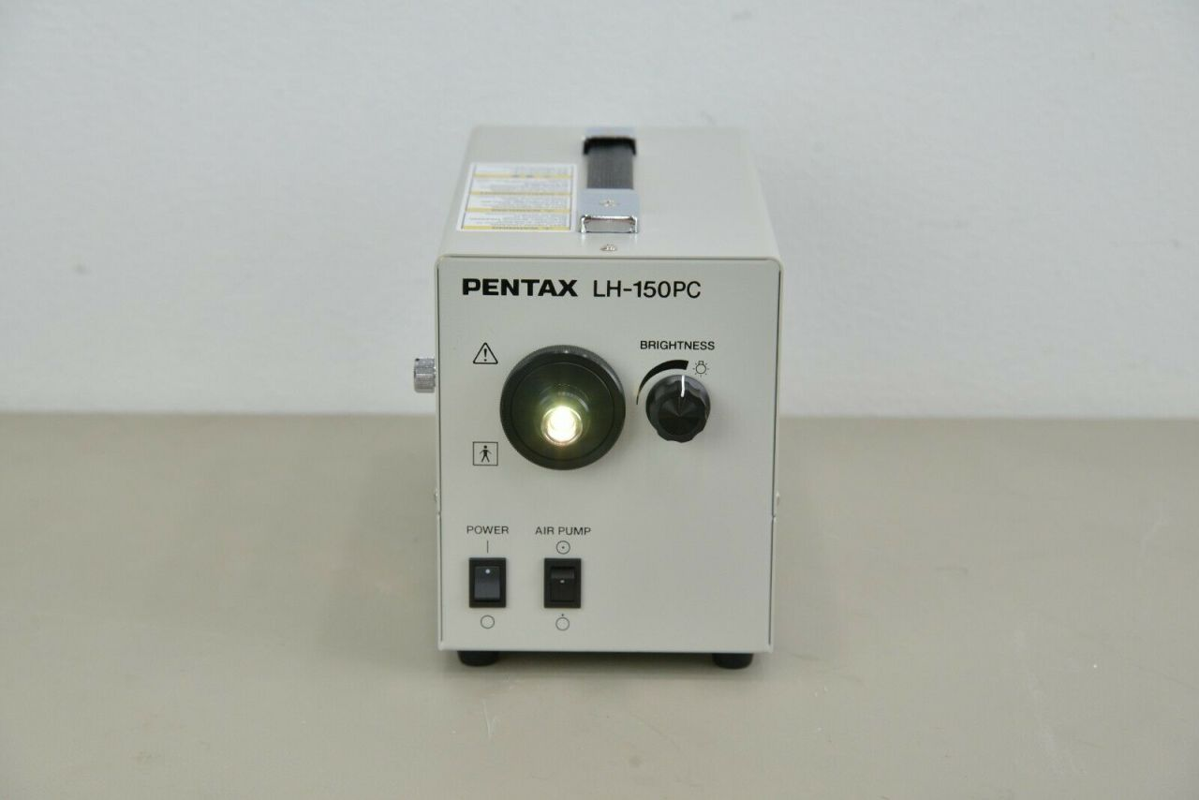
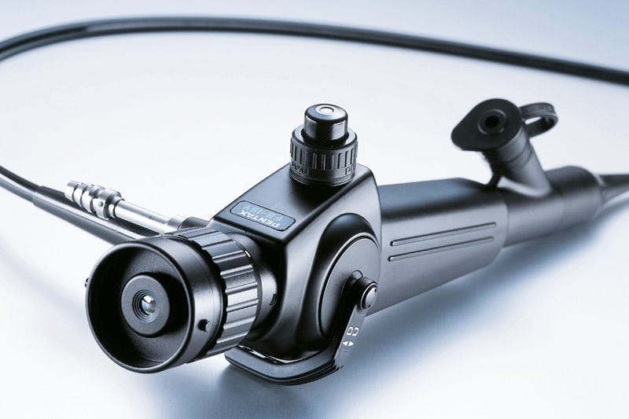
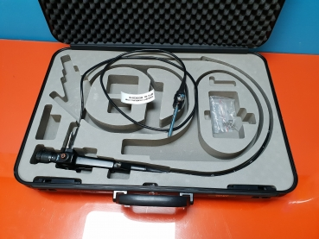
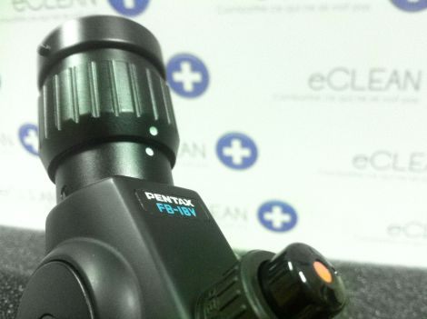
Methods – Cont’d
The used bronchoscope is Pentax FB-18V fiber-optic bronchoscope

Slide 21
Methods – Cont’d
BALF retreived was sent for
culture and sensitivity.
Differential cell count.

Slide 22
Differential cell count:
The sample was harvested into a non-reagent tube, then centrifuged in no-longer than 120 minutes for 10-15 minutes using "cence centrifuge TD3". The deposit is then examined under light microscopy "OLYMPUS CX 21", after being left to air-dry and fixation. Leishman stain is applied and manual count is anticipated.

Slide 23
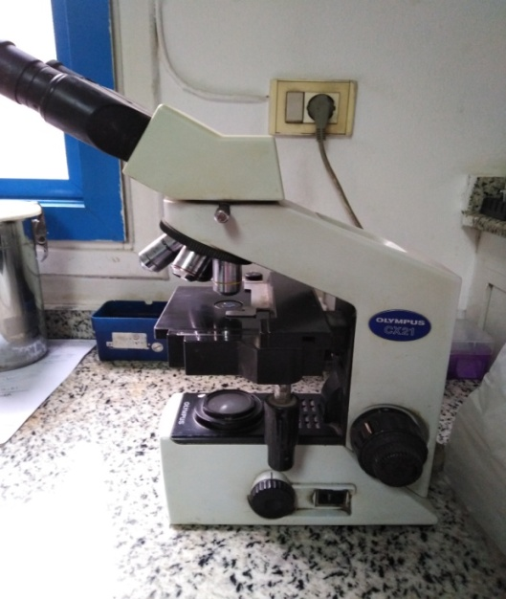
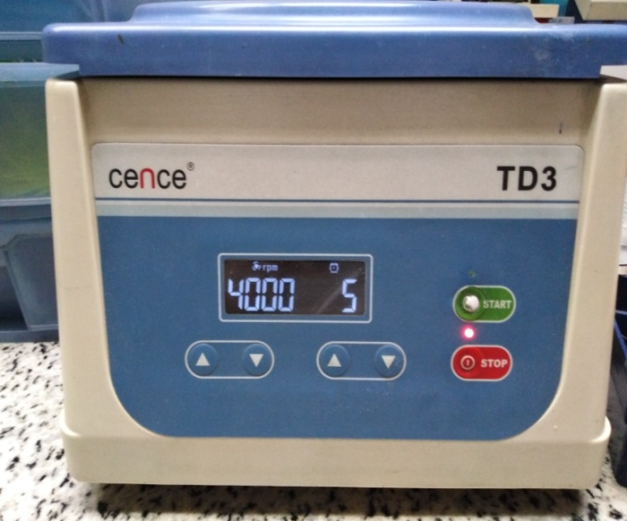

Slide 24
Clinical management & Follow-up
All patients initially received empirical antimicrobial treatment, and the regimen was adjusted according to microbiological results. In case of negative microbiological findings antimicrobial treatment was not stopped.

Slide 25
All patient were followed up probable hypoxia, arrythmias or bleeding just in the first two hours after bronchocopy. Complications of bronchoscopy are in general rare to happen.
Chest clinical examination and chest radiology whether chest X-ray or CT Chest. Follow up sepsis markers.

Slide 26
Response to BALF culture and sensitivity results.
Follow up clinical, radiological and laboratory wise after modification of antibiotics, for improvement and weaning of mechanical ventilation up to discharge out of ICU or worsening and failure of weaning.

Slide 27
Results

Slide 28
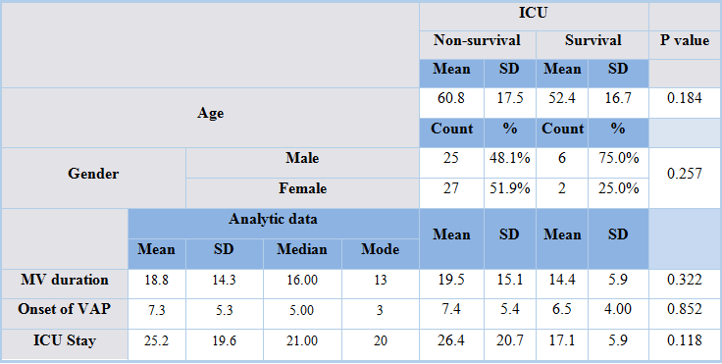

Slide 29
Mechanical ventilation cause: More than half (55%) of the population of the study were ventilated for actual or impending respiratory failure. While 45% were intubated for shock state or to secure airway (Disturbed consciousness). The cause of mechanical ventilation did not have statistical relation with survival (P value 1)

Slide 30
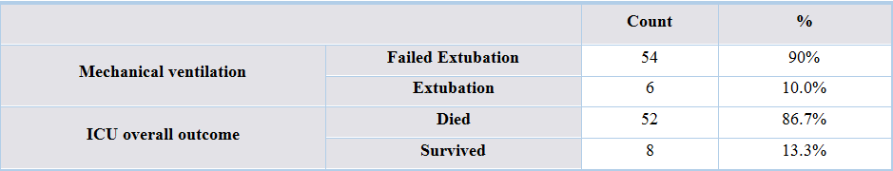
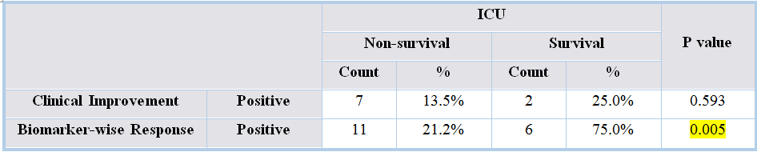

Slide 31
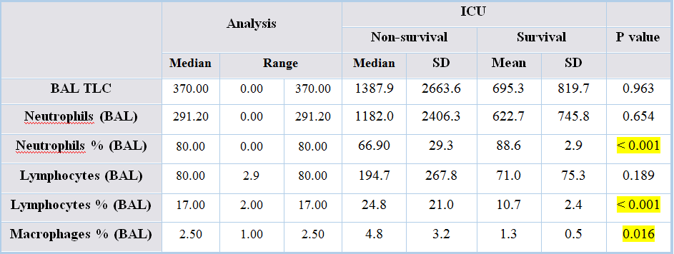

Slide 32
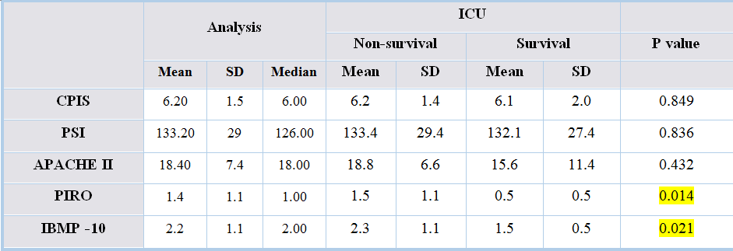

Slide 33
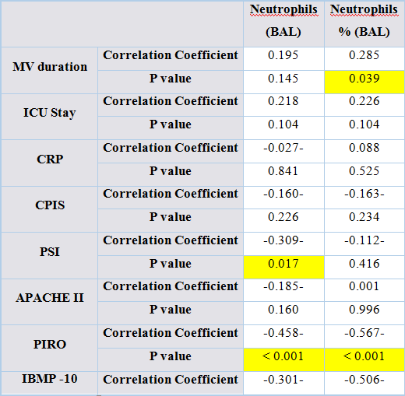

Slide 34
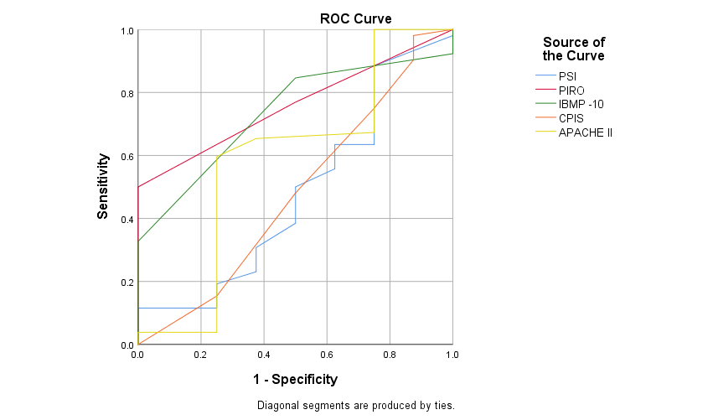
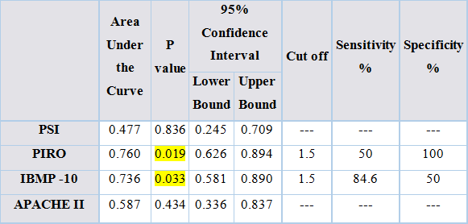

Slide 35
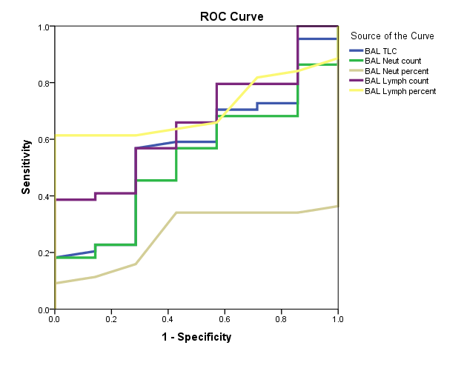
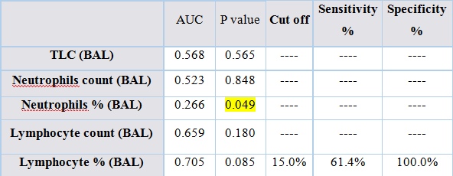

Slide 36
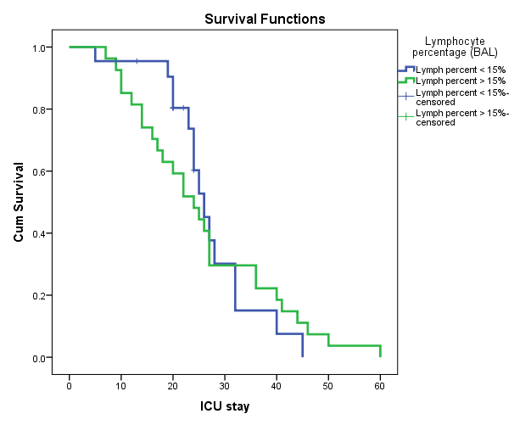
Kaplan-Meier analysis was done where patients were divided into two groups according to lymphocyte percentage in BALF (either more than 15% or less). Log-rank test showed no significant difference.

Slide 37
Conclusion

Slide 38
Unlike Pneumonia severity index and APACHE II scores, PIRO and IBMP-10 scores were good predictors for mortality in patients with ventilator-associated pneumonia. Where high PIRO and IBMP-10 were associated with higher mortality.

Slide 39
Higher lymphocyte percentage in BALF was associated with higher mortality. Also, macrophages in BALF were associated with high mortality.

Slide 40


