Slide 1


Slide 2
Predictive value of NT-proBNP on Postoperative Outcome of Isolated Coronary Artery Bypass Patients
Thesis submitted by
Ibrahim AbuBakr Elsedeeq
In partial fulfillment of MD
in Critical Care Medicine
Faculty of medicine - cairo university
2021

Slide 3
Supervisors
Prof. Dr. Gamal Hamid Ahmed
Professor of Critical Care Medicine
Prof. Dr. Tarek El Tawil
Professor of Cardiothoracic Surgery
Prof. Dr. Amal Rizk
Consultant of Clinical Pathology
Critical Care Department
Dr. Mohamed Fawzy Abdel-Aleem
Assistant Professor of Critical Care Medicine

Slide 4
Introduction

Slide 5
BNP is produced in both atria and ventricles in response to increased myocardial stretch and wall stress.
Other stimuli for its induction and release include inflammation, activation of the sympathetic nervous system, and the renin-angiotensin-aldosterone system as well as myocardial ischemia.
Other pathologies such as exacerbated chronic obstructive pulmonary disease, arrhythmias and myocarditis can cause eleveted BNP levels.
Higher NP levels are associated with: female gender, impaired renal function, and older age.
BNP induces diuresis, natriuresis, vascular dilatation and inhibition of the sympathetic nervous system reducing cardiac preload and afterload to counteract the detrimental effects of pressure and volume overload seen in HF.

Slide 6
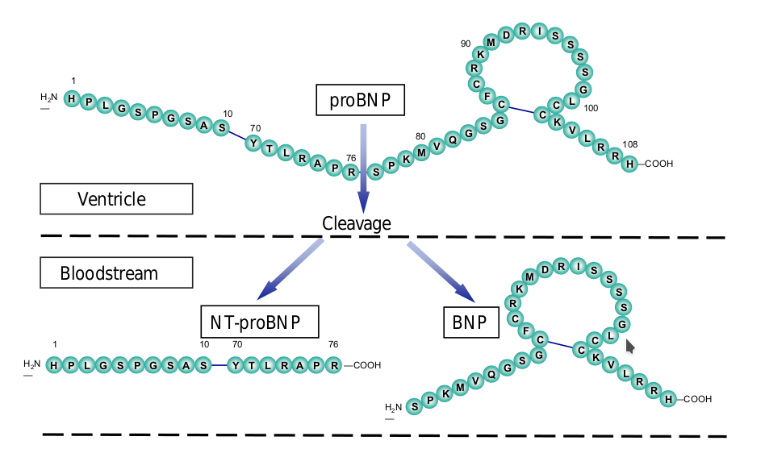
The pro-hormone pre-proBNP, is cleaved into biologically active BNP and the inactive N-terminal-proBNP (NTproBNP), thus they are secreted in equimolar quantites into the circulation.

Slide 7
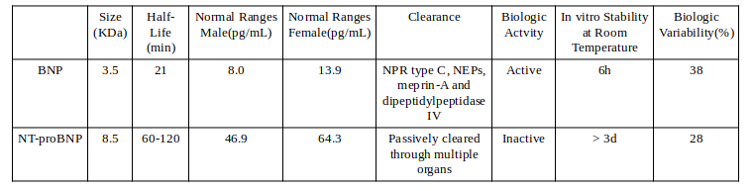
BNP has a serum half-life of 20 minutes, whereas NTproBNP has a half-life of 120 minutes causing serum levels of BNP to be significantly lower than those of NTproBNP, despite equimolar secretion.
Both BNP and NTproBNP are established markers for cardiac failure. NTproBNP is also more stable, which makes its measurement more reliable.

Slide 8
Changes in hemodynamic parameters (such as left ventricular ejection fraction, EF) and plasma natriuretic peptides (NPs) levels are closely related in patients with cardiovascular diseases.
NPs assay are useful as a prognostic marker in HF and acute coronary artery syndromes.
NPs concentrations are independent risk markers for morbidity and/or mortality in patients with acute or chronic HF.
Both BNP and NTproBNP have been shown to be predictive of adverse outcomes in patients presenting with acute coronary syndrome revealed important prognostic information.

Slide 9
In patients undergoing cardiac surgery risk adjustment is of paramount importance for clinical audit, benchmarking and research and to identify high-risk patients that may benefit from prophylactic interventions to reduce post-operative adverse outcomes.
There are many clinical prognostic models such as EuroSCORE. Most of these clinical prognostic scores for cardiac surgery are useful in predicting mortality but not adverse events such as AF or cardiogenic shock requiring IABP.
Elevated levels of BNP and NT pro-BNP are associated with adverse outcomes in patients undergoing major non-cardiac surgery.

Slide 10
Aim of the study

Slide 11
to investigate whether preoperative NTproBNP levels are associated with in-hospital mortality and post-operative outcome variables in patients undergoing elective offpump coronary artery bypass grafting.

Slide 12
Patients & Methods

Slide 13
65 consecutive cases registered for elective off-pump coronary artery bypass grafting OPCAB were recruited from 3 cardiothoracic surgery centers in this study constrained by the following inclusion and exclusion criteria

Slide 14
Inclusion criteria
Patients undergoing elective OPCAB.
Age group between 18 and 80 years old.

Slide 15
Exclusion criteria
Patients with signicant valvular heart disease, dilated or hypertophic cardiomyopathy, NYHA III or IV, EF < 40 %, need for inotropic support or intra-aortic balloon pump before surgery
preoperative atrial fibrillation
creatinine clearance < 60 ml/min/1.73 m2
hyperthyoidism and hypothyroidism (serum TSH levels above or below reference ranges respectively. It was measured only upon clinical suspicion.)
moderate to severe COPD (Shortness of breath at own pace on the level, FEV1 < 80% of predicted, or continuous use of bronchodilators for > 2 weeks).

Slide 16
Study’s Procedure and Data Collection
Beta-blocking agents and statins were given to all patients until the morning of surgery.
Oral antiplatelets were stopped 5-7 days before surgery
Euroscore II was calculated.
Anesthetic and surgical management was not standardized.
All patients were transferred to the intensive care unit ICU, after conclusion of surgery; intubated and mechanically ventilated.
The patients were assessed for extubation within 4-8 hours of arrival in the ICU.

Slide 17
Study’s Procedure and Data Collection
The following data were collected :
Full history taking and clinical examination.
Echocardiography pre-operative.
Labs:
routine pre-operative labs: CBC, coagulation profile, liver and kidney functions test
specific: pre-operative NTproBNP
Calculated of EUROSCORE II
Data collection to evaluate incidence of complications postoperative ICU stay and till discharge from hospital including:
prolonged intubation
ischemic stroke
timing, duration and dose of inotropic support
use of intra-aortic ballon pump
myocardial infarction
arrhythmias
Length of postoperative ICU and hospital stay
death

Slide 18
Study’s Procedure and Data Collection
Clinical end points
low output heart failure (inotropic support at second post-operative day, adrenaline > 50ng/kg/min or dobutamine > 10mcg/kg/min at any time and/or need for intra-aortic balloon pump)
mortality
arrhythmias
perioperative myocardial Infarction
length of ICU
length of postoperative hospital stay
prolonged intubation (Intubation more than 24 hours postoperatively and/or reintubation following planned extubation).

Slide 19
Lab and sample analysis methods
Venous samples for measuring NT-proBNP were collected on the day of surgery before induction.
Samples were sent for analysis at critical care department laboratories, Cairo University hospitals.
EDTA samples were collected and plasma samples were stored in deep freezer till measured once.
Lab staff were blinded to the clinical conditions
and clinicians were blinded to the preoperative NTproBNP sample results.

Slide 20
Lab and sample analysis methods
We used ELISA immunoassay technique that allows in vitro quantitative determination of human NTproBNP concentrations in serum, plasma and biological fluids.
ELISA (Enzyme-Linked Imuunosorbent Assay) is based on the competitive binding enzyme immunoassay technique. The microtiter plate provided in the kit has been pre-coated with an antibody specific to NTproBNP. During the reaction, NTproBNP in the sample or standard competes with a fixed amount of biotin-labeled for sites on a precoated monoclonal antibody (Ab) specific to NTproBNP.

Slide 21
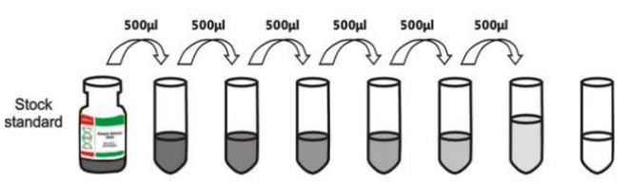
Lab and sample analysis methods
Standard was reconstituted with 1 ml of sample diluent. This produces a stock standard of 20ng/mL.
The undiluted standard serves as high standard concentration (20ng/mL) and the sample diluent serves as zero standard concentration.

Slide 22
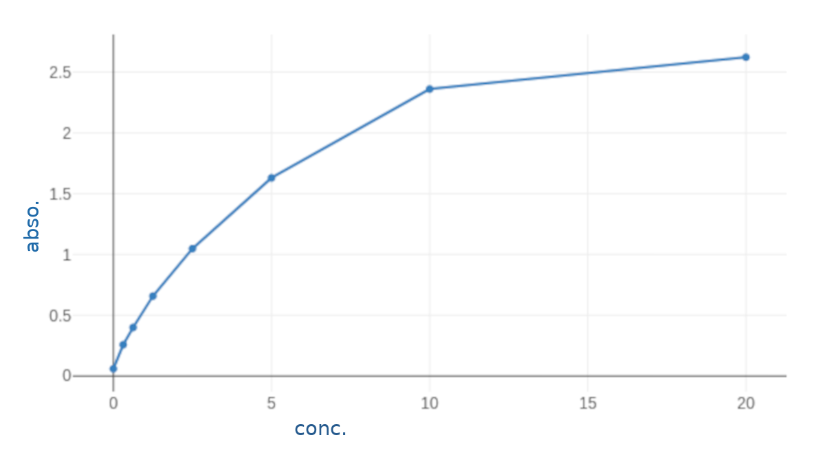
Lab and sample analysis methods
A curve is plotted with serial standard dilutions log graph, plotting the mean absorbance for each standard on the X-axis against the concentration on the Y-axis and draw a best fit curve through the points on the graph.
The concentration of NTproBNP in the samples is then determined by plotting the OD (optical density) of the samples on the standard curve.

Slide 23
Lab and sample analysis methods
We used ELISA immunoassay technique that allows in vitro quantitative determination of human NTproBNP concentrations in serum, plasma and biological fluids.
ELISA (Enzyme-Linked Imuunosorbent Assay) is based on the competitive binding enzyme immunoassay technique. The microtiter plate provided in the kit has been pre-coated with an antibody specific to NTproBNP. During the reaction, NTproBNP in the sample or standard competes with a fixed amount of biotin-labeled for sites on a precoated monoclonal antibody (Ab) specific to NTproBNP.

Slide 24
Results

Slide 25
Demographics and Risk Factors
Sixty-five patients were recruited
The average age was 57.62 ±7.21
56 (86.15%)were males
10 (15.38%) had diabetes mellitus
42 (64.62%) were hypertensive
only one had peripheral vascular disease

Slide 26
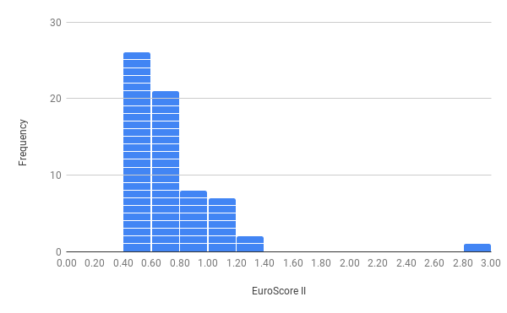
preoperative ejection fraction averaged 50.91±8.13
EuroscoreII averaged 0.76±0.34. Its median was 0.68(0.50-2.94) with IQR [0.55-0.82]

Slide 27
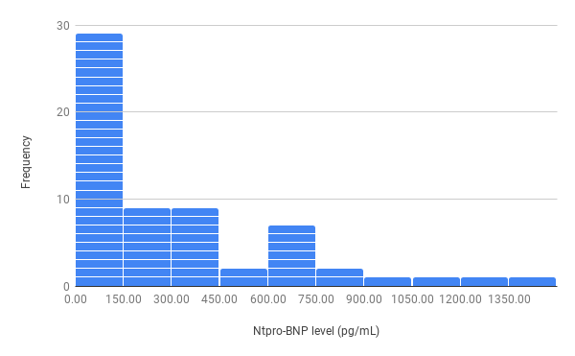
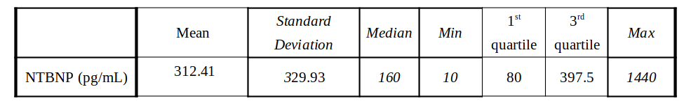
Preoperative NTproBNP Levels

Slide 28
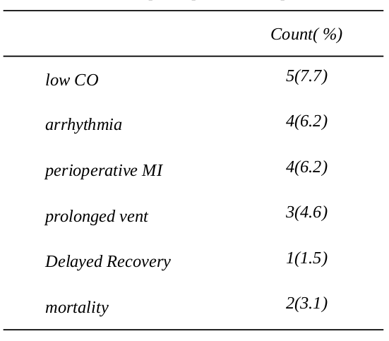
Postoperative Outcome
mean ICU stay was 3.37±0.84 days
mean hospital stay was 6.38±1.3 ( 3-12) days

Slide 29
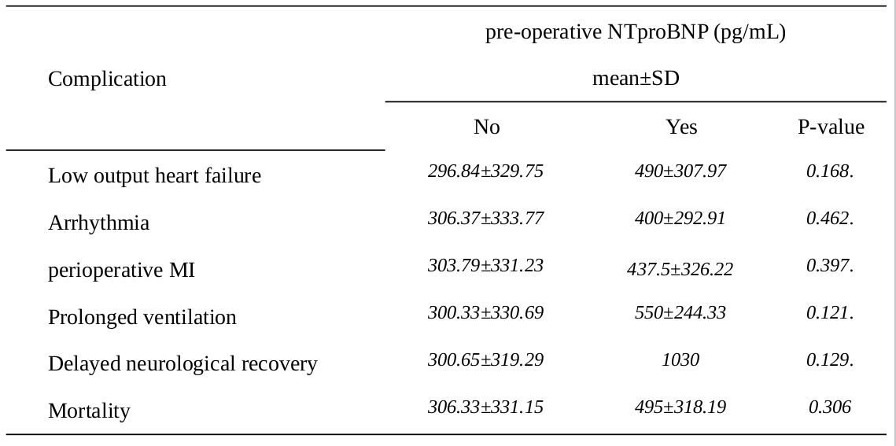
Relation between NTproBNP and Outcome

Slide 30
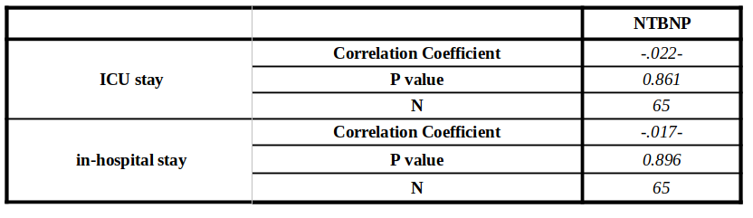
Relation between NTproBNP and Outcome

Slide 31
Conclusion

Slide 32
Our study didn’t show significant correlation between pre-operative NTproBNP and post-operative heart failure, arrhythmias, perioperative myocardial infarction, length of ICU stay, prolonged intubation, hospital stay or mortality.
This is likely due to the low incidence of complications and low NTproBNP levels secondary to favorable outcomes in our patients given that they had very low risk factors.

Slide 33
Thank You

