Slide 1
Chapter 4 – Dimension Reduction
Data Mining for Business Analytics in Python
Shmueli, Bruce, Gedeck & Patel

Slide 2
Exploring the data
Statistical summary of data: common metrics
Average
Median
Minimum
Maximum
Standard deviation
Counts & percentages

Slide 3
Exploring the data
fix name for CAT.MEDV
bostonHousing_df = pd.read_csv('BostonHousing.csv')
bostonHousing_df = bostonHousing_df.rename(columns={'CAT.
MEDV': 'CAT_MEDV'})
# Compute mean, standard dev., min, max, median, length,
and missing values for all variables
pd.DataFrame({'mean': bostonHousing_df.mean(),
'sd': bostonHousing_df.std(),
'min': bostonHousing_df.min(),
'max': bostonHousing_df.max(),
'median': bostonHousing_df.median(),
'length': len(bostonHousing_df),
'miss.val': bostonHousing_df.isnull().sum(),
})

Slide 4
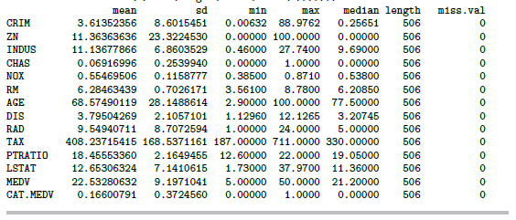
Summary Statistics for Boston Housing Data

Slide 5
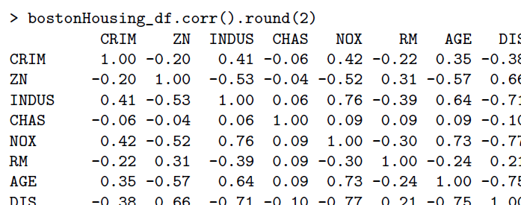
Correlation Matrix for Boston Housing Data
portion of the correlation table shown, using corr from pandas

Slide 6
Using value_counts(), in pandas, to tabulate counts
> bostonHousing_df.CHAS.value_counts()
0 1
471 35
Name: CHAS, dtype: int64
35 neighborhoods have a CHAS value of “1,” i.e. they border the Charles River

Slide 7
Using groupby() to tabulate counts using multiple variables
# Create bins of size 1 for variable using the method pd.cut. Default
# creates a categorical variable, e.g. (6,7]. labels=False determines
# integers instead, e.g. 6.
bostonHousing_df['RM_bin'] = pd.cut(bostonHousing_df.RM, range(0, 10),
labels=False)
# Compute average of MEDV by (binned) RM and CHAS. First group the data frame
# using the groupby method, then restrict the analysis to MEDV and determine the
# mean for each group.
bostonHousing_df.groupby(['RM_bin', 'CHAS'])['MEDV'].mean()
RM_bin CHAS
3 0 25.300000
4 0 15.407143
5 0 17.200000
1 22.218182
6 0 21.769170
1 25.918750
7 0 35.964444
1 44.066667
8 0 45.700000
1 35.950000
In neighborhoods where houses averaged 3 rooms and did not border the Charles, median value was 25.3 ($000)

Slide 8
Use pivot_table() in pandas for pivot tables
# create bins of size 1 for RM
bostonHousing_df['RM_bin'] = pd.cut(bostonHousing_df.RM, range(0, 10),
labels=False)
# use pivot_table() to reshape data and generate pivot table
pd.pivot_table(bostonHousing_df, values='MEDV', index=['RM_bin'],
columns=['CHAS'], aggfunc=np.mean, margins=True)
CHAS 0 1 All
RM_bin
3 25.300000 NaN 25.300000
4 15.407143 NaN 15.407143
5 17.200000 22.218182 17.551592
6 21.769170 25.918750 22.015985
7 35.964444 44.066667 36.917647
8 45.700000 35.950000 44.200000
All 22.093843 28.440000 22.532806
neighborhoods not bordering Charles River, with 8 rooms, have MEDV = 45.7

Slide 9
Reducing Categories
A single categorical variable with m categories is typically transformed into m or m-1 dummy variables (handled automatically by most R modeling functions
Each dummy variable takes the values 0 or 1
0 = “no” for the category
1 = “yes”
Problem: Can end up with too many variables
Solution: Reduce by combining categories that are close to each other
Use pivot tables to assess outcome variable sensitivity to the dummies
Exception: Naïve Bayes can handle categorical variables without transforming them into dummies

Slide 10
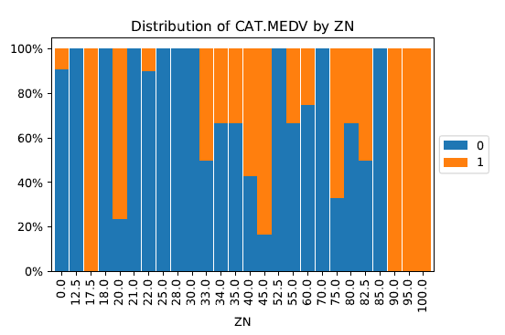
Combining Categories
Stacked bar chart: Many zoning categories are the same or similar with respect to CATMEDV

Slide 11
CODE FOR STACKED BAR CHART
# use method crosstab to create a cross-tabulation of two
variables
tbl = pd.crosstab(bostonHousing_df.CAT_MEDV, bostonHousing_df.ZN)
# convert numbers to ratios
propTbl = tbl / tbl.sum()
propTbl.round(2)
# plot the ratios in a stacked bar chart
ax = propTbl.transpose().plot(kind='bar', stacked=True)
ax.set_yticklabels(['{:,.0\%}'.format(x) for x in ax.get_yticks()])
plt.title('Distribution of CAT.MEDV by ZN')
plt.legend(loc='center left', bbox_to_anchor=(1, 0.5))
plt.show()

Slide 12
Principal Components Analysis
Goal: Reduce a set of numerical variables.
The idea: Remove the overlap of information between these variable. [“Information” is measured by the sum of the variances of the variables.]
Final product: A smaller number of numerical variables that contain most of the information

Slide 13
Principal Components Analysis
How does PCA do this?
Create new variables that are linear combinations of the original variables (i.e., they are weighted averages of the original variables).
These linear combinations are uncorrelated (no information overlap), and only a few of them contain most of the original information.
The new variables are called principal components.
Notes:
‹#›

Slide 14
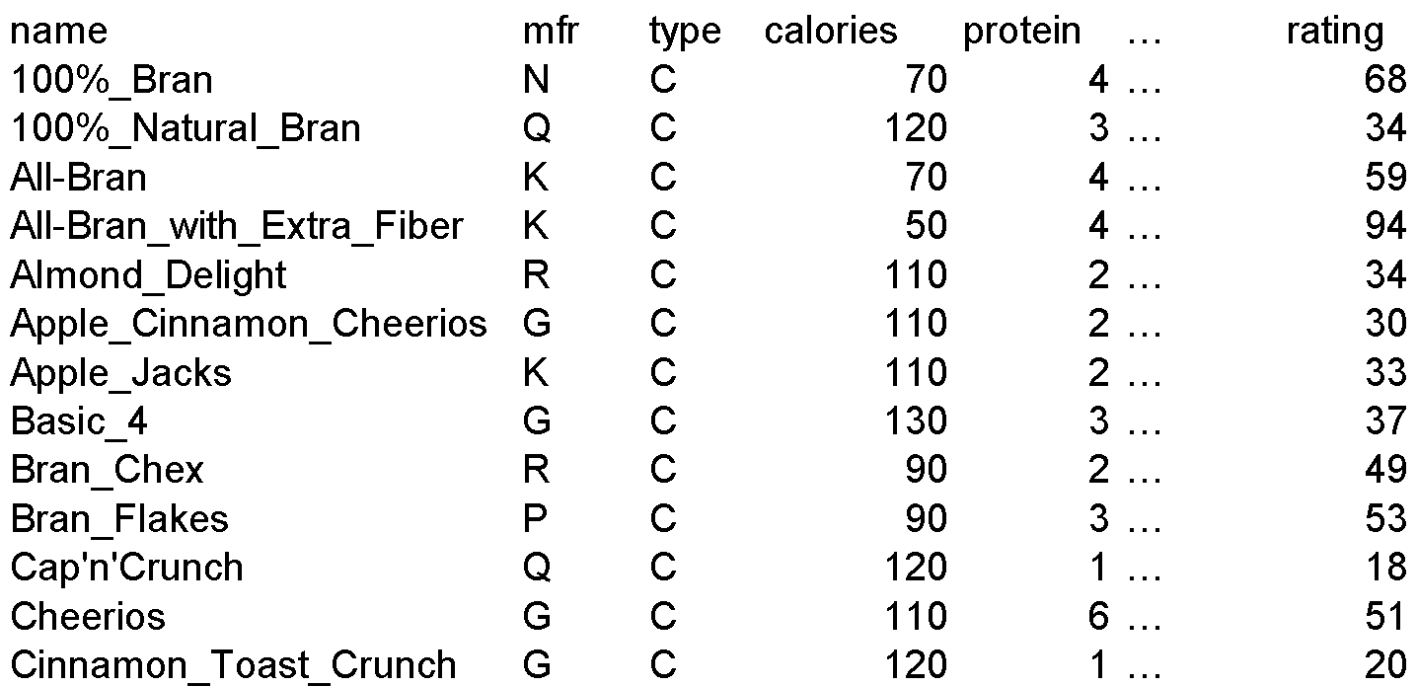
Example – Breakfast Cereals (excerpt)

Slide 15
Description of Variables
Name: name of cereal
mfr: manufacturer
type: cold or hot
calories: calories per serving
protein: grams
fat: grams
sodium: mg.
fiber: grams
carbo: grams complex carbohydrates
sugars: grams
potass: mg.
vitamins: % FDA rec
shelf: display shelf
weight: oz. 1 serving
cups: in one serving
rating: consumer reports

Slide 16
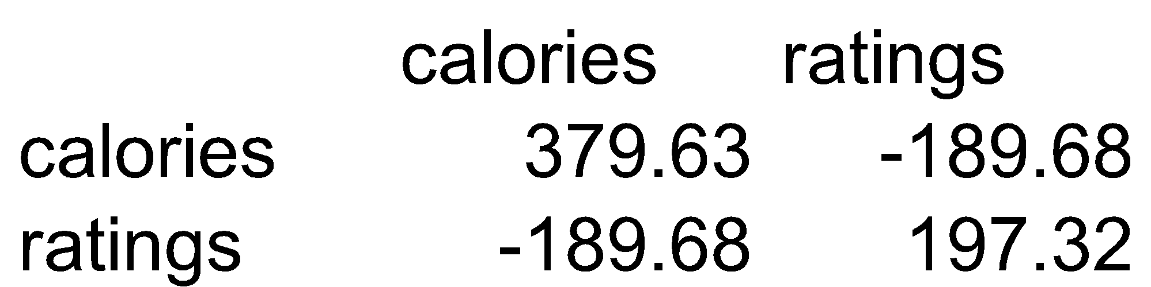
Consider calories & ratings covariance matrix
Total variance (=“information”) is sum of individual variances: 379.63 + 197.32
Calories accounts for 379.63/577 = 66%
If we want to make do with just calories, we lose 34% of the variation

Slide 17
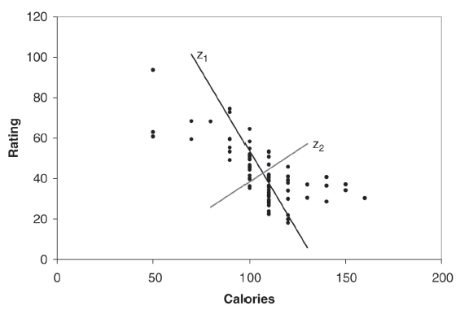
Using linear combinations to redistribute the variability in a more polarized way
Z₁ and Z₂ are two linear combinations.
Z₁ has the highest variation (spread of values)
Z₂ has the lowest variation

Slide 18
PCA output for these 2 variables
pcs = PCA(n_components=2)
pcs.fit(cereals_df[['calories', 'rating']])
Weights to project original data onto Z₁ & Z_{2,} e.g. (-0.847, 0.532) are weights for Z₁
PC1 PC2
cereals.df.calories -0.8470535 0.5315077
cereals.df.rating 0.5315077 0.8470535
Importance of components:
PC1 PC2
Standard deviation 22.3165 8.8844
Proportion of Variance 0.8632 0.1368
Cumulative Proportion 0.8632 1.0000
86% of the total variance is accounted for by component 1

Slide 19
Principal Component Scores for the First Five Records
PC1 PC2
[1,] 44.921528 2.1971833
[2,] -15.725265 -0.3824165
[3,] 40.149935 -5.4072123
[4,] 75.310772 12.9991256
[5,] -7.041508 -5.3576857

Slide 20
PCA for the 13 Numerical Variables in the Cereals Data
pcs = PCA()
pcs.fit(cereals_df.iloc[:, 3:].dropna(axis=0))
pcsSummary_df = pd.DataFrame({'Standard deviation':
np.sqrt(pcs.explained_variance_), 'Proportion of variance':
pcs.explained_variance_ratio_,'Cumulative proportion':
np.cumsum(pcs.explained_variance_ratio_)})
pcsSummary_df = pcsSummary_df.transpose()
pcsSummary_df.columns = ['PC{}'.format(i) for i in range(1,
len(pcsSummary_df.columns) + 1)]
pcsSummary_df.round(4)
PC1 PC2 PC3 PC4 PC5 PC6
Standard deviation 83.7641 70.9143 22.6437 19.1815 8.4232 2.0917
Proportion of variance 0.5395 0.3867 0.0394 0.0283 0.0055 0.0003
Cumulative proportion 0.5395 0.9262 0.9656 0.9939 0.9993 0.9997
PC7 PC8 PC9 PC10 PC11 PC12 PC13
Standard deviation 1.6994 0.7796 0.6578 0.3704 0.1864 0.063 0.0
Proportion of variance 0.0002 0.0000 0.0000 0.0000 0.0000 0.000 0.0
Cumulative proportion 0.9999 1.0000 1.0000 1.0000 1.0000 1.000 1.0
The first two components account for 93% of the total variance, so using 2-3 components in further modeling would probably be sufficient

Slide 21
The Weightings for the First Five Components
PC1 PC2 PC3 PC4 PC5
calories -0.077984 -0.009312 0.629206 -0.601021 0.454959
protein 0.000757 0.008801 0.001026 0.003200 0.056176
fat 0.000102 0.002699 0.016196 -0.025262 -0.016098
sodium -0.980215 0.140896 -0.135902 -0.000968 0.013948
fiber 0.005413 0.030681 -0.018191 0.020472 0.013605
carbo -0.017246 -0.016783 0.017370 0.025948 0.349267
sugars -0.002989 -0.000253 0.097705 -0.115481 -0.299066
potass 0.134900 0.986562 0.036782 -0.042176 -0.047151
vitamins -0.094293 0.016729 0.691978 0.714118 -0.037009
shelf 0.001541 0.004360 0.012489 0.005647 -0.007876
weight -0.000512 0.000999 0.003806 -0.002546 0.003022
cups -0.000510 -0.001591 0.000694 0.000985 0.002148
rating 0.075296 0.071742 -0.307947 0.334534 0.757708

Slide 22
Generalization
X₁, X₂, X₃, … X_{p}, original p variables
Z₁, Z₂, Z₃, … Z_{p}, weighted averages of original variables
All pairs of Z variables have 0 correlation
Order Z’s by variance (z₁ largest, Z_{p} smallest)
Usually the first few Z variables contain most of the information, and so the rest can be dropped.

Slide 23
Normalizing data
In these results, sodium dominates first PC
Just because of the way it is measured (mg), its scale is greater than almost all other variables
Hence its variance will be a dominant component of the total variance
Normalize each variable to remove scale effect
Divide by std. deviation (may subtract mean first)
Normalization (= standardization) is usually performed in PCA; otherwise measurement units affect results
pcs = PCA()
pcs.fit(preprocessing.scale(cereals_df.iloc[:, 3:].dropna(axis=0)))
Normalize the variables

Slide 24
PCA Output Using all 13 Normalized Numerical Variables
PC1 PC2 PC3 PC4 PC5 PC6
Standard deviation 1.9192 1.7864 1.3912 1.0166 1.0015 0.8555
Proportion of variance 0.2795 0.2422 0.1469 0.0784 0.0761 0.0555
Cumulative proportion 0.2795 0.5217 0.6685 0.7470 0.8231 0.8786
PC7 PC8 PC9 PC10 PC11 PC12 PC13
Standard deviation 0.8251 0.6496 0.5658 0.3051 0.2537 0.1399 0.0
Proportion of variance 0.0517 0.0320 0.0243 0.0071 0.0049 0.0015 0.0
Cumulative proportion 0.9303 0.9623 0.9866 0.9936 0.9985 1.0000 1.0

Slide 25
Weightings for the First Five Normalized Components
PC1 PC2 PC3 PC4 PC5
calories -0.299542 -0.393148 0.114857 -0.204359 0.203899
protein 0.307356 -0.165323 0.277282 -0.300743 0.319749
fat -0.039915 -0.345724 -0.204890 -0.186833 0.586893
sodium -0.183397 -0.137221 0.389431 -0.120337 -0.338364
fiber 0.453490 -0.179812 0.069766 -0.039174 -0.255119
carbo -0.192449 0.149448 0.562452 -0.087835 0.182743
sugars -0.228068 -0.351434 -0.355405 0.022707 -0.314872
potass 0.401964 -0.300544 0.067620 -0.090878 -0.148360
vitamins -0.115980 -0.172909 0.387859 0.604111 -0.049287
shelf 0.171263 -0.265050 -0.001531 0.638879 0.329101
weight -0.050299 -0.450309 0.247138 -0.153429 -0.221283
cups -0.294636 0.212248 0.140000 -0.047489 0.120816
rating 0.438378 0.251539 0.181842 -0.038316 0.057584

Slide 26
PCA in Classification/Prediction
Apply PCA to training data
Decide how many PC’s to use
Use variable weights in those PC’s with validation/new data
This creates a new reduced set of predictors in validation/new data

Slide 27
Regression-Based Dimension Reduction
Multiple Linear Regression or Logistic Regression
Use subset selection
Algorithm chooses a subset of variables
This procedure is integrated directly into the predictive task

Slide 28
Summary
Data summarization is an important component of data exploration
Data summaries include numerical metrics (average, median, etc.) and graphical summaries
Data reduction is useful for compressing the information in the data into a smaller subset
Categorical variables can be reduced by combining similar categories
Principal components analysis transforms an original set of numerical data into a smaller set of weighted averages of the original data that contain most of the original information in less variables.

