Slide 1
Chapter 5 – Evaluating Classification & Predictive Performance
Data Mining for Business Analytics in Python
Shmueli, Bruce, Gedeck & Patel

Slide 2

Why Evaluate?
Multiple methods are available to classify or predict
For each method, multiple choices are available for settings
To choose best model, need to assess each model’s performance

Slide 3
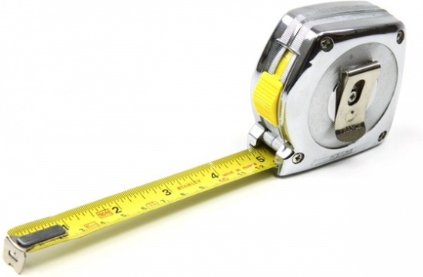
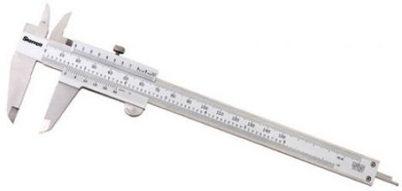
Evaluating Predictive Performance

Slide 4
Outcomes of Interest
Numerical value
Membership in a class
“Propensity” - probability of belonging to a class

Slide 5
Python Functionality Needed
import math
import pandas as pd
from sklearn.model_selection import train_test_split
from sklearn.linear_model import LinearRegression
from sklearn.metrics import accuracy_score, roc_curve, auc
import matplotlib.pylab as plt
from dmba import regressionSummary, classificationSummary
from dmba import liftChart, gainsChart

Slide 6
Measuring Predictive error - Numerical Value
Not the same as “goodness-of-fit”
We want to know how well the model predicts new data, not how well it fits the data it was trained with
Key component of most measures is difference between actual y and predicted y (“error,” “loss”)

Slide 7
Some measures of error
MAE or MAD: Mean absolute error (deviation)
Gives an idea of the magnitude of errors
Average error
Gives an idea of systematic over- or under-prediction
MAPE: Mean absolute percentage error
RMSE (root-mean-squared-error): Square the errors, find their average, take the square root
Total SSE: Total sum of squared errors

Slide 8
Lift Chart for Predictive Error
Y axis is cumulative value of numeric target variable (e.g., revenue), instead of cumulative count of “responses”
X axis is cumulative number of cases, sorted left to right in order of predicted value
Benchmark is average numeric value per record, i.e. not using model

Slide 9
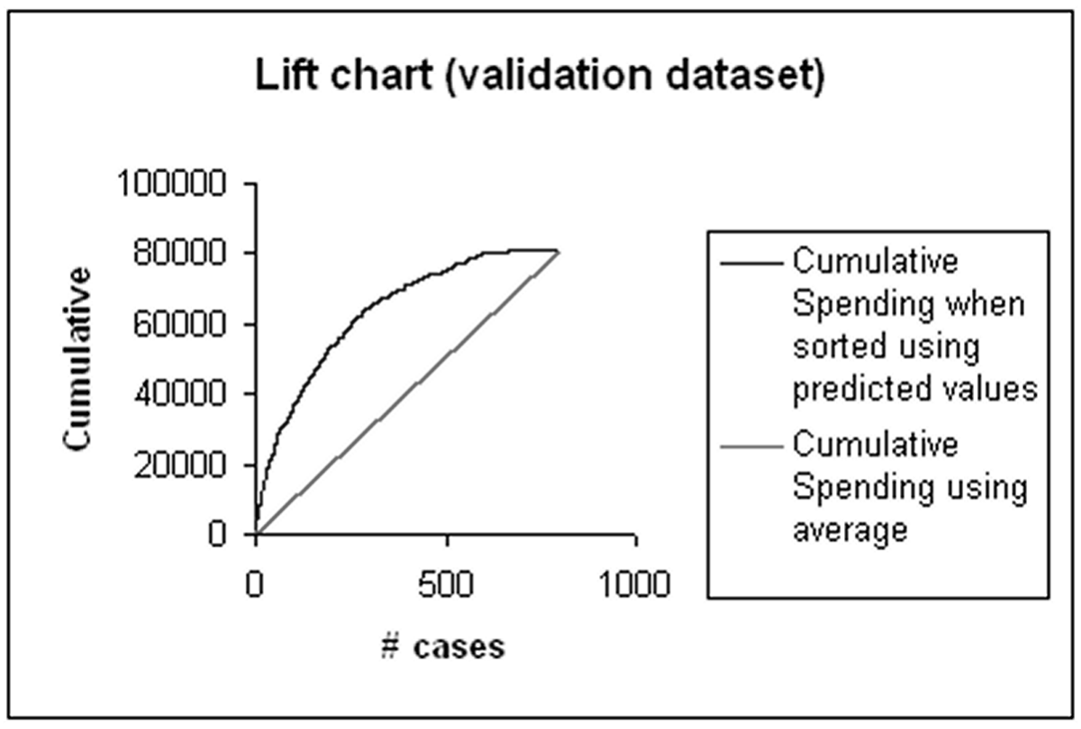
Lift chart example – spending

Slide 10
Accuracy Measures (Classification)

Slide 11
Misclassification error
Error = classifying a record as belonging to one class when it belongs to another class.
Error rate = percent of misclassified records out of the total records in the validation data

Slide 12
Naïve Rule
Naïve rule: classify all records as belonging to the most prevalent class
Often used as benchmark: we hope to do better than that
Exception: when goal is to identify high-value but rare outcomes, we may do well by doing worse than the naïve rule (see “lift” – later)

Slide 13
Separation of Records
“High separation of records” means that using predictor variables attains low error
“Low separation of records” means that using predictor variables does not improve much on naïve rule

Slide 14
Confusion Matrix, 3000 cases function: “classificationSummary” found in Appendix
 |  | Actual Class
 |  | 0 | 1
Predicted Class | 0 | 2689 | 85
 | 1 | 25 | 201
201 1’s correctly classified as “1”
85 1’s incorrectly classified as “0”
25 0’s incorrectly classified as “1”
2689 0’s correctly classified as “0”

Slide 15
Error Rate
 |  | Actual Class
 |  | 0 | 1
Predicted Class | 0 | 2689 | 85
 | 1 | 25 | 201
Overall error rate = (25+85)/3000 = 3.67%
Accuracy = 1 – err = (201+2689) = 96.33%
If there are multiple classes, the error rate is:
(sum of misclassified records)/(total records)

Slide 16
Cutoff for classification
Most DM algorithms classify via a 2-step process:
For each record,
Compute probability of belonging to class “1”
Compare to cutoff value, and classify accordingly
Default cutoff value is 0.50
If >= 0.50, classify as “1”
If < 0.50, classify as “0”
Can use different cutoff values
Typically, error rate is lowest for cutoff = 0.50

Slide 17
Cutoff Table
Predicted Probability of Being an Owner
ACTUAL Pred. Prob. ACTUAL Pred. Prob.
owner 0.9959 owner 0.5055
owner 0.9875 nonowner 0.4713
owner 0.9844 nonowner 0.3371
owner 0.9804 owner 0.2179
owner 0.9481 nonowner 0.1992
owner 0.8892 nonowner 0.1494
owner 0.8476 nonowner 0.0479
nonowner 0.7628 nonowner 0.0383
owner 0.7069 nonowner 0.0248
owner 0.6807 nonowner 0.0218
owner 0.6563 nonowner 0.0161
nonowner 0.6224 nonowner 0.0031
if cutoff is 0.5, then 11 records classified as “owner”

Slide 18
Cutoff Table
Predicted Probability of Being an Owner
ACTUAL Pred. Prob. ACTUAL Pred. Prob.
owner 0.9959 owner 0.5055
owner 0.9875 nonowner 0.4713
owner 0.9844 nonowner 0.3371
owner 0.9804 owner 0.2179
owner 0.9481 nonowner 0.1992
owner 0.8892 nonowner 0.1494
owner 0.8476 nonowner 0.0479
nonowner 0.7628 nonowner 0.0383
owner 0.7069 nonowner 0.0248
owner 0.6807 nonowner 0.0218
owner 0.6563 nonowner 0.0161
nonowner 0.6224 nonowner 0.0031
if cutoff is 0.8, then 7 records classified as “owner”

Slide 19
Confusion Matrix for Different Cutoffs
predicted = ['owner' if p > 0.5 else 'nonowner' for p in
owner_df.Probability]
classificationSummary(owner_df.Class, predicted, class_names=['nonowner', 'owner'])
Confusion Matrix (Accuracy 0.8750)
Prediction
Actual nonowner owner
nonowner 10 2
owner 1 11
cutoff = 0.25 (Accuracy 0.7917)
Prediction
Actual nonowner owner
nonowner 8 4
owner 1 11
Cutoff 0.75 (Accuracy 0.7500)
Prediction
Actual nonowner owner
nonowner 11 1
owner 5 7

Slide 20
When One Class is More Important
In many cases it is more important to identify members of one class
Tax fraud
Credit default
Response to promotional offer
Detecting electronic network intrusion
Predicting delayed flights
In such cases, we are willing to tolerate greater overall error, in return for better identifying the important class for further attention

Slide 21
Alternate Accuracy Measures
If “C₁” is the important class,
Sensitivity (also called “recall) = % of “C₁” class correctly classified
Specificity = % of “C₀” class correctly classified
Precision= % of predicted “C₁’s” that are actually“C₁’s”

Slide 22
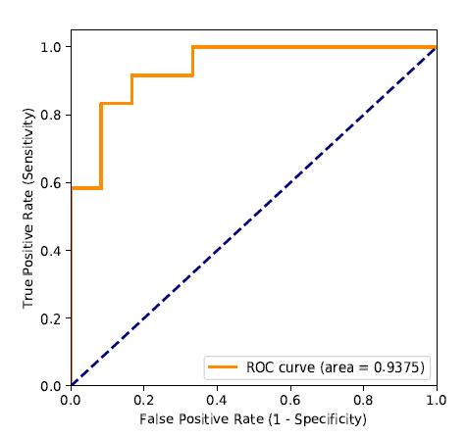
ROC Curve (library roc_curve)
Area under the ROC curve (“AUC,” function auc) is a useful metric
Diagonal reflects random classification on a sliding probability, from 0 to 1, of labeling a record as a “1”
Other software sometimes plots x-axis as “specificity” with 1 on left, 0 on right.

Slide 23
ROC = “Receiver Operating Characteristics”
Term originated in WWII, applied to radar
US sought to measure effectiveness in identifying enemy aircraft, i.e. distinguishing signal from noise

Slide 24

ROC’s are one way to measure a model’s effectiveness in separating the “wheat from the chaff”
“Lift” (“gains”) is a similar metric, but measuring “how much does the model improve on random chance in finding the class of interest”

Slide 25
Lift (also termed “gains”): Goal
Evaluates how well a model identifies the most important class
Helps evaluate, e.g.,
How many tax records to examine
How many loans to grant
How many customers to mail offer to

Slide 26
Lift (gains) and Decile Charts – Cont.
Compare performance of DM model to “no model, pick randomly”
Measures ability of DM model to identify the important class, relative to the average prevalence of the class
Charts give explicit assessment of results over a large number of cutoffs
Notes:
‹#›

Slide 27
Lift and Decile Charts: How to Use
Sort records by predicted probability of belonging to the important class (“1’s”)
Move down the list, noting actual class
As you go, compare the number of actual 1’s to the number of 1’s you would expect with no model
In lift chart: compare step function to straight line
In decile chart compare to ratio of 1
Notes:
‹#›

Slide 28
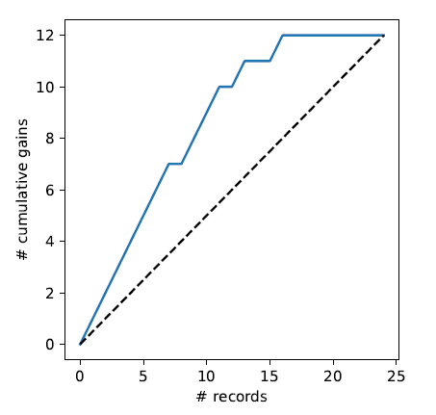
Lift (Gains) Chart – cumulative performance
After examining (e.g.) 10 cases (x-axis), 9 owners (y-axis) have been correctly identified
df = pd.read_csv('liftExample.csv')
df = df.sort_values(by=['prob'], ascending=False)
gainsChart(df.actual, figsize=(4, 4))

Slide 29
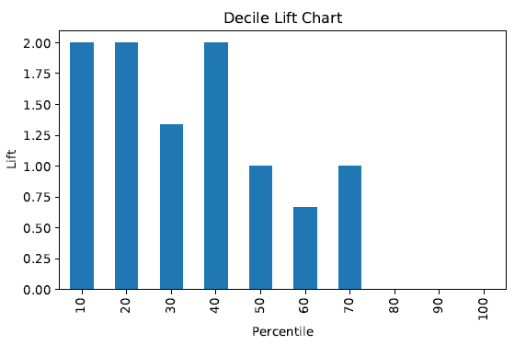
Decile Chart
In “most probable” (top) decile, the model is twice as likely to identify the important class compared to just picking at random.

Slide 30
Lift (Gains): How to Compute
Using the model’s output, sort records from most likely to least likely members of the important class
Compute lift: Accumulate the correctly classified “important class” records (Y axis) and compare to number of total records (X axis)

Slide 31
Lift (gains) curve vs. Decile Charts
Both embody concept of “moving down” through the records, starting with the most probable 1’s
Decile chart does this in decile chunks of data
Y axis shows ratio of decile mean to overall mean
Lift chart shows continuous cumulative results
Y axis shows number of important class records identified
Notes:
‹#›

Slide 32
Lift (gains) vs. ROC curve
Gains and ROC curves have similar appearance
ROC curve and AUC provide a widely used single metric and visual to assess a model’s ability to separate classes overall
Lift (gains) yields intuitive measure of model performance at different cutoffs, but no overall metric
Notes:
‹#›

Slide 33

Asymmetric Costs

Slide 34
Misclassification Costs May Differ
The cost of making a misclassification error may be higher for one class than the other(s)
Looked at another way, the benefit of making a correct classification may be higher for one class than the other(s)

Slide 35
Example – Response to Promotional Offer
Suppose we send an offer to 1000 people, with 1% average response rate (“1” = response, “0” = nonresponse)
“Naïve rule” (classify everyone as “0”) has error rate of 1% (seems good)
Using DM we can correctly classify eight 1’s as 1’s
It comes at the cost of misclassifying twenty 0’s as 1’s and two 1’s as 0’s.

Slide 36
Example (cont.)
The Confusion Matrix*
 | Actual 0 | Actual 1
Predicted 0 | 970 | 2
Predicted 1 | 20 | 8
Error rate = (2+20) = 2.2% (higher than naïve rate)
*confusion matrix is often shown with predictions as rows, actuals as columns, the reverse of what Python produces

Slide 37
Introducing Costs & Benefits
Suppose:
Profit from a “1” is $10
Cost of sending offer is $1
Then:
Under naïve rule, all are classified as “0”, so no offers are sent: no cost, no profit
Under DM predictions, 28 offers are sent.
8 respond with profit of $10 each
20 fail to respond, cost $1 each
972 receive nothing (no cost, no profit)
Net profit = $60

Slide 38
Profit Matrix
 | Actual 0 | Actual 1
Predicted 0 | $0 | $0
Predicted 1 | ($20) | $80

Slide 39
Lift (again)
Adding costs to the mix, as above, does not change the actual classifications
Better: Use the lift curve and change the cutoff value for “1” to maximize profit

Slide 40
Generalize to Cost Ratio
Sometimes actual costs and benefits are hard to estimate
Need to express everything in terms of costs (i.e., cost of misclassification per record)
Goal is to minimize the average cost per record
A good practical substitute for individual costs is the ratio of misclassification costs (e,g,, “misclassifying fraudulent firms is 5 times worse than misclassifying solvent firms”)

Slide 41
Minimizing Cost Ratio
q₁ = cost of misclassifying an actual “1”,
q₀ = cost of misclassifying an actual “0”
Minimizing the cost ratio q₁/q₀ is identical to
minimizing the average cost per record
Software may provide option for user to specify cost ratio
Notes:
‹#›

Slide 42
Note: Opportunity costs
As we see, best to convert everything to costs, as opposed to a mix of costs and benefits
E.g., instead of “benefit from sale” refer to “opportunity cost of lost sale”
Leads to same decisions, but referring only to costs allows greater applicability

Slide 43
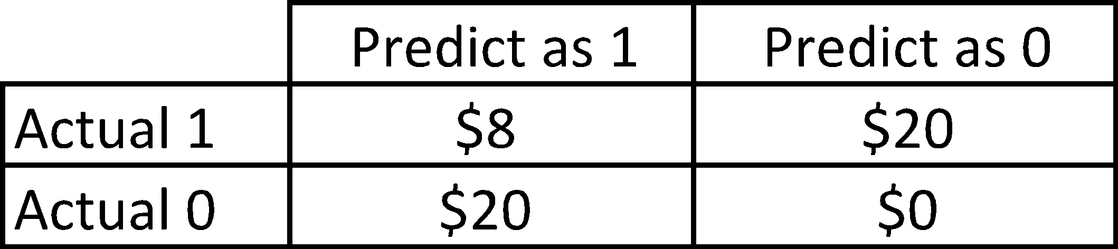
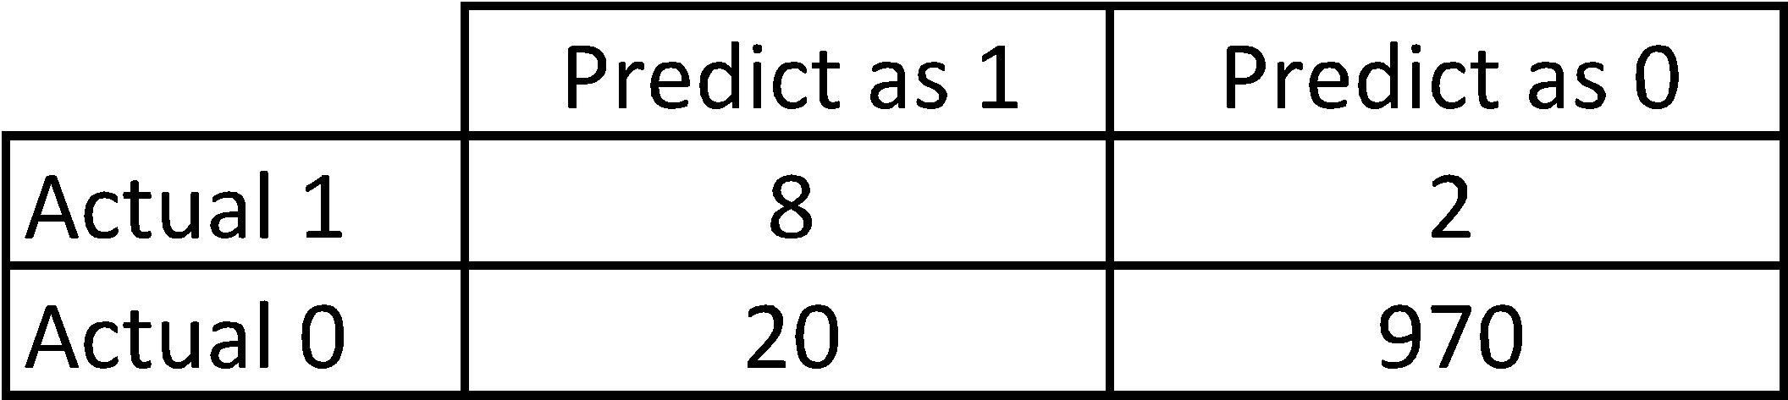
Cost Matrix (inc. opportunity costs)
Recall original confusion matrix (profit from a “1” = $10, cost of sending offer = $1):

Slide 44
Multiple Classes
For m classes, confusion matrix has m rows and m columns
Theoretically, there are m(m-1) misclassification costs, since any case could be misclassified in m-1 ways
Practically, too many to work with
In decision-making context, though, such complexity rarely arises – one class is usually of primary interest

Slide 45
Adding Cost/Benefit to Lift Curve
Sort records in descending probability of success
For each case, record cost/benefit of actual outcome
Also record cumulative cost/benefit
Plot all records
X-axis is index number (1 for 1st case, n for n^{th} case)
Y-axis is cumulative cost/benefit
Reference line from origin to y_{n} ( y_{n} = total net benefit)

Slide 46
Lift Curve May Go Negative
If total net benefit from all cases is negative, reference line will have negative slope
Nonetheless, goal is still to use cutoff to select the point where net benefit is at a maximum

Slide 47
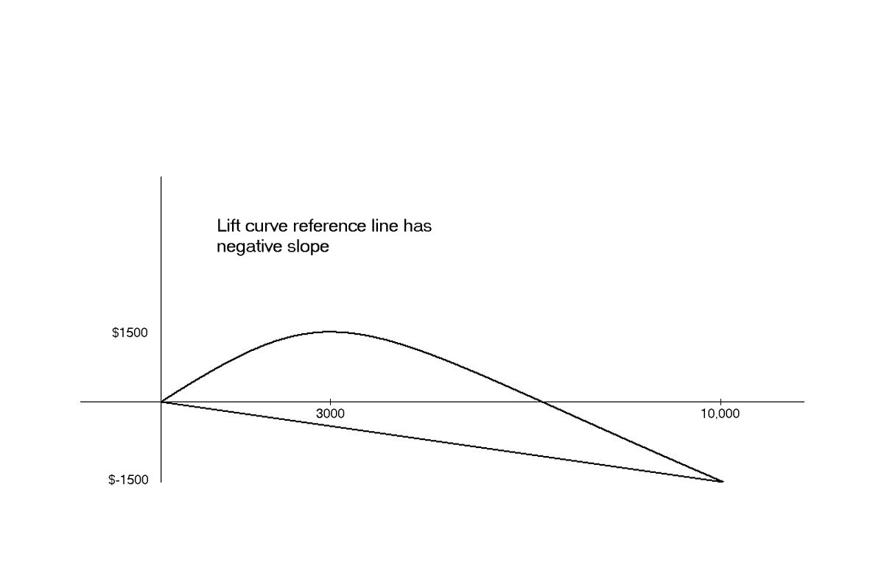
Negative slope to reference curve

Slide 48
Oversampling and Asymmetric Costs

Slide 49
Rare Cases
Asymmetric costs/benefits typically go hand in hand with presence of rare but important class
Responder to mailing
Someone who commits fraud
Debt defaulter
Often we oversample rare cases to give model more information to work with
Typically use 50% “1” and 50% “0” for training

Slide 50
Example
Following graphs show optimal classification under three scenarios:
assuming equal costs of misclassification
assuming that misclassifying “o” is five times the cost of misclassifying “x”
Oversampling scheme allowing DM methods to incorporate asymmetric costs

Slide 51
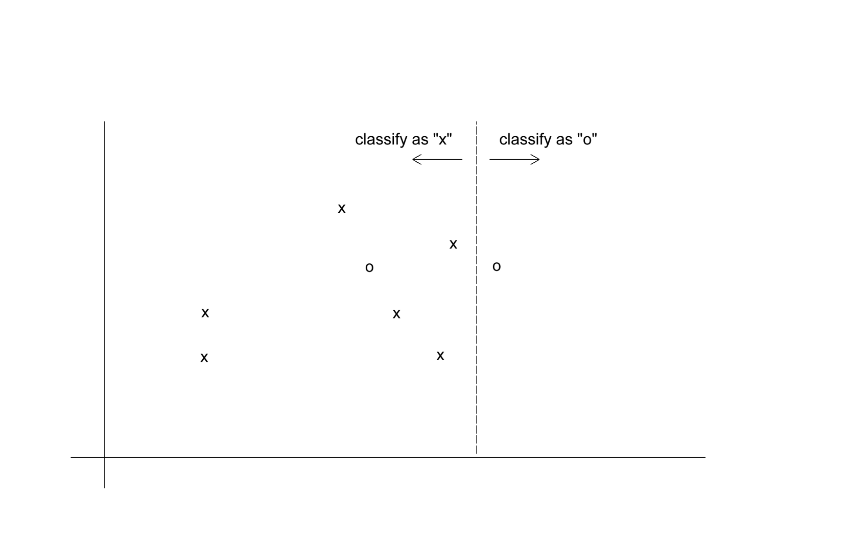
Classification: equal costs

Slide 52
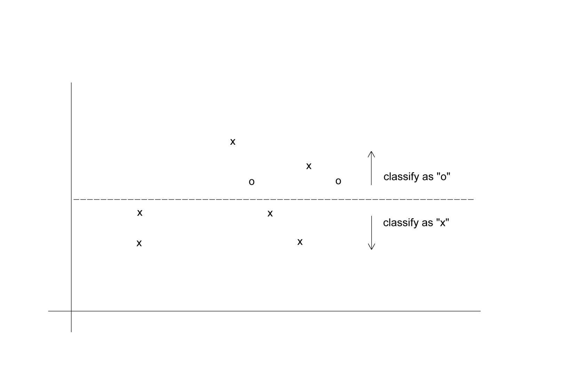
Classification: Unequal costs
Suppose misclassifying “o” 5 times as costly as misclassifying “x”

Slide 53
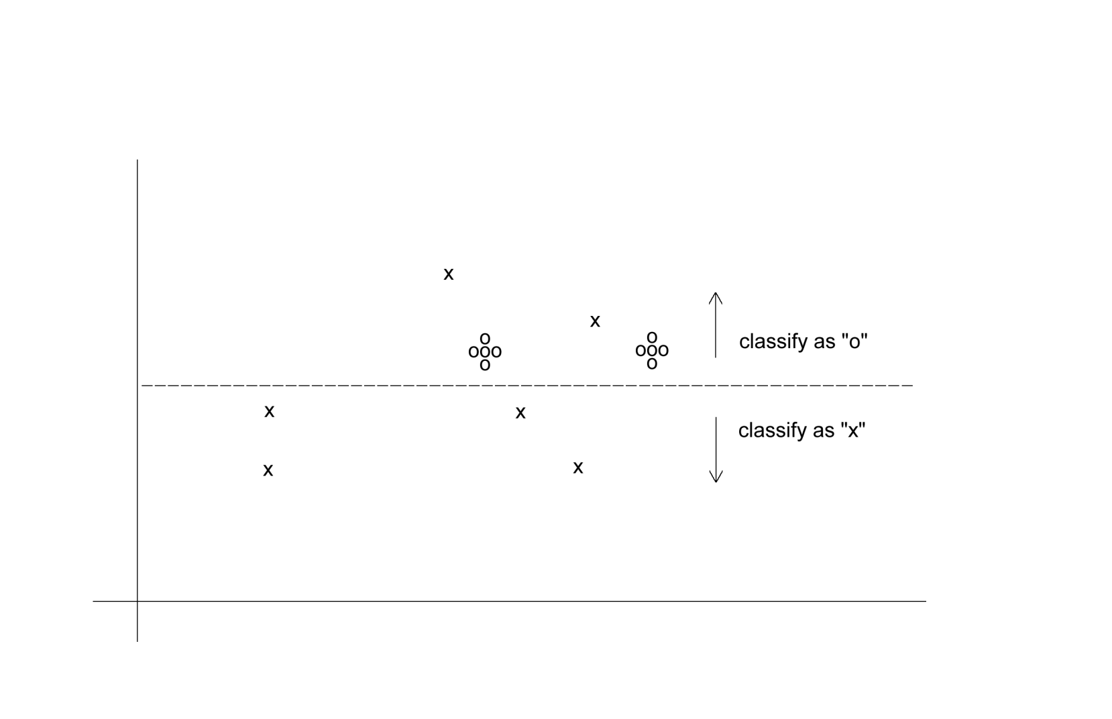
Oversampling Scheme
Oversample “o” to appropriately weight misclassification costs

Slide 54
An Oversampling Procedure
Separate the responders (rare) from non-responders
Randomly assign half the responders to the training sample, plus equal number of non-responders
Remaining responders go to validation sample
Add non-responders to validation data, to maintain original ratio of responders to non-responders
Randomly take test set (if needed) from validation

Slide 55
Classification Using Triage
Take into account a gray area in making classification decisions
Instead of classifying as C₁ or C₀, we classify as
C₁
C₀
Can’t say
The third category might receive special human review

Slide 56
Summary
Evaluation metrics are important for comparing across DM models, for choosing the right configuration of a specific DM model, and for comparing to the baseline (“no model”)
Major metrics: confusion matrix, error rate, predictive error
Other metrics when
one class is more important
asymmetric costs
When important class is rare, use oversampling
In all cases, metrics computed from validation data

