Slide 1
Chapter 6: Multiple Linear Regression
Data Mining for Business Analytics in Python
Shmueli, Bruce, Gedeck & Patel

Slide 2

We assume a linear relationship between predictors and outcome:
outcome
coefficients
constant
error (noise)
predictors

Slide 3
Topics
Explanatory vs. predictive modeling with regression
Example: prices of Toyota Corollas
Fitting a predictive model
Assessing predictive accuracy
Selecting a subset of predictors

Slide 4
Explanatory Modeling
Goal: Explain relationship between predictors (explanatory variables) and target
Familiar use of regression in data analysis
Model Goal: Fit the data well and understand the contribution of explanatory variables to the model
“goodness-of-fit”: R², residual analysis, p-values

Slide 5
Predictive Modeling
Goal: predict target values in other data where we have predictor values, but not target values
Classic data mining context
Model Goal: Optimize predictive accuracy
Train model on training data
Assess performance on validation (hold-out) data
Explaining role of predictors is not primary purpose (but useful)

Slide 6
Example: Prices of Toyota Corolla ToyotaCorolla.xls
Goal: predict prices of used Toyota Corollas based on their specification
Data: Prices of 1000 used Toyota Corollas, with their specification information

Slide 7
Variables Used
Price in Euros
Age in months as of 8/04
KM (kilometers)
Fuel Type (diesel, petrol, CNG)
HP (horsepower)
Metallic color (1=yes, 0=no)
Automatic transmission (1=yes, 0=no)
CC (cylinder volume)
Doors
Quarterly_Tax (road tax)
Weight (in kg)

Slide 8
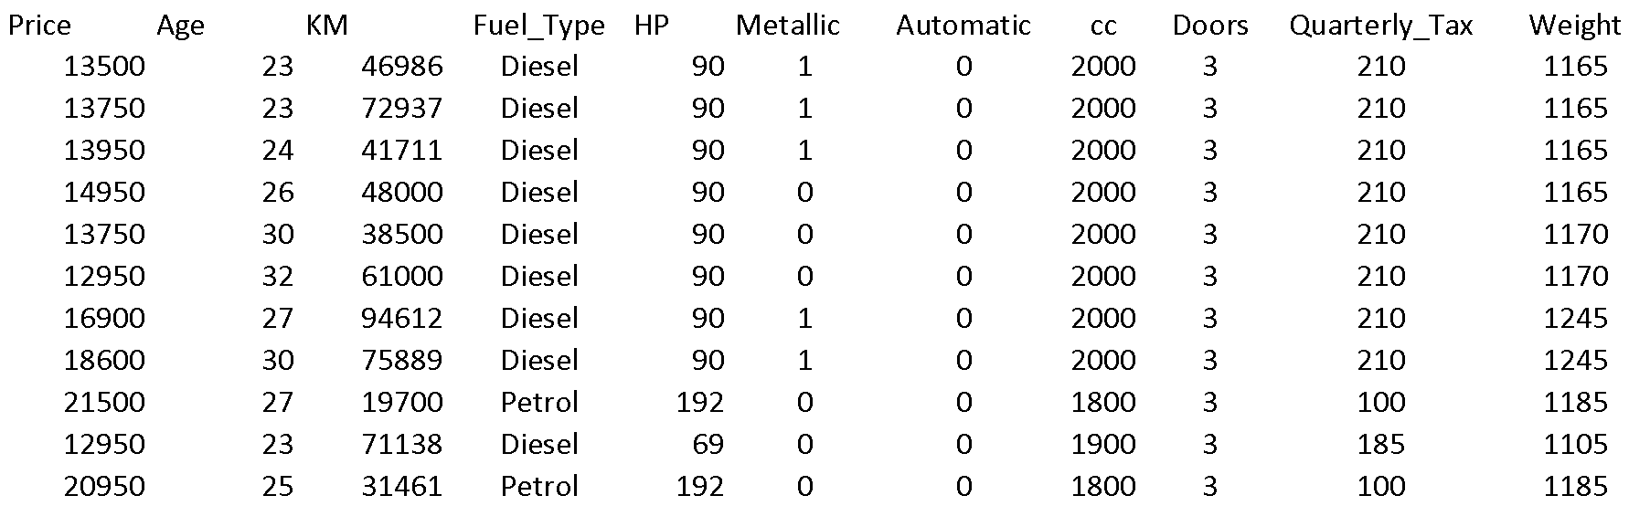
Data Sample (showing only the variables to be used in analysis)

Slide 9
Preprocessing
Fuel type is categorical (in R - a factor variable), must be transformed into binary variables. R’s lm function does this automatically.
Diesel (1=yes, 0=no)
Petrol (1=yes, 0=no)
None needed* for “CNG” (if diesel and petrol are both 0, the car must be CNG)
*You cannot include all the binary dummies; in regression this will cause a multicollinearity error. Other data mining methods can use all the dummies.

Slide 10
Fitting a Regression Model to the Toyota Data
# reduce data frame to the top 1000 rows and select columns for
regression analysis
car_df = pd.read_csv('ToyotaCorolla.csv')
car_df = car_df.iloc[0:1000]
predictors = ['Age_08_04', 'KM', 'Fuel_Type', 'HP', 'Met_Color',
'Automatic', 'CC', 'Doors', 'Quarterly_Tax', 'Weight'] outcome = 'Price'
# partition data
X = pd.get_dummies(car_df[predictors], drop_first=True)
y = car_df[outcome]
train_X, valid_X, train_y, valid_y = train_test_split(X, y, test_size=0.4,
random_state=1)
car_lm = LinearRegression()
car_lm.fit(train_X, train_y)
put 40% in validation (test) partition

Slide 11
Output of the Regression Model
# print coefficients
print(pd.DataFrame({'Predictor': X.columns, 'coefficient':
car_lm.coef_}))
Partial Output
Predictor coefficient
0 Age_08_04 -140.748761
1 KM - 0.017840
2 HP 36.103419
3 Met_Color 84.281830
4 Automatic 416.781954
5 CC 0.017737
6 Doors -50.657863
7 Quarterly_Tax 13.625325
8 Weight 13.038711
9 Fuel_Type_Diesel 1066.464681
10 Fuel_Type_Petrol 2310.249543

Slide 12
Accuracy Metrics for the Regression Model
# print performance measures (training data)
regressionSummary(train_y, car_lm.predict(train_X))
Regression statistics
Mean Error (ME) : 0.0000
Root Mean Squared Error (RMSE) : 1400.5823
Mean Absolute Error (MAE) : 1046.9072
Mean Percentage Error (MPE) : -1.0223
Mean Absolute Percentage Error (MAPE) : 9.2994
These are traditional metrics, i.e. measured on the training data

Slide 13
Make the Predictions for the Validation Data
(and show some residuals)
# Use predict() to make predictions on a new set
car_lm_pred = car_lm.predict(valid_X)
result = pd.DataFrame({'Predicted': car_lm_pred,
'Actual': valid_y, ‘Residual': valid_y - car_lm_pred})
print(result.head(20))
Predicted Actual Residual
507 10607.333940 11500 892.666060
818 9272.705792 8950 -322.705792
452 10617.947808 11450 832.052192
368 13600.396275 11450 -2150.396275
242 12396.694660 11950 -446.694660
929 9496.498212 9995 498.501788
262 12480.063217 13500 1019.936783

Slide 14
How Well did the Model Do With the Validation Data?
# print performance measures (validation data)
regressionSummary(valid_y, car_lm_pred)
Regression statistics
Mean Error (ME) : 103.6803
Root Mean Squared Error (RMSE) : 1312.8523
Mean Absolute Error (MAE) : 1017.5972
Mean Percentage Error (MPE) : -0.2633
Mean Absolute Percentage Error (MAPE) : 9.0111

Slide 15
Selecting Subsets of Predictors
Goal: Find parsimonious model (the simplest model that performs sufficiently well)
More robust
Higher predictive accuracy
We will assess predictive accuracy on validation data
Exhaustive Search = “best subset”
Partial Search Algorithms
Forward
Backward
Stepwise
© Galit Shmueli and Peter Bruce 2017

Slide 16
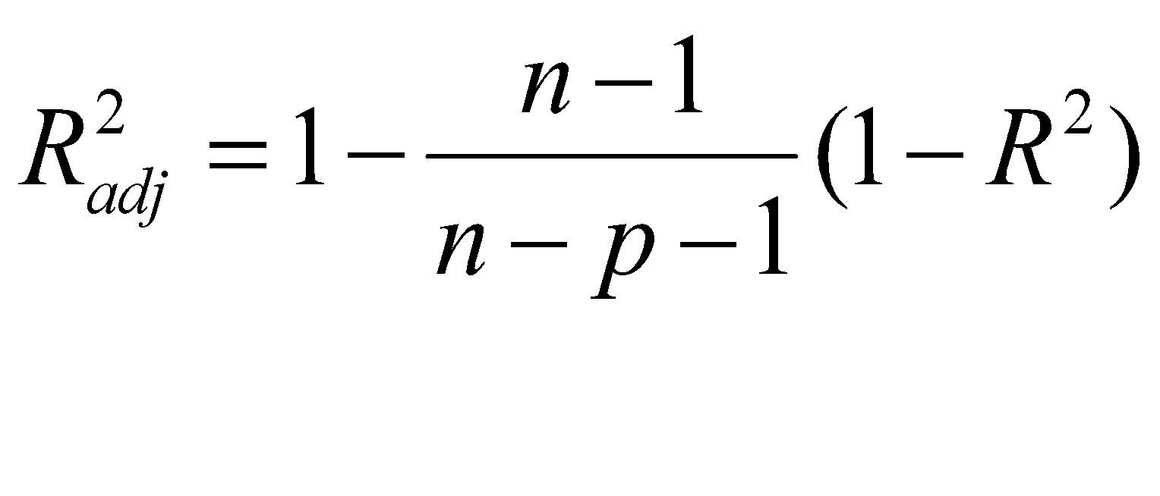
Exhaustive Search = Best Subset
All possible subsets of predictors assessed (single, pairs, triplets, etc.)
Computationally intensive, not feasible for big data
Judge by “adjusted R²”
Use regsubsets() in package leaps
Penalty for number of predictors
© Galit Shmueli and Peter Bruce 2017

Slide 17
scikit-learn and statsmodels Lack Out-of-Box Support for Exhaustive Search
Use Exhaustive Search Function (see appendix)
Takes 3 arguments - variable list, training model, scoring model
def train_model(variables):
model = LinearRegression()
model.fit(train_X[list(variables)], train_y)
return model
def score_model(model, variables):
pred_y = model.predict(train_X[list(variables)])
# we negate as score is optimized to be as low as possible
return -adjusted_r2_score(train_y, pred_y, model)
allVariables = train_X.columns
results = exhaustive_search(allVariables, train_model,
score_model)

Slide 18
Exhaustive Search Code, cont.
data = []
for result in results:
model = result['model']
variables = list(result['variables'])
AIC = AIC_score(train_y, model.predict(train_X[variables]), model)
d = {'n': result['n'], 'r2adj': -result['score'], 'AIC': AIC}
d.update({var: var in result['variables'] for var in allVariables})
data.append(d)
pd.DataFrame(data, columns=('n', 'r2adj', 'AIC') + tuple(sorted(allVariables)))

Slide 19
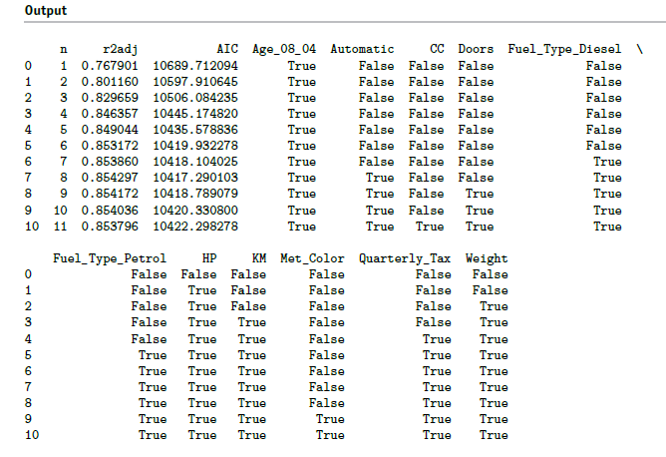
Exhaustive output shows best model for each number of predictors
Performance metrics improve as you add predictors, up to approx. 8

Slide 20
Backward Elimination
Start with all predictors
Successively eliminate least useful predictors one by one
Stop when all remaining predictors have statistically significant contribution

Slide 21
Backward Elimination, Using AIC
def train_model(variables):
model = LinearRegression()
model.fit(train_X[variables], train_y)
return model
def score_model(model, variables):
return AIC_score(train_y, model.predict(train_X[variables]), model)
allVariables = train_X.columns
best_model, best_variables = backward_elimination(allVariables, train_model,
score_model, verbose=True)
print(best_variables)
regressionSummary(valid_y, best_model.predict(valid_X[best_variables]))

Slide 22
Backward Elimination, Using AIC, Output
Variables: Age_08_04, KM, HP, Met_Color, Automatic, CC, Doors, Quarterly_Tax, Weight, Fuel_Type_Diesel, Fuel_Type_Petrol
Start: score=10422.30
Step: score=10420.33, remove CC
Step: score=10418.79, remove Met_Color
Step: score=10417.29, remove Doors
Step: score=10417.29, remove None
['Age_08_04', 'KM', 'HP', 'Automatic', 'Quarterly_Tax', 'Weight',
'Fuel_Type_Diesel', 'Fuel_Type_Petrol']
Regression statistics
Mean Error (ME) : 103.3045
Root Mean Squared Error (RMSE) : 1314.4844
Mean Absolute Error (MAE) : 1016.8875
Mean Percentage Error (MPE) : -0.2700
Mean Absolute Percentage Error (MAPE) : 8.9984

Slide 23
Forward Selection
Start with no predictors
Add them one by one (add the one with largest contribution)
Stop when the addition is not statistically significant

Slide 24
Forward Selection, Using AIC
# The initial model is the constant model - this requires special handling
# in train_model and score_model
def train_model(variables):
if len(variables) == 0:
return None
model = LinearRegression()
model.fit(train_X[variables], train_y)
return model
def score_model(model, variables):
if len(variables) == 0:
return AIC_score(train_y, [train_y.mean()] * len(train_y), model, df=1)
return AIC_score(train_y, model.predict(train_X[variables]), model)
best_model, best_variables = forward_selection(train_X.columns, train_model, score_model,
verbose=True)
print(best_variables)

Slide 25
Forward Selection, Output
print(best_variables)
Output
Start: score=11565.07, constant
Step: score=10689.71, add Age_08_04
Step: score=10597.91, add HP
Step: score=10506.08, add Weight
Step: score=10445.17, add KM
Step: score=10435.58, add Quarterly_Tax
Step: score=10419.93, add Fuel_Type_Petrol
Step: score=10418.10, add Fuel_Type_Diesel
Step: score=10417.29, add Automatic
Step: score=10417.29, add None
['Age_08_04', 'HP', 'Weight', 'KM', 'Quarterly_Tax', 'Fuel_Type_Petrol',
'Fuel_Type_Diesel', 'Automatic']

Slide 26
Stepwise
Like Forward Selection
Except at each step, also consider dropping non-significant predictors
(No out-of-box support for stepwise in scikit-learn or statsmodels; see appendix for function stepwise_selection)

Slide 27
Comparing Methods
(in this particular dataset, same results)
Variable | Forward | Backward | Both | Exhaustive
Age_08_04 | ✔ | ✔ | ✔ | ✔
KM | ✔ | ✔ | ✔ | ✔
HP | ✔ | ✔ | ✔ | ✔
Met_Color
Automatic | ✔ | ✔ | ✔ | ✔
CC
Doors
Quarterly_Tax | ✔ | ✔ | ✔ | ✔
Weight | ✔ | ✔ | ✔ | ✔
Fuel_TypeDiesel | ✔ | ✔ | ✔ | ✔
Fuel_TypePetrol | ✔ | ✔ | ✔ | ✔

Slide 28
Regularization (shrinkage)
Alternative to subset selection
Rather than binary decisions on including variables, penalize coefficent magnitudes
This has the effect of “shrinking” coefficients, and also reducing variance
Predictors with coefficients that shrink to zero are effectively dropped
Variance reduction improves prediction performance

Slide 29
Shrinkage - Ridge Regression
OLR minimizes sum of squared errors (residuals) - SSE
Ridge regression minimizes SSE subject to penalty being below specified threshold
Penalty, called L2, is sum of squared coefficients
Predictors are typically standardized

Slide 30
Ridge Regression in scikit-learn
alpha is penalty threshold, “0” would be no penalty, i.e. same as OLS
ridge = Ridge(normalize=True, alpha=1)
ridge.fit(train_X, train_y)
regressionSummary(valid_y, ridge.predict(valid_X))

Slide 31
Shrinkage - Lasso
OLR minimizes sum of squared errors (residuals) - SSE
Ridge regression minimizes SSE + penalty
Penalty, called L1, is sum of absolute values for coefficients
Predictors are typically standardized

Slide 32
lasso - in scikit-learn
alpha is penalty threshold, “0” would be no penalty, i.e. same as OLS
lasso = Lasso(normalize=True, alpha=1)
lasso.fit(train_X, train_y)
regressionSummary(valid_y, lasso.predict(valid_X))
or choose penalty threshold automatically thru cross-validation
lasso_cv = LassoCV(normalize=True, cv=5)
lasso_cv.fit(train_X, train_y)
regressionSummary(valid_y, lasso_cv.predict(valid_X))

Slide 33
Summary
Linear regression models are very popular tools, not only for explanatory modeling, but also for prediction
A good predictive model has high predictive accuracy (to a useful practical level)
Predictive models are fit to training data, and predictive accuracy is evaluated on a separate validation data set
Removing redundant predictors is key to achieving predictive accuracy and robustness
Subset selection methods help find “good” candidate models. These should then be run and assessed.

