Slide 1
Chapter 7 – K-Nearest-Neighbor
Data Mining for Business Analytics in Python
Shmueli, Bruce, Gedeck & Patel

Slide 2
Characteristics of K-NN
Data-driven, not model-driven
Makes no assumptions about the data
Simple idea: classify a record like similar records

Slide 3
Basic Concept
For a given record to be classified, identify nearby records
“Near” means records with similar predictor values X₁, X₂, … X_{p}
Classify the record as whatever the predominant class is among the nearby records (the “neighbors”)

Slide 4
Import Needed Functionality
import pandas as pd
from sklearn import preprocessing
from sklearn.model_selection import train_test_split
from sklearn.metrics import accuracy_score
from sklearn.neighbors import NearestNeighbors,
KNeighborsClassifier
import matplotlib.pylab as plt

Slide 5
How to measure “nearby”?
The most popular distance measure is Euclidean distance
Typically, predictor variables are first normalized (= standardized) to put them on comparable scales
Otherwise, metrics with large scales dominate

Slide 6
Choosing k
K is the number of nearby neighbors to be used to classify the new record
K=1 means use the single nearest record
K=5 means use the 5 nearest records
Typically choose that value of k which has lowest error rate in validation data

Slide 7
Low k vs. High k
Low values of k (1, 3, …) capture local structure in data (but also noise)
High values of k provide more smoothing, less noise, but may miss local structure
Note: the extreme case of k = n (i.e., the entire data set) is the same as the “naïve rule” (classify all records according to majority class)

Slide 8
Example: Riding Mowers
Data: 24 households classified as owning or not owning riding mowers
Predictors: Income, Lot Size

Slide 9
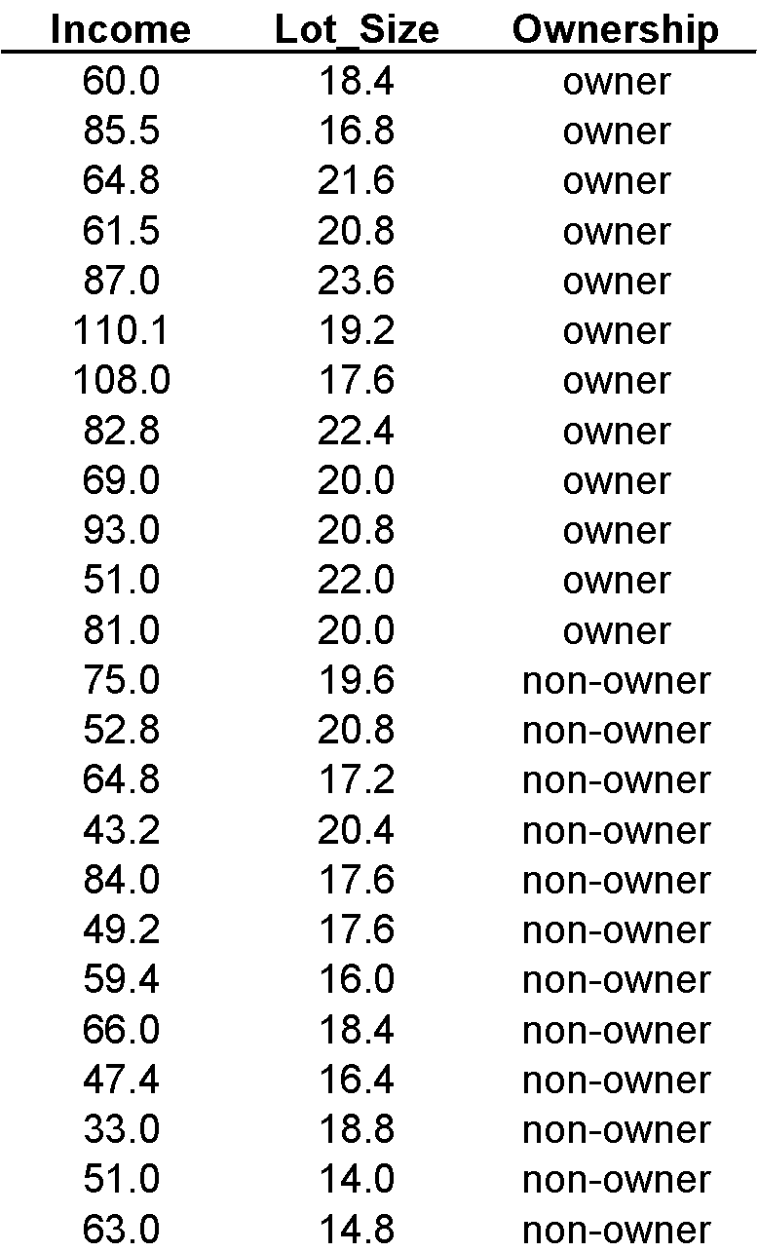

Slide 10
Normalizing data, based on training set
# use the training data to learn the transformation.
scaler = preprocessing.StandardScaler()
scaler.fit(trainData[['Income', 'Lot_Size']]) # Note use of
array of column names
# Transform the full dataset
mowerNorm = pd.concat([pd.DataFrame(scaler.transform
(mower_df[['Income', 'Lot_Size']]),columns=['zIncome',
'zLot_Size']), mower_df[['Ownership', 'Number']]], axis=1)
trainNorm = mowerNorm.iloc[trainData.index]
validNorm = mowerNorm.iloc[validData.index]
newHouseholdNorm = pd.DataFrame(scaler.transform(newHousehold),
columns=['zIncome', 'zLot_Size'])
*termed the test set in R

Slide 11
Consider a new record to be classified
New household with $60,000 income and lot size 20,000 ft2
newHousehold = pd.DataFrame([{'Income': 60, 'Lot_Size': 20}])
newHouseholdNorm = pd.DataFrame(scaler.transform(newHousehold),
columns=['zIncome', 'zLot_Size'])

Slide 12
Find Nearest Neighbors
# use NearestNeighbors from scikit-learn to compute knn
from sklearn.neighbors import NearestNeighbors
knn = NearestNeighbors(n_neighbors=3)
knn.fit(trainNorm.iloc[:, 0:2])
distances, indices = knn.kneighbors(newHouseholdNorm)

Slide 13
Results
# indices is a list of lists, we are only
# interested in the first element, which is
# the 3 neighbors for the new record
trainNorm.iloc[indices[0], :]
Output
zIncome zLot_Size Ownership Number
3 -0.409776 0.743358 Owner 4
13 -0.804953 0.743358 Nonowner 14
0 -0.477910 -0.174908 Owner 1

Slide 14
Accuracy for Different k (measured on validation data)
train_X = trainNorm[['zIncome', 'zLot_Size']]
train_y = trainNorm['Ownership']
valid_X = validNorm[['zIncome', 'zLot_Size']]
valid_y = validNorm['Ownership']
# Train a classifier for different values of k
results = []
for k in range(1, 15):
knn = KNeighborsClassifier(n_neighbors=k).fit(train_X,
train_y)
results.append({
'k': k,
'accuracy': accuracy_score(valid_y,
knn.predict(valid_X))
})

Slide 15
Accuracy for Different k (measured on validation data)
k accuracy
0 1 0.6
1 2 0.7
2 3 0.8
3 4 0.9 <==
4 5 0.7
5 6 0.9
6 7 0.9
7 8 0.9
8 9 0.9
9 10 0.8
10 11 0.8
11 12 0.9
12 13 0.4
13 14 0.4
maximum accuracy with smallest k
Note: for even k, ties are broken randomly

Slide 16
Using K-NN for Prediction (for Numerical Outcome)
Instead of “majority vote determines class” use average of response values
May be a weighted average, weight decreasing with distance

Slide 17
Advantages
Simple
No assumptions required about Normal distribution, etc.
Effective at capturing complex interactions among variables without having to define a statistical model

Slide 18
Shortcomings
Required size of training set increases exponentially with # of predictors, p
This is because expected distance to nearest neighbor increases with p (with large vector of predictors, all records end up “far away” from each other)
In a large training set, it takes a long time to find distances to all the neighbors and then identify the nearest one(s)
These constitute “curse of dimensionality”

Slide 19
Dealing with the Curse
Reduce dimension of predictors (e.g., with PCA)
Computational shortcuts that settle for “almost nearest neighbors”

Slide 20
Summary
Find distance between record-to-be-classified and all other records
Select k-nearest records
Classify it according to majority vote of nearest neighbors
Or, for prediction, take the as average of the nearest neighbors
“Curse of dimensionality” – need to limit # of predictors

