Slide 1
Overview
Data Mining for Business Analytics in Python
Shmueli, Bruce, Gedeck, & Patel

Slide 2
Core Ideas in Data Mining
Classification
Prediction
Association Rules & Recommenders
Data & Dimension Reduction
Data Exploration
Visualization

Slide 3
Paradigms for Data Mining (variations)
SEMMA (from SAS)
Sample
Explore
Modify
Model
Assess
CRISP-DM (SPSS/IBM)
Business Understanding
Data Understanding
Data Preparation
Modeling
Evaluation
Deployment

Slide 4
Supervised Learning
Goal: Predict a single “target” or “outcome” variable
Training data, where target value is known
Score to data where value is not known
Methods: Classification and Prediction

Slide 5
Unsupervised Learning
Goal: Segment data into meaningful segments; detect patterns
There is no target (outcome) variable to predict or classify
Methods: Association rules, collaborative filters, data reduction & exploration, visualization

Slide 6
Supervised: Classification
Goal: Predict categorical target (outcome) variable
Examples: Purchase/no purchase, fraud/no fraud, creditworthy/not creditworthy…
Each row is a case (customer, tax return, applicant)
Each column is a variable
Target variable is often binary (yes/no)

Slide 7
Supervised: Prediction
Goal: Predict numerical target (outcome) variable
Examples: sales, revenue, performance
As in classification:
Each row is a case (customer, tax return, applicant)
Each column is a variable
Taken together, classification and prediction constitute “predictive analytics”

Slide 8
Unsupervised: Association Rules
Goal: Produce rules that define “what goes with what” in transactions
Example: “If X was purchased, Y was also purchased”
Rows are transactions
Used in recommender systems – “Our records show you bought X, you may also like Y”
Also called “affinity analysis”

Slide 9
Unsupervised: Collaborative Filtering
Goal: Recommend products to purchase
Based on products that customer rates, selects, views, or purchases
Recommend products that “customers like you” purchase (user-based)
Or, recommend products that share a “product purchaser profile” with your purchases (item-based)

Slide 10
Unsupervised: Data Reduction
Distillation of complex/large data into simpler/smaller data
Reducing the number of variables/columns (e.g., principal components)
Reducing the number of records/rows (e.g., clustering)

Slide 11
Unsupervised: Data Visualization
Graphs and plots of data
Histograms, boxplots, bar charts, scatterplots
Especially useful to examine relationships between pairs of variables

Slide 12
Data Exploration
Data sets are typically large, complex & messy
Need to review the data to help refine the task
Use techniques of Reduction and Visualization

Slide 13
The Process of Data Mining

Slide 14
Steps in Data Mining
Define/understand purpose
Obtain data (may involve random sampling)
Explore, clean, pre-process data
Reduce the data; if supervised DM, partition it
Specify task (classification, clustering, etc.)
Choose the techniques (regression, CART, neural networks, etc.)
Iterative implementation and “tuning”
Assess results – compare models
Deploy best model

Slide 15
Preliminary Exploration in Python loading data, viewing it, summary statistics
1. Open Anaconda-Navigator and launch a ‘jupyter’ notebook. It opens a new browser window.
2. Navigate to the directory where your csv file is saved and open a new Python notebook.
import pandas as pd
# Load data
housing_df = pd.read_csv('WestRoxbury.csv')
housing_df.shape #find dimension of data frame
housing_df.head() #show the 1st five rows
print(housing_df) #show all the data

Slide 16
Data Exploration in Python, cont.
# Rename columns: replace spaces with '_' housing_df = housing_df.rename
(columns={'TOTAL VALUE ': 'TOTAL_VALUE'})
# explicit
housing_df.columns = [s.strip().replace(' ',
'_') for s in housing_df.columns] # all
columns
# Show first four rows of the data
housing_df.loc[0:3]
# loc[a:b] gives rows a to b, inclusive
housing_df.iloc[0:4]
# iloc[a:b] gives rows a to b-1

Slide 17
Data Exploration in Python, cont.
# Different ways of showing the first 10
# values in column TOTAL_VALUE
housing_df['TOTAL_VALUE'].iloc[0:10]
housing_df.iloc[0:10]['TOTAL_VALUE']
housing_df.iloc[0:10].TOTAL_VALUE # use dot
notation if the column name has no spaces
# Show the fifth row of the first 10 columns
housing_df.iloc[4][0:10]
housing_df.iloc[4, 0:10]
housing_df.iloc[4:5, 0:10] # use a slice to
return a data frame

Slide 18
Data Exploration in Python, cont.
# Use pd.concat to combine non-consecutive
# columns into a new data frame. Axis
# argument specifies dimension along which
# concatenation happens, 0=rows, 1=columns.
pd.concat([housing_df.iloc[4:6,0:2], housing_df.iloc[4:6,4:6]], axis=1)
# To specify a full column, use:
housing.iloc[:,0:1]
housing.TOTAL_VALUE
housing_df['TOTAL_VALUE'][0:10] # show the
first 10 rows of the first column

Slide 19
Data Exploration in Python, cont.
# Descriptive statistics
print('Number of rows ', len(housing_df['TOTAL_VALUE'])) # show length
of first column
print('Mean of TOTAL_VALUE ', housing_df['TOTAL_VALUE'].mean()) # show mean
of column
housing_df.describe() # show summary
statistics for each column

Slide 20
Import Needed Functionality
import numpy as np
import pandas as pd # repeating - we did this
earlier
from sklearn.model_selection import train_test_split
from sklearn.metrics import r2_score
from sklearn.linear_model import
LinearRegression
The abbreviations pd, np, and sm are commonly used in the data science community.

Slide 21
Obtaining Data: Sampling
Data mining typically deals with huge databases
For piloting/prototyping, algorithms and models are typically applied to a sample from a database, to produce statistically-valid results
Once you develop and select a final model, you use it to “score” (predict values or classes for) the observations in the larger database

Slide 22
Rare Event Oversampling
Often the event of interest is rare
Examples: response to mailing, fraud in taxes, …
Sampling may yield too few “interesting” cases to effectively train a model
A popular solution: oversample the rare cases to obtain a more balanced training set
Later, need to adjust results for the oversampling

Slide 23
Sampling & Oversampling
# random sample of 5 observations
housing_df.sample(5)
# oversample houses with over 10 rooms
weights = [0.9 if rooms > 10 else 0.01 for
rooms in housing_df.ROOMS]
housing_df.sample(5, weights=weights)

Slide 24
Types of Variables
Determine the types of pre-processing needed, and algorithms used
Main distinction: Categorical vs. numeric
Numeric
Continuous
Integer
Categorical
Ordered (low, medium, high)
Unordered (male, female)

Slide 25
Variable handling
Numeric
Most algorithms can handle numeric data
May occasionally need to “bin” into categories
Categorical
Naïve Bayes can use as-is
In most other algorithms, must create binary dummies (number of dummies = number of categories – 1) [see Table 2.6 for R code]

Slide 26
Reviewing Variables
housing_df.columns # print a list of
variables
# REMODEL needs to be converted to a
categorical variable
housing_df.REMODEL = housing_df.REMODEL.astype('category')
housing_df.REMODEL.cat.categories # Show
number of categories
housing_df.REMODEL.dtype # Check type of
converted variable
output on next slide…

Slide 27
Partial output of code on previous slide
> housing_df.columns
Index(['TOTAL_VALUE', 'TAX', 'LOT_SQFT',
'YR_BUILT', 'GROSS_AREA','LIVING_AREA',
'FLOORS', 'ROOMS', 'BEDROOMS', 'FULL_BATH',
'HALF_BATH','KITCHEN', 'FIREPLACE',
'REMODEL'], dtype='object')
> housing_df.REMODEL.cat.categories
Index(['None', 'Old', 'Recent'], dtype='object')
> housing_df.REMODEL.dtype category

Slide 28
Creating binary dummies
# use drop_first=True to drop the first dummy
variable
housing_df = pd.get_dummies(housing_df,
prefix_sep='_', drop_first=True)
housing_df.columns
housing_df.loc[:,'REMODEL_Old':
'REMODEL_Recent'].head(5)
output on next slide…

Slide 29
Creating Binary Dummies – Output
REMODEL_Old REMODEL_Recent
0 0 0
1 0 1
2 0 0
3 0 0
4 0 0

Slide 30
Detecting Outliers
An outlier is an observation that is “extreme”, being distant from the rest of the data (definition of “distant” is deliberately vague)
Outliers can have disproportionate influence on models (a problem if it is spurious)
An important step in data pre-processing is detecting outliers
Once detected, domain knowledge is required to determine if it is an error, or truly extreme.

Slide 31
Detecting Outliers
In some contexts, finding outliers is the purpose of the DM exercise (airport security screening). This is called “anomaly detection”.
Notes:
‹#›

Slide 32
Handling Missing Data
Most algorithms will not process records with missing values. Default is to drop those records.
Solution 1: Omission
If a small number of records have missing values, can omit them
If many records are missing values on a small set of variables, can drop those variables (or use proxies)
If many records have missing values, omission is not practical
Solution 2: Imputation
Replace missing values with reasonable substitutes
Lets you keep the record and use the rest of its (non-missing) information

Slide 33
Replacing Missing Data with Median
# To illustrate missing data procedures, we first convert a few entries for bedrooms to NA's. Then we impute these missing values using the median of the remaining values.
missingRows = housing_df.sample(10).index
housing_df.loc[missingRows, 'BEDROOMS'] = np.nan
print('Number of rows with valid BEDROOMS values
after setting to NAN: ',
housing_df['BEDROOMS'].count())
# remove rows with missing values
reduced_df = housing_df.dropna()
print('Number of rows after removing rows with missing values: ', len(reduced_df))

Slide 34
Replacing Missing Data with Median, cont.l
# To illustrate missing data procedures, we first convert a few entries for bedrooms to NA's. Then we impute these missing values using the median of the remaining values.
# replace the missing values using the median of
the remaining values.
medianBedrooms = housing_df['BEDROOMS'].median()
housing_df.BEDROOMS =
housing_df.BEDROOMS.fillna(value=medianBedrooms)
print('Number of rows with valid BEDROOMS values after filling NA values: ',
housing_df['BEDROOMS'].count())

Slide 35
Normalizing (Standardizing) Data
Used in some techniques when variables with the largest scales would dominate and skew results
Puts all variables on same scale
Normalizing function: Subtract mean and divide by standard deviation
Alternative function: scale to 0-1 by subtracting minimum and dividing by the range
Useful when the data contain dummies and numeric

Slide 36
Code for Normalizing Data
from sklearn.preprocessing import MinMaxScaler, StandardScaler
df = housing_df.copy()
# pandas:
norm_df = (housing_df - housing_df.mean()) /
housing_df.std()
# scikit-learn:
scaler = StandardScaler()
norm_df = pd.DataFrame(scaler.fit_transform(housing_df),
index=housing_df.index,
columns=housing_df.columns)
# the result of the transformation is a numpy
array, we convert it into a dataframe

Slide 37
Code for Normalizing Data, cont.
# Rescaling a data frame
# pandas:
norm_df = (housing_df - housing_df.min()) /
(housing_df.max() - housing_df.min())
# scikit-learn:
scaler = MinMaxScaler()
norm_df = pd.DataFrame(scaler.fit_transform(housing_df),
index=housing_df.index,
columns=housing_df.columns)

Slide 38
The Problem of Overfitting
Statistical models can produce highly complex explanations of relationships between variables
The “fit” may be excellent
When used with new data, models of great complexity do not do so well.
Notes:
‹#›

Slide 39
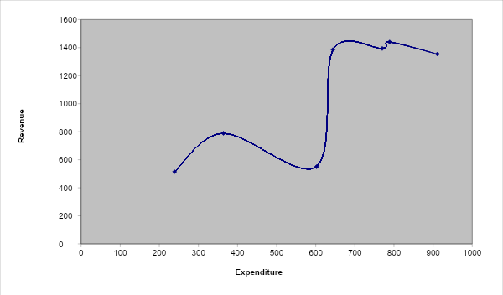
100% fit – not useful for new data
Notes:
‹#›

Slide 40
Overfitting (cont.)
Causes:
Too many predictors
A model with too many parameters
Trying many different models
Consequence: Deployed model will not work as well as expected with completely new data.
Notes:
‹#›

Slide 41
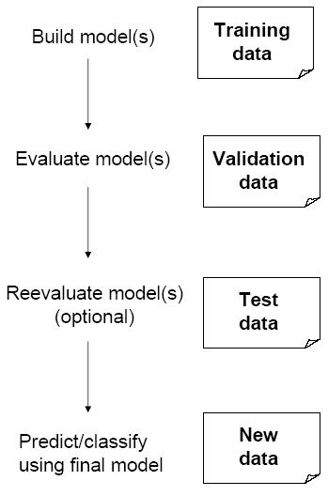
Partitioning the Data
Problem: How well will our model perform with new data?
Solution: Separate data into two parts
Training partition to develop the model
Validation partition to implement the model and evaluate its performance on “new” data
Addresses the issue of overfitting

Slide 42
Test Partition
When a model is developed on training data, it can overfit the training data (hence need to assess on validation)
Assessing multiple models on same validation data can overfit validation data
Some methods use the validation data to choose a parameter. This too can lead to overfitting the validation data
Solution: final selected model is applied to a test partition to give unbiased estimate of its performance on new data

Slide 43
“Test” Partition - Terminology
In Data Mining for Business Analytics, the “test” partition is the third partition for unbiased assessment.
More generally in data science, and in Python syntax, “test” refers to the partition set aside from the training partition

Slide 44
Partitioning the Data
# set random_state for reproducibility
# training (60%) and validation (40%)
trainData, validData = train_test_split(housing_df,
test_size=0.40, random_state=1)
# produces Training: 3481 Validation: 2321
# training (50%), validation (30%), and test (20%)
trainData, temp = train_test_split(housing_df, test_size=0.5, random_state=1)
# now split temp into validation and test
validData, testData = train_test_split(temp, test_size=0.4, random_state=1)
# produces Training: 2901 Validation: 1741
Test: 1160

Slide 45
Cross Validation
Repeated partitioning = cross-validation (“cv”)
k-fold cross validation, e.g. k=5
For each fold, set aside ⅕ of data as validation
Use full remainder as training
The validation folds are non-overlapping
In Python
cross\_val\_score()
more general cross\_validate
argument cv determines the number of folds

Slide 46
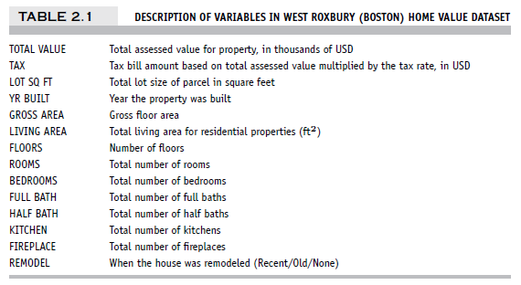
Example – Linear Regression West Roxbury Housing Data

Slide 47
Data Prep
# data loading and preprocessing
housing_df = pd.read_csv('WestRoxbury.csv')
housing_df.columns = [s.strip().replace(' ', '_')
for s in housing_df.columns]
housing_df = pd.get_dummies(housing_df,
prefix_sep='_', drop_first=True)
# create list of predictors and outcome
excludeColumns = ('TOTAL_VALUE', 'TAX')
predictors = [s for s in housing_df.columns if s
not in excludeColumns]
outcome = 'TOTAL_VALUE'

Slide 48
Data Partitioning
# partition data
X = housing_df[predictors]
y = housing_df[outcome]
train_X, valid_X, train_y, valid_y =
train_test_split(X, y, test_size=0.4,
random_state=1)

Slide 49
Fit Model and Make Predictions (Training Data)
model = LinearRegression()
model.fit(train_X, train_y)
train_pred = model.predict(train_X)
train_results = pd.DataFrame({
'TOTAL_VALUE': train_y,
'predicted': train_pred,
'residual': train_y - train_pred
})
# show sample of predictions
train_results.head()

Slide 50
Sample Output
TOTAL_VALUE predicted residual
2024 392.0 387.726258 4.273742
5140 476.3 430.785540 45.514460
5259 367.4 384.042952 -16.642952
421 350.3 369.005551 -18.705551
1401 348.1 314.725722 33.374278

Slide 51
Scoring the validation data
valid_pred = model.predict(valid_X)
valid_results = pd.DataFrame({
'TOTAL_VALUE': valid_y,
'predicted': valid_pred,
'residual': valid_y - valid_pred
})
valid_results.head()
TOTAL_VALUE predicted residual
1822 462.0 406.946377 55.053623
1998 370.4 362.888928 7.511072
5126 407.4 390.287208 17.112792
808 316.1 382.470203 -66.370203
4034 393.2 434.334998 -41.134998

Slide 52
Assess Accuracy
# import the utility function regressionSummary
# from dmba import regressionSummary
# training set
regressionSummary(train_results.TOTAL_VALUE,
train_results.predicted)
# validation set
regressionSummary(valid_results.TOTAL_VALUE, valid_results.predicted)

Slide 53
Assess Accuracy - Output
Regression statistics (training)
Mean Error (ME) : -0.0000
Root Mean Squared Error (RMSE) : 43.0306
Mean Absolute Error (MAE) : 32.6042
Mean Percentage Error (MPE) : -1.1116
Mean Absolute Percentage Error (MAPE) : 8.4886
Regression statistics (validation)
Mean Error (ME) : -0.1463
Root Mean Squared Error (RMSE) : 42.7292
Mean Absolute Error (MAE) : 31.9663
Mean Percentage Error (MPE) : -1.0884
Mean Absolute Percentage Error (MAPE) : 8.3283

Slide 54
Error metrics
Error = actual – predicted
ME = Mean error
RMSE = Root-mean-squared error = Square root of average squared error
MAE = Mean absolute error
MPE = Pean percentage error
MAPE = Mean absolute percentage error

Slide 55
Summary
Data mining consists of supervised methods (Classification & Prediction) and unsupervised methods (Association Rules, Data Reduction, Data Exploration & Visualization)
Before algorithms can be applied, data must be explored and pre-processed
To evaluate performance and to avoid overfitting, data partitioning is used
Models are fit to the training partition and assessed on the validation and test partitions
Data mining methods are usually applied to a sample from a large database, and then the best model is used to score the entire database

