Slide 1


Advancing Million Hearts by Predicting possibility of cardio vascular disease
Student Name: Shilpa Nayak
Assisted by : Dr. Itauma Itauma

Slide 2
Project Goal
Project goal: Predict the possibility of a person having Cardiovascular disease or not based on various parameters specified in dataset provided by Svetlana Ulianova on Kaggle.
Submission Date : 7-May-2023
Professor : Dr. Itauma Itauma
Project Executer : Shilpa Nayak
Field of Research : Healthcare
Project Source : Kaggle Dataset
ML/AI technologies : a. Simple Neural Network
b. Logistic Regression/Random Forest
c. NLTK

Slide 3
types of cardiovascular diseases
Cardiovascular diseases (CVDs) are a group of disorders of the heart and blood vessels and they include:
Coronary heart disease
Cerebrovascular disease
Peripheral arterial disease
Rheumatic heart disease
Congenital heart disease Deep vein thrombosis and pulmonary embolism

Slide 4
VARIABLE DESCRIPTION
CVDs are the number 1 cause of death globally
Dataset: https://www.kaggle.com/code/sulianova/eda-cardiovascular-data
Dataset contains the following Features:
id : It's just the Id no of the row. Not revelant
age : It's the age of a person in Days
gender : It's the gender of the person
height : It's the height of the person in cm
weight : It's the weight of the person in kg
ap_hi : It's the Systolic blood pressure i.e. Pressure exerted when Blood is ejected in arteries. Normal value : 120mmhg or Below

Slide 5
ap_low : It's the Diastolic blood pressure i.e. Pressure exerted when Blood exerts between arteries and heartbeats. Normal Value : 80mmhg or Below
cholesterol : It's the Cholestreol value (Cholesterol is a type of fat found in your blood) of your blood. In Adults, 200 mg/dL is desired with 200 and 239 mg/dL as Boderline High. In Children, 170 mg/dL is desired with 170 and 199 mg/dL as Boderline High
gluc : It's the Glucose Level. They're less than 100 mg/dL after not eating (fasting) for at least 8 hours. And they're less than 140 mg/dL 2 hours after eating. For most people without diabetes, blood sugar levels before meals hover around 70 to 80 mg/dL
smoke : It contain Binary Values stating whether Person is a Smoker or not i.e. {0 : 'Not a Smoker', 1 : 'Smoker'}
alco : It contain Binary Values stating whether Person is an alchoalic or not i.e. {0 : 'Not a Alchoalic', 1 : 'Alcholic'}
active : It contain Binary Values stating whether Person is involved in physical activites or not i.e. {0 : 'Not involved in Physical Activites', 1 : 'involved in physical activites'}
cardio : It's our Target Value Binary Values stating whether Person can have Cardiovascular diseases (CVDs) or Not i.e. {0 : 'Not Have CVD', 1 : 'Have CVD'}

Slide 6
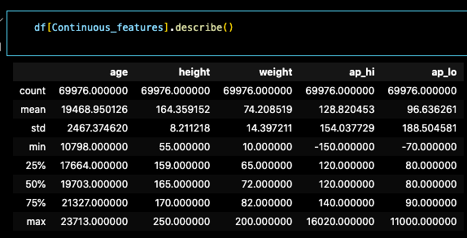
Distribution of the Numerical Values

Slide 7
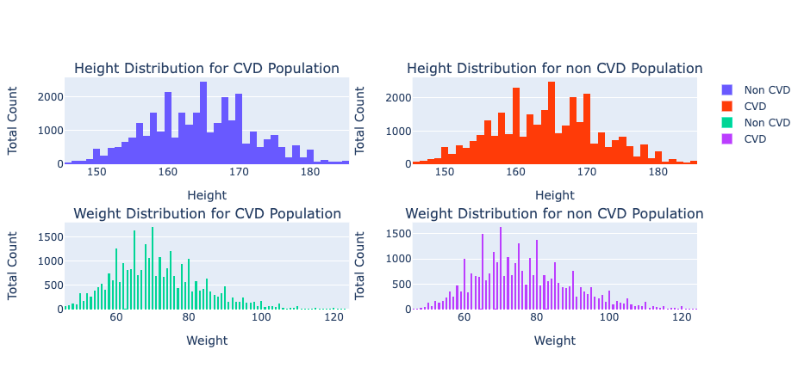
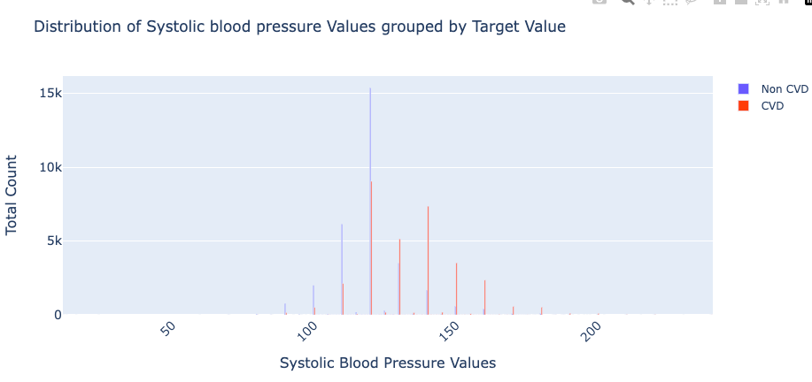
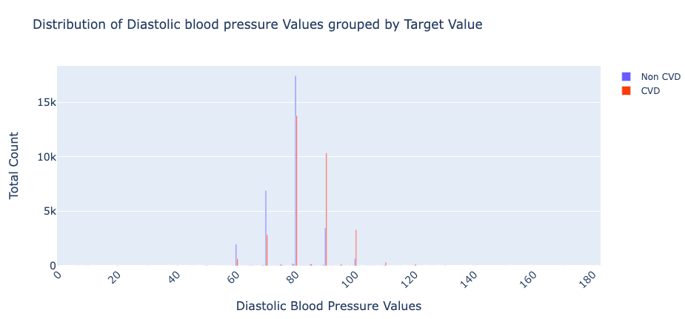
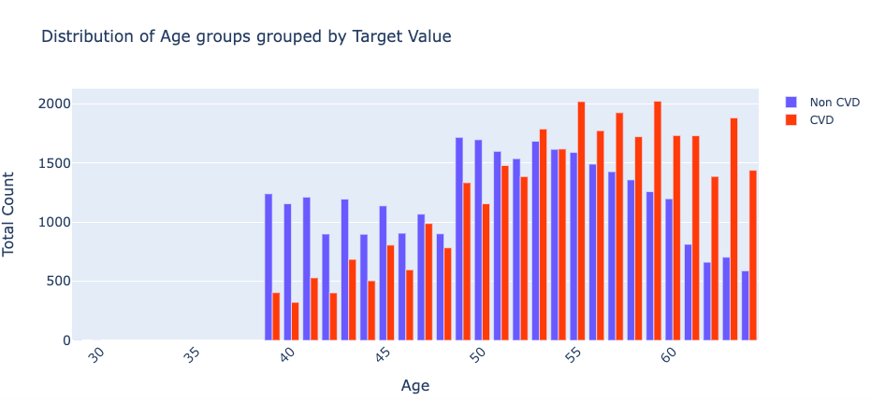
DISTRIBUTION

Slide 8
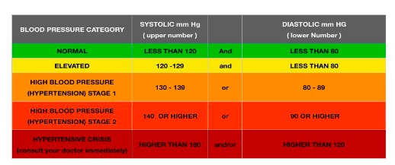
BLOOD PRESSURE Category

Slide 9
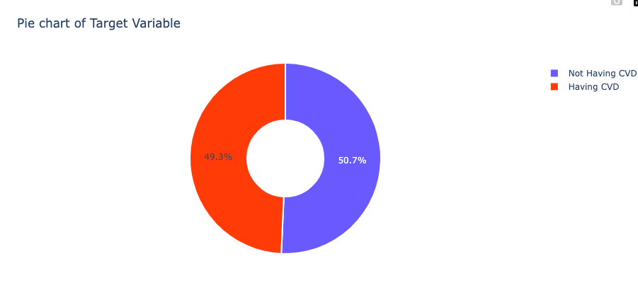

Slide 10
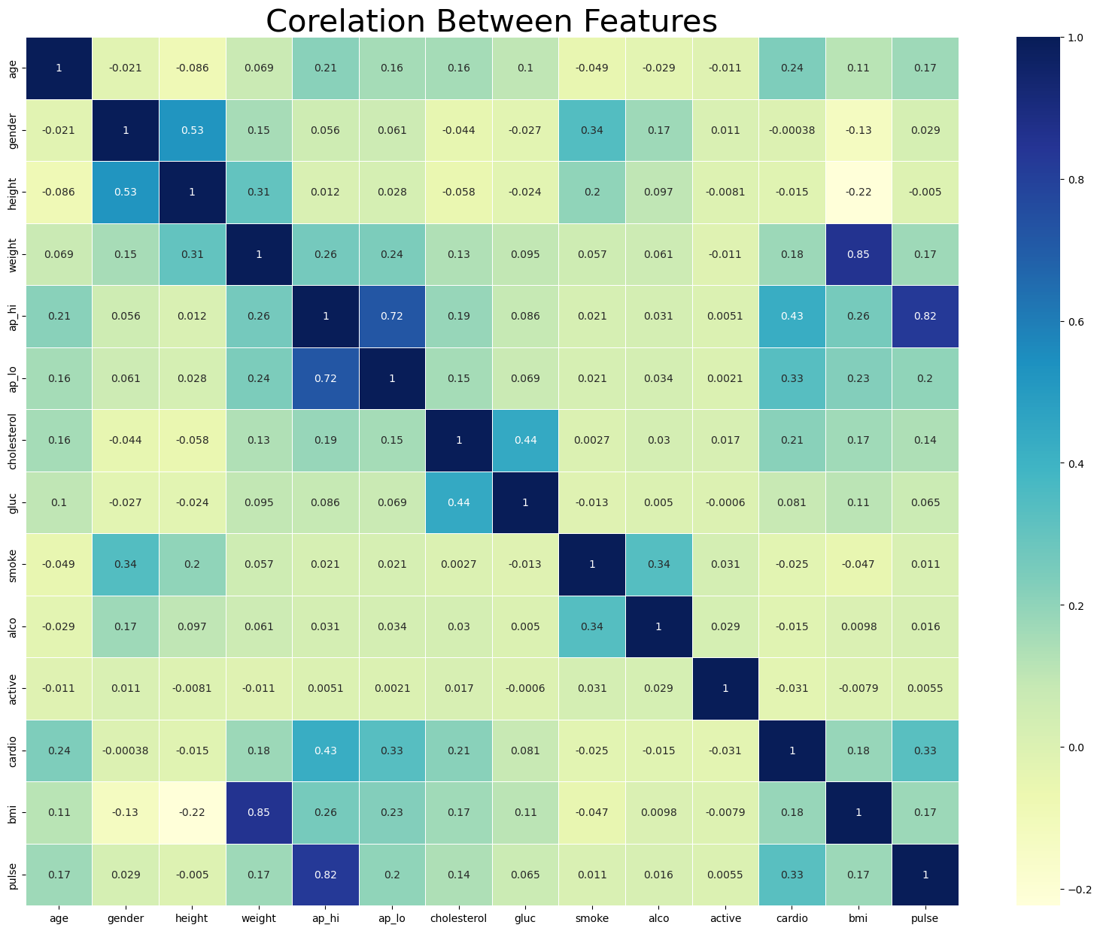

Slide 11
fEATURE SELECTION BASED ON CONFUSION MATRIX
ap_hi has the correlated with quite features but since it has the maximum correlation with Target Value, We can't afford to ignore it <br>
Similar case is with pulse and ap_lo
Unfortunately our newly formed feature 'bmi' doesn't have good correlation with target + corelates with ap_lo
Similar case is with weight
'gender' is the least correlated feature + adding correlation with smoke and height
Features like height, smoke, alco, active have quite low amount of correlation with target feature
Preserving Good data, We'll gonna drop 'bmi', 'weight', 'gluc', 'gender', 'height', 'smoke', 'alco', 'active'

Slide 12
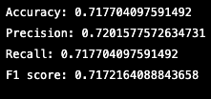
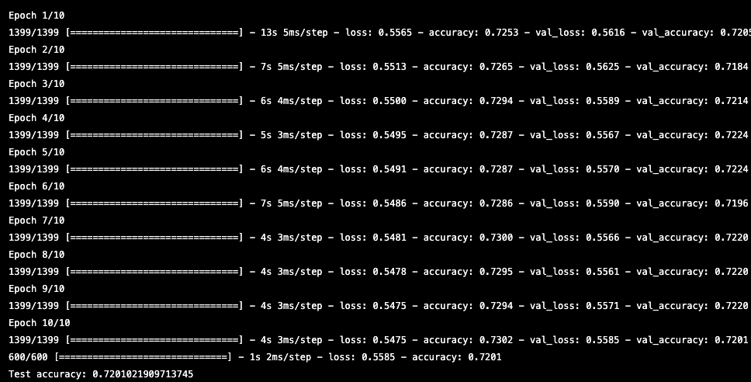

MODEL EVALUATION
Logistic regression Simple neural network model with 2 hidden layers Random Forest

Slide 13
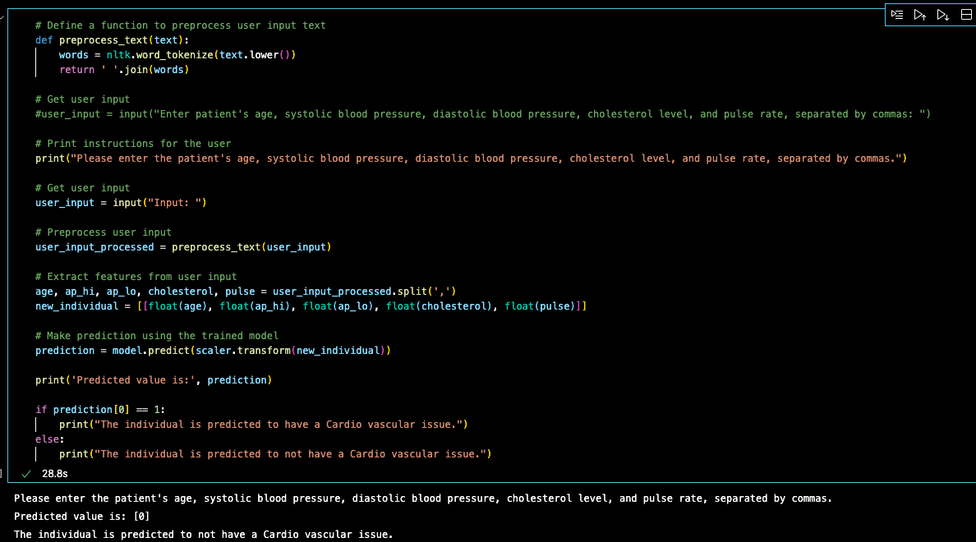
preprocess text data USING NLTK

Slide 14

Thank You
QUESTIONS ?

