Slide 1
R Analysis : Predictors of drug response
ICR Bioinformatics introduction
3rd June 2015

Slide 2
Overview
Get your data sets
Explore the data
Analyse and visualise

Slide 3
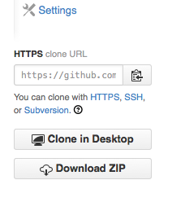
Pull from Github
Genomics of Drug Sensitivity in
Cancer (cancerrxgene.org)
Browse to https://github.com/DrJCampbell
Look for genexdrugdemo project
Download all files to a local directory
git clone \
https://github.com/DrJCampbell/genexdrugdemo.git
Or you can get the zip file

Slide 4
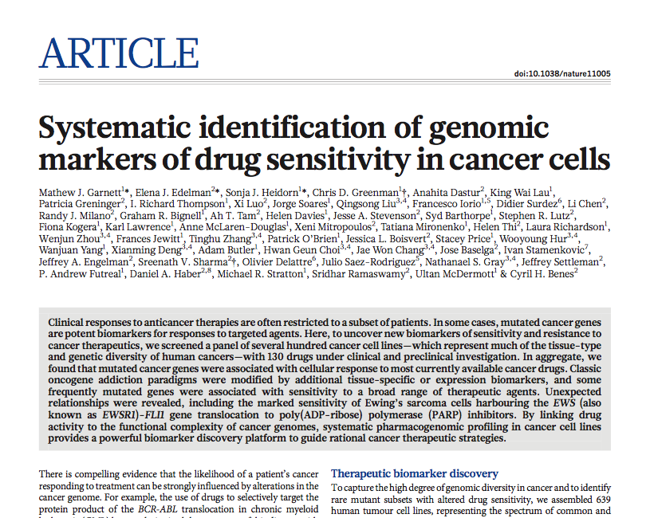
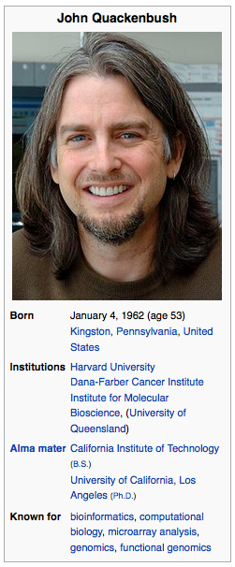
The data set

Slide 5
Data overview here
asd
asd

Slide 6
Run Spearman Correlation Tests
asd
asd

Slide 7
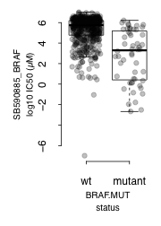
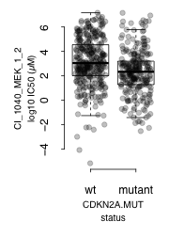
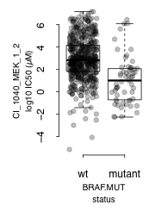
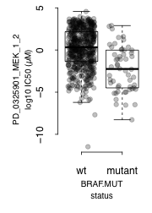
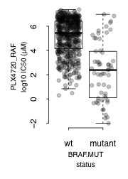
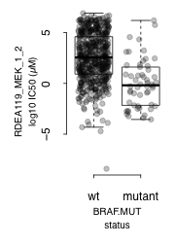
Visualise a subset of statistically significant gene-drug associations
Boxplot by mutation status
BRAF mutation correlates with sensitivity to multiple RAF and MEK inhibitors

Slide 8
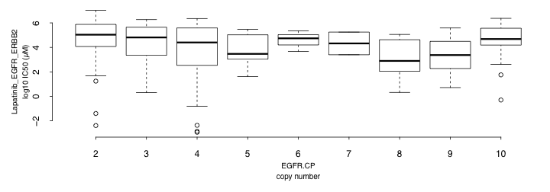
Visualise a subset of statistically significant gene-drug associations
Boxplot by copy number
EGFR amplification correlates with sensitivity to lapatinib (r=-0.2, p=4e-04)

Slide 9
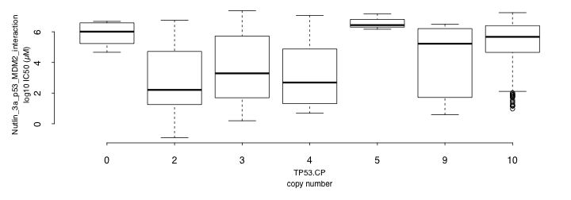
Visualise a subset of statistically significant gene-drug associations
Boxplot by copy number
TP53 deletion correlates with resistance to nutlin (r=0.43, p=6.5e-29)

Slide 10
asd
asd
asd

Slide 11
asd
asd
asd

Slide 12
asd
asd
asd

Slide 13
asd
asd
asd

