Slide 1
Xriegsspiel
MCU–NPS AI Learning Initiatives Hackathon
Collaborative wargaming across headsets and browsers
Notes:
0:00–0:25 (25 seconds)
I’m Fabio Garcia, creator of XRiegsspiel. I’m building a tabletop wargaming platform for training and education, with Quest as the primary interface and browser access alongside it. I’ll show the current experience, how the AI supports practice, and how the database preserves decisions so an instructor can return to them afterward.
Sources: owner instructions in this task; README.md; docs/product-requirements.md.

Slide 2
The learning problem
Attention spent on mechanics
Rule lookups and bookkeeping interrupt the planning conversation. Instructors need a clear record of what learners knew, chose and observed.
Collaboration across interfaces
Online wargames already exist. XRiegsspiel’s goal is a shared tabletop where learners can join through a headset or browser and reason together.
Notes:
0:25–1:05 (40 seconds)
Online wargames already provide valuable ways to practice. Our goal is to bring learners together across different interfaces while making the exercise easier to understand.
Rule lookups and bookkeeping compete with the planning conversation. And a final score tells an instructor very little about why a learner made a choice.
XRiegsspiel connects the board, permitted actions and decision history. The headset offers a spatial tabletop, while browser access lets people participate without owning a headset. Broader remote collaboration is our next direction.
Sources: docs/product-requirements.md, “Proposed first user journey” and owner future-development direction; docs/exercise-database.md. Reduced burden and improved learning remain goals to evaluate.

Slide 3
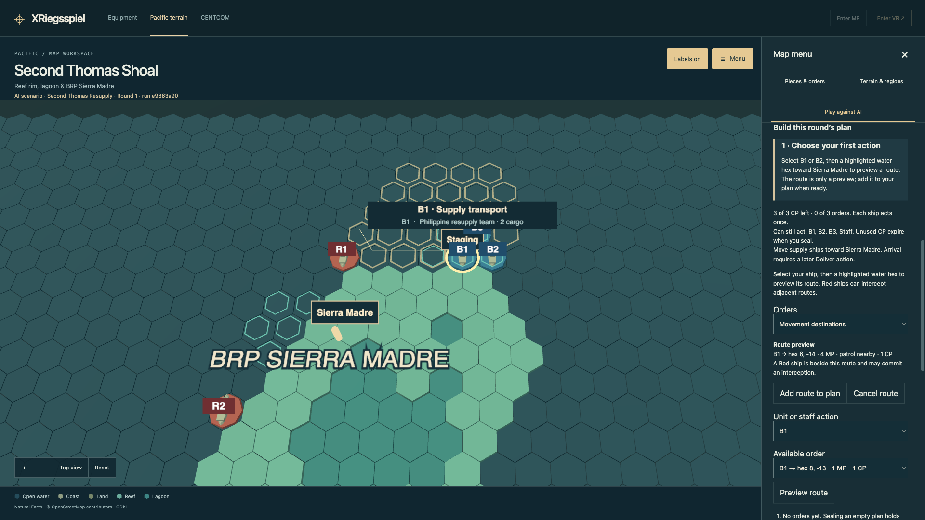
Inside XRiegsspiel
Quest 3 and browser play
Move 3D miniatures and preview routes before committing.
Eight scenarios, three opponent difficulties, and human referee controls.
Automatic resolution and bookkeeping keep play moving.
Route preview: 4 movement points, nearby patrol, interception possible
Notes:
1:05–3:00 (115 seconds, including a 90-second VR demonstration)
This browser capture shows Second Thomas Resupply. The player can see a route and a warning about a nearby patrol before committing. The application supports geographic pieces, eight authored scenarios and three difficulty levels, with automatic bookkeeping and human referee controls.
[Play the 90-second VR demonstration here, narrated live. Use the browser screenshot as the still-image fallback. Explain the actual choice and consequence shown in the recording.]
Sources: docs/ai-opponent.md; docs/playable-terrain.md; screenshot 24-ai-route-preview-patrol-warning.png. All demonstration screenshots 21–34 come from the same six-round exercise. The actual final result was Red wins, Blue 40 / Red 100. The record is a referee-modified teaching run. Do not imply a successful Blue delivery or that a separate VR recording is the same exercise without checking it.

Slide 4
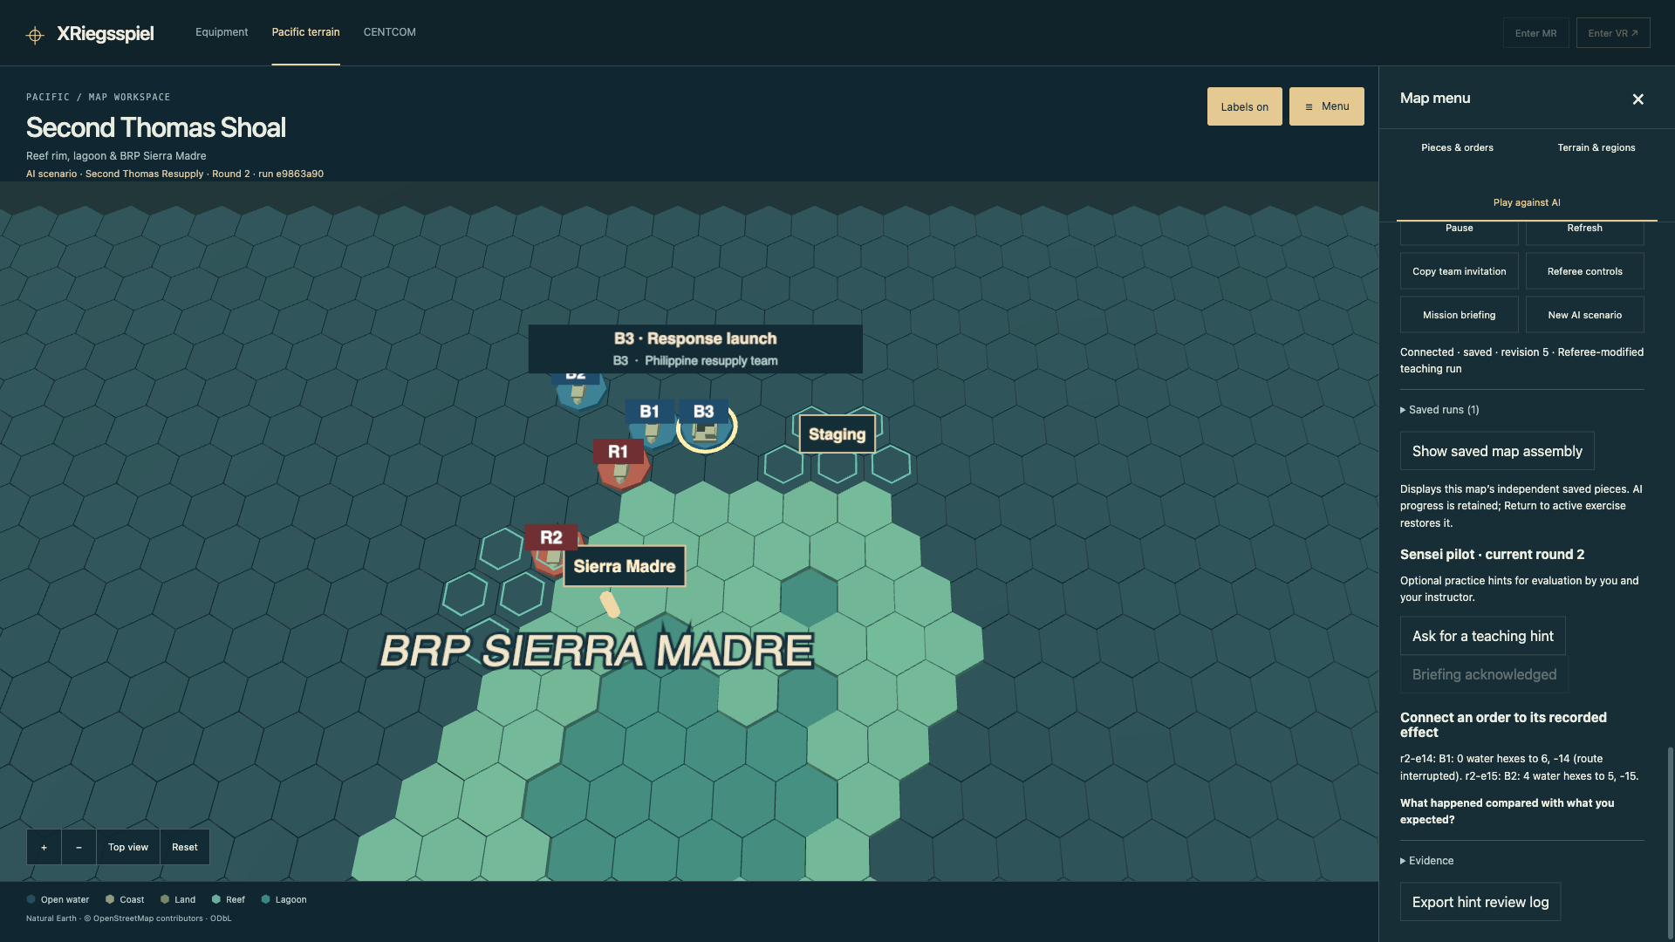
AI opponent and guide
The opponent
Authored planning and search provide the opposition.
The guide
A trained model selects a teaching topic. Rules and recorded events explain it.
“What happened compared with what you expected?”
Sensei connects the order to its recorded outcome
Notes:
3:00–3:50 (50 seconds)
The opponent and the Sensei do different jobs. The opponent uses authored priorities and search to plan its moves. In my own play, even a delivery task can become difficult against it.
The Sensei pilot uses a small trained model to choose a teaching topic. The rules and recorded events provide its explanation. In this example, a route was interrupted. The hint connects that outcome to the order and asks what happened compared with the player’s expectation.
The training run gave us a working starting point. An instructor and I still need to evaluate whether the hints help people understand and transfer a lesson.
Sources: docs/ai-opponent.md; docs/training/guided-policy-v1.md; screenshot 29-sensei-explains-round-outcome.png. The hint selector used 15,638 synthetic training examples from 360 simulated games. The opponent is not a learned playing model. The presenter’s difficulty against it is owner-reported experience, not a benchmark.

Slide 5
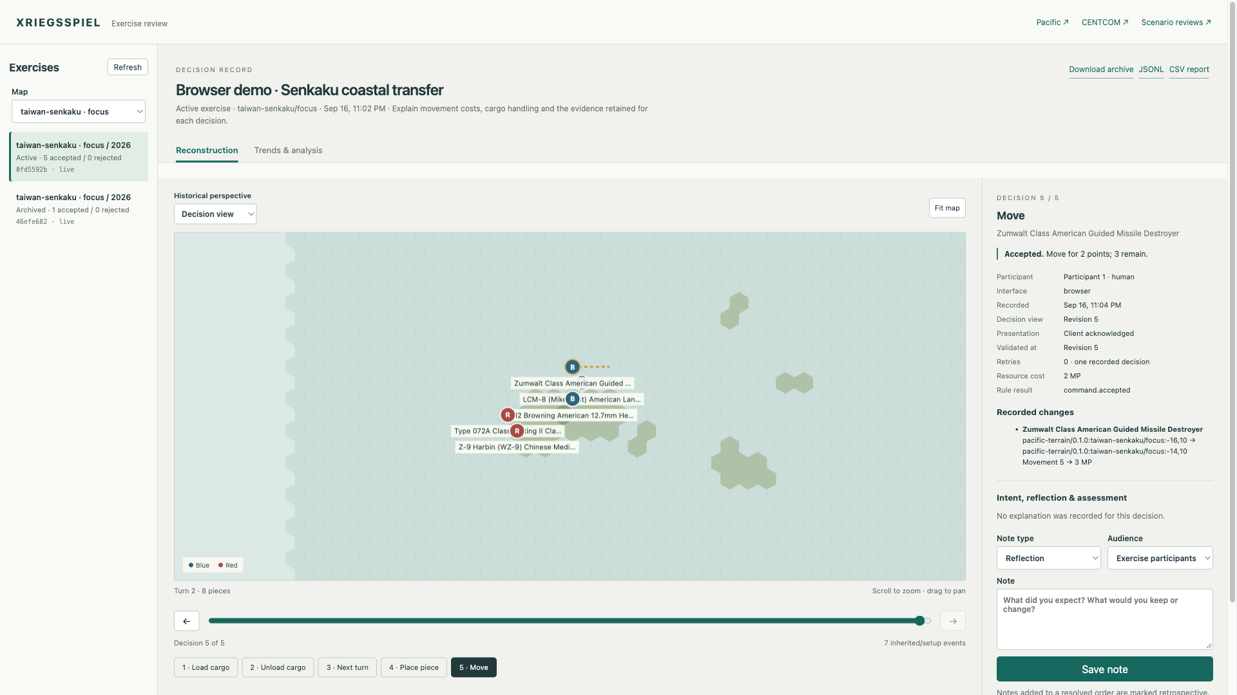
The database preserves each decision
A record of each order
Who acted, when, and through which interface.
The information available before the decision.
The accepted or rejected order, resource cost and resulting state.
Earlier exercises remain available for review.
Recorded example: move accepted, 2 points spent, 3 remaining
Notes:
3:50–4:45 (55 seconds)
The database is a core part of the learning experience. It preserves the order together with its context: who acted, when, what information was available, and how the rules resolved the action.
Here we have switched to the Senkaku coastal-transfer demonstration. The historical board and timeline let us revisit a particular move. On the right, the record shows that the move was accepted, cost two movement points, and left three. Those are authored game units.
The record preserves the earlier view and the resulting state. Resetting the board does not erase the previous exercise. That gives an instructor evidence for a discussion about the decision rather than relying on memory.
Sources: docs/exercise-database.md; output/playwright/presentation-demo/README.md and manifest.json (captures from 16 September 2026). Screenshots are browser captures, not physical-headset evidence. Screenshot: 35-map-replay-movement-and-cost.png. The example contains five accepted game actions. The movement record contains no submitted rationale; an absent explanation remains absent. Role-specific scenario views and full-information map exercises have different access rules.

Slide 6
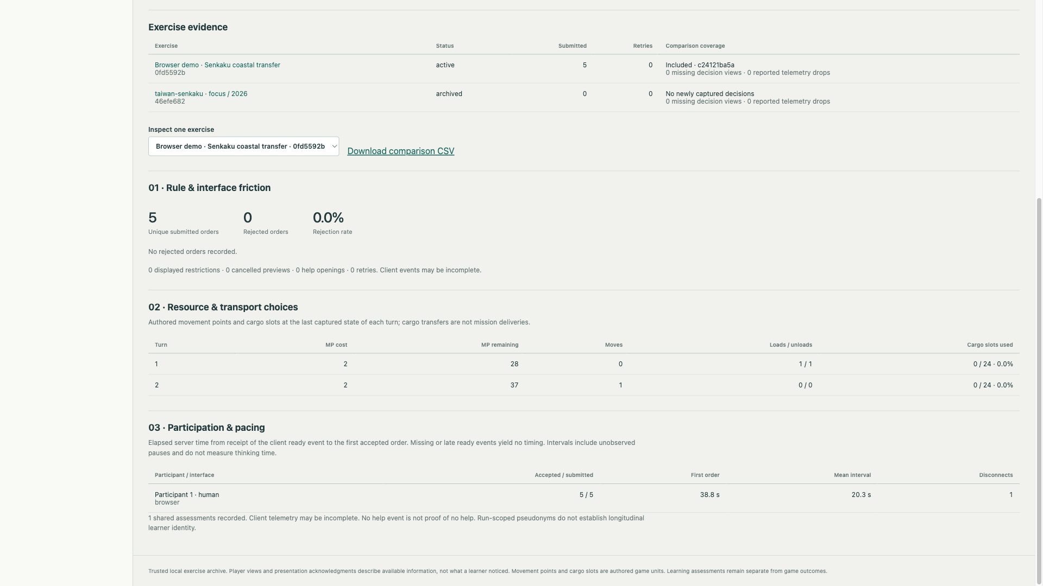
Review, reflect and compare
Evidence for instruction
Reconstruct actions and add reflections or rubric assessments.
Compare compatible exercises and inspect resource use, friction and participation.
Export records for discussion and further analysis.
Demo: 5 orders, 0 rejections. Activity measures do not establish learning.
Notes:
4:45–5:40 (55 seconds)
Capture also supports review across an exercise. We can reconstruct the sequence, add a reflection or an assessment against a named rubric, and inspect reports on resources, interface friction and participation.
This report comes from the same coastal-transfer demonstration. It shows five submitted orders and no rejected orders, along with movement and cargo activity. The application can group comparable exercises and export their records for further analysis.
These are descriptions of what happened in the software. They do not tell us, by themselves, whether someone learned. The sample reflections and rubric entries in this demonstration are illustrative. An instructor still needs to assess the reasoning and whether the lesson transfers.
Sources: docs/exercise-database.md; output/playwright/presentation-demo/README.md and manifest.json (captures from 16 September 2026). Screenshots are browser captures, not physical-headset evidence. Screenshot: 39-friction-resources-participation-analytics.png. The report has one populated comparable exercise, not a measured class-wide trend. Missing telemetry may limit counts and pacing does not measure thinking time. Sample assessments are presenter-authored examples, not actual learner evaluations. Exports do not automatically authorize training reuse.

Slide 7
Future development
Platform connections
An API to connect other board gaming platforms to a shared exercise.
Remote tabletop presence
Avatars around the board, with participants moving pieces together from different locations.
Broader headset support
Connect players across VR headsets and browsers, with shared state and consistent controls.
AI that teaches better
Use instructor feedback to improve explanations and test whether lessons transfer to a new scenario.
Notes:
5:40–6:40 (60 seconds)
Next, I want to connect the experience across platforms and locations. An API could let other board gaming platforms participate in a shared exercise. Players using different headsets or a browser could meet around the same board, with avatars representing the people moving the pieces. This interoperability and remote presence remain future work.
The other direction is a better teacher. The decision record gives us a starting point for evaluating explanations and finding where learners need help. With instructor feedback, we can improve the Sensei and test whether people can apply a lesson in a changed scenario.
A small instructor-supported trial would help us evaluate collaboration, usability and learning before expanding the platform further.
Sources: owner future-development direction in this task; docs/design/agent-training-plan.md; docs/training/guided-policy-v1.md; docs/exercise-database.md. Public integrations, universal device compatibility, automated learning judgments and central cloud hosting are not claimed as implemented.

Slide 8
Questions
XRiegsspiel
Fabio Garcia
Notes:
6:40–7:00 transition margin; 7:00–10:00 questions
Why capture decisions? To preserve the original information, order and result for reconstruction and instructor discussion.
What is trained? The Sensei teaching-topic selector. The opponent uses authored planning and bounded search.
Can any headset connect from anywhere? Broader headset compatibility, remote avatars and platform APIs are future work.
Does the report score learning? No. Activity and outcomes are separate from instructor assessments and learning-transfer evaluation.
Is this combat prediction? No. The scenarios use authored educational abstractions.
What did the database check establish? The separate screenshot-collection verifier reported integrity ok and matching replay/checkpoint sources. It verified all six rounds of the completed demonstration scenario. This presentation revision did not repeat application or headset testing.
Sources: docs/ai-opponent.md; docs/training/guided-policy-v1.md; docs/exercise-database.md; output/playwright/presentation-demo/database-verification.json. Owner timing: seven-minute brief plus three-minute questions.

