Slide 1
Deploying Models using Plumber
A walkthrough with RStudio, Heroku and Amazon Web Services
By Ooi Wen Fong

Slide 2
Overview
Data Science Life Cycle
What is Web API and Plumber?
Plumber Syntax and Examples
Demos

Slide 3
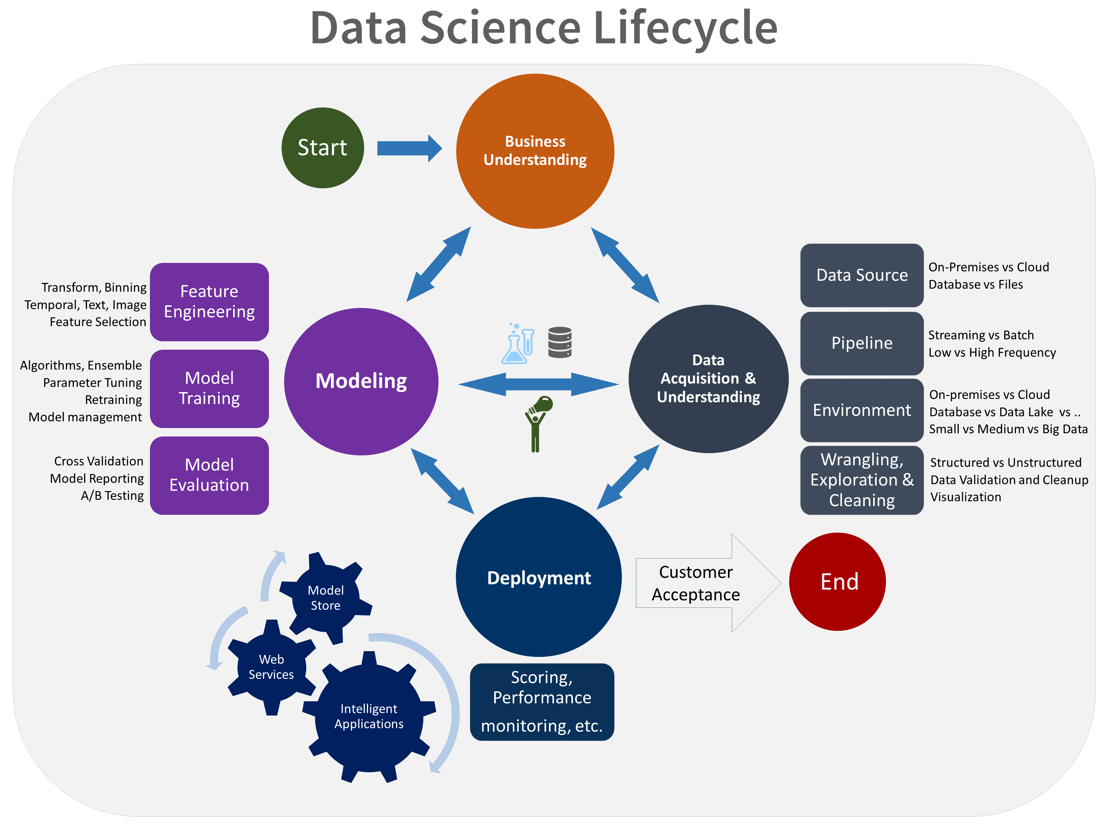
Data Science Life Cycle
Source: https://docs.microsoft.com/en-us/azure/machine-learning/team-data-science-process/lifecycle

Slide 4





Communication
Enable data to be summarised in charts and diagrams.
Enable the development of interactive dashboards from R
Transform analyses into documents, reports, presentations and dashboards.
Transform R functions into web APIs

Slide 5
API
Application Programming Interface
Web API
HTTP
Representational State Transfer (REST)
A software architectural style for creating web services
6 guiding constraints
Focus on performance and scalability
Enable developers using other programming languages (php, node.js, etc) to connect to R models via web APIs.

Slide 6
Plumber
Turn R functions into REST API endpoint
Use special comments and decorators
#* - plumber comments
@ - endpoint attributes / details.

Slide 7
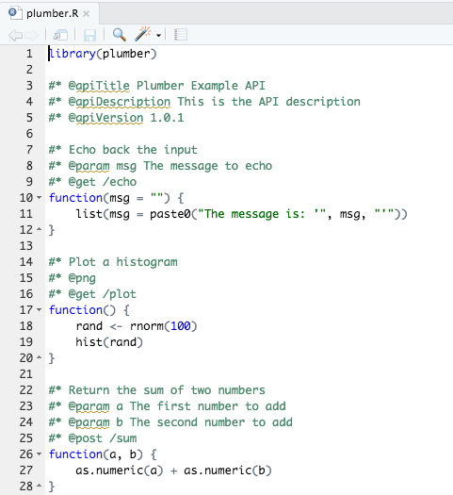
Building REST API using RStudio

Slide 8
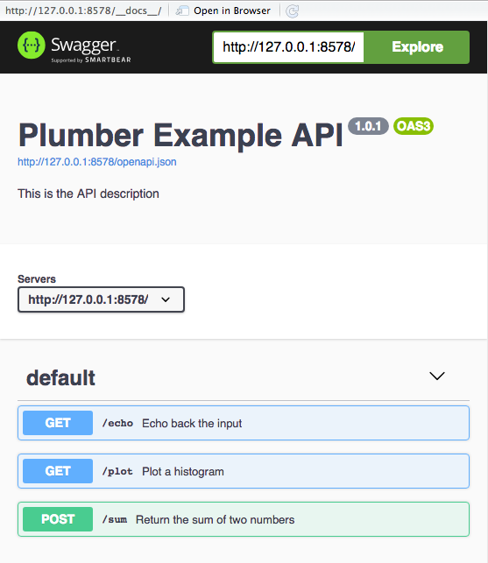
Building REST API using RStudio

Slide 9
Demo #1 (Local Machine)
Create new Web APIs using Plumber and RStudio
Publish the Web APIs using RStudio on local machine
Test the Web APIs and observe the output

Slide 10
Demo #2: More Plumber
How does the output look like if a Web API returns a data.frame?
Can a Web API return an output in formats, such as HTML, CSV, etc?
Can I build a ”pipeline” in handling incoming request?

Slide 11
Demo #3: Connecting a ML model with Web API
Train a model using random forest that classifies species of iris (flower)
Save the model
Setup a Web API that returns the prediction of the species given sepal’s length and width, and petal’s length and width.

Slide 12
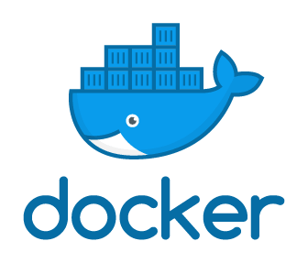
Packaging Web APIs into Docker Image
What do you need?
Docker
Dockerfile
What is Docker?

Slide 13
Demo #4 (Building a Docker Image)
Demonstrate the working folder
Prepare a Dockerfile
Build a Docker image
Run the image
Test the Web APIs on local machine (using web browsers, e.g. Chrome)
Publish the Docker Image to Docker Hub (Docker Hub’s account is required)

Slide 14

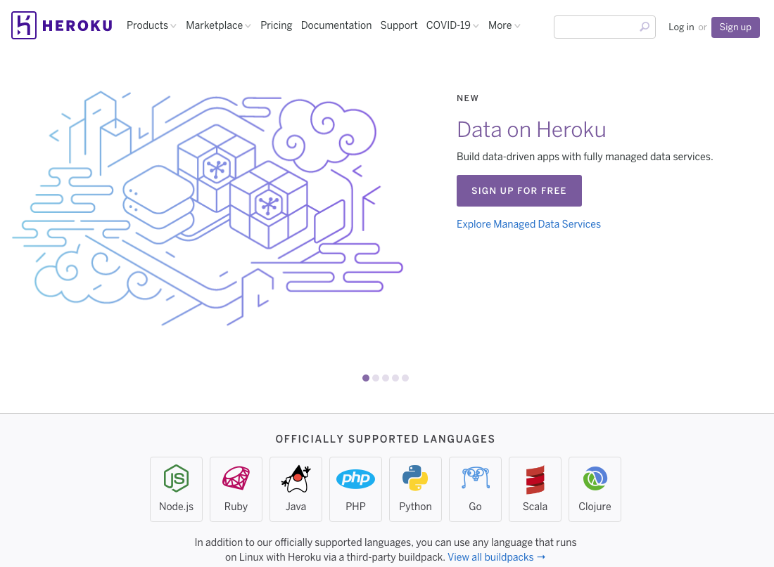
Deploying Web APIs to Heroku
Heroku is a cloud platform as a service (PaaS) supporting several programming languages.
To deploy web APIs, you need to
create an account (Free and Hobby), and
install Heroku Command Line Interface (CLI).

Slide 15
Demo (Deploying Web APIs to. )
Open Terminal
Login Heroku using CLI
Create a new web application
Push a docker container as a web application
Test the web APIs using any web browser
View the log files

Slide 16


Deploying Web APIs to
One of the services offered by AWS
Provide a serverless compute engine for containers
Removes the need to provision and manage servers

Slide 17
Demo (Deploy API to Amazon Web Services)
Login the AWS Console
Choose “Elastic Container Service”
Create a cluster
Choose the option powered by AWS Fargate
Create a new task definition and select ”Fargate”
Specify task size – choose the smallest for memory and vCPU
Add container
Select the task and “Run Task” from “Actions”
Choose VPC and Security Group
Update Security Group so that the inbound rules include the permission for accessing the port 8000

Slide 18
Security
Denial Of Service (DoS)
Sanitization & Injection
Cross-Origin Resource Sharing (CORS)
More information: https://www.rplumber.io/articles/security.html

Slide 19
Summary
R functions can be easily transformed into web APIs using Plumber.
These web APIs can be packaged into Docker’s image and then be deployed into public cloud platforms.
Security measures protecting the web APIs from malicious attacks deserve more attention.

Slide 20
Useful Links
https://www.rplumber.io/index.html
https://www.youtube.com/watch?v=pCXYzN0HbwA

Slide 21
Thank you!

