Slide 1
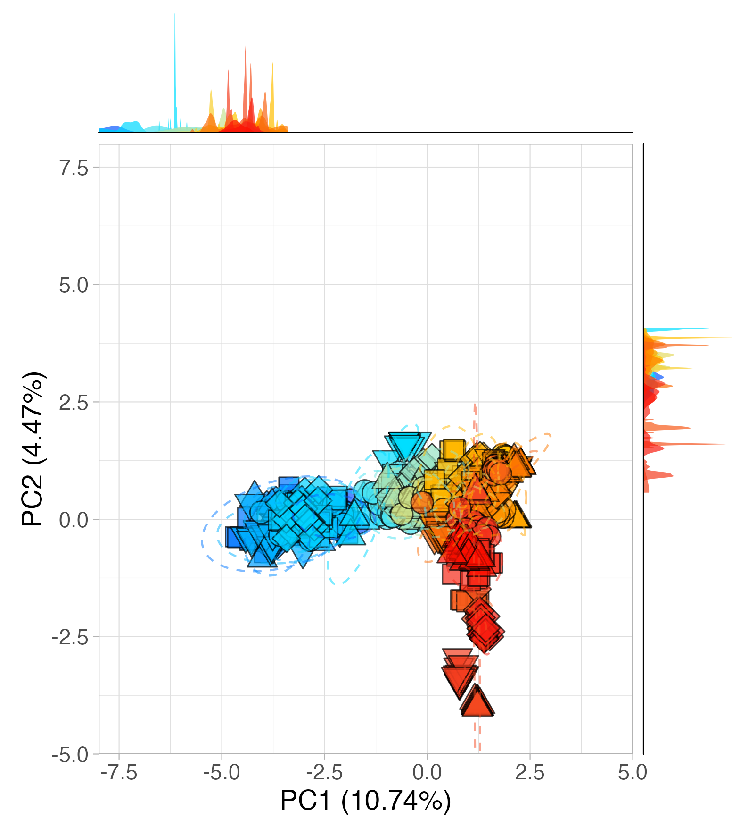
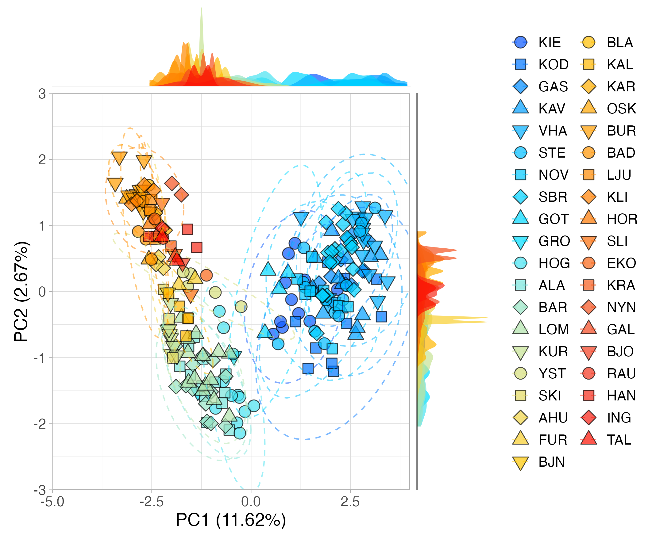
PCA axis 1 and 2 – with clones
PCA axis 1 and 2 – without clones

