Slide 1
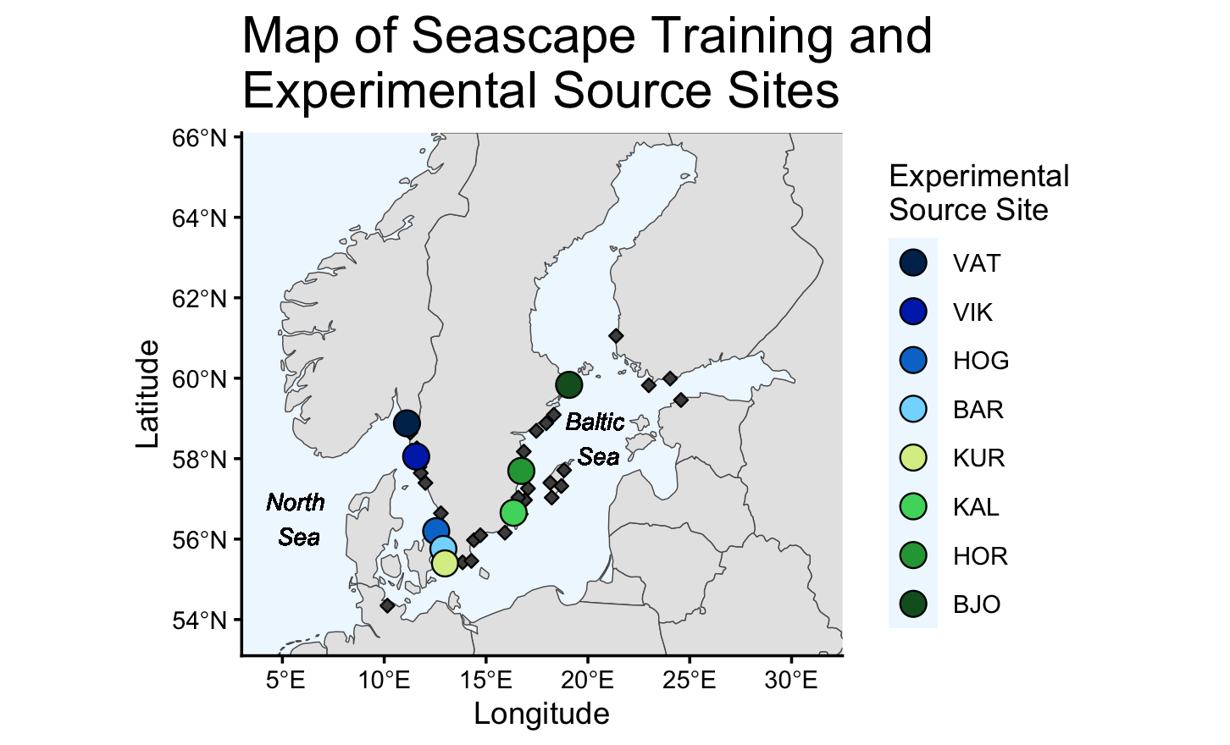
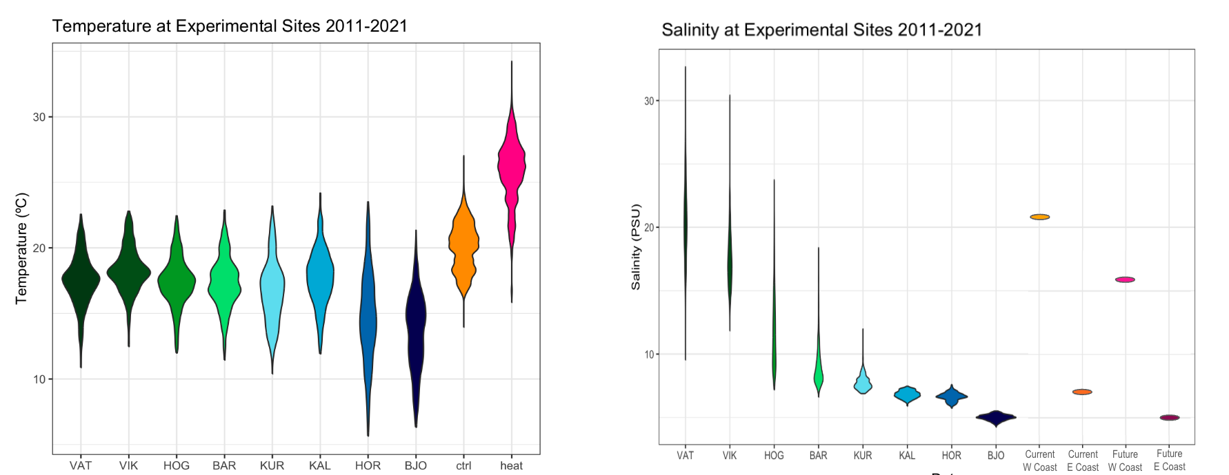
Seascape
Current (+0ºC)
Future (+5ºC)
Current North Sea
(21 psu)
Future North Sea
(16 psu)
Current Baltic Sea
(7 psu)
Future Baltic Sea
5 psu

Slide 3
(A) Temperature at Experimental Source Sites (2011-2021) and in Experimental Treatments
(A) Map of Seascape and Experimental Sites
(B) Temperature at Experimental Source Sites and Mesocosm Treatments
35
Treatment
Current N. Sea (21psu)
30
Current Baltic (7psu)
Future N. Sea (16psu)
25
Future Baltic (5psu)
Temperature (ºC)
Population
20
VAT
15
VIK
HOG
10
BAR
VAT
VIK
HOG
BAR
KUR
KAL
HOR
BJO
KUR
Future North
Sea
Future Baltic
Sea
KAL
Current Baltic
Sea
Current North
Sea
HOR
(C) Experimental Design
(D) Salinity at Experimental Source Sites and Mesocosm Treatments
BJO
Current (Ambient)
+ 0ºC
Future (Heated)
+ 5ºC
30
20
Salinity (PSU)
10
VAT
VIK
HOG
BAR
KUR
KAL
HOR
BJO
Future North
Sea
Future Baltic
Sea
Current Baltic
Sea
Current North
Sea
x 6 tanks
x 6 tanks

Slide 4
(A) Map of Seascape Training
and Experimental Source
Sites
(B) Temperature and Salinity at
Experimental Source Sites and in
Mesocosm Treatments
35
Treatment
30
Current N. Sea (21psu)
25
Temperature (ºC)
Current Baltic (7psu)
20
Future N. Sea (16psu)
15
Current (Ambient)
+ 0ºC
Future Baltic (5psu)
10
30
Population
20
VAT
Salinity (PSU)
VIK
10
HOG
(C) Experimental Design
VAT
VIK
HOG
BAR
KUR
KAL
HOR
BJO
Current
Baltic
Future N.
Sea
Future
Baltic
BAR
Current N.
Sea
KUR
KAL
HOR
Future (Heated)
+ 5ºC
BJO
x 6 tanks
x 6 tanks

Slide 5
(A) Map of Seascape Training and Source
Sites
(B) Experimental Mesocosm Design
Current (Ambient)
+ 0ºC
Future (Heated)
+ 5ºC
(C) Temperature and Salinity at Source Sites
and in Mesocosm Treatments
35
30
25
Temperature (ºC)
20
x 6 tanks
x 6 tanks
15
10
30
Treatment
Population
Current N. Sea (21psu)
VAT
KUR
Salinity (PSU)
20
Current Baltic (7psu)
VIK
KAL
10
Future N. Sea (16psu)
HOG
HOR
Future Baltic (5psu)
BAR
BJO
VAT
VIK
HOG
BAR
KUR
KAL
HOR
BJO
Future N. Sea
Future Baltic
Current N. Sea
Current Baltic

