Slide 1
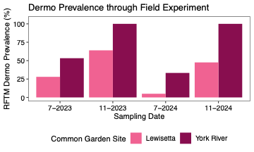
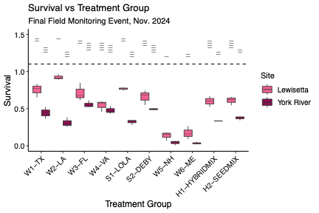
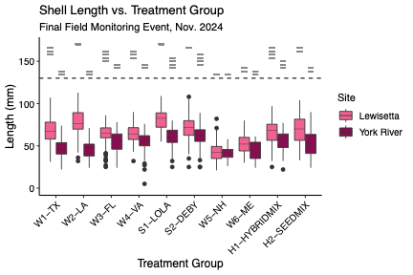
A
B
Pairwise comparisons
C
Pairwise comparisons
Parental Treatment
Southern
Local
Northern
Polyculture

