Slide 1
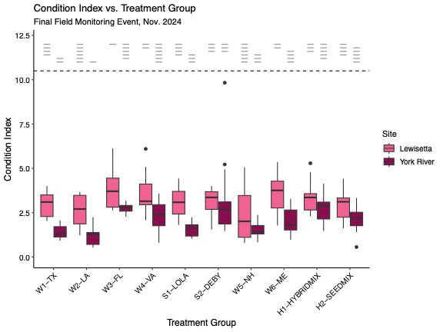
Pairwise comparison levels
Southern
Local
Northern
Polyculture
Treatment Groups

