Slide 1
DNA Quality Control: Gel Electrophoresis
Nicole Mongillo
16 September 2025

Slide 2
Gel electrophoresis is a procedure that shows how long DNA fragments are.
In what situations would scientists want to know this information?
Make sure PCR worked properly
Make sure DNA extraction worked properly
Quality check samples before sequencing them

Slide 3
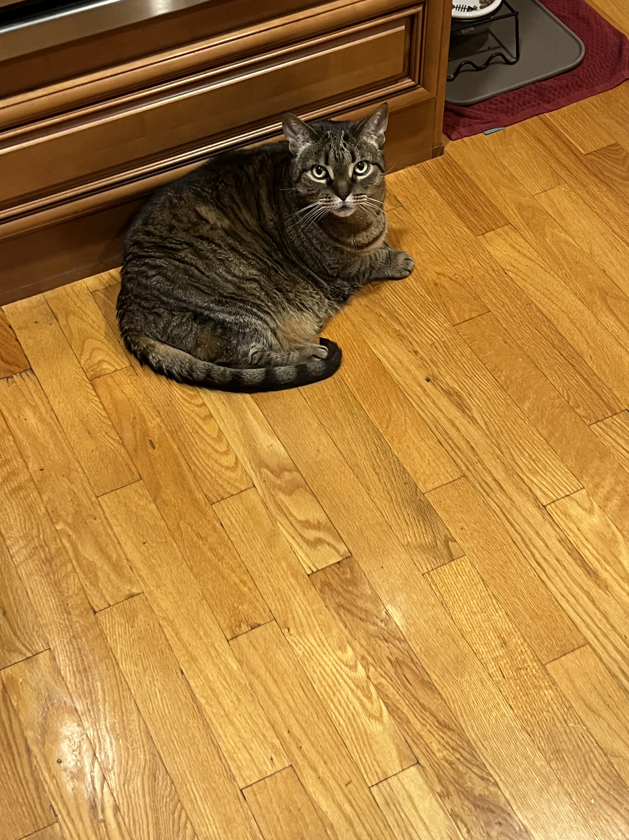


Imagine two objects of unequal size.
Nutmeg: 15 pounds
Gremlin: 70 pounds
Water current direction

