Slide 1
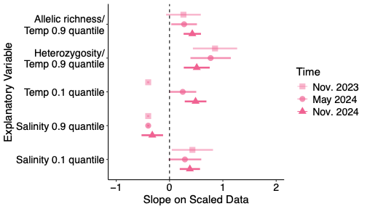
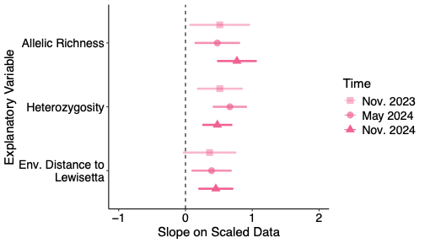
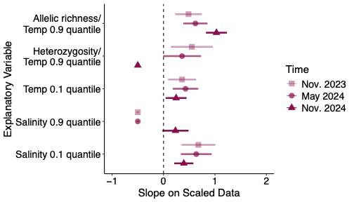
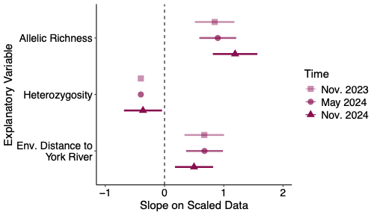
Slopes of Survival vs. Genetic Variables and Env. Quantiles
Slopes of Survival vs. Genetic Variables and Env. Distance
Lewisetta
A
B
Monitoring event
NS
NS
NS
York River
C
D
NS
NS
Monitoring event
NS
NS
NS

